Slide 1
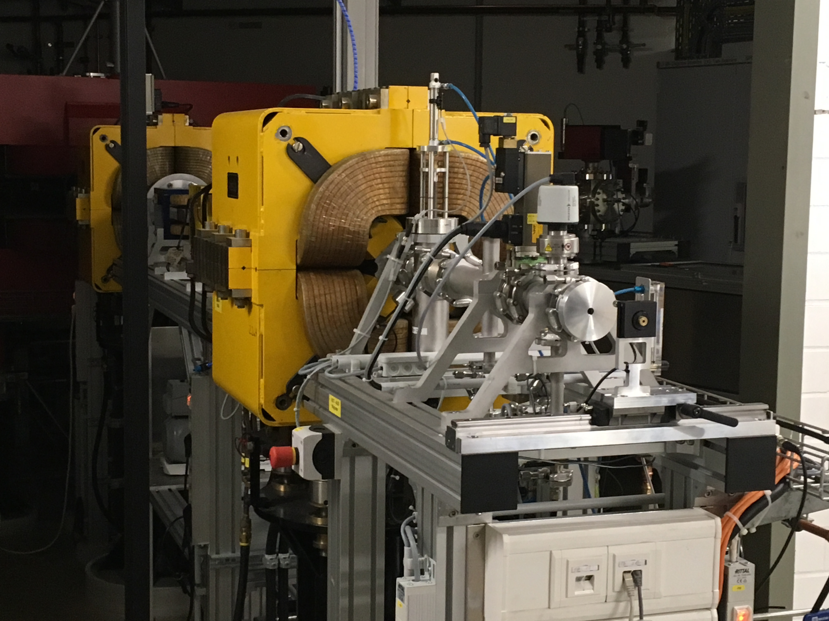
Test beam period Bonn ELSA from 2 to 6 October
2013
Lepton Collider meeting 29 october
With Fred Hartjes, Kees Ligtenberg, Jan Timmermans, Jochen Kaminsky, Tobias Schiffer, Markus Gruber, Klaus Desch and Peter Kluit

Slide 2
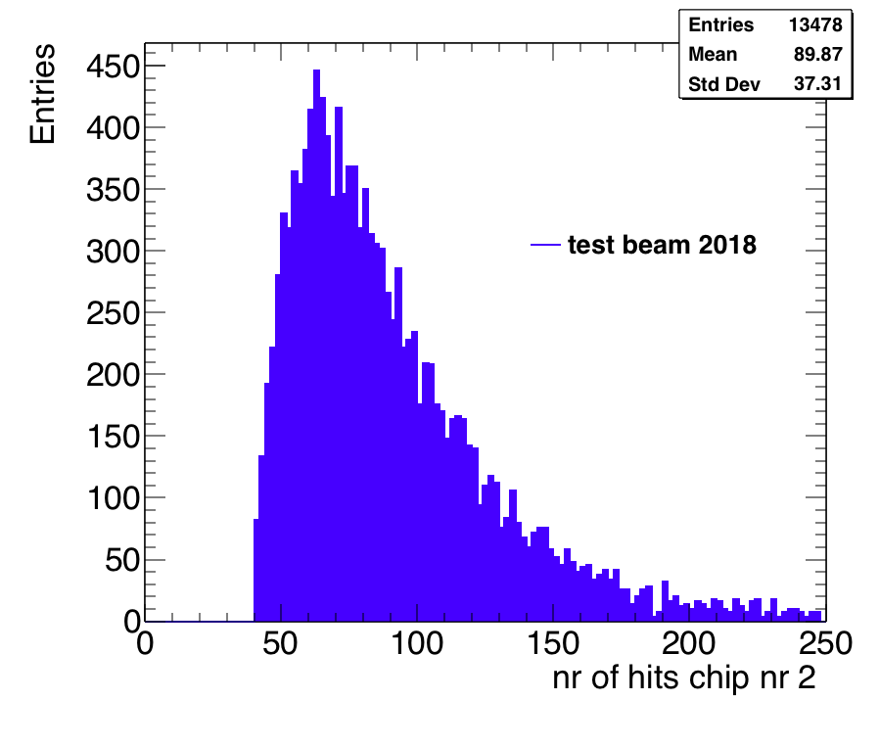
Test beam period Bonn
2013
Data taken at 330 V
New Quad
Slightly less hits than single chip test beam due to HV (350 V)

Slide 3
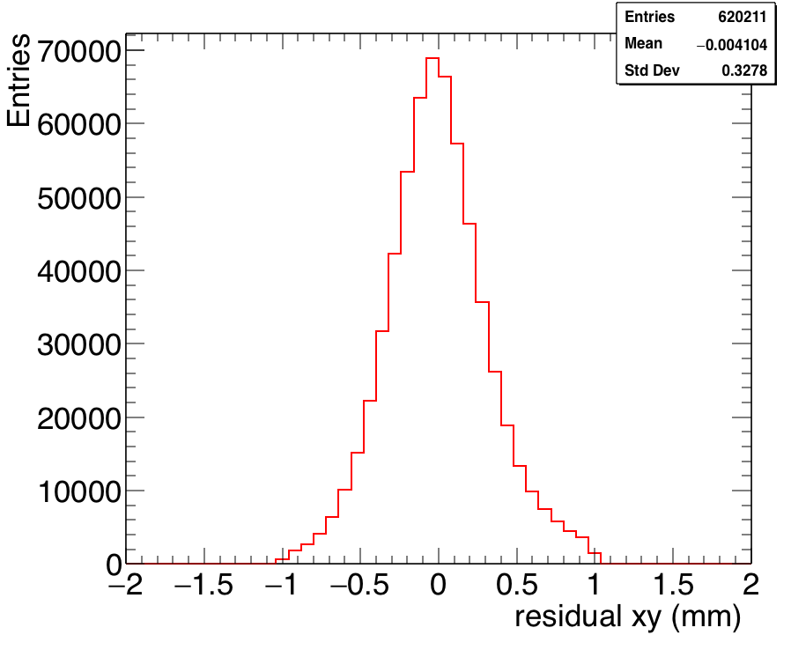
Test beam period Bonn
2013
Comparing the telescope and the chip2 hits
After alignment
Of telescope and chip2
rms = 0.33 mm
in the xy pixel plane. Single electrons: diffusion dominated
Telescope better than 5 μm

Slide 4
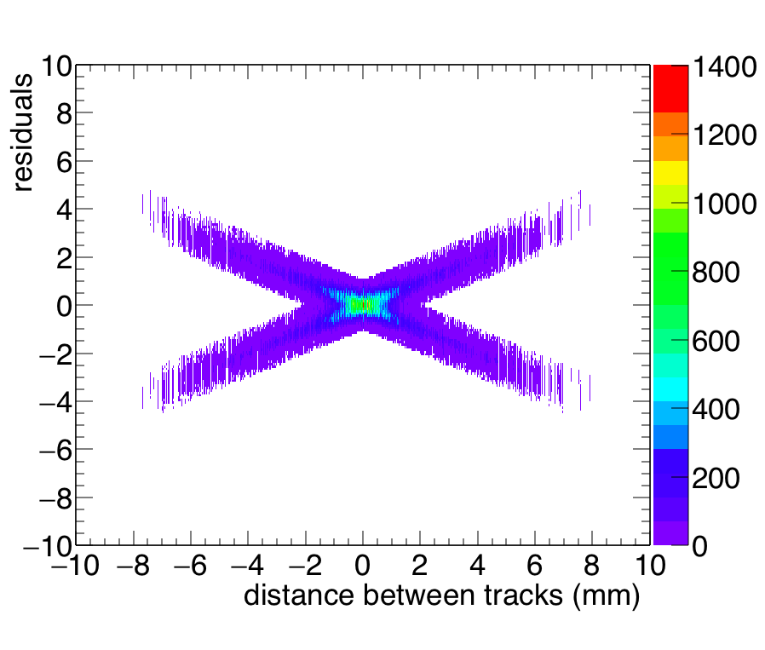
Studying the two track resolution
Procedure. Tracks are defined by telescope. They are pretty parallel. Take two events and superimpose them. Then calculate distance in middle of chip2 for the two tracks (x axis). Recalculate the residuals of the hits wrt one (unsplitted) track in the middle.
2013

Slide 5
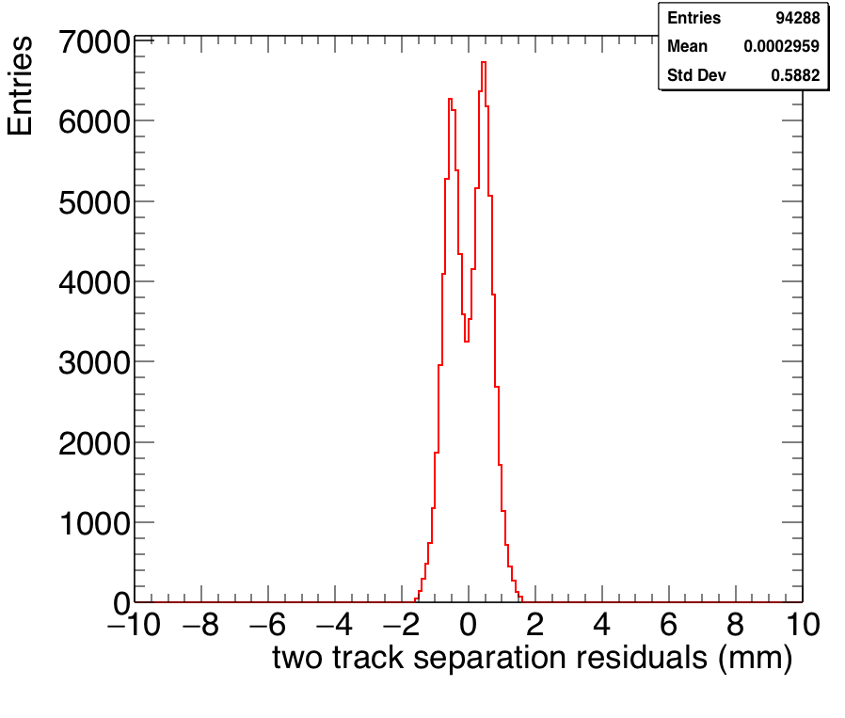
Studying the two track resolution
2013
Here a slice of the distribution on slide 4 around a distance of 1 mm.
One can visually distinguish the two tracks.

Slide 6
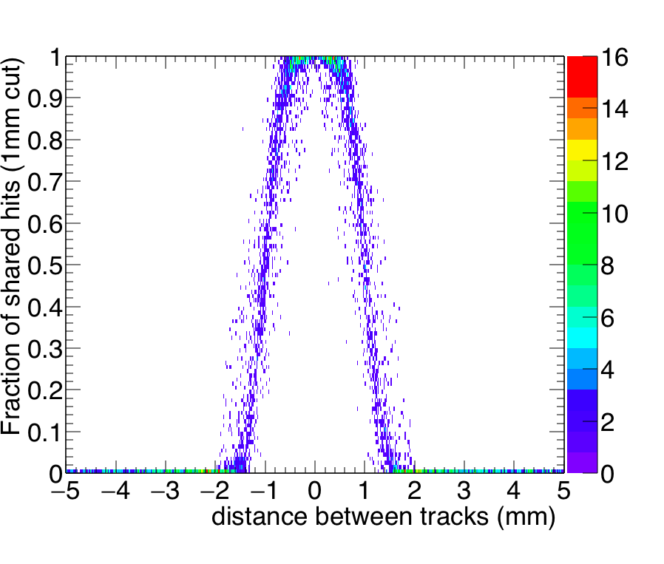
Studying the two track resolution
2013
Knowing the two tracks from the telescope one can calculate the shared hits for a 1 mm cut around the expected track position

Slide 7
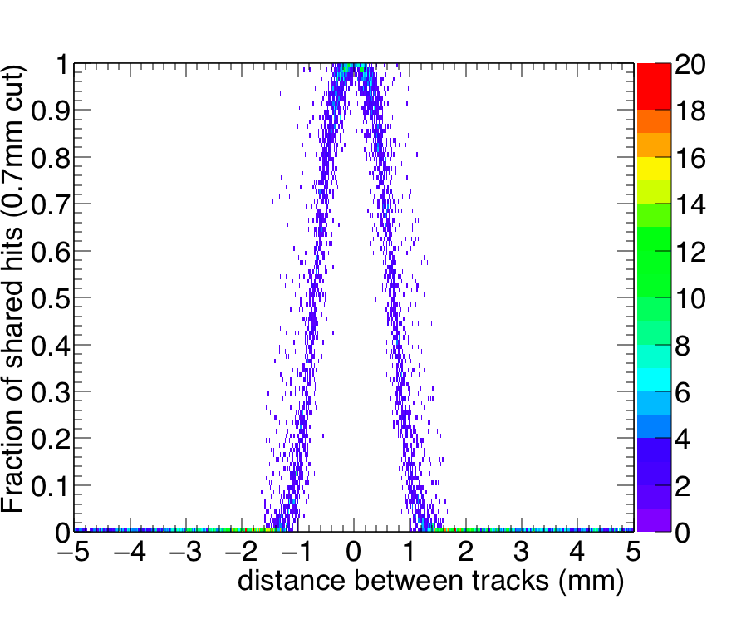
Studying the two track resolution
2013
Calculating the shared hits for a 0.7 mm track association cut
Looks like we can reach for this resolution a two track separation of 0.7 mm

Slide 8
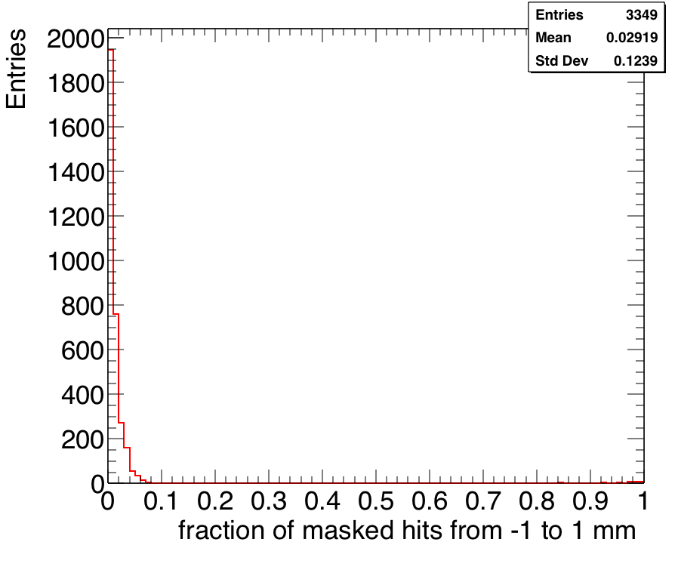
Studying the two track resolution
2013
Calculating the masked hits: the ones wit the same column and row
For the tracks within a range of -1 +1 mm, where tracks start to overlap
This means that the track will have a mean dEdx of 1.97 times larger.
So we know that there were two tracks.
NB only 3% of the hits are masked.

Slide 9
Conclusions on two track separation
2013
Residuals in xy of pixel chip2 have an rms of 330 microns.
For this case the two track separation of about 0.7 mm can be achieved (slide 7). This is about two sigma.
There is another possibility for tracks having a distance of less than 0.7 mm. They will have a mean dEdx of 1.97 times larger.
For a full ILD TPC with a (pixel) resolution of dEdx of better than 4%, we know (by more than 20 sigma) that there are two tracks (and not one).
This leaves the possibility to reassign the TPC pixel hits to different tracks, using a more sophisticated track fitting model (such as the gaussian sum filter), e.g. in combination with the ILD pixel detector.

