Slide 1
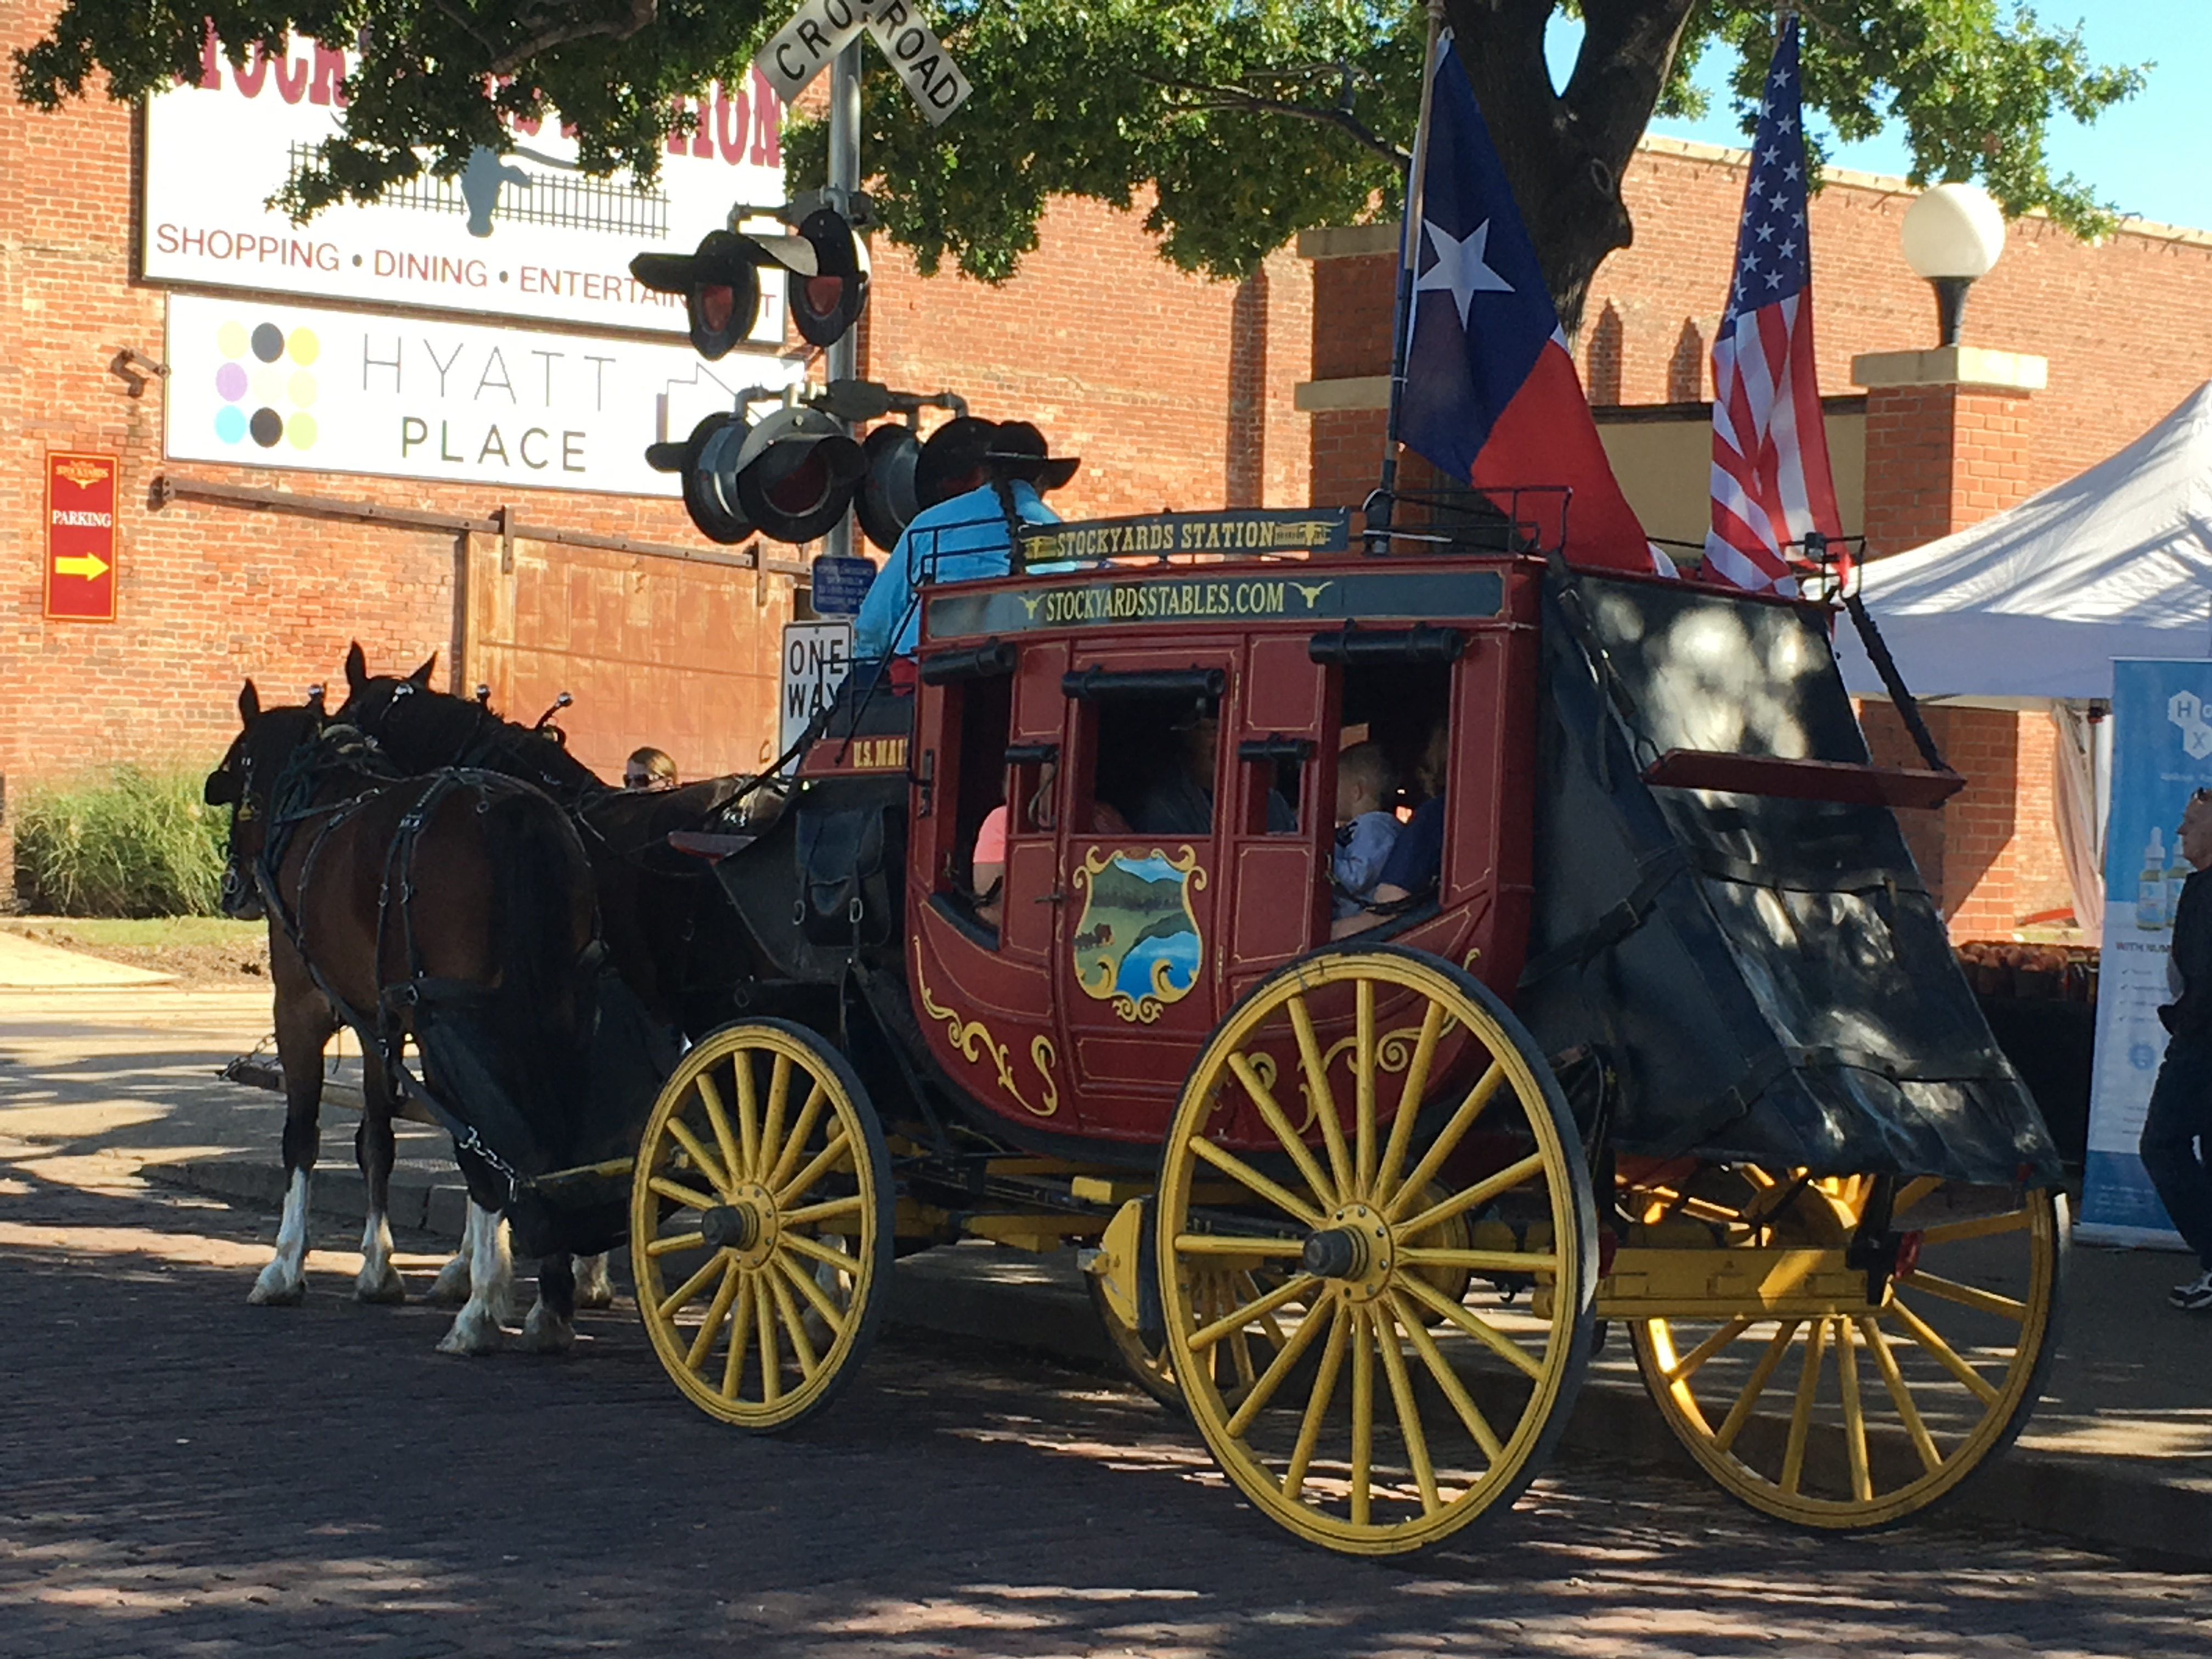
LCWS 2018 Arlington
Lepton Collider meeting 29 october
Kees Ligtenberg, and Peter Kluit

Slide 2
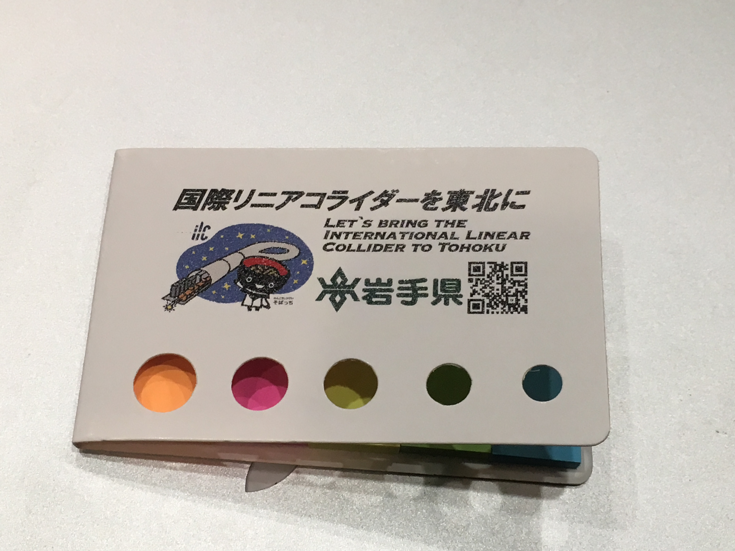
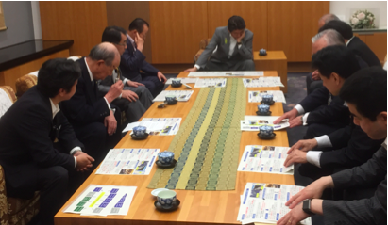
LCWS Meeting
Many high officials and relevant reports
https://agenda.linearcollider.org/event/7889/timetable/
Process in Japan moving ahead steadily. Target is still a decision by the end of this year.
- Note the Industrial session: European part is taking shape
- Report for the secretary of DOE; US strongly committed to ILC and will contribute about a 1B US$
China also committed;
France and Germany well prepared for bi-lateral agreement
2013

Slide 3
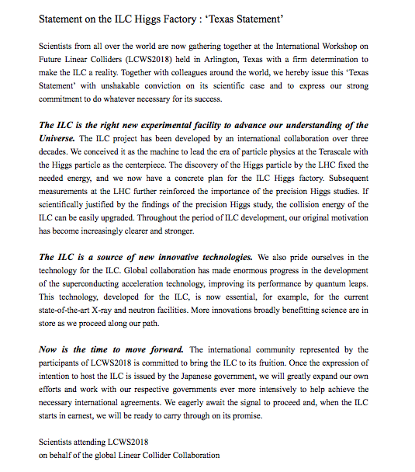
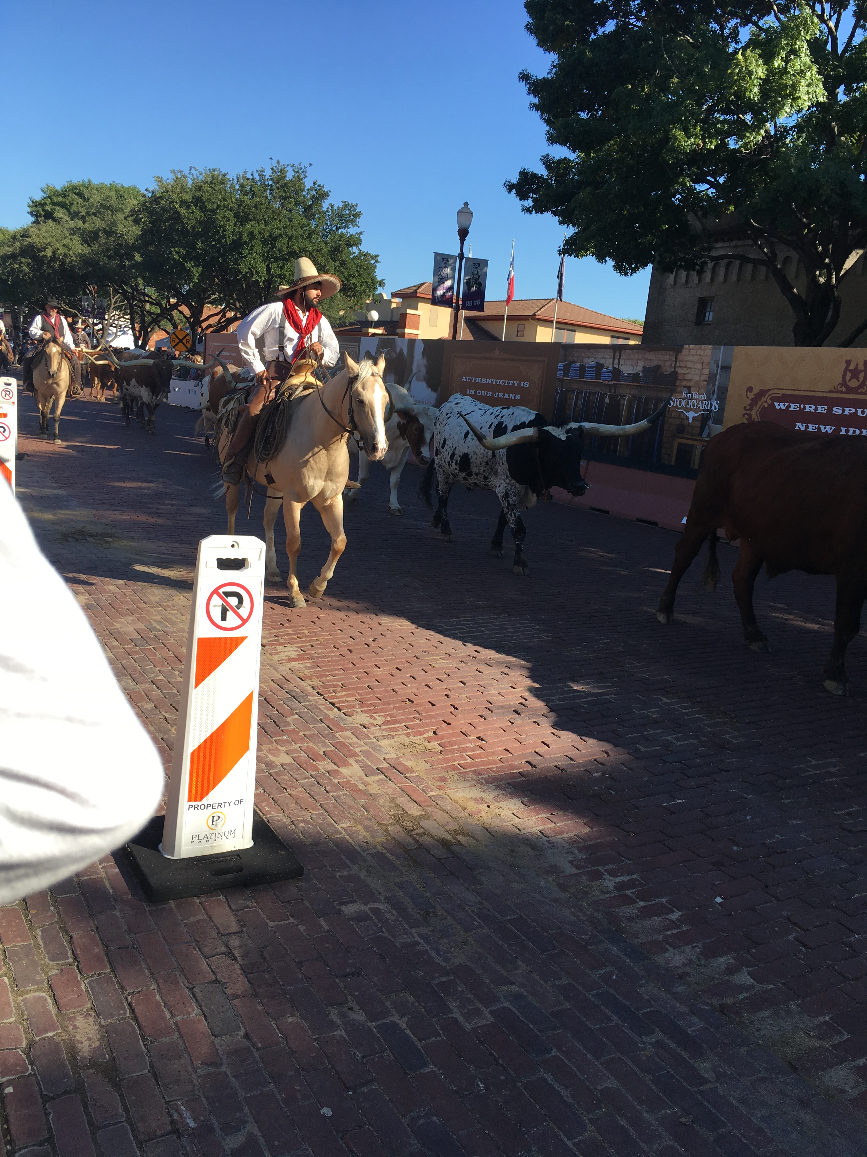
Texas statement 2018
Send to Japanese Science Council

Slide 4
LCWS Meeting
Many preparations for European Strategy. Yelllow report from CLIC. From ILC documents and also from one experiment ILD (we are in it) a document.
ILD physics and detector studies @LCWS were more elaborated and realistic than SiD (man power limited).
Very interesting vision from ICFA chair on world-wide & CERN
Physics side:
Classical case emphasis on Higgs precision measurements
Plus top (not for 250 GeV) physics
Peskin emphasized BSM reach two fermion processes
More emphasis:
ILC as discovery machine; areas that were not accessible at LEP (2HDM Higgs < mZ) and BSM that escapes the LHC typical with mass < 200 GeV.
2013

