Slide 1
Long-Lived Particles
“Theory meets Experiment”
R. Fleischer, O. Igonkina, M. Merk

Slide 2

Long-Lived Particles in the Standard Model
1
LLP’s theoretically well motivated by many NP models

Slide 3
LHC and particle searches
2

Slide 4

Long-lived particles in the Experiment
3
Long-lived particles are displaced from PV, perhaps large dE/dx, backward/kinks, etc..
Exp.: Nice feautures, but also watch out for
material conversions etc.!
Example: “hidden valley” particles
eg. from $H→π_{v}π_{v}$
Long-lived particles producing pairs of muons
eg. Majorana neutrino’s producing same sign leptons
More: ALPs, dark photons, R-parity violating,..

Slide 5
Theory & Experiment
5
Shift from model-first/signature second to signature first/model second mindset

Slide 6
Map the LLP Signature space
4

Slide 7
LLP
6
Stolen from
D. Curtin.

Slide 8
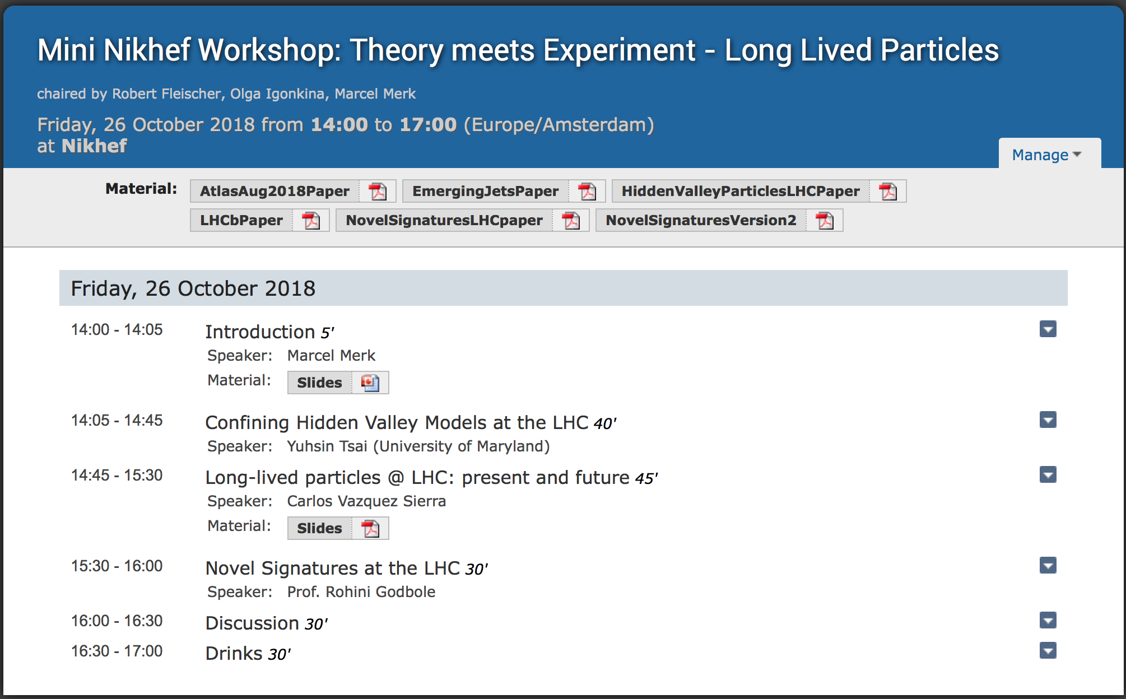
Agenda this afternoon
7

