Slide 1
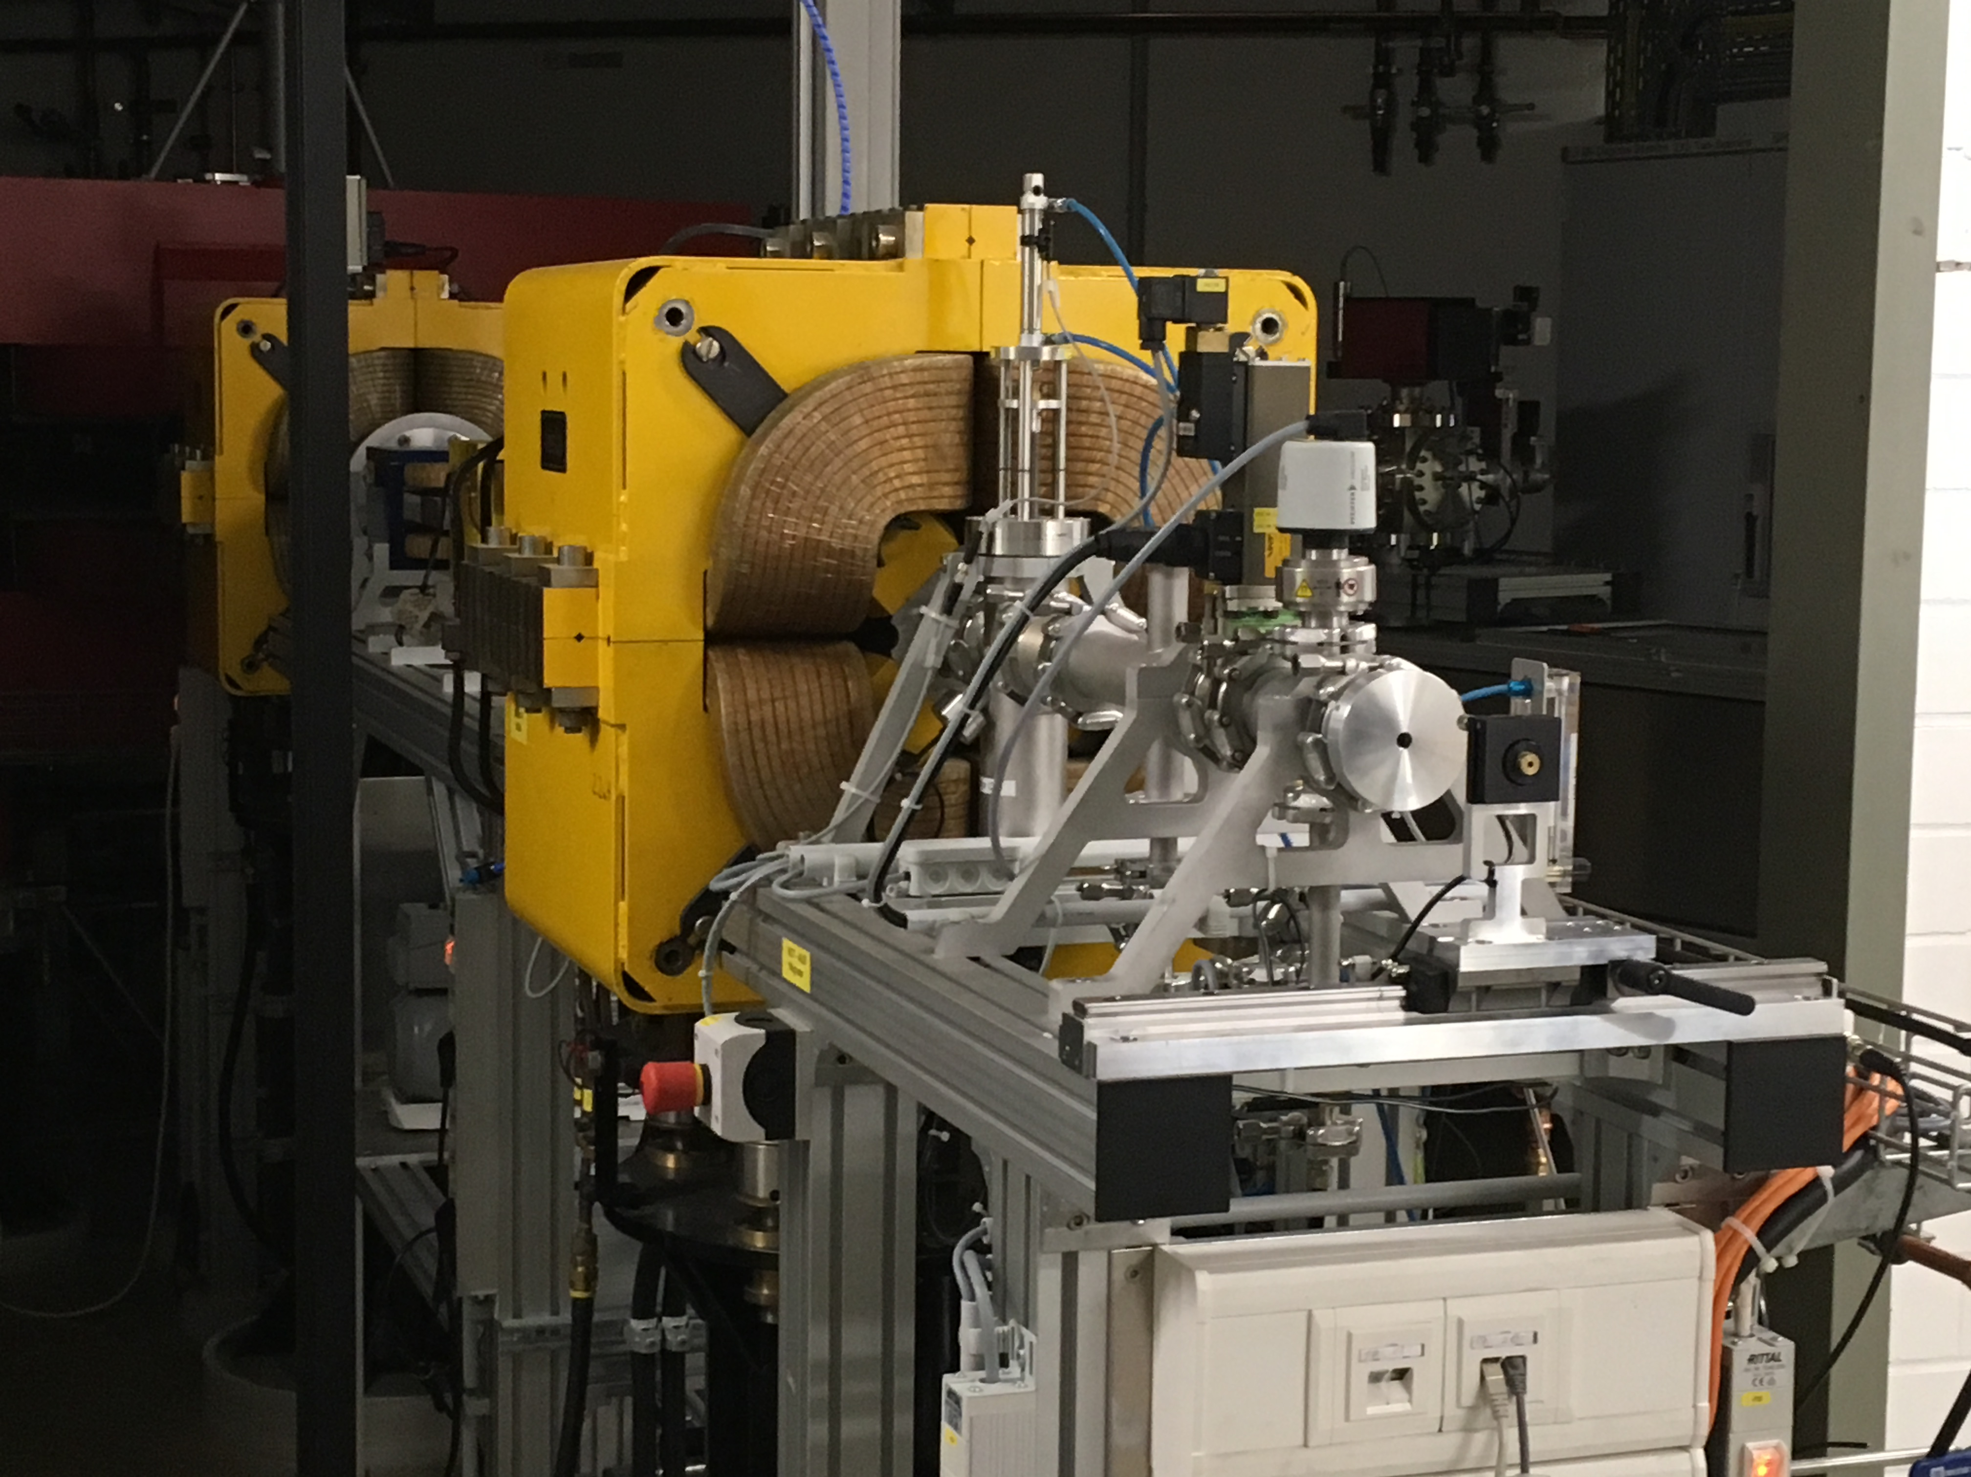
Test beam period Bonn ELSA from 2 to 6 October
2013
With Fred Hartjes, Kees Ligtenberg, Jan Timmermans, Jochen Kaminsky, Tobias Schiffer, Markus Gruber, Klaus Desch and Peter Kluit

Slide 2
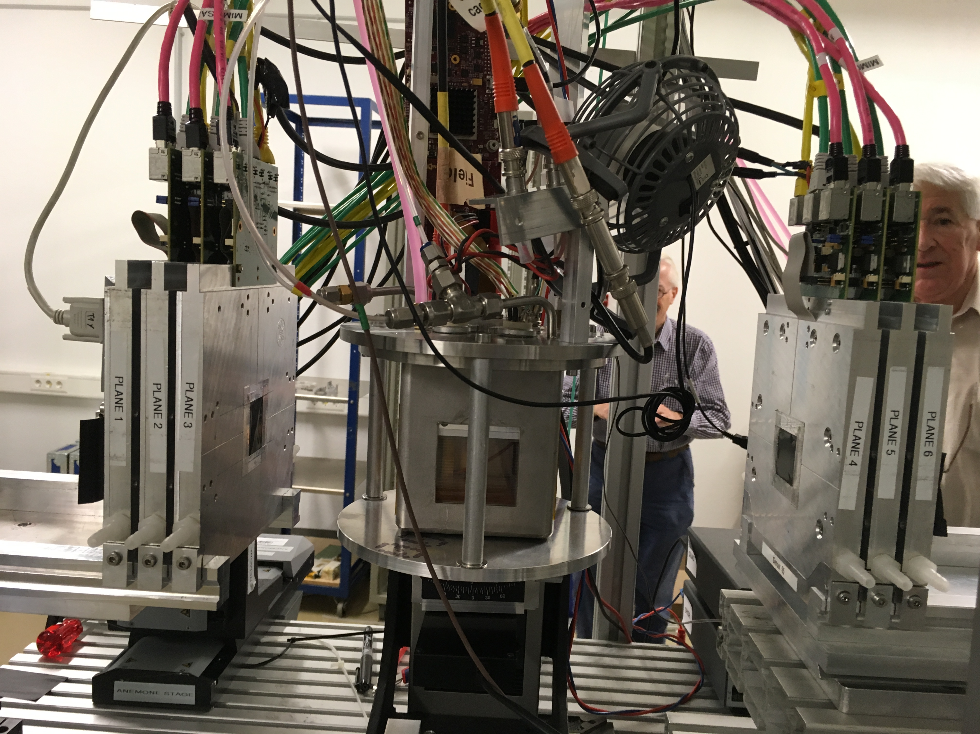
Test beam period Bonn
Started with installing the Quad that was tested in the laser set up at Nikhef. The telescope was fully functional and the Quad placed in between the 2 times three silicon planes
2013

Slide 3
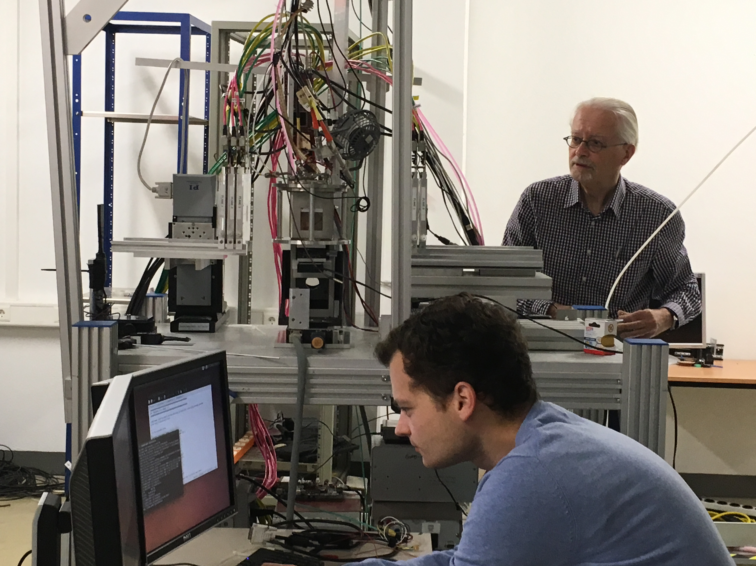
Test beam period Bonn
After aligning the detectors. Setting up the DAQ using the SPDR. Thursday succesful data taking: millions of tracks.
2013

Slide 4
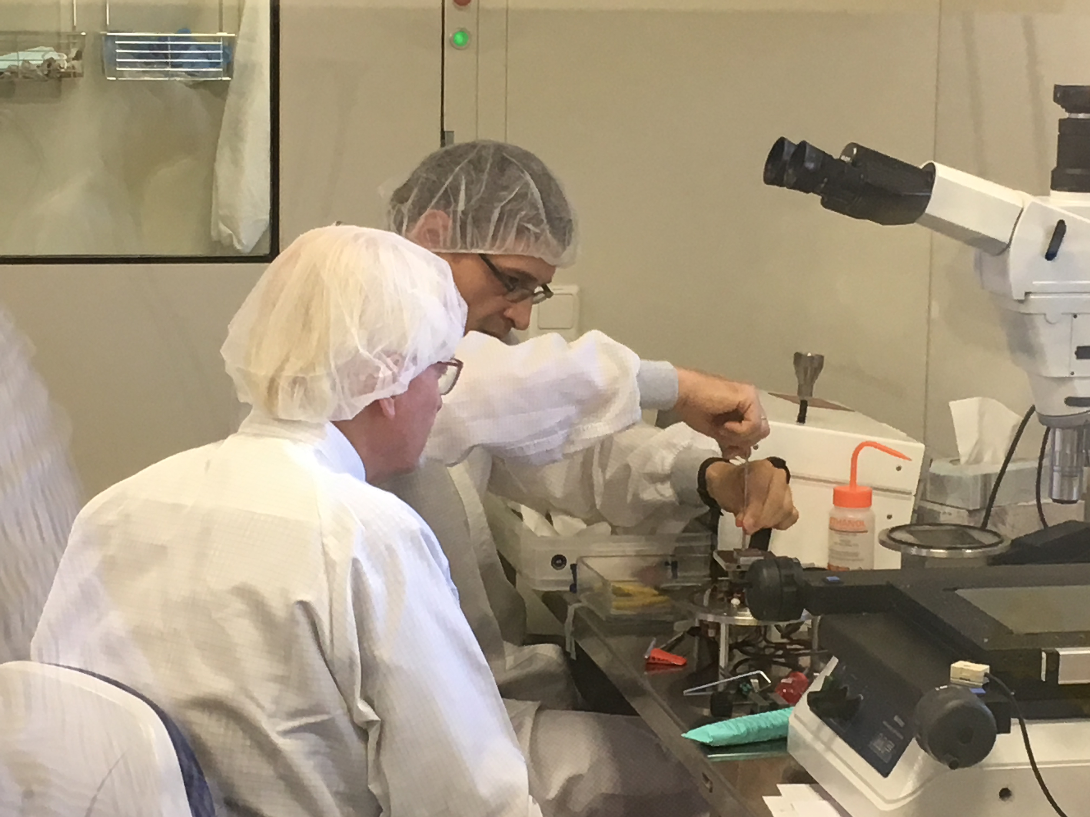
Test beam period Bonn
Friday: changing the Quad to the new Quad with better Grids.
2013

Slide 5
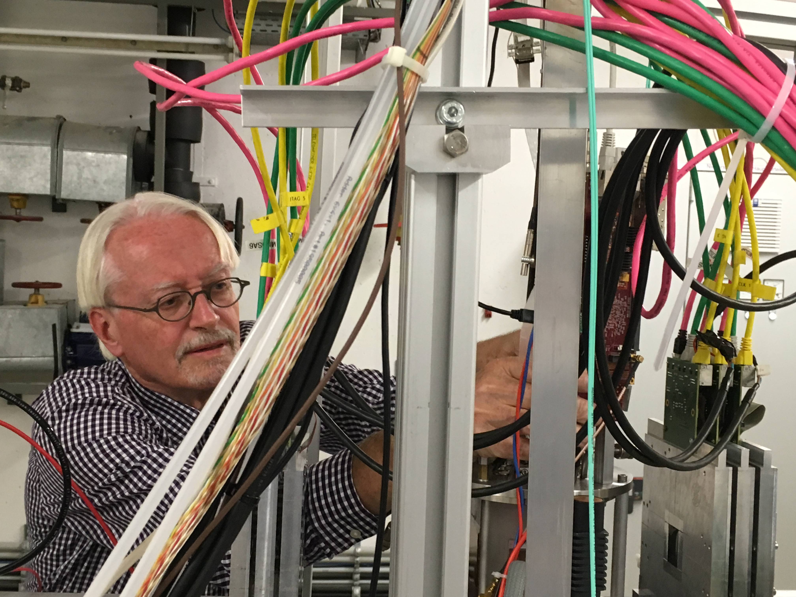
Test beam period Bonn
Reconnecting the new Quad
2013

Slide 6
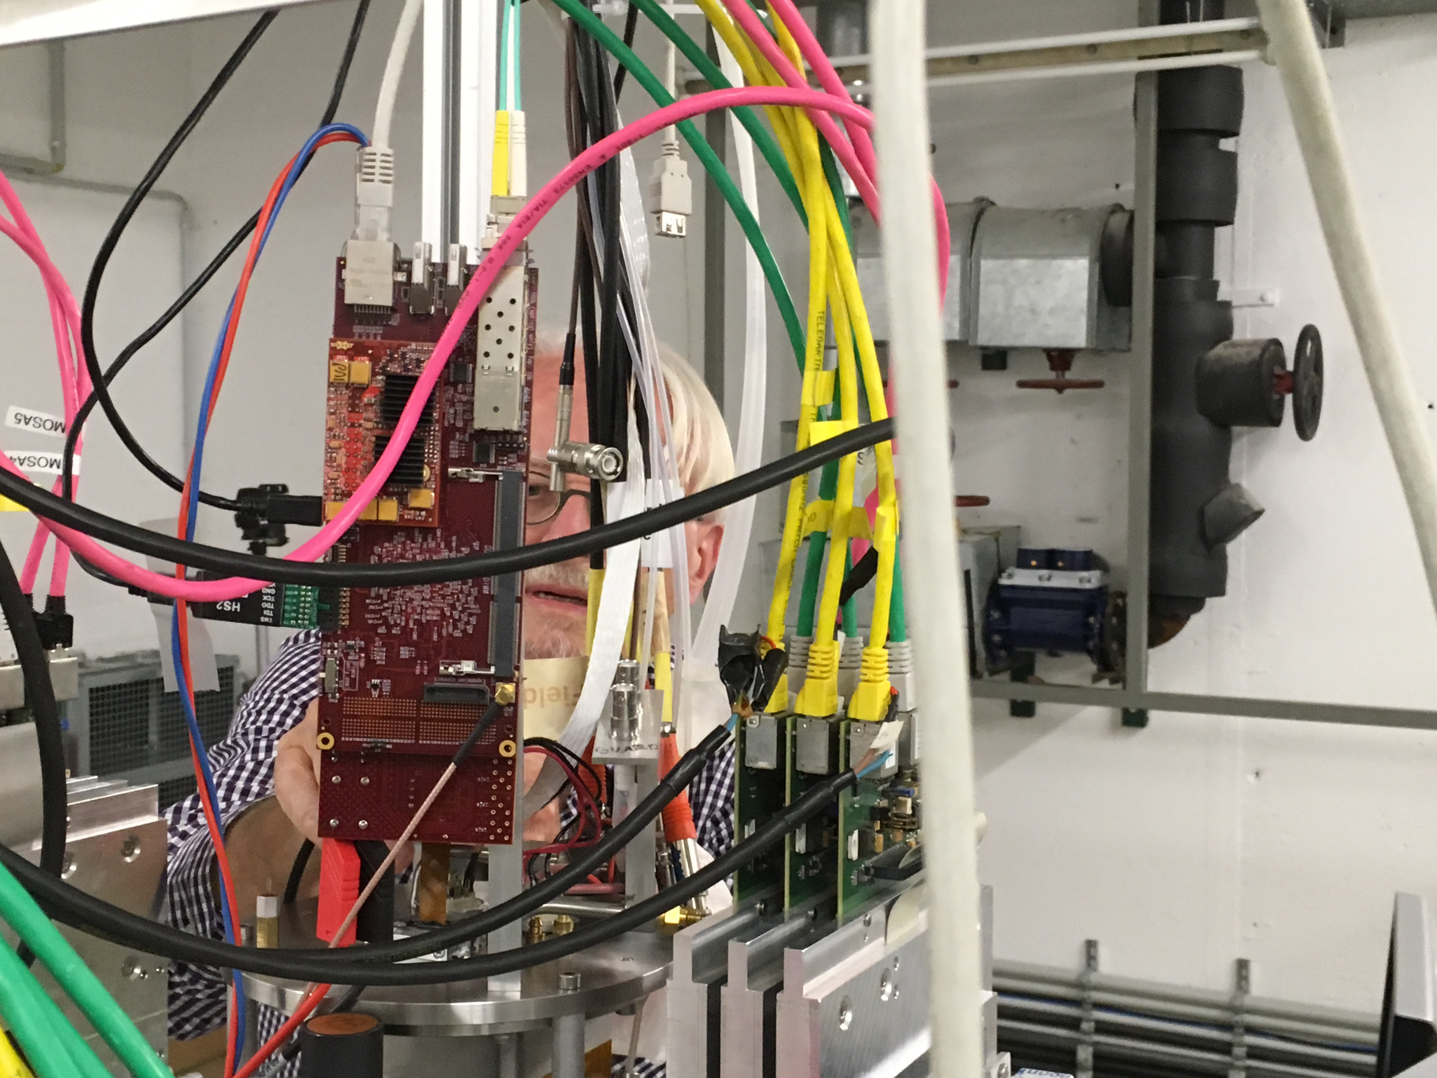
Test beam period Bonn
Reconnecting the new Quad
2013

Slide 7
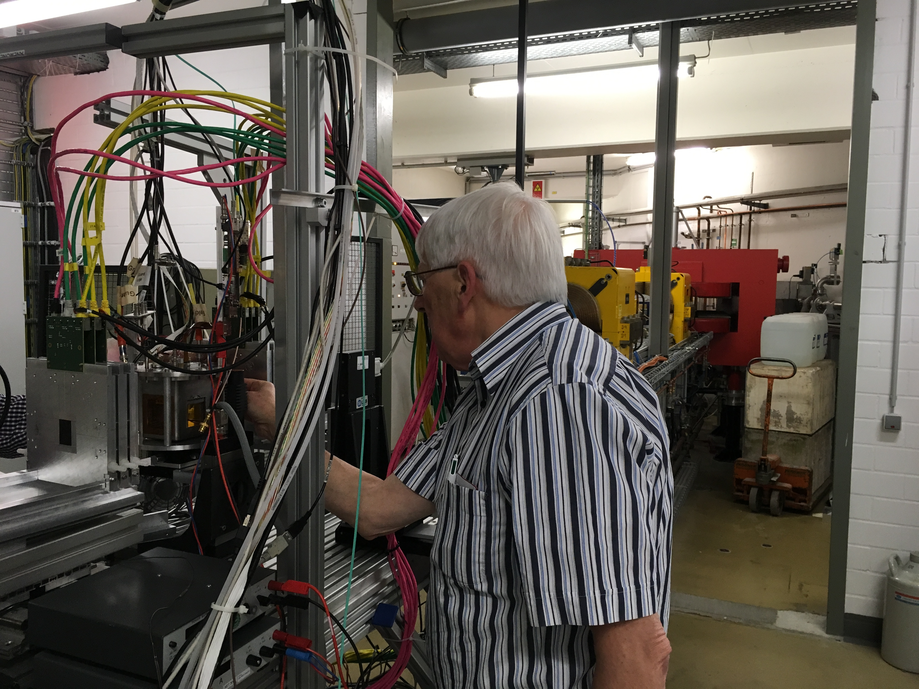
Test beam period Bonn
Reconnecting the new Quad, shift back telescope
2013

Slide 8
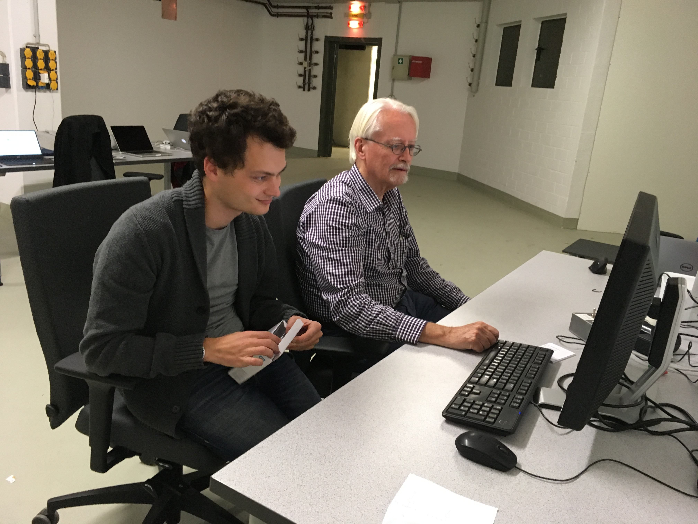
Test beam period Bonn
Successful data taking with the new Quad: millions of tracks
2013

Slide 9
Test beam period Bonn
Overview of runs taken see also logbook
Large data set old Quad (30 Million triggers):
Vgrid = -330 Vdrift = -400 V/cm
with low threshold = noise + 55 cnts.
At different x (3 pts) and z (8pts) positions;
Also changing drift voltage and the guard voltages for deformations.
Some data at different threshold values.
Large data set new Quad (12 Million triggers)
Vgrid = -330 Vdrift = -400 V/cm
with low threshold = noise + 55 cnts.
At different x (3 pts) and z (2pts) positions;
Also changing drift voltage and the guard voltages for deformations.
Some data at different threshold values.
We would have liked to take more data (at different z positions) but ELSA was stopped on Friday night with RF problems. It would take till over the weekend to repair this.
2013

