Slide 1
National Trust Platform
September 24th, 2018

Slide 2
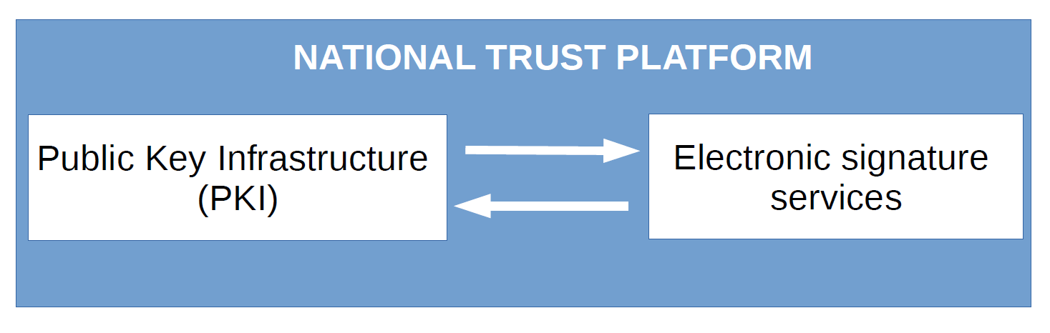
What do we call the « National Trust Platform » ?

Slide 3

Why do we need a Trust Platform ?
Authentication
Confidentiality
Integrity
Non repudiation

Slide 4





Trusted certificates
Encryption
Signature
Fab5f62863
Cdedc51435
52c9d3
Clear
Text
Message
Fab5f62863
Cdedc51435
52c9d3
Verify
signature

Slide 5
The National Platform PKI
Certification authority
Root authority
Subordinate authorities:
National Education CA
Person
CA
Infrastructure
CA
Signature
CA
Others
…
Registration authority
Log management
HSM
Enrollment Entity
Users
PKCS#10
Forms
Servers
SCEP
PKCS#10
Forms

Slide 6
The Certification Authority entity
Trusted certification authorities
Trusted certificates
Certificates lifecycle
Certificate policy

Slide 7
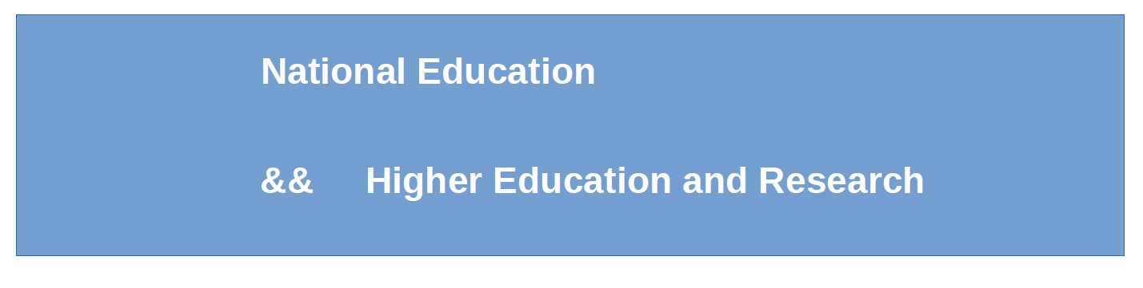
The Root Certification Authority
Signature of Subordinate Certification Authority certificates
Subordinate Certification Authority certificates lifecycle
Issuing Certificate Revocation List (CRL)

Slide 8
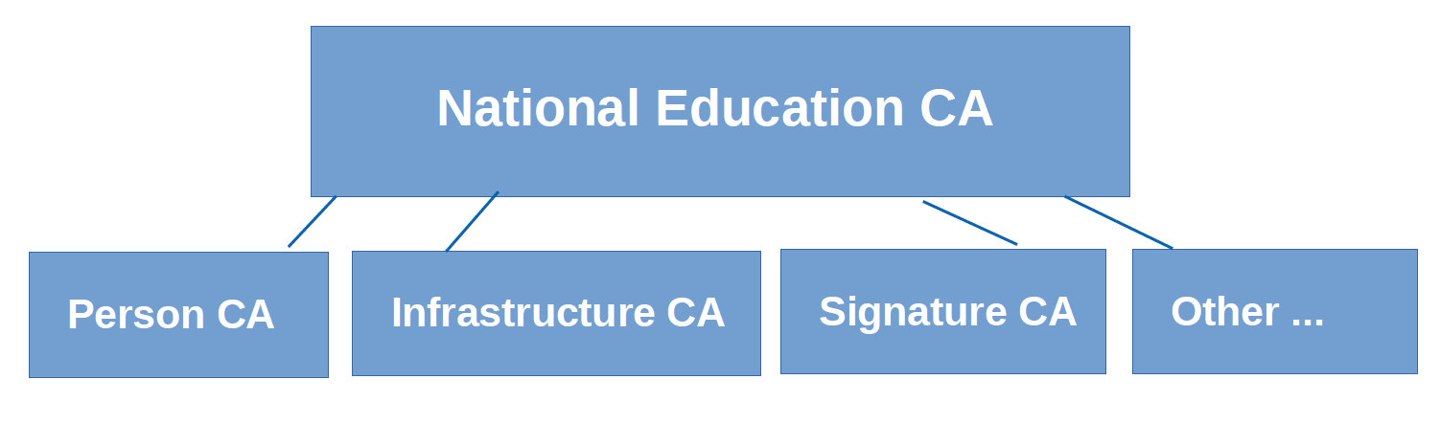
The subordinate certification authorities
Signature of User / Server Certificate Requests
Backup of encryption key pairs
User / Server certificates lifecycle
CRL updating and publication

Slide 9
The Person Certification Authority
User authentication
User data encryption
User signature
09/2017 – 09/2018 = 634 certificates
The cost of one user authentication certificate from an external provider is 100 €

Slide 10
The Infrastructure Certification Authority
Client / Server authentication
Encryption
Time stamping
Server stamping
Code signature
09/2017 – 09/2018 = 369 certificates
The cost of one SSL certificate from an external provider = 250 €

Slide 11
The Signature Certification Authority
Electronic signature
09/2017 – 09/2018 = 790129 certificates !
The cost of one temporary signature certificate from an external provider = 26 €
Money saving ? Yes, it is money saving.

Slide 12

Keys management
HSM BULL PROTECCIO
RSA upto 4096 bits key length

Slide 13

The Registration Authority
Search / retrieval of issued certificates
Certificate requests
Key recovery requests
Revocation requests
Renewal requests

Slide 14
The Enrollement Entity
Requester:
Certificate request
Enrollment
Entity
NO
Regiistration Authority
YES
Certification
Authority

Slide 15
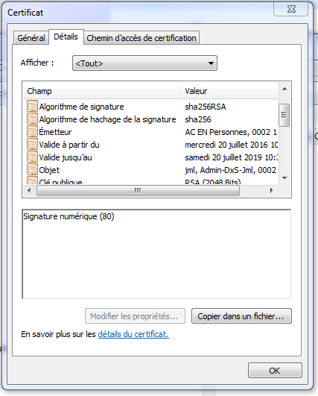
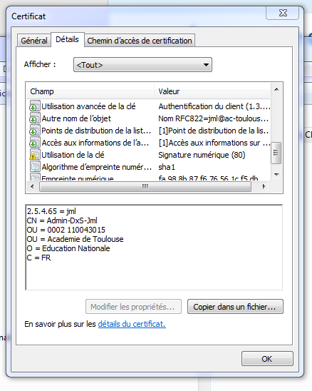
The certificate policy
Issuer DN
Key
Usage
Validity
dates
User DN
User’s
Public
key

Slide 16
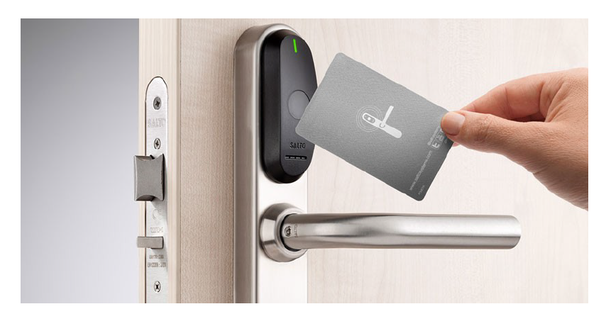
The secure environment
ACLs
TLS authentication with certificates
PKI Officer validation
Security tokens

Slide 17
The Signature services
The signature service
The signature validation service
The timestamping service
The safebox service

Slide 18


The Signature service
To ensure the signer’s identity
To establish a relation between the signer and the signed document (non repudiation)
To ensure that the document was not modified (integrity)
    Signer Signed document
fab5f62863cdedc5143552c9d37d6679e3304f7a

Slide 19
The Signature validation service
To verify the document’s integrity since its signature
To verify the relation between the signer and the signed document
To verify the signer’s certificate (CRLs, validity, trustworthy CA)
    Certificate
    Revocation
    Lists
    Certification
    Authorities
fab5f62863cdedc5143552c9d37d6679e3304f7a

Slide 20









The Timestamping service
To ensure that the document was signed at a precise time
To ensure that the document has not been modified since this time
fab5f62863cdedc5143552c9d37d6679e3304f7a
Certificate
Date&
Time
Signature
Timestamping
Authority
Certification
Authority
Data to be
timestamped
fab5f62863cdedc5143552c9d37d6679e3304f7a
NTP
server
Sattelite
GPS

Slide 21





The Safebox service
To ensure the storage of the data protected from any modification
To ensure the confidentiality of the stored data (encryption, secure access)
Deposit
Decryption of the digital object
Deposit hash validation
Deposit access request
Deposit proof validation
Fab5f62863
Cdedc51435
52c9d37d66
79e3304f7a
Deposit
Hash of the digital object
Encryption of the digital object
Deposit proof signed and timestamped

Slide 22
To sum up
The National Trust Platform provides us with trusted mechanisms which allow to:
Safely authenticate users, processes, machines
Encrypt the data to keep it confidential
Ensure the integrity of the data stored or transferred
We can dematerialize procedures by using electronic signature services and secure storage. We have the mecanisms to identify document signers, verify signatures and securely store the proof of valid signatures.

