Slide 1
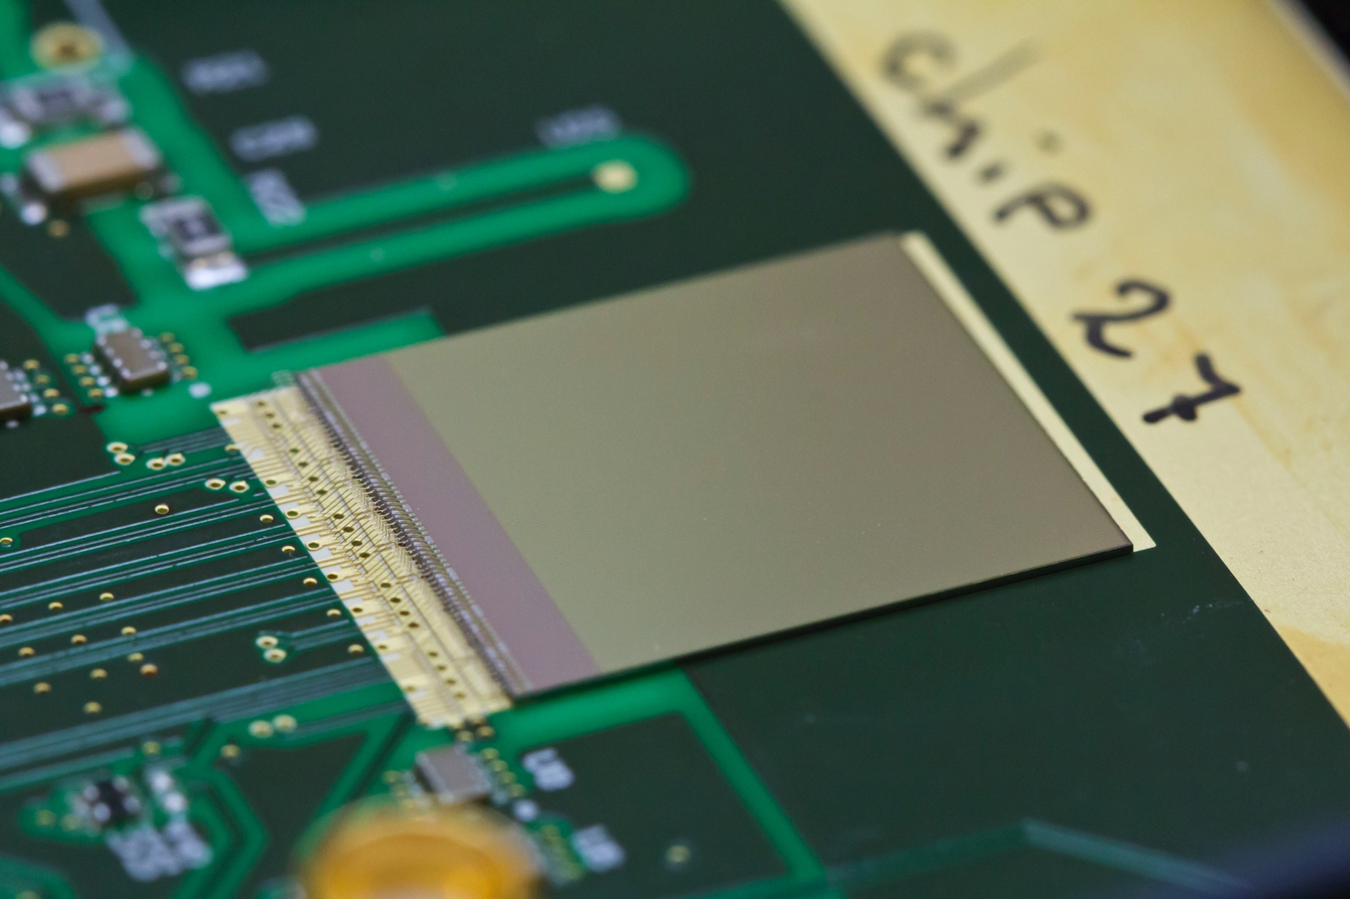
Detector R&D
SPIDR training
Martin van Beuzekom Kevin Heijhoff
(Bas van der Heijden)
21-22 August 2018

Slide 2
Medipix chip family
15+ years of chip design with CERN Medipix group
Nikhef initiated per pixel time measurement
Matching readout systems
RELAXD
SPIDR3
SPIDR4
hard X-rays
high-Z sensors
greyscale
spectral
X-ray, photon counting
imaging
medipix2
medipix3
medipix4
10 ns
~1 ns
~0.1 ns
charged particles, timing
tracking
?
timepix
timepix3
timepix4
0.01 ns
VeloPix
LHCb
VeloPix
time
today

Slide 3
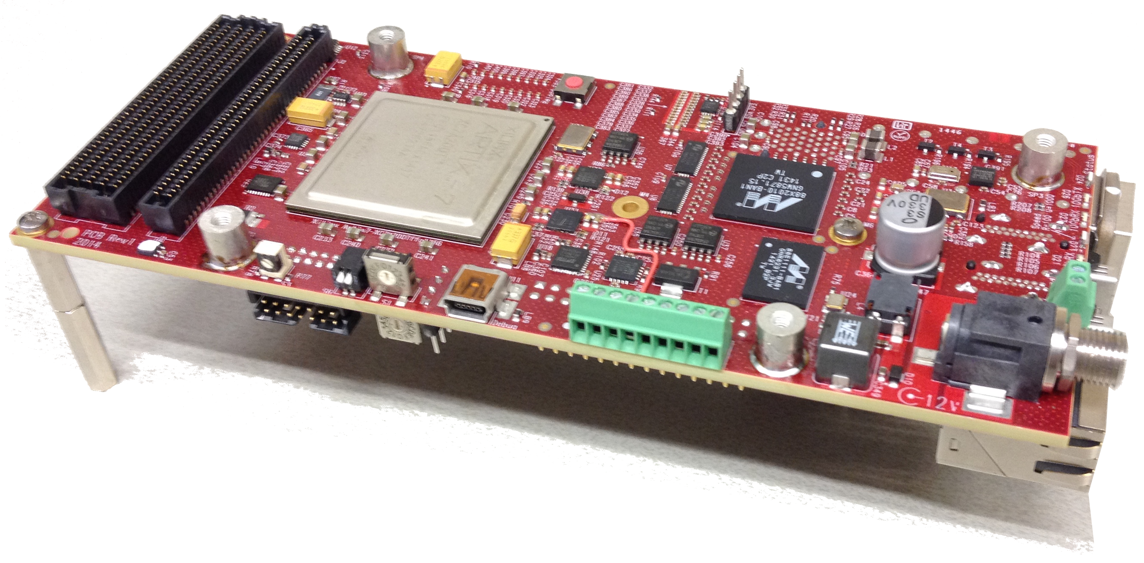
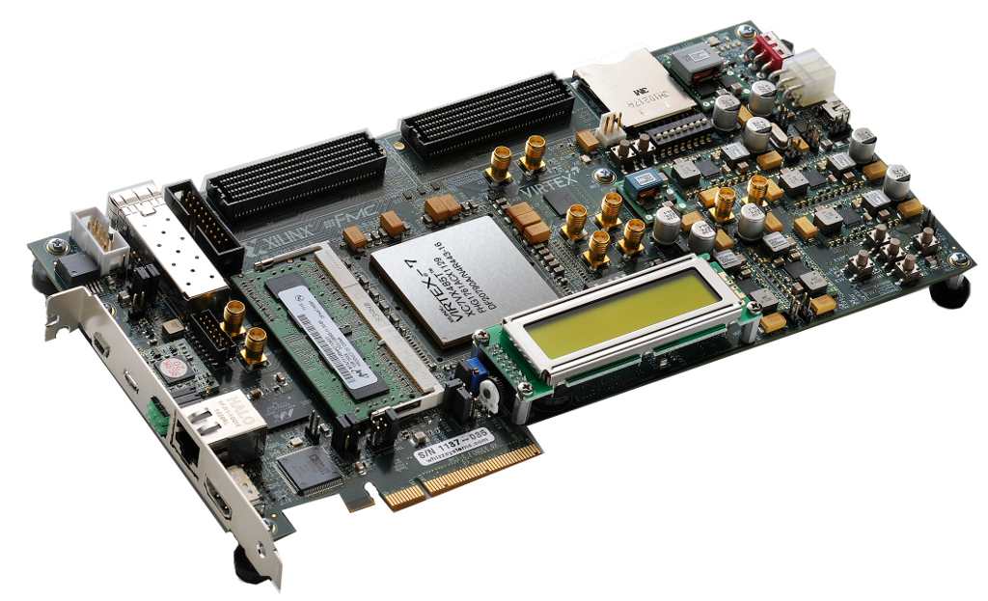
Two variants
Compact SPIDR
Up to 12 links
1 TPX3 at full speed
4 TPX3 at 30 Mhits/s via Quad chipboard
Commercially available via ASI
(Amsterdam Scientific Instruments)
Prototype, using Xilinx VC707 development board
up to 16 links
1 TPX3 at 80 Mhits/s
2 TPX3 at 60 Mhits/s

Slide 4
SPIDR overview
tpx3
Data driven architecture
When shutter is open, data are sent by the TPX3 and pushed to memory/disk
Read out 1 TPX3 at max rate
or up to 12 (16) TPX3/MPX3 chips at reduced rate
Even larger detectors (like LepCol) also possible, via data concentrator
1 or 10 Gbit ethernet
C/C++ software API
(or SoPhy software)
all packets
(data and
slow control)
slow control
cpu
filter
filter
TCP
UPD
1 or 10 Gbit ethernet
TCP
UPD
Spidr
Controller
Spidr
Daq

Slide 5
Data flow
SPIDR uses 3 data streams
(1) Slow control: to configure the TPX3/SPIDR via TCP/IP
(2) Full data stream: ‘the’ data via UDP
(3) Optional Monitoring stream: selected fraction of the data, via UDP
needed for synchronous sampling of data across multiple SPIDRs
not yet thoroughly tested
For each of the 3 streams one can select whether it runs over 1 or 10 Gbit ethernet

Slide 6
Data packets
tpx3
Timepix3 sends data and slow control packets on same output
4 bit packet header to distinguish content
Header filter selects which packets go where
Slow control packets (replies) must go to the CPU in SPIDR that issued the command
and CPU sends the reply via TCP to the SpidrController
Data/others packets go directly to disk
Multiple TPX3 -> multiple UDP ports -> multiple files
all packets
(data and
slow control)
slow control
cpu
filter
filter
TCP
UPD
1 or 10 Gbit ethernet
TCP
UPD
Spidr
Controller
Spidr
Daq

Slide 7
(quite) a few slides on timing

Slide 8
Everything in Timepix3 and SPIDR is based on timestamps
Clusters / tracks are reconstructed offline using timestamps
Time counters in TPX3 and SPIDR are reset at the same moment
For systems with multiple SPIDRs, use external clocking etc.
one can daisy chain compact SPIDRs
for larger systems it is better to use a star configuration with central clock source

Slide 9
Timepix3 time measurement
ToA and ToT measurement using 40 MHz counters
ToA: 14 bits (resolution 25 ns, range 409 µs)
ToT: 10 bits (resolution 25 ns, range 25 µs)
Fast ToA measurement (640 MHz counter)
4 bits (resolution 1.56 ns, range 25 ns)
common stop TDC -> subtract fast TDC value from time measurement

Slide 10
Extending timestamps
The timestamp from TPX3 has a 14 bit range = 409 us
Extension of timestamp needed for a long(er) unique timestamp
Extension in 2 steps
In SPIDR FPGA: add 16 bits, range becomes 26.8 seconds
we often call this extra 16 bits “SPIDR time”, in units of 409 us (2^14 * 25 ns)
In analysis software: add another 22 bits, range ~1300 days
using 1 Hz heartbeat
but for SW one is of course free to choose their own format
data format of pixel packets in raw datafile

Slide 11
Extending timestamps: SPIDR FPGA
In principle the user does not need to worry about this
However some background info is useful in case one sees ‘weird’ things
The SPIDR runs with the same 40 MHz clock as the Timepix3 and is reset by the same T0-reset -> SPIDR is in sync with TPX3
Because of the latency in the transmission of the data packets, the timestamp in the data packet is always older than the current-time in the SPIDR board
The timestamp is extended based on packet-time and (long) current-time
Think of Timepix3 as only transmitting the ‘seconds’, while the FPGA knows about seconds and minutes/hours
if (packet-seconds < SPIDR-seconds) then add SPIDR-minute as-is
if (packet-seconds > SPIDR-seconds) then add SPIDR-minute-1

Slide 12
Extending timestamp, when it can fail
However it may fail when there are bursts of data (‘flashes’) because ToA range of TPX3 is too short w.r.t. the readout rate
Imagine all 64k pixels fire at the same time and hence should get the same timestamp in the packet
At max. rate the TPX3 can send out 80 Mhits/s = 1 hit every 12.5 ns
Hence within the 409 us ToA range it can send 32k packets
After 409 us, the SPIDR will go to the next coarse clock tick (‘minute’)
So if there are more than 32k packets, SPIDR will assign the wrong coarse time
This is unlikely, but not impossible…

Slide 13
Extending timestamp: 1 Hz heartbeat, step1
Time stamp extension beyond 26.8 seconds is done in software
For this we use a so-called heartbeat in the DAQ
Every second it reads out the 48 bit timestamp of the Timepix3
In principle the analysis SW takes care of glueing together the timestamps. Some caveats:
the 48 bit timestamp comes in 2 pieces and hence can suffer from the ‘second-minute’ problem. Solved by checking for large jumps (~6 seconds) in the timestamps

Slide 14
Extending timestamp: 1 Hz heartbeat, step2
Compare heartbeat timestamp to pixel-timestamp
Check if bits 29 and 28 match those of heartbeat timestamp
If yes, copy 18 MSBs of heartbeat timestamp
If not, and difference = -1/+1 then add/subtract 1 from heartbeat MSBs
47
32
31
0
Timer MSBs 16b
Timer LSBs 32b
0
3
0
SPIDR time 16b
ToA 14b
FTOA 4b
29
28
check

Slide 15
Trigger
SPIDR has no (classical) hardware trigger, i.e. no event selection
A rising edge on the trigger input adds a data packet with trigger timestamp to the data stream
Event selection is done offline using a time window around the trigger timestamp
TDC bins are 260 ps, about 20% bin to bin variation

Slide 16
Trigger timestamp details
TDC word
6F 8b
Trigger Counter 12b
320MHz Timestamp 35b
Stamp 4b
reserved 5b
6 phase shifted
320MHz clocks
Trigger
PLL
1
2
3
4
5
6
RefClk
40Mhz
The stamped value is translated to 12 bins of 260 ps (1 to C), 0 means a decode error
5 bits reserved for future TDC implementation, with higher resolution

Slide 17
Timepix3 configuration options
(too) many modes / options
Some are only useful for debugging
We have a lot of experience but with only a few modes, not all are well tested
If you use a different mode, and encounter problems, first check default mode
Most used settings:
16 clock phases in chip, to reduce noise
phase shift of 25/16 ns between neighbouring double columns
correct phase shift in offline data analysis
40 MHz matrix clock
40 or 80 MHz periphery clock
Data driven mode, or sequential mode with 1 token
640 Mbits/s link speed

Slide 18
How to get going

Slide 19
Configuring / starting the SPIDR
Setting up:
Selection switches for 1 or 10 Gbit ethernet
Configure network interface of computer
Ping the SPIDR
Check if one can configure the SPIDR and TPX3
Check if data packets are written to disk
Then
Equalise a chip
Take ‘real’ data, and analyse it

Slide 20
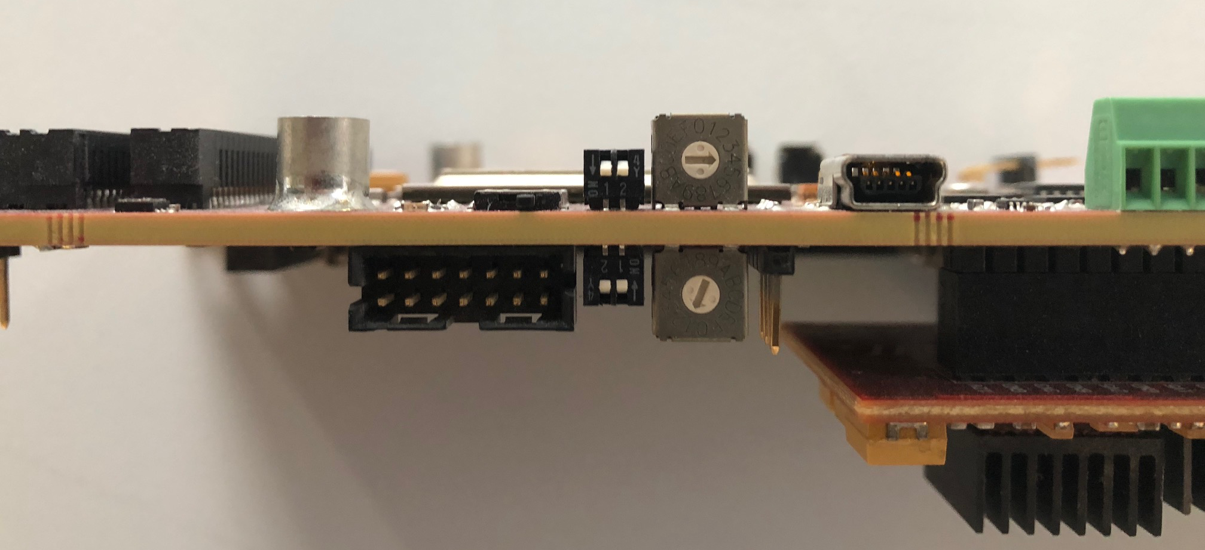
1) Select which network speed you want to use
Reminder: SPIDR has 3 data streams
Slow control
Full data stream
Monitoring stream: selected fraction of the data, UDP
For each of stream one can select whether it runs over 1 or 10 Gbit ethernet
1
2
switch towards PCB = 10 Gbit
control
data
monitoring
3
4

Slide 21
2) configure the computer network interface
By default SPIDR listens on 192.168.1.10 (1 Gbit) or 192.168.100.10 (10 Gbit)
And sends data to 192.168.1.1 or 192.168.100.1
But this can be changed !
Figure out the name of the network interface (on linux: dmesg, or lspci)
Configure the interface, on linux: in /etc/sysconfig/network-scripts/ifcfg-NNN
IPADDR=192.168.1.1
MTU=9000 (MTU is max size of ethernet packet)
Or temporary on command line:
ifconfig NNN 192.168.1.1 and ifconfig NNN MTU 9000
watch out that the network manager does not change settings on the fly

Slide 22
3) ping the SPIDR
ping 192.168.1.10 (or 192.168.100.10)
If this does not work:
check network settings with ifconfig –a
check blinking leds on SPIDR (remove network cable and check for change)
If this is all OK, then SPIDR might be at a different IP address:
hook up the USB serial port, serial connection speed: 115200
At power up SPIDR gives information on network address, TPX3 IDs etc.
On linux:
check which USB port, e.g. /dev/ttyUSB0 (dmesg, tail /var/log/messages)
connect via: screen /dev/ttyUSB0 115200

Slide 23
Last checks before taking some real data
4) Check if one can configure the SPIDR and TPX3
for example by running the DAQ example
5) Check if data packets are written to disk
a running DAQ does not mean data packets are received

Slide 24
Network traffic related problems
For full data stream you need MTU=9000
Default MTU=1500
MTU=1500 will work at low packet rate, but not for higher rates.
the computer will drop packets with size > MTU
If you don’t understand, then wireshark is your friend
UDP packets might also be filtered by the computer’s firewall
UDP packets come on port 8192 (8193, etc)
check it!
In case of doubt, use wireshark; if wireshark doesn’t see packets then no packets are being sent.

Slide 25
Raw data format

Slide 26
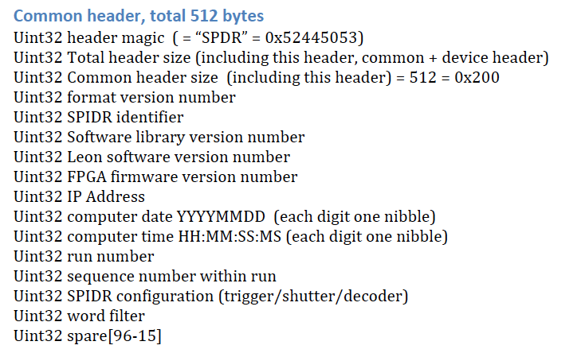
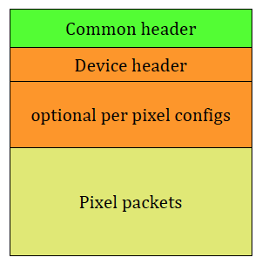
SPIDR raw file format (binary)
pixel data format only allows data of 1 TPX3 per file
-> multiple chips means multiple files
512
256
(64k)

Slide 27
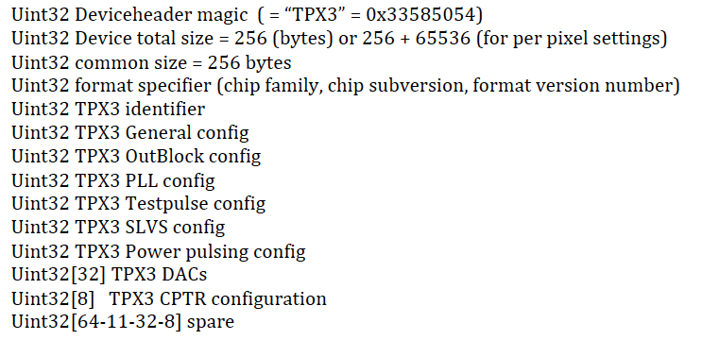
File format: TPX3 header

Slide 28
Packet format
48 bit packets described in Timepix3 manual
SPIDR adds 16 bits at end of packet
16 bits extended timestamp for ToA/ToT packets
0xAAAA (or 0x0000) for other packets
One extra packet (header 0x6F) generated by SPIDR: the trigger packet
6F 8b
Trigger Counter 12b
320MHz Timestamp 35b
Stamp 4b
reserved 5b

Slide 29
Other

Slide 30
Multiple SPIDRs
To run multiple SPIDRs synchronously, 4 control signals are defined
For the compact SPIDR these are on the hdmi connector, signal level LVDS
1) Clock input, 40 MHz
2) T0-reset input
3) Shutter input, starts the sending of TPX3 data packets
4) Busy output, asserted in case of buffer overflow
currently only buffer overflows in the FPGA are handled
buffer overflow in DAQ computer not yet implemented (but prepared in firmware)

Slide 31
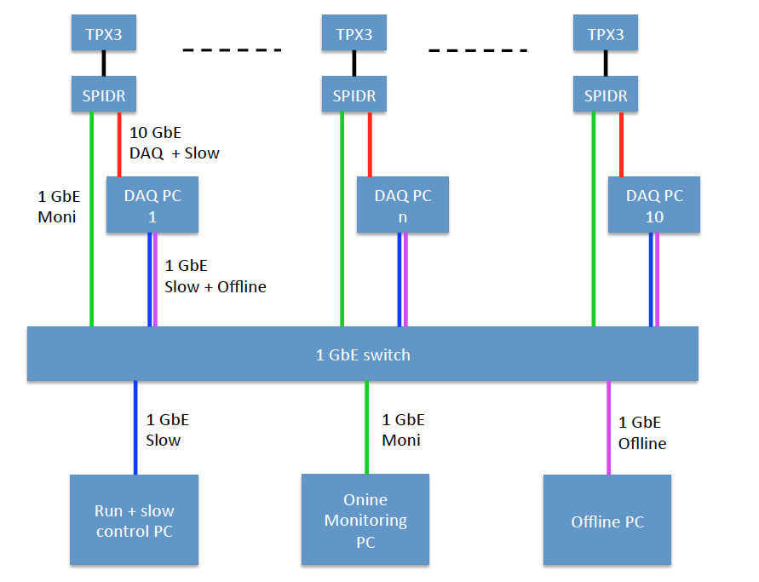

Slide 32
svn
svn co svn+ssh://yourname@svn.cern.ch/reps/SPIDR/software/trunk
go to the SpidrTpx3Lib directory
qmake
make
this creates the library in the trunk/Release dir
add it to the library path with:
export LD_LIBRARY_PATH=$LD_LIBRARY_PATH:yourdir/trunk/Release

