Slide 1


KM3NeT hydrophones for relic neutrino detection
November, 2018, The Netherlands
Rasa Muller
PhD student at Nikhef, Amsterdam
Previous intern at TNO Delft
Contributions
Ernst-Jan Buis – Ivo van Vulpen

Slide 2
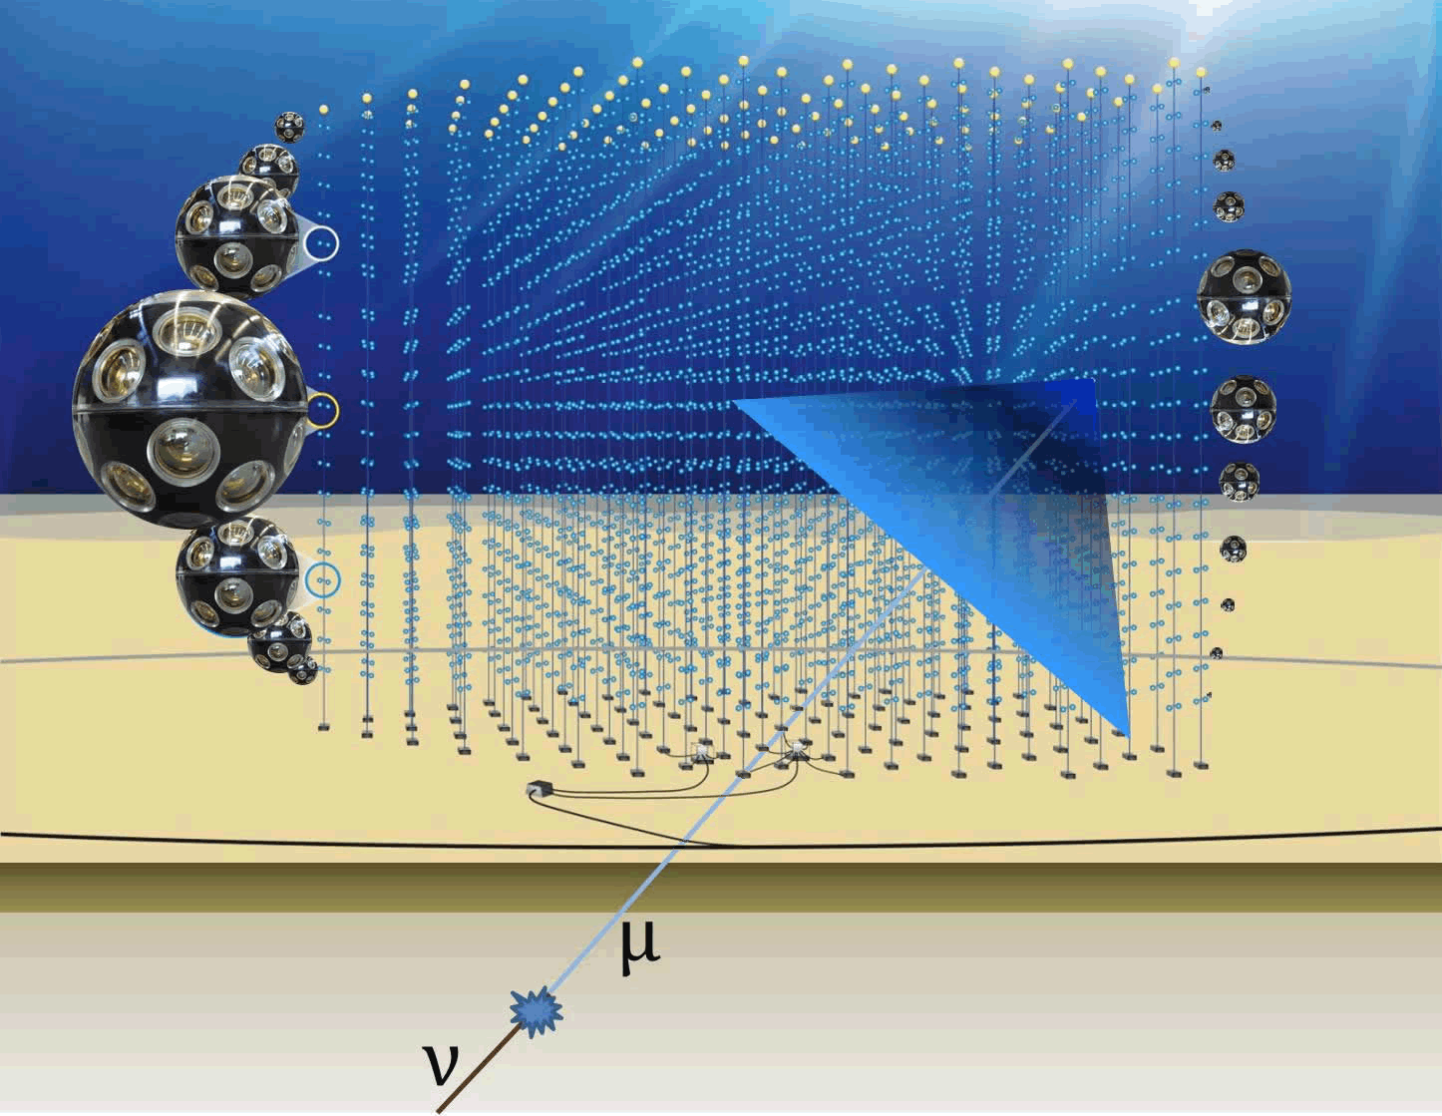
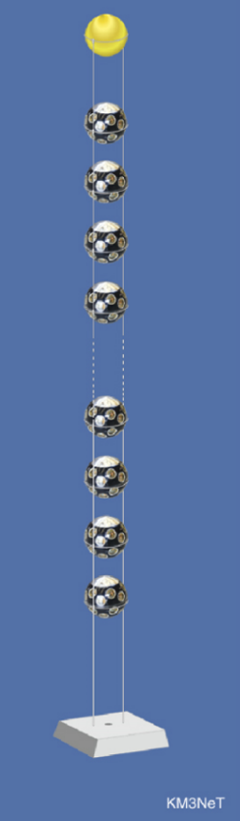
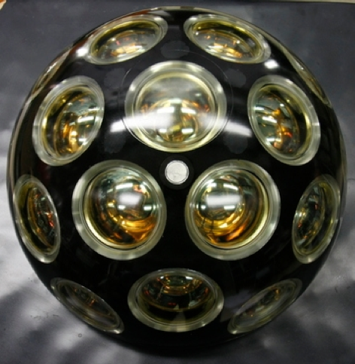
KM3NeT hydrophones for relic neutrino detection
November, 2018, The Netherlands
Km³
Neutrino
Telescope

Slide 3
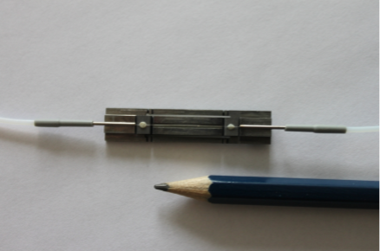
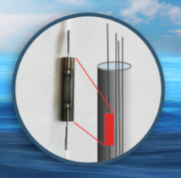
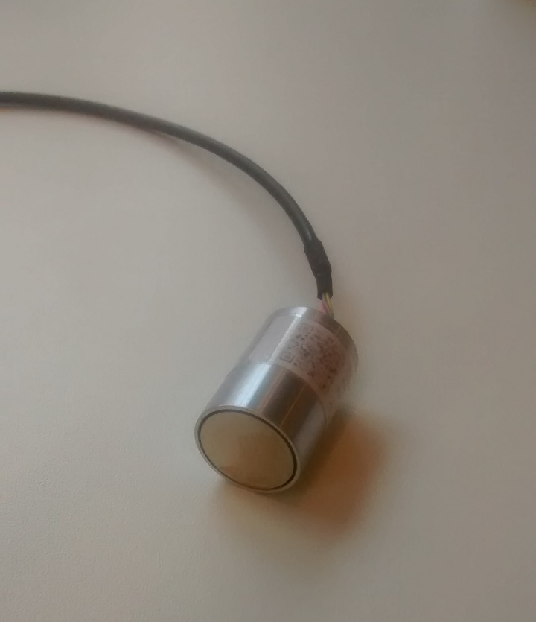
KM3NeT hydrophones for relic neutrino detection
November, 2018, The Netherlands
Microphones
underwater
Optical fiber
Piezo

Slide 4
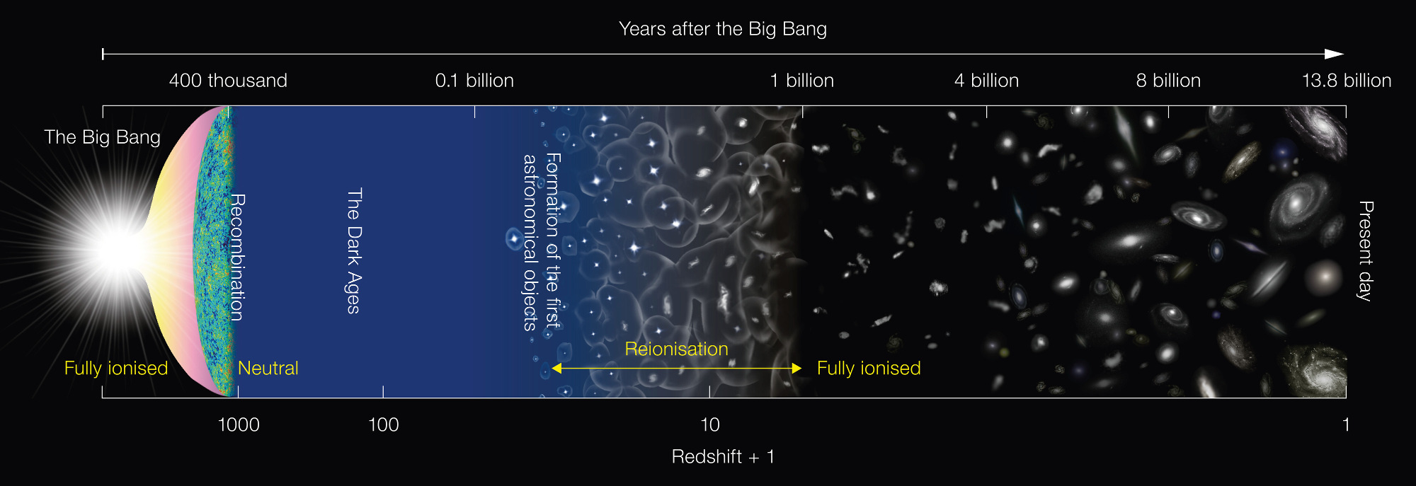
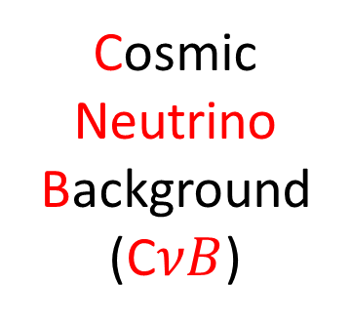
KM3NeT hydrophones for relic neutrino detection
November, 2018, The Netherlands
Cosmic
Neutrino
Background
(C$νB$)
Cosmological
neutrino

Slide 5
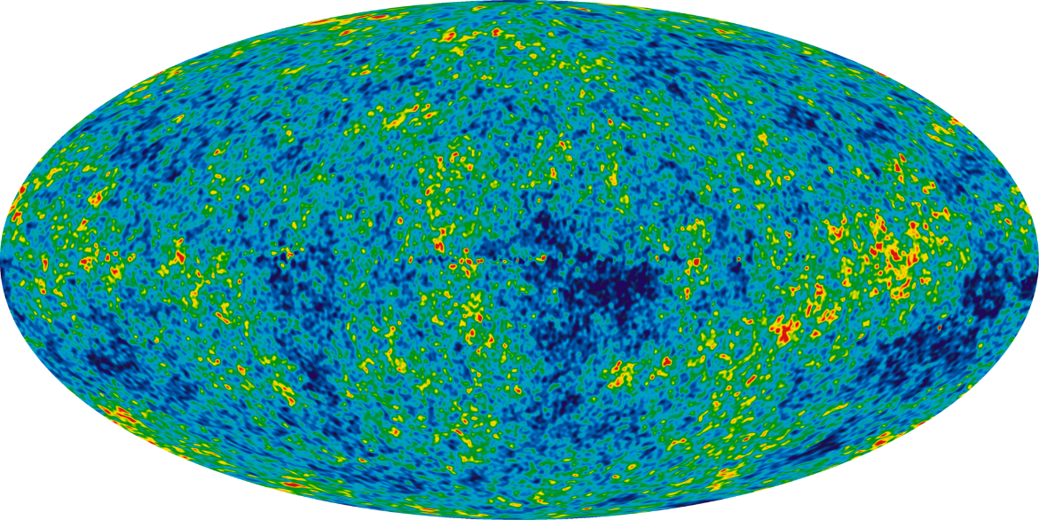
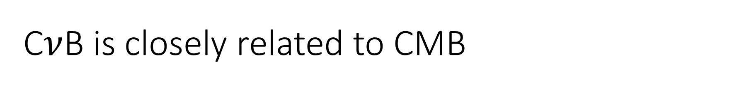


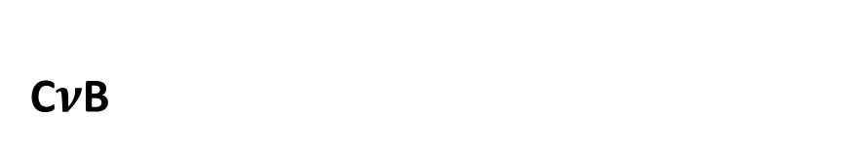
C$ν$B is closely related to CMB
I. Context/Theory | II. Monte Carlo simulation | III. Conclusion
CMB
C$ν$B
Cosmic microwave background
Due to expansion of universe past 13.8 billion year history:
2.725 K
Cosmic neutrino background
${\left(\frac{4}{11}\right)}^{1/3}$ of the CMB temp:
1.95 K
Energy per particle
$μ$eV - meV range
R.S. Muller ‘KM3NeT hydrophones for relic neutrino detection’ November 2018 5

Slide 6
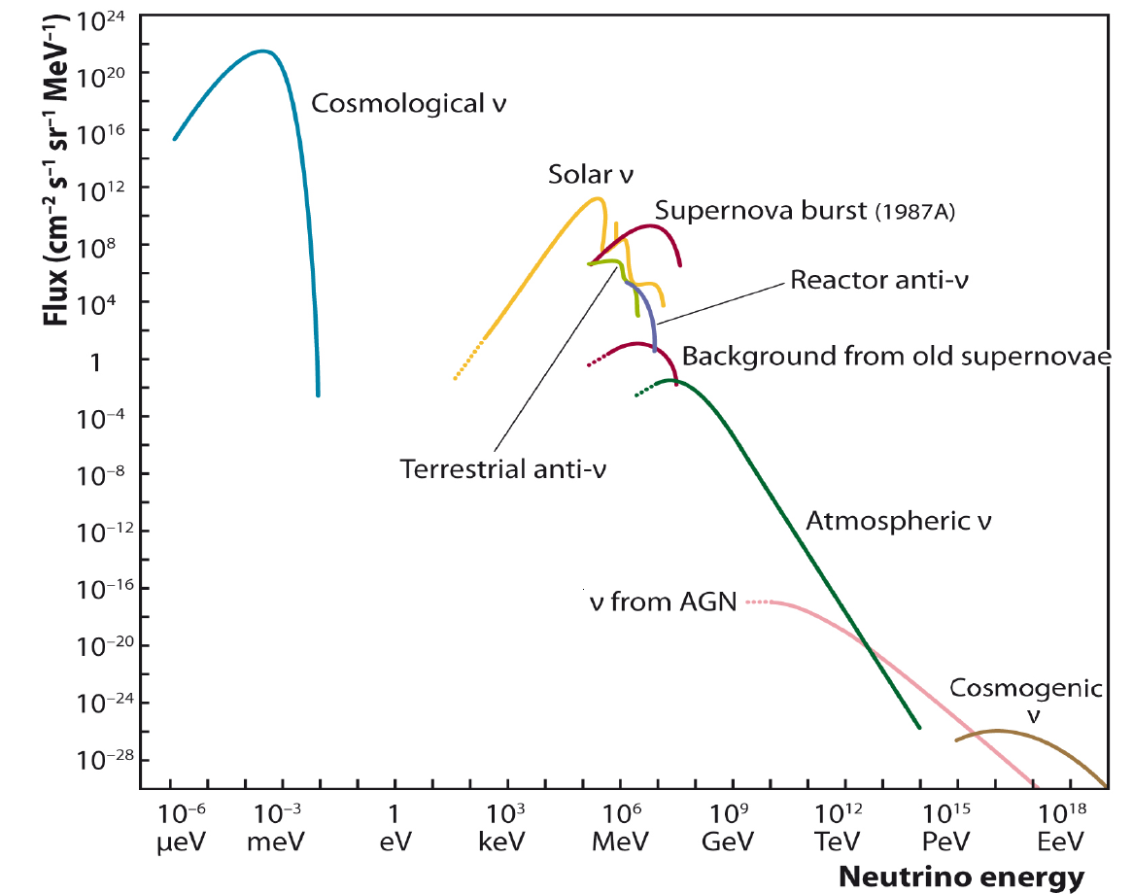
Neutrino’s exist in a wide E-range
I. Context/Theory | II. Monte Carlo simulation | III. Conclusion
U.F. Katz, Ch. Spiering 2011:
High-Energy Neutrino Astrophysics: Status and Perspectives
R.S. Muller ‘KM3NeT hydrophones for relic neutrino detection’ November 2018 6

Slide 7
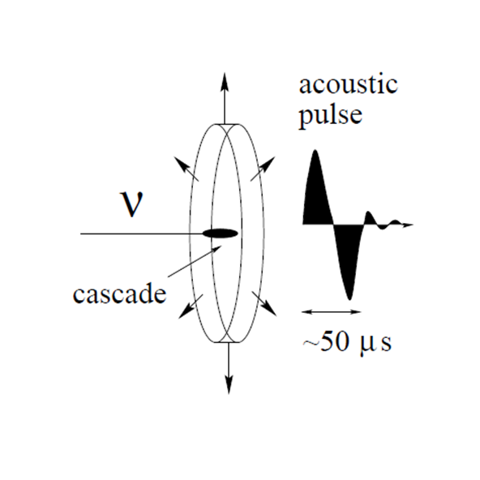
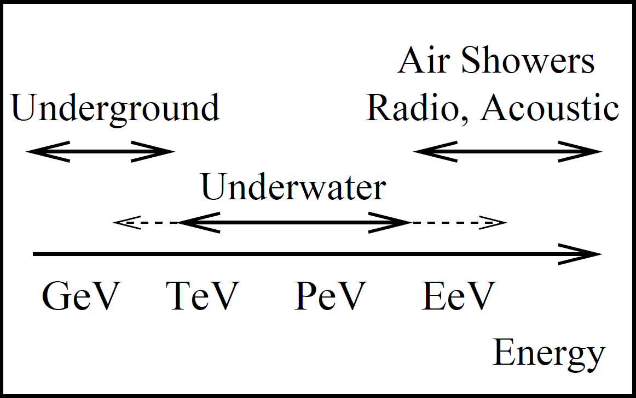
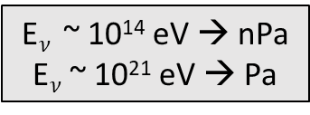
Large variety to detect neutrino’s
I. Context/Theory | II. Monte Carlo simulation | III. Conclusion
E$ν$ ~ 10¹⁴ eV → nPa
E$ν$ ~ 10²¹ eV → Pa
Ice,
Alternative techniques
Acoustics!
U.F. Katz, Ch. Spiering 2011:
High-Energy Neutrino Astrophysics: Status and Perspectives
R.S. Muller ‘KM3NeT hydrophones for relic neutrino detection’ November 2018 7

Slide 8
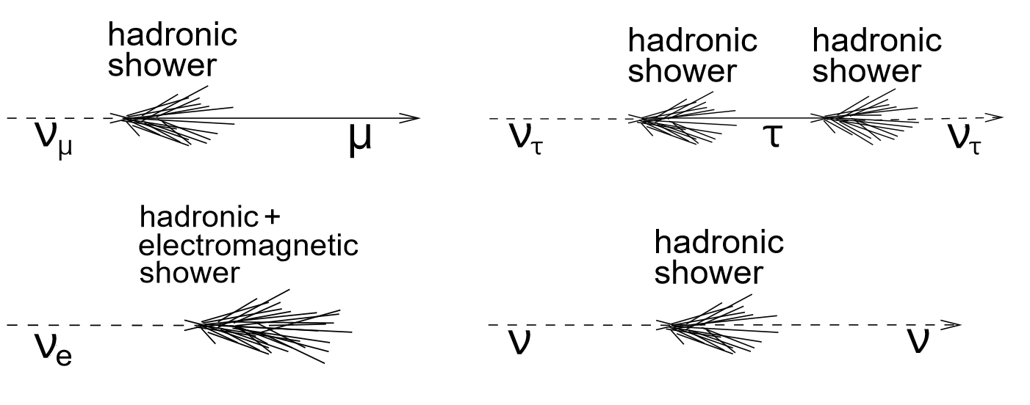
Acoustic neutrino detection
I. Context/Theory | II. Monte Carlo simulation | III. Conclusion
Rapid expansion of medium after energy deposition
and subsequent heating
Expansion leads to a pressure wave in water
Acoustics!
G.A. Askariyan, et al., 1979:
Acoustic detection of high energy particle showers in warer
R.S. Muller ‘KM3NeT hydrophones for relic neutrino detection’ November 2018 8

Slide 9
Method to detect cosmic neutrino’s
I. Context/Theory | II. Monte Carlo simulation | III. Conclusion
?
Alternative techniques
Acoustics!
U.F. Katz, Ch. Spiering 2011:
High-Energy Neutrino Astrophysics: Status and Perspectives
R.S. Muller ‘KM3NeT hydrophones for relic neutrino detection’ November 2018 9

Slide 10
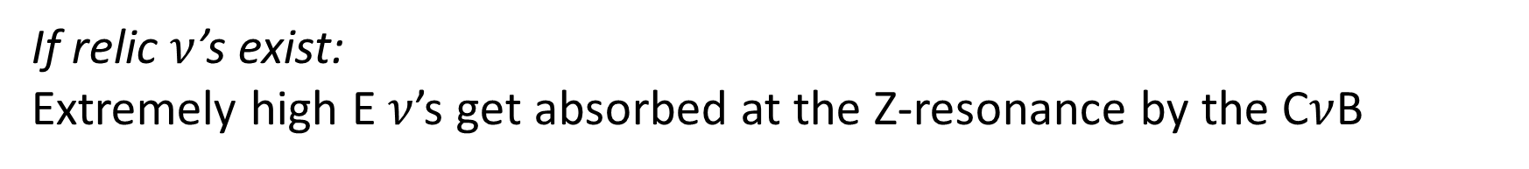
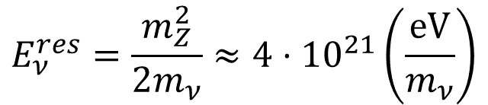

Relic neutrinos
I. Context/Theory | II. Monte Carlo simulation | III. Conclusion
If relic $ν$’s exist:
Extremely high E $ν$’s get absorbed at the Z-resonance by the C$ν$B
$$ν+{\overline{ν}}_{CνB}→ Z^{0}→X$$
$$E_{ν}^{res}=\frac{m_{Z}^{2}}{2m_{ν}}≈4⋅{10}^{21}\left(\frac{eV}{m_{ν}}\right)$$
R.S. Muller ‘KM3NeT hydrophones for relic neutrino detection’ November 2018 10

Slide 11
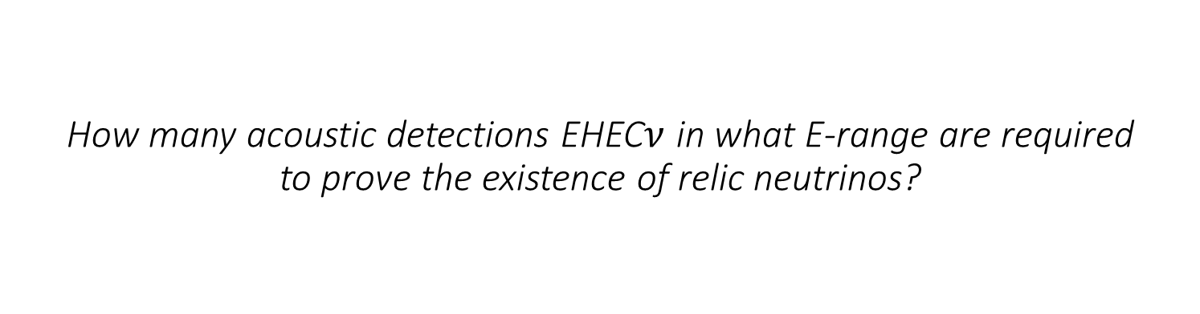
How many acoustic detections EHEC$ν$ in what E-range are required to prove the existence of relic neutrinos?
KM3NeT hydrophone network to detect relic neutrinos

Slide 12

Relic neutrinos
I. Context/Theory | II. Monte Carlo simulation | III. Conclusion
$$ν+{\overline{ν}}_{CνB}→ Z^{0}→X$$
Monte Carlo simulation
Redshift (z)
R.S. Muller ‘KM3NeT hydrophones for relic neutrino detection’ November 2018 12

Slide 13
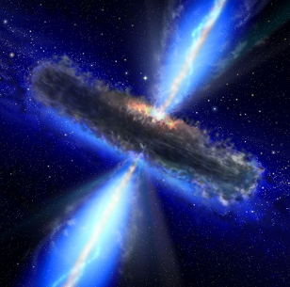
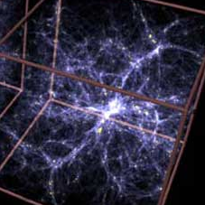
High energy sources are required
I. Context/Theory | II. Monte Carlo simulation | III. Conclusion
Bottom up
Sources capable of extreme “acceleration”
(galactic)
z ∼ 2
GRB / AGN
Top down
High energy particles were “born” with these energies
(physics beyond the
standard model)
z ∼ 20
super heavy dark matter decay
R.S. Muller ‘KM3NeT hydrophones for relic neutrino detection’ November 2018 13

Slide 14
Expected flux at Earth
I. Context/Theory | II. Monte Carlo simulation | III. Conclusion
Primary Flux
Survival Probability P(E(1+z), z)
Chance of a cosmic neutrino (injected at redshift z with energy E) to survive on its way to Earth
Source emissivity L(E(1+z), z)
Number of neutrinos (per flavor and Energy) emitted per comoving volume
R.S. Muller ‘KM3NeT hydrophones for relic neutrino detection’ November 2018 14

Slide 15
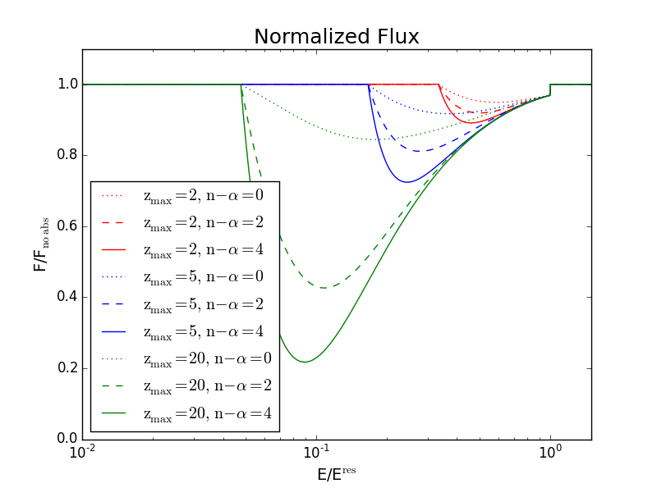



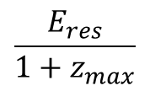
Expected flux at Earth
I. Context/Theory | II. Monte Carlo simulation | III. Conclusion
$$m_{ν}$$
Primary Flux
$$\frac{E_{res}}{1+z_{max}}$$
$$E_{res}$$
Survival Probability P(E(1+z), z)
Chance of a cosmic neutrino (injected at redshift z with energy E) to survive on its way to Earth
Source emissivity L(E(1+z), z)
Number of neutrinos (per flavor and Energy) emitted per comoving volume
Source
evolution
$$n−α$$
Energy
spectrum
R.S. Muller ‘KM3NeT hydrophones for relic neutrino detection’ November 2018 15

Slide 16
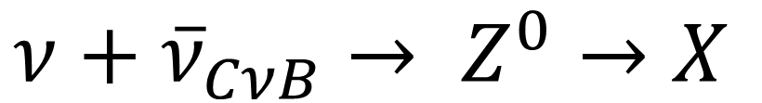
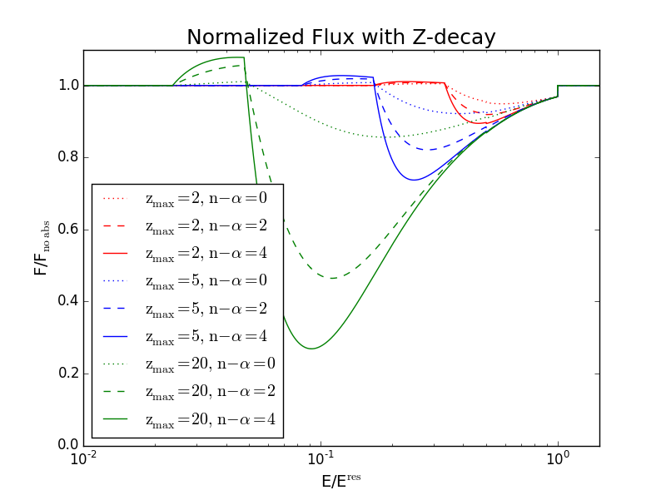
Expected flux at Earth
I. Context/Theory | II. Monte Carlo simulation | III. Conclusion
Primary Flux
Secondary flux
Survival Probability P(E(1+z), z)
Chance of a cosmic neutrino (injected at redshift z with energy E) to survive on its way to Earth
Source emissivity L(E(1+z), z)
Number of neutrinos (per flavor and Energy) emitted per comoving volume
R.S. Muller ‘KM3NeT hydrophones for relic neutrino detection’ November 2018 16

Slide 17
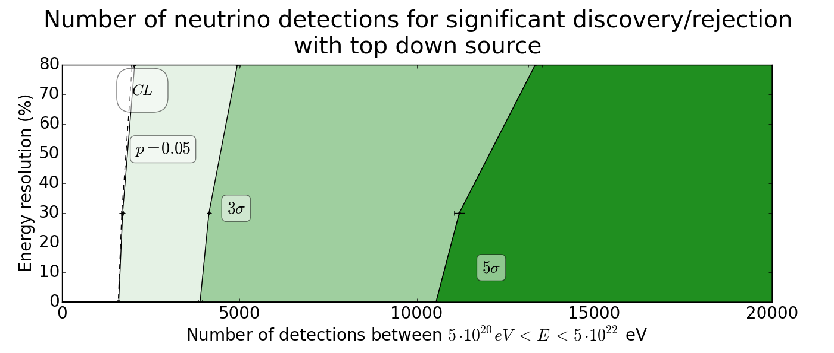
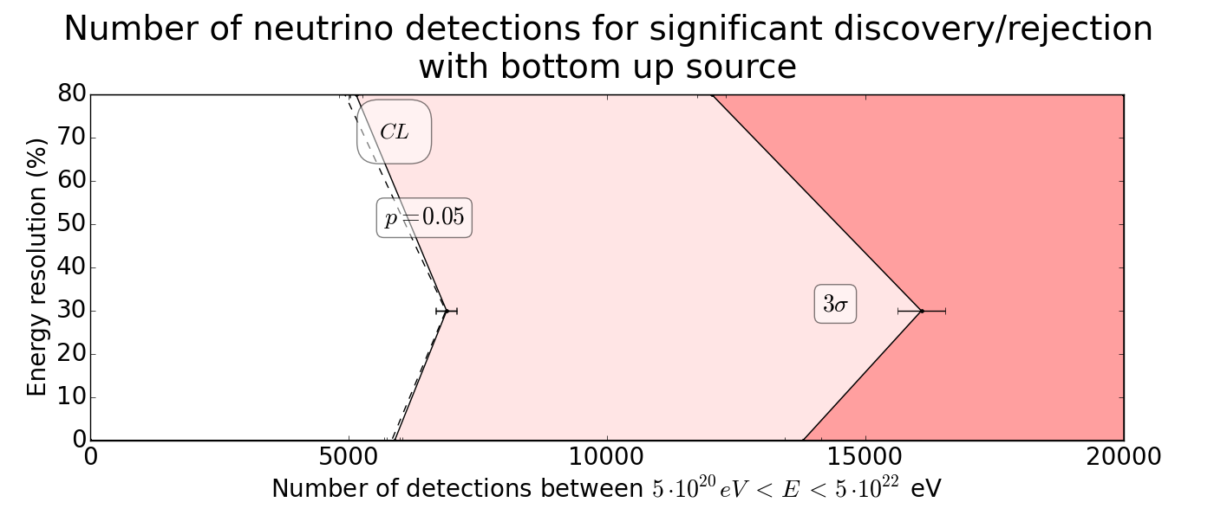
Top down and Bottom up results
I. Context/Theory | II. Monte Carlo simulation | III. Conclusion
Theoretical flux
Results
R.S. Muller ‘KM3NeT hydrophones for relic neutrino detection’ November 2018 17

Slide 18
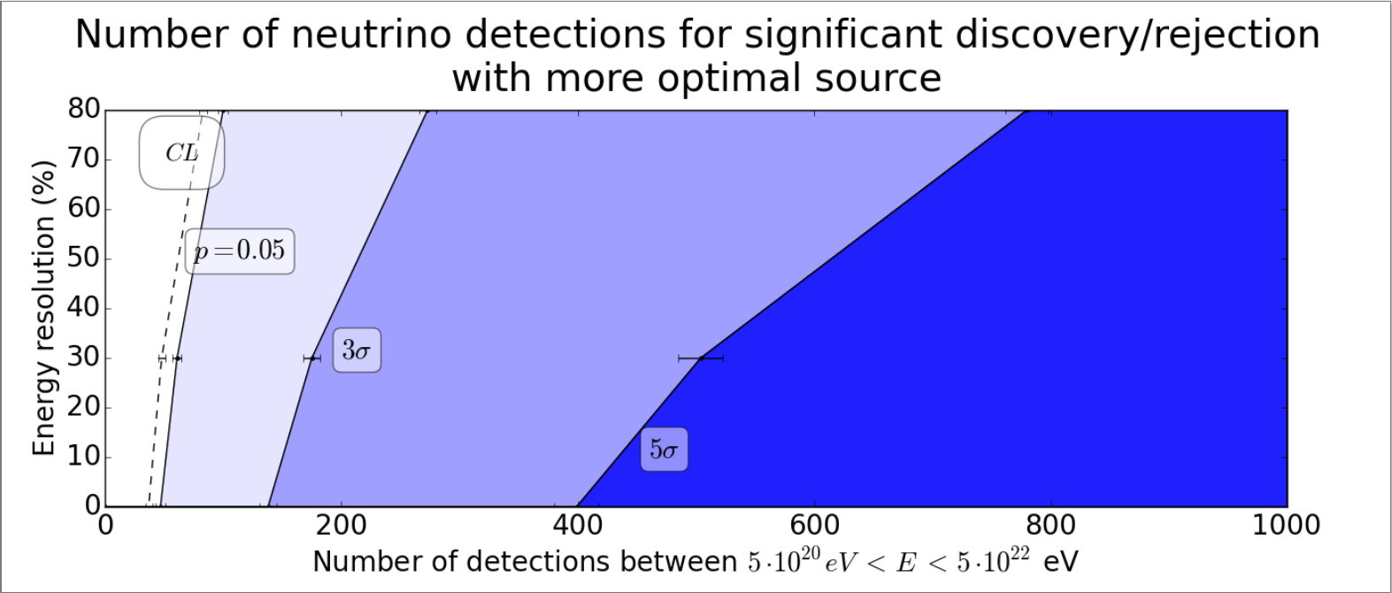
More optimal scenario
I. Context/Theory | II. Monte Carlo simulation | III. Conclusion
Theoretical flux
Results
R.S. Muller ‘KM3NeT hydrophones for relic neutrino detection’ November 2018 18

Slide 19
Observations and Conclusions
I. Context/Theory | II. Monte Carlo simulation | III. Conclusion
Type of source of major importance compared to Energy resolution of telescope
Significant detection of TD & BU require large sample of events
Optimal scenario factor 10 less detections required
  Large source evolution enhances signal
Prove of CνB not straightforward, but once detected: wealth of information on particle, astrophysical & cosmological physics
R.S. Muller ‘KM3NeT hydrophones for relic neutrino detection’ November 2018 19

Slide 20
Remember:
I. Context/Theory | II. Monte Carlo simulation | III. Conclusion
It is a really new part of physics!
  Unknown absolute flux of extremely high energetic neutrinos
  So far no one dared to give exact characteristics about the possible sources
    Top Down & Bottom up
All we need is time (and a nice hydrophone network)
Don’t forget the additional science…
R.S. Muller ‘KM3NeT hydrophones for relic neutrino detection’ November 2018 20

Slide 21
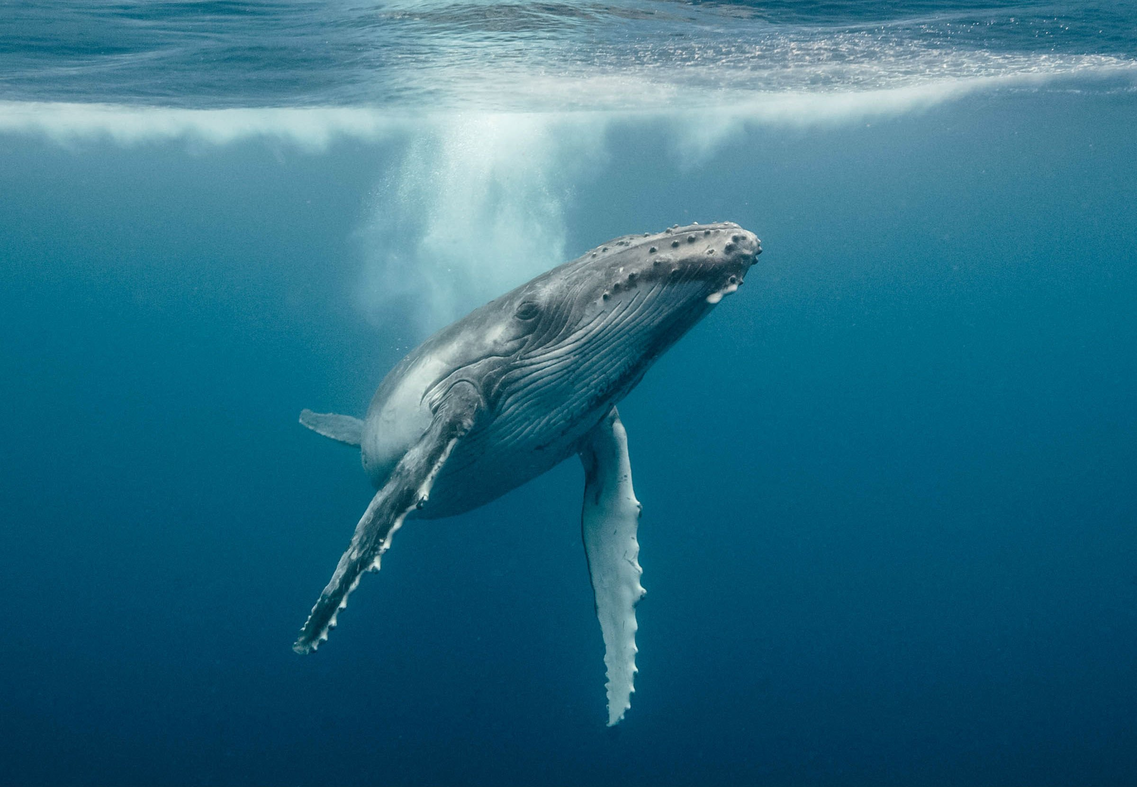
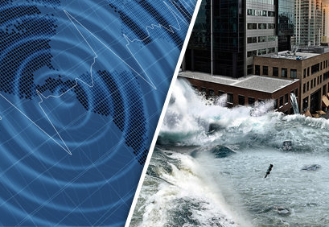
… other applications!
I. Context/Theory | II. Monte Carlo simulation | III. Conclusion
Sea life communication
Earthquake detection
R.S. Muller ‘KM3NeT hydrophones for relic neutrino detection’ November 2018 21

Slide 22
Thank you

Slide 23
Back-up Slides

Slide 24
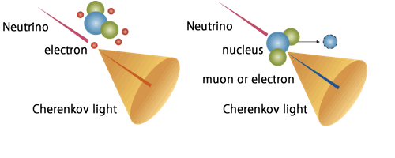
Neutrino interactions

Slide 25
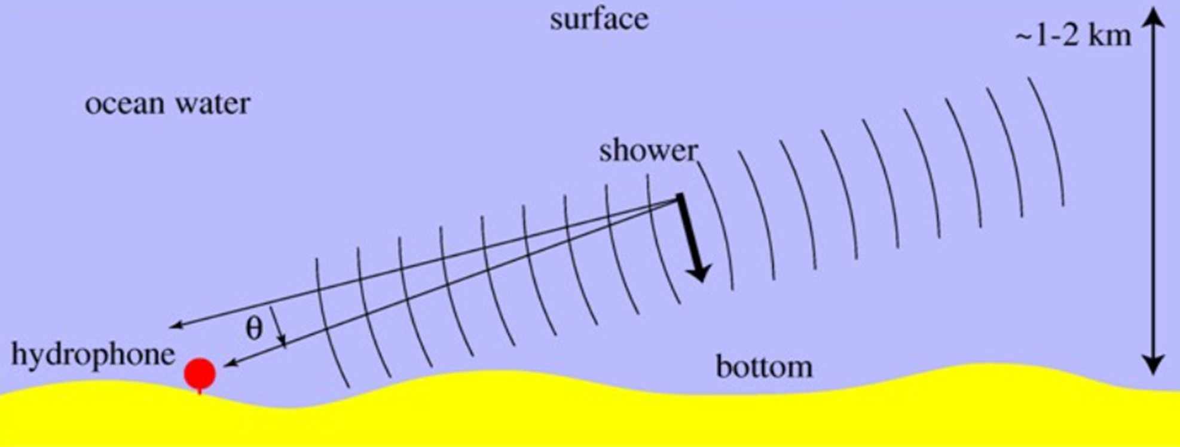
Acoustic signal

Slide 26
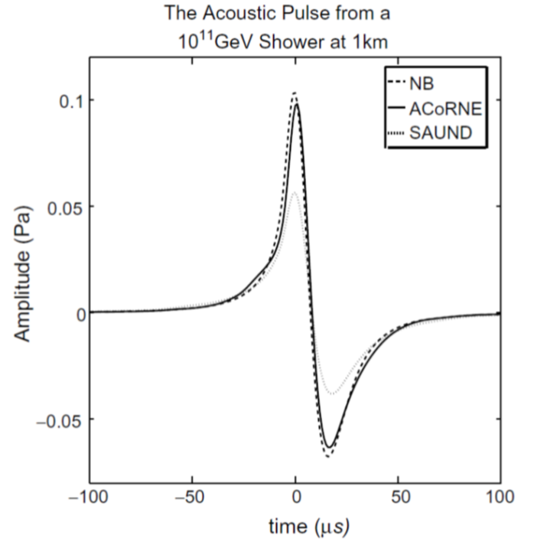

Pressure wave detection of neutrino
Bipolar pulse
10 – 50 kHz
E$ν$ ~ 10¹⁴ eV → nPa
E$ν$ ~ 10²¹ eV → Pa

Slide 27
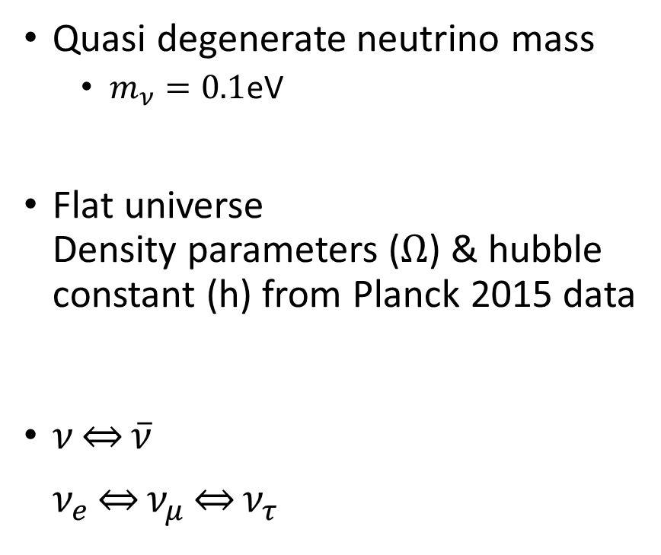

Assumptions
Spectral index
  $α=2$
Bottom up
  z ∼ 2
  n = 4 ($n−α=2$)
Top down
  z ∼ 20
  n = 2 ($n−α=0$)
Quasi degenerate neutrino mass
  $m_{ν}=0.1$eV
Flat universe
Density parameters ($Ω$) & hubble constant (h) from Planck 2015 data
$ν\underset{⇔}{}\overline{ν}$
$ν_{e}\underset{⇔}{}ν_{μ}\underset{⇔}{}ν_{τ}$

