Slide 1





Lepton (non)-universality
in W decays in ATLAS
Daniil Ponomarenko
Supervisor: Nicolo de Groot
02-Nov-2018 NNV Annual meeting

Slide 2
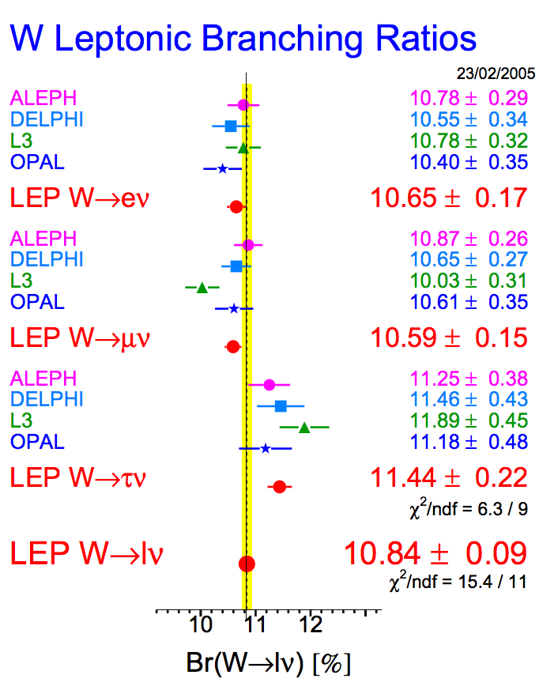
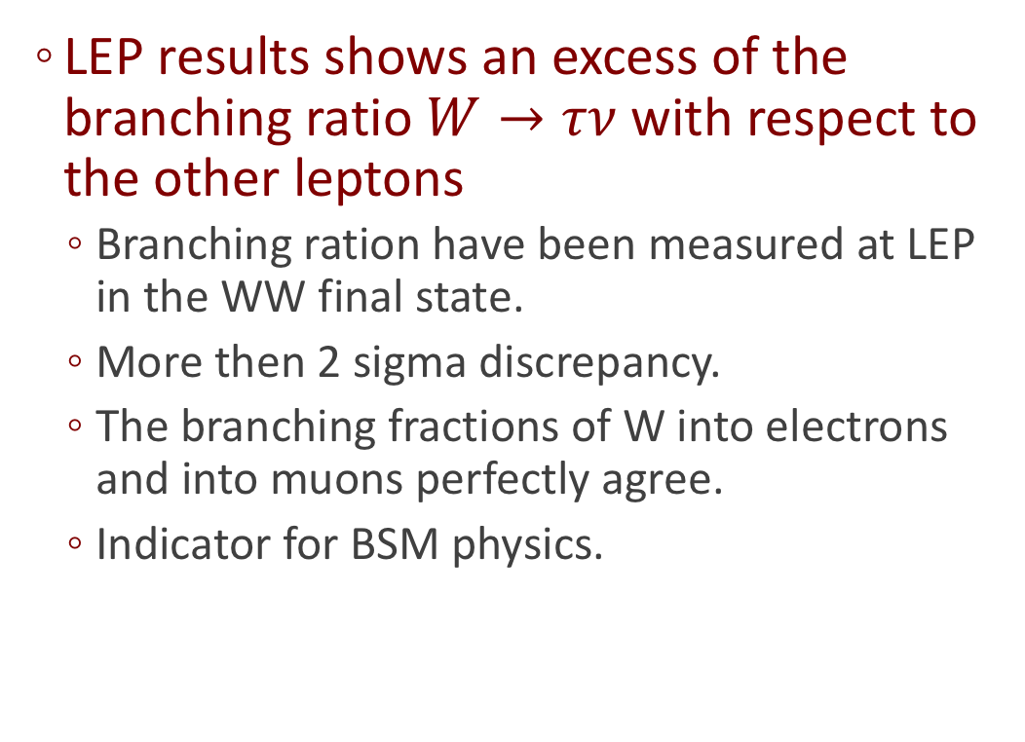
Motivation
LEP results shows an excess of the branching ratio $W→τν$ with respect to the other leptons
  Branching ration have been measured at LEP in the WW final state.
  More then 2 sigma discrepancy.
  The branching fractions of W into electrons and into muons perfectly agree.
  Indicator for BSM physics.
Source: arXiv:hep-ex/0511027

Slide 3
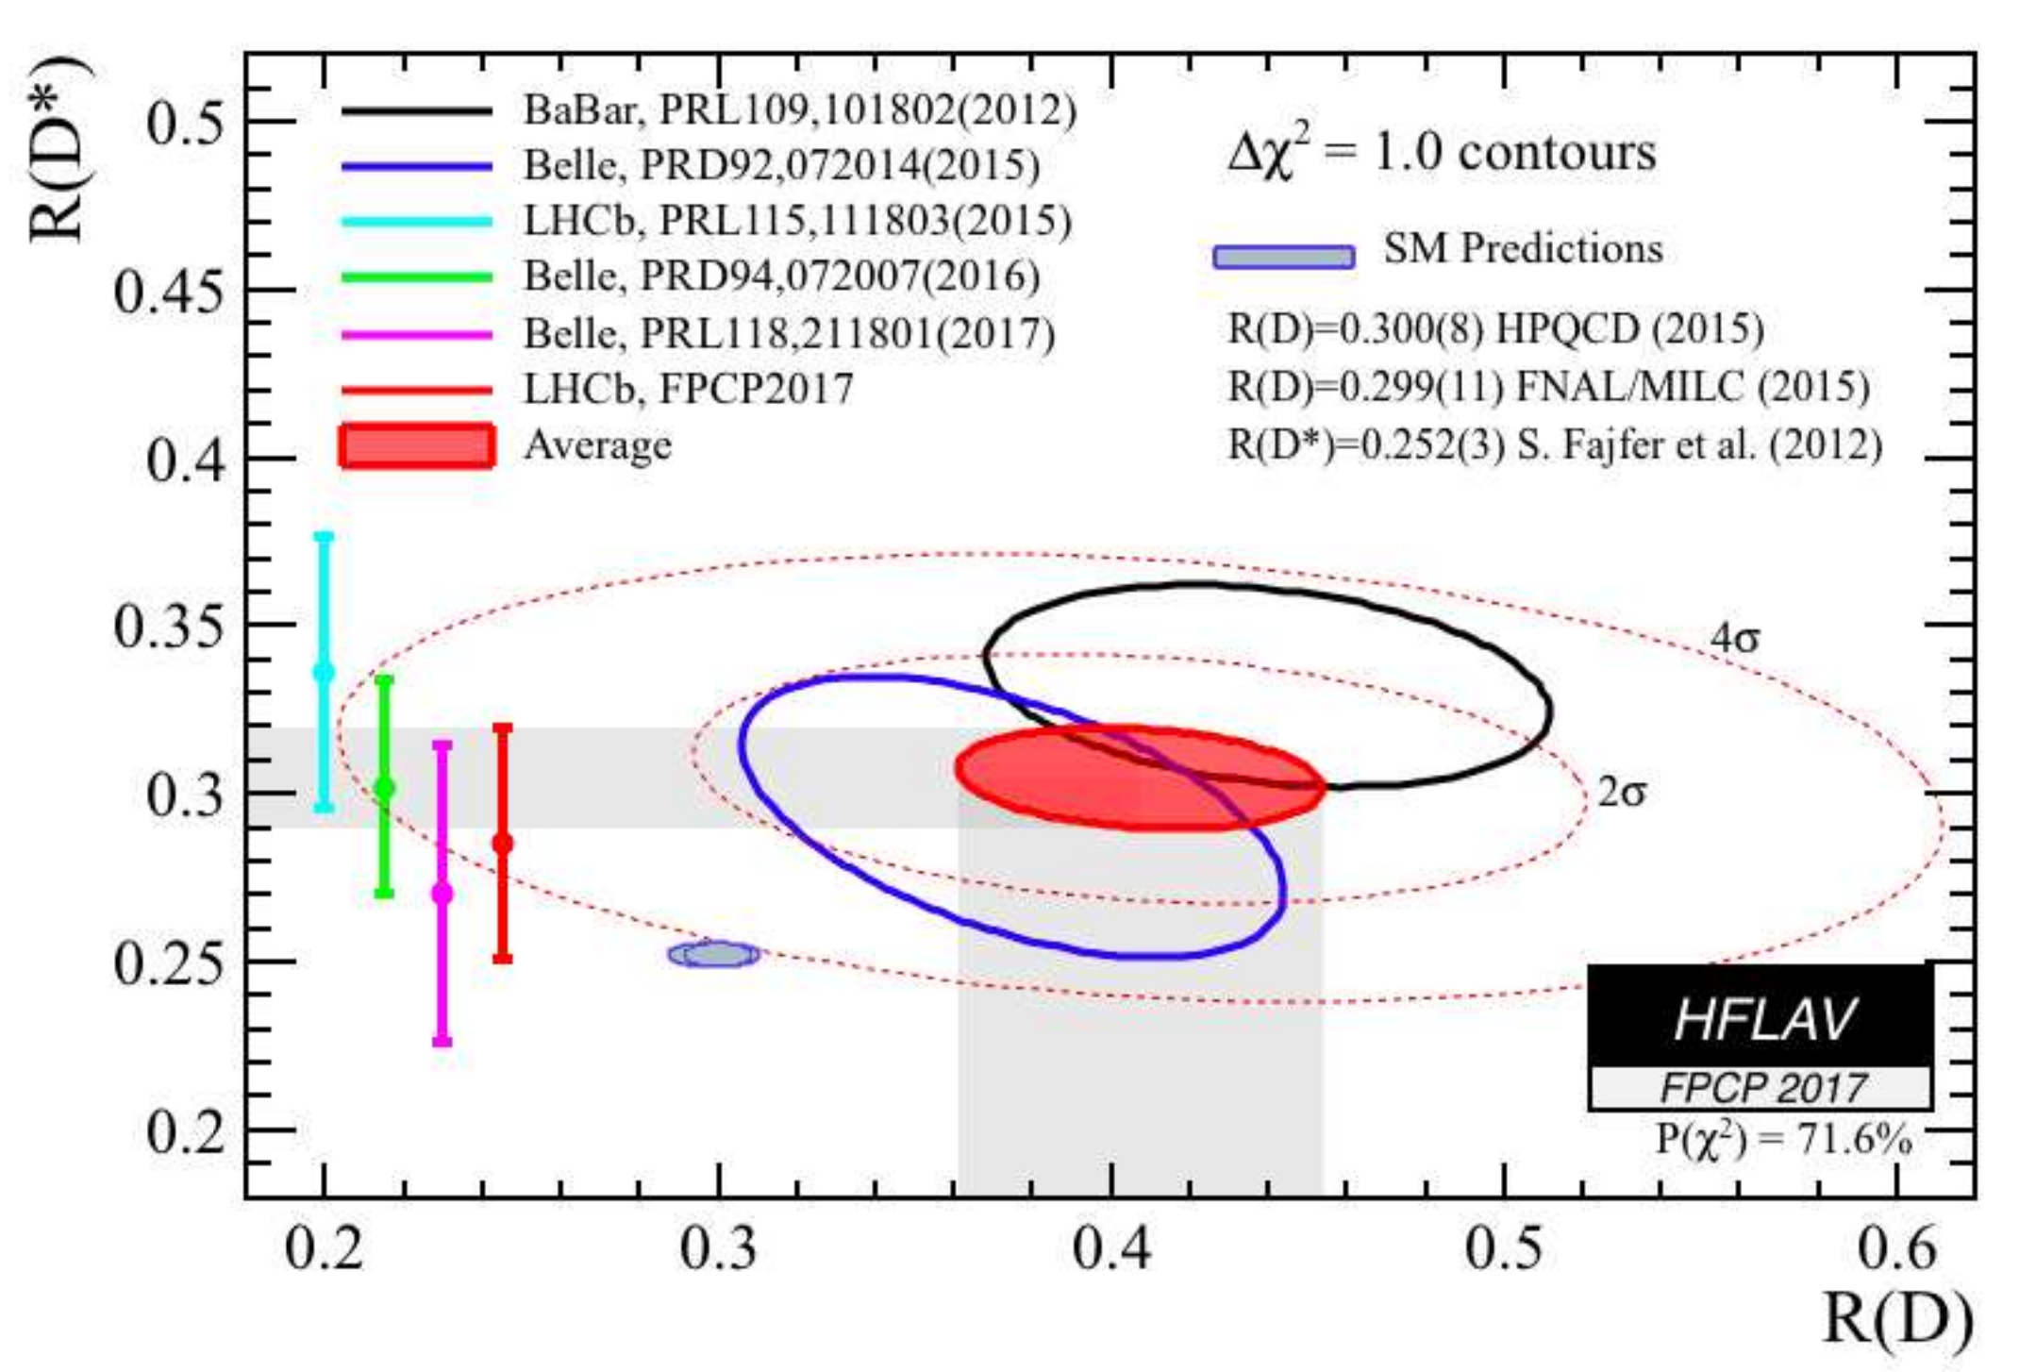
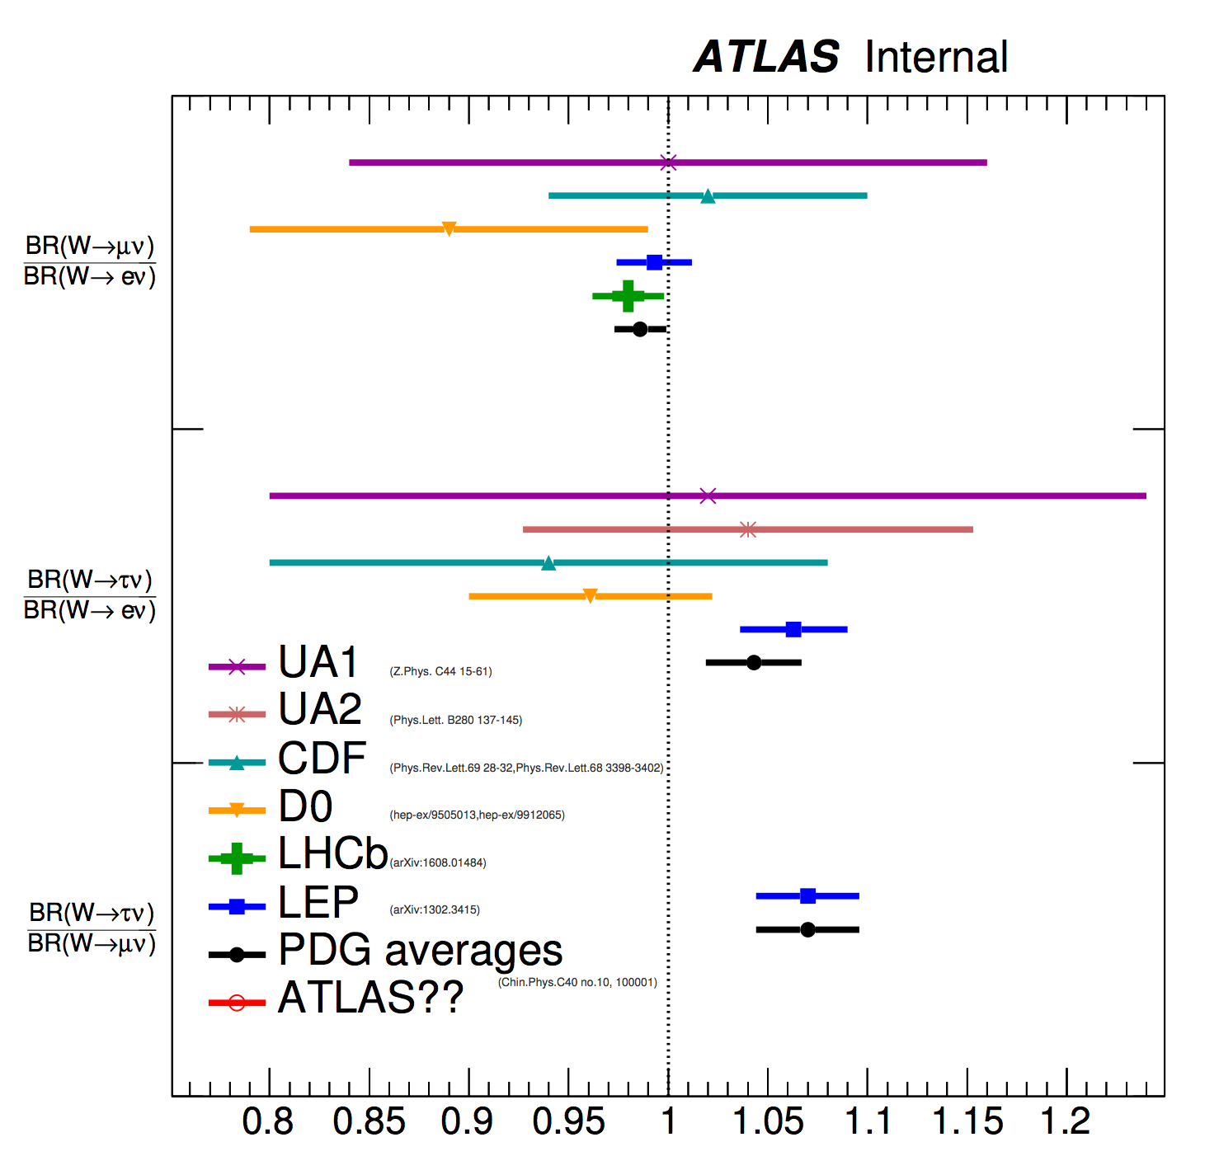
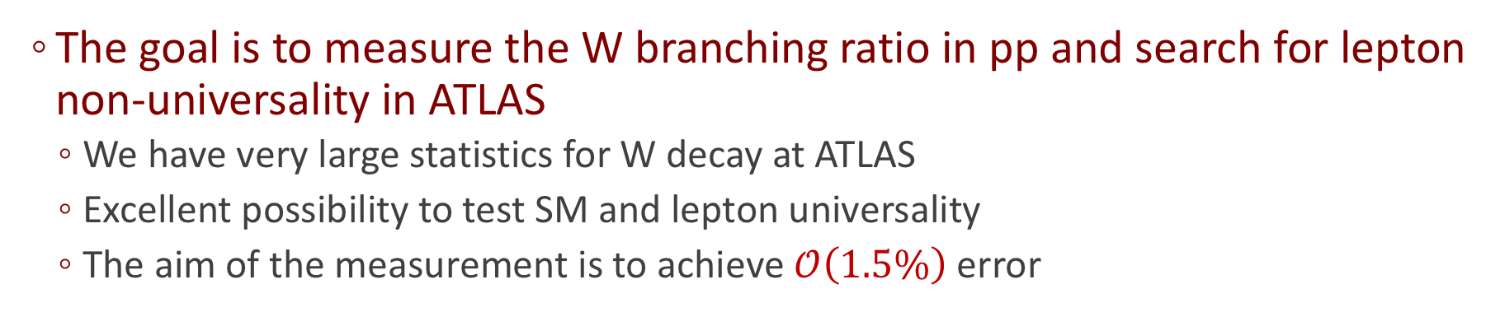
Motivation
Source: arXiv:1612.07233
The goal is to measure the W branching ratio in pp and search for lepton non-universality in ATLAS
  We have very large statistics for W decay at ATLAS
  Excellent possibility to test SM and lepton universality
  The aim of the measurement is to achieve $𝒪\left(1.5\%\right)$ error

Slide 4
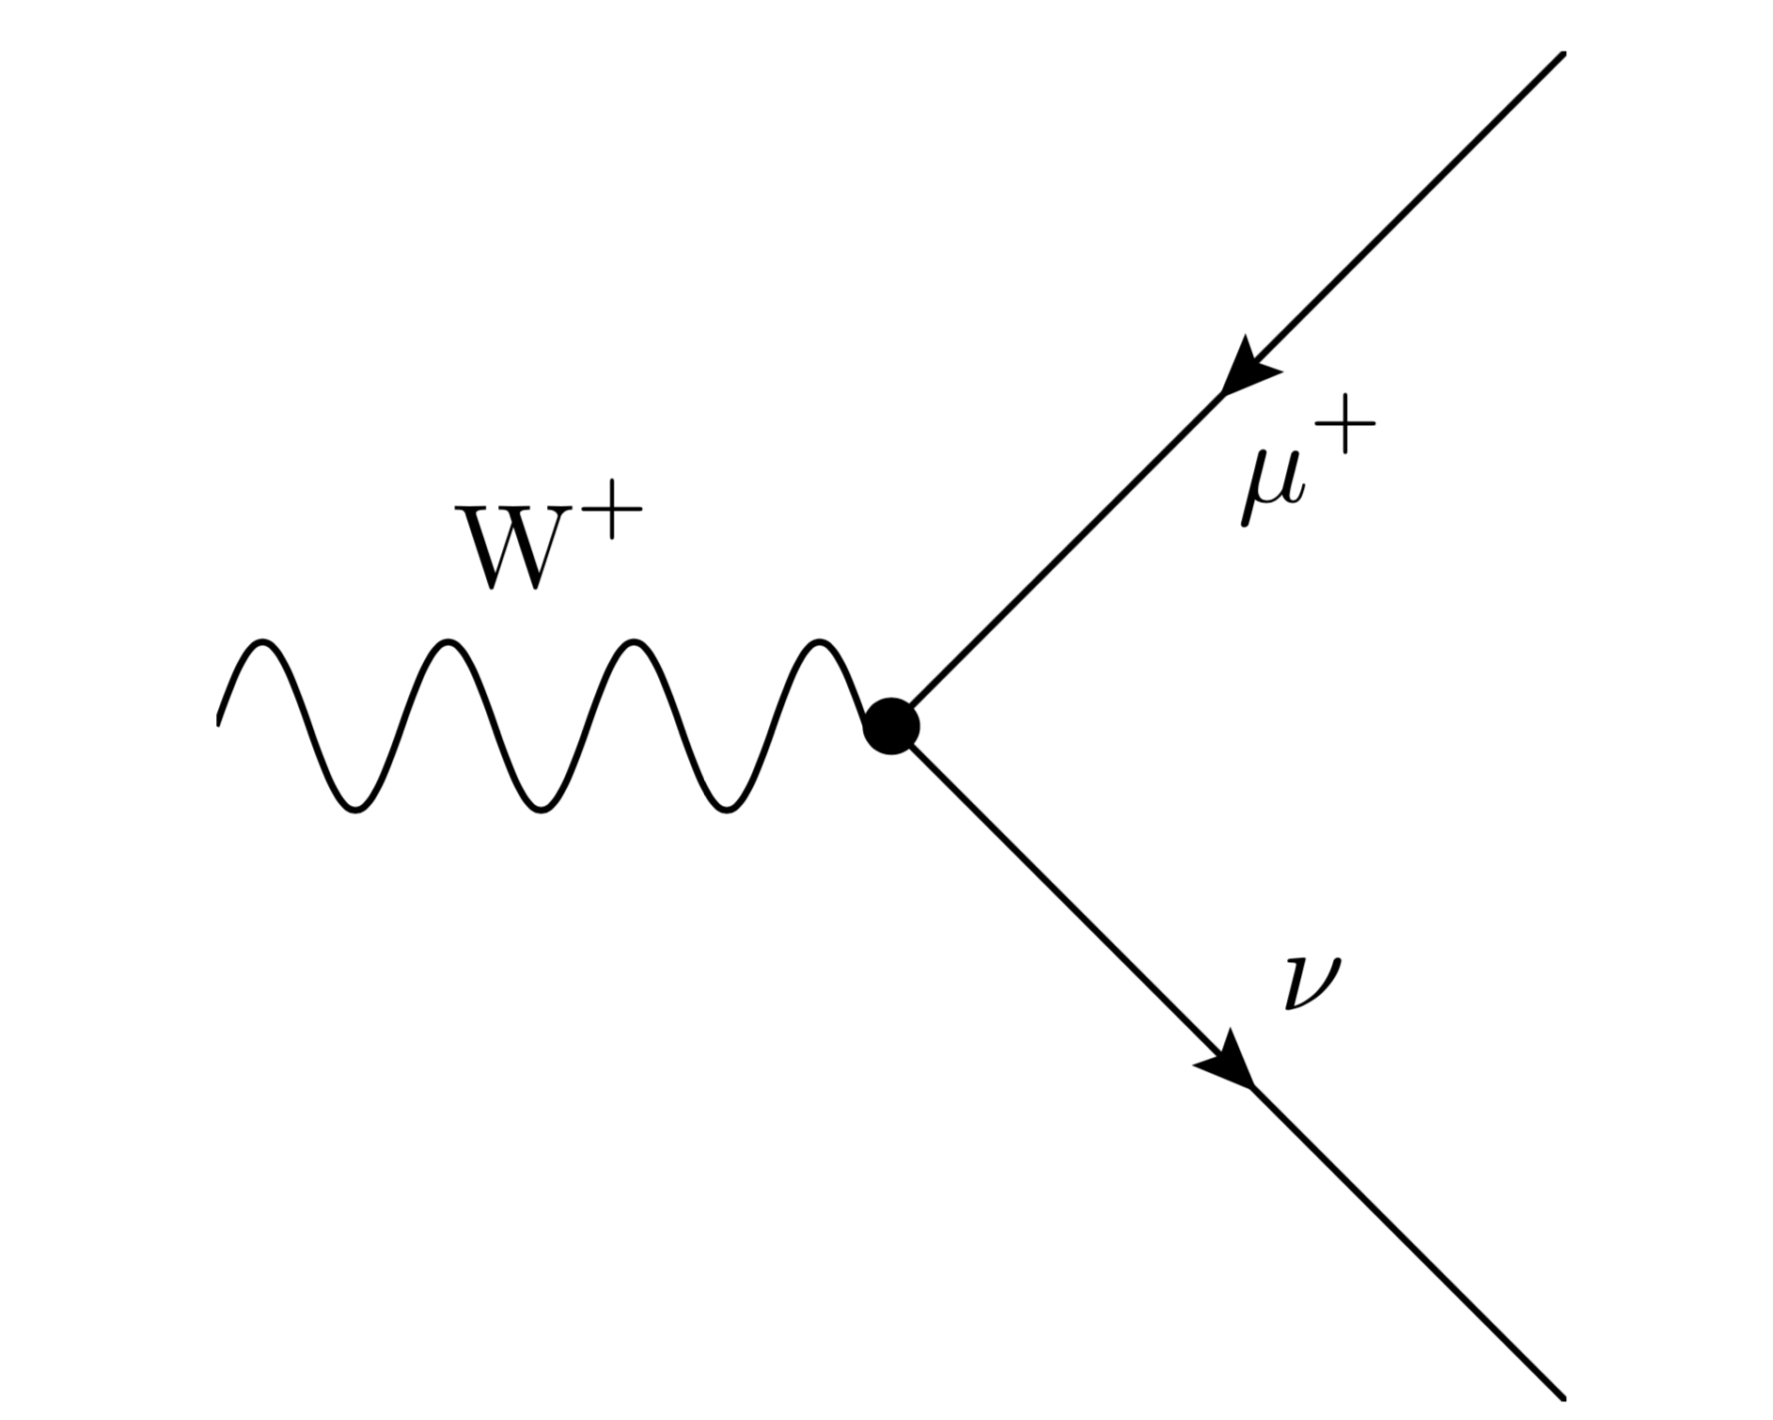
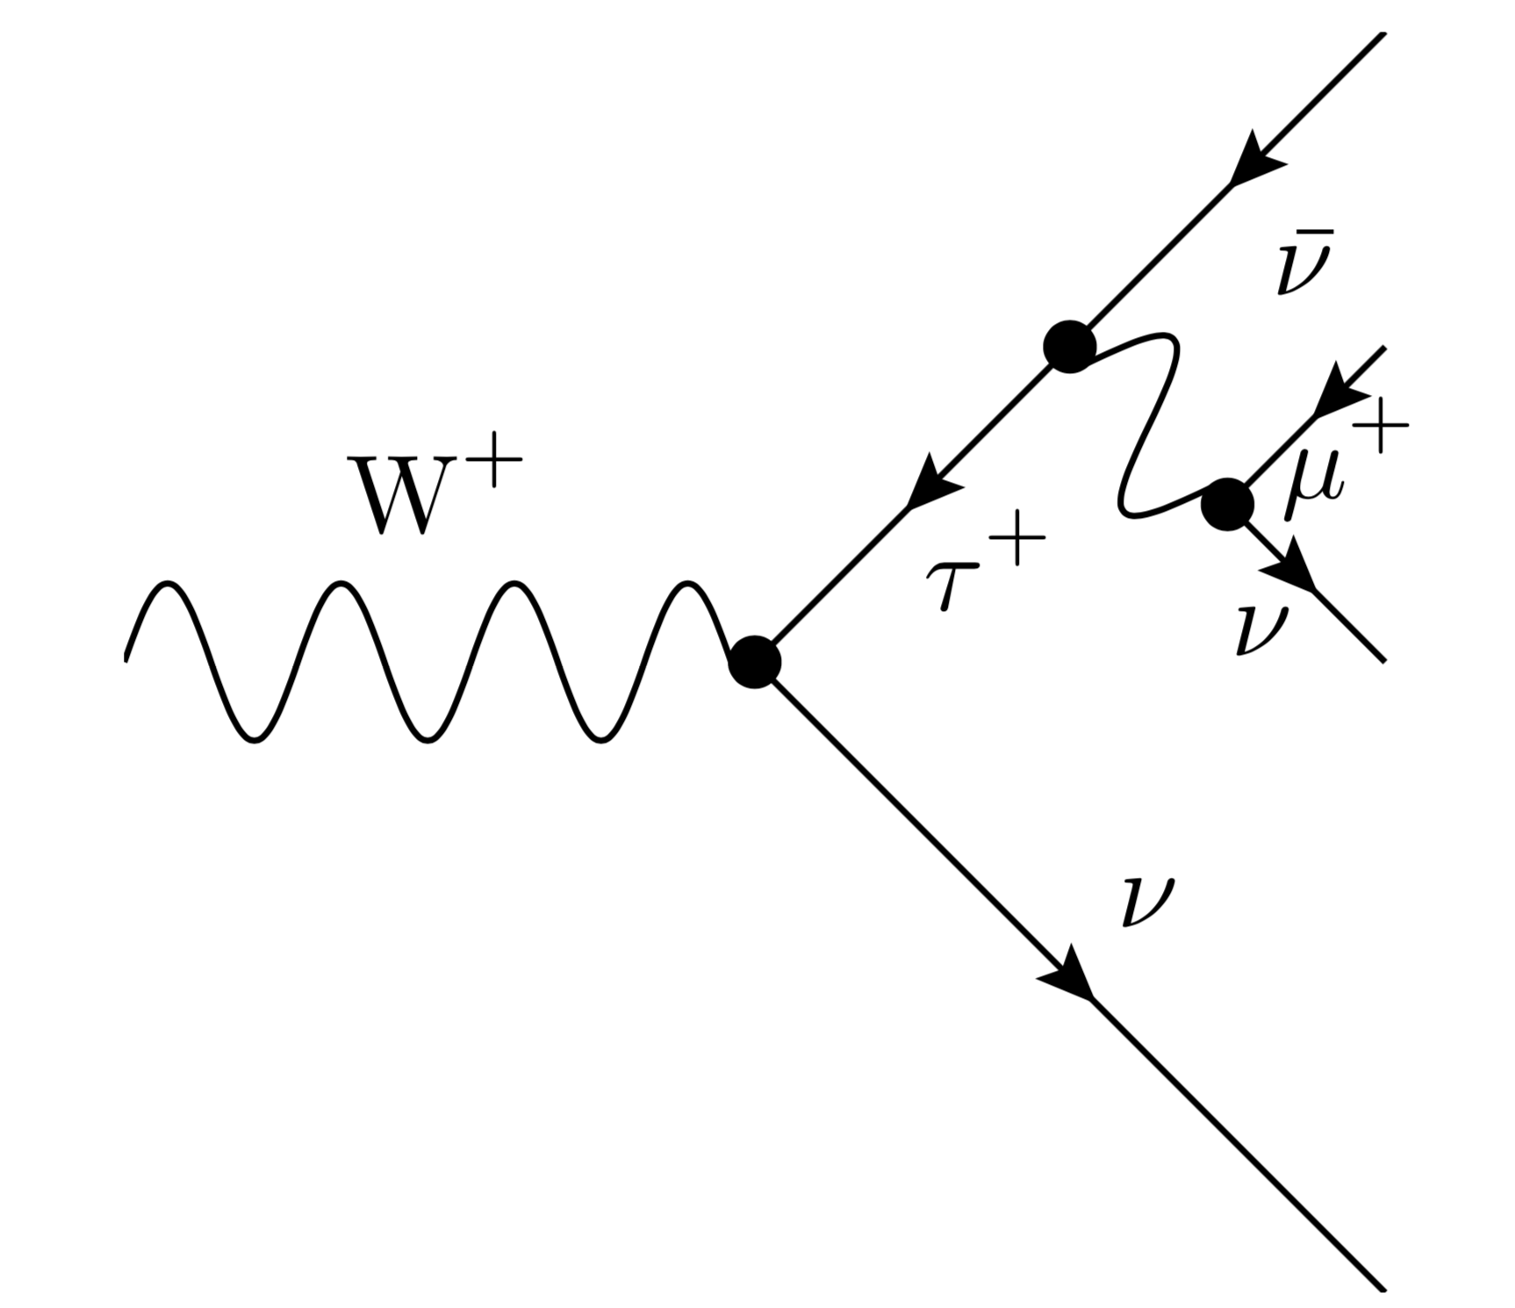
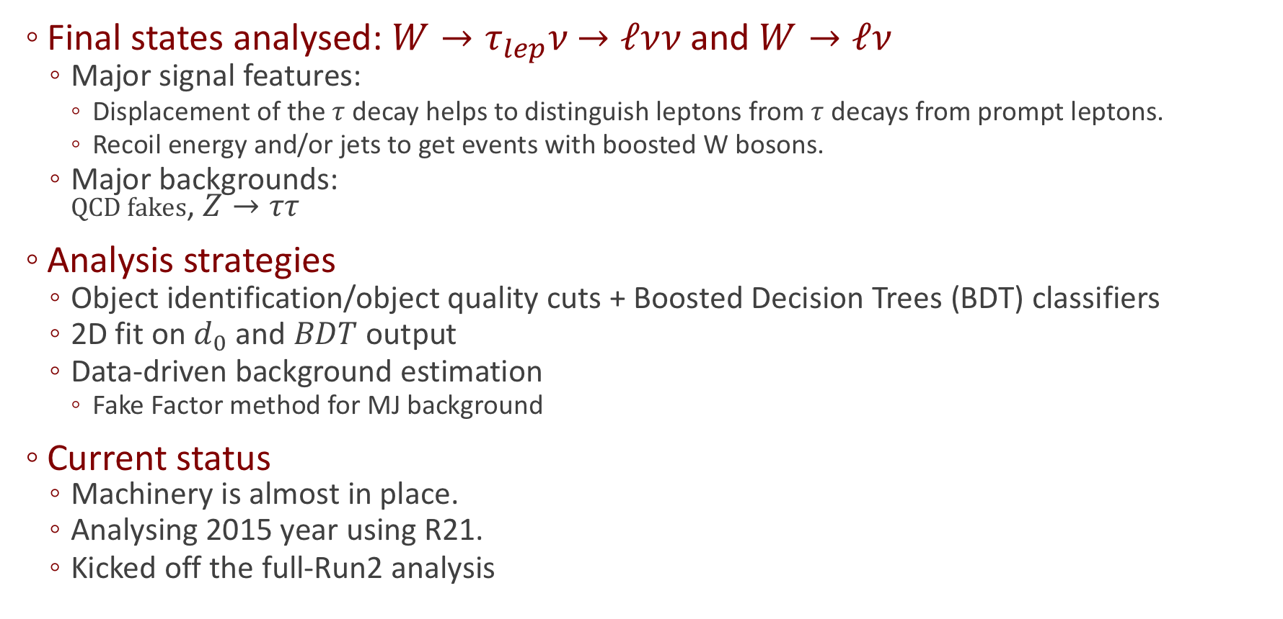
Overview and current status
Final states analysed: $W→τ_{lep}$𝜈 $→ℓ\text{ν}$𝜈 and $W→ℓ$𝜈
  Major signal features:
    Displacement of the $τ$ decay helps to distinguish leptons from $τ$ decays from prompt leptons.
    Recoil energy and/or jets to get events with boosted W bosons.
  Major backgrounds:
  $QCD fakes$, $Z→ττ$
Analysis strategies
  Object identification/object quality cuts + Boosted Decision Trees (BDT) classifiers
  2D fit on $d_{0}$ and $BDT$ output
  Data-driven background estimation
    Fake Factor method for MJ background
Current status
  Machinery is almost in place.
  Analysing 2015 year using R21.
  Kicked off the full-Run2 analysis
～11%
～11% x 17.4%

Slide 5
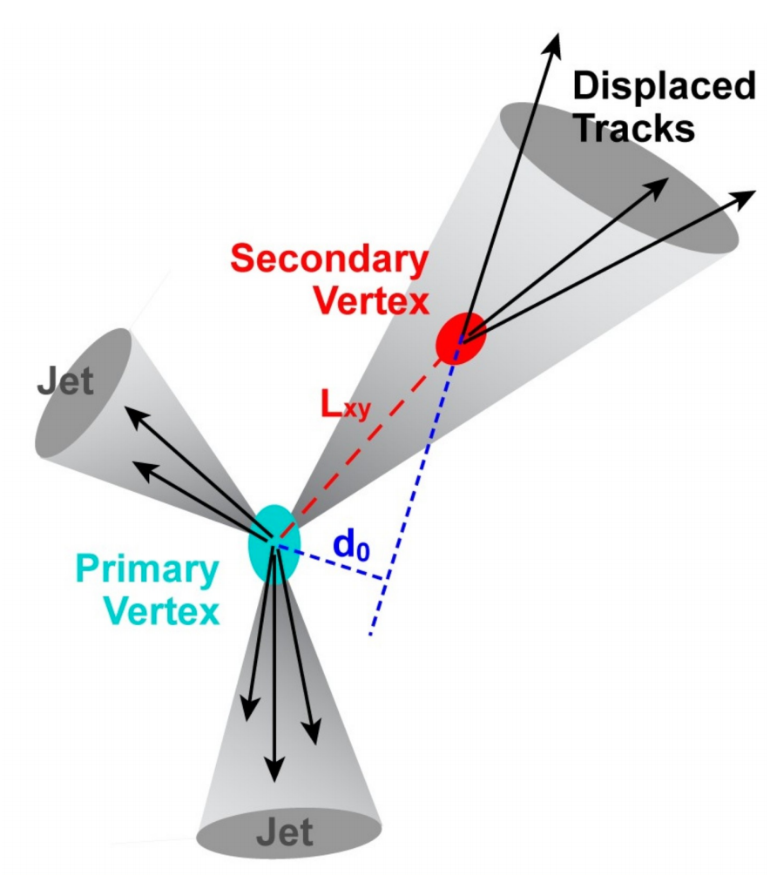
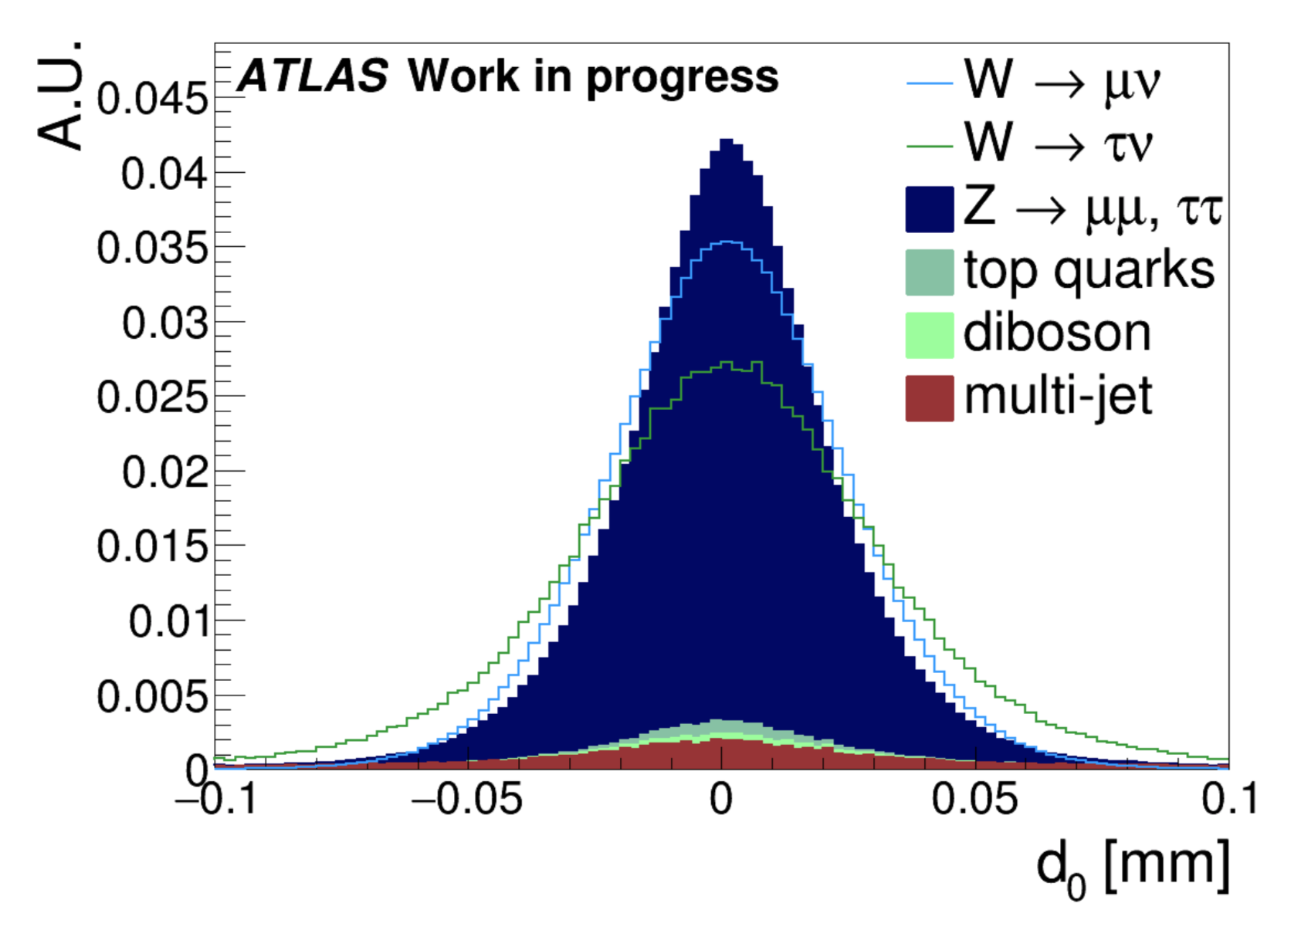
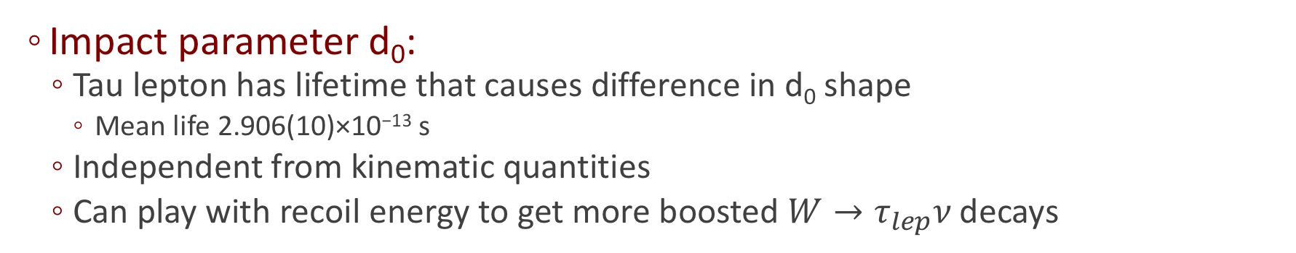
Vertexing
Impact parameter d₀:
  Tau lepton has lifetime that causes difference in d₀ shape
    Mean life 2.906(10)×10⁻¹³ s
  Independent from kinematic quantities
  Can play with recoil energy to get more boosted $W→τ_{lep}$𝜈 decays

Slide 6
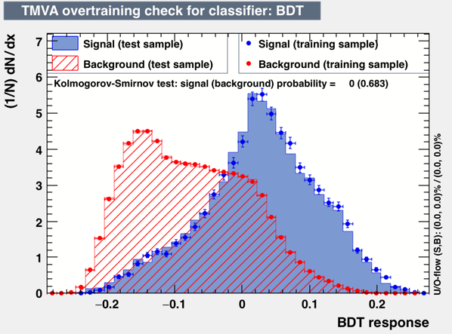
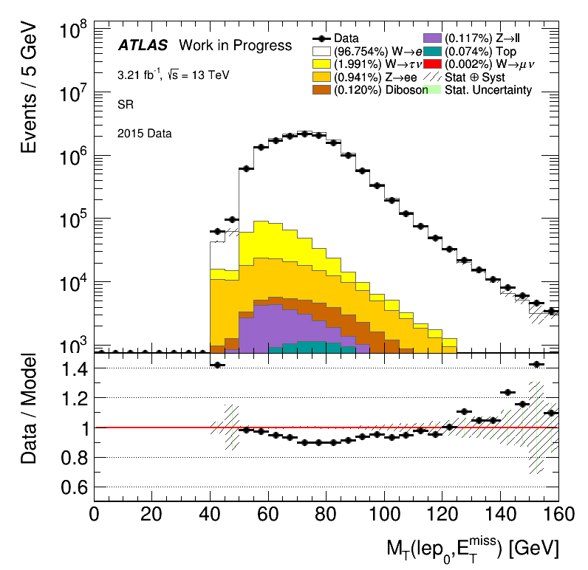
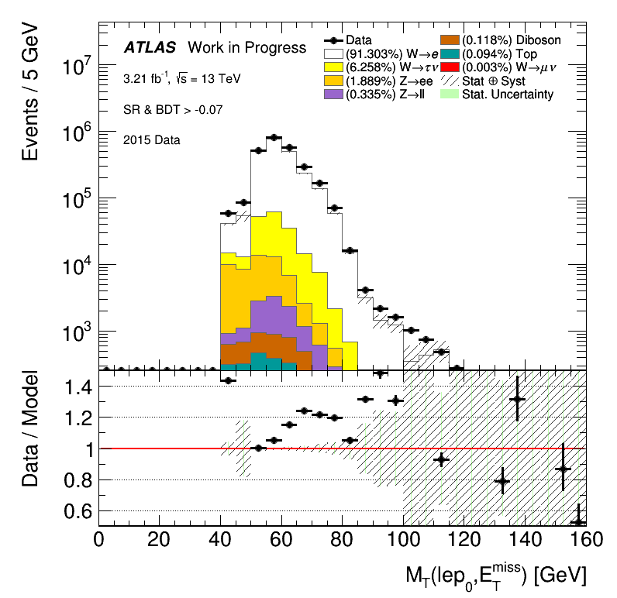
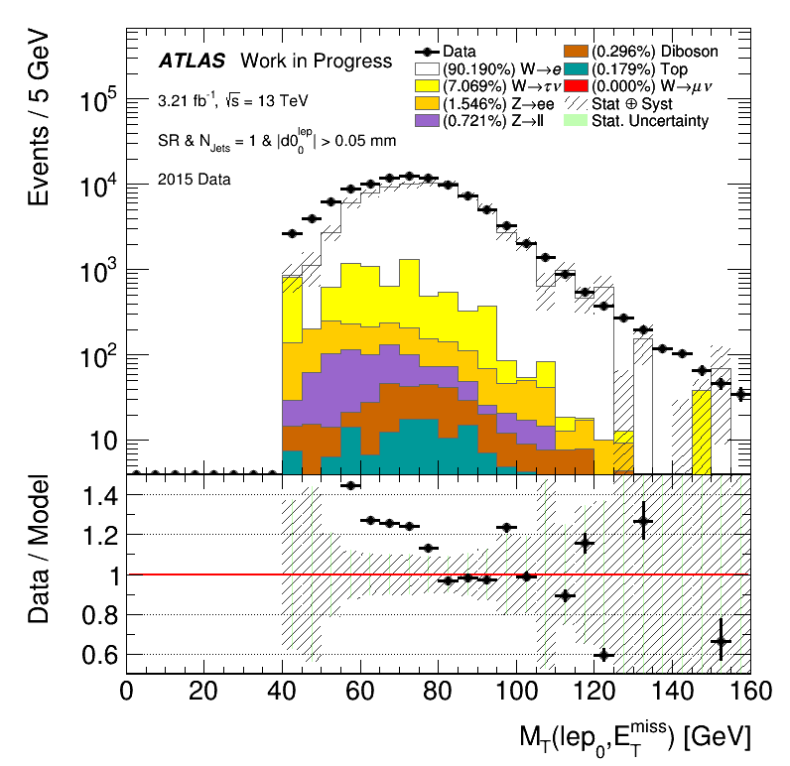
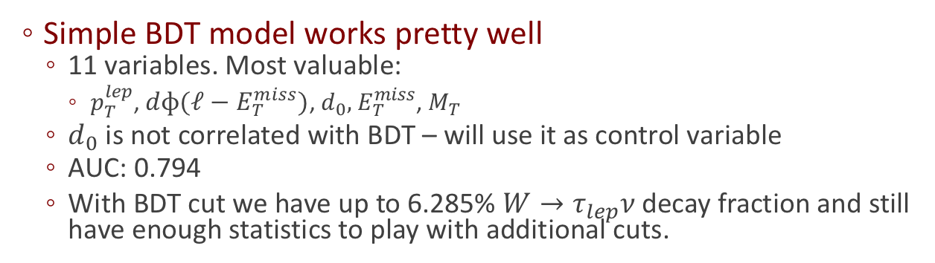
Gaining signal with TMVA
Simple BDT model works pretty well
  11 variables. Most valuable:
    $p_{T}^{lep}$, $dɸ(ℓ−E_{T}^{miss})$, $d_{0},$ $E_{T}^{miss}$, $M_{T}$
  $d_{0}$ is not correlated with BDT – will use it as control variable
  AUC: 0.794
  With BDT cut we have up to 6.285% $W→τ_{lep}$𝜈 decay fraction and still have enough statistics to play with additional cuts.

Slide 7
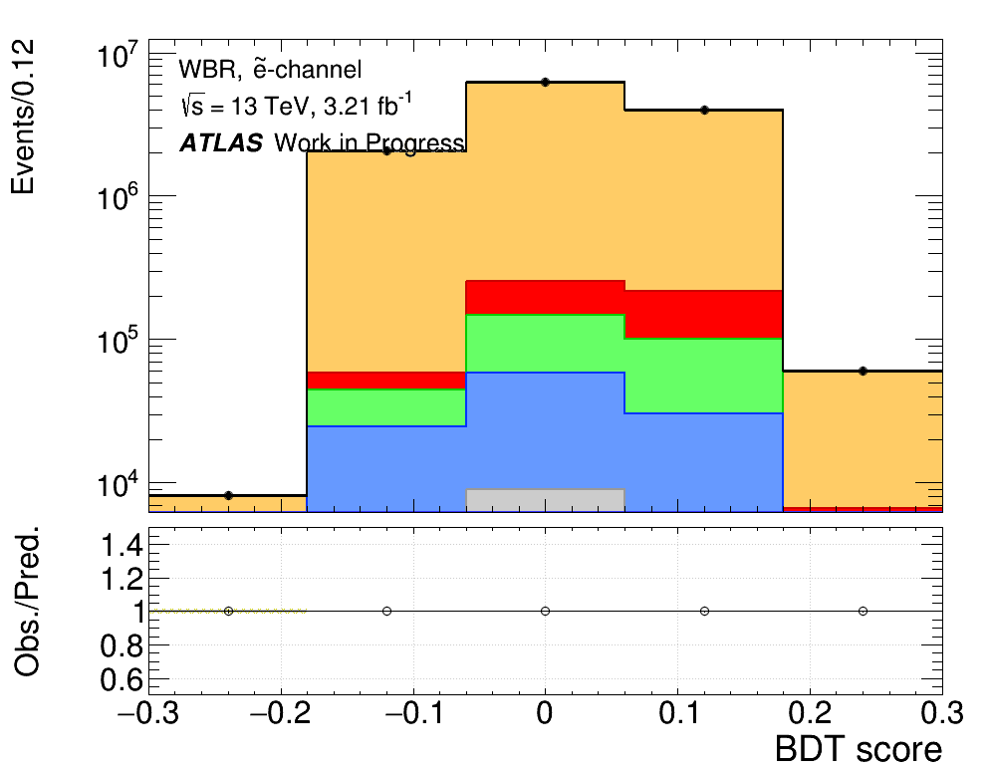
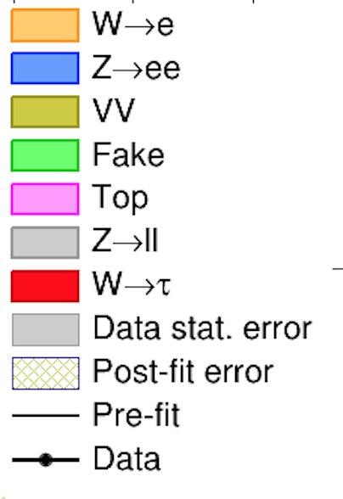
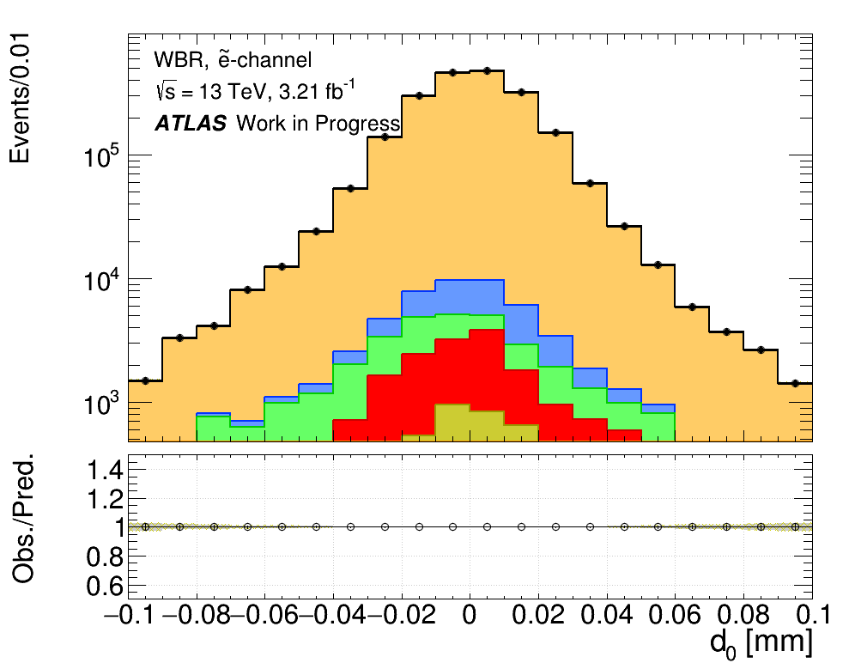
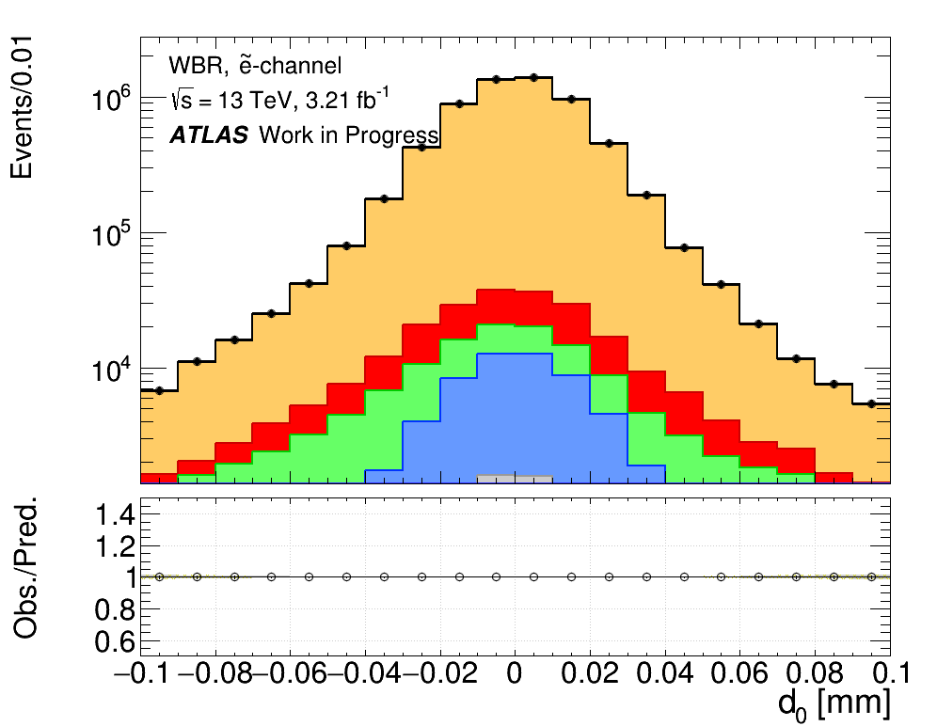
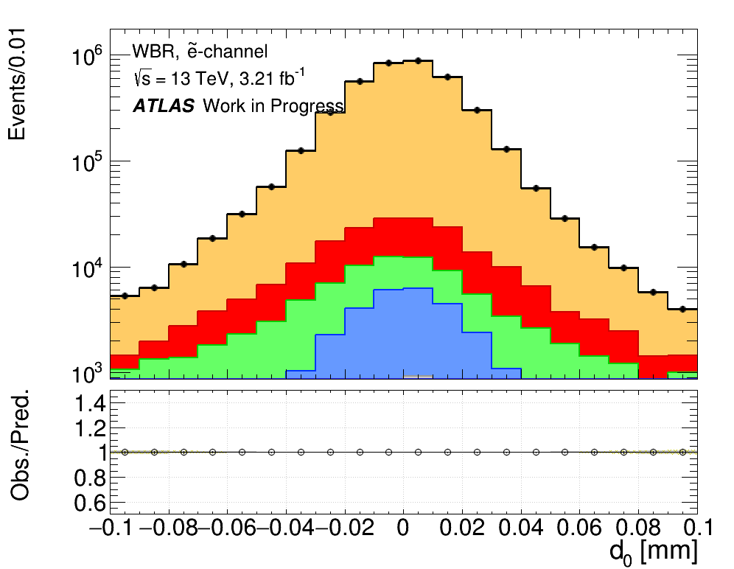
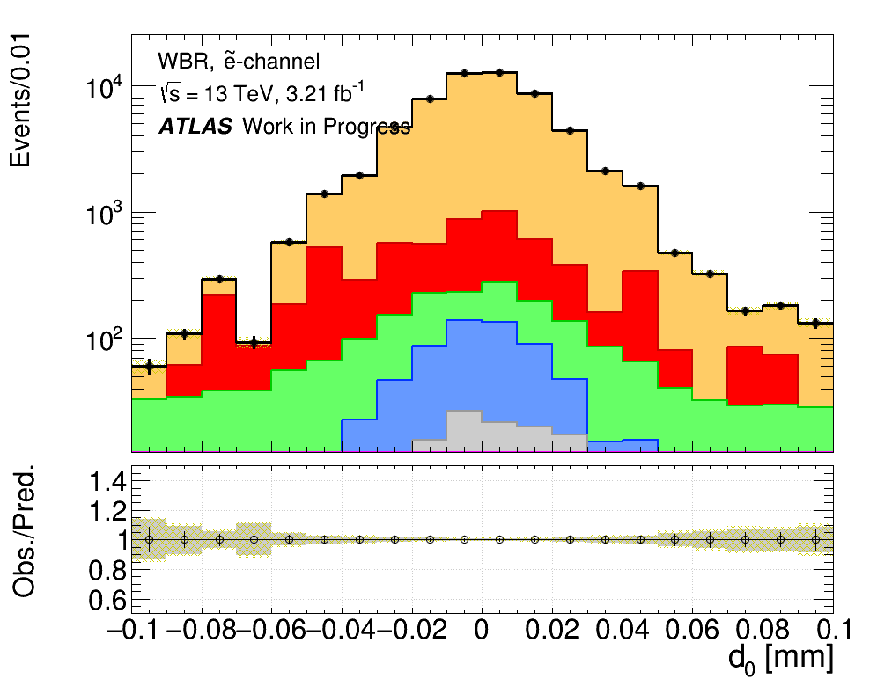
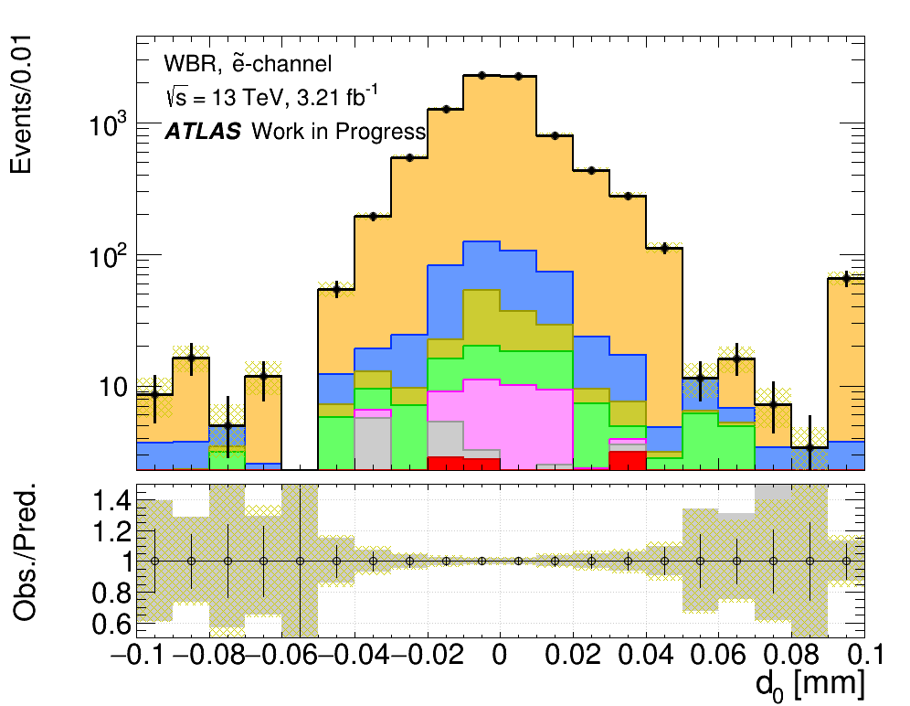
Signal region
d₀ has no correlation with other BDT input variables:
  Use d₀ as control variable
Two dimensional fit performed via 1D hack:
  Split BDT distribution to the 5 bins.
  Certainly sufficient approach for any histogram-based model with no 2D continuous function in the fit.
Asimov data
BDT bin0
BDT bin1
BDT bin2
BDT bin3
BDT bin5

Slide 8
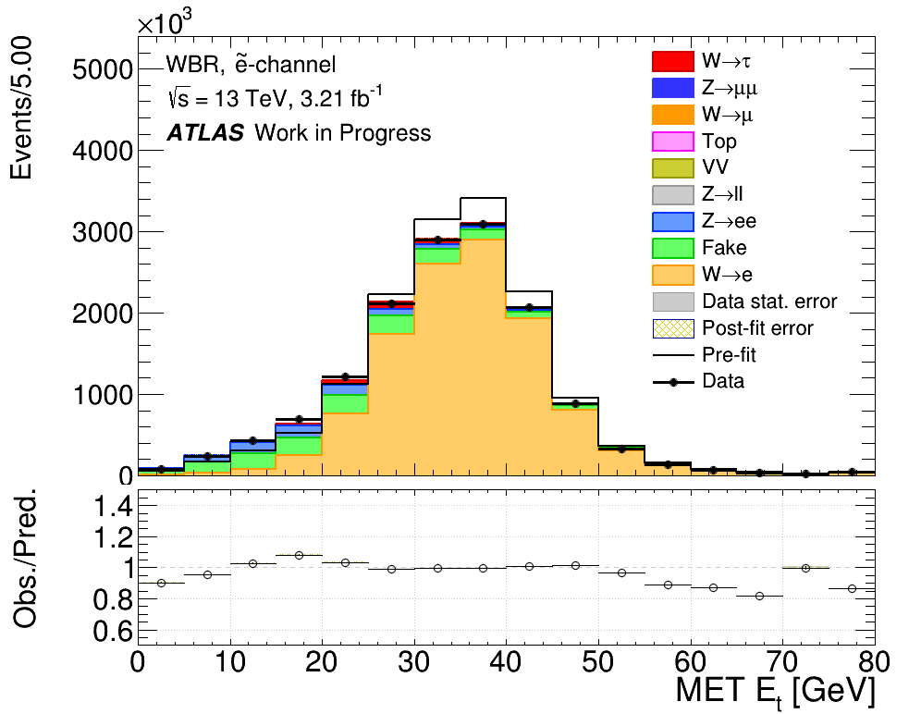
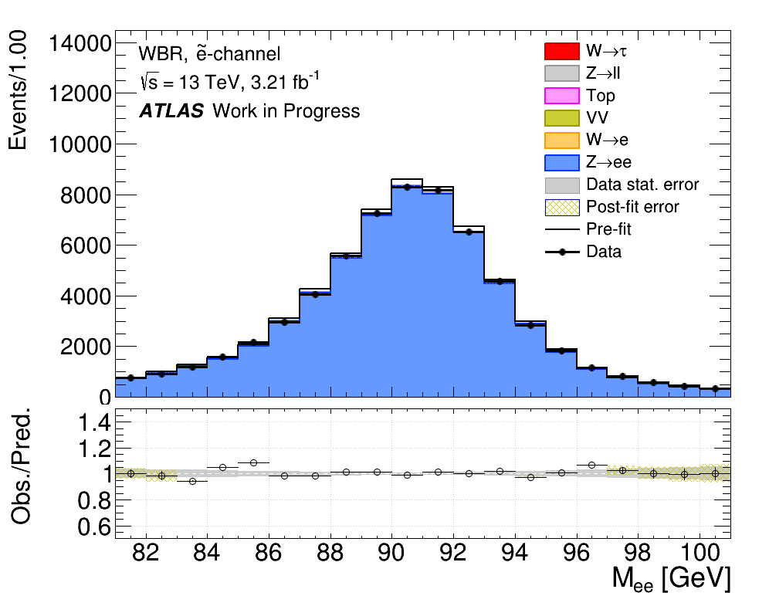
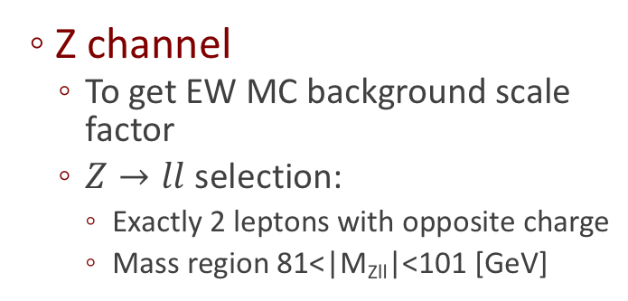
Control regions
Fake region
  To get QCD background scale factor
  Template fit method:
    Relaxed cuts om E_{T}^{MISS} and P_{T}
    Inverted lepton Isolation and lepton quality cuts
Z channel
  To get EW MC background scale factor
  $Z→ll$ selection:
    Exactly 2 leptons with opposite charge
    Mass region 81<|M_{Zll}|<101 [GeV]

Slide 9
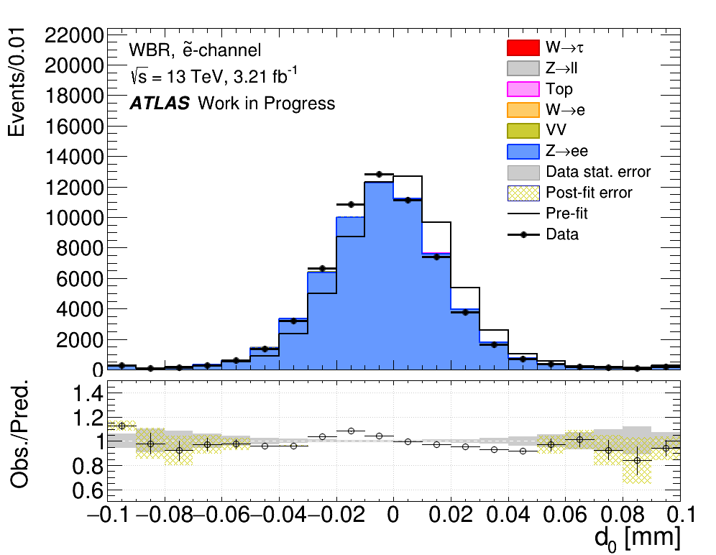
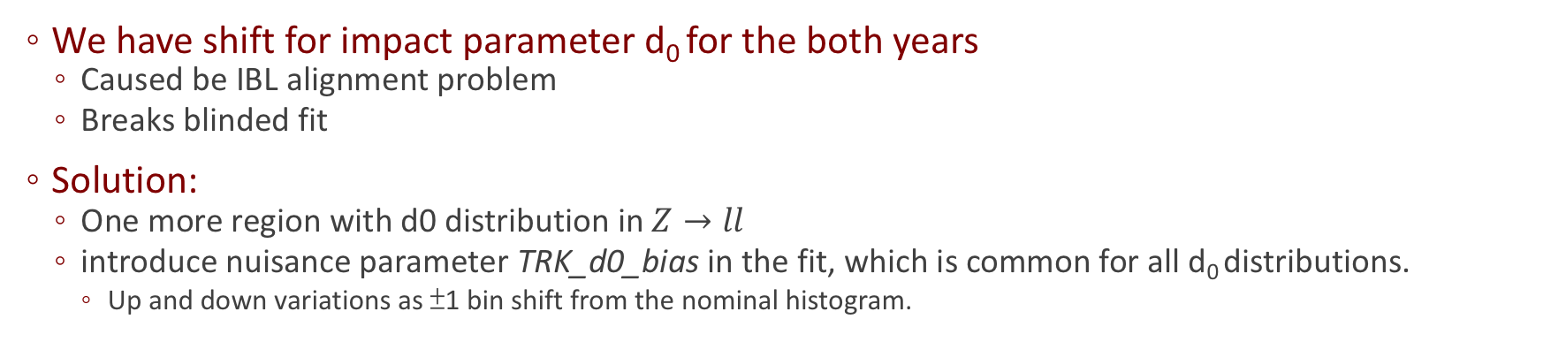
d₀ bias for 2015 and 2016
Asimov data
We have shift for impact parameter d₀ for the both years
  Caused be IBL alignment problem
  Breaks blinded fit
Solution:
  One more region with d0 distribution in $Z→ll$
  introduce nuisance parameter TRK_d0_bias in the fit, which is common for all d₀ distributions.
    Up and down variations as ±1 bin shift from the nominal histogram.

Slide 10
Fit results: Asimov Data
Nuisance parameter | Value | Uncertainty
TRK_d0_bias | -1.4285e-09 | 7.33e-03
norm_W | 1. | 4.35e-04
norm_Z | 1. | 5.41e-04
norm_QCD | 1. | 5.43e-03
POI | Error
mu_SIG | 1.
MCSTAT | 3.73e-03
NORM | 1.83e-02
STAT | 8.82e-03
SYST | 1.43e-05
Total | 2.07e-02
Fit uncertainty breakdown:
  SYST includes d0 bias only
  STAT is the remaining error after all nuisance parameters are held constant
QCD background is under good control (0.5%)
POI has 2% uncertainty
  For 2015 year only. Could be less then 1.2% for all Run-II statistics.

Slide 11
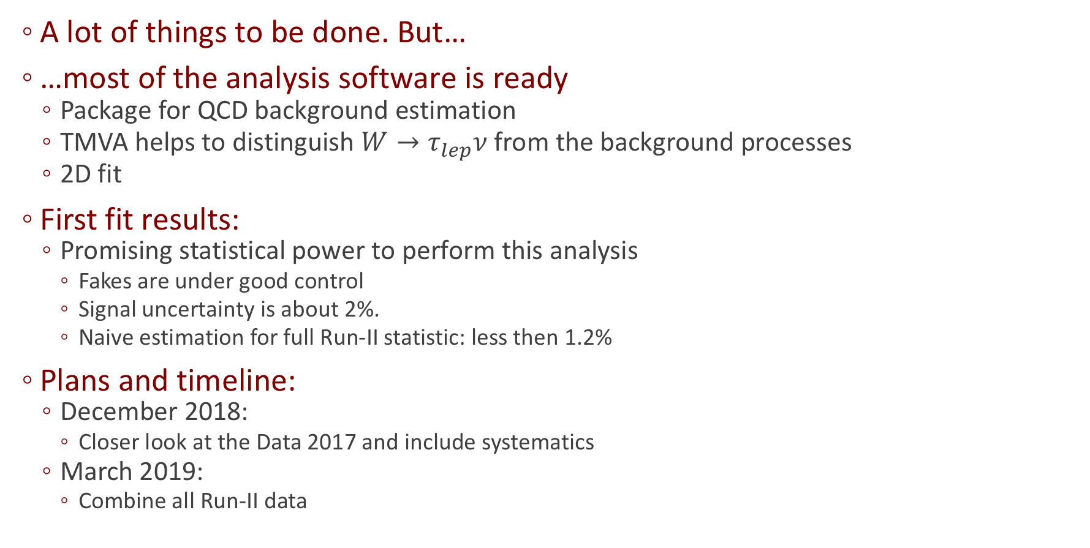
Conclusions
A lot of things to be done. But…
…most of the analysis software is ready
  Package for QCD background estimation
  TMVA helps to distinguish $W→τ_{lep}$𝜈 from the background processes
  2D fit
First fit results:
  Promising statistical power to perform this analysis
    Fakes are under good control
    Signal uncertainty is about 2%.
    Naive estimation for full Run-II statistic: less then 1.2%
Plans and timeline:
  December 2018:
    Closer look at the Data 2017 and include systematics
  March 2019:
    Combine all Run-II data

Slide 12
Backup

Slide 13
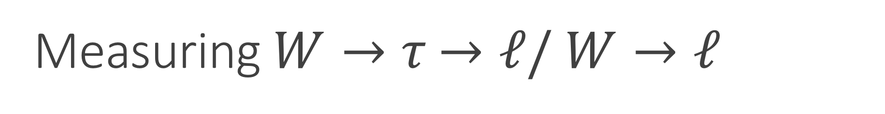
Measuring $W→τ$ $→ℓ/$ $W→ℓ$
Daniil Ponomarenko, Nicolo de Groot

Slide 14
Links related to $W→τ$ $→ℓ/$ $W→ℓ$analysis
JIRA:
  https://its.cern.ch/jira/browse/ATLASSMWBR-1
GIT:
  https://gitlab.cern.ch/Wlep_BR
TWiki:
  https://twiki.cern.ch/twiki/bin/viewauth/AtlasProtected/Vtaus13TeV

Slide 15
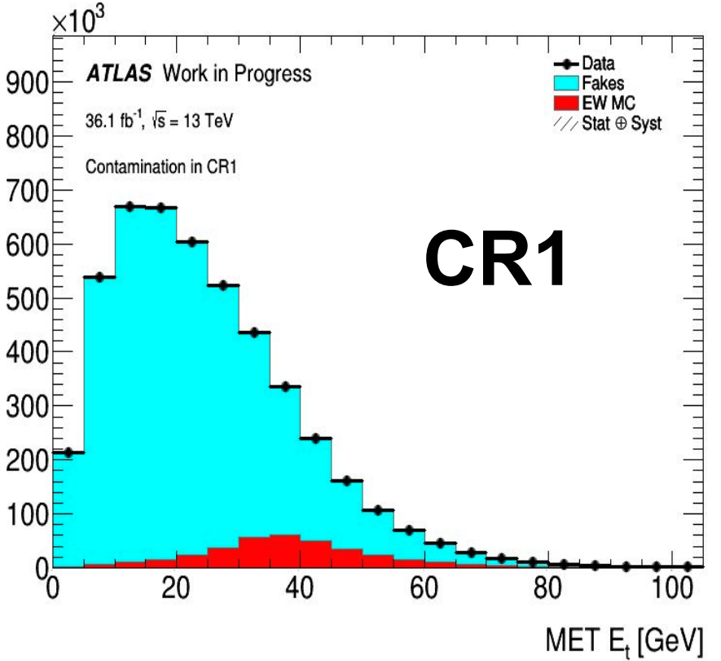
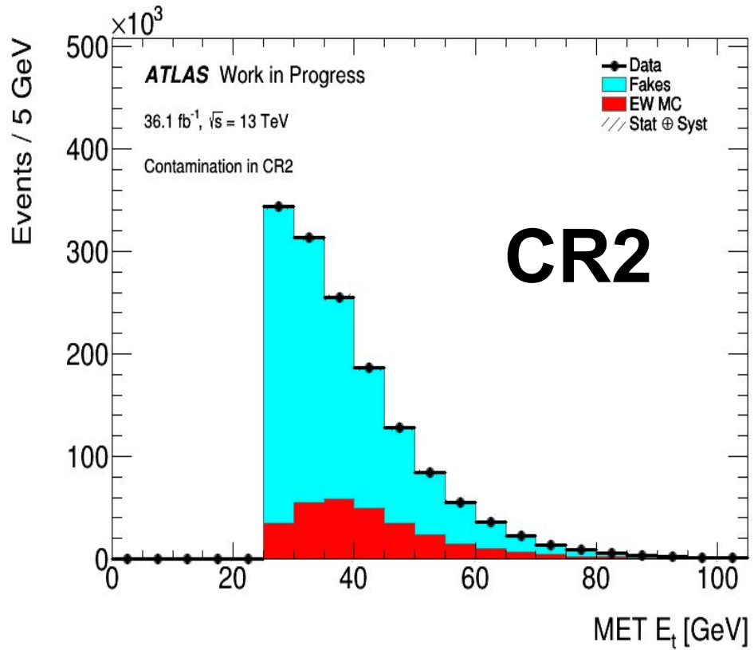
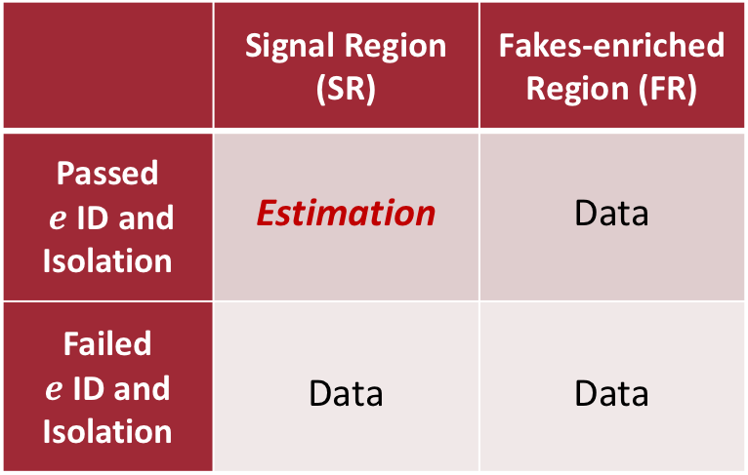
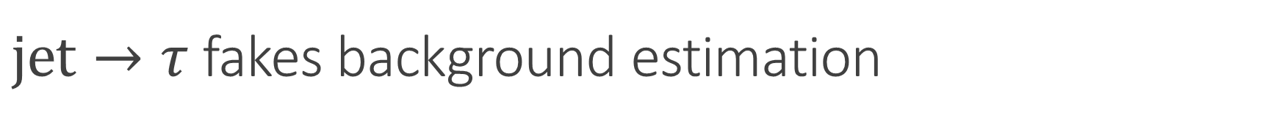
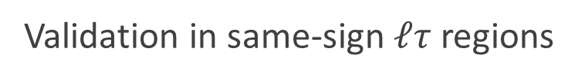
$jet→τ$ fakes background estimation
Fakes background is one of the dominant backgrounds
Need a reliable estimation method with acceptable uncertainties
Fake Factor (FF) method
  Basically a transfer factor method
  1. Obtain FF = pass/fail ratio
  in Fakes-enriched Region
  2. Apply FF in Signal Region
 | Signal Region (SR) | Fakes-enriched Region (FR)
Passed $e$ ID and Isolation | Estimation | Data
Failed $e$ ID and Isolation | Data | Data
2.
1.
  Validation in same-sign $ℓτ$ regions

Slide 16
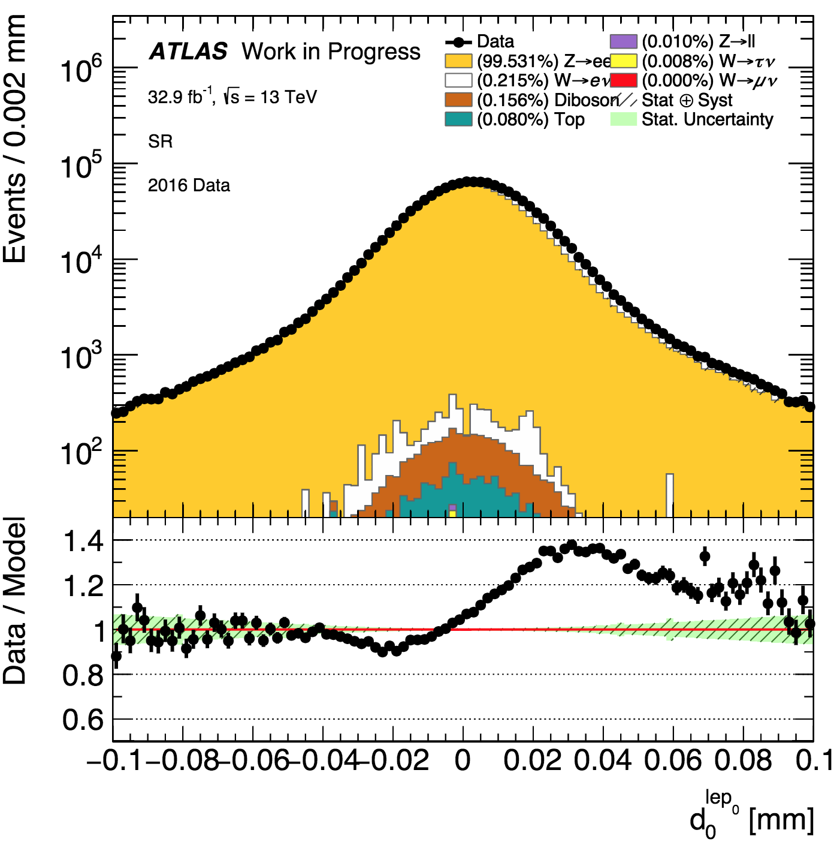
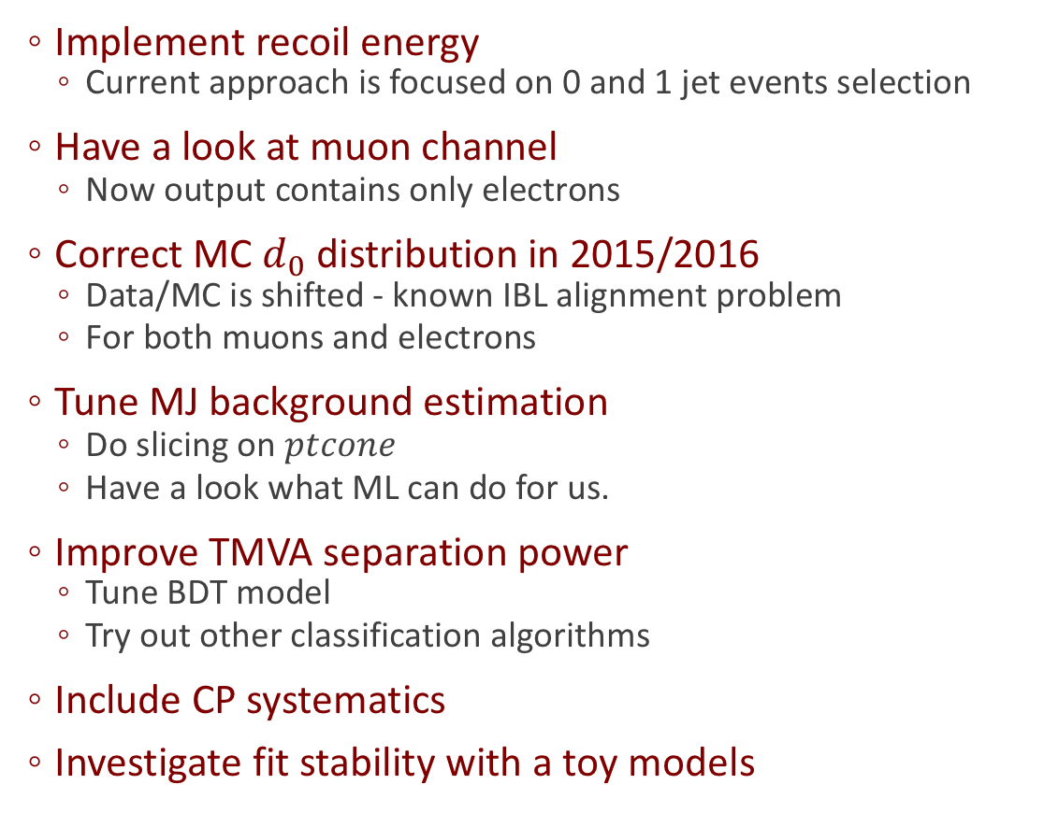
ToDo list
Implement recoil energy
  Current approach is focused on 0 and 1 jet events selection
Have a look at muon channel
  Now output contains only electrons
Correct MC $d_{0}$ distribution in 2015/2016
  Data/MC is shifted - known IBL alignment problem
  For both muons and electrons
Tune MJ background estimation
  Do slicing on $ptcone$
  Have a look what ML can do for us.
Improve TMVA separation power
  Tune BDT model
  Try out other classification algorithms
Include CP systematics
Investigate fit stability with a toy models

