Slide 1
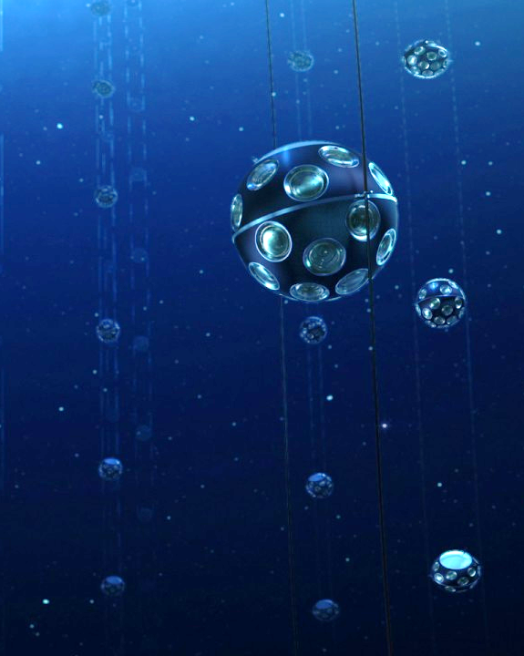
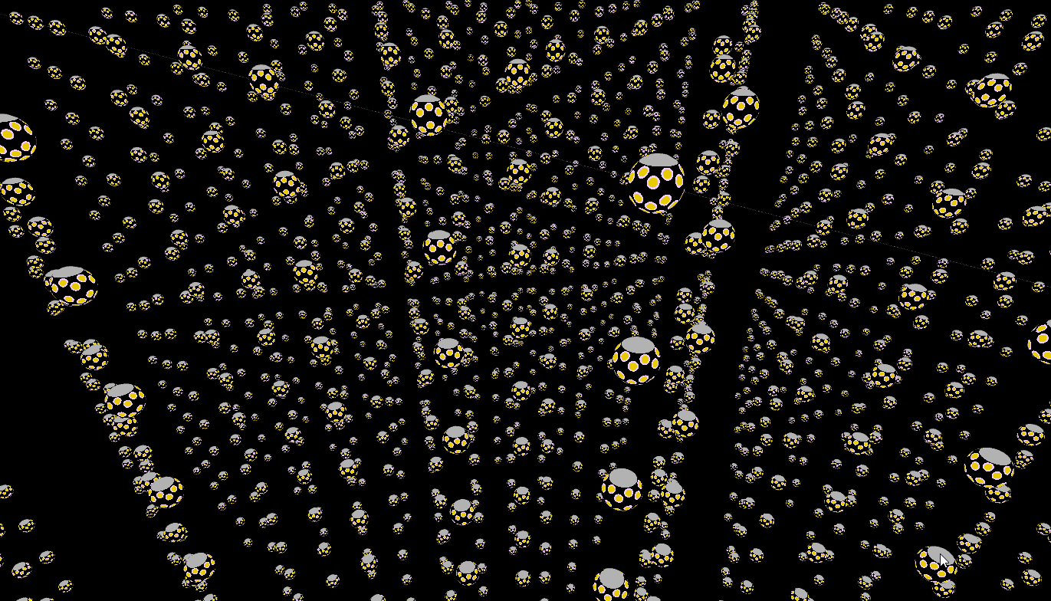
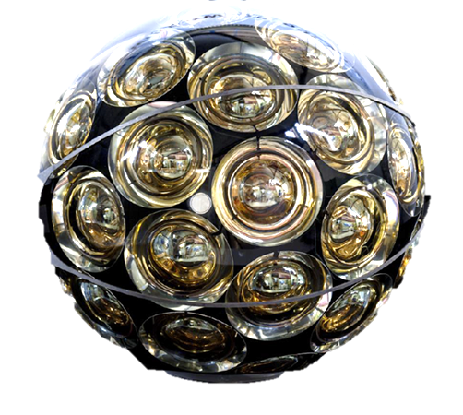
KM3NeT
Neutrino astronomy
Aart Heijboer

Slide 2
Neutrino astronomy
High-energy cosmic neutrinos discovered
Recent neutrino/X-ray/gamma-ray coincidence:
First hint of a neutrino source?
Neutrinos from Galactic accelerators
“Real neutrino astronomy”
The exploration
of the high-energy
Universe requires
multi-messenger studies
including neutrinos!
See presentation
by Ignacio Taboada

Slide 3
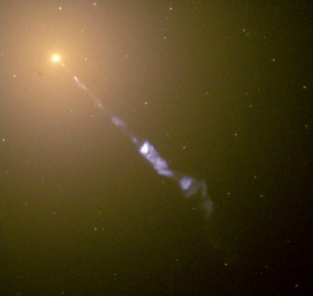
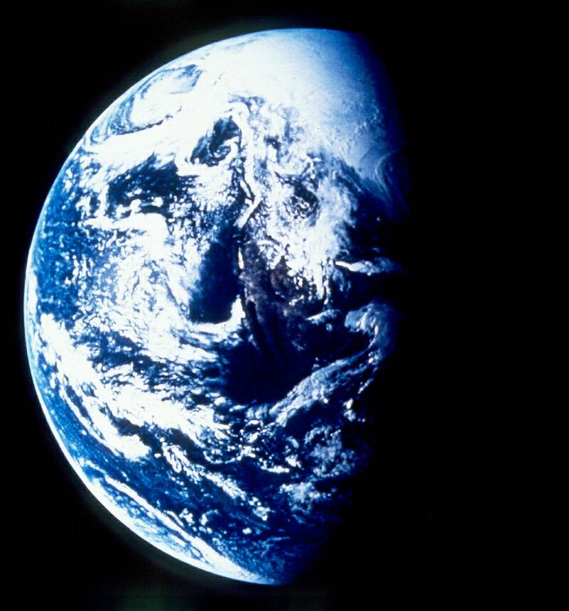
high energy
Neutrino from the Universe
Universe contains very high
Energy particle accelerators
(E = up to 10⁶ X LHC)
protons are deflected
by magnetic fields in the
universe → sources unknown
photon
ν
high energy neutrinos:
travel in straight lines → point to their source
are produced in proton accelerators
are not absorbed on their way here
  → “ideal” messenger particle
  free very-long baseline beam of very
  high energy neutrino

Slide 4
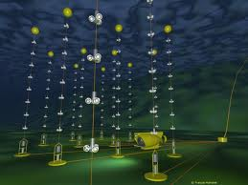
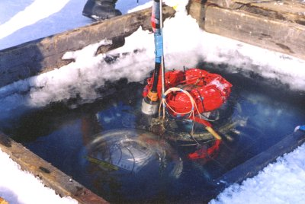

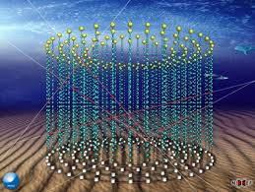
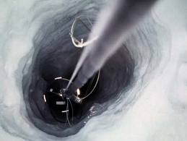
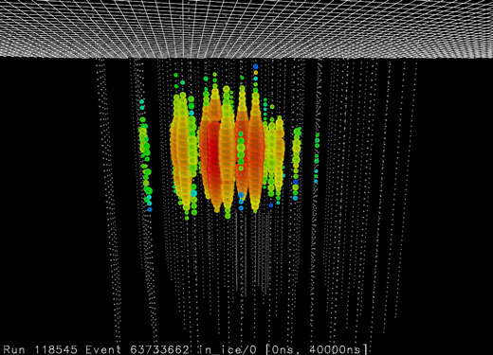
neutrino telescopes
Antares
2007-now
Lake Baikal, NT200+, GVD
KM3NeT
2015+
Amanda
-2009
IceCube
2007-now

Slide 5



http://www.cherenkov.nl/aa3d/?f=../aa3d_files/numucc_8.js.gz
http://www.cherenkov.nl/aa3d/?f=../aa3d_files/nuecc_3.js.gz
http://www.cherenkov.nl/aa3d/?f=../aa3d_files/taux_evt_8.js.gz

Slide 6
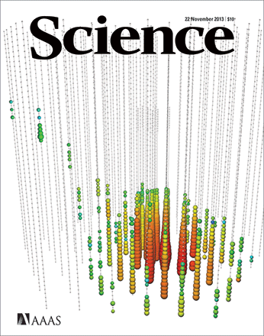
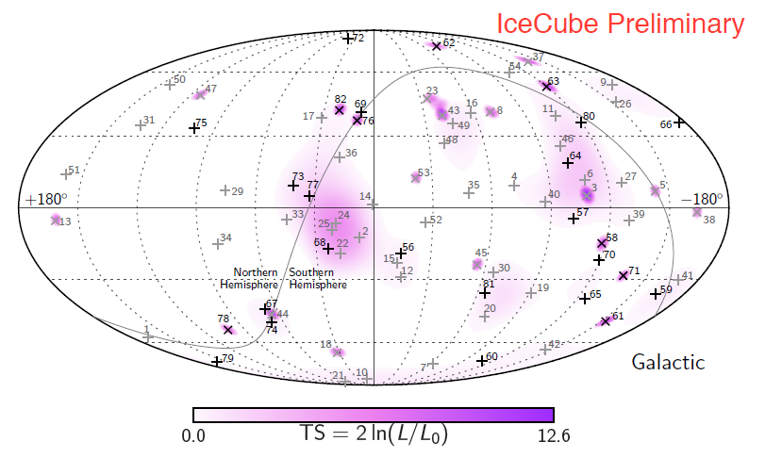
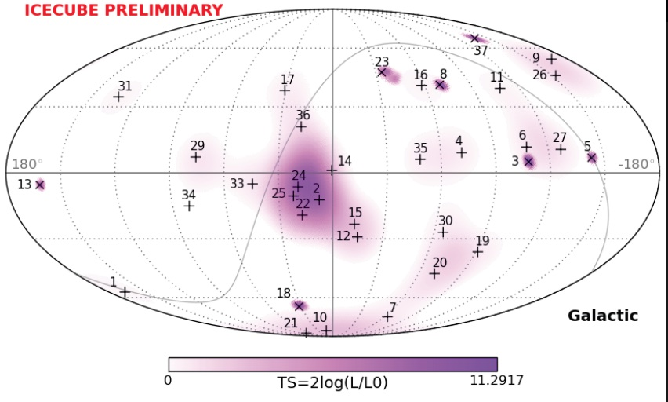
Cosmic neutrinos observed!
Tracks quoted as <1.2 deg
Cosmic neutrinos seen with Icecube.
Energies: PeV
Most are electron- and tau neutrinos
  Bad resolution
  Sources unknown

Slide 7
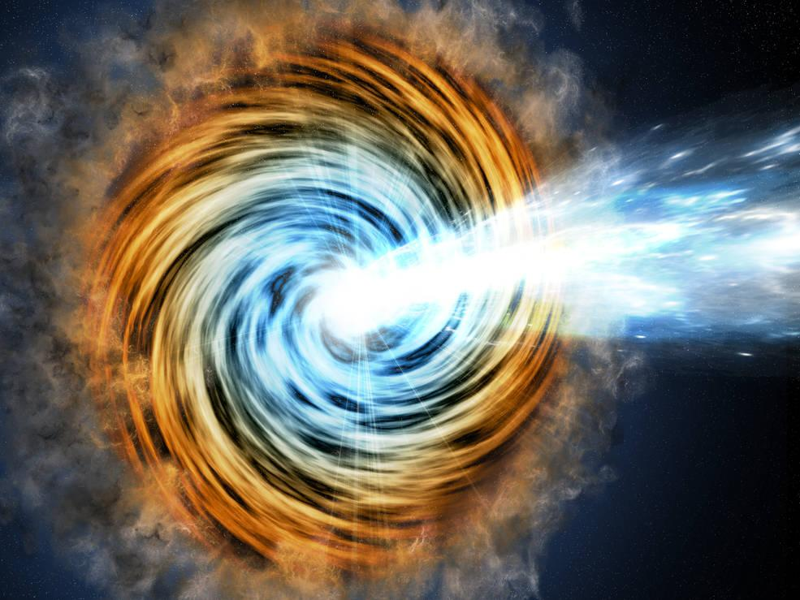
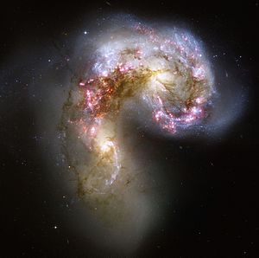
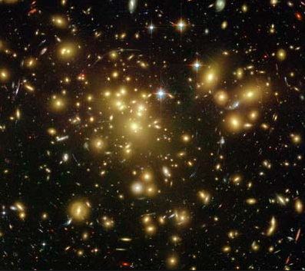
Sources of IceCube neutrinos?
AGN and BLAZARS
(SNR inside)
Starburst Galaxies
(SNR inside)
Galaxy Clusters
[ and/or Galactic component, heavy dark matter decay, new physics?]

Slide 8
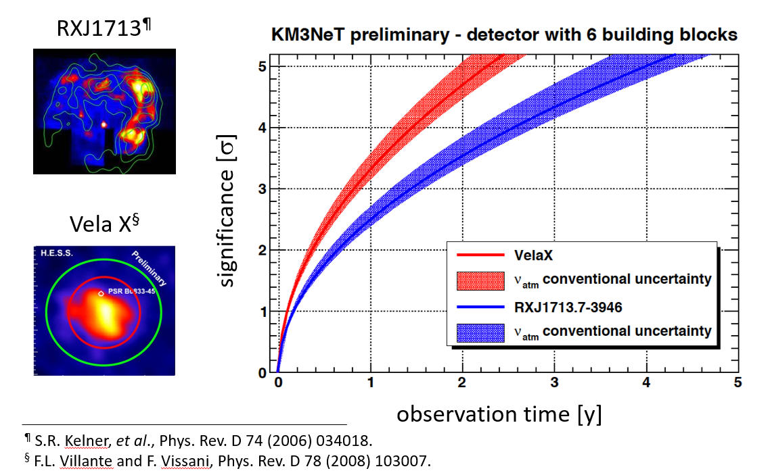
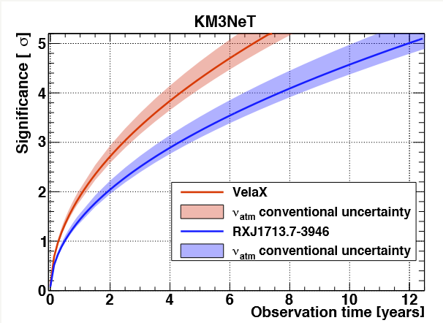
Galactic Supernova Remnants – if hadronic

Slide 9
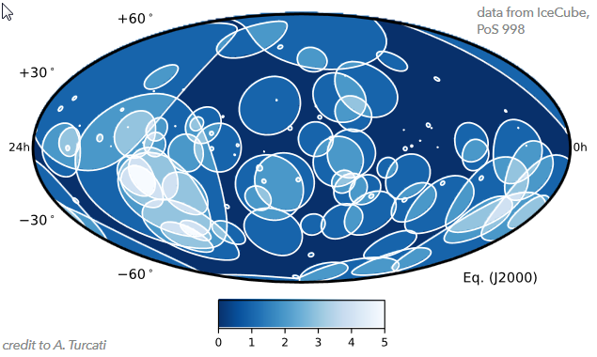
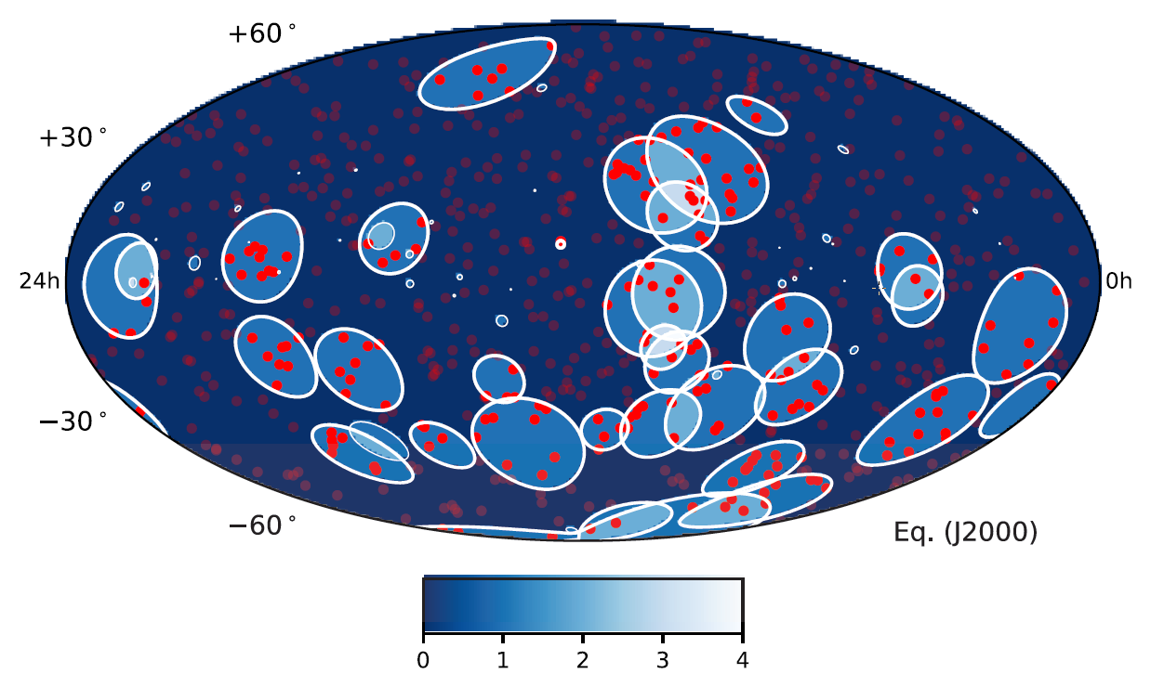
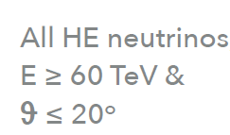
Resolution is key
From E. Resconi,
6 year HESE data
E > 60 TeV
ϴ<20º
Points : 3FHL, HBL
Resolution for ν_{e}
ANTARES
KM3NeT
Resolution for ν_{μ}
ANTARES
KM3NeT
.
Resolution of key
importance
for catalogue searchers
.

Slide 10
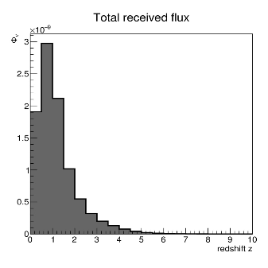
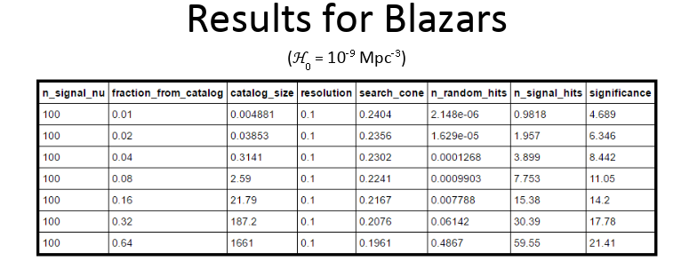
Catalog searches : explorative studies
Neutrinos reach us from too far away -> many
neutrinos, but also many sources.
B. Jongewaard
Blazars are among the rarest objects (per Mpc3)

Slide 11
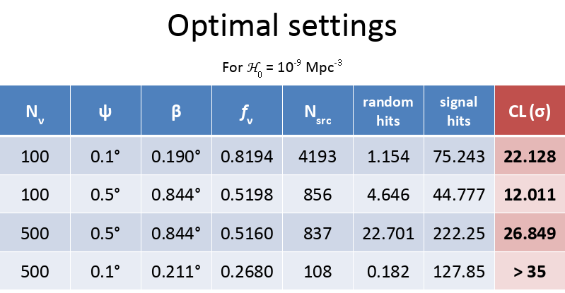
Catalog searches : explorative studies
Message:
Resolution just as
important as
acceptance.
Neutrinos reach us from too far away -> many
neutrinos, but also many sources.
B. Jongewaard
Blazars are among the rarest objects (per Mpc3)

Slide 12
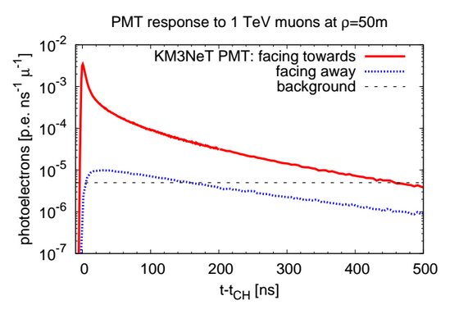
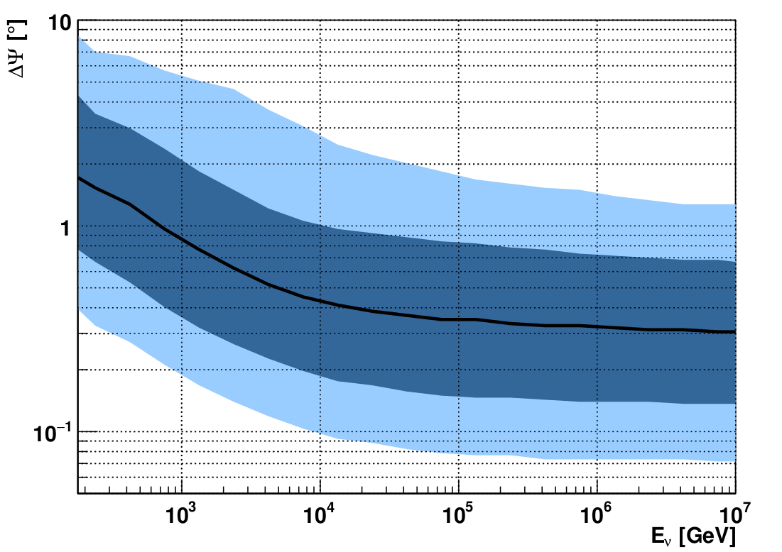
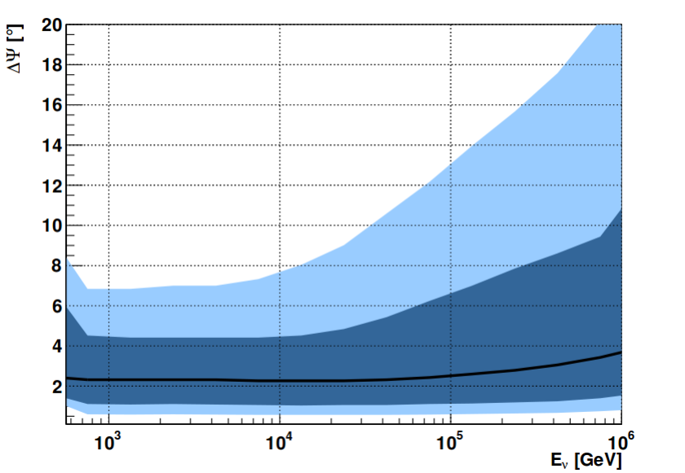
Sea water as detection medium
ANTARES
Tracks
Cherenkov light arrives on-time
Upgoing tracks (ν_{μ}CC)
Angular resolution <0.4° for E_{ν}>10 TeV
Upgoing cascades(ν_{e/}ν_{t} CC, NC)
Angular resolution < 3°
Energy resolution for ν_{e} : 5%
PoS ICRC2015 (2016) 1078
ANTARES
Cascades

Slide 13
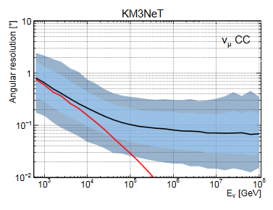
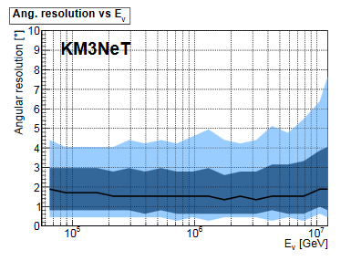
Sea water as detection medium
ANTARES
Tracks
Cherenkov light arrives on-time
ν-μ angle
ANTARES
Cascades (ν_{e})
Track s (ν_{μ}CC)
Angular resolution <0.1° for Eν>100 TeV
Cascade events (ν_{e/}ν_{t} CC, NC)
Angular resolution < 1.5°
Energy resolution for ν_{e} ~5%

Slide 14
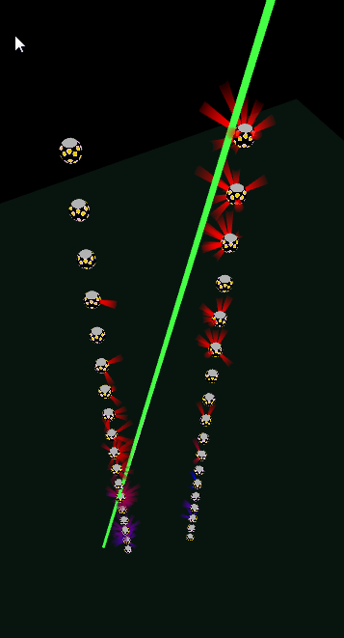
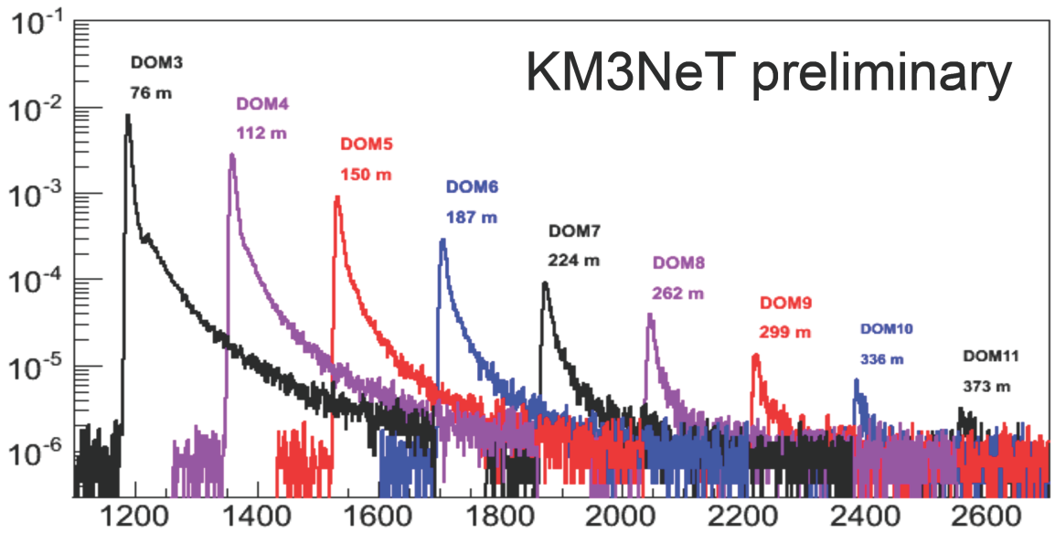
First detection lines
Timing check with LED flashers
Time after flash (ns)
Nanobeacon analysis confirms simulations:
Light signals maintain timing information even
after hundreds of meters
Deployed
May 2016
Deployed
Dec 2015

Slide 15
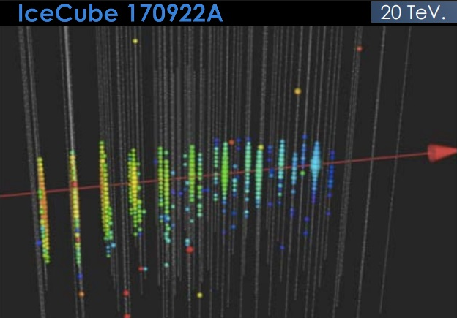
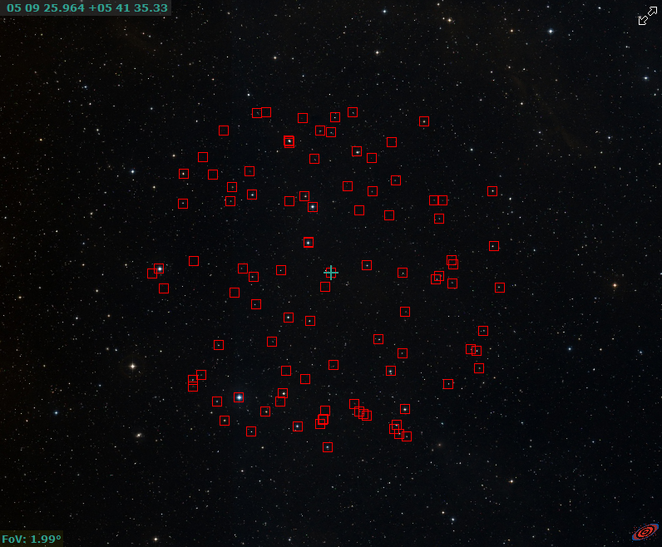
IceCube-170922A / TXS 0506+056
Simbad
Notice horizontal track

Slide 16
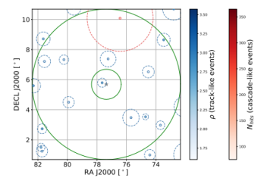
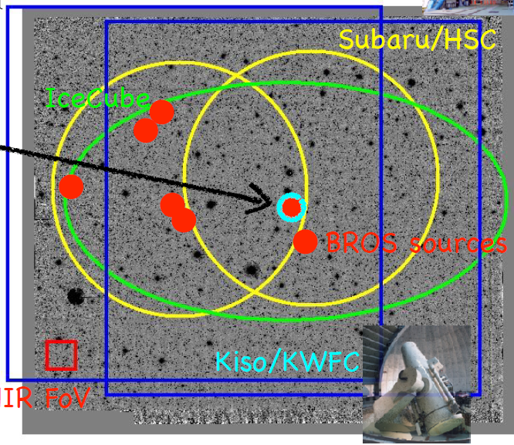
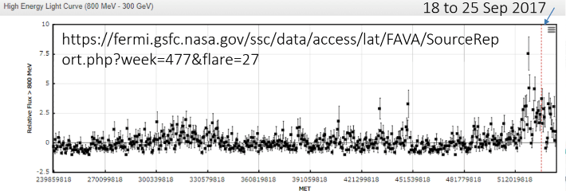
IceCube-170922A / TXS 0506+056
Specialized blazar candidate catalog (BROS):
6 more blazar candidates in error box.

Slide 17
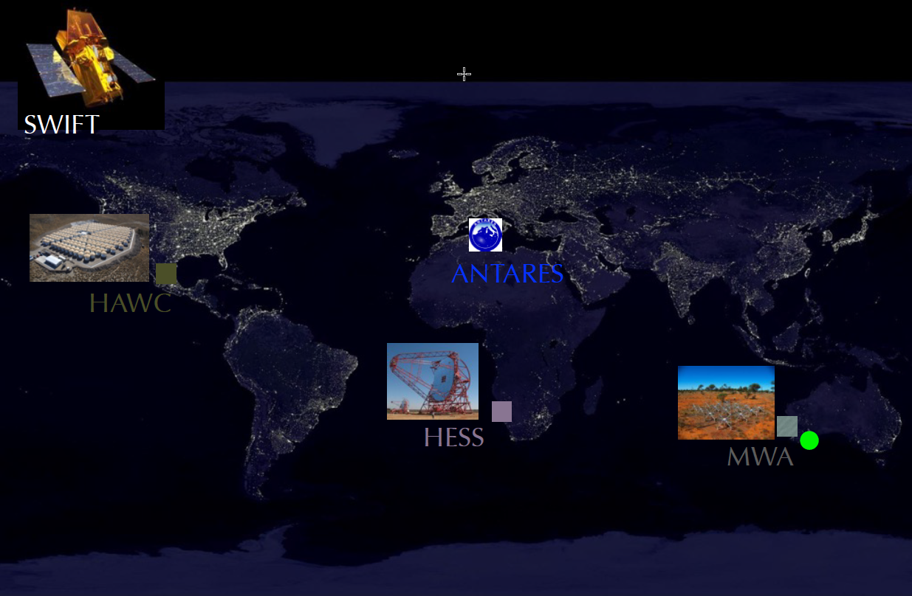

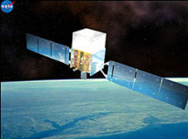
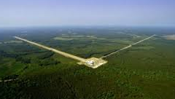
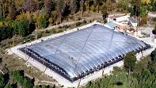

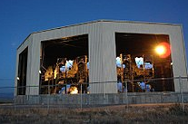
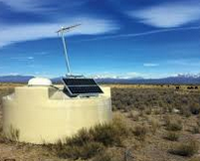
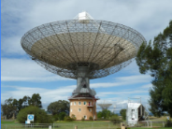

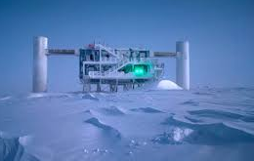
Multi-messenger observations
Maxi
Milagro
Fermi
Ligo
Virgo
HAWK
TA
Parkes
Auger
Utmost
IceCube

Slide 18
Multi-messenger observations
Maxi
Milagro
Fermi
Ligo
Virgo
HAWK
TA
Correlation with other observations
is crucial, not only for real-time follow-up
but also for ‘offline’ analyses.
Parkes
Auger
Utmost
IceCube

Slide 19
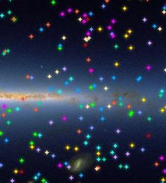
Collecting signal
Source will be discovered by:
High energy track (nm) events
Time correlation
Correlation with known object
Next:
Once a neutrino source is established
Identify compatible
  Low energy tracks
  Shower-events
  Tau neutrinos
Understand flavour composition
-> sample of long-baseline neutrinos

Slide 20
Collecting signal
Source will be discovered by:
High energy track (nm) events
Time correlation
Correlation with known object
Next:
Once a neutrino source is established
Identify compatible
  Low energy tracks
  Shower-events
  Tau neutrinos
Understand flavour composition
-> sample of long-baseline neutrinos

Slide 21
Collecting signal
Source will be discovered by:
High energy track (nm) events
Time correlation
Correlation with known object
Next:
Once a neutrino source is established
Identify compatible
  Low energy tracks
  Shower-events
  Tau-neutrinos
Understand flavour composition
-> sample of long-baseline neutrinos

Slide 22
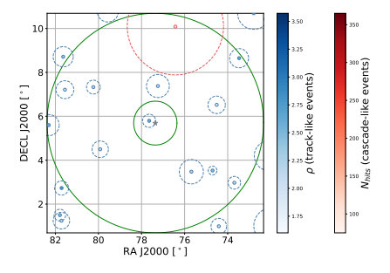
Towards a sample of neutrinos
If you believe TX 0506+056
Is a neutrino source, it’s
quite likely this is a signal
track.
(similar signal is rumoured
to be present in Icecube
Track data).
ANTARES Track
TXS 0506+056

Slide 23
Thoughts
Angular resolution is absolutely key.
With KM3NeT: can do better, especially for electron- and tau-neutrinos
Strong sources may give multiple events (case for TXS 0506+056)
Time dependence (flaring) is important
  Activity in the Netherlands? Or simply send alerts?
  Optical, radio, gamma ?
Weak sources : < 1 event can be studied on statistical bases
-> catalog searches

Slide 24
Neutrino physics at a PeV

Slide 25
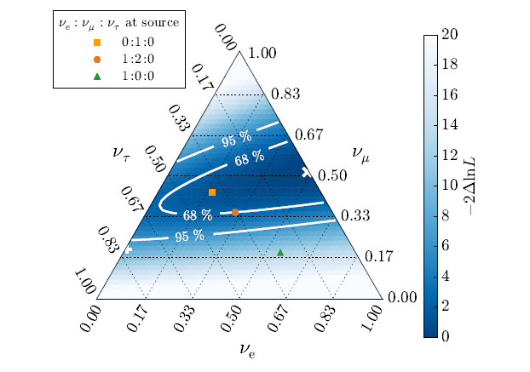
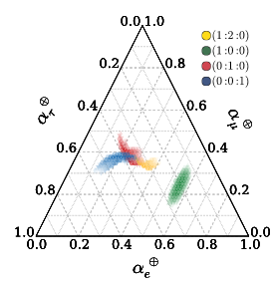
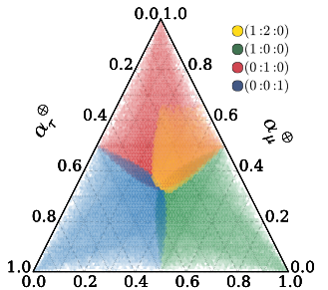
Flavour ratios contain (astro) physics
IceCube flavour ratio fit
Phys.Rev.Lett. 115 (2015) 161303
ν_{μ}
New Physics
SM
}
astro
ν_{τ}
ν_{e}
Oscillations affect flavour ratios of cosmic
neutrinos.
non-standard interaction, Lorentz-invariance
violation, ν-decay, steriles…
Works better when sources are understood
(and then, can even probe δ_{cp})
KM3NeT will contribute a lot here
Fit to IceCube data consistent with 1:1:1
More data to come

Slide 26
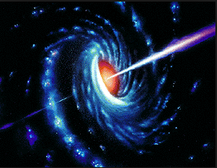


PeV Neutrino physics
bron:
astrofysica
onderweg:
deeltjesfysica
Flavour ratio’s probe both astro- , but also particle- physics
energy (100 x LHC) and baseline : completely new domain
Probe exotic scenarios of mass generation
measure δ_{CP} (requires lots of statistics)

Slide 27




PeV Neutrino physics
bron:
astrofysica
onderweg:
deeltjesfysica
decay
Pseudo-dirac neutrinos:
See-saw with very light Majorana
mass -> right handed neutrinos
have tiny mass difference with
left handed neutrinos.
Oscillations over huge lengths
Scattering on CνB
(new interaction)

Slide 28

Can we improve angular resolution?
Tau neutrinos :
- precisely reconstruct position of each bang
(likelihood-fit of hit times) -> angular resolution
Cascades:
- including timing information in direction-fit
(don’t know about the gain)
Tracks:
At highest energies, can we do better?
(difference with IC seems not so large)
There is one class of events….

Slide 29

Can we improve angular resolution?
Tau neutrinos :
- precisely reconstruct position of each bang
(likelihood-fit of hit times) -> angular resolution
Cascades:
- including timing information in direction-fit
(don’t know about the gain)
Tracks:
At highest energies, can we do better?
(difference with IC seems not so large)
There is one class of events….

Slide 30

Can we improve?
Tracks going through both building blocks
Should have extremely good resolution
Horizontal tracks : good for very high energy
What is the resolution?
Interesting region in the sky?
May make good case for 3rd building block….
(idea for master project)

Slide 31

Can we improve?
Tracks going through both building blocks
Should have extremely good resolution
Horizontal tracks : good for very high energy
What is the resolution?
Interesting region in the sky?
May make good case for 3rd building block….
(idea for master project)

Slide 32
The end

Slide 33

Sample of signal-like neutrinos

Slide 34



Library of new physics

