Slide 1
ORCA – more than Neutrino Mass Hierarchy
Atmospheric ‘neutrino beam’ systematics
ANTARES recent analyses

Slide 2
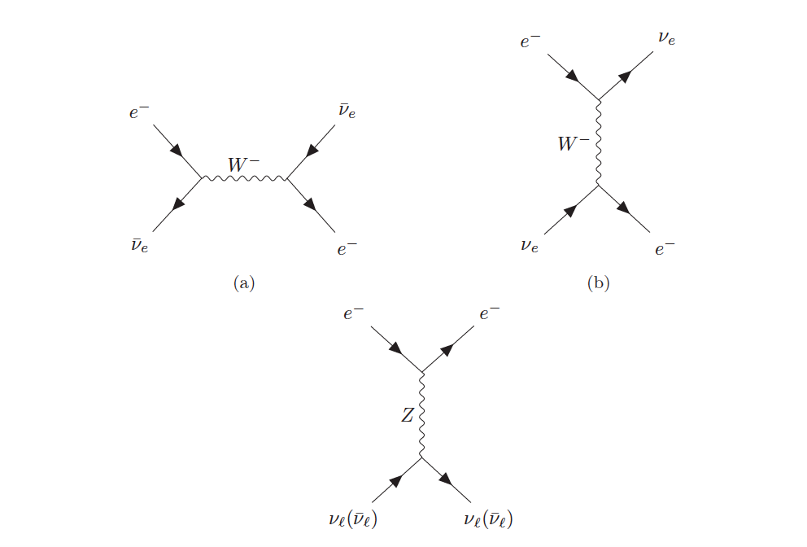
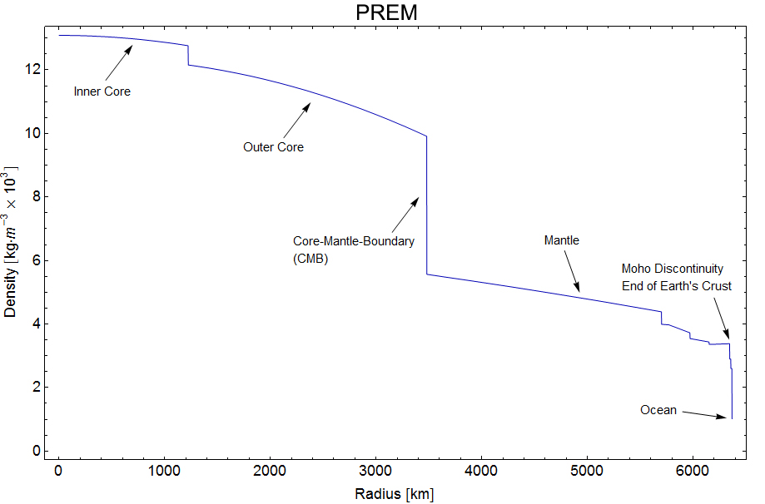
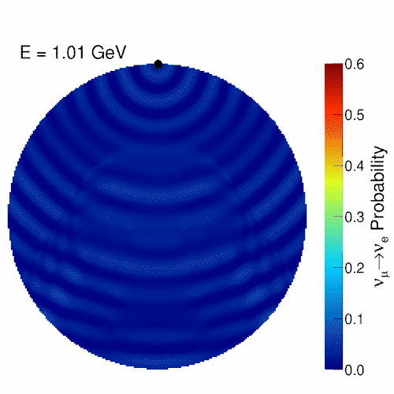
Neutrinos traversing the Earth
-> ν_{e} interaction with electrons
-> depending on mass ordering
Earth model
Animation J. Coelho

Slide 3
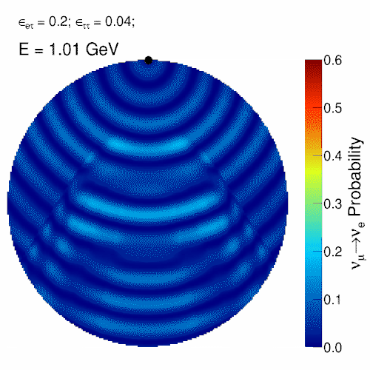
Adding non-standard interactions
Adding non-standard interactions
Animation J. Coelho

Slide 4
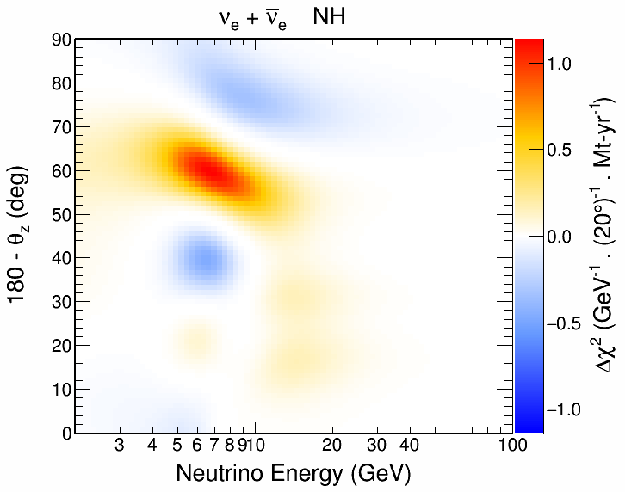
Non-standard-interaction signature:
Same energy range as NMH pattern, but at different zenith range

Slide 5
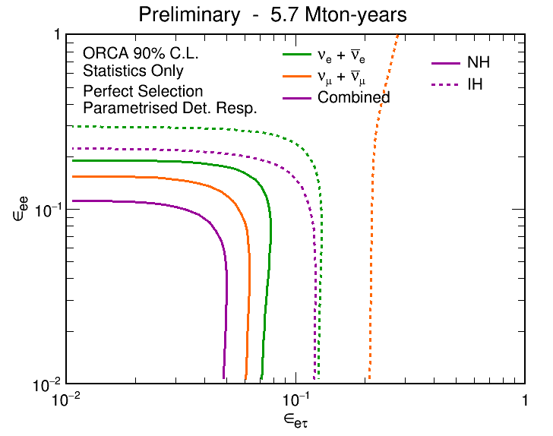
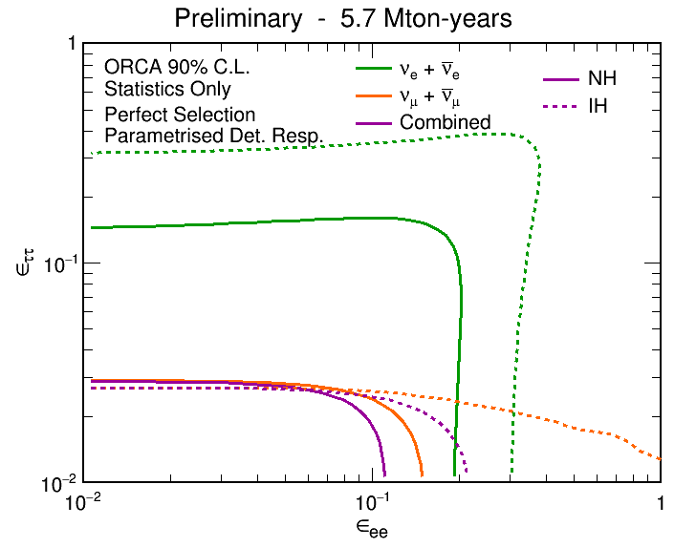
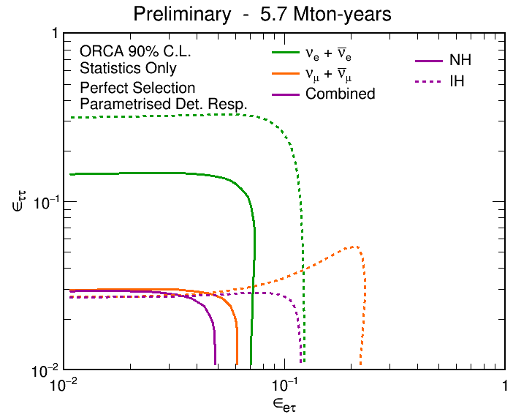

Slide 6
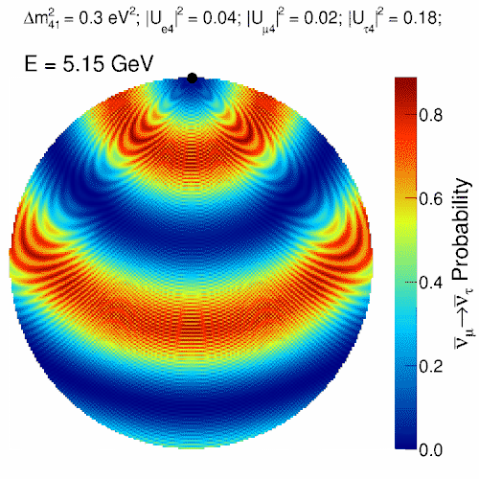
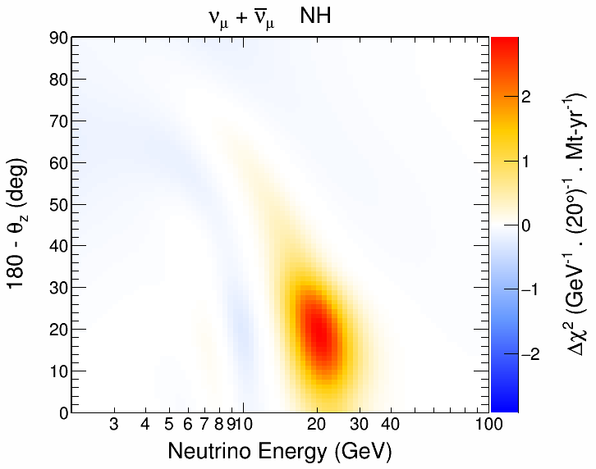
Sterile neutrinos in ORCA
http://www.apc.univ-paris7.fr/Downloads/antares/Joao/animations/

Slide 7
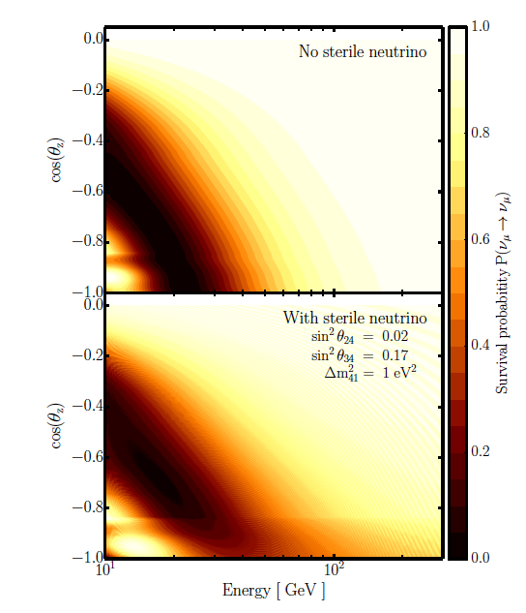
IceCube/Deepcore analysis for m²=1eV²

Slide 8
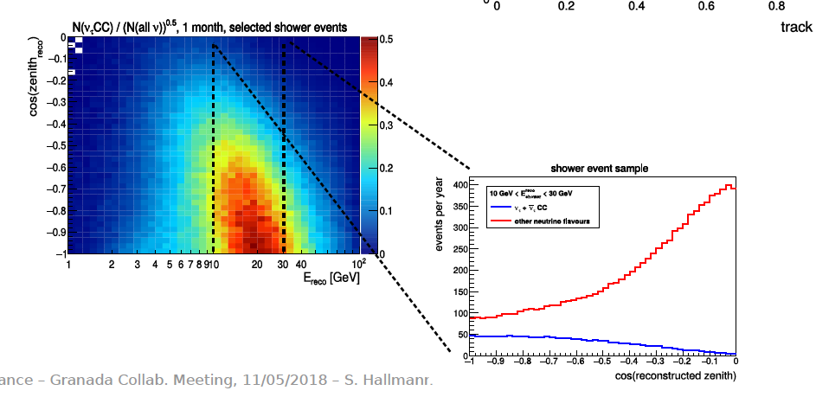
ν_{τ} appearance
ν_{μ} −> ν_{τ} measurement valuable to check unitarity of PMNS matrix

Slide 9
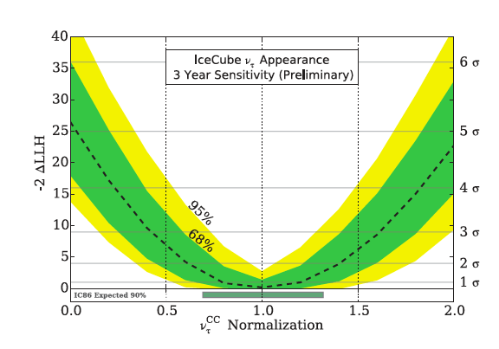
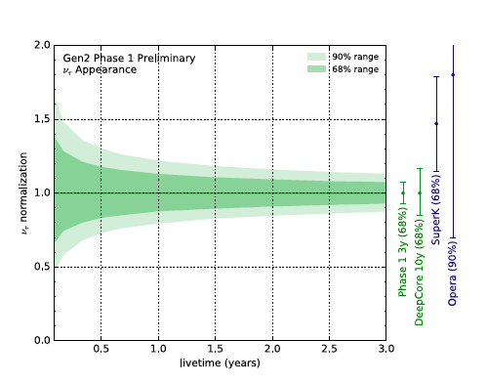
ν_{τ} appearance
ν_{μ} −> ν_{τ} measurement valuable to check unitarity of PMNS matrix
Prospects for IceCube/Deepcore and Phase-1
Koskinen (NEUTRINO 2016)

Slide 10
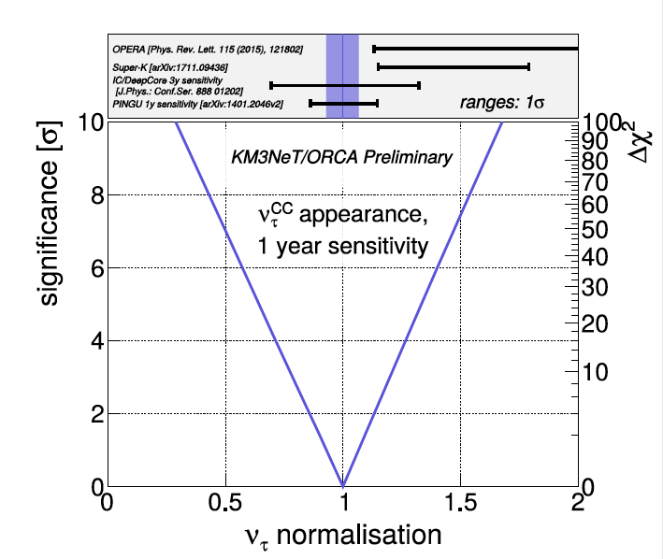
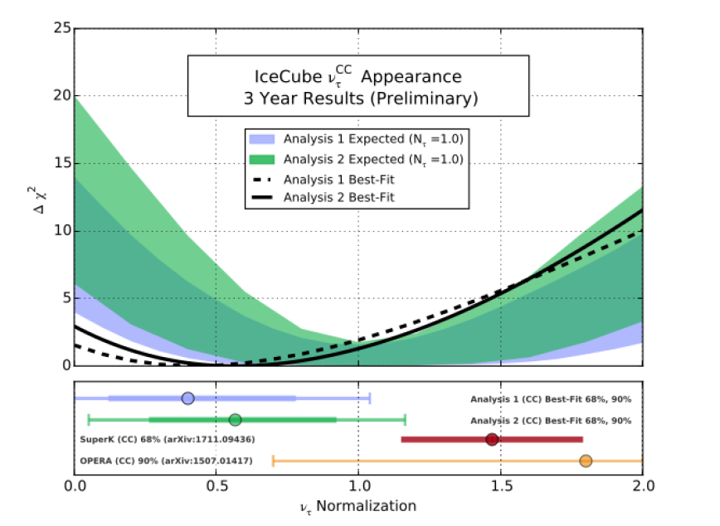
DeepCore Measurement and ORCA sensitivity

Slide 11
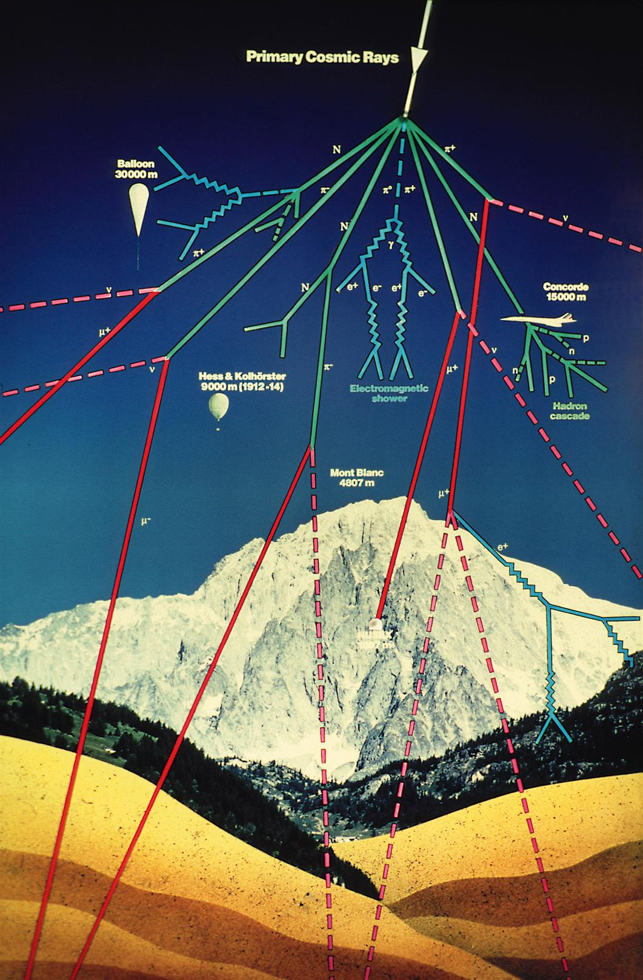

Slide 12
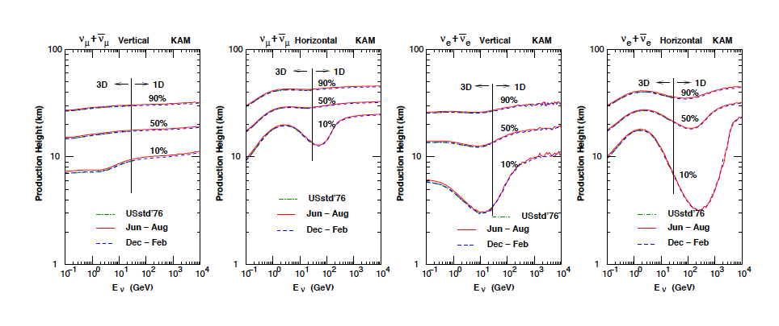
Collisions of primary cosmic rays with atmosphere (N, O, C …)
-> pions, kaons, … -> decay
Production height distribution at the site of Superkamiokande

Slide 14
Geomagnetic effect
Muon (high energy)
Muon (low energy)
Earth

Slide 15
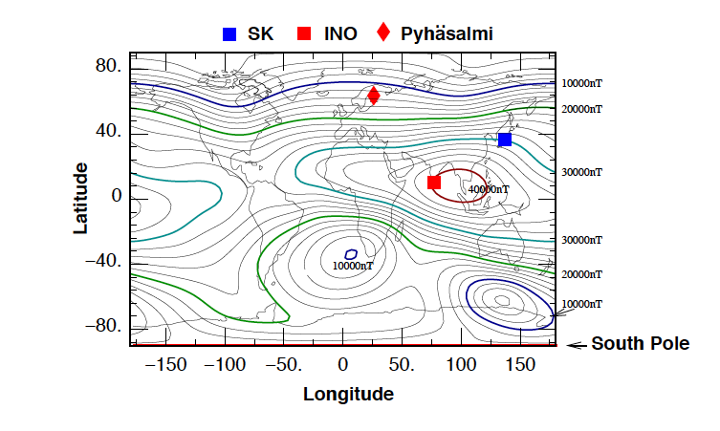
Geomagnetic effect

Slide 16
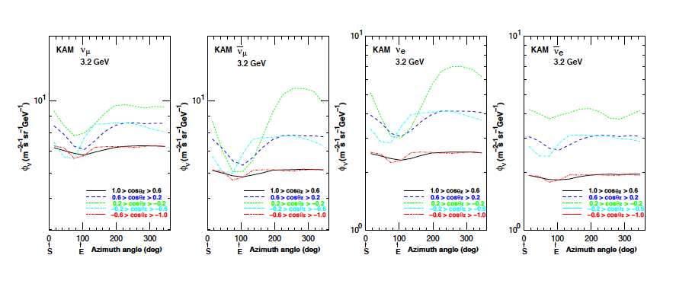
Azimuthal asymmetries
Noticable asymmetries for low energetic neutrinos

Slide 17
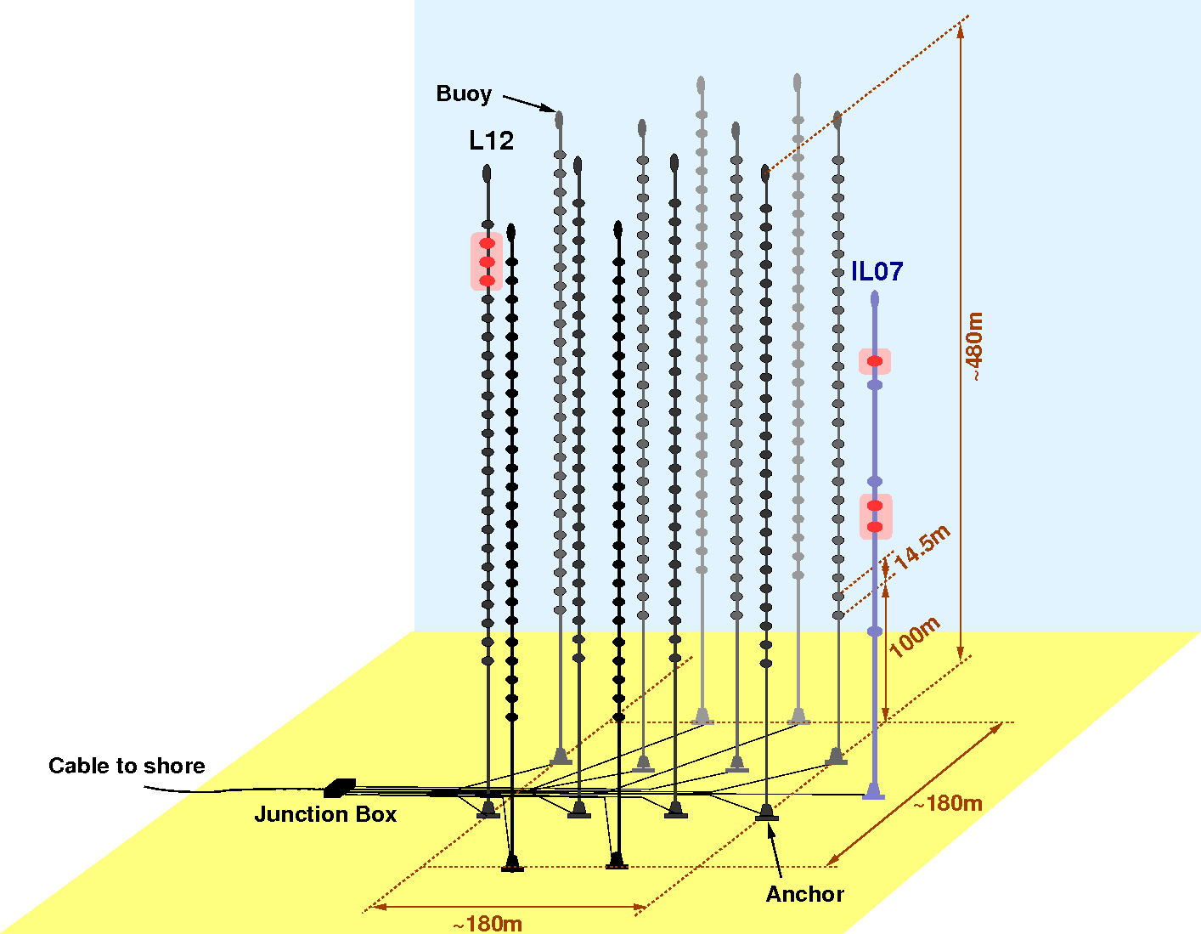
ANTARES
ANTARES
Running since 2007 at 2475m depth
885 10” PMTs
12 lines
25 storeys/line
3 PMTs / storey
PMT
PMT
40 km to
shore

Slide 18
The search for cosmic neutrinos:
So far only single high energy neutrino events, no source identified as correlated by other means (electromagnetic, cosmic rays, gravitational waves)
Guaranteed neutrino sources at positions of IceCube high energy neutrino
-> ANTARES: Search in time correlation
-> ANTARES: Search in stacking

Slide 19
A first neutrino source seen in γ-rays?
April 2016-End of 2017:
6 EHE alerts, 8 HESE alerts
(1 overlapping event)
Interesting Alert 22 September 20:55 EHE-170922A
Followup:
Integral, ANTARES, HAWC, HESS: no detection
SWIFT XRT: 9 X-ray emitters
FERMI: increased gamma-ray activity of TXS 0506+56
MAGIC: detection of VHE gamma rays
.... Many more observatories followed

Slide 20
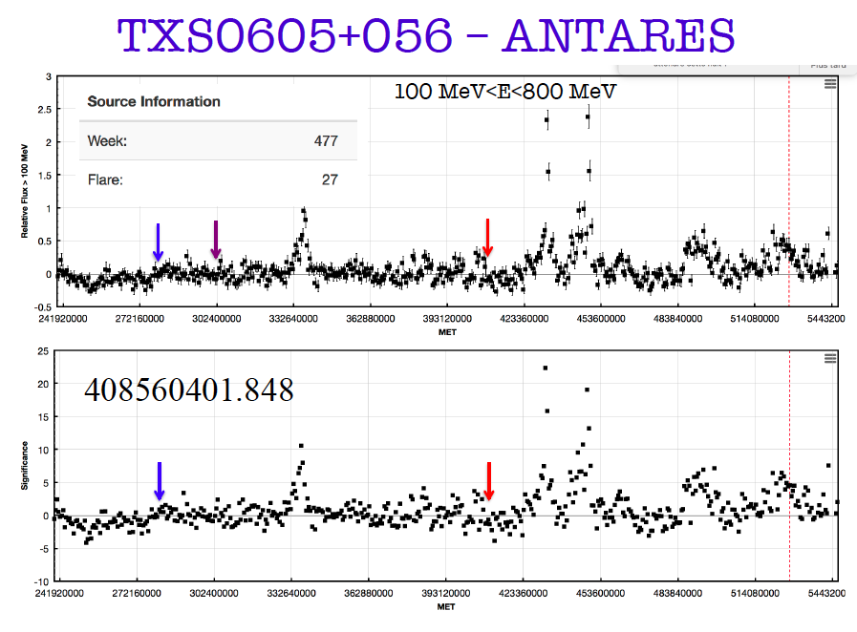
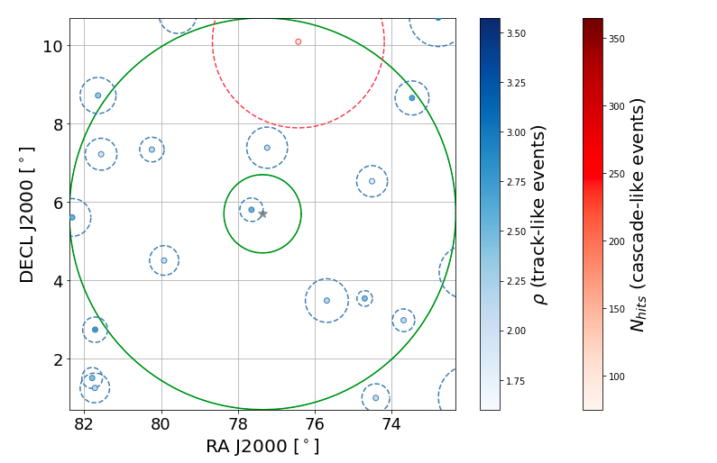

Slide 21
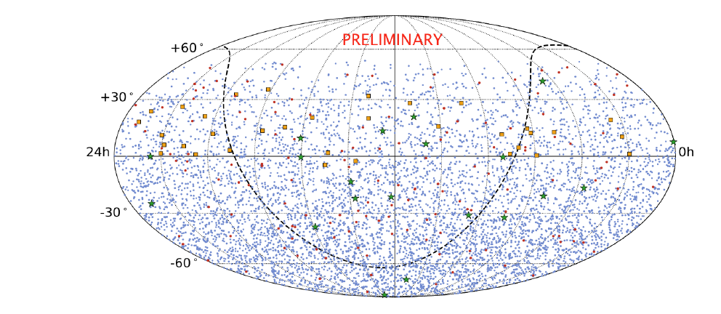
ANTARES:
6310 tracks
147 showers
IceCube:
20 HESE neutrinos
34 HE neutrinos

Slide 22
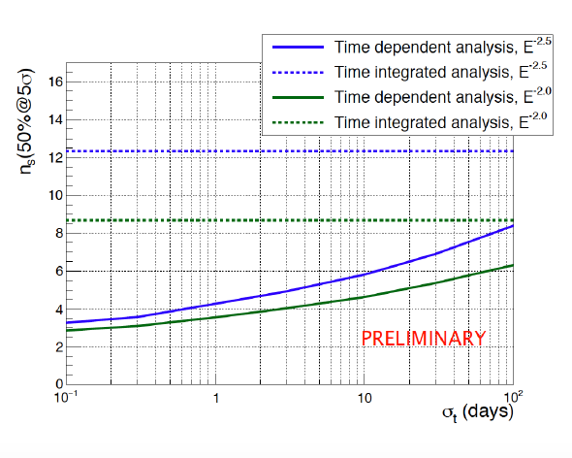

Slide 23
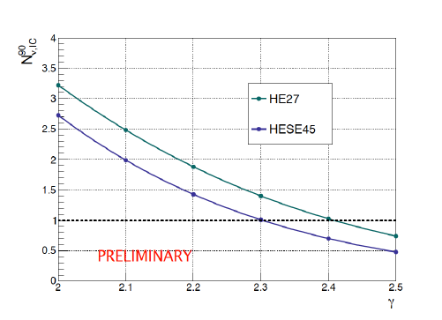
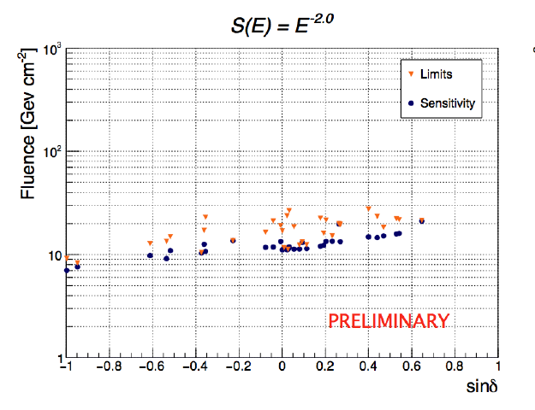
Constraint on 0.1 day flare
for 2 highest energetic events
Limits for sources where positive fluctuation was found

Slide 24
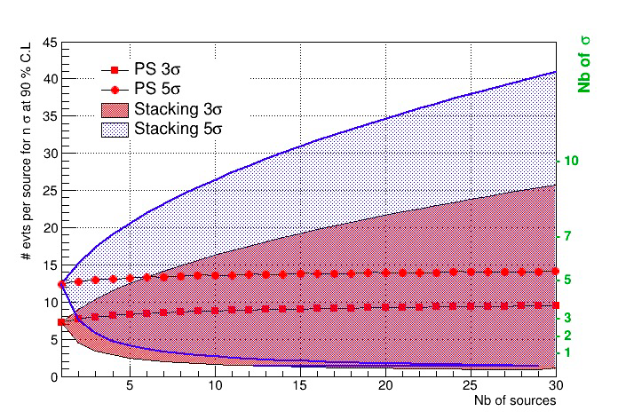
Potential sensitivity gain with stacking source ensembles
-> depends on variation of flux between sources

