Slide 1
Attribute Authority Operations Security
Authentication and Authorisation for Research and Collaboration
Hannah Short
AARC2 Operational Security Task Leader
CERN
EUGridPMA, Karlsruhe
23-25 May 2018

Slide 2
Background
AARC is extending (and crafting) policies for research communities to ensure that Federated Identity Management considerations are supported
Existing work has covered
Sirtfi (trust framework for incident response between IdPs and SPs)
Snctfi to bind components behind proxies together
What next?
How should Community Attribute Authorities and Proxies be operated?
How can they be included in Incident Response?

Slide 3
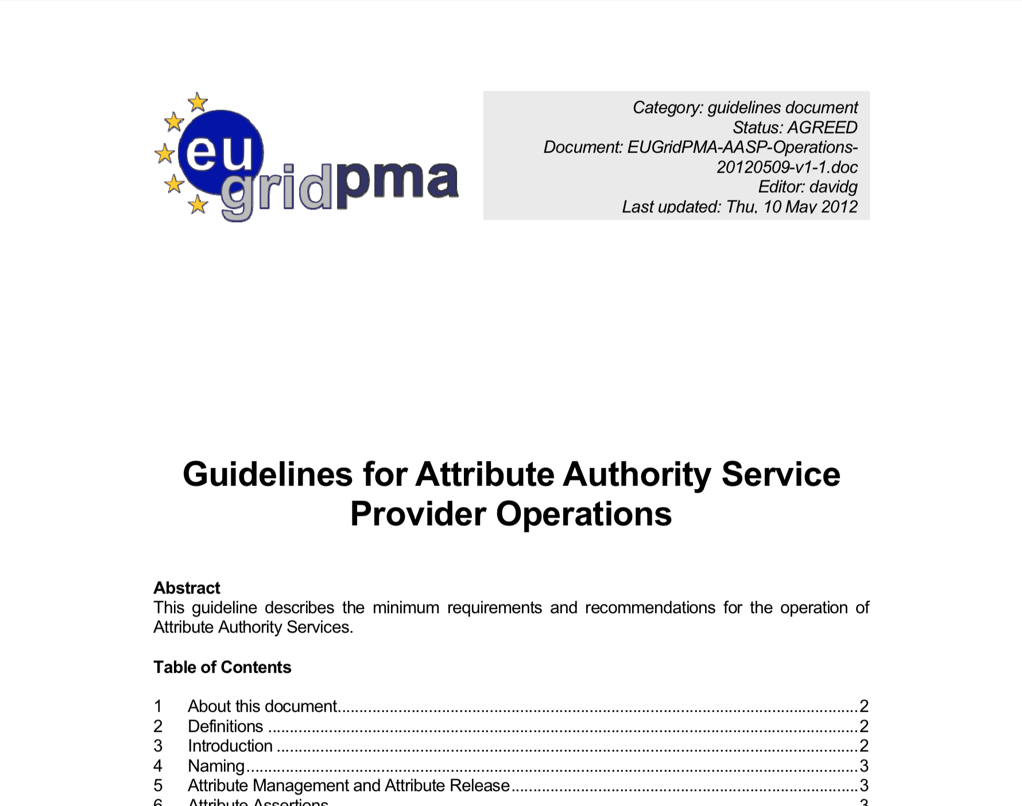
Basis
IGTF Draft from 2012
Guidelines for Attribute Authority Operation
Attribute quality, traceability and lifetime
Physical security
Disaster recovery
Audits
…
Written with VOMS and LDAP in mind

Slide 4
What is needed?
Define scope
Review existing draft
Update in the context of current practices in Federated Identity
Add incident response capability, requirement to provide security contacts
Make guidelines flexible to be applied to either stand-alone Attribute Authorities or those included in Proxy Components (effectively anything part of the process to issue authorisation tokens)
Add copyright
Publish as an IGTF document, supported by AARC

Slide 5
Working document
http://cern.ch/go/bP6p

Slide 6
hannah.short@cern.ch

