Slide 1
Nikhef communications
Martijn van calmthout
RECFA meeting
Amsterdam 19.10.18

Slide 2
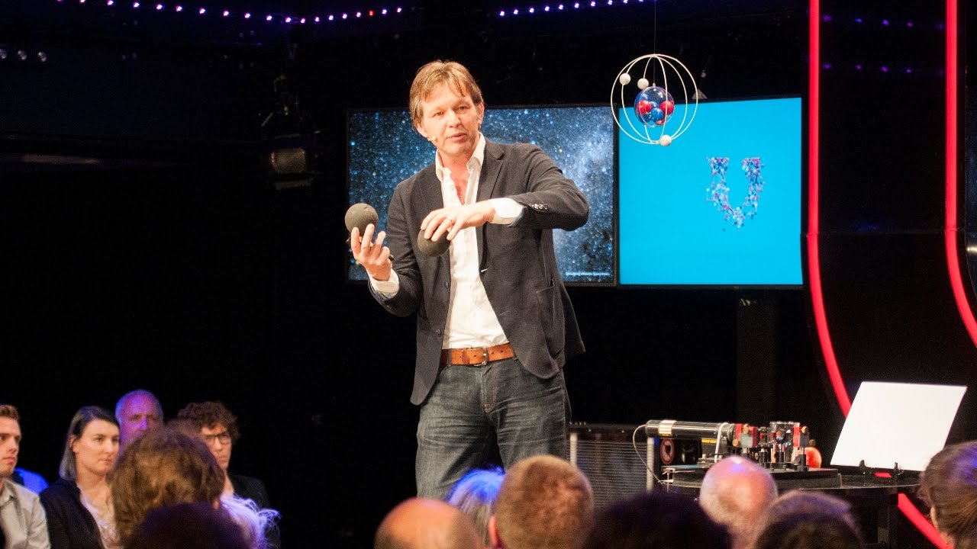
Nikhef, a story worth telling

Slide 3
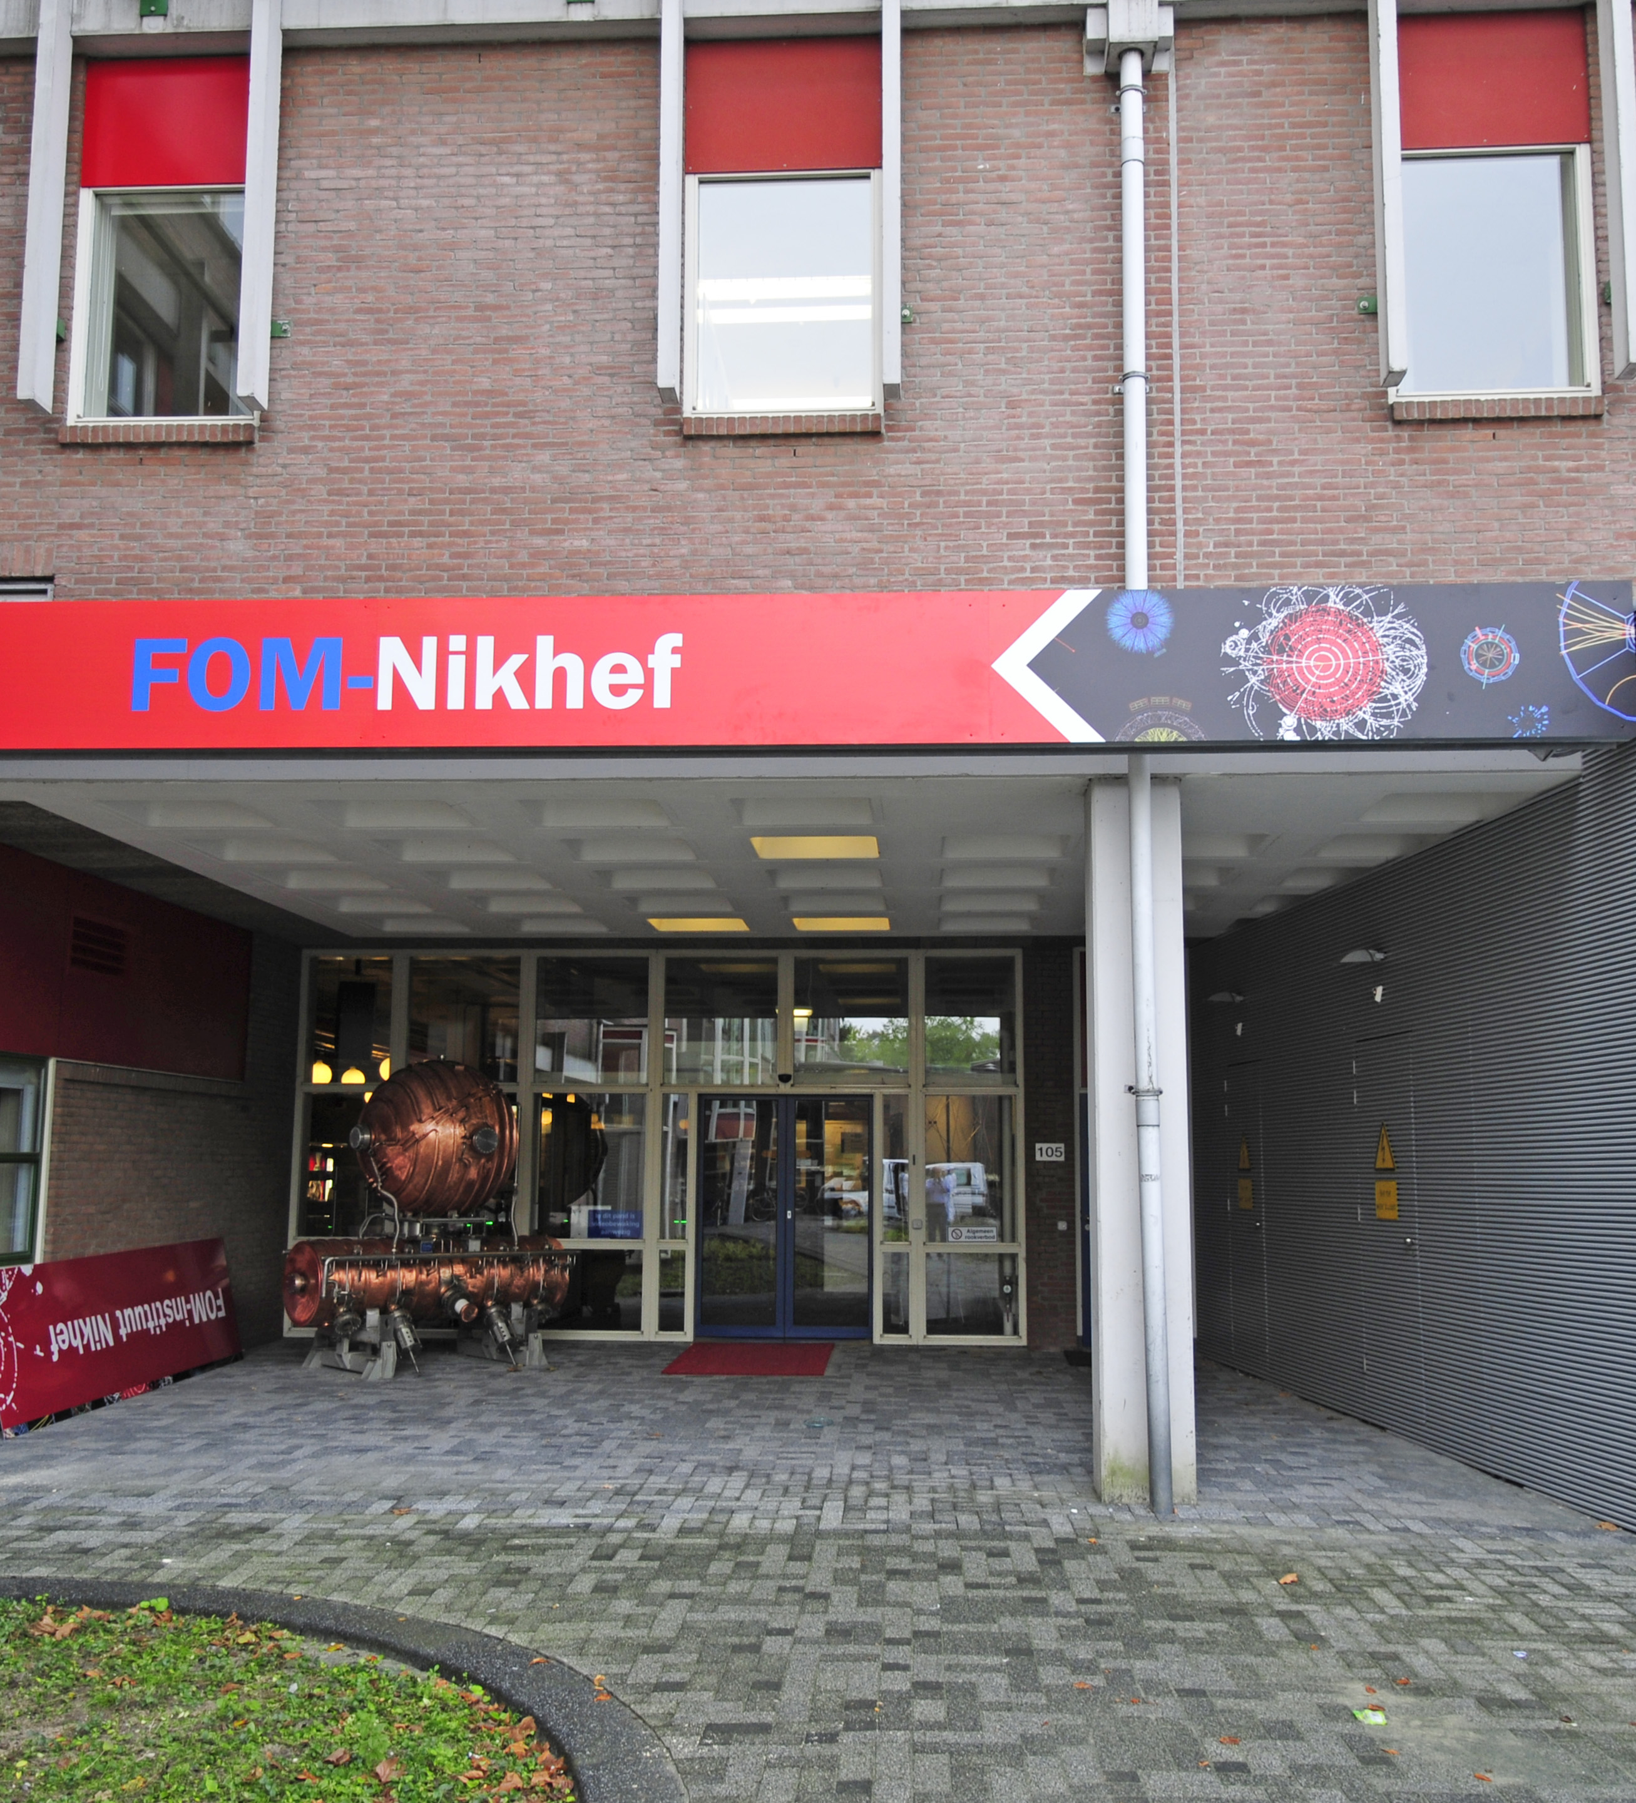
for nikhef, for physics, for the public good
Why communicate

Slide 4
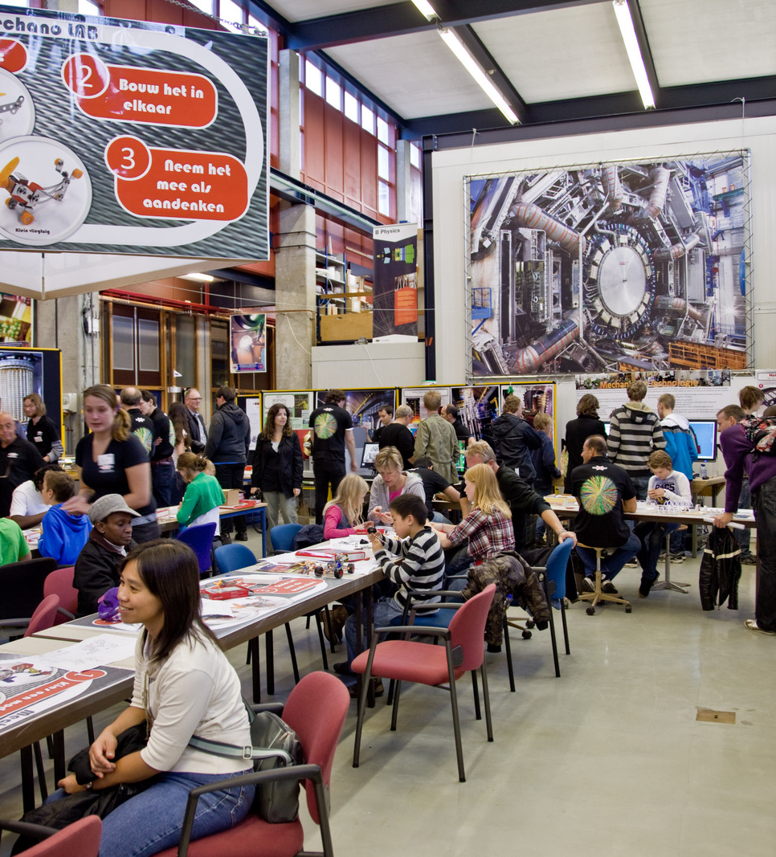
Public and media schools / students policy and industry
Who to communicate with

Slide 5
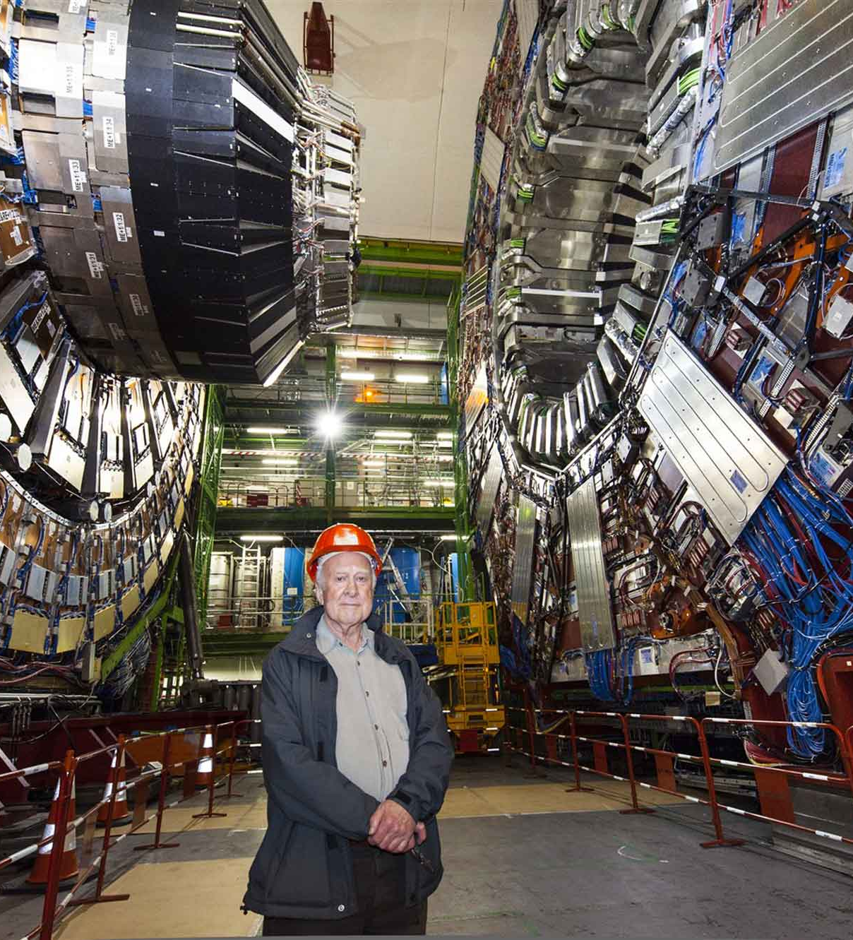
journey of science
What to communicate

Slide 6
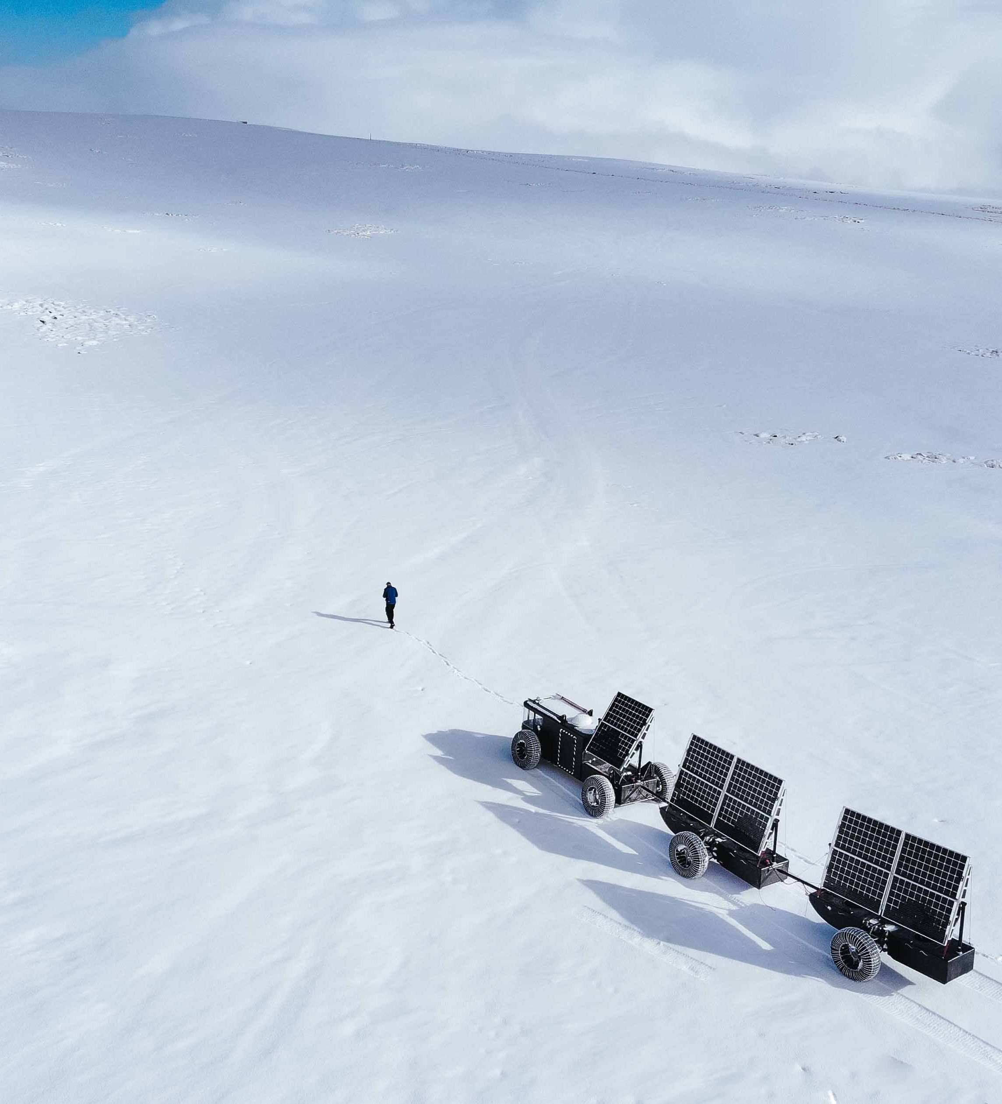
curiosity dedication human endeavour
The narrative

Slide 7

What’s the matter
Questions and answers

Slide 8
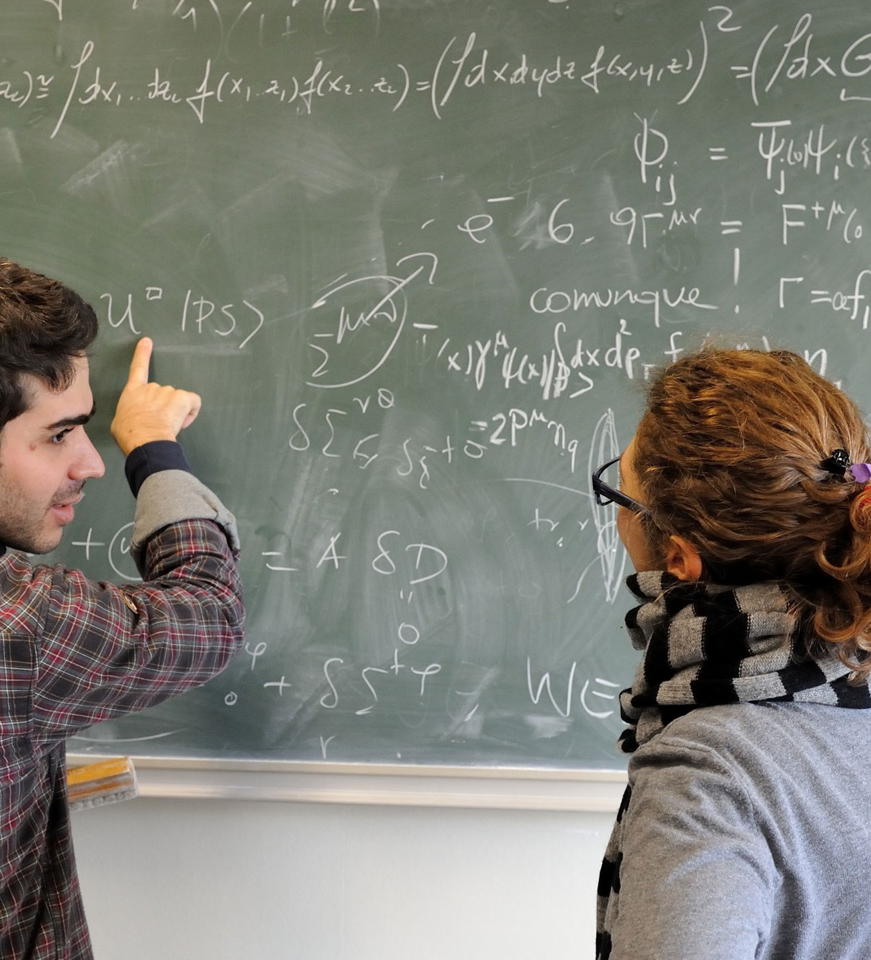
Why’s the matter?
Questions and answers

Slide 9
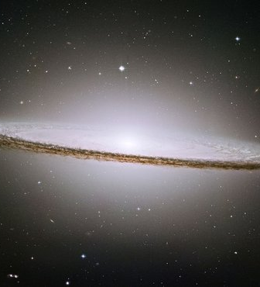
Where’s the matter?
Questions and answers

Slide 10
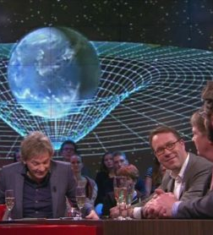
The eternal birthday party questions
A story worth telling

Slide 11
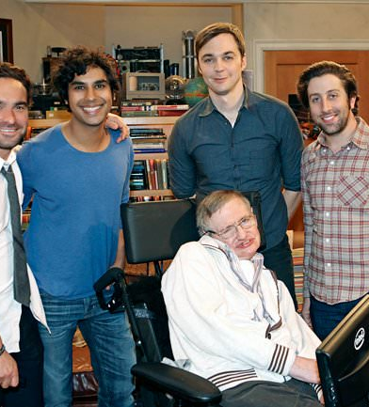
Big bang time travel black holes
Over a beer

Slide 12

Big bang time travel black holes
Over a beer

Slide 13
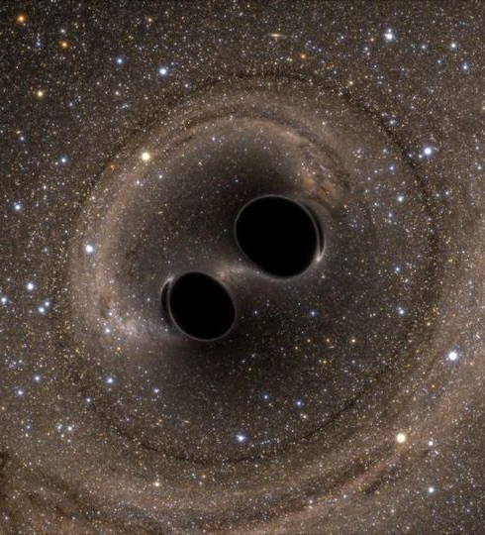
Big bang time travel black holes
Over a beer

Slide 14

The hard work that goes into it
Being honest

Slide 15
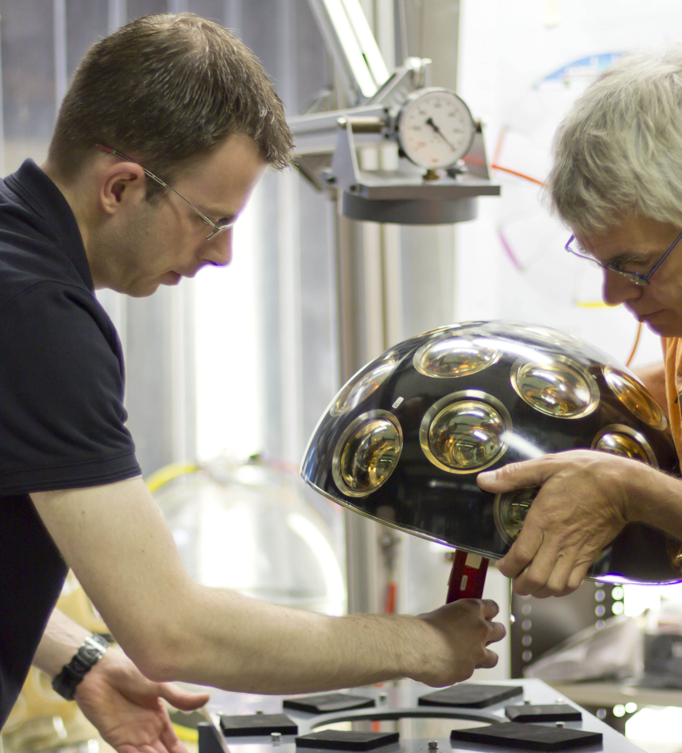
The hard work that goes into it
Being honest

Slide 16
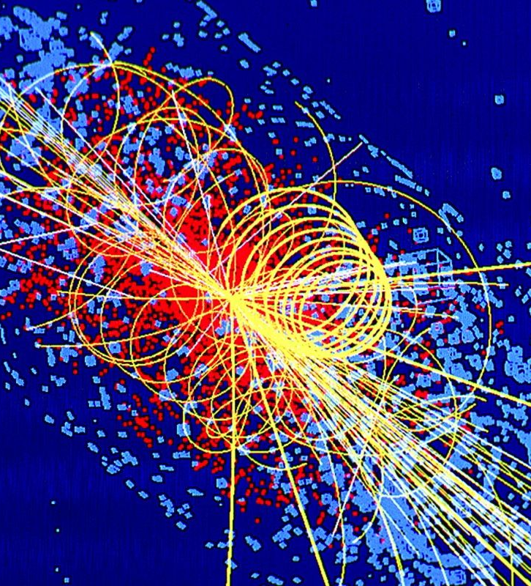
The art of finding out
answers

Slide 17
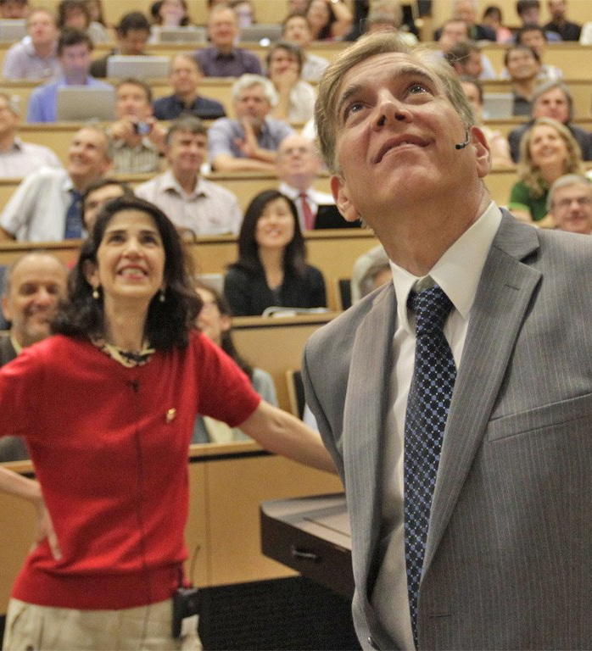
The pleasure of finding things out
answers

Slide 18
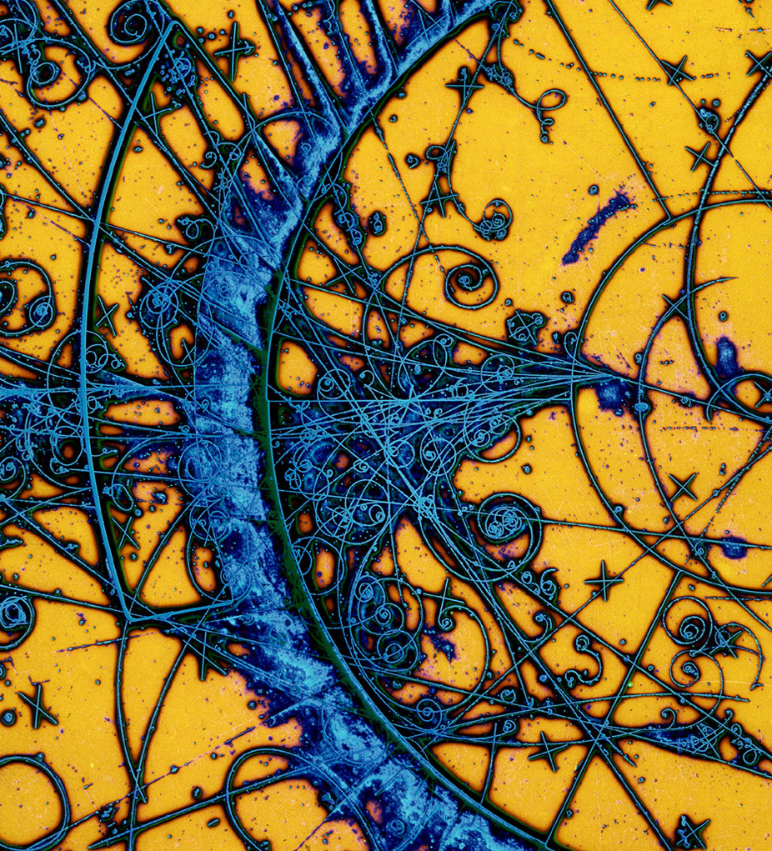
A Team a community other networks
nikhef communication

Slide 19
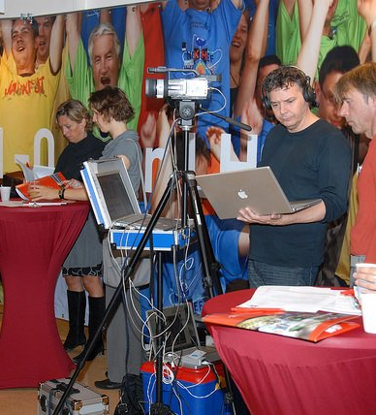
Press contacts outreach and visits masterclasses
Communications team

Slide 20

Public affairs
Communications team

Slide 21
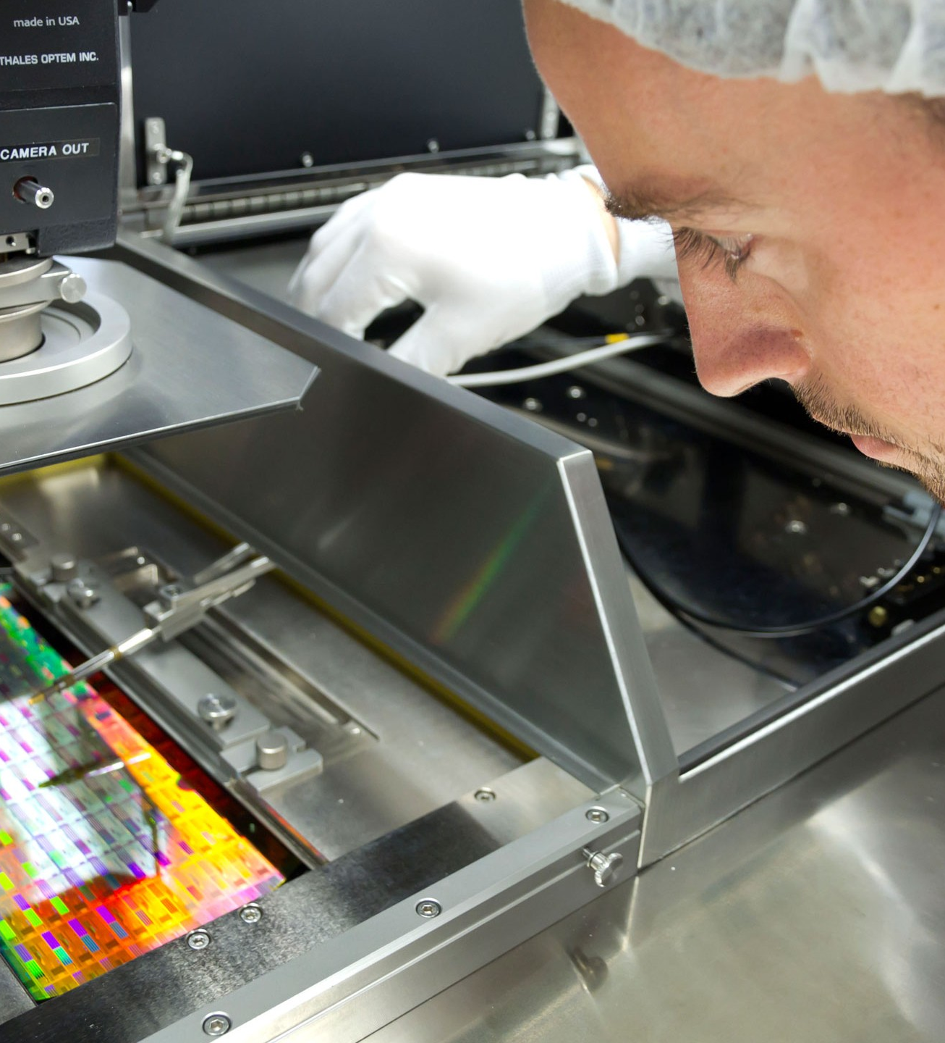
Something amazing happens every day
The nikhef community

Slide 22
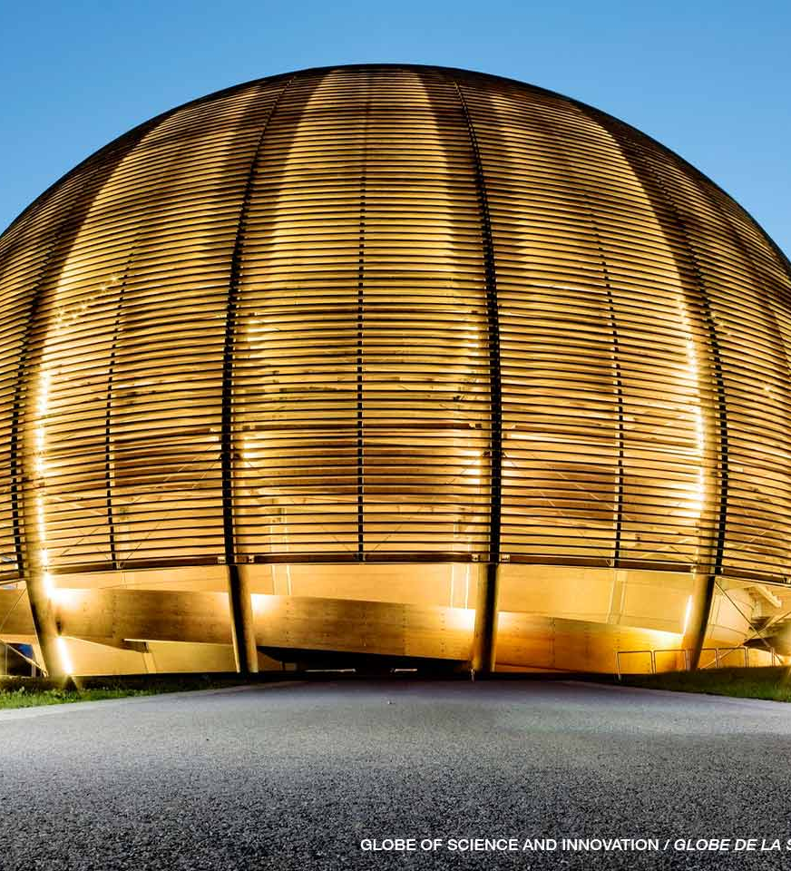
CERN institutes universities
networks

Slide 23
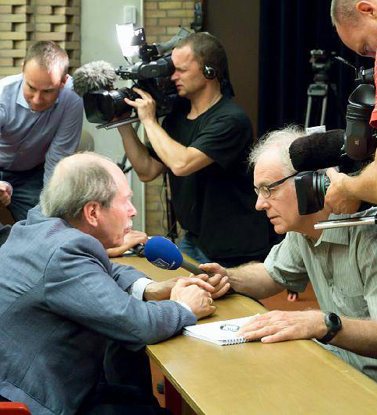
Mass media
Website / social media talks and events
Where to communicate

Slide 24
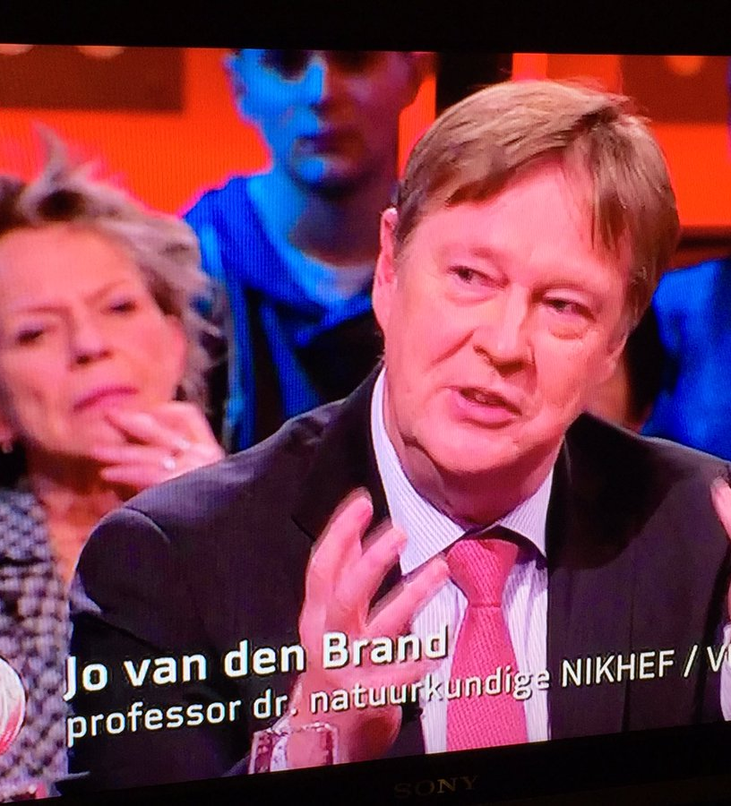
Evening news talk shows kids news
Mass media

Slide 25
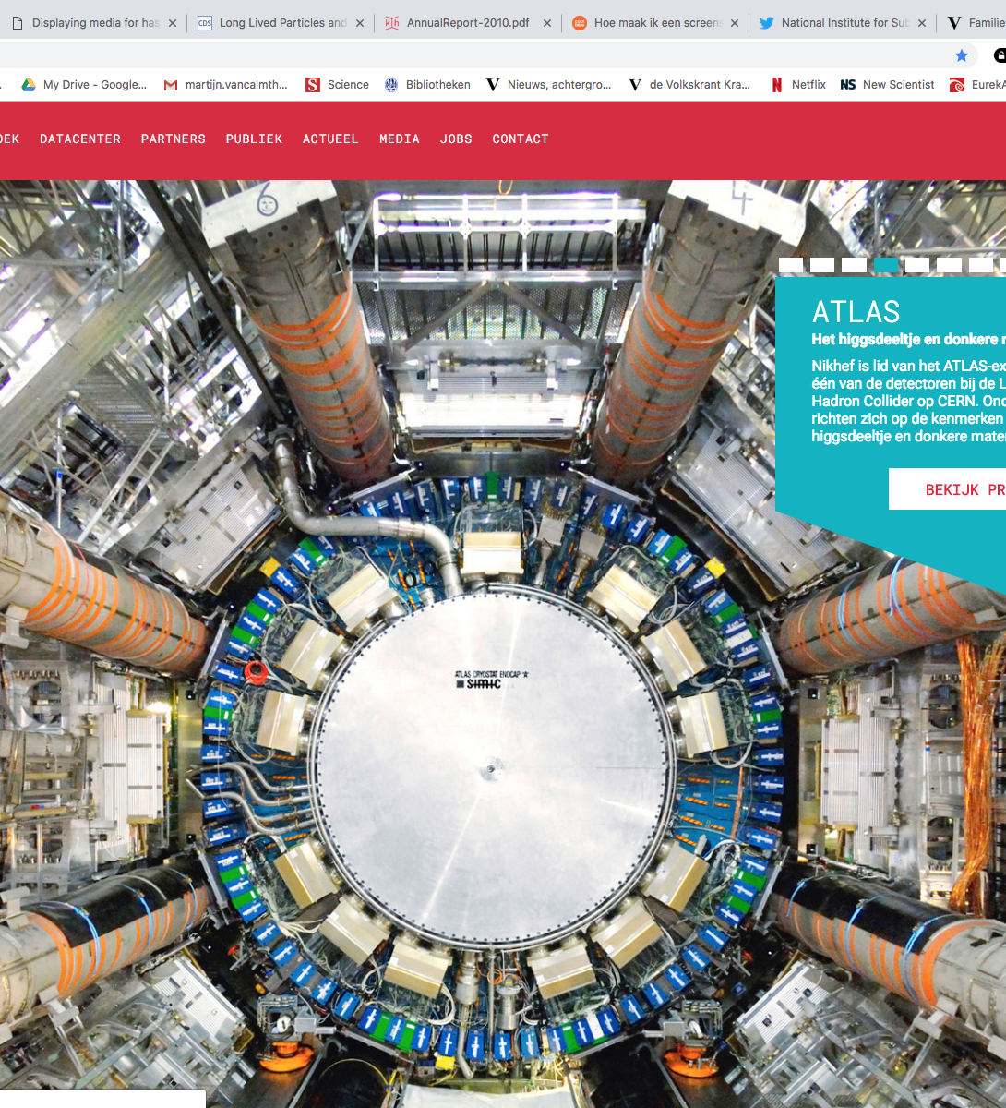
Nikhef.nl
Website and social media

Slide 26
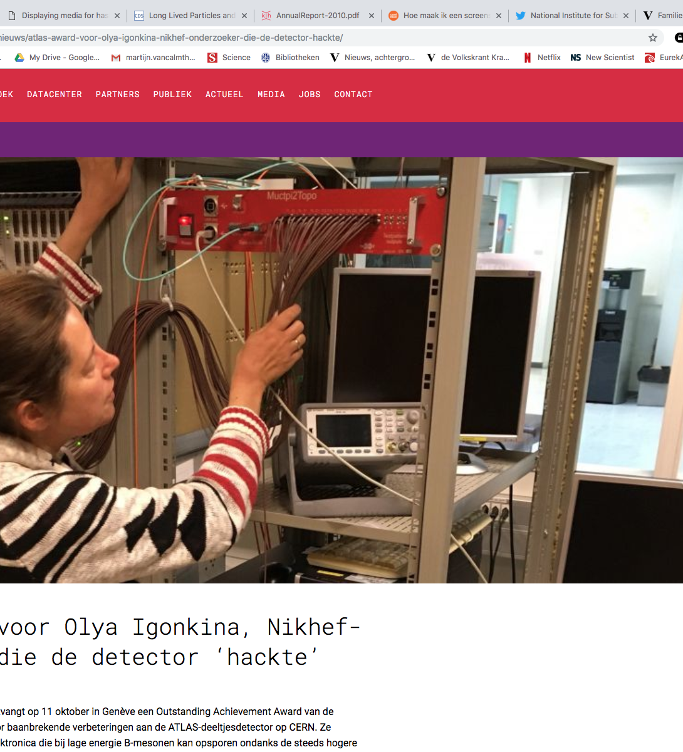
Nikhef.nl
Website and social media

Slide 27
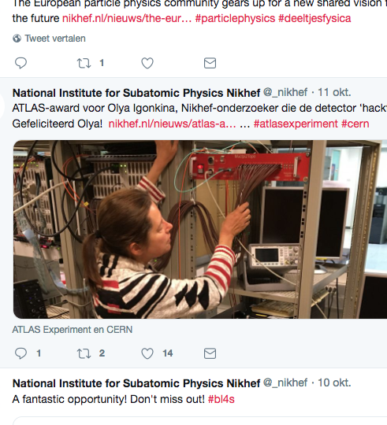
twitter / facebook
Website and social media

Slide 28
Museums science cafe’s town hall meetings
Talks and events

Slide 29
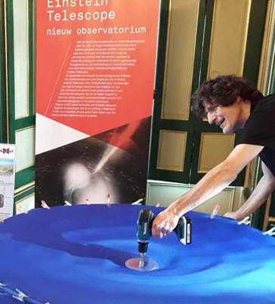
Industry policy tech schools
Other stake holders

Slide 30
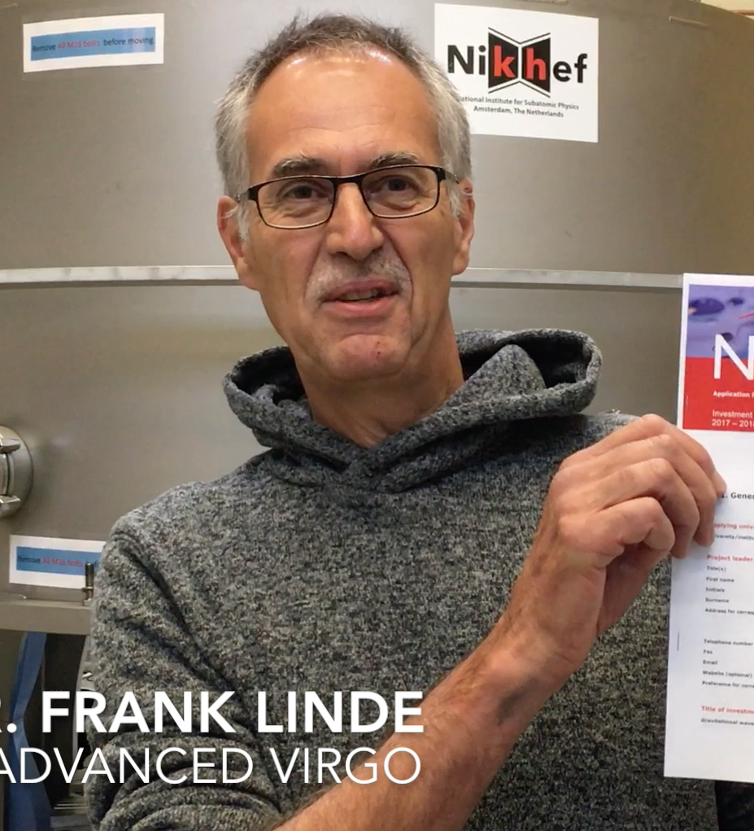
life after the higgs and gravity waves?
The dilemma of success

Slide 31
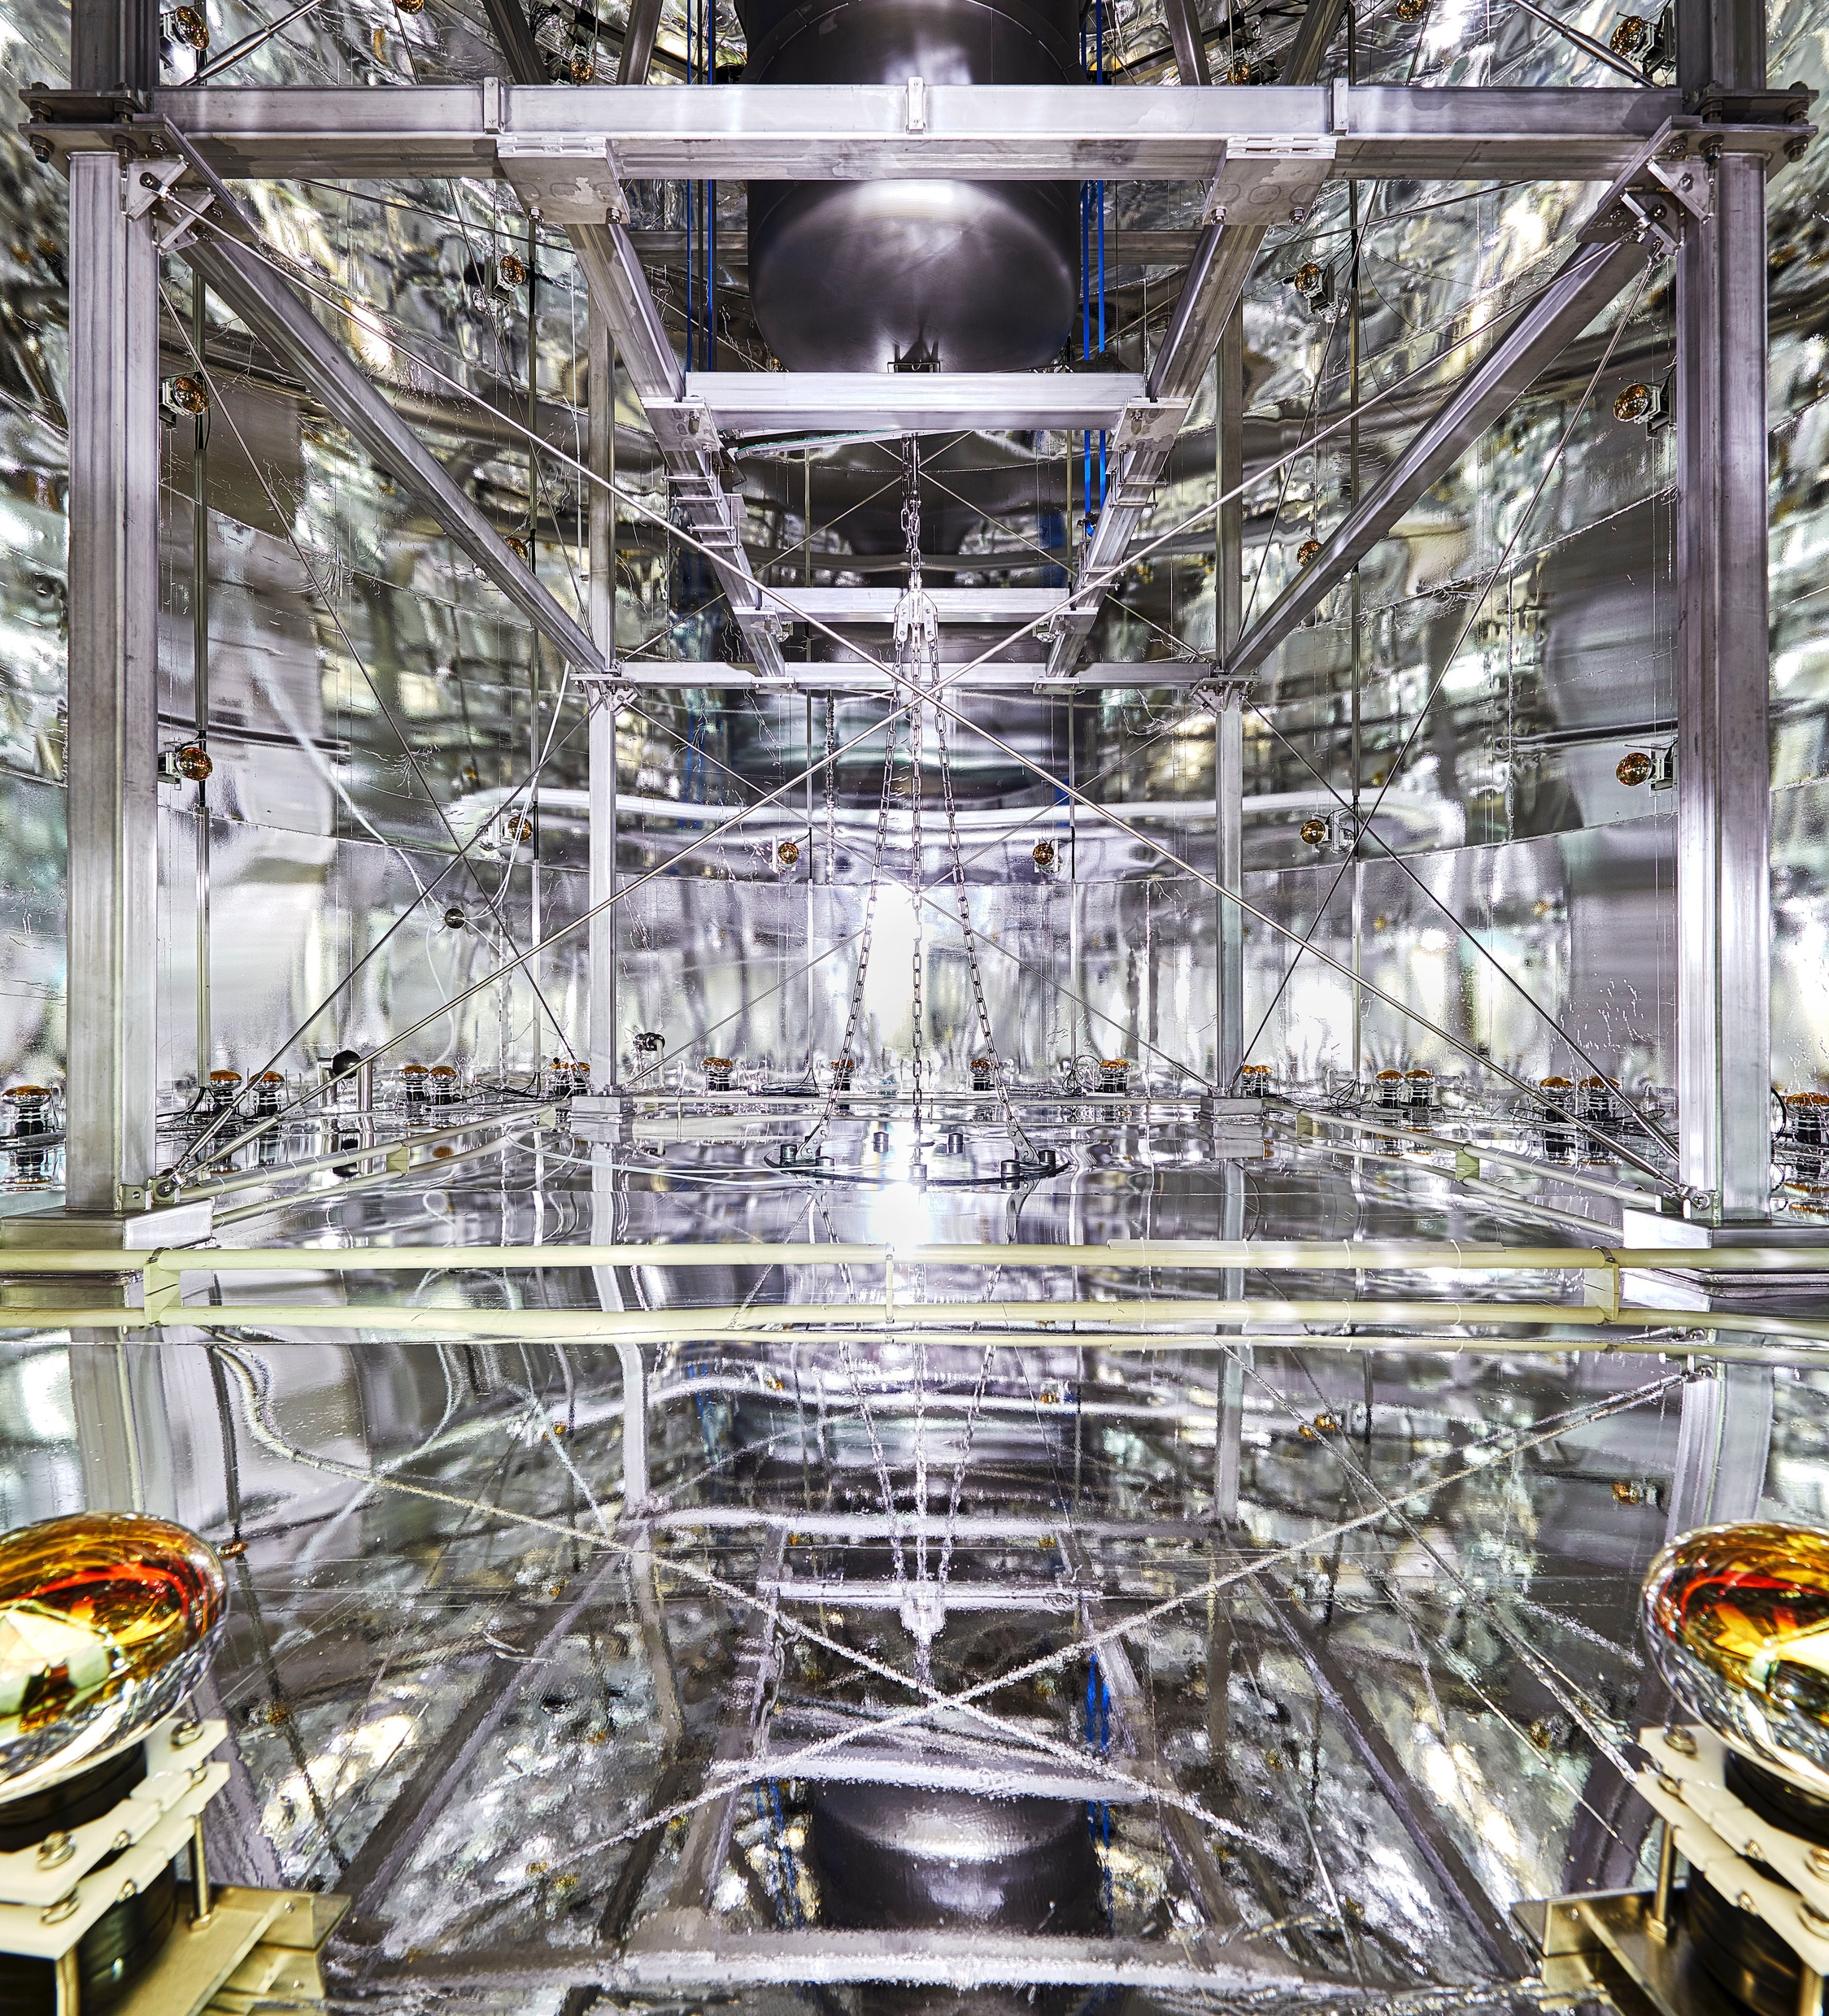
journey of science
A story to tell

Slide 32

Something amazing happens every day
Our story

