Slide 1
Dark Matter and Neutrinos
RECFA visit Nikhef 19 October 2018
Dorothea Samtleben
Nikhef and Leiden University

Slide 2
The HIDDEN Universe
- DARK MATTeR and neutrinos
Aiming beyond the Standard Model
Exploiting synergies between experiments

Slide 3






DUTCH INVOLVEMENT
Dark Matter
XENON /DARWIN
Nikhef
University of Amsterdam
Leiden University
Radboud University Nijmegen
Groningen University / KVI-CART
Utrecht University
TNO (National organisation for applied scientific research)
NIOZ (Royal Netherlands Institute for Sea Research)
Well connected in
both experimental
and theoretical
expertise
Neutrinos
ANTARES/KM3NeT
DUNE
New physics
SHIP
BSM modelling/fitting
GAMBIT

Slide 4
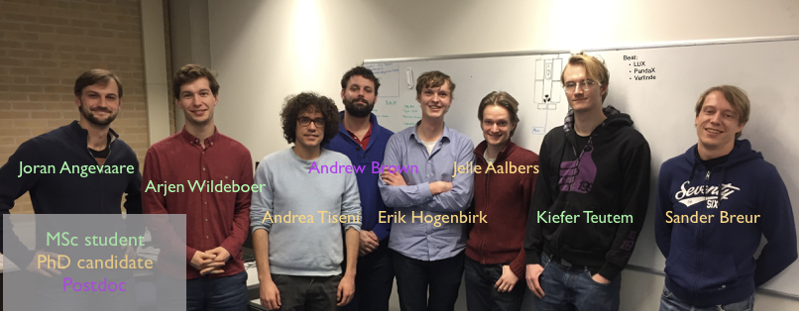

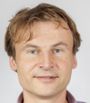
DARK matter Program: XENON, DARWIN, XAMS
Program Leader:
  M.P. Decowski
Group size (2017):
  2 staff + 1 postdoc + 3 PhD + 4 MSc
Funding (2013-now):
  - FOM/NWO program funding: 2 M€
  - Investment from Mission Budget: 900 k€
  Personal Grants:
  - e-Science Pathfinder C.Tunnell/M.P. Decowski (2015-2016)
  - UvA-IoP 1 PhD M.P. Decowski/A.P. Colijn (2018)
Partner University:
  University of Amsterdam
Auke-Pieter Colijn
Patrick Decowski
Notes:
The Dark Matter Program at Nikhef consists of 2 staff members.
It was funded through an NWO program, which ended at the start of 2018. An application for new program funding, together with the neutrino program is currently in review.
The sole partner university is the University of Amsterdam.

Slide 5
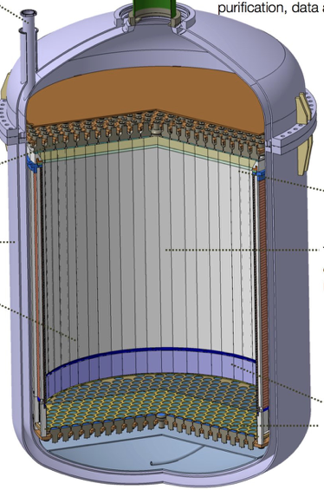
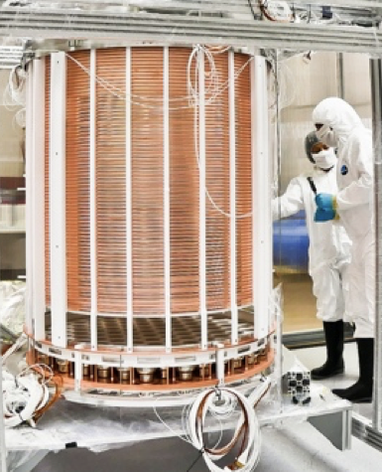
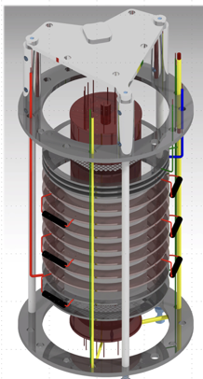

Nikhef Direct detection DM Activities
1 m
1.5 m
2.6 m
10 cm
XENON1T (2016-2019)
3200kg of liquid Xe
Cryostat Support and Alignment
DAQ / Trigger
Dataprocessor
Analysis
Computing (PDP/SurfSARA)
XENONnT (2019-)
8000kg of liquid Xe
Cryostat Support and Alignment
DAQ / Trigger
Part of 0ν2β electronics
Dataprocessor
Computing (PDP/SurfSARA)
DARWIN (2025-)
50 tons of liquid Xe
GridPix R&D (2010-2013)
SiPMs R&D
XAMS
0.5 kg of liquid Xe
R&D @
Everything ;-)
Nikhef responsibility
Notes:
The group is active in a number of projects, all of them use liquid xenon TPCs to search for WIMP dark matter or related physics channels.
Our present activities: main focus on, the currently running, XENON1T detector. XENON1T (3.2 t of LXe) is scheduled to stop in January 2019, to start construction and commissioning of XENONnT (8 tons of LXe), the next phase of the XENON program. XENONnT is scheduled to start operation in 2019. We are also contributing to the DARWIN program – which will be the ‘ultimate’ WIMP dark matter detector. Finally, we have a small–scale LXe detector, called XAMS, running in our Nikhef lab. This detector is mainly used for R&D, we also find that it is an attraction for MSc students.
[list the Nikhef responsibilities for the various projects – the bullets]
The group joined the XENON collaboration in 2010 and with it we participated in the operation and analysis of the predecessor to XENON1T, XENON100.

Slide 6
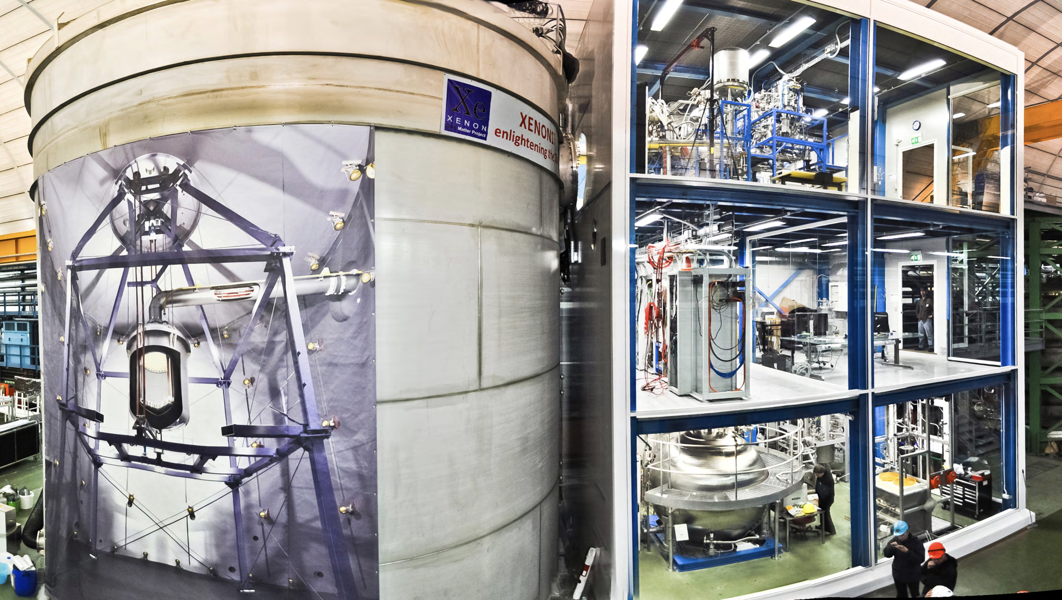
XENON1T @ LNGS
25 institutions from Europe, US, Middle-East
150 collaboration members
Notes:
XENON1T is located at the Gran Sasso underground laboratory of INFN.
The XENON collaboration is, with 150 members from 25 institutions, a relatively small collaboration where PhDs and postdocs make a (disproportionally) large contribution to all aspects of the experiment.
It’s currently the world’s most sensitive DM detector.

Slide 7
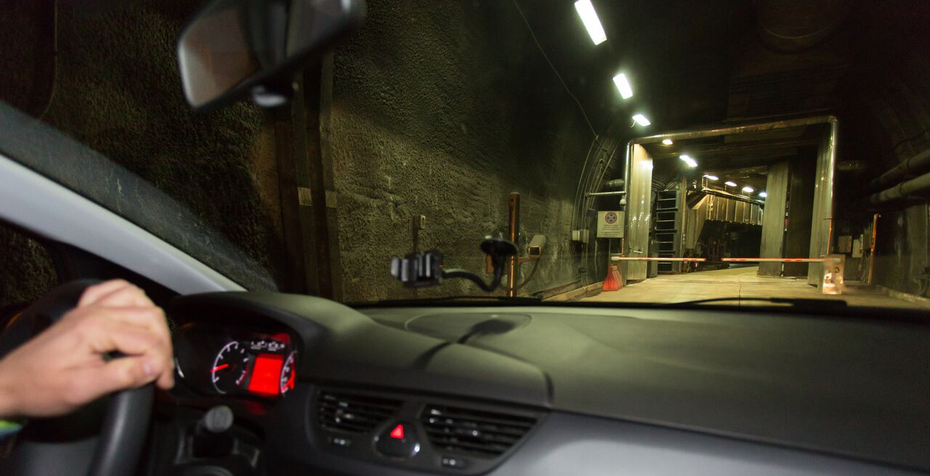

Slide 8
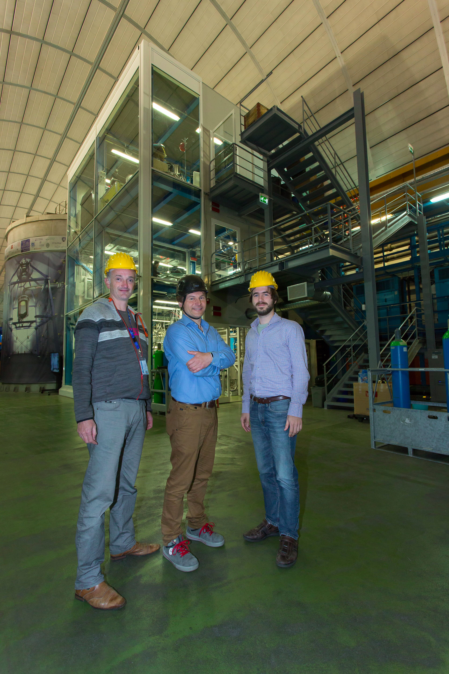
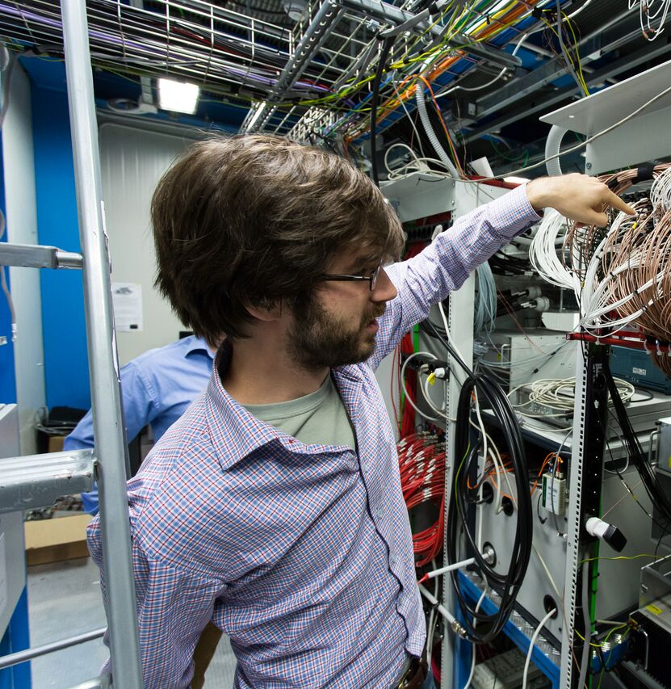
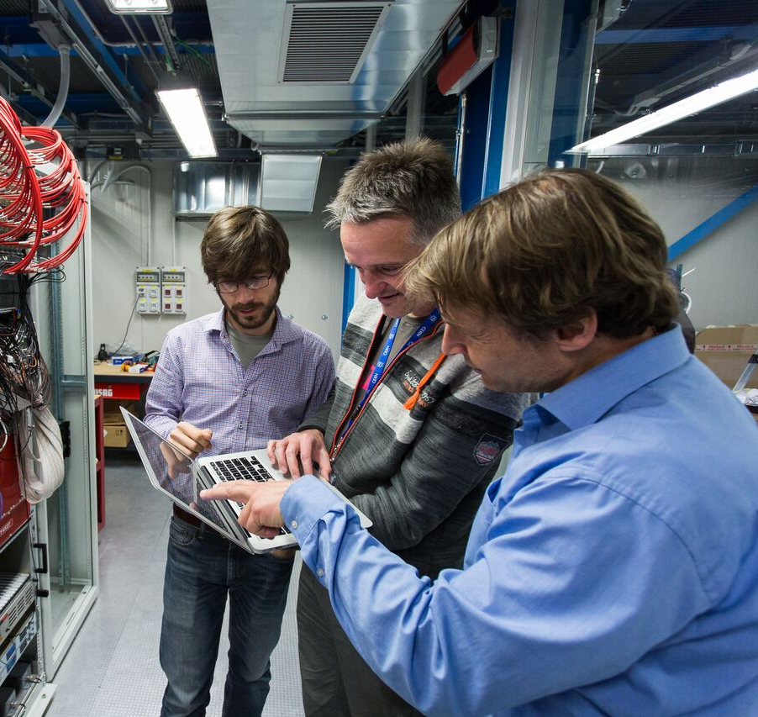

Slide 9
Leadership positions
XENON collaboration (150 people)
  M.P. Decowski
    Collaboration Board (2010 – present)
    Publication Board (2011 – present), chair (2016-2017)
    DAQ Work Group Leader (2010 - present)
  A.P. Colijn
    Technical Coordinator (2017 – present)
    Cryostat, Support & Alignment WG Leader (2017 – present)
  A. Brown [PD]
    Cuts & efficiencies sub-WG Leader (2016-2018)
  J. Aalbers [PhD]
    Cuts & efficiencies sub-WG Leader (2018-present)
  P.A. Breur [PhD]
    Backgrounds sub-WG Leader (2016-present)
DARWIN collaboration
  M.P. Decowski
    Collaboration Board (2009 – present)
    Publications & Outreach (2017 – present)
    Physics WG Leader (2009 - 2013)
Our group is also involved in other projects:
KamLAND(-Zen) [M.P. Decowski]: studying neutrino properties
Modulations [A.P. Colijn]:
investigating the decay law of radioactivity
Notes:
Our group has had a number of important leadership positions in the collaboration. Decowski was chair of the Publication Board during the first results coming from XENON1T and while various XENON100 results were still being wrapped up. Colijn is currently the Technical Coordinator for the XENONnT experiment. Nikhef postdocs and even PhD students have played important roles in analyses as sub-working-group leaders.
Both Decowski and Colijn are also involved in other side-projects: Decowski in the KamLAND(-Zen) experiment in Japan and Colijn is running an experiment, with one station running at Nikhef, to investigate the decay law of radioactivity, called Modulations.

Slide 10
Phd Theses (2013-now)
R. Schön (2015): “XAMS – development of liquid xenon detector technology for dark matter searches”
A. Tiseni (2017): “Low-mass dark matter search with the XENON100 Experiment”
J. Aalbers (2018): “Dark Matter Search with XENON1T”
P.A. Breur (2019): ”Backgrounds in XENON1T”
E. Hogenbirk (2019): “A spark in the dark - scintillation time dependence and neutron-induced signals in liquid xenon TPCs”

Slide 11
Publications 2013-present
XENON100:
Signal Yields of keV Electronic Recoils and Their Discrimination from Nuclear Recoils in Liquid Xenon, Phys. Rev. D 97, 092007 (2018), arXiv:1709.10149
Intrinsic backgrounds from Rn and Kr in the XENON100 experiment, Eur. Phys. J. C 78, 132 (2018), arXiv:1708.03617
Search for Bosonic Super-WIMP Interactions with the XENON100 Experiment, Phys. Rev. D 96, 122002, arXiv:1709.02222
Search for magnetic inelastic dark matter with XENON100, JCAP 10 (2017) 039, arXiv:1704.05804
Search for WIMP Inelastic Scattering Off Xenon Nuclei With XENON100, Phys. Rev. D 96, 022008 (2017), arXiv:1705.05830
Effective field theory search for high-energy nuclear recoils using the XENON100 dark matter detector, Phys.Rev. D 96 042004 (2017), arXiv:1705.02614
Online Rn-222 removal by cryogenic distillation in the XENON100 experiment, Eur. Phys. J. C 77, 358 (2017), 1702.06942
Results from a calibration of XENON100 using a source of dissolved radon-220, Phys. Rev. D 95, 072008 (2017), arXiv:1611.03585
Search for Electronic Recoil Event Rate Modulation with 4 Years of XENON100 Data, Phys. Rev. Lett. 118, 101101 (2017), arXiv:1701.00769
Search for Double Electron Capture of Xe-124 with XENON100, Phys. Rev. C 95, 024605 (2017), arXiv:1609.03354
XENON100 dark matter results from a combination of 477 live days, Phys. Rev. D 94, 122001 (2016), arXiv:1609.06154
Low-mass dark matter search using ionization signals in XENON100, Phys. Rev. D 94, 092001 (2016), arXiv:1605.06262
Search for Event Rate Modulation in XENON100 Electronic Recoil Data, Phys. Rev. Lett. 115, 091302 (2015), arXiv:1507.07748
Exclusion of Leptophilic Dark Matter Models using XENON100 Electronic Recoil Data, Science 2015 vol. 349 no. 6250 pp. 851, arxiv:1507.07747
First Axion Results from the XENON100 Experiment, Phys. Rev. D 90, 062009, arXiv:1404.1455
Observation and applications of single-electron charge signals in the XENON100 experiment, J. Phys. G: Nucl. Part. Phys. 41 (2014) 035201, arXiv:1311.1088
Analysis of the XENON100 Dark Matter Search Data, Astropart.Phys. 54 (2014) 11, arXiv:1207.3458
The neutron background of the XENON100 dark matter search experiment, J. Phys. G: Nucl. Part. Phys. 40, 115201 (2013), arXiv:1306.2303
Response of the XENON100 dark matter detector to nuclear recoils, Phys. Rev. D 88, 012006 (2013), arXiv:1304.1427
Limits on spin-dependent WIMP-nucleon cross sections from 225 live days of XENON100 data, Phys. Rev. Lett. 111, 021301 (2013), arXiv:1301.6620
94 citations
38 citations
71 citations
316 citations
XENON1T
Dark matter search results from a one ton-year exposure of XENON1T, Phys. Rev. Lett. 121, 111302, arXiv:1805.12562
The XENON1T Dark Matter Experiment, XENON Collaboration, Eur. Phys. J. C (2017) 77: 881, arXiv:1708.07051
Material radioassay and selection for the XENON1T dark matter experiment, Eur. Phys. J. C (2017) 77: 890, arXiv:1705.01828
First Dark Matter Search Results from the XENON1T Experiment, Phys. Rev. Lett. 119, 181301 (2017), arXiv:1705.06655
Removing krypton from xenon by cryogenic distillation to the ppq level, EPJC (2017) 77:275, arXiv:1612.04284
Physics reach of the XENON1T dark matter experiment, JCAP04(2016)02, arXiv:1512.07501
Lowering the radioactivity of the photomultiplier tubes for the XENON1T dark matter experiment, Eur. Phys. J. C75 (2015) 11, 546, arXiv:1503.07698
Conceptual design and simulation of a water Cherenkov muon veto for the XENON1T experiment, JINST 9, P11006 (2014), arXiv:1406.2374
109 citations
488 citations
348 citations
XAMS
Field dependence of electronic recoil signals in a dual-phase liquid xenon time projection chamber, Accept. JINST, arXiv:1807.07121
Precision measurements of the scintillation pulse shape for low-energy recoils in liquid xenon, JINST 13 (2018) no.05, P05016, arXiv:1803.07935
Commissioning of a dual-phase xenon TPC at Nikhef, NIM A840 (2016), arXiv:1602.01974
Cyan = large Nikhef contribution
Citation cnt from inspire, Oct 16, 2018
Notes:
Publication list: 20 XENON100 papers, 8 XENON1T papers and 3 peer-reviewed XAMS papers (apart from proceedings). The papers in cyan are ones with a significant Nikhef contribution.
Citation count is listed for a selected papers, others often have tens of counts.

Slide 12
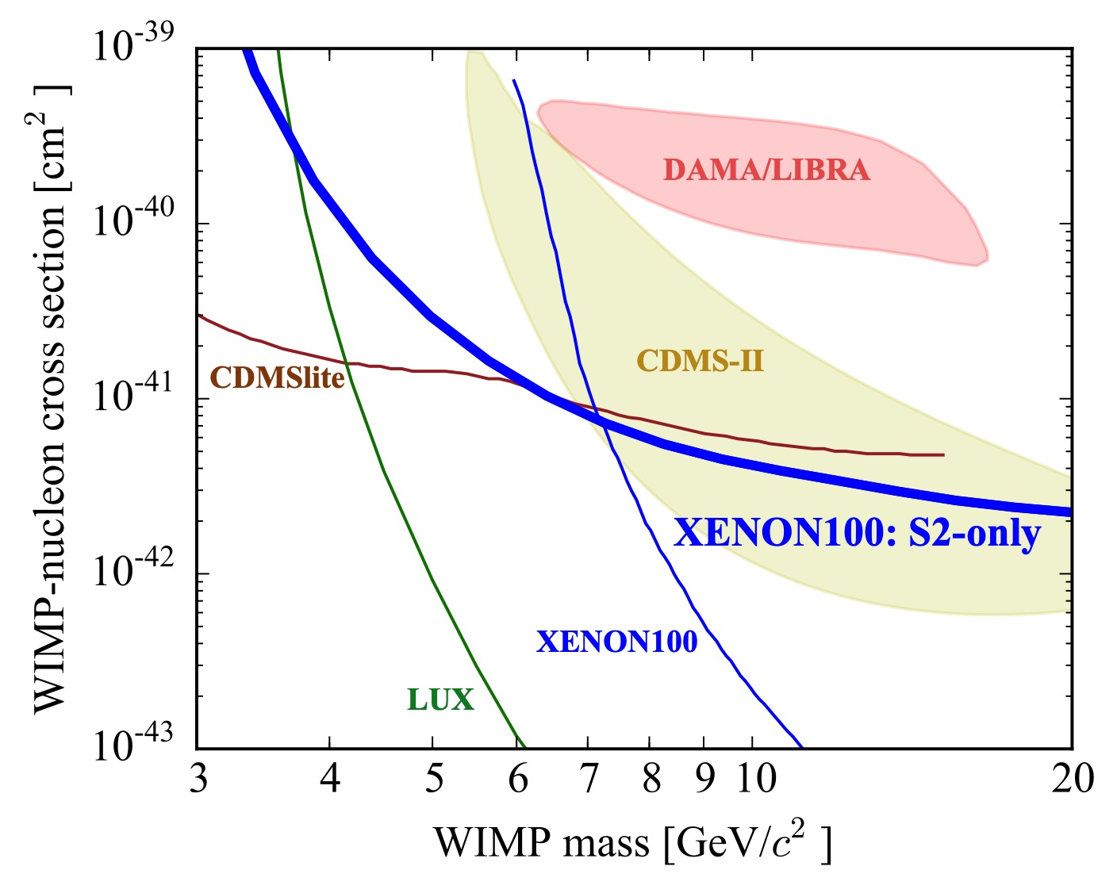
Analysis Highlights from the Nikhef GROUP
Low mass WIMP search
First Science run results
Pulse Shape Discrimination in LXe
JINST 13 (2018), no. 05, P05016
PRD 95, 059901 (2017)
Phys. Rev. Lett. 119, 181301 (2017)
XENON100 Analysis led by Nikhef PhD A. Tiseni and
Nikhef PD C. Tunnell
First Science Run results from XENON1T Analysis led by Nikhef PhD J. Aalbers and
ex-Nikhef PD C. Tunnell, with very significant inputs from Nikhef PhD S. Breur
Nikhef PhD E. Hogenbirk did a series of studies with XAMS to investigate Pulse Shape Discrimination in LXe, to improve upon ER/NR discrimination. He also performed E-field dependency studies that help in understanding the micro-physics of LXe TPCs. Both will aid future analysis of LXe data.
Notes:
Our group has led a number of analyses, including writing and corresponding authorship on the papers.
We performed a low-mass search using XENON100 data. This allowed further exclusion of one of the DM detection claims.
We were very heavily involved in the analysis of the first results from XENON1T, released in May 2017. While there were many contributions from the whole XENON analysis team, the Nikhef PhD student Jelle Aalbers and (by-then) ex-Nikhef postdoc Chris Tunnell led the analysis and authored the paper.
Finally, our local XAMS LXe setup is also producing a steady-stream of R&D-related papers.

Slide 13
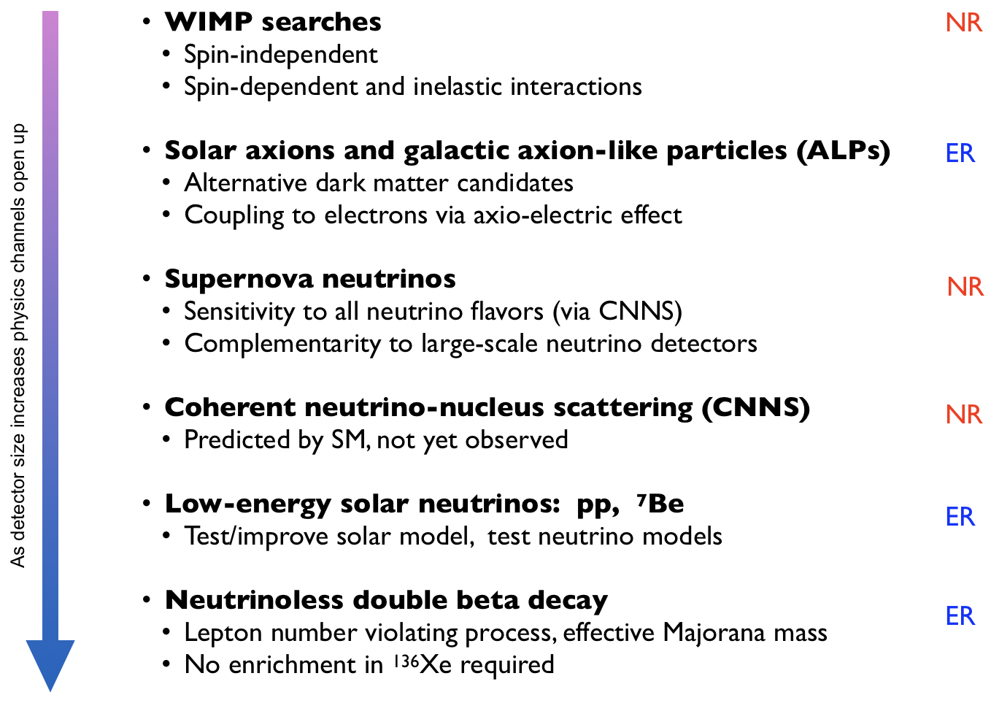
Our ambition
Large, ultra low-BG LXe will open new Physics Channels, beyond DM searches
Utilize XENONnT and DARWIN for
WIMP and WIMP-like searches
  XENONnT next step, DARWIN will be the
  “ultimate” WIMP DM detector
Axions, ALPs + sterile neutrinos
  Alternative DM models
Neutrinoless double beta decay
  DARWIN will have ~3.5 tons ¹³⁶Xe, potentially
  leading 0ν2β detector and sensitive to most of IH
Notes:
As LXe detectors are getting larger, and the background is pushed even lower, new physics channels open up and are accessible to be investigated in these detectors. The ambition of the group is to continue doing WIMP searches, but in addition to also investigate alternative DM models, such as axions, ALPs and sterile neutrinos (part of the NWO VP application).
We are also very interested in using larger detectors for neutrinoless double beta decay and our group did the initial neutrinoless double beta decay sensitivity studies for XENONnT.
DARWIN will be the ultimate WIMP detector, before hitting the ‘neutrino-floor’, but it will also be a world-leading neutrinoless double beta decay detector. The 40 tons of natural LXe in the active volume translates to about 3.5 tons of Xe-136, the double beta decay candidate isotope. Not all of this is useful, but together with the exquisite self-shielding properties of LXe and the (already achieved!) energy resolution, this will be a very important player in the neutrinoless double beta decay field.

Slide 14
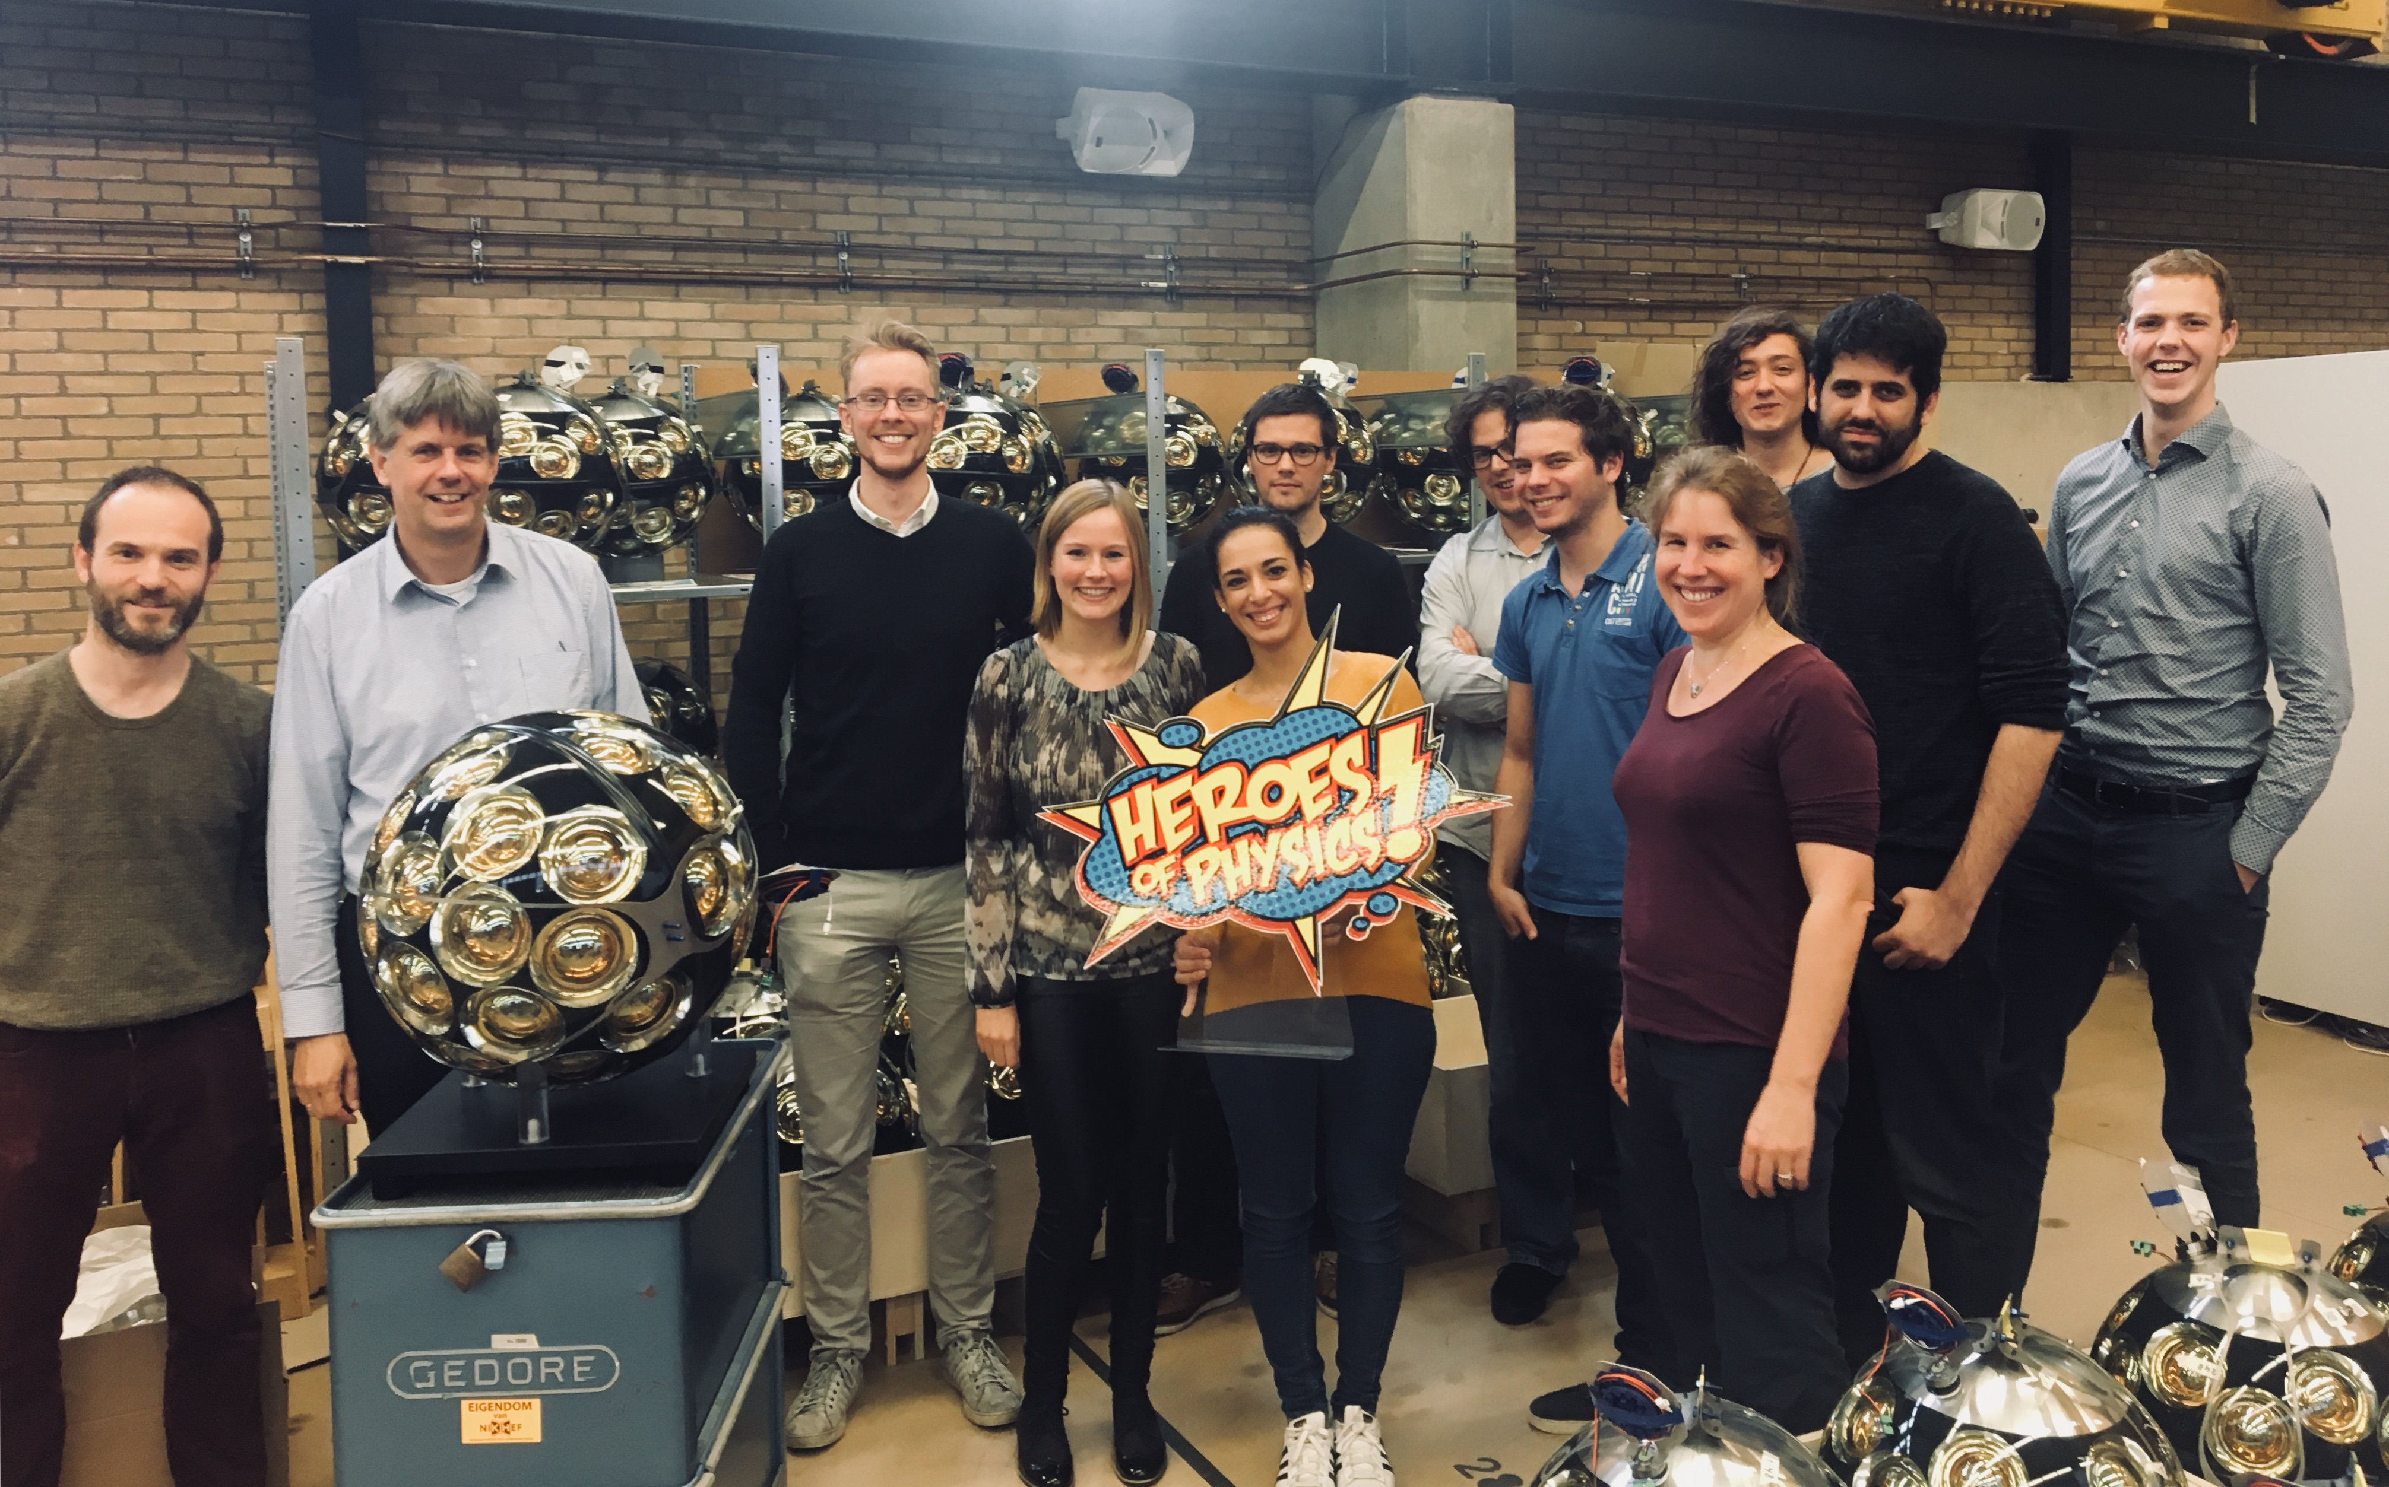
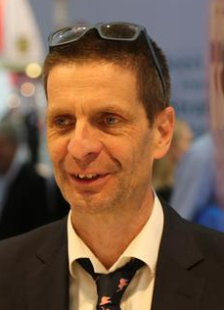
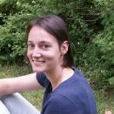
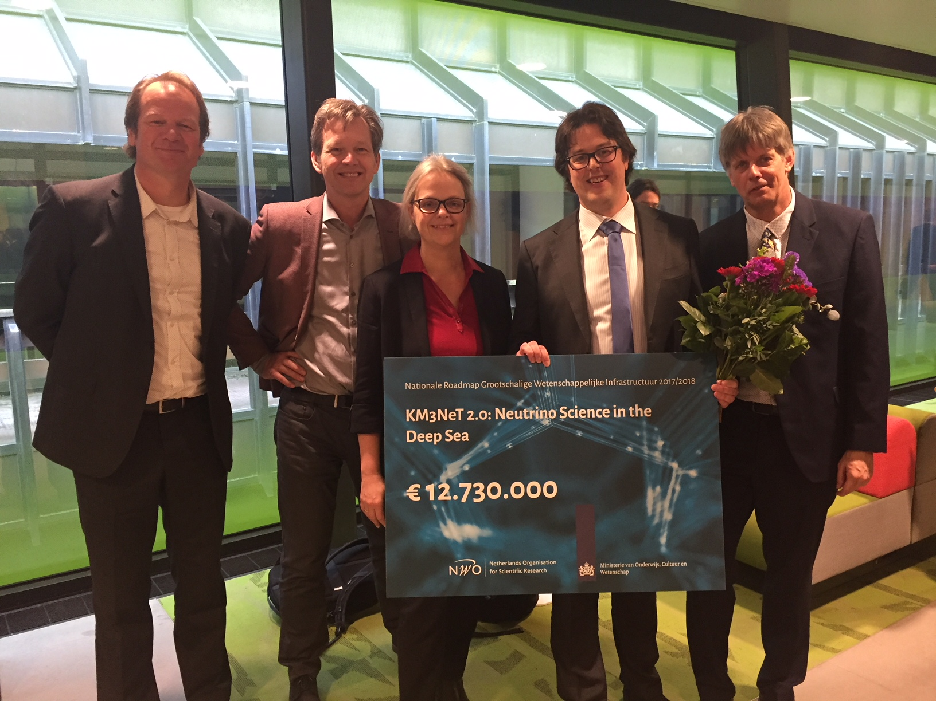
NEUTRINO Program: ANTAREs, KM3NeT, DUNE
51 institutes, 250 people
Program Leader:
  P. de Jong
Group size (2017):
  7 staff + 2 postdoc + 4 PhD + 2 MSc + engineering
Funding (2013-now):
  - FOM/NWO program funding: 3.6 M€ 2008-2017
  - H2020 2016 KM3NeT 2.0, PI M. de Jong
  - ASTERICS 2015 , 2yr engineering
  - ESCAPE 2018, 1 PD+1yr computing
  - Mission budget 2017/18, 2 PhD, 1 PD
  - National Roadmap phase 1
  4.0 M€ 2013-2018, from 8.8 M€ awarded in 2008
  - National Roadmap 2018 phase 2
  12.7 M€ starting 2019
  Personal Grants:
  - e-science pathfinder D. Samtleben/ R. Bruijn 2015
  - VICI A. Heijboer 2017
  - UvA IoP R. Bruijn 1 PhD 2018
  - VIDI A. Heijboer 2009-2014
  - NWO Physics/f grant for S. Basegmez du Pree 2018
Involved Universities
University of Amsterdam
Leiden University
Groningen University/KVI-CART
(Utrecht University)

Slide 15
Ernst-Jan Buis (TNO)
Stan Bentvelsen
Aart Heijboer
Els Koffeman
Paul de Jong

Slide 16
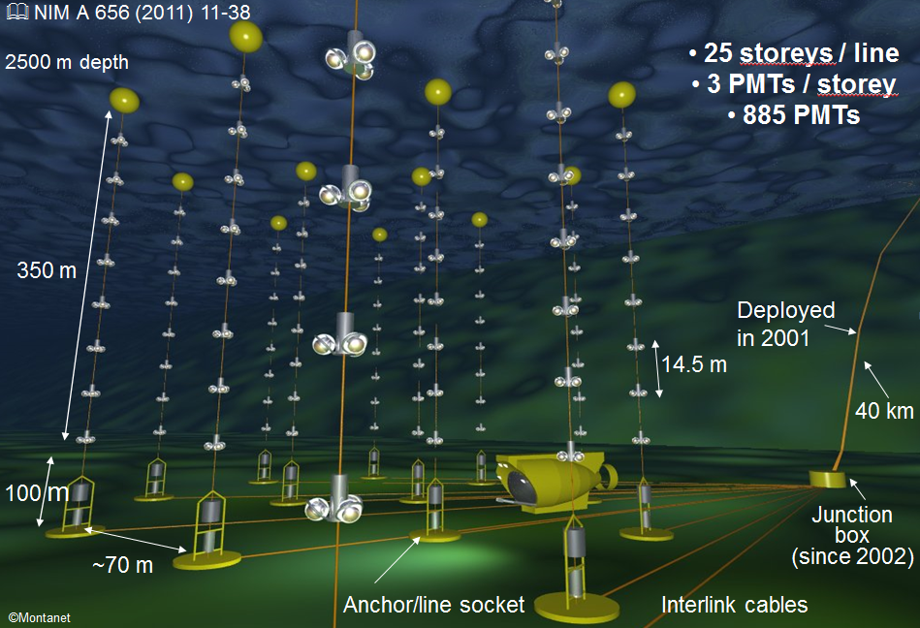
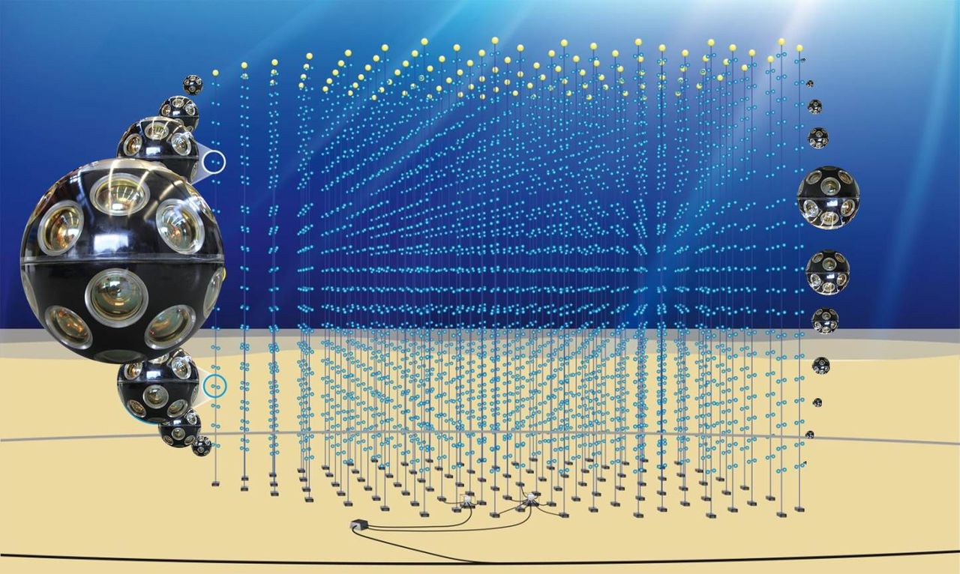
ANTARES
12 lines
ARCA
2 x115 strings
700m
2500m – 3500m below sea level
ORCA
115 strings
ANTARES (French Site)
Running since 2007
KM3NeT/ARCA (Italian Site) and ORCA (French Site)
First strings deployed 2015-2017
KM3NeT/ORCA ANTARES KM3NeT/ARCA
Low Energy Medium Energy High Energy
3GeV<E<50 GeV 10 GeV<E<1TeV E>1TeV
E
Earth and sea sciences

Slide 17
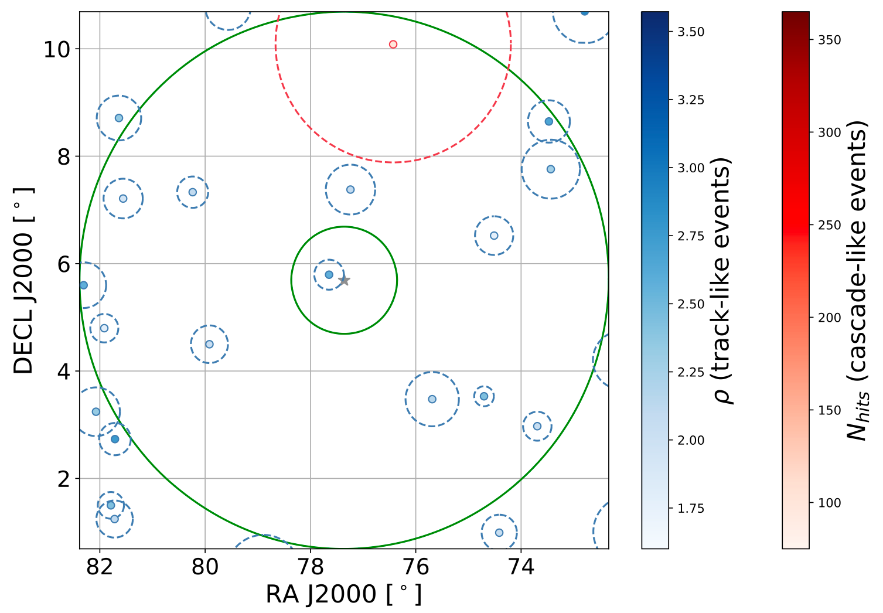
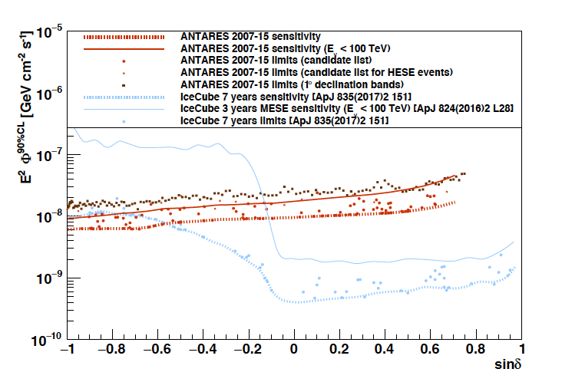
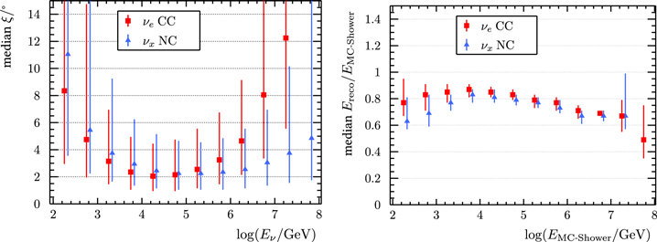
ANALYSIS HIGHLIGHTS WITH STRONG NIKHEF INVOLVEMENT
New cascade reconstruction with 2degree angular resolution
ANTARES all-flavour Point Source Analyses, also combination with IceCube
(PhD thesis T. Michael, A. Heijboer, D. Samtleben)
ANTARES search for neutrinos from blazar TXS0506 - first cosmic high energy neutrino source identified by IceCube in coincidence with electromagnetic observations
(D. Samtleben workgroup coordination)
ANTARES sky around position of TXS
Angular resolution for
cascade events Point Source Limits
Blue: Track candidates
Red: Cascade candidates
Circles provide error regions
Green circes: 1 and 5 degrees

Slide 18
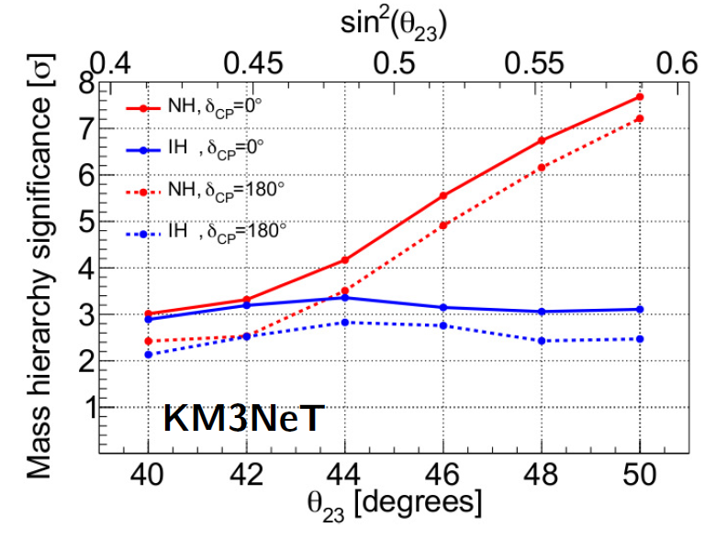
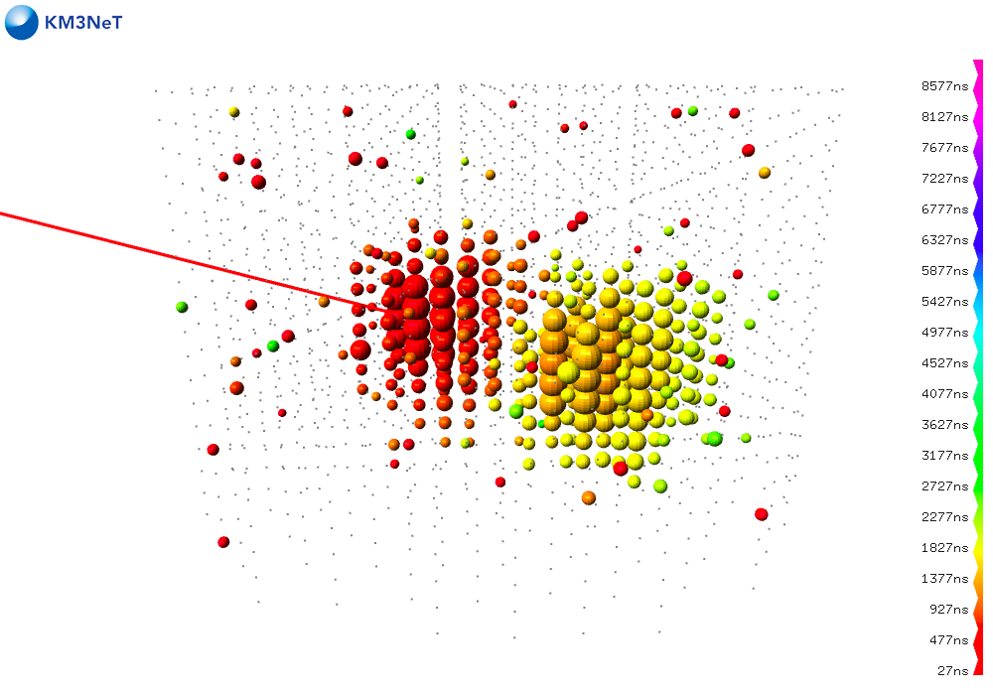
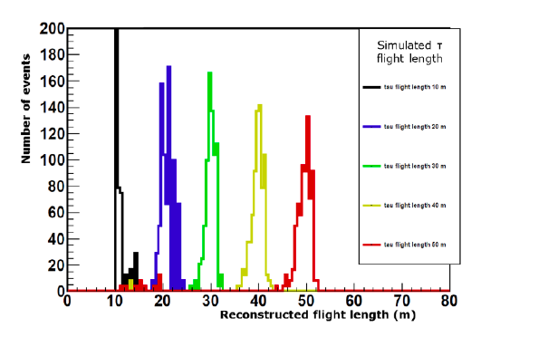
ANALYSIS HIGHLIGHTS WITH STRONG NIKHEF INVOLVEMENT
KM3NeT/ARCA High resolution shower reconstruction, first reconstruction of tau signature (‘double bang’)
-> improved flavour sensitivity for the identification
of cosmic neutrinos
-> can help identifying flavour anomalies (new physics)
(R. Bormuth PhD thesis, A. Heijboer, D. Samtleben)
KM3NeT/ORCA Estimates for the sensitivity to the neutrino mass ordering published in KM3NeT Letter of Intent (M. Jongen, PhD thesis)
Reconstructed tau flight length
3 year projection

Slide 19
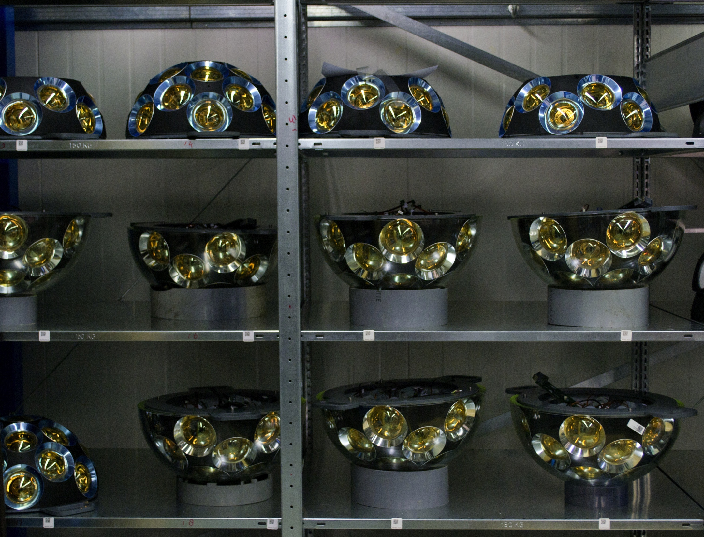
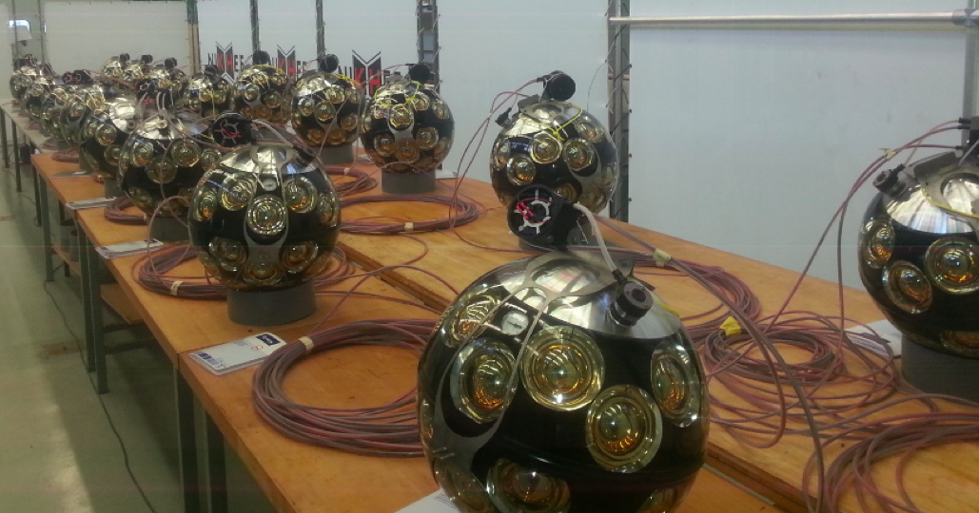
DOM mass production and string assembly at Nikhef
-> lab tour R. Bruijn

Slide 20
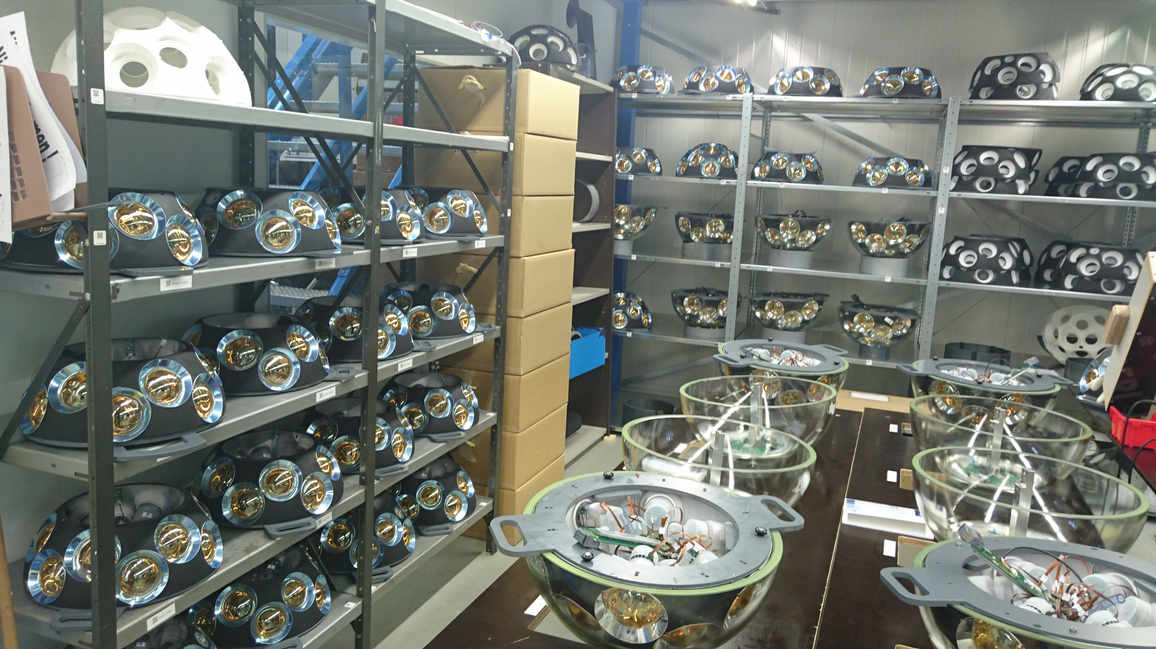
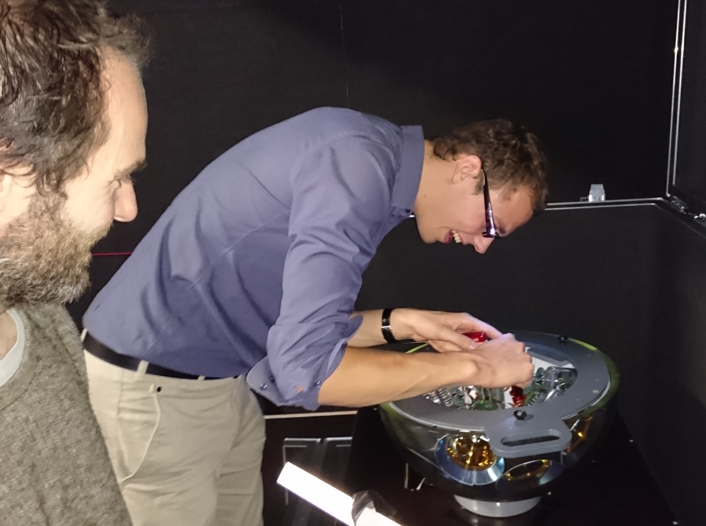
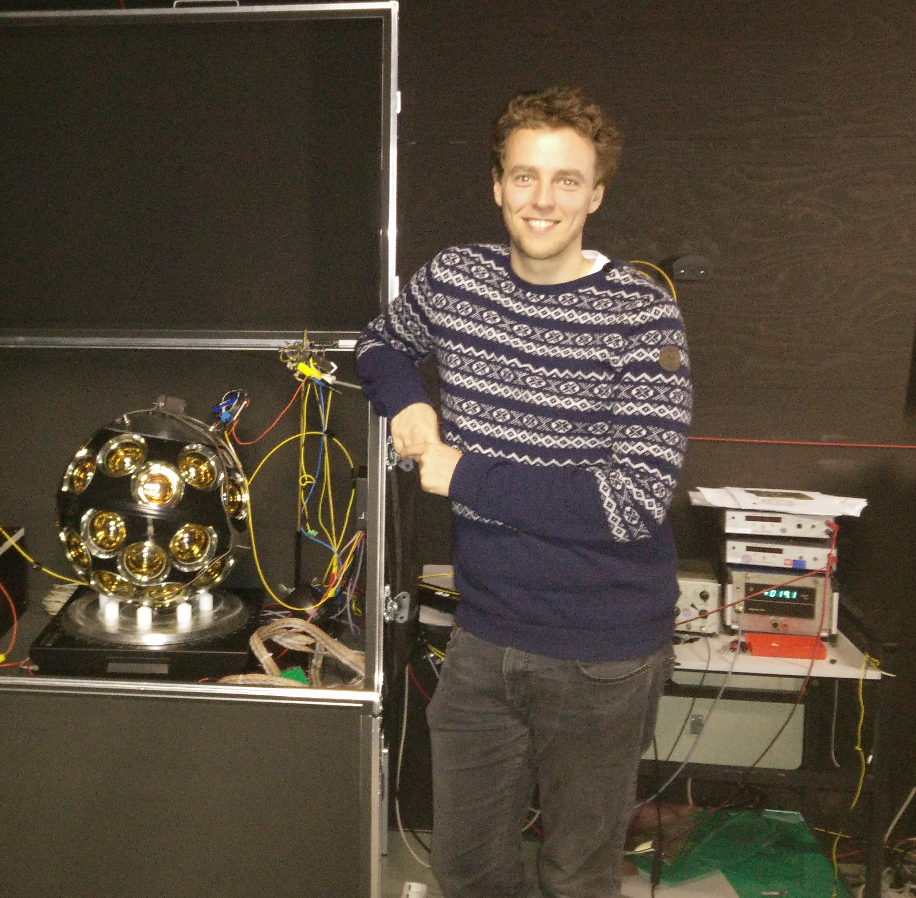
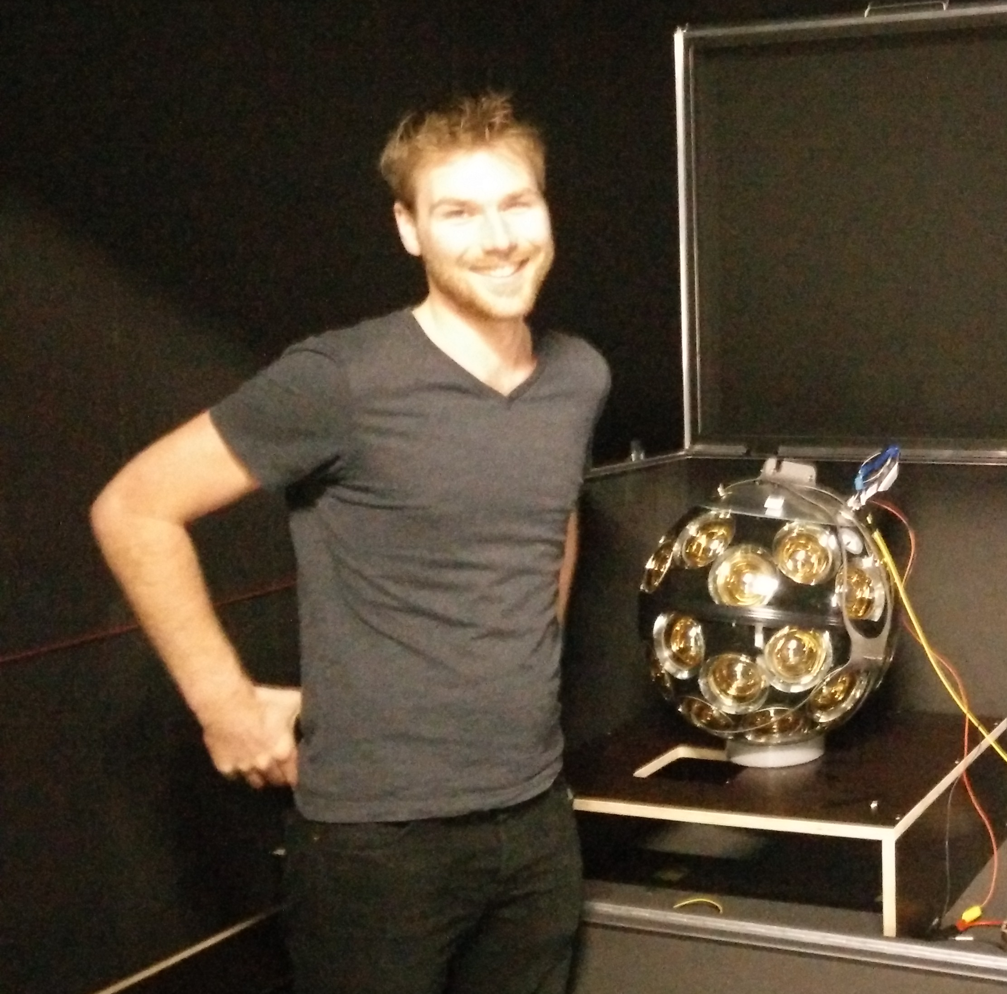

Slide 21
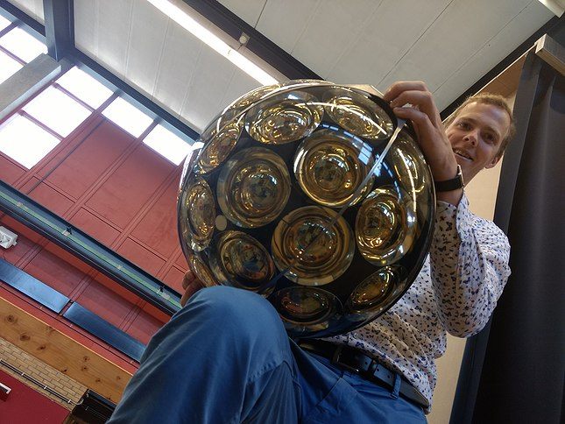

Slide 22
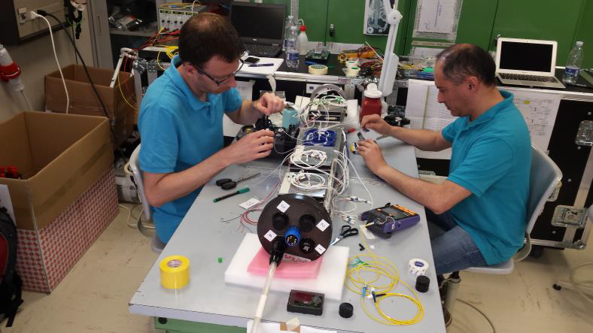
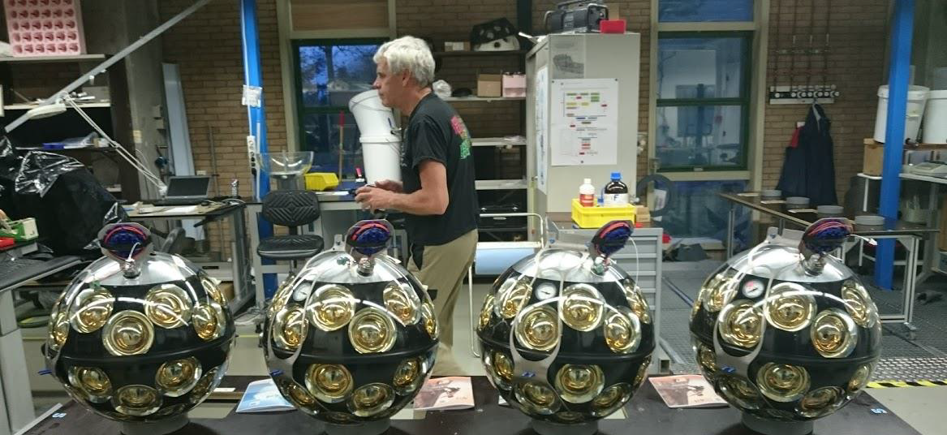

Slide 23
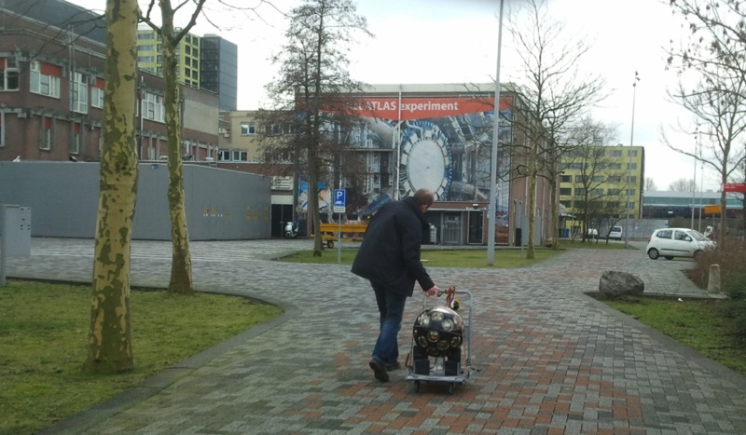
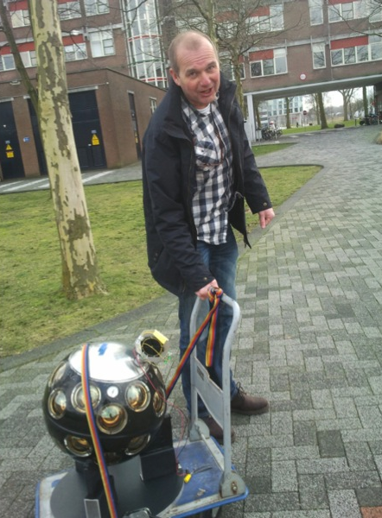
Once upon a time …
…. first steps of the first DOMs (2014)

Slide 24
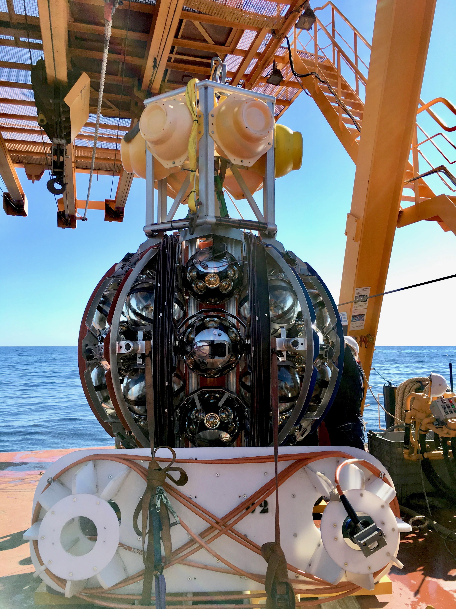
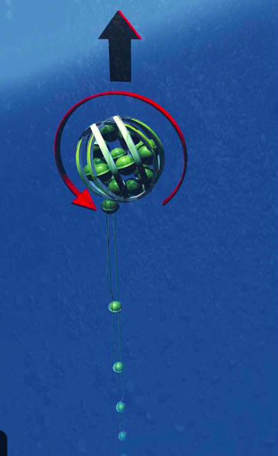
Deployment of first ORCA string September 2017
NIKHEF INVOLVEMENT
Nikhef deeply involved from design to production
Major DOM and string production site
DAQ & Event reconstruction for both ANTARES and KM3NeT by Nikhef (M. de Jong, R. Bruijn, A. Heijboer
Multi-PMT DOM and string Dutch design
Deployment tool (LOM) developed by NIOZ (sea sciences) and Nikhef

Slide 25
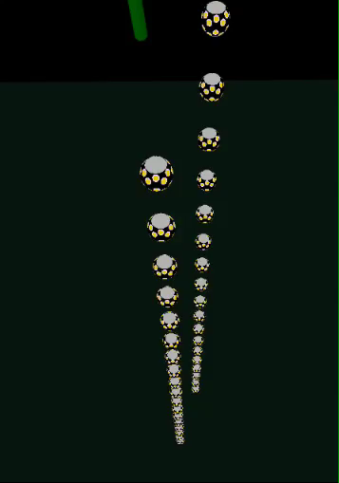
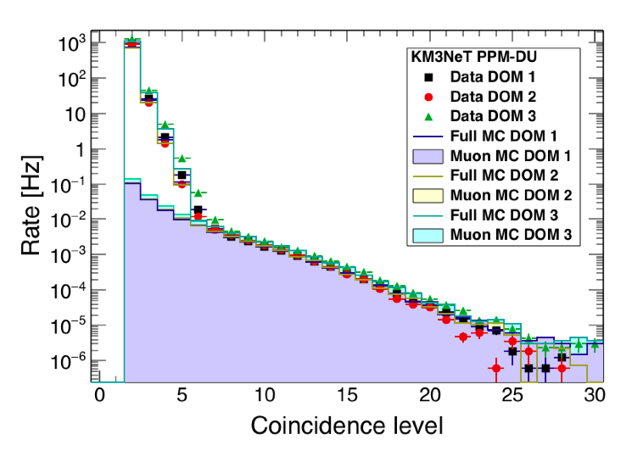
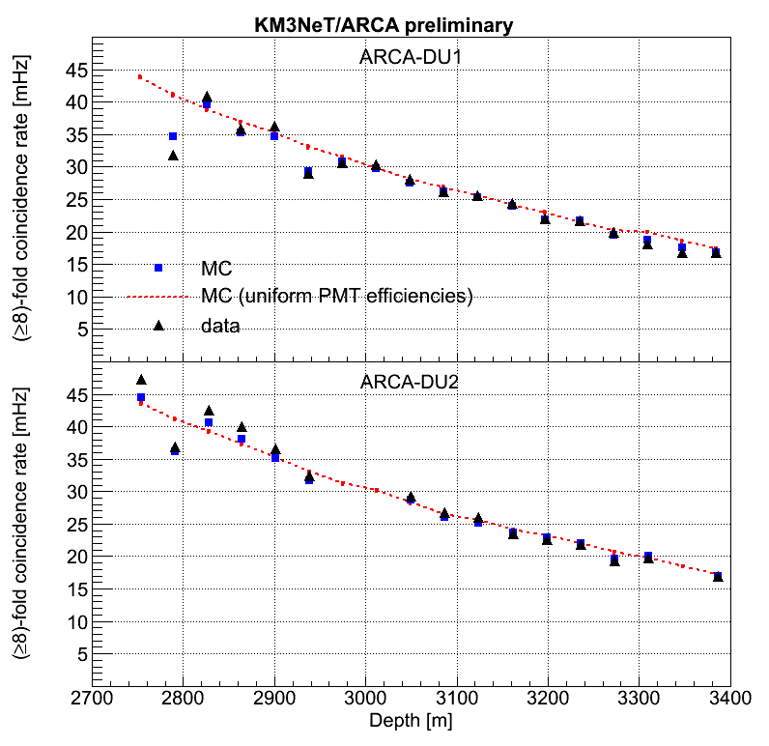
Multi-PMT coincidence rate on a DOM
FIRST DATA
KM3NeT/ARCA first data
muon track (slow motion)
3D event display (also VR)
by A. Heijboer
-> cherenkov.nl
First data analyses of prototype detectors in the water:
(single DOM, mini-string with
3 DOMs, first strings)
PhD students T. Michael, R.Bormuth, M. Jongen, K. Melis
Depth-dependence of muon rate
Status ORCA:
October 2018 Cable replacement
5 strings to be deployed this year
Status ARCA:
Reworking Seafloor network
New deployments fall 2019

Slide 26
Leadership positions
KM3NeT / ANTARES collaborations
  M. de Jong
    Spokesperson KM3NeT ((2012-2016)
  A. Heijboer
    Deputy Spokesperson KM3NeT (2016-present)
    Conference Committee ANTARES (2012-2016)
  E. Koffeman
    Technical Coordinator KM3NeT (2016-present)
  D. Samtleben
    Point-Source Working Group Leader ANTARES (2012-present)
    Publication Committee ANTARES (2012-2016)
    Conference Committee ANTARES & KM3NeT (2016-present)
  R. Bruijn
  Nikhef/KM3NeT DOM and DU production coordination
  P. Kooijman
  Publication Committee KM3NeT (2016-present)
  E. de Wolf
  Publication Committee ANTARES&KM3NeT
  (2016-present)
  Conference Committee KM3NeT (2012-2016)
  E. Berbee (mechanics)
  Steering Committee KM3NeT (2012-present)
  G. Kieft / A. d’Amico (optics)
  Steering Committee KM3NeT (2012-present)

Slide 27
Phd Theses (2013-now)
T. Astraatmadja (2013):“Starlight beneath the waves: in search of TeV photon
emission from Gamma Ray Bursts with the ANTARES neutrino telescope”
C. Bogazzi (2014): “Search for cosmic neutrinos with ANTARES”
E. Visser (2015): “Neutrinos from the Milky Way”
T. Michael (2016): “Light at the end of the shower: an all-flavour neutrino
point-source search with the ANTARES neutrino telescope”
R. Bormuth (2017): “Chasing cosmic tau neutrinos in the abyss“
M. Jongen (2018): “Neutrino Physics in the Mediterranean Sea: Determining
the Neutrino Mass Hierarchy with KM3NeT/ORCA”

Slide 28
KEY (NIKHEF-related) Publications since 2013
Searches for Point-like and Extended Neutrino Sources Close to the Galactic Center Using the ANTARES Neutrino Telescope [ANTARES collaboration] The Astrophys. J. Letters 786L5 (2014)
The First Combined Search for Neutrino Point-sources in the Southern Hemisphere With the Antares and Icecube Neutrino Telescopes, [ANTARES and IceCube collaborations] Astrophys.J. 823 no 1, 65 (2016)
First all-flavor neutrino pointlike source search with the ANTARES neutrino telescope [ANTARES collaboration],
Phys. Rev. D96, 082001 (2017)
Search for neutrinos from TXS 0506+056 with the ANTARES telescope, [ANTARES collaboration]
The Astrophys. J. Letters 863, 2 (2018)
Deep Sea tests of a prototype of the KM3NeT digital optical module [KM3NeT collaboration] Eur.Phys.J. C74 (2014)
Letter of Intent for KM3NeT 2.0 [KM3NeT collaboration]
Journal of Physics G: Nuclear and Particle Physics, 43 (8), 084001 (2016)
The prototype detection unit of the KM3NeT detector [KM3NeT collaboration] Eur.Phys.J. C76 no 2, 54 (2016)
In total since 2013 ANTARES 45 publications
KM3NeT 8 publications
Notes:
Publication list: 20 XENON100 papers, 8 XENON1T papers and 3 peer-reviewed XAMS papers (apart from proceedings). The papers in cyan are ones with a significant Nikhef contribution.
Citation count is listed for a selected papers, others often have tens of counts.

Slide 29
Nikhef is member of DUNE: long-baseline neutrino oscillations Fermilab → Sanford Lab (SD)
Goals: full single-experiment determination of main oscillation parameters (also CP phase)
Group: F. Filthaut, P. Decowski, P. de Jong, M. Vermeulen (PhD student)
CP Violation Sensitivity
2018: protoDUNEs at CERN
2019: TDRs
2019: start excavation main caverns
2022: start installing first far detector
2026: beam on
Nikhef contributes to DAQ and computing
DAQ design based on FELIX system (ATLAS, LHC)
Single-phase protoDUNE: 1 APA read with FELIX

Slide 30
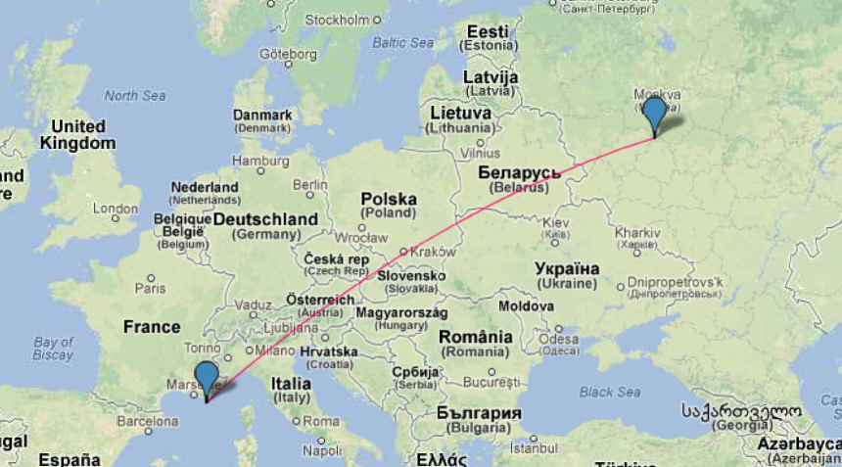
Beam for ORCA: Protvino To ORCA (P2O)
First negotiations starting
Letter of Intent is in the works
IHEP/Protvino, founded 1967
100km South of Moscow
Baseline 2588km
Beam inclination : 11.7˚ (cosθ = 0.2)
Both Neutrino Mass Hierarchy and CP violation accessible
No degeneracies, small cross section systematics
After 6 years non CP-violation excluded for 35% of δ_{CP} values at about 3σ
High precision measurement of δ_{CP} within few years (with 450kW)

Slide 31
Our ambition
High-precision measurement of neutrino oscillations
=> First determination of Neutrino mass ordering
=> Measurement of CP violation
Identification of Cosmic High Energy neutrino sources
=> Full multimessenger picture (neutrinos, photons, cosmic rays, GW)
=> Origin of Cosmic Rays
Physics beyond the Standard Model
- Neutrinos from Dark Matter annihilation/decay
- Sterile neutrinos
- Non-standard interactions
- …….

Slide 32
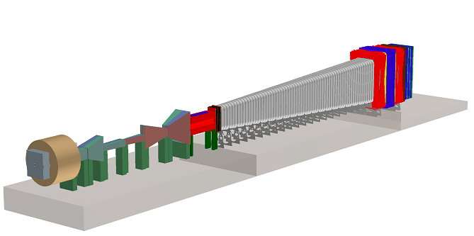
Search for Hidden Particles (SHIP)
Proposed Fixed-target experiment at CERN to search for very weakly interacting long-lived particles including Heavy Neutral Leptons
A. Boyarsky (Leiden University)
ERC Advanced Grant with
Shaposhnikov(TU Lausanne) & O. Ruchayskiy (NBI Copenhagen)
Evaluating potential signatures of new physics
Global And Modular BSM Inference Tool (GAMBIT)
Framework for optimal probing of different models on experimental data also in combination of different experiments.
C. Weniger (University of Amsterdam)
co-author of GAMBIT together with S. Caron (Radboud University Nijmegen), W. Beenakker (Radboud University Nijmegen & University of Amsterdam) application in global fits
Focus on synergies
between different experiments
Included in current NWO program
application ‘The hidden Universe’ (2.2M€)

Slide 33

The HIDDEN Universe
- DARK MATTeR and neutrinos
Aiming beyond the Standard Model
Exploiting synergies between experiments
Expect the unexpected!

