Slide 1
GRAVITATIONAL WAVES
Virgo – Einstein Telescope – LISA
Frank Linde

Slide 2
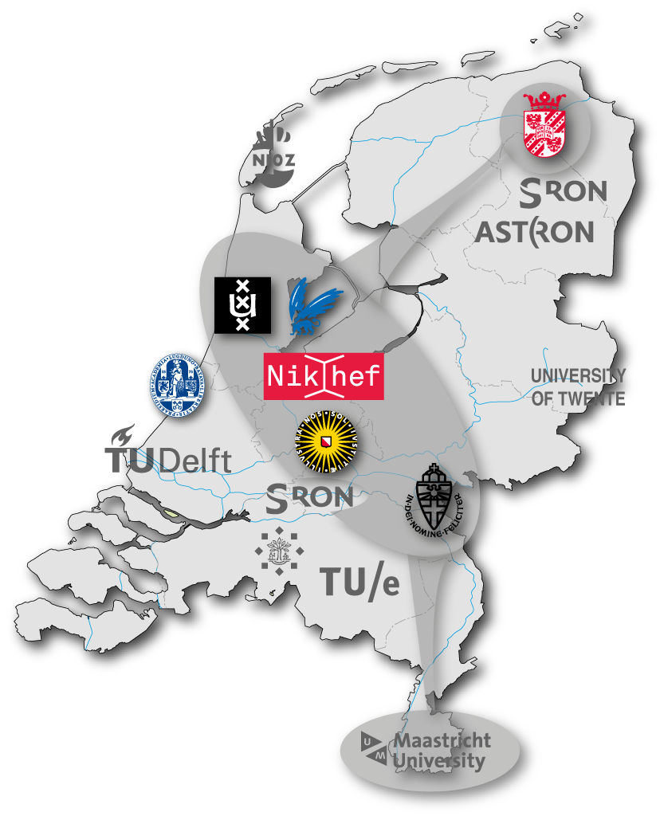
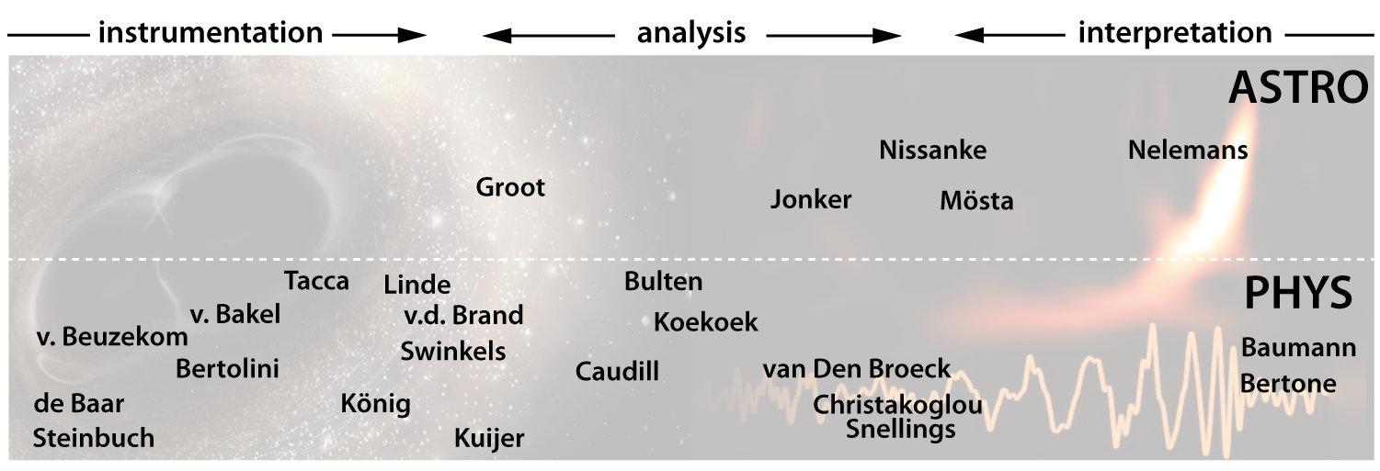
Dutch landscape & Group size
2018
Staff
10%
growing fast thru migration, new hirings & entirely new groups
(e.g. Maastricht University)
M. Bader, V. van Beveren, B. Boom, Y. Guo, J. van Heijningen,
P.-T. Ho, S. Koley, J. Meidam, G. Raaijmakers, L. v/d Schaaf, R. Walet
PhD
30%
T. Dietrich, A. Gosh, T. Hinderer, D. Nichols, D. Pascucci, A. Samajdar, P. Schmidt, A. Williamson
Postdoc
∼ 40 people
50%
Plus: invaluable technical, engineering, computing, communication, organizational & political support

Slide 3
Funding & Funding perspective
Note: staff scientists, technical support, running budget (memberships, consumables, etc.) funded from baseline Nikhef & university budgets
Secured funding
2015-2019 NWO-physics 1,600 k€
2015-2020 FOM-projectruimte 400 k€
2017 NWA-startimpuls (Alessandro B.) 362 k€
2017 NWA-startimpuls (Niels van B.) 348 k€
2018-2019 Limburg Province, borehole 800 k€
2018-2023 NWO-Vici (Chris v/d B.) 1,500 k€
2018-2023 NWO-groot 3,520 k€
2018-2023 Limburg Province, UM support 500 k€
PhD, Postdoc & TT
PhD, Postdoc & TT
capital investment
capital
investment
Submitted & anticipated funding requests
2019-2023 Interreg Vlaanderen-Nederland 14,500 k€
2019-2024 NWO-physics 2,765 k€
2019 • • • NWO-Vidi (3×) 2,400 k€
2019 • • • ERC-starting grant (1×) 800 k€
2019 • • • NWA-ORC 5,200 k€
2019 • • • OP-Zuid (anticipated) 3,000 k€
2020 • • • Interreg EMR (anticipated) 12,000 k€

Slide 4
Selected leadership positions
Virgo Computing &
Data Processing coordinator Sarah Caudill 2018 →
Spokesperson Jo van den Brand 2017 →
Suspended bench coordinator Alessandro Bertolini 2013 →
Data analysis coordinator Chris van den Broeck 2014-2016
Commission coordinator Bas Swinkels 2013-2017
+ various tasks/responsibilities in miscellaneous committees, paper reviews, etc.
1st Virgo observations!
1st BBH merger!
EGO Council observer Stan Bentvelsen 2015 →
Virgo STAC Frank Linde 2016-2017
Einstein Telescope – Europe
Steering committee Jo van den Brand & Frank Linde 2018 →
Gravitational Waves International Committee (GWIC) – World
Co-chair 3G multi-messenger Samaya Nissanke 2018 →
Co-chair 3G fundamental physics Chris van den Broeck 2018 →
3G generation governance team Frank Linde 2018 →
Overall organization Jo van den Brand 2018 →

Slide 5
Output: Publications, PhDs, Prizes, Spin-offs
Publications
High impact: 1st binary black hole merger observed on 14 September 2015 – Nobel Prize
1st binary neutron star merger observed 17 August 2017 – ‘multimessenger’
 | 2012 | 2013 | 2014 | 2015 | 2016 | 2017
# papers | 33 | 11 | 24 | 14 | 26 | 37
PhD theses 2012 -
2013 M. Beker & T. Li
2014 -
2015 M. Blom
2016 G. D'Ambrosi
2017 -
2018 J. van Heijningen & J. Meidam
Prizes 2015 FOM Valorisation Prize Jo v/d Brand “from fluctuations in space-time to industrial sensors”
2016 The Kavli Prize astrophysics LIGO & Virgo “for the direct detection of gravitational waves.”
2017 Physicaprijs Jo v/d Brand
Spin-off Innoseis, autonomous seismic sensors

Slide 6
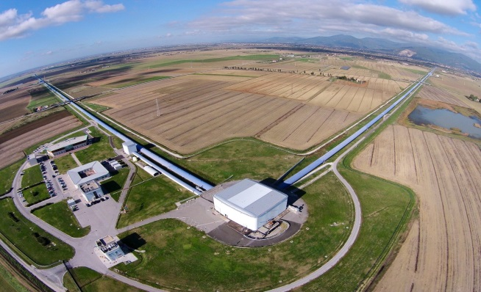
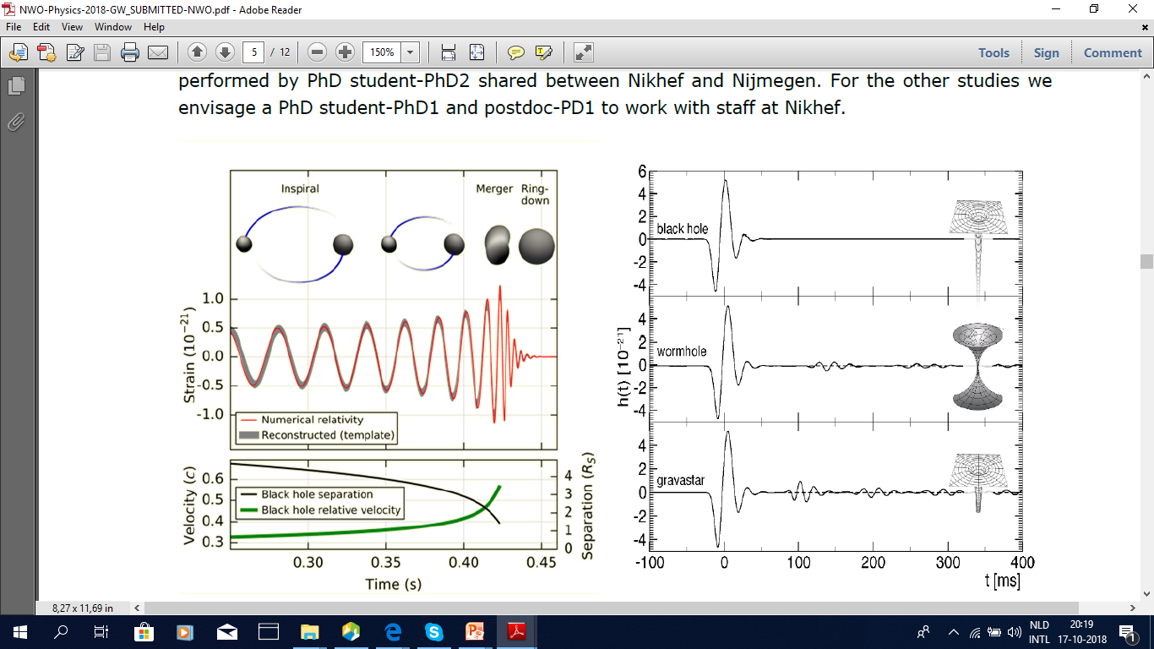
Virgo: harvesting science & making it better
Virgo
fundamental physics: black holes

Slide 7
Virgo: harvesting science & making it better
Virgo
graviton mass: < 7,7×10⁻²³ eV
[photon mass: < 1,0×10⁻¹⁸ eV]

Slide 8
Virgo: harvesting science & making it better
Virgo
sky
localisation

Slide 9
Virgo: harvesting science & making it better
Virgo
Hubble
parameter

Slide 10
Virgo: harvesting science & making it better
Virgo
neutron star
equation-of-state

Slide 11
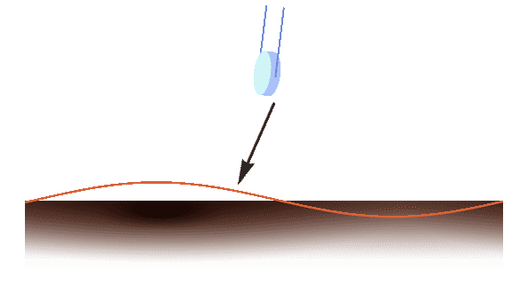
Virgo: harvesting science & making it better
Virgo
Newtonian
Noise (NN)
impossible
to attenuate
background
noise

Slide 12
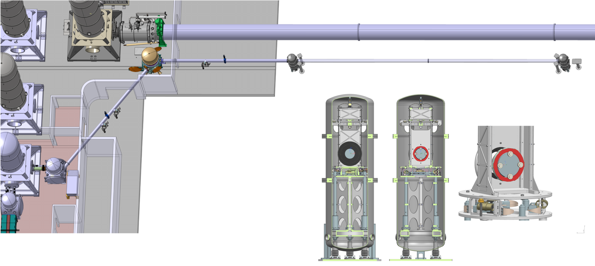
Virgo: harvesting science & making it better
Virgo
Frequency Dependant Squeezer (FDS)
out-smarting
quantum
noise
(ask expert!)

Slide 13
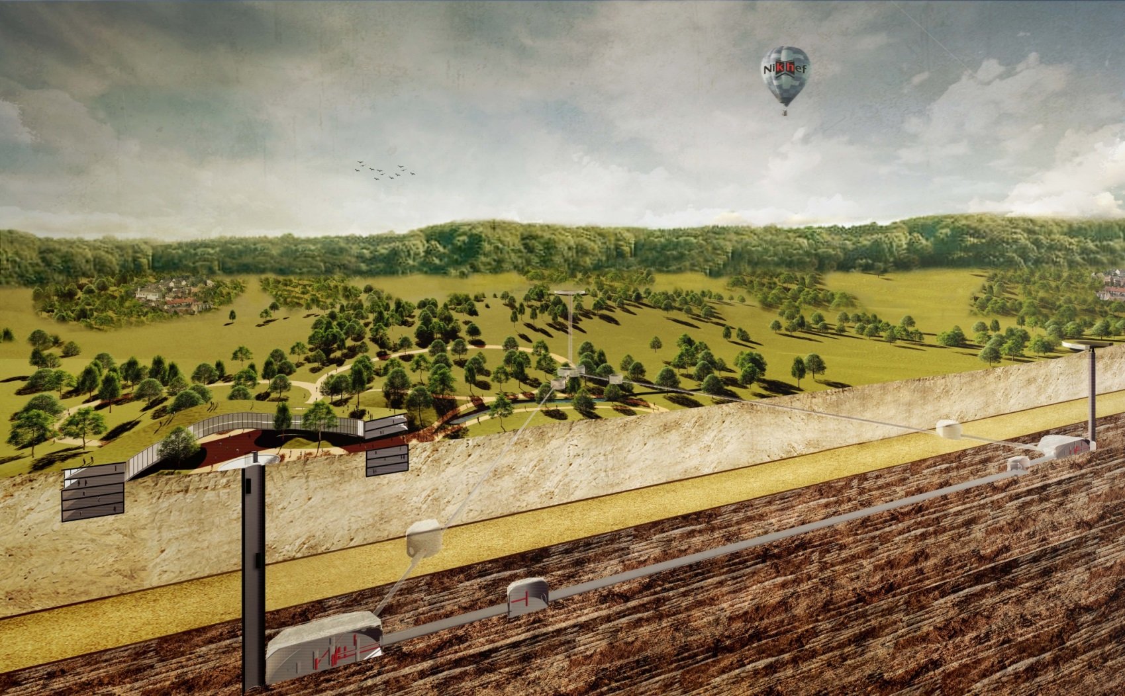
Einstein Telescope: a multi-facetted endeavor •• • •
LARGER
UNDERGROUND
CRYOGENIC
ΔL
better
L
less vibrations
3e generation observatory

Slide 14
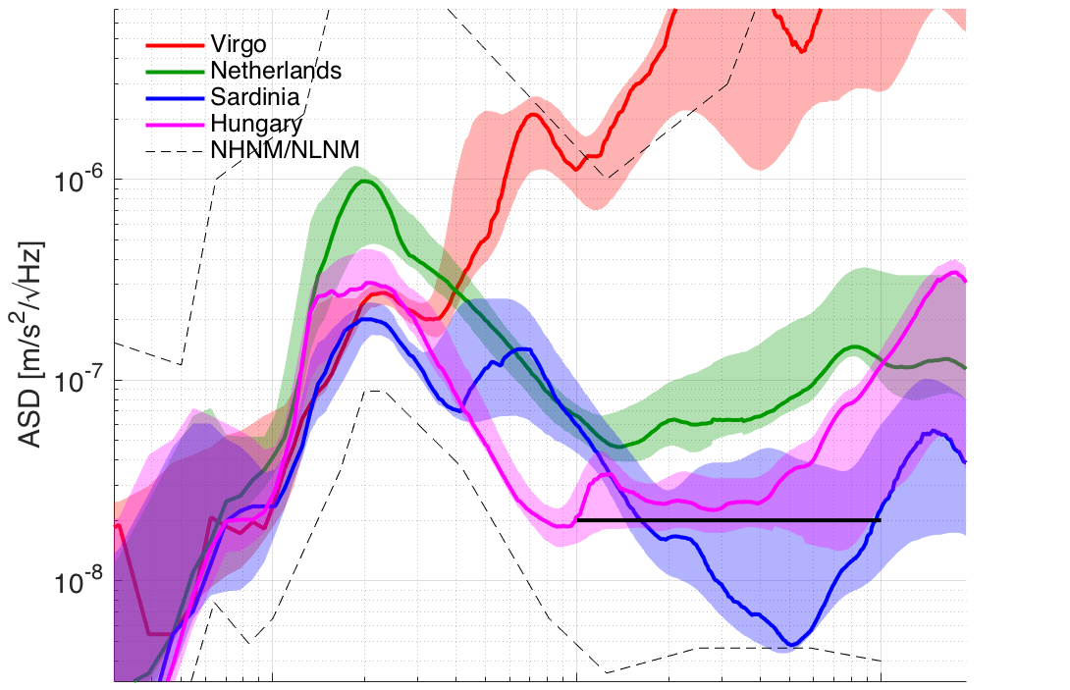
Einstein Telescope : a multi-facetted endeavor •• • •
seismic environment
ELAt
Virgo 0 m
EUregion -10 m
specification
Mátra -400 m
Sardegna -185 m
Eindhoven-Leuven-Aachen triangle
0.1
→ f [Hz]
1
10

Slide 15
Einstein Telescope : a multi-facetted endeavor •• • •
seismic environment
ELAt
soft top layer
hard underground
Eindhoven-Leuven-Aachen triangle

Slide 16
Einstein Telescope : a multi-facetted endeavor •• • •
seismic environment
ELAt
Eindhoven-Leuven-Aachen triangle

Slide 17
Einstein Telescope : a multi-facetted endeavor •• • •
seismic environment
ELAt
seismic sensors
Borehole
planning
Terziet
2018
De Plank
2019?
Time [s]
Eindhoven-Leuven-Aachen triangle
Offset [m]

Slide 18
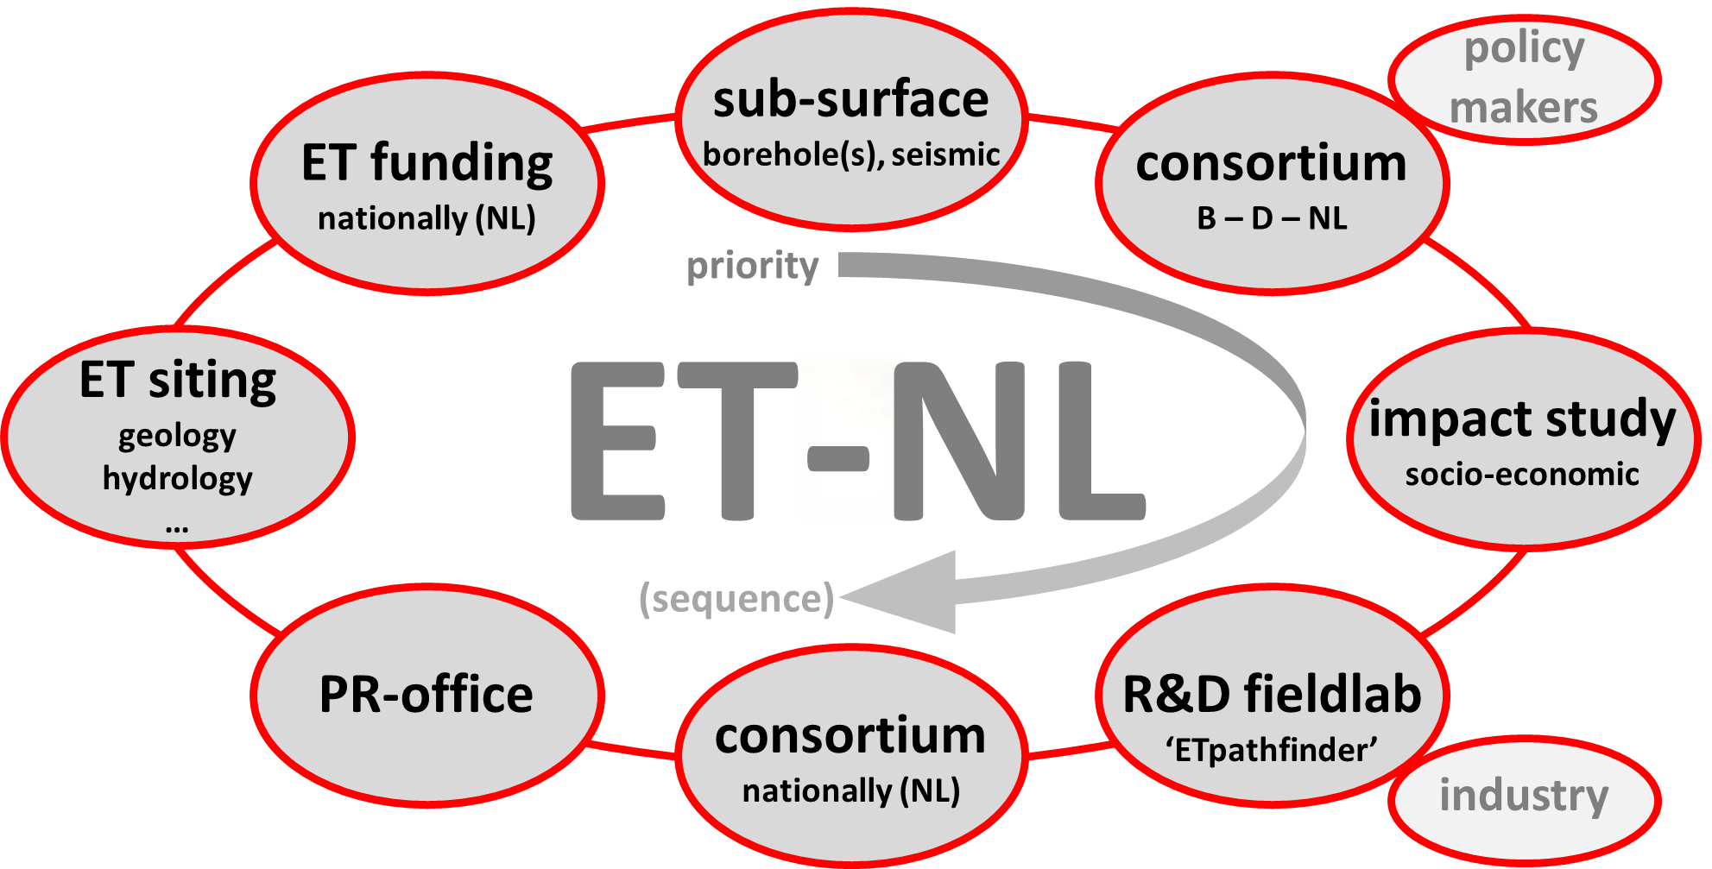
Einstein Telescope : a multi-facetted endeavor •• • •
work packages

Slide 19
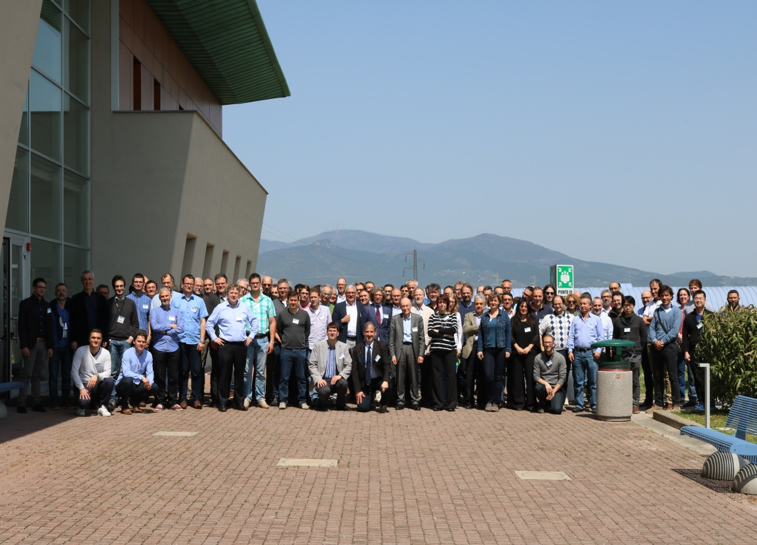
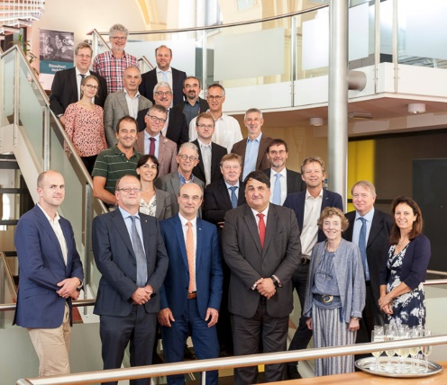
Einstein Telescope : a multi-facetted endeavor •• • •
consortium building
Europe – April 2018
B-D-NL – September 2018
LoI Einstein Telescope: now ∼ 600 members
MoU all B universities, many NL, some D

Slide 20
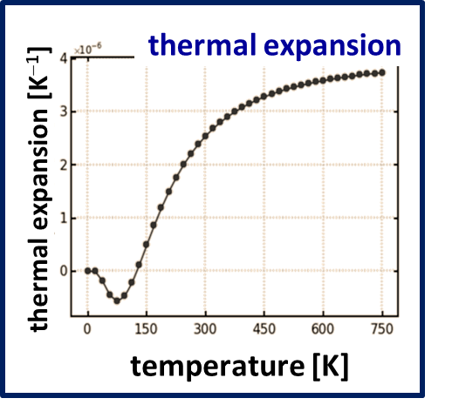
Einstein Telescope : a multi-facetted endeavor •• • •
R&D facility -- expertise
Cryogenic Si mirrors

Slide 21
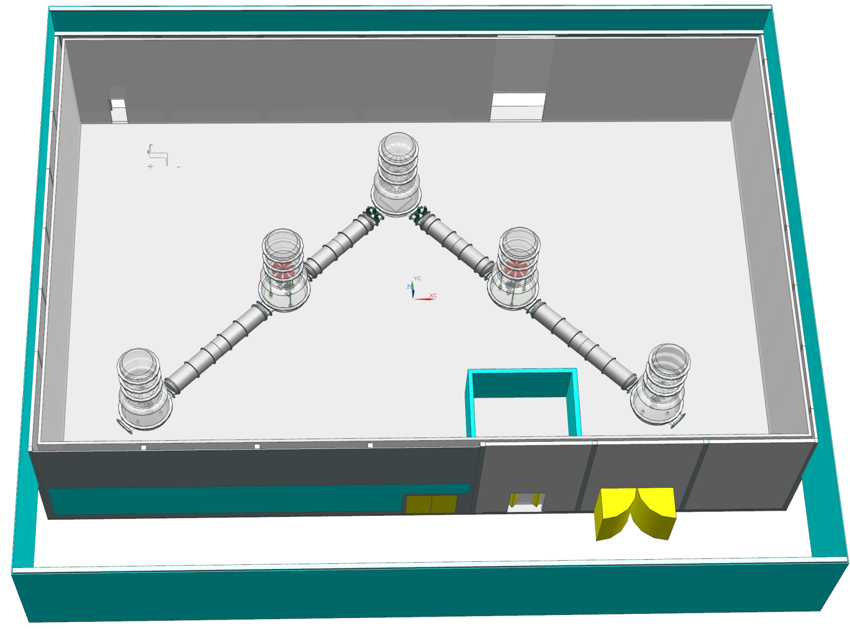
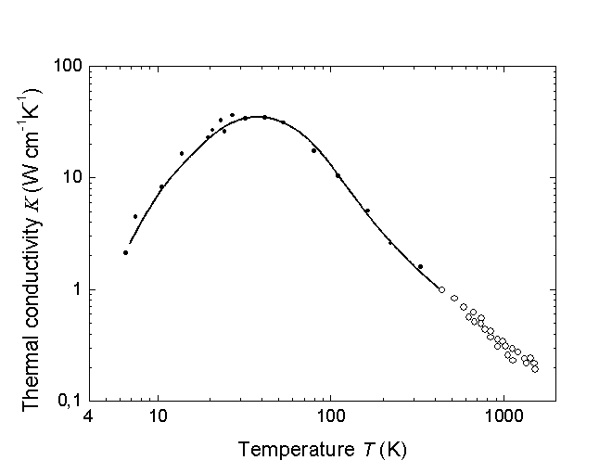
Einstein Telescope : a multi-facetted endeavor •• • •
R&D facility -- expertise
Cryogenic Si mirrors
B-D-NL 14,5 M€ ‘Interreg’ project
thermal conductivity
25 m
better!
thermal conductivity [Wcm⁻¹ K⁻¹]
temperature [K]

Slide 22
Einstein Telescope : a multi-facetted endeavor •• • •
socio-economic impact

Slide 23
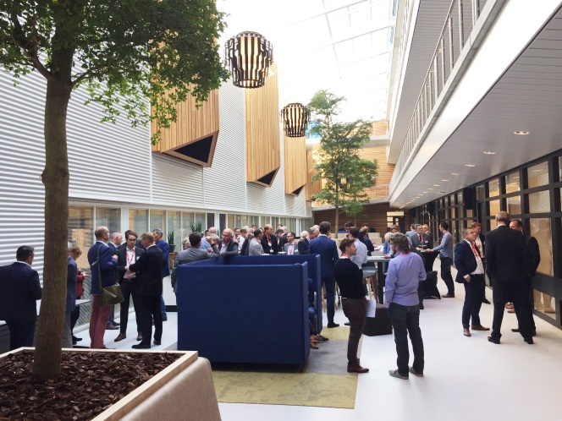
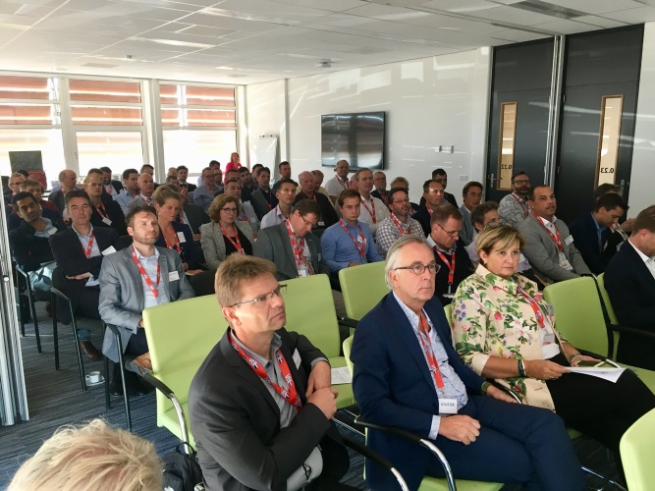
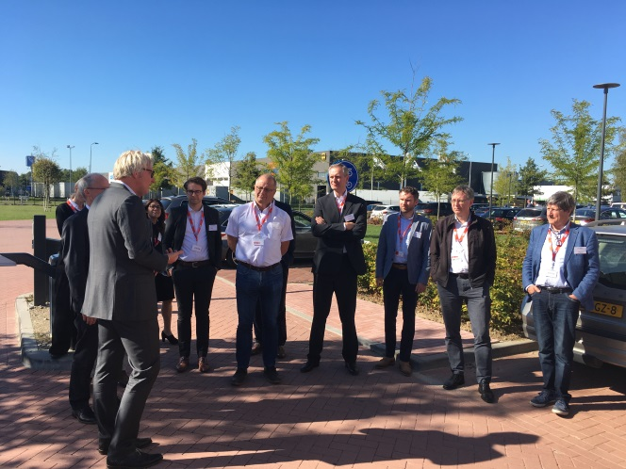
Einstein Telescope : a multi-facetted endeavor •• • •
Big Science industry day (ET)
Einstein Telescope dedicated
Engineering
Machining
Vacuum technology
Cooling technology
Civil engineering
• • • • •

Slide 24
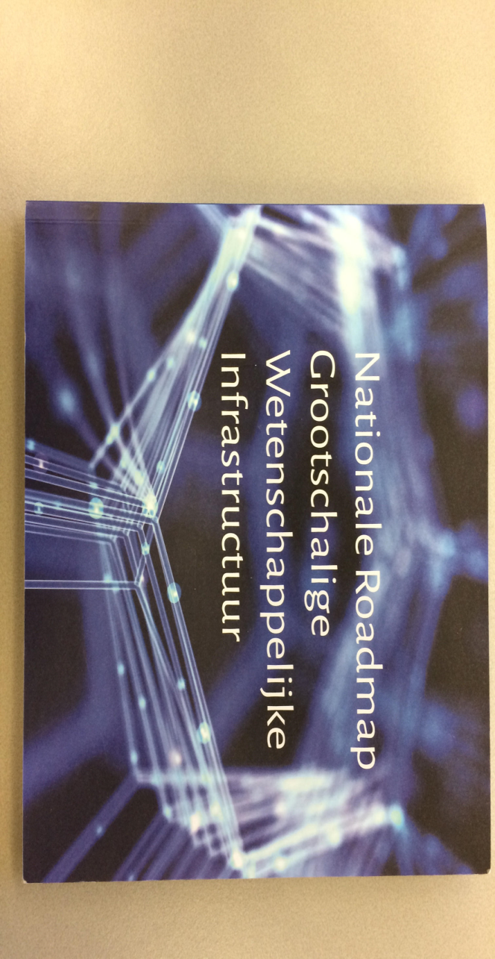
Einstein Telescope : a multi-facetted endeavor •• • •
science policy
ET 1 out of 33
ET 1 out of 13
ET ‘game changer’

Slide 25
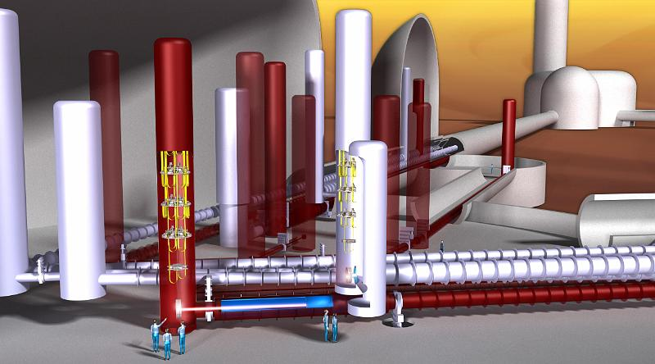
Einstein Telescope : a multi-facetted endeavor •• • •
our future?

Slide 26
Dreaming about timelines?
ETpathfinder
Einstein
Telescope

Slide 27
Einstein Telescope: reality check
2011
Attention required!
Technical Design Report(s)
Detailed cost scrutiny
Realistic exploitation cost estimate
Governance structure
2021?
Workplan/mission (assuming ESFRI status)
To allow a proper decision in ∼ 2021 whether or not to submit a joint (B-D-NL) bid to host Einstein Telescope in the ELAt region

Slide 28
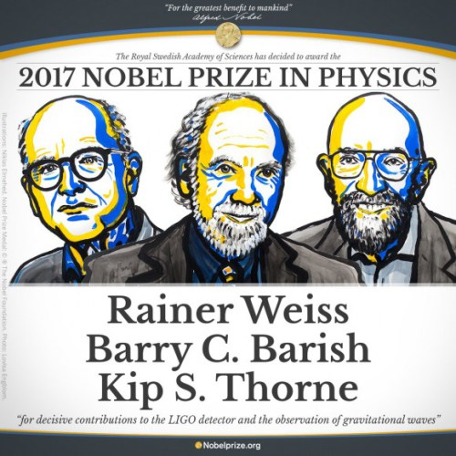
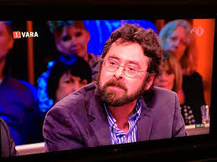
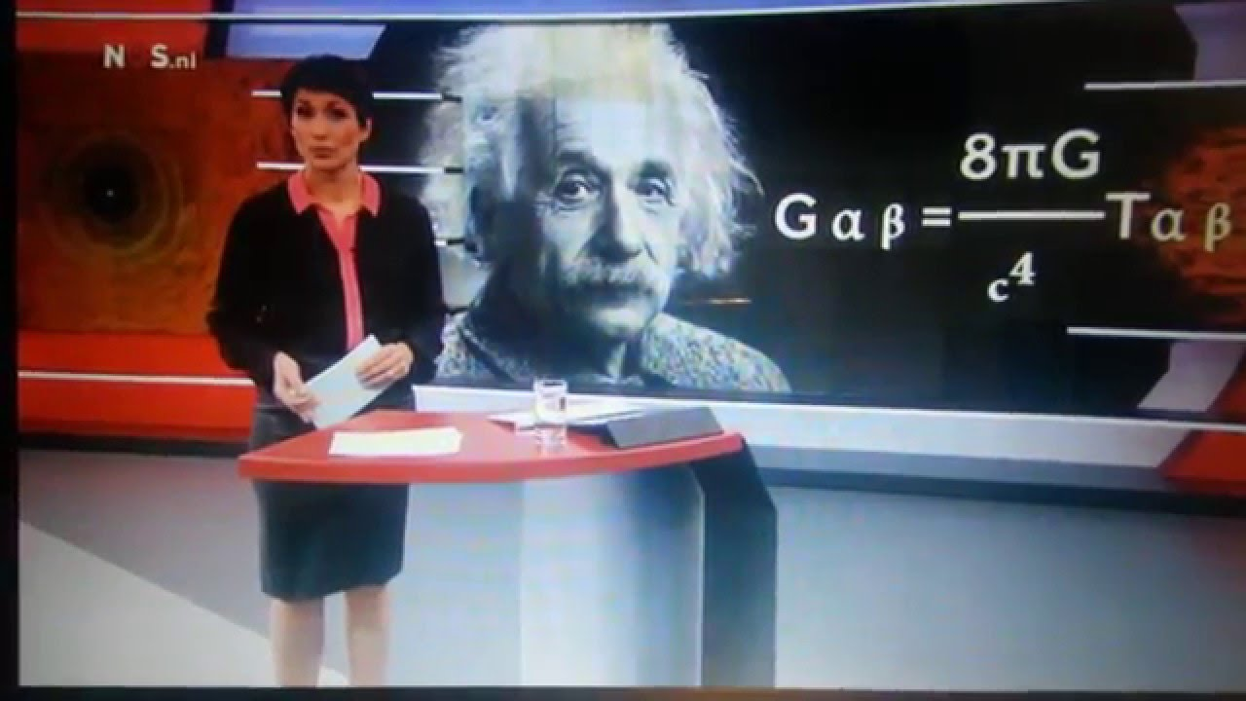
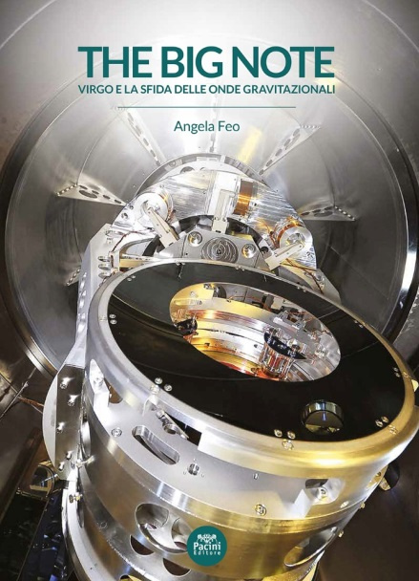
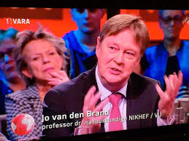
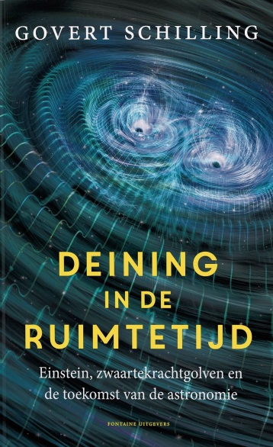
Gravitational waves in (Dutch) media
The Netherlands rECFA visit, 19 October 2018, GRAVITATIONAL WAVES, Frank linde 28

