Slide 1

Education and research school
2
RECFA Amsterdam, oct 19, 2018
Patrick Decowski
decowski@nikhef.nl

Slide 2
Education at Nikhef
MSc level education
PhD education guided through two research schools
  OSAF research school, mostly experimental PhDs
  DRSTP research school for theory students
BSc level education (@Nikhef, the institute)
  No formal program, although UvA/VU organize various BSc short projects
  BSc thesis projects (~3 months)
    Mostly UvA/VU students, some Utrecht, occasionally other universities
Also Secondary School Students and Teachers
  2011-2016: ~1300 visitors and ~350 Masterclass participants

Slide 3
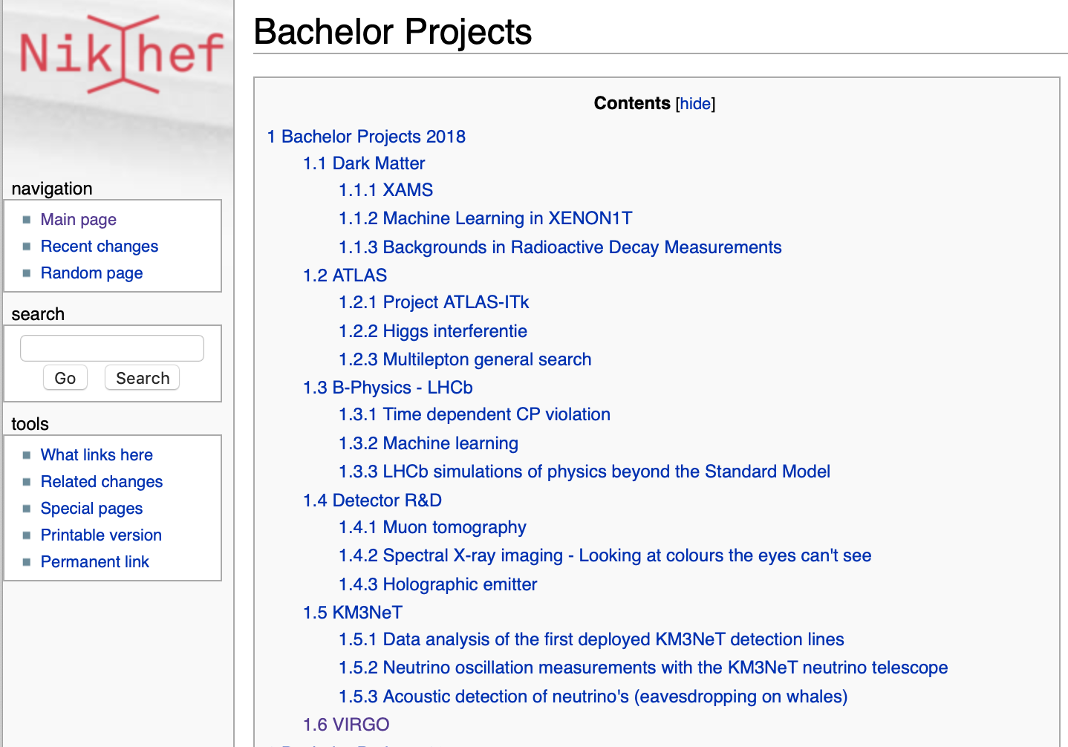
About 10 students did a
BSc thesis at Nikhef in 2018
http://wiki.nikhef.nl/education/Bachelor_Projects

Slide 4
MSc (astro-)Particle Physics programs in NL
MSc Physics programs in NL
  2 years
  English language
  Usually 1st year course work (~60EC)
  2nd year devoted to thesis (~60EC)
Universities with an (astro-)particle physics track:
  University of Amsterdam / VU Amsterdam (joint)
  Utrecht University
  Radboud University Nijmegen
  University of Groningen
Example – GRAPPA-track:
GRavitation, Astro-, and Particle Physics Amsterdam
  Joint degree UvA / VU
  25 MSc students per year
  1/3 of students is international
  Theoretical / Observational / Experimental
  60-70% continue as PhD students (NL/abroad)
@Nikhef, the institute
  Shared (A)PP-related courses, many taught by Nikhef-staff
  Thesis research: ~20-30 students per year
Similar situation at “more remote” universities

Slide 5
Many courses available
GR
Cosmology
Beyond Standard Model
Quantum Field Theory
High Energy Astrophys.
Particle Physics I+II
String Theory
…
Particle Detection A+B
UvA/VU
Gravitational Waves
Nijmegen, Groningen
Flavor Phys. & CPV
Programming C++
Nikhef Project
Stat. Data Analysis
Astroparticle Physics
Particles & Fields
Exp. Quantum Physics
Nikhef, the institute
Quantum Field Theory
Computation QM
…
Utrecht
Delft, Enschede, Leiden, …
Patrick Decowski / Education and Research School

Slide 6
MSC thesis projects
1.1 XENON: The XENON Dark Matter Experiment: Data Analysis
1.2 XENON: The Modulation Experiment: Data Analysis
1.3 Theory: Stress-testing the Standard Model at the high-energy frontier
1.4 Theory: The quark and gluon internal structure of heavy nuclei in the LHC era
1.5 Theory: Combined QCD analysis of parton distribution and fragmentation functions
1.6 ALICE: Charm is in the Quark Gluon Plasma
1.7 ALICE: Probing the time evolution of particle production in the Quark-Gluon Plasma
1.8 ALICE: CP violating effects in QCD: looking for the chiral magnetic effect with ALICE at the LHC
1.9 ALICE: Particle polarisation in strong magnetic fields
1.10 ATLAS : Excited lepton searches with multiple leptons
1.11 ATLAS : A search for lepton flavor violation with tau decays
1.12 ATLAS : A search for lepton non-universality in Bc meson decays
1.13 LHCb: Searching for dark matter in exotic six-quark particles
1.14 LHCb: Measurement of BR(B0 → Ds+ Ds-)
1.15 LHCb: Measurement of relative ratio of B+ → D0D+ and B+ → D0Ds decays
1.16 Virgo: Searching for gravitational waves from compact binary coalescence
1.17 Virgo: Simulations of Binary Neutron Star Mergers and applications for multimessenger astronomy
1.18 Virgo: Measuring cosmological parameters from gravitational-wave observations of compact binaries
1.19 Detector R&D: Spectral X-ray imaging - Looking at colours the eyes can't see
1.20 Detector R&D: Compton camera
1.21 Detector R&D: Holographic projector
1.22 Detector R&D: Laser Interferometer Space Antenna (LISA)
1.23 KM3NeT : Reconstruction of first neutrino interactions in KM3NeT
1.24 ANTARES: Analysis of IceCube neutrino sources.
1.25 VU LaserLaB: Measuring the electric dipole moment (EDM) of the electron
1.26 VU LaserLab: Physics beyond the Standard model from molecules
…
Many Nikhef-staff supervise MSc students
Students from any university can join a project,
irrespective of the ‘partner university’
20-25 students annually
http://wiki.nikhef.nl/education/Master_Projects
Patrick Decowski / Education and Research School

Slide 7
Phd in the Netherlands
PhD is a 4-year program, after MSc
Projects usually defined (and advertised) by supervisors
PhDs are employees - ~100 PhDs in the Nikhef collaboration
  ~80 employed by NWO-I
  ~20 employed by partner universities
NWO-I PhD students are also embedded at one of the partner universities
  PhD degree is issued by partner university
Partner university
  Usually the university where the supervisor/promotor is from
  PhDs often follow (university dependent) “soft skills” courses
  Do teaching (~10%)
Nikhef PhDs are associated with one of the Research Schools
  OSAF
  DRSTP
Median PhD duration was 55 months in 2016
Patrick Decowski / Education and Research School

Slide 8
OSAF Research School
The Nikhef graduate school for PhD candidates
Partners:
  University of Amsterdam
  Vrije Universiteit Amsterdam
  University of Groningen
  Radboud University Nijmegen
  Utrecht University
  Nikhef
16 committee members
  Full professors at partner universities
Chair: R. Snellings (UU)
OSAF Director = Nikhef Director
About 100 PhD candidates in school
Formal Learning Objectives:
able to function as original and independent researcher
place own work in theoretical context
integrate own work in broader area of research
competent in communicating and discussing results in publications, posters and seminars
be familiar with current results in particle- and astroparticle physics
familiar with current experimental techniques in particle- and astroparticle physics
Patrick Decowski / Education and Research School

Slide 9
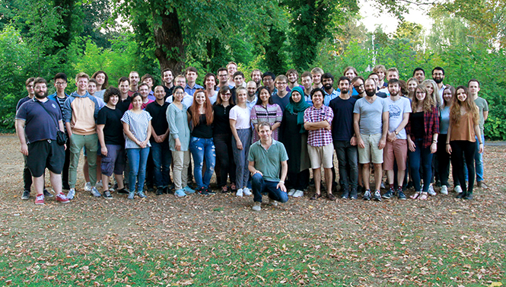
OSAF Supervision & Requirements
Supervision
  Promotor + (co-) promotor
Project plan + time table
Independent ”C3” member
  Progress meetings at 6, 12, 24 and 36 months
  As need arises
For PhDs working on particle physics:
2x two-week BND research schools
All PhDs participate as Teaching Assistants in education (~10% time)
6 Topical Lectures
Belgian Dutch German graduate school Berlin Sept 2018
Patrick Decowski / Education and Research School

Slide 10
OSAF Topical Lectures & Courses
Past Topical Lectures
Dec 18: Statistics
Jun 18: Physics at Future accelerators
April 18: Machine Learning
Dec 17: Dark Matter
Jun 17: Gravitational Waves
Mar 17: Symmetries
Dec 16: Flavor Physics
Jun 16: Statistics
Apr 16: Higgs
Dec 15: Neutrino Physics
Jun 15: Kinetic Th, Hydro and Ads/CFT to model Heavy Ions
Courses offered
Taking charge of your PhD project (obligatory)
The art of presenting science
Being successful in Dutch organizations
Business Orientation Week (Nyenrode Business University)
Write it right (scientific writing skills)
Teaching and Learning
In addition
C++ programming
Python programming
Patrick Decowski / Education and Research School

Slide 11
DRSTP Research school
Aim: to structure and coordinate the graduate education in theoretical physics
Run by:
  University of Amsterdam
  Vrije Universiteit Amsterdam
  University of Groningen
  Leiden University
  Radboud University Nijmegen
  Utrecht University
  Nikhef
Chair: D. Baumann (UvA)
Two themes:
  Particle physics, cosmology, quantum gravity and string theory
  Quantum matter, quantum information, soft condensed matter and biophysics
Nationally, about 120 PhDs in program
Small fraction at Nikhef
Patrick Decowski / Education and Research School

Slide 12
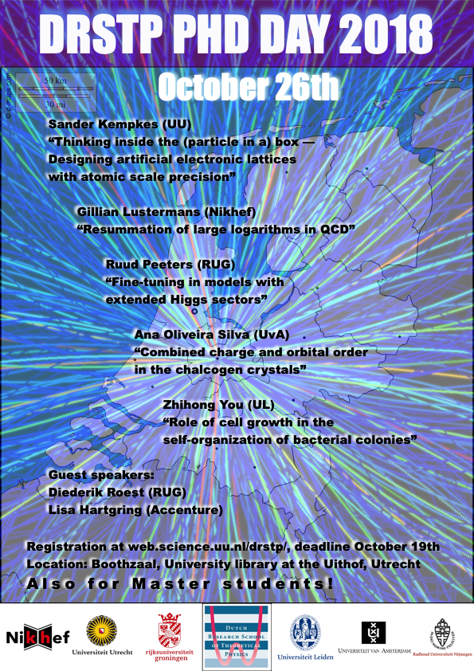
DRSTP Research school
Compulsory program consists of:
All PhD students attend twice one of
  PhD School for Theoretical High Energy Physics
  PhD School for Statistical Physics and Theory of Condensed Matter
One to two week long schools
Annual PhD day
  Students present their work
Trends in Theoretical Physics symposium
Patrick Decowski / Education and Research School

Slide 13
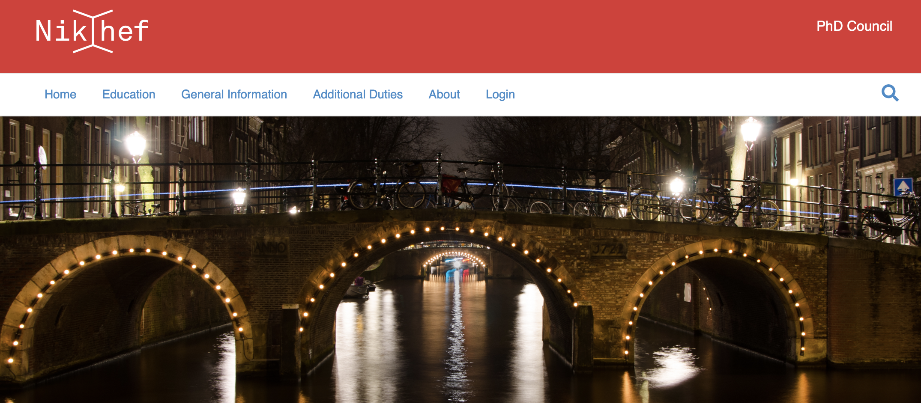
Phd council
Nikhef PhD students are represented by the Nikhef PhD Council:
Independent body
Currently 7 members, Chair: Jorinde van der Vis
Meets 2-3 per year with all PhDs to discuss current issues, feedback on program
Represents PhDs during OSAF meetings
Gives advice on housing, living in NL, practical graduation tips, buddy system, etc.
Patrick Decowski / Education and Research School

Slide 14
Phd Recruitment
There are about 20-25 PhD positions offered annually at Nikhef
PhDs can start throughout the year (not following academic calendar)
Low application rate from students that did MSc at a Dutch University (both NL & int. students)
  Dutch students seem to make their “what next” choice rather late
  International students already decided to move for their MSc studies once, easy to move another time
We recently decided to streamline the recruitment and close PhD advertisements 4x a year
  September 15
  January 15
  April 15
  June 15
Also advertise, in addition to specific ad, through generic web page and flyers
Patrick Decowski / Education and Research School

Slide 15
Conclusions
Education at all levels is a vital part of Nikhef
  Secondary School visits/projects
  BSc thesis projects
  MSc program: courses and MSc thesis projects
  PhDs are enrolled in a Research School providing a framework and supervision
Good and steady number of graduating students over the years
  MSc & PhD graduates succeed in getting good positions inside and outside academia
Patrick Decowski / Education and Research School

Slide 16
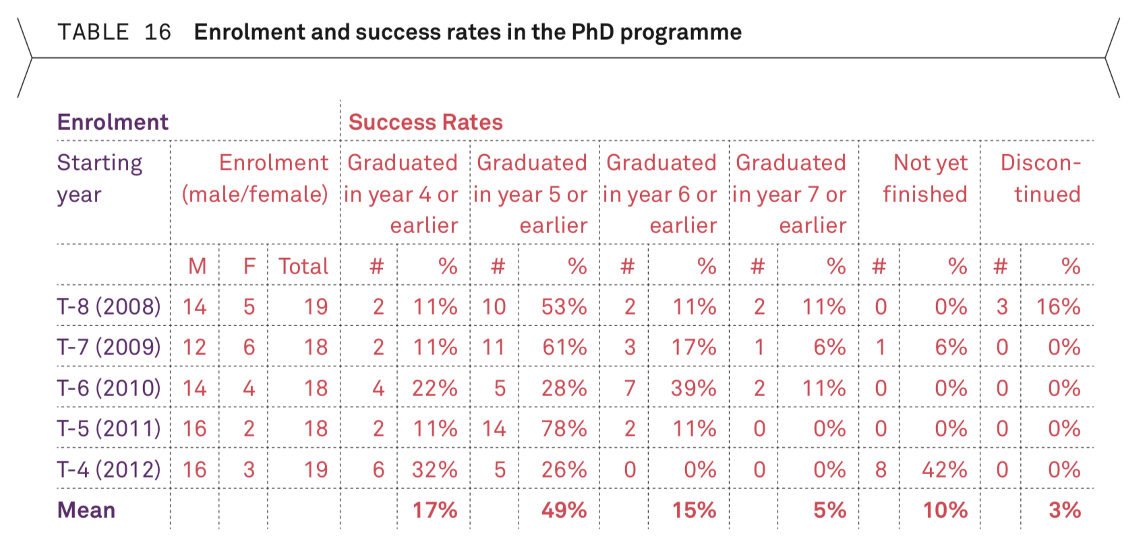
Enrolment and Success rate PhD
T=2016
Patrick Decowski / Education and Research School

Slide 17
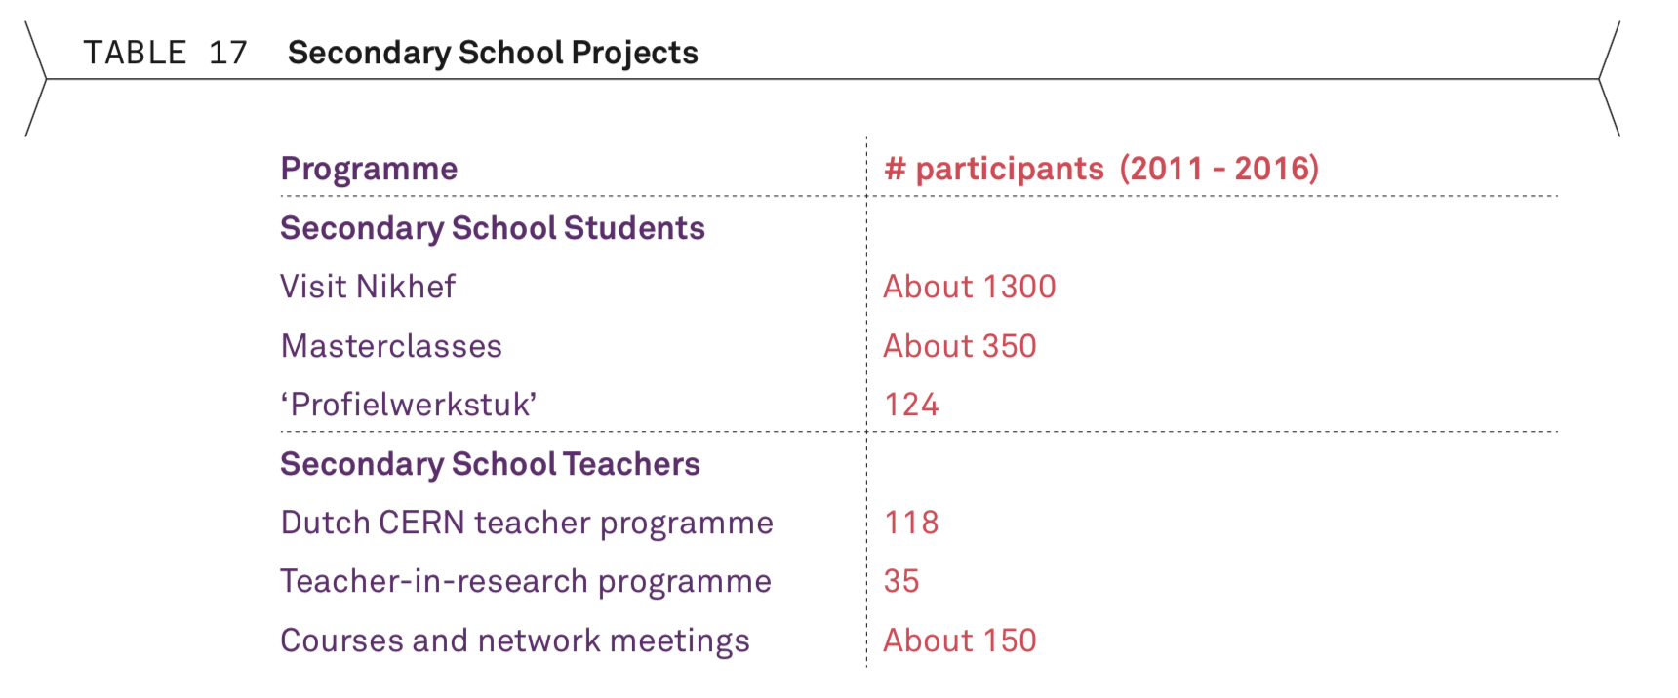
Secondary schools and nikhef
Patrick Decowski / Education and Research School

