Slide 1
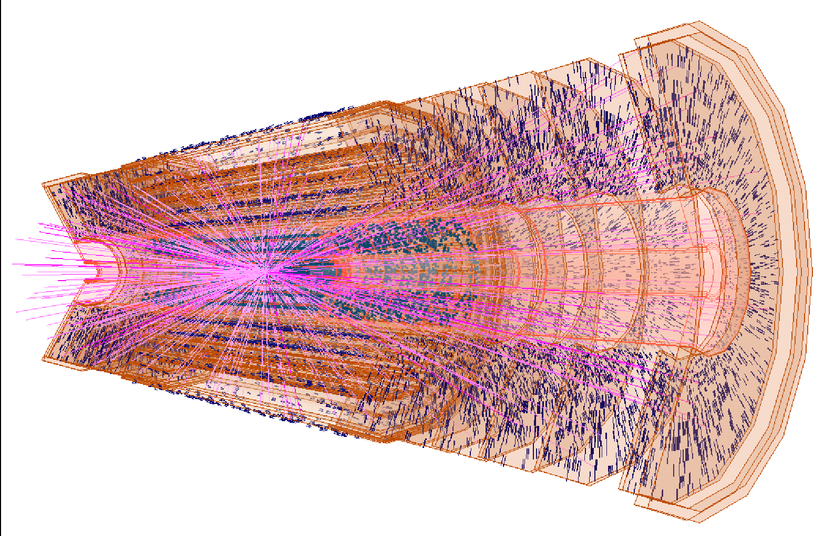
ATLAS
Programme leadership
W. Verkerke & N. De Groot
16 staff, 7 Postdocs, 18 PhD (2017)
University partners: UvA, RU
Program funding 2014-2021: 10.2m€
Personal grants 2012-2017: 5.6m€
Investment Funding : 5.2m€
W. Verkerke

Slide 2


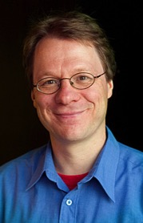
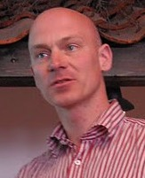



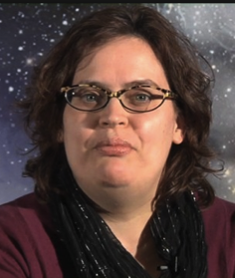
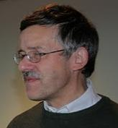


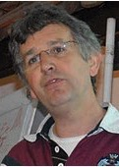
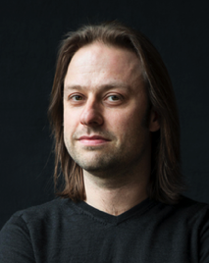


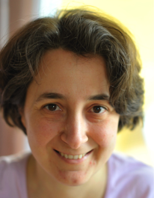
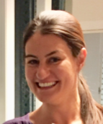
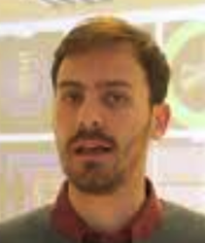


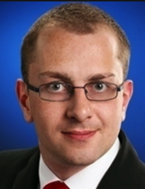


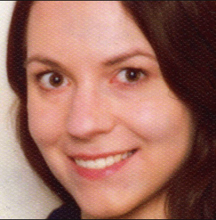
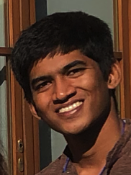

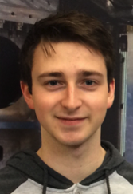
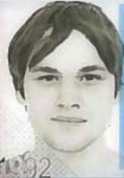

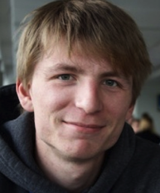
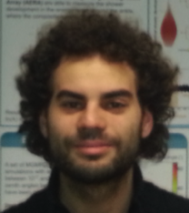
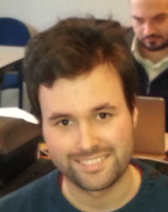
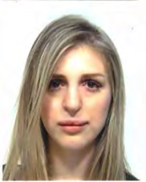
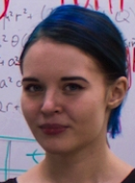
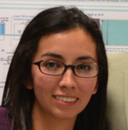


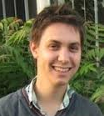
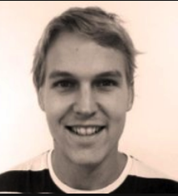

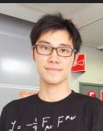



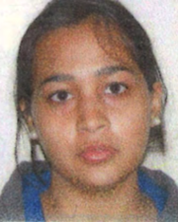
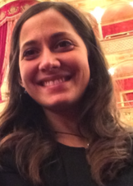
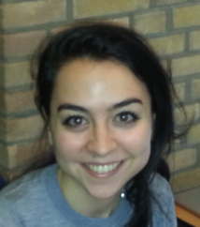
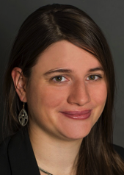
The Atlas group
Staff
17 staff
(= ~14 fte)
Postdoc
7 postdocs
PhD
24 PhDs

Slide 3
Goal – exploration of the TeV scale
SM describes most of what we see – but leaves many open questions,
as it doesn’t naturally explain all it describes
What is the origin of mass for fundamental particles?
Are there undiscovered principles of nature:
new symmetries, new physical laws?
How can we solve the mystery of dark energy?
Are there extra dimensions of space?
Do all forces become one?
Why are there so many kinds of particles?
What is dark matter? How can we make it in the laboratory?
What are neutrinos telling us?
How did the universe come to be?
What happened to the antimatter?
From “The Quantum Universe”, HEPAP 2004
Many unsolved questions & puzzles → There surely is new physics! – But can we see & understand it?

Slide 4
Goal – exploration of the TeV scale
SM describes most of what we see – but leaves many open questions,
as it doesn’t naturally explain all it describes
Measure
Search
Higgs, top
What is the origin of mass for fundamental particles?
Are there undiscovered principles of nature:
new symmetries, new physical laws?
How can we solve the mystery of dark energy?
Are there extra dimensions of space?
Do all forces become one?
Why are there so many kinds of particles?
What is dark matter? How can we make it in the laboratory?
What are neutrinos telling us?
How did the universe come to be?
What happened to the antimatter?
H/A
SUSY/V’/Vlq
KK
LFV decay
DM candidate
lepton
non-universality
From “The Quantum Universe”, HEPAP 2004
Many unsolved questions & puzzles → There surely is new physics! – But can we see & understand it?

Slide 5
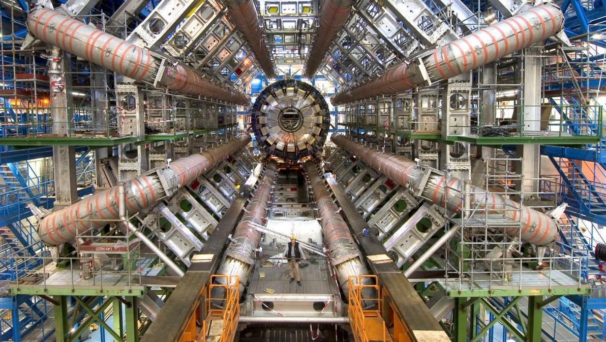

2012-2017
RECFA site visit – October 19th, 2018
5

Slide 6
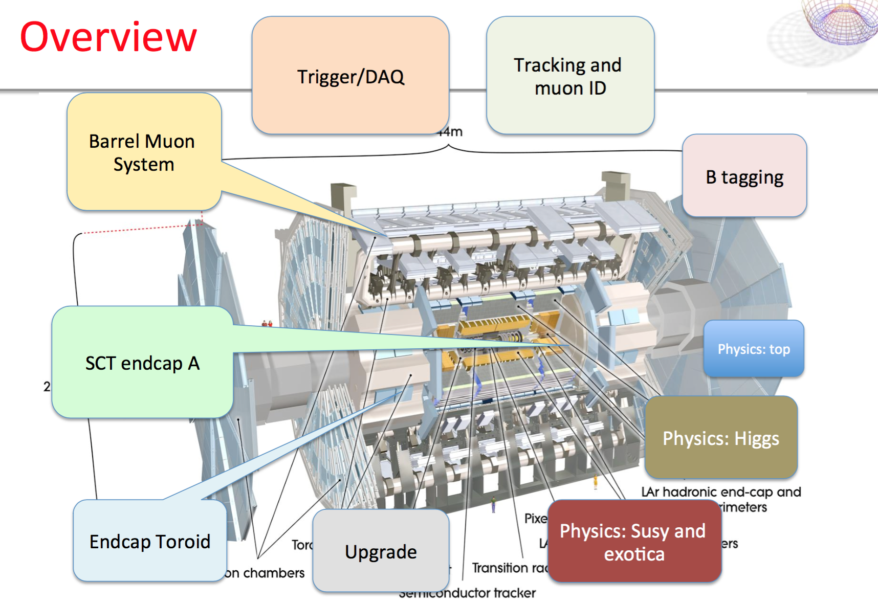
Overview of nikhef contributions

Slide 7
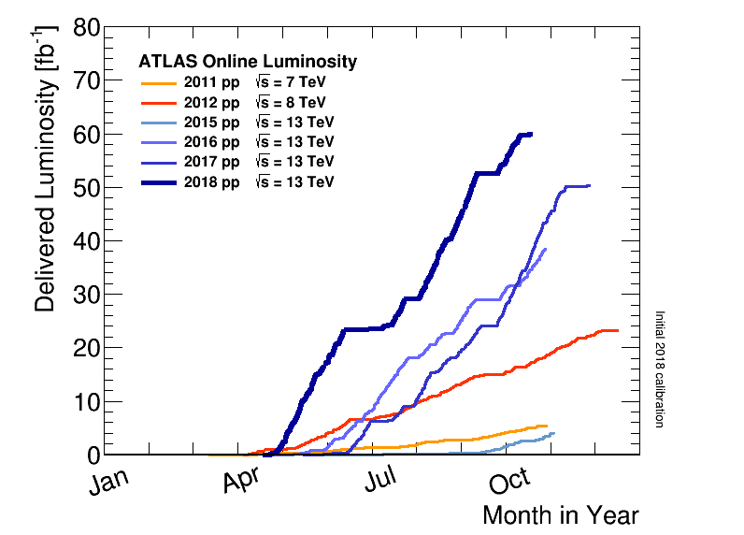
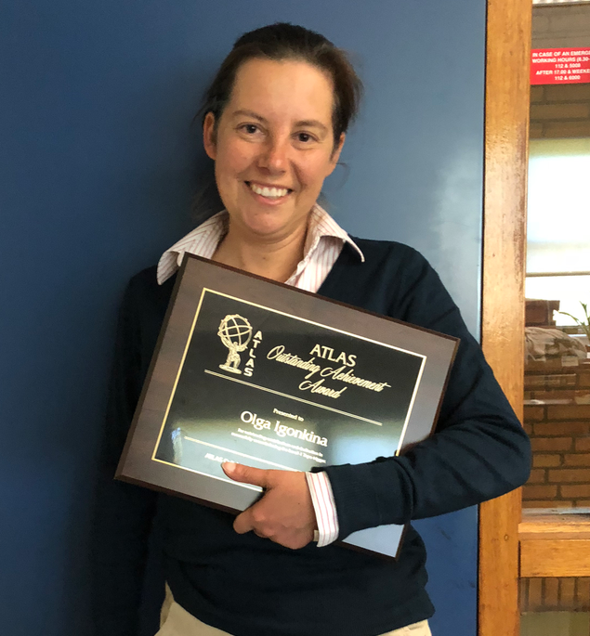

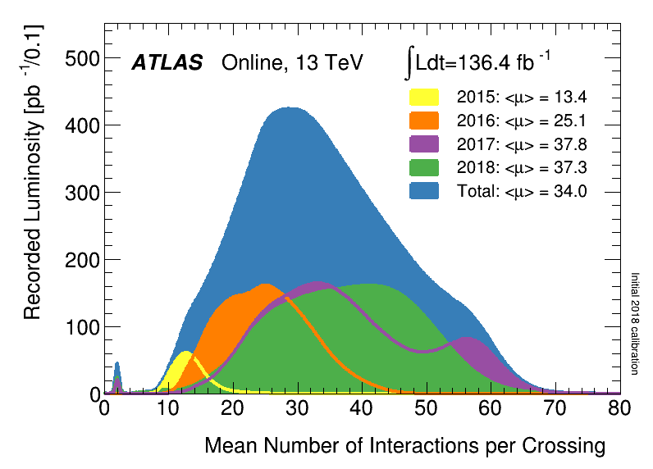
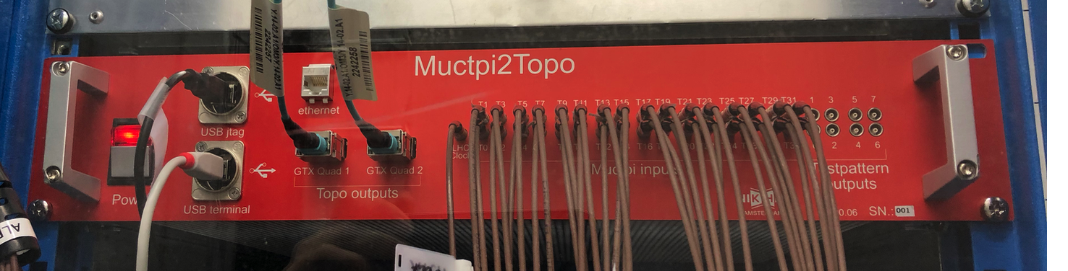
LHC timeline and luminosity profile
Rapidly rising luminosity and increased run-2 beam energy
crucial to success of ATLAS physics program
But higher occupancies & rates, faster radiation damage
ATLAS must keep up by
      Improving trigger and DAQ system
      Adding and replacing detector systems
Insertable B-layer
New muon readout system
Updated MET hardware triggers
Muon Topology Trigger in L1
2017, 2018
37 average collisions
per bunch crossing
L1 topo – Atlas outstanding
achievement award for Olya

Slide 8
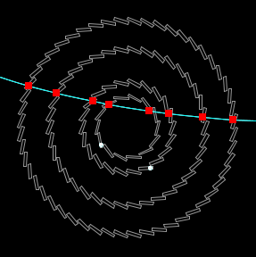
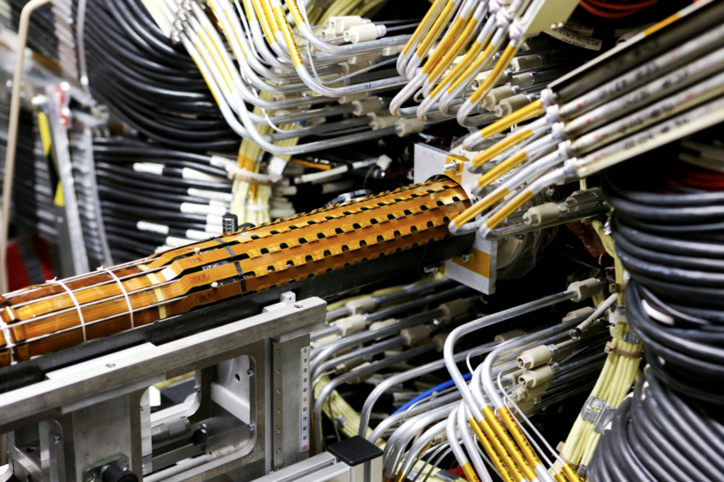
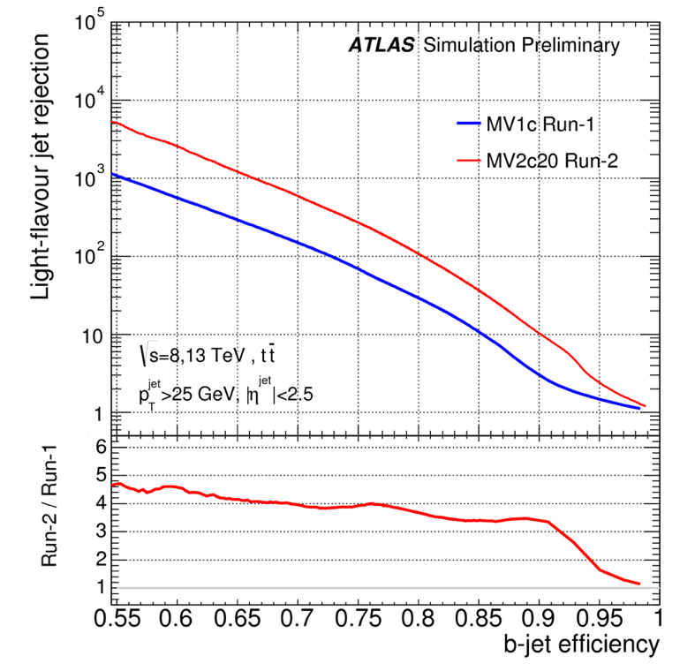
Run-2 upgrade highlight – the IBL
MT
ET
ATLAS installed a new inner pixel tracking layer
in 2015 inside the innermost layer of the pixel tracker
New hits on track from IBL
Installation of IBL in ATLAS
65nm frontend readout chips
(with Nikhef ET department)
CO2 cooling system
(with Nikhef MT department)
In-situ alignment in ATLAS
tracking environment
Factor 4 improvement
in light jet rejection
in flavor tagging

Slide 9
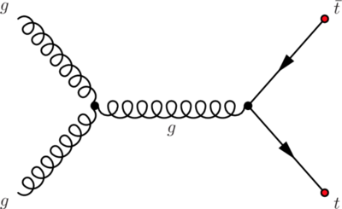
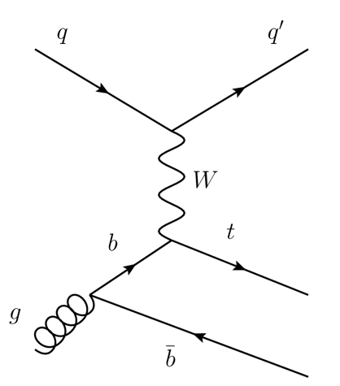
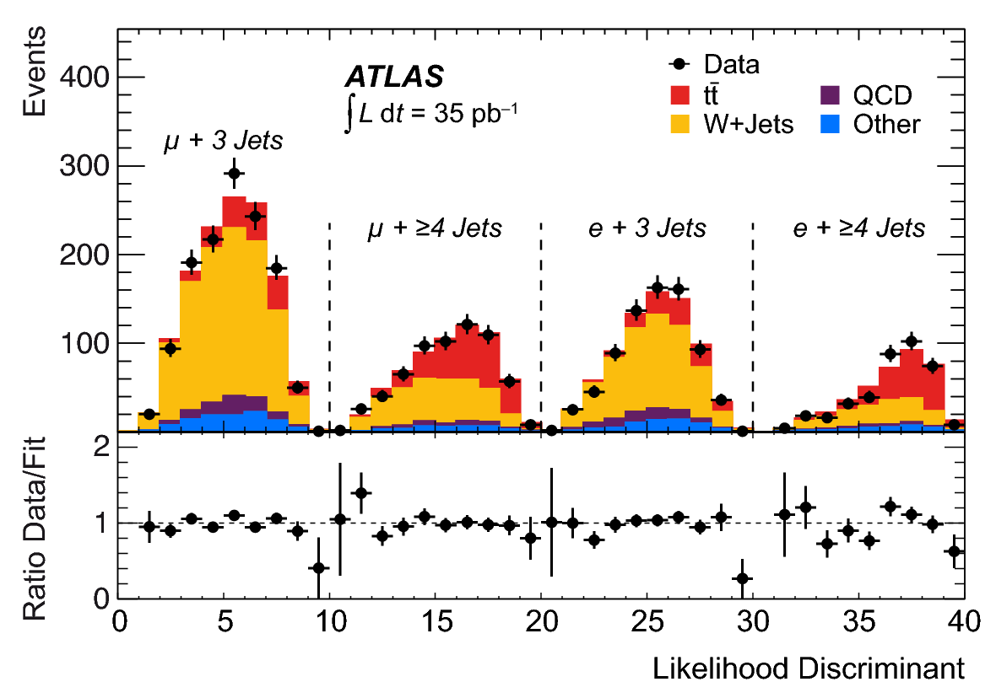
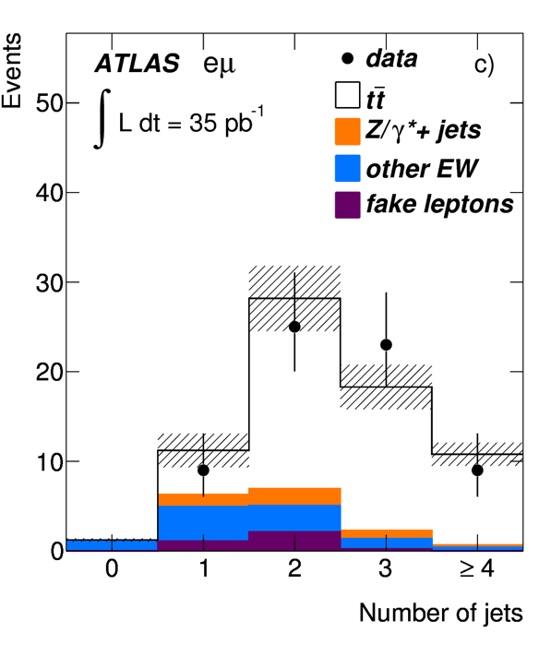
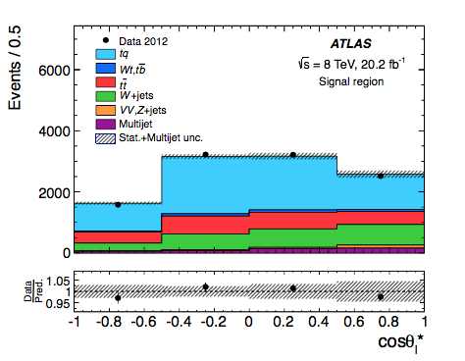
Highlights – Nikhef top quark physics
Early Run-1: establishing top quark, understand detector
Mid Run-2: precision EW tests
top quark pair production
polarized single top production
Lepton+jets analysis
Dilepton analysis
Tau+jets analysis
Convenerships,
paper editors
σ=80 pb
σ=170 pb
NLO interpretation
of polarized top
quark production
Joint project
with Nikhef theory
department
0.0035 fb⁻¹ → O(100) reconstruct events
20 fb⁻¹ → O(10.000) reconstructed events

Slide 10
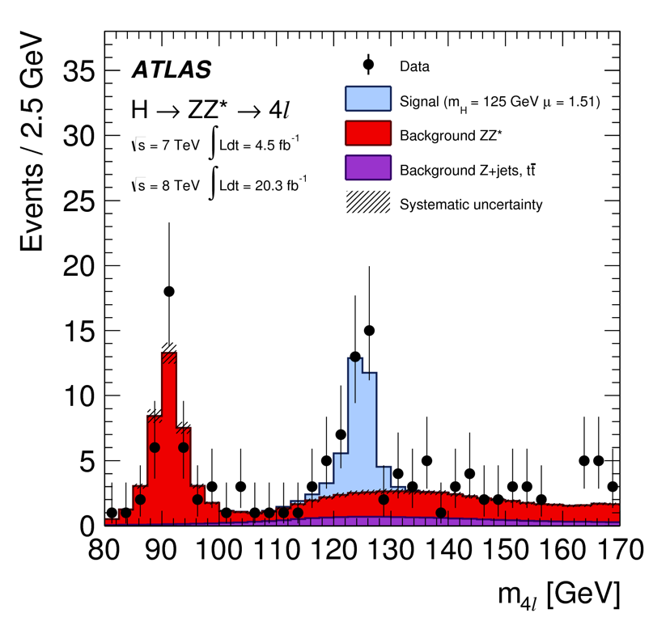
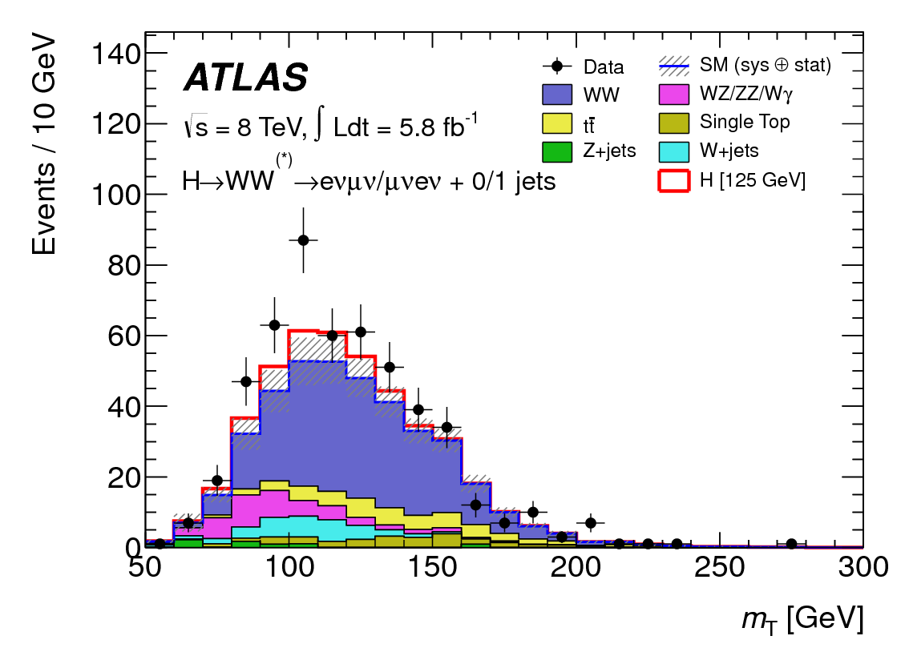
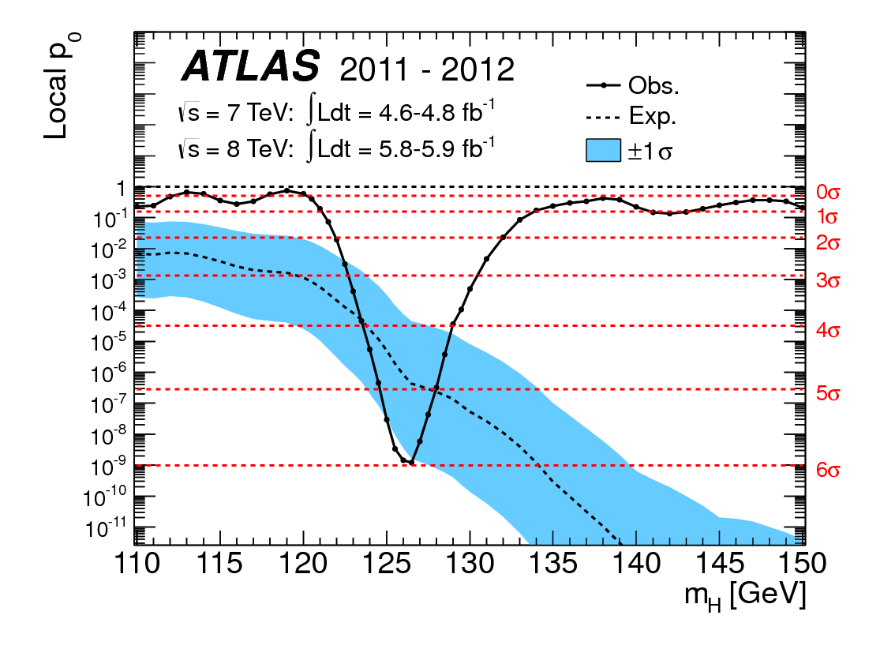
Nikhef Higgs physics highlights
Early phase – Higgs discovery effort
Higgs decay to ZZ
Higgs decay to WW
Discovery from combined channels
RooFit/
RooStats
Analysis design with focus on
muon requirements and understanding of resolution
Event selection design,
Data driven estimate of Vγ bkg
Complete implementation and execution of statistical analysis
Software tools for combinatios
and statistical analysis (RooFit/RooStats)
used by most ATLAS and CMS Higgs analysis

Slide 11
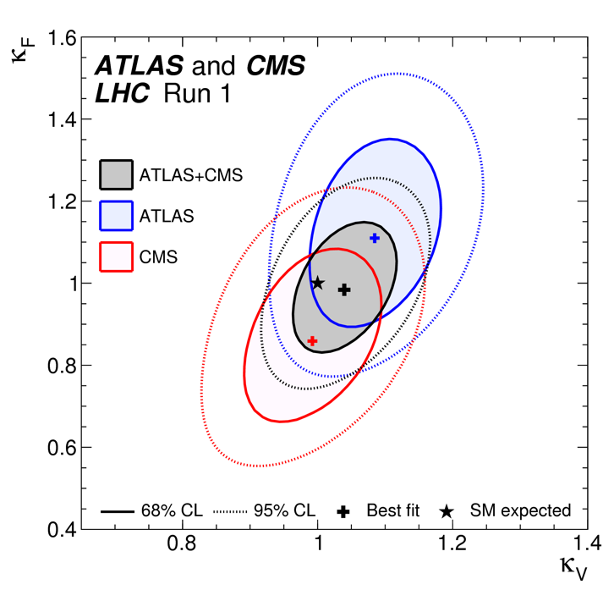
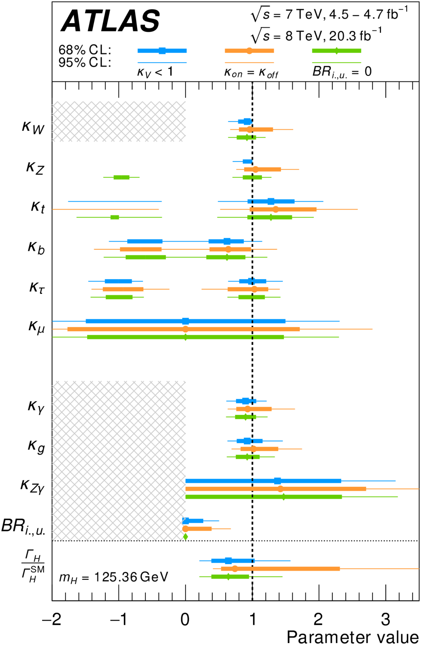
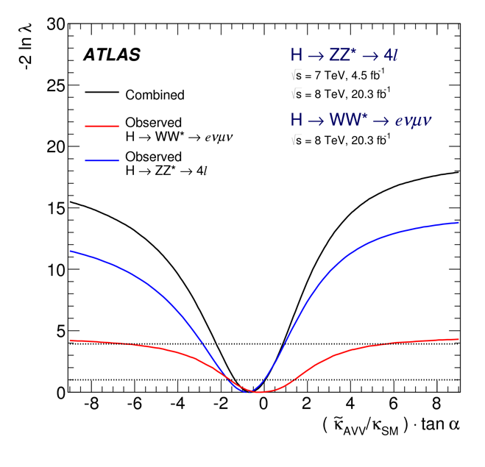
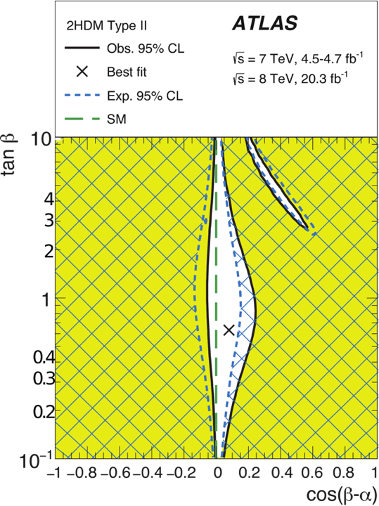

Nikhef Higgs physics highlights
RooFit/
RooStats
Current phase – Higgs characterization
Coupling combination ATLAS+CMS
Higgs 9-channel combination Run-1
Higgs spin &
CP properties
Main analyzer from ATLAS side
Author combination
software tools
Combination convener
Paper editors
2/3 of analysis
effort
Author combination
software tools
BSM interpretation of h(125)
Paper/Note editor
Author reinterpretation
software tools
Main analyzer
Paper editor
Key analyzer H→ZZ
Main analyzer H→WW
e.g. constraints
on 2HDM
parameters α,tan(β)

Slide 12
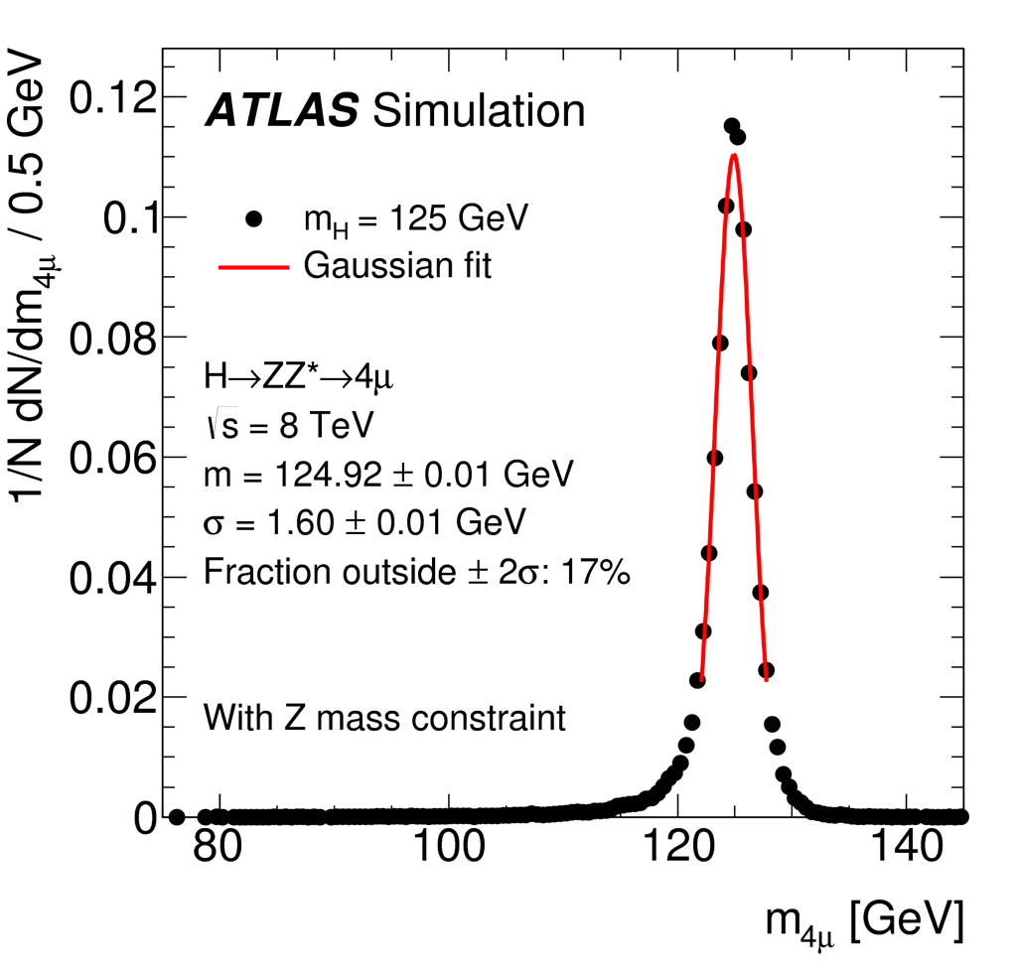

Nikhef Higgs physics highlights
Higgs mass measurement in H→4l
Observation of ttH
Understanding of
muon tracking
performance and its
impact mass resolution
ttH(bb) event selection
and control regions
Statistical analysis
ttH(bb) and combination
Plus involvement in many other channels
H→ττ, VH(bb), VH(cc), H→WW high mass search, H→ZZ high mass search, H→invisible

Slide 13




Searches for new physics - highlights
Charged Lepton Flavor Violation
Supersymmetry
tau → 3 mu
Large Nikhef effort
SUSY with
no leptons
and MET
Nikhef idea, 80% of analysis effort
stop → stau
Nikhef idea, one
of the main analyzers
Z→ tau mu
Main analyzer of hadronic channel

Slide 14




Data Science Connections
Interaction and good cooperation between ATLAS group and data science
efforts outside Nikhef and outside HEP
Computational efficiency
Make super-complex HEP likelihoods
run faster → parallelization/vectorization/GPUs
Machine Learning
Use ML tools to accelerate searches
for difficult signatures such as SUSY
1 full-time e-Science engineer
1 ATLAS postdoc
1 full-time e-Science engineer
1 PhD student
www.darkmachines.org (160 scientists)
www.idarksurvey.com
susy-ai.org

Slide 15


Nikhef-ATLAS Physics output
Published ATLAS Papers per year with
substantial or leading Nikhef role in analysis
(including conference notes)

Slide 16
NIKHEF-ATLAS Key papers
Higgs Channels
WW - Phys. Rev. D 92, 012006 (2015) - Observation and measurement of Higgs boson decays to WW* with the ATLAS detector
WW - JHEP 01 (2016) 172 - Search for invisible decays of a Higgs boson using vector-boson fusion in pp collisions at s√=8 TeV with the ATLAS detector
ZZ - PLB 776 (2017) 318 - Search for an invisibly decaying Higgs boson or dark matter candidates produced in association with a Z boson in pp collisions at s√= 13 TeV with the ATLAS detector
ttH - Phys. Rev. D 97 (2018) 072016 - Search for the Standard Model Higgs boson produced in association with top quarks and decaying into a bb¯ pair in pp collisions at s√ = 13 TeV with the ATLAS detector
WW - Eur. Phys. J. C 78 (2018) 24 - Search for heavy resonances decaying into WW in the eνμν final state in pp collisions at s√=13 TeV with the ATLAS detector
Higgs Combined Properties
Discovery - Phys. Lett. B 716 (2012) 1-29 - Observation of a new particle in the search for the Standard Model Higgs boson with the ATLAS detector at the LHC
Spin - Phys. Lett. B 726 (2013) 120 - Evidence for the spin-0 nature of the Higgs boson using ATLAS data
Spin/CP - Eur. Phys. J. C75 (2015) 476 - Study of the spin and parity of the Higgs boson in diboson decays with the ATLAS detector
Couplings - Eur. Phys. J. C (2016) 76:6 - Measurements of the Higgs boson production and decay rates and coupling strengths using pp collision data at s√=7 and 8TeV in the ATLAS experiment
BSM interp. - JHEP11(2015)206 - Constraints on new phenomena via Higgs boson couplings and invisible decays with the ATLAS detector
ATLAS+CMS - JHEP 08 (2016) 045 - Measurements of the Higgs boson production and decay rates and constraints on its couplings from a combined ATLAS and CMS analysis of the LHC pp collision data at s√= 7 and 8 TeV
Lepton Flavor violation
τ→3μ - Eur. Phys. J. C (2016) 76:232 - Probing lepton flavour violation via neutrinoless τ⟶3μ decays with the ATLAS detector
H/Z→τμ - Eur. Phys. J. C 77 (2017) 70 - Search for lepton-flavour-violating decays of the Higgs and Z bosons with the ATLAS detector
Supersymmetry
0lepton+met+jets - JHEP09(2014)176 - Search for squarks and gluinos with the ATLAS detector in final states with jets and missing transverse momentum using 20.3 fb−1 of √s=8 TeV proton-proton collision data
1lepton direct stop - JHEP11(2014)118 - Search for top squark pair production in final states with one isolated lepton, jets, and missing transverse momentum in sqrt(s)=8 TeV pp collisions with the ATLAS detector
incl squark/gluino - JHEP 10 (2015) 054 - Summary of the searches for squarks and gluinos using s√=8 TeV pp collisions with the ATLAS experiment at the LHC
0lepton+met+jets - Eur. Phys. J. C 76 (2016) 392 - Search for squarks and gluinos in final states with jets and missing transverse momentum at s√= 13 TeV with the ATLAS detector
compressed - Phys. Rev. D 97 (2018) 052010 - Search for electroweak production of supersymmetric states in scenarios with compressed mass spectra at s√=13 TeV with the ATLAS detector
Top quarks
σ(tt) - Phys. Lett. B711 (2012) 244 - Measurement of the top quark pair production cross-section with ATLAS in the single lepton channel
Wtb - JHEP 04 (2017) 124 - Probing the Wtb vertex structure in t-channel single-top-quark production and decay in pp collisions at s√=8 TeV with the ATLAS detector
Methodology & interpretation/prediction*
SUSY pheno/astro - JCAP12(2017)040 - Implications of the Fermi-LAT Pass 8 Galactic Center Excess on Supersymmetric Dark Matter
Analysis methods – NIMA 771(2015)39 - Interpolation between multi-dimensional histograms using a new non-linear moment morphing method
*) Non-ATLAS Collaboration papers
by Nikhef/ATLAS group members
related to ATLAS physics

Slide 17
Completed PhD theses (27)
2013 (2)
Magda Chelstowa - The road to the discovery of the Higgs boson in the H → WW(*) →lνlν channel
Hurng-Chun Lee - Single top quark production at the LHC: Data processing and cross section measurement
2014 (5)
Robin van der Leeuw - Strong supersymmetry : A search for squarks and gluinos in hadronic channels using the ATLAS detector
Lucie de Nooij - The φ(1020)-meson production cross section measured with the ATLAS detector at √s = 7 TeV
Priscilla Pani - To the bottom of the stop: Calibration of bottom-quark jets identification algorithms and search for scalar top-quarks and dark matter with the Run 1 ATLAS data CUM LAUDE
Antonio Salvucci - The Higgs boson in the H → ZZ(*)→ 4l decay channel with the ATLAS detector at the LHC CUM LAUDE
Valerio Dao - Over the Top: from tt measurements to the search for the associated production of the Higgs boson and a top quark pair with the ATLAS detector CUM LAUDE
2015 (7)
Geert Jan Besjes - Pushing SUSY’s boundaries; searches and prospects for strongly-produced supersymmetry at the LHC with the ATLAS detector
Stefan Gadatsch - The Higgs boson CUM LAUDE
Rosemarie Zoe Aben - Spinning the Higgs – Spin and parity measurement of the discovered Higgs-like boson in the H→WW→lvlv decay mode
Rogier van der Geer - Searches for new physics through single top
Angelantonio Castelli - Measuring the Higgs boson mass using event-by-event uncertainties
Nika Valenčič - Fusing the Vector Bosons – Higgs production through VBF and WW scattering at the current and future LHC
Daniel Geerts - The single top t-channel fiducial cross section at 8 TeV measured with the ATLAS detector
2016 (6)
Joern Mahlstedt - Search for excited leptons with the ATLAS detector
Nikolaos Karastathis - Determination of spin and parity of the Higgs boson in the WW* →eνμν decay channel with the ATLAS detector
Pieter van der Deijl - Double parton interactions with a Z + 2 jet signature in proton-proton collisions at the LHC
Koen Pieter Oussoren - Reflecting on Higgs:spin and parity measurement in the H → WW → eνμν channel
Hartger Weits - Looking for lepton flavour violation with the ATLAS detector. A search for Z → τl decays
Ingrid Deigaard - Searches for coloured supersymmetry with ATLAS at √s = 8 TeV, 13 TeV, and 14 TeV
2017 (6)
Lars Beemster - Same sign W pair production in double parton interactions
Wouter van den Wollenberg - Sparkling Beauty: A measurement of the bb̅γγ cross-section at 8 TeV with ATLAS
Vincent Croft - A Tauists hunt for Higgles
Lydia Brenner - Character profile of the Higgs boson
Pierfrancesco Butti - Stop into stau : Search for scalar top quarks decaying into scalar tau leptons with ATLAS at √s = 8 TeV
Ivan Angelozzi - In pursuit of lepton flavour violation : A search for the τ→ μγγ decay with atlas at √s=8 TeV
2018 (1)
Antonia Struebig - Finger on the trigger - SUSY in the focus

Slide 18
Leadership positions in ATLAS
Trigger, data preparation, performance
Flavor tagging group convener [ F. Filthaut 2012-2014 ]
Data Quality group convener [ P. Ferrari 2016-2018 ]
Luminosity group [ D. Salek 2014-2016 ]
Non-collision background group [ D. Salek 2012-2013 ]
Trigger menu coordinator [ O. Igonkina, 2010-2011 ]
Muon Trigger coordinator [ M. Morgenstern, 2017-2019 ]
B physics trigger coordinator [ O. Igonkina 2016-2017 ]
Trigger express stream coordinator [ O. Igonkina 2014-2018 ]
Software & detector
Computing Coordinator [ K. Bos 2010-2011 ]
Inner trigger alignment subgroup [ P. Butti 2015-2016 ]
Muon Software coordinator [ J. Meyer 2014-2016 ]
Muon MDT Coordinator [ G. Bobbink 2014-2018 ]
Flavor tagging software coordinate [ F. Filthaut 2017-2018 ]
Activity coordinator global structures ITk strips [ M. Vreeswijk 2017 - ]
Physics & general management
  Top quark physics group [ W. Verkerke 2009-2011 ]
Higgs combination subgroup [ W. Verkerke [ 2014 - 2015 ]
Higgs H→WW subgroup [ P. Ferrari 2015-2016 ]
Higgs H→WW subgroup [ F. Filthaut 2016-2017 ]
Astroparticle physics forum [ D. Berge 2013-2015 ]
Exotics Lepton+X subgroup [ N. Hod 2015-2016 ]
Exotics Lepton+X subgroup [ N. Illic 2018-2019 ]
Exotics Leptons+X subgroup [ O. Igonkina, 2013-2014 ]
B-physics rare decays subgroup [ M. Morgenstern 2018-2019 ]
Statistics forum [ W. Verkerke 2013-2015 ]
Publication committee chair [ P. de Jong 2014-2016 ]
Publication committee (deputy) chair [ P. Ferrari 2019-2021 ]
Speakers committee (deputy) chair [ P. Ferrari 2012-2013 ]
Collaboration Board Chair advisory group [ P. de Jong 2012-2013 ]
Statistics Committee [ W. Verkerke 2018-2020 ]

Slide 19
Personal Grants and awards
Grants
2011
FOM Projectruimte 2011 – P. De Jong (400k€)
EU Talent Grant – N. Hessey
2012
EU ITN INFIERI 2012 – N. Hessey (2 PhDs)
FOM Projectruimte 2012 – O. Igonkina (400k€)
2013
FOM Projectruimte 2013 – B. Van Eijk & S. Bentvelsen (400k€)
FOM Projectruimte 2013 – P. Ferrari (400k€)
FOM Projectruimte 2013 – F. Filthaut & N. De Groot (400k€)
2014
EU ITN HiggsTools – S. Bentvelsen & E. Laenen (1 PhD)
2015
NL eScience ASDI grant 2015 – W. Verkerke (500k€)
NL eScience ASDI grant 2015 – S. Caron (500k€)
2016
NWO VICI grant 2016 – O. Igonkina (1500k€)
NWO VIDI grant 2016 – T. Du Pree (900k€)
FOM Projectruimte 2016 – M. Vreeswijk (450k€)
2017
UvA Physics Internal Competion – I. Van Vulpen & H. Snoek (1 PhD)
EU ITN INSIGHTS 2017 – W. Verkerke (2 PhDs)
2018
NWO VENI grant 2018 – N. Illic (250k€)
NWO Projectruimte 2018 – P. Ferrari & B. Van Eijk (400k€)
Awards
2011
Jan Kluyver Thesis Award 2011 – A. Doxiadis
2013
Physica Prize 2013 – F. Linde & S. Bentvelsen
Radboud Science Award 2013 – F. Filthaut & N. De Groot
2014
ATLAS Thesis Award 2014 – P. Pani
2015
Snellius Medal 2015 – Dutch ATLAS group
Jan Kluyver Thesis Award – S. Gadatsch
2017
ATLAS Thesis Award 2017 – P. Butti
Jan Kluyver Thesis Award – L. Brenner
2018
ATLAS Outstanding Achievement award – O. Igonkina

Slide 20

2018-2024
RECFA site visit – October 19th, 2018
20

Slide 21



Muon NSW (2019-2020)
ET
CT
fake-dominated
triggers
Tristan du Pree
Project Leader
Nikhef Atlas
group visiting
NSW construction site
tracks
B & T sensor system
Felix DAQ system
Software ROD
Implementation
in simulation software
  Status NSW:
  Various production delays due to HV problems with MM and industrial production printed circuit board. May install only one wheel in LS2 !

Slide 22

FELIX (Front-End LInk eXchange) TDAQ 2019-2025
Flexible, modular, universal DAQ system for event data, timing and trigger control
Nikhef is one of the main
developers of FELIX
(firmware and software coordinator)
First deployment in ATLAS
foreseen in 2020 (NSW & L1)
(on detector)
(on detector)
Front
End
Front
End
Fiber
coupler
TTC
input
VME
Read
Out
Driver
FELIX PC
Server
PC
PCI express
FPGA
S-Link
Ethernet
Felix firmware
(F. Schreuder
FW coordinator)
Felix software
(M. Donszelmann
SW coordinator)
Server
PC
Read
Out
Buffer
Software
ROD/ ROS
Server
PC
Jos Vermeulen
Project Leader
Ethernet
Ethernet

Slide 23


FELIX TDAQ 2019-2025
ET
CT
Phase-I deployment (2019-2020)
Scope: Muon NSW, LAr/Calo trigger = ~100 Felix cards, ~2K links
Status: tendering I/O cards done, prototype production started;
tendering server PCs started, installation in 2019
Phase-II deployment (2024-2025)
Scope: all ATLAS subsystems = ~550 Felix card, ~11K links
Challenge 10 times higher readout rates L0 (Front-End electronics).
Status: TDR approved, current planning:
Q4 2018: I/O Card baseline technology identification.
Q3 2019: Specification Review
Q3 2022: Production Readiness Review,
Q4 2023: Installation Readiness Review
Felix Spinoffs
FELIX for ProtoDUNE experiment
ISOTDAQ School 2017
OliScience startup company (A. Borga – ET dept)

Slide 24


Hardware ambitions – Inner Tracker
Inner Tracker end cap (2025)
MT
Every increasing pileup and radiation will necessitate
a new all-silicon tracker in ATLAS by 2025
Marcel Vreeswijk
Project Leader
165 m² of silicon,
60M channels
2 endcaps & barrel
Nikhef ambition is to
- Build carbon fiber support structure for both end caps (2019)
- Assemble a full end-cap of the new ITk tracker (2020 onwards)
Main design
Excellent collaboration
DESY-Hamburg and IFIC-Valencia

Slide 25




Inner tracker end cap (2025)
Mechanical Structure Validation
Glue irradiation tests
Design → FEA → Prototype → Validate
All epoxy adhesives survive expected dose

Slide 26




Inner tracker end cap (2025)
CO2 cooling system
Orbital welding
Test 2-phase cooling
system in all orientations
2 kW Lucasz cooling plant
(4x for INFN, CERN, DESY, Nikhef)

Slide 27



Inner tracker endcap (2025) - assembly
Petals from external institutes
1. Petal reception test
5. Insertion
with robot
3. Felix DAQ test
4. DCS test
2. CO2 cooling tests
27

Slide 28






Inner Tracker end cap (2025)
Challenge:
All upgrade work
to be done with
5 FTE less staff
w.r.t construction
Valencia services mockup
Preparing wheels, services, assembly + petal insertion frame, Cooling machines, Electrical setup lab space
Attach Bulkhead & Services,
and Horizontal test
2x: DESY and Nikhef
Transport CERN
Nikhef 2-wheel EC mockup
CERN test and
installation
DESY: petal insertion prototype
Petal Insertion
Assembly 2x
Petal Reception
Today 2017 2018 2019 2020 2021 2022 2023 2024 2025

Slide 29

Physics ambitions - searches
Establishing existing on-shell new fundamental particles
is still the ‘holy grail’ of HEP experimental discoveries
  Search for solution-motivated BSM theories: SUSY/DM/Higgs partners etc…
  General searches for deviations in data (experimentally-driven)
What are most promising search strategies in 2020-2025-2030?
Strategy in later phase – low-section signatures
NB: Many BSM theories can realize NP (exclusively)
in low cross-section processes w/o substantial fine-tuning
New particle searches
- Electroweak SUSY
- Mapping cosmological
DM costraints back
to LHC SUSY
phenomenology
- General search
Lepton Flavor Violation
- τ→3μ, Z→τl
- model-independent
multilepton
Example: electroweak SUSY production
Synergy with LHCb
anomalies searches
Low cross-section → late discovery / late onset of limiting systematics

Slide 30
Physics ambitions - Higgs
Challenge
Analysis to be
done in parallel
to large upgrade effort
The Higgs sector is both
the most interesting and the least tested
The Higgs sector needs stress-testing
              Is Higgs fundamental or composite?
            If fundamental, is it minimal (or 2HDM, EWS etc…)?
            Are Yukawa couplings responsible for masses of all generations?
              Is the potential really φ⁴?
            Is Higgs a portal to new physics?
The Higgs sector is not yet well measured
Couplings to W,Z and 3rd gen fermions measured to 10-20%.
But many Higgs couplings are experimentally accessible
(now W,Z,t,b,τ,(γ,g) later μ,c,h). This is an unexpected treasure!
So far mostly probing Higgs rate deviations, not looking at distributions
Boosted/off-shell regime particularly sensitive to contributions from new phyics
In Higgs decay channels
add emphasis to
- 2nd generation (cc,μμ)
- boosted regimes (bb)
- offshell regime (width)
In Higgs combination/
interpretation work
- Develop theo/stat.
framework to exploit
Higgs distributions
- Exploit novel theoretical
ideas (e.g. self-coupling
from single H)
Synergy with expertise in muons, flavor tagging, theory dept

Slide 31

Ambitions – high luminosity LHC
Large group effort in preparing the ATLAS detector for HL-LHC era
→ We are interested in exploring the HL-LHC physics
Only few % of total expected data recorded now
Excellent (discovery) physics potential
with HL rare Higgs decay, self coupling
Plenty of ideas for continued
direct searches, LFV, top physics
→ Several group members
also active in ILC/FCC
Hosted April 2018 FCC week Amsterdam
HL
ultimate
now
run-3

Slide 32

Outlook
Activities in ATLAS upgrade efforts rapidly ramping up
Vibrant physics program, on the road to explore the vast amounts of data ahead of us

