Slide 1
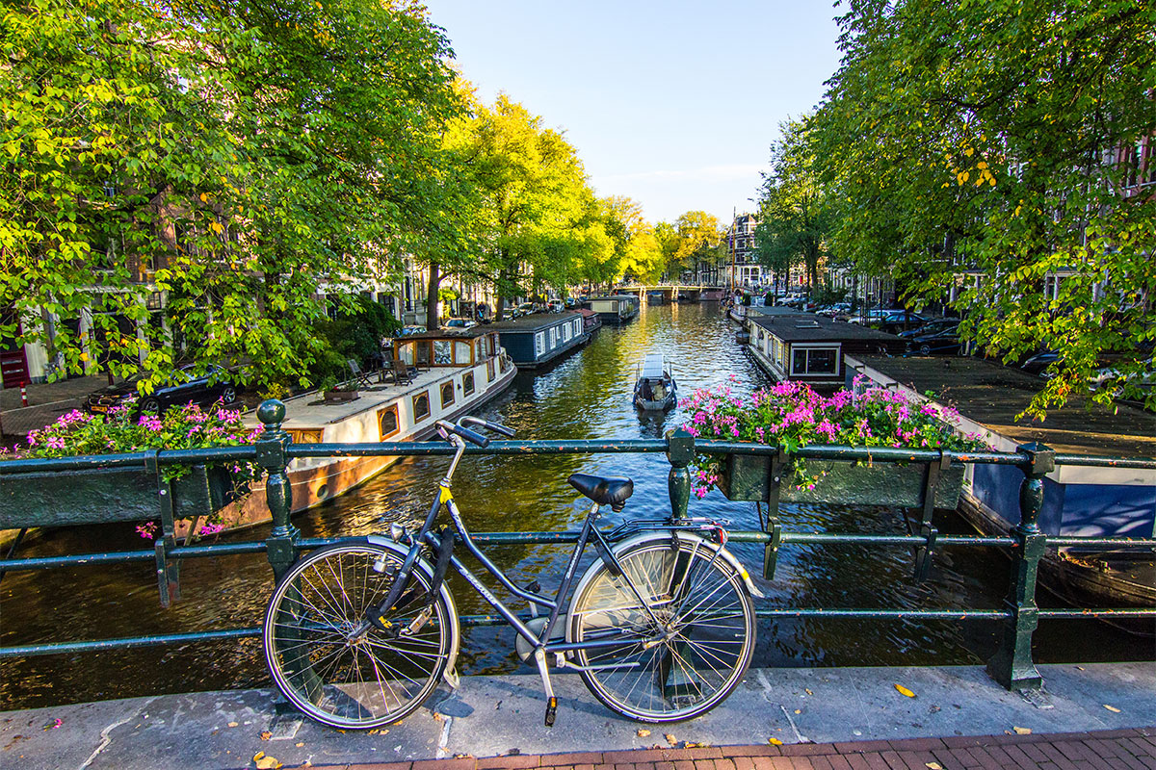
FUTURE CIRCULAR COLLIDERS
Alain Blondel, University of Geneva, FCC coordination group

Slide 2
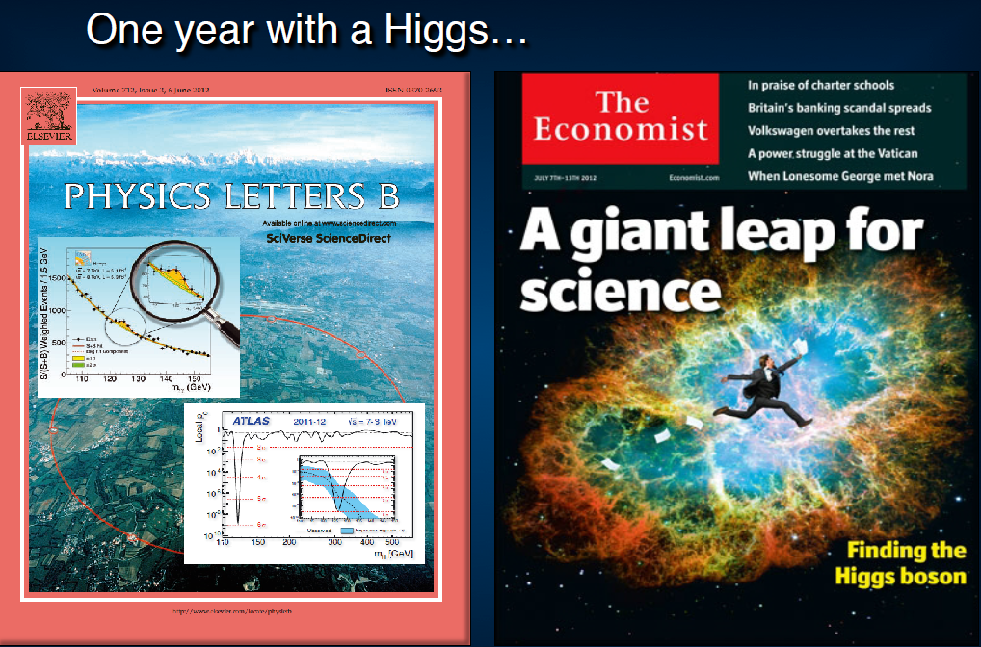
SIX YEARS AGO ALREADY

Slide 3
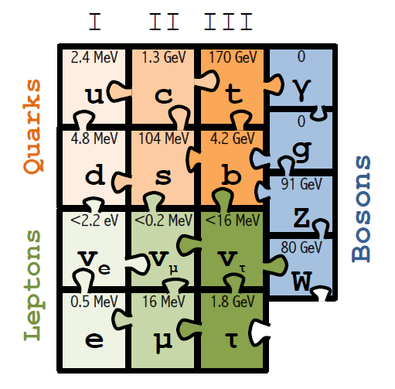
1994-1999: top mass predicted (LEP, mostly Z mass&width)
top quark discovered (Tevatron)
t’Hooft and Veltman get Nobel Prize
(c) Sfyrla

Slide 4
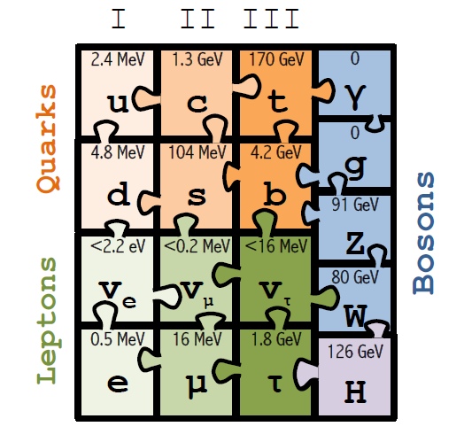
1997-2013 Higgs boson mass cornered (LEP H, M_{Z} etc +Tevatron m_{t} , M_{W})
Higgs Boson discovered (LHC)
Englert and Higgs get Nobel Prize
IT LOOKS LIKE THE
STANDARD MODEL
IS COMPLETE.....
(c) Sfyrla

Slide 5
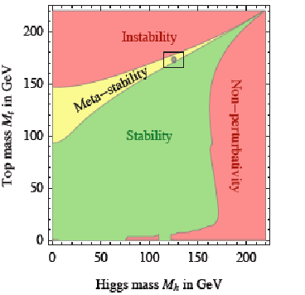
Is it the end?

Slide 6
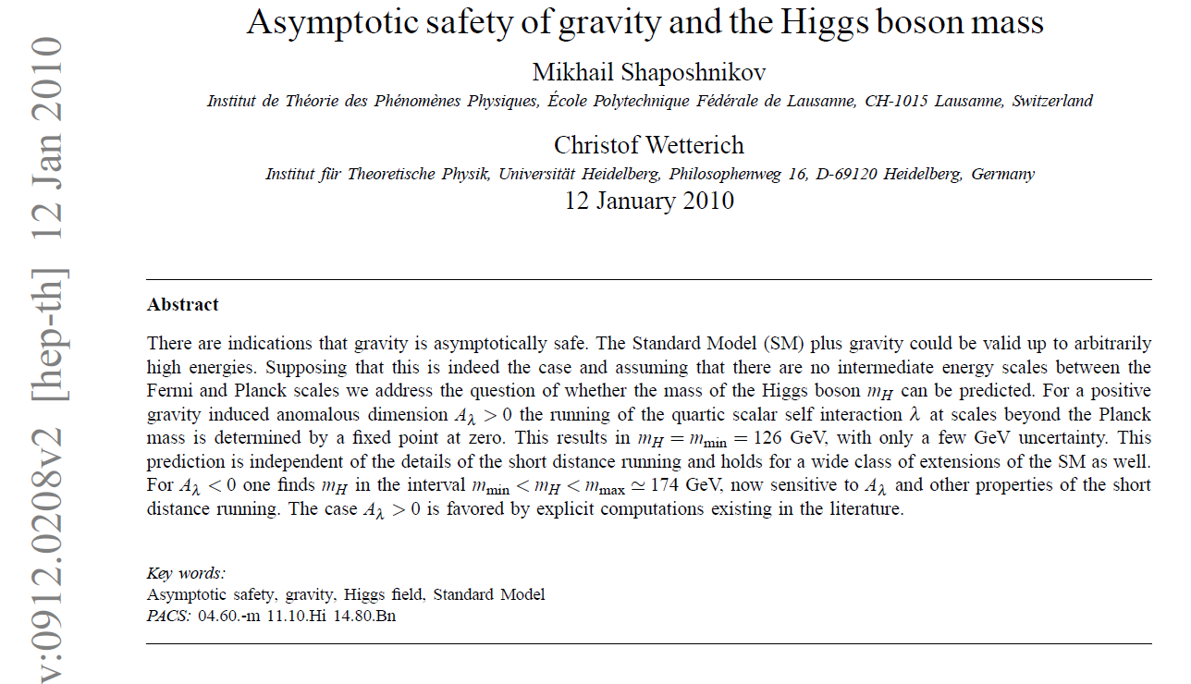
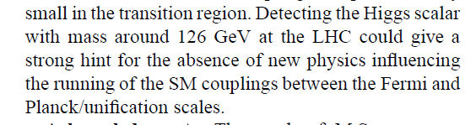
Is it the end?

Slide 7
Is it the end?
Certainly not!
-- Dark matter
-- Baryon Asymmetry in Universe
-- Neutrino masses
are experimental proofs that there is more to understand.
We must continue our quest
HOW?
Direct observation of new particles (but not only!)
New phenomena (Neutral currents, CP violation, neutrino oscillations…)
Deviations from precise predictions
(ref. Uranus to Neptune, top and Higgs preds from LEP/SLC/Tevatron/B factories, g-2, etc…)

Slide 8
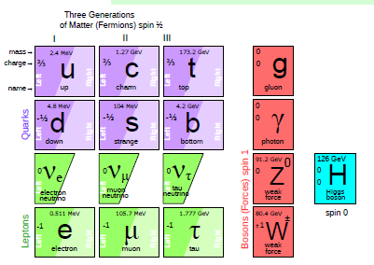
at least 3 pieces are still missing
Since 1998 it is established that neutrinos have mass
and this very probably implies new degrees of freedom

Slide 9
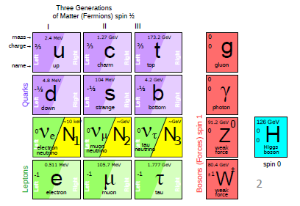
at least 3 pieces are still missing
Since 1998 it is established that neutrinos have mass
and this very probably implies new degrees of freedom
➔ «sterile», very small coupling to known particles
completely unknown masses (eV to ZeV), nearly impossile to find.
.... but could perhaps explain all: DM, BAU,ν-masses

Slide 10
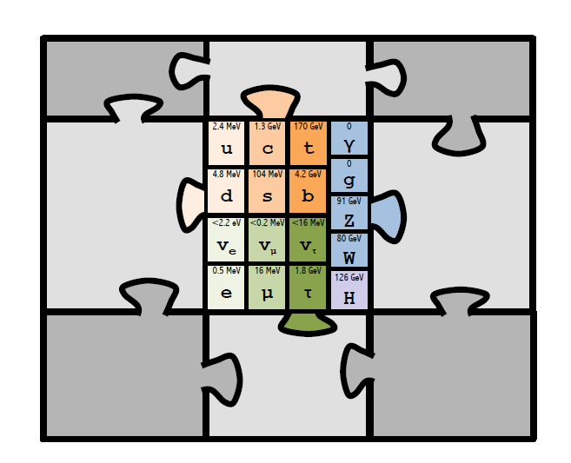
or perhaps new world(s) of SM replicas
Extra-dimensions
Super
Symmetry
you
Funny
Higgses
name
it

Slide 11
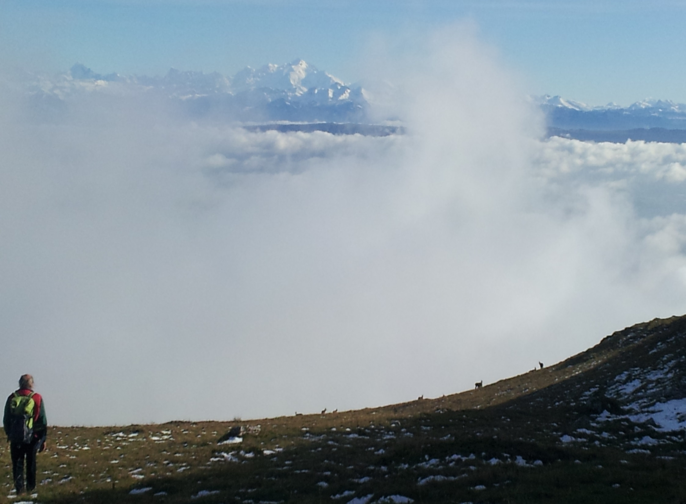

Nima
At higher masses -- or at smaller couplings?

Slide 12
FUTURE ACCELERATORS
1. High Luminosity LHC (3000 fb⁻¹ @ 14 TeV) → 2035
An approved program
2. ILC/CLIC as Higgs and top factory and upgrades
A very ‘mature’ study of a new technique
‘or’
2’. Circular e+e- Z,W,H,top factories (FCC)
«Young» studies of a very mature technique
3. HE-LHC (FCC)
apparently straightforward... but
‘or’
4. 100 TeV hadron collider (FCC)
The ‘ultimate’ energy exploration
4. muon collider (possibly FCC?)
not so young but still no very mature (will briefly mention H width)

Slide 13
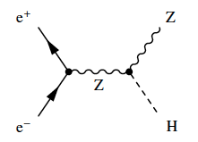
pp collisions / e⁺e⁻ collisions
proton
electron
positron
p-p collisions | e⁺e⁻ collisions
Proton is compound object Initial state not known event-by-event Limits achievable precision | e⁺/e⁻ are point-like Initial state well defined (√s / polarisation) High-precision measurements
High rates of QCD backgrounds Complex triggering schemes High levels of radiation | Cleaner experimental environment Trigger-less readout Low radiation levels
High cross-sections for colored-states | Superior sensitivity for electro-weak states
High-energy circular pp colliders feasible | High energy (>≈380 GeV) e⁺e⁻ requires linear collider High precision (<≈380 GeV) best at circular collider
Notes:
While the LHC is a perfect discovery machine, and reaches already a remarkable precision for the studies, a different type of accelerator can even do better.
This is because the LHC collides protons, which are composite particles. When you collide electrons with their antimatter twins positrons, this opens the door for much higher precision in the physics analysis.

Slide 14
The Physics Landscape
1. we know that new physics beyond the SM is needed for
dark matter,
baryon asymmetry of the universe
neutrino masses
the fact that electron and proton have the same charge to 10⁻²² precision...
and more.
2. The Standard Model without any new particles with couplings .ge. the
weak coupling works very well:
-- predicted the top and Higgs masses from m_{Z} vs m_{W} vs Γ_{z} vs sin²θ^{eff}_{W} etc..
-- and seems to extrapolate smoothly to the Planck scale.
3. Fascinating situation: where to look and what will we find?
4. search must continue but tools must be as broad and powerful as possible,
as there is no precise target.

Slide 15


Slide 16
At the moment we do not know for sure what is the most sensible scenario
LHC offered 3 possible scenarios: (could not lose)
Discover that there is nothing in this energy range.
➔ This would have been a great surprise and a
great discovery!
Discover SM Higgs Boson
and that nothing else
is within reach
Most Standard scenario
great discovery!
Discover many new effects or particles
great discovery!
NO
So far we are here
But….
Keep looking
in 13/14 TeV data!
Also: understand scaling
of LHC errors with luminosity
Answer in 2018
High precision
High energy
BE PREPARED!

Slide 17
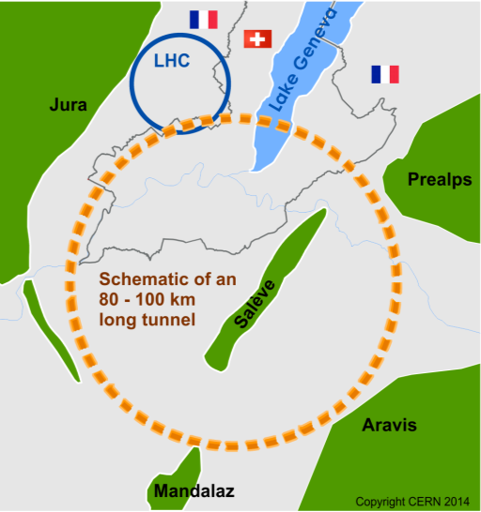
The Future Circular Colliders
CDR and cost review for the next ESU (2018)
International collaboration to Study Colliders fitting in a new ~100 km infrastructure, fitting in the Genevois
Ultimate goal:
100 TeV pp-collider (FCC-hh)
→ defining infrastructure requirements
Two possible first steps:
e⁺e⁻ collider (FCC-ee)
High Lumi, E_{CM} =90-400 GeV
HE-LHC 16T ⇒ 28 TeV
in LEP/LHC tunnel
Possible add-on:
p-e (FCC-he) option
~16 T magnets
From what we know today :
the way by FCC-ee is probably the fastest and cheapest way to 100 TeV.
That combination also produces the most physics. It is the assumption in the following.
also a good start for μC!
From European Strategy in 2013: “ambitious post-LHC accelerator project”
Study kicked-off in Geneva Feb 2014

Slide 18

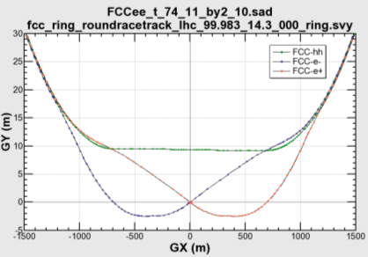

common layouts for hh & ee
11.9 m
IP
30 mrad
FCC-hh/
ee Booster
9.4 m
Lepton beams must cross over through the common RF to enter the IP from inside.
Only a half of each ring is filled with bunches.
0.6 m
Common
RF (tt)
Common
RF (tt)
Max. separation of 3(4) rings is about 12 m:
wider tunnel or two tunnels are necessary around the IPs, for ±1.2 km.
IP
FCC-ee 1, FCC-ee 2,
FCC-ee booster (FCC-hh footprint)
Asymmetric IR for ee, limits SR to expt
2 main IPs in A, G for both machines
Notes:
Check with Katsunobu to have latest layout.
Check with detector people if 9 m offset is acceptable for ee detector

Slide 19
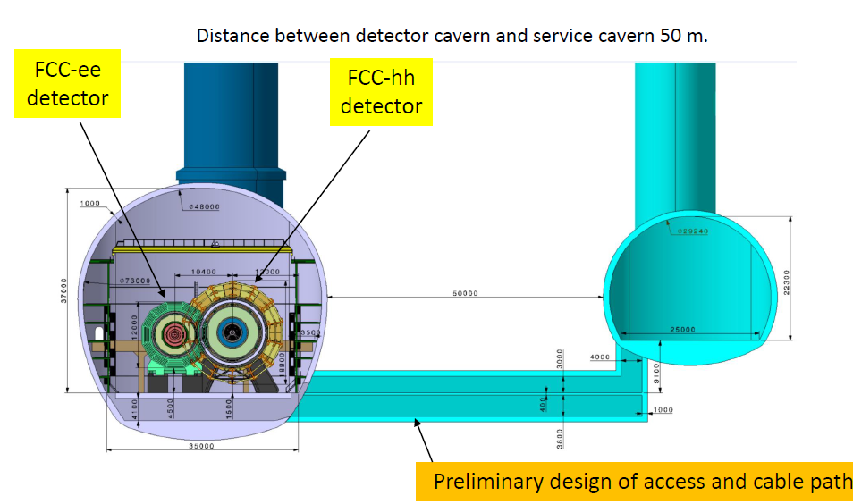

Slide 20
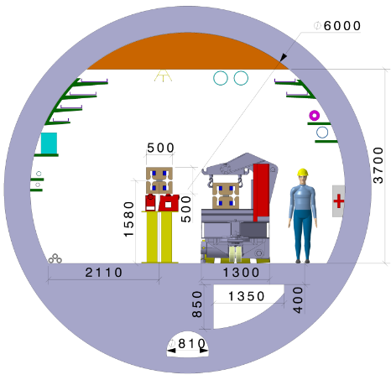
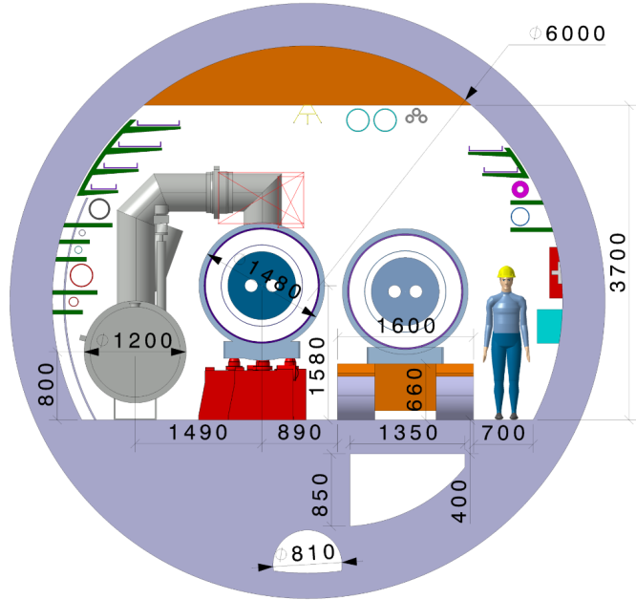
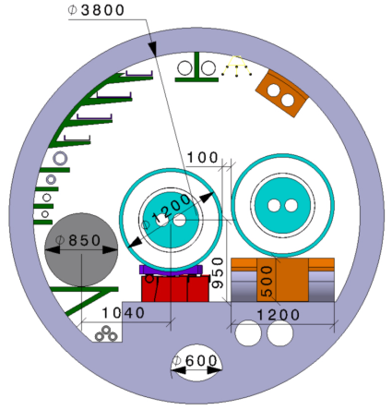
FCC-ee
FCC-hh
HE-LHC :
constraints:
No civil engineering, same beam height as LHC
→ Magnets OD ca. 1200 m max
QRL (shorter than FCC) OD ca. 850 mm (all included)
Magnet suspended during „handover“ from transport vehicle to installation transfer table
Compliant 16T magnet design ongoing (challenge)
+ still many items to study!
If HE-LHC can
work in 3.8m ∅ ...
it will feed-back
to FCC tunnel
design!

Slide 21
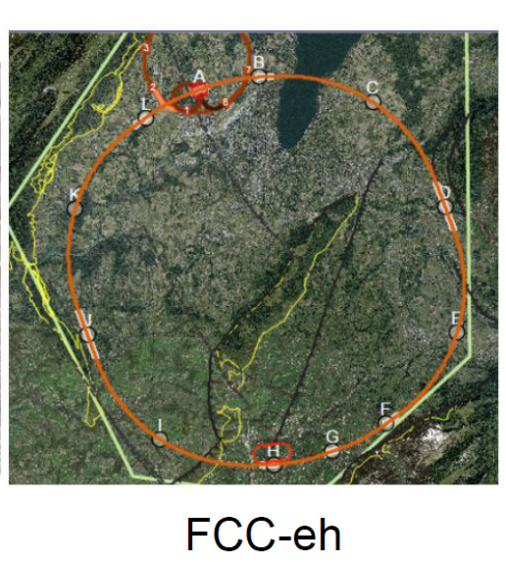
LHeC or FCC-eh function as an add-on to LHC or FCC-hh respectively:
additional 10km cicumference
Electron Reciculating Linac ERL.
The possibility to collide FCC-ee with FCC-hh is not considered in the framework of the study
In the case of FCC-eh it could profit from the -- then existing -- FCC-hh,
and, perhaps, from considerable RF of the -- then dismantled -- FCC-ee

Slide 22
e+
e-
e+ e- colliders have a very rich history of discoveries
examples:
-- charm and tau (1974-76) and tau neutrino (81) SPEAR at SLAC (USA), DORIS
-- gluon (1978) PETRA at DESY (Germany)
-- B mixing (1985) DORIS at DESY
-- Number of neutrinos is 3 LEP at CERN 1989
-- Prediction of top quark mass LEP 1994
-- CP violation in the B system 1999 PEPII at SLAC and Belle at KEK (Japan)
and of precision measurements
ex:
tau mass at BEPC, Beijing 1776.99 +0.29−0.26 (1.5 10⁻⁴)
J/ψ mass at Novosibirsk, 3096.916 ± 0.011 MeV (3.510⁻⁶)
Z mass and width at LEP 91.1876 ± 0.0021 (2 10⁻⁵)

Slide 23
The e+e- colliders:
Circular e+e- colliders
Placed in a tunnel of circumference C and bending radius ρ (2π ρ ~0.8 C)
Acceleration occurs in a few RF sections around the ring.
total RF volts needed = energy loss by synchrotron radiation (scales as E⁴/ρ)
Main limitation : power and ring size → cost + power + beam energy
Beams collide 10⁶ to 10⁷ times
Many e+e- storage rings and many successes: c and b factories, LEP
LEP = 27km circumference reached 209 GeV -- long believed to be the last
at high energies. Luminosity of b factories has reached unexpected levels
Linear e+ e- colliders
Acceleration takes place once through a large set of RF cavities
total RF volts needed = center-of-mass Energy
e.g. 500 GeV Linear collider requires > 500 GV of RF voltage
Main limitation = cost + power + beam energy
beam polarization is easy for electrons, feasible for positrons
beam energy spread few percent, beam energy calibration ΔE/E~10⁻⁴
Beams collide only once
Only one example that worked: SLC at SLAC (1988-1998) -- not easy!

Slide 24
LEP3, CEPC and TLEP/FCC-ee
Circular e+e- colliders designed to study the Higgs boson
but also Z, W and top factories
AB, F. Zimmermann
Dec. 13 2011

Slide 25

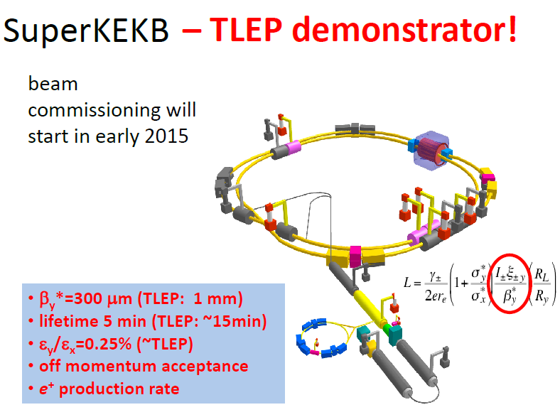
beam commissionning
started,
physics → end 2018
2016

Slide 26
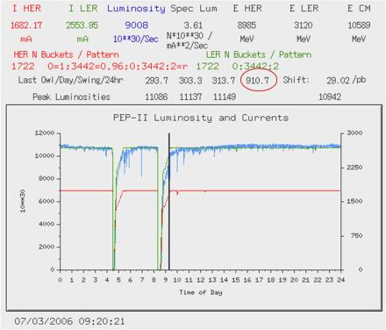
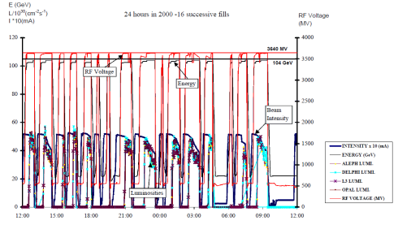
Toping up ensures constant current, settings, etc...
and greater reproducibility of system
LEP2 in 2000 (12th year!):
fastest possible turnaround but
average luminosity ~ 0.2 peak luminosity
B factory in 2006 with toping up
average luminosity ≈ peak luminosity

Slide 27
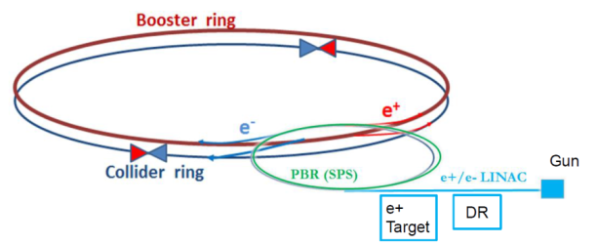
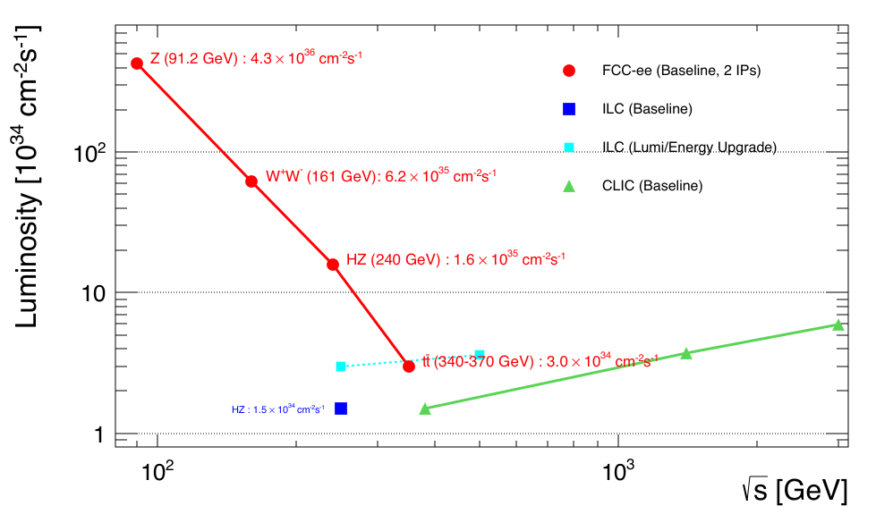
FCC-ee
AB, F. Zimmermann 2011 (LEP3@240 GeV)
Q: Why is luminosity so much higher than LEP?
A: inspired by b-factory designs
-- continuous injection (high efficiency)
-- e+ and e- separate (→many bunches)
-- fix 100 MW Synchrotron Radiation at all E
-- low β*_{y} , O(1mm)
-- larger ring (P_{SR}∝ E⁴/ρ)
-- beam cross at angle (30 mrad)
-- crab waist crossing
-- asymmetric IP to avoid SR → LEP levels
top-up injection for high duty factor
several schemes possible
Z WW HZ tt
LEPx10⁵!
Luminosity performance
dominated by
-- at Z, WW, H energies:
beam-beam instabilities
→ simulations
-- at top energy: beamstrahlung
depends on value of ε_{y}/ε_{x}
0.2% assumed (0.25%@superKEKB)
0.4% achieved at LEP
-- limit from injector is much higher
based on latest lumi optimization by Shatilov

Slide 28
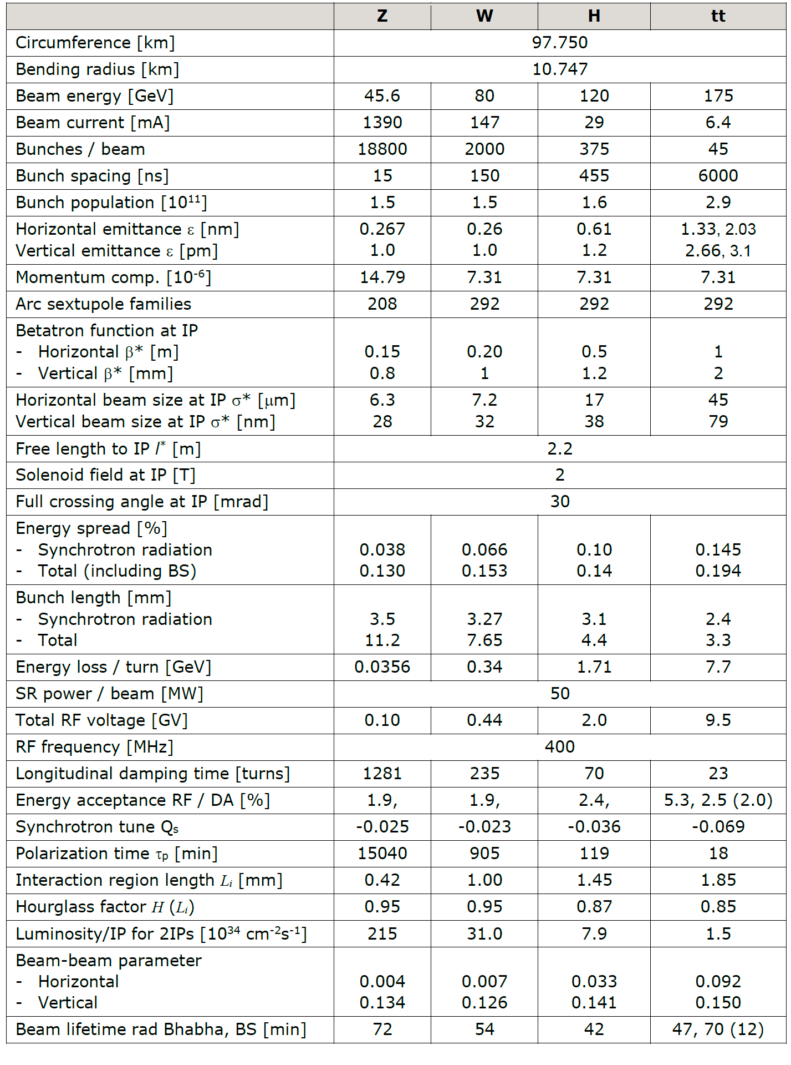
Recent FCC-ee parameter list
1.9

Slide 29
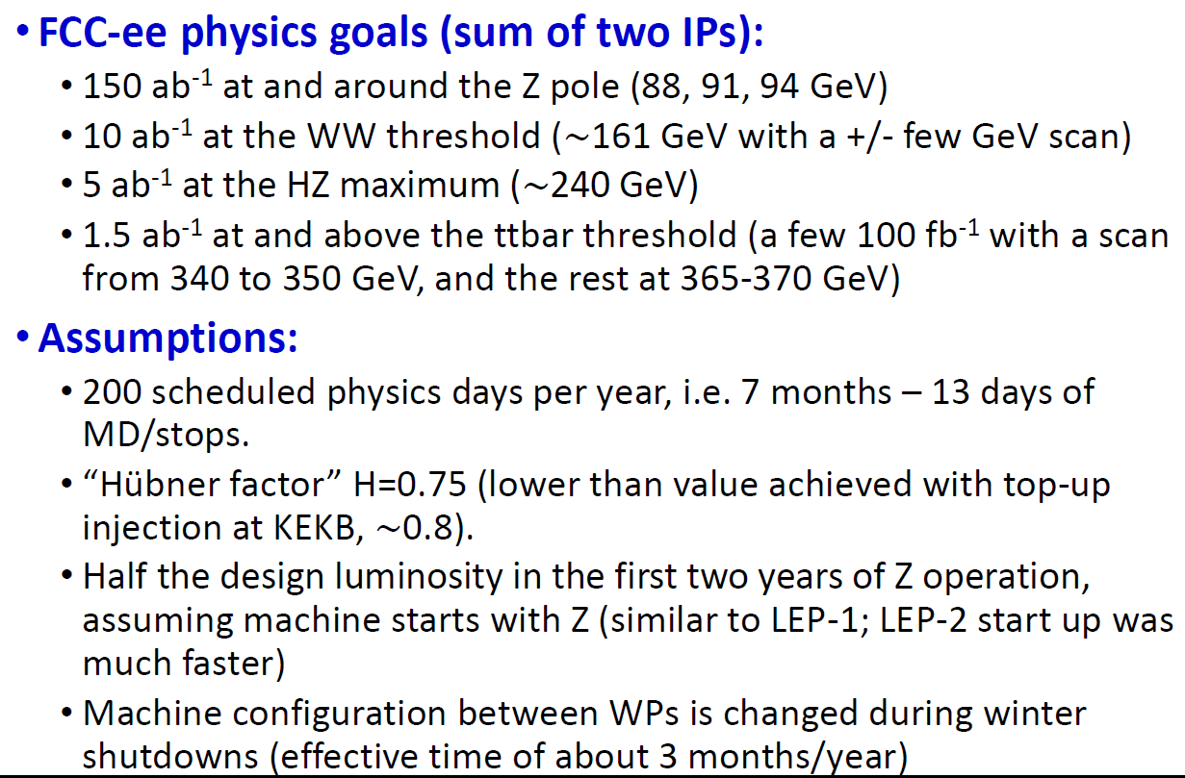
FCC-ee physics run

Slide 30
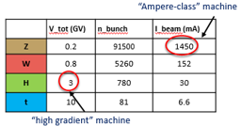
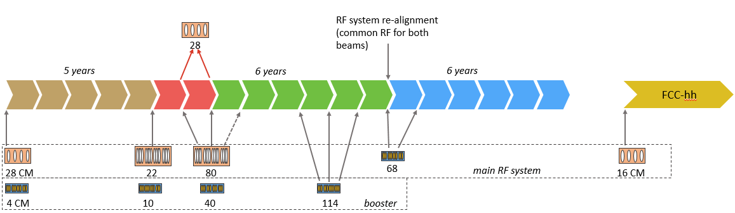
IMPLEMENTATION AND RUN PLAN
Three sets of RF cavities for FCCee & Booster:
Installation as LEP ( ≈30 CM/winter)
high intensity (Z, FCC-hh): 400 MHz mono-cell cavities, ≈ 1MW source
high energy (W, H, t): 400 MHz four-cell cavities, also for W machine
booster and t machine complement: 800 MHz four-cell cavities
Adaptable 100MW, 400MHz RF power distribution system
➔ Spreads the funding profile
Z 150 ab⁻¹
W 10 ab⁻¹
ZH thresh 5ab⁻¹
tt thresh + tt 365 1.5ab⁻¹
4 years
2 yrs
3 years
5 years
indicative: 2(comm) + 2 2 3 5 total ~14 years

Slide 31

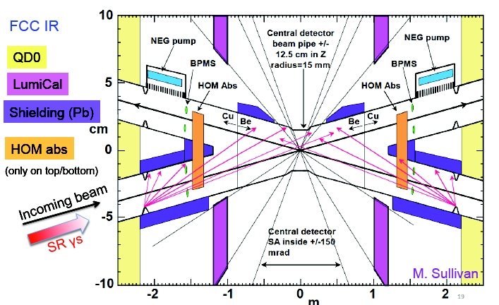
Detailed layout of the Interaction Region
Beam pipe radius at IP is 15mm ☺

Slide 32
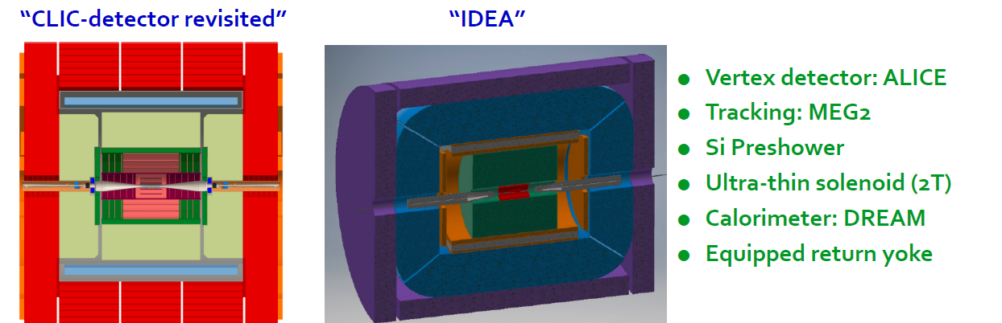
FCC-ee Detectors
Two integration, performance and cost estimates ongoing:
-- Linear Collider Detector group at CERN has undertaken the adaption of
CLIC-SID detector for FCC-ee
-- new IDEA, detector specifically designed for FCC-ee (and CEPC)
MAPS

Slide 33
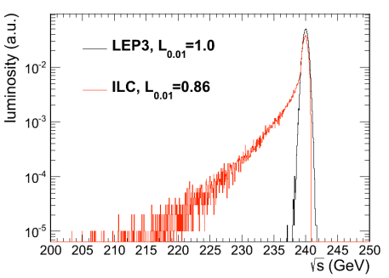
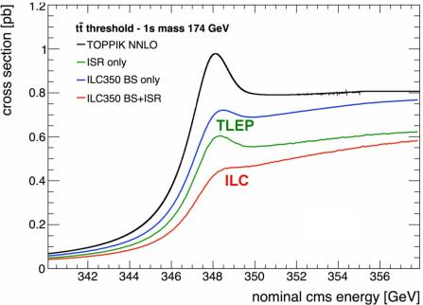
BEAMSTRAHLUNG
Luminosity E spectrum
Effect on top threshold
➔
Beamstrahlung @TLEP is benign: particles are either lost or recycled on a synchrotron oscillation
➔ some increase of energy spread
but no change of average energy
Little EM background in the experiment.

Slide 34

FCC-ee discovery potential
Today we do not know how nature will surprise us. A few things that FCC-ee could discover :
EXPLORE 10-100 TeV energy scale (and beyond) with Precision Measurements
-- ~20-50 fold improved precision on many EW quantities (equiv. to factor 5-7 in mass)
m_{Z,} m_{W}, m_{top} , sin² θ_{w}^{eff} , R_{b} , α_{QED} (m_{z}) α_{s} (m_{z} m_{W} m_{τ}), Higgs and top quark couplings
DISCOVER a violation of flavour conservation or universality
-- ex FCNC (Z --> μτ , eτ) in 5 10¹² Z decays.
+ flavour physics (10¹² bb events) (B→s τ τ etc..)
DISCOVER dark matter as «invisible decay» of H or Z or in LHC loopholes.
DISCOVER very weakly coupled particle in 5-100 GeV energy scale
such as: Right-Handed neutrinos, Dark Photons etc…
+ an enormous amount of clean, unambiguous work on QCD etc….
NB the «Z factory» plays an important role in the ‘discovery potential’
“First Look at the Physics Case of TLEP”, JHEP 1401 (2014) 164,

Slide 35
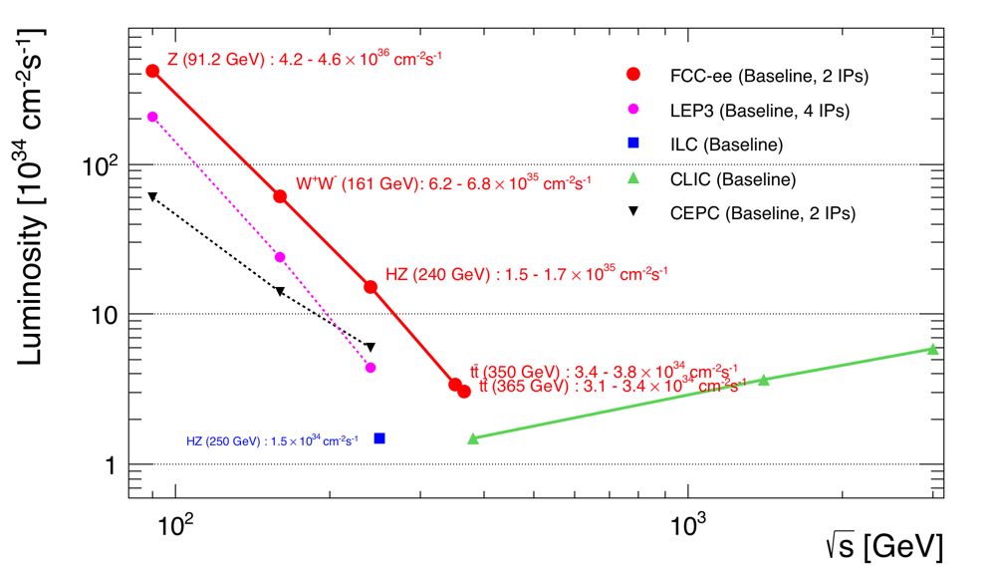
e+e- colliders
Z WW HZ tt
LEPx10⁵!
Overlap in Higgs/top region, but differences and complementarities
between linear and circular machines:
Circ: High luminosity, experimental environment (up to 4 IP), E_{CM} calibration
Linear: higher energy reach, longitudinal beam polarization

Slide 36
FCC-ee
Z WW HZ tt
LEPx10⁵!
Event statistics :
E_{CM} errors:
Z peak E_{cm} : 91 GeV 5 10¹² e+e- → Z
WW threshold E_{cm} : 161 GeV 10⁸ e+e- → WW
ZH threshold E_{cm} : 240 GeV 10⁶ e+e- → ZH
‾tt threshold E_{cm} : 350 GeV 10⁶ e+e- →‾tt
LEP x 10⁵
LEP x 2.10³
Never done
Never done
100 keV
300 keV
5 MeV
10 MeV

Slide 37
HIGGS FACTORIES
Higgs provides a very good reason why we need e+e- (or μμ) collider

Slide 38
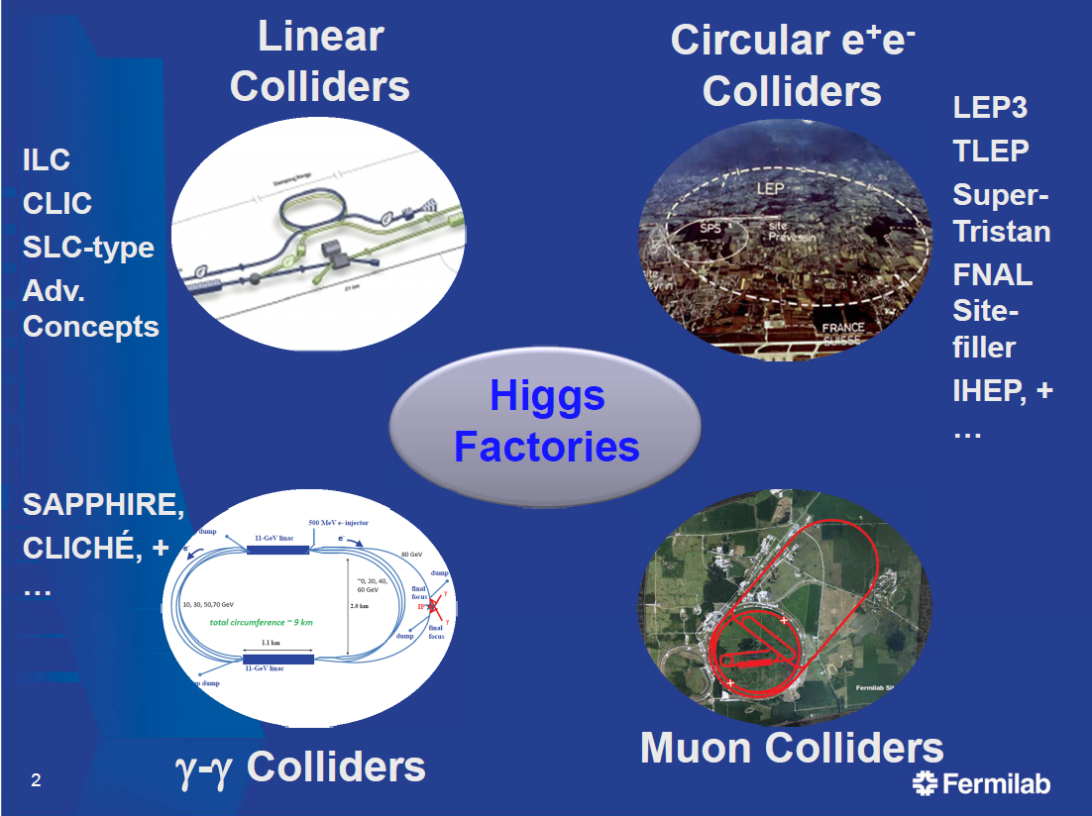
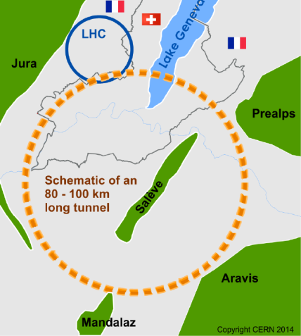

S. Henderson

Slide 39
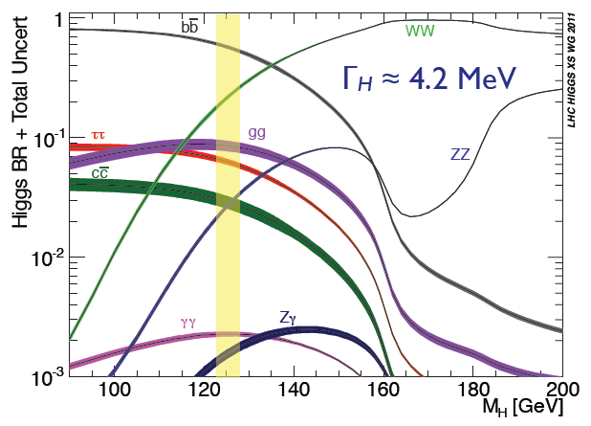
Once the Higgs boson mass is known, the Standard Model is entirely defined.
-- with the notable exception of neutrino masses, nature & mixings
***the only new physics there is***
but we expect these to be almost completely decoupled from Higgs observables. (true?)
Does H(125.9)
Fully accounts for EWSB (W, Z couplings)?
Couples to fermions?
Accounts for fermion masses?
Fermion couplings ∝ masses?
Are there others?
Quantum numbers?
SM branching fractions to gauge bosons?
Decays to new particles?
All production modes as expected?
Implications of MH ≈ 126 GeV?
Any sign of new strong dynamics?
your Banker’s question:
What precision is needed to see something interesting?
physicist answer: as much as possible.

Slide 40
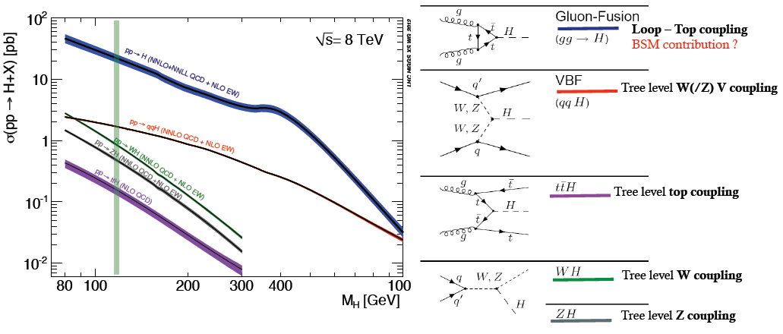
THE LHC is a Higgs Factory
The LHC is a Higgs Factory !
several tens of Million Higgs already produced > than most Higgs factory projects.
Difficulties: several production mechanisms to disentangle and
significant systematics in the production cross-sections σ_{prod} .
Challenge will be to reduce systematics by measuring related processes.
σ_{i→f} ^{observed} ∝ σ_{prod} (g_{Hi} )²(g_{Hf})² difficult to extract the couplings because σ_{prod} uncertain
Γ_{H} and Γ_{H} is unknown (invisible channels)

Slide 41
Why do we need a new machine after and in addition to HL-LHC?
the Higgs boson itself:
σ_{i→f} ^{observed} ∝ σ_{prod} (g_{Hi} )²(g_{Hf})² difficult to extract the couplings because
Γ_{H} σ_{prod} uncertain and Γ_{H} is unknown
also (g_{Hgluon} is sensitive to new physics… )
2. There might be other Higgs bosons or other generation of masses
which modifiy the properties of the Higgs (126) by small amounts
-> want to measure H properties as well as possible (10⁻³)
3. New physics with small couplings is difficult to see at the LHC
4. Precision measurements are limited at LHC,
yet precision measurements at LEP were used to predict
the top quark and Higgs boson masses
Can we improve the measurements by large factors?
5. In the following we will examine what we can learn from a next e+e- collider

Slide 42
Question:
H→ bb is ~60% of H decays.
what is more sensitive to the H→bb coupling:
pp→ ttH with H→ WW , H→ γγ
-- or –
pp→ ttH with H→ bb ?

Slide 43
Measuring the Higgs boson total width
(or its lifetime)

Slide 44
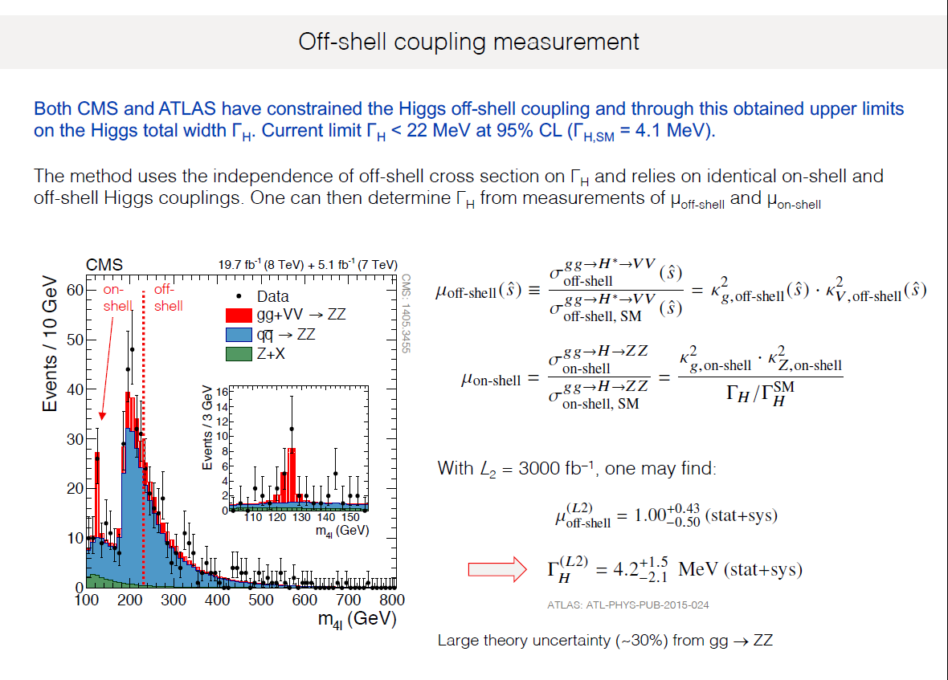
at HL-LHC
even at FCC-hh with 100 times more Higgses precision is limited at ~5-10%
➔ all couplings measts have this absolute error.

Slide 45
Higgs production mechanism
“higgstrahlung” process close to threshold
Production xsection has a maximum at near threshold ~200 fb
10³⁴/cm²/s ➔ 20’000 HZ events per year.
e⁻
H
Z – tagging
by missing mass
Z*
e⁺
Z
For a Higgs of 125GeV, a centre of mass energy of 240GeV is sufficient
➔ kinematical constraint near threshold for high precision in mass, width, selection purity

Slide 46
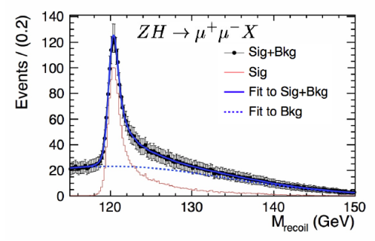
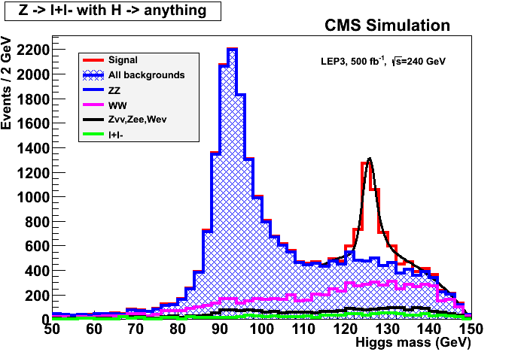
ILC
Z – tagging
by missing mass
total rate ∝ g_{HZZ}²
ZZZ final state ∝ g_{HZZ}⁴/ Γ_{H}
➔ measure total width Γ_{H}
e⁻
H
Z*
e⁺
Z
empty recoil = invisible width
‘funny recoil’ = exotic Higgs decay
easy control below theshold

Slide 47
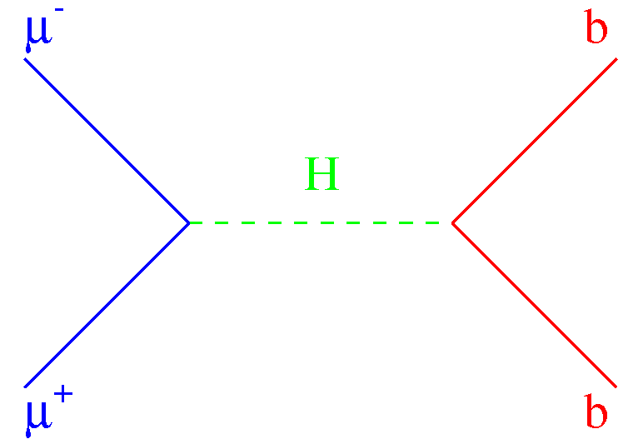
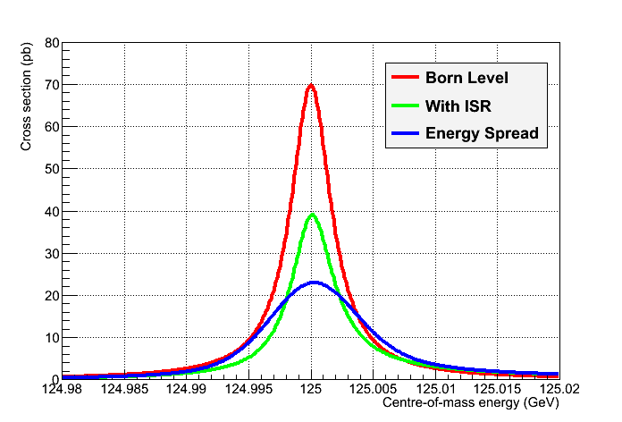
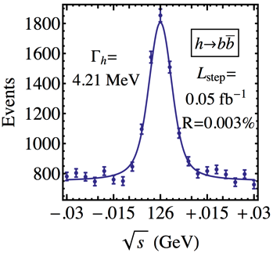
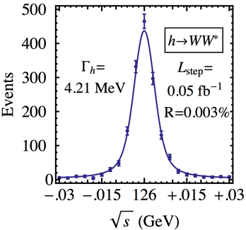
μ⁺μ⁻ Collider vs e⁺e⁻ Collider ?
A μ⁺μ⁻ collider can do things that an e⁺e⁻ collider cannot do
  Direct coupling to H expected to be larger by a factor m_{μ}/m_{e}
    ,jh [σ_{peak} = 70 pb at tree level]
  Beam energy spread δE/E may be reduced to 3×10⁻⁵
    6D Cooling, no beamstrahlung, ~no bremsstrahlung
    For δE/E = 0.003% (δE ~ 3.6 MeV, Γ_{H} ~ 4 MeV)
      Corresponding luminosity ~ 10³¹ cm⁻²s⁻¹
        Expect 2300 Higgs events in 100 pb⁻¹/ year
  Polarization, beam energy and energy spectrum
    Can be measured with an exquisite precision
      From the electrons of the muon decays
  Then measure the lineshape of the Higgs at √s ~ m_{H}
    Five-point scan, 50 + 100 + 200 + 100 + 50 pb⁻¹
      Precision from H→bb and WW :
[16,17]
, W, …
σ (pb)
_{, W, …}
√s
σ(m_{H}), TLEP
m_{H} | σ_{Peak} | Γ_{H}
0.1 MeV | 0.6 pb | 0.2 MeV
10⁻⁶ | 2.5% | 5%

Slide 48
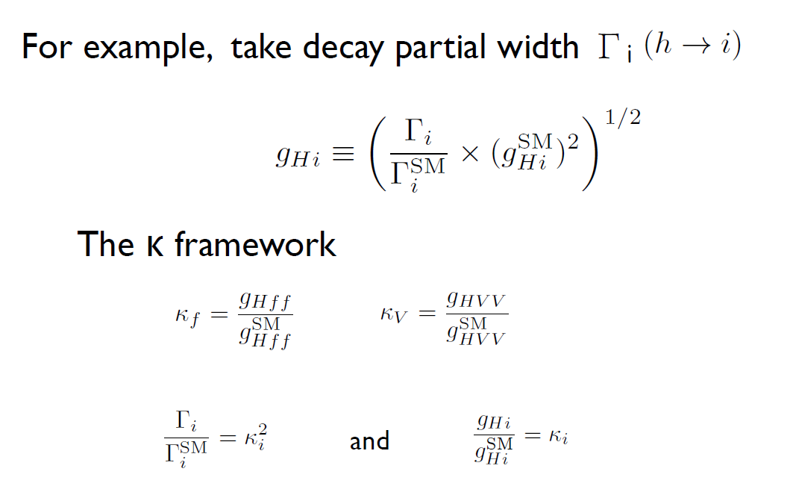
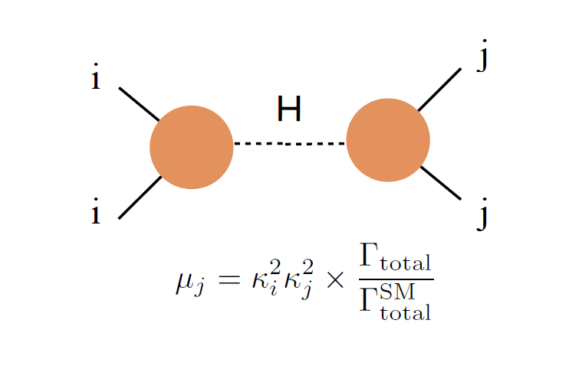
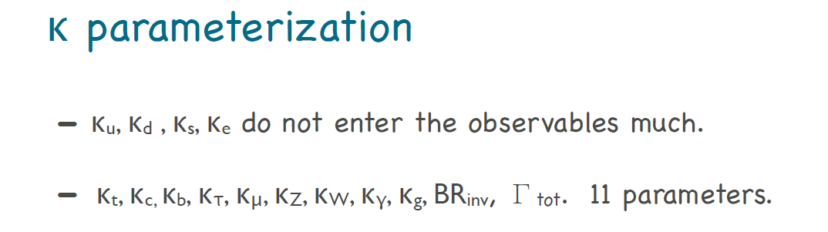
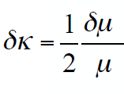
μ’s and κ’s and couplings
μ_{ij} ≡ σ_{i→H→j} / (σ_{i→H→j} )SM
μ_{ij} = κ_{i}² κ_{j}² . (Γ_{tot} SM / Γ_{tot} )
It is important to remember than Γ_{tot} = (∑ κ_{i}² Γ_{i} SM ) + Γ_{inv} + Γ _{exo}

Slide 49
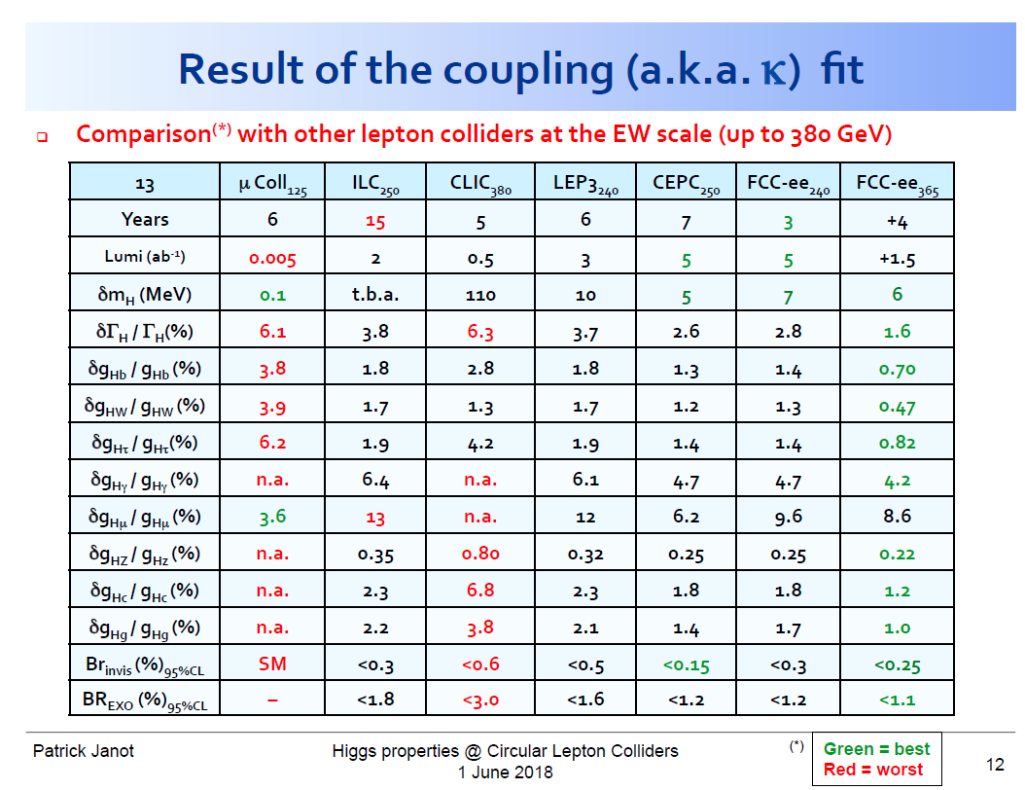

Slide 50
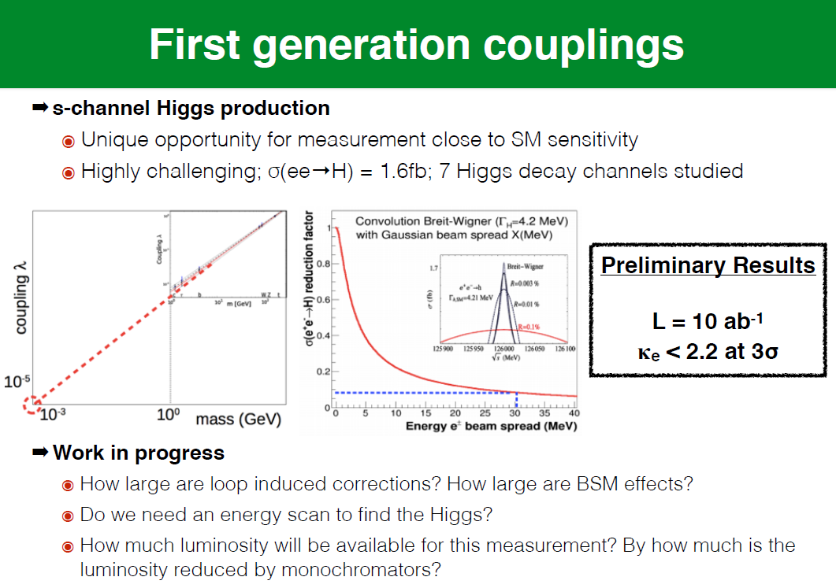

Slide 51


Slide 52


Slide 53


Slide 54

NB these are similar precisions as obtained from HL-LHC

Slide 55


Slide 56


HIGGS SELF COULING VERY DIFFICULT TO MEASURE PRECISELY AT LINEAR COLLIDERS
30% precision after 20 years
needs high energy (another 10-20 years) for 10% precision

Slide 57
Measurements of most of Higgs physics and couplings, CP violation etc..
are best made with the ZH process at 240-350 GeV
Top quark and Higgs self couplings can be made with a linear collider of energy
above 500 GeV (at least 550 GeV for ttH, at least 1 TeV for HHH).
However for ttH and HHH, similar precisions can be achieved by combining
the HL-LHC with a 250-350 GeV e+e- machine.
And what about a higher energy pp collider?

Slide 58
100 TeV

Slide 59
Hadron collider parameters
parameter | FCC-hh |  | HE-LHC* | (HL) LHC
collision energy cms [TeV] | 100 |  | >25 | 14
dipole field [T] | 16 |  | 16 | 8.3
circumference [km] | 100 |  | 27 | 27
# IP | 2 main & 2 |  | 2 & 2 | 2 & 2
beam current [A] | 0.5 |  | 1.12 | (1.12) 0.58
bunch intensity [10¹¹] | 1 | 1 (0.2) | 2.2 | (2.2) 1.15
bunch spacing [ns] | 25 | 25 (5) | 25 | 25
beta* [m] | 1.1 | 0.3 | 0.25 | (0.15) 0.55
luminosity/IP [10³⁴ cm⁻²s⁻¹] | 5 | 20 - 30 | >25 | (5) 1
events/bunch crossing | 170 | <1020 (204) | 850 | (135) 27
stored energy/beam [GJ] | 8.4 |  | 1.2 | (0.7) 0.36
synchrotr. rad. [W/m/beam] | 30 |  | 3.6 | (0.35) 0.18
*tentative
Performance easier to achieve with 25 ns second spacing… 5ns preferred by expts!

Slide 60


Slide 61


Slide 62



Slide 63


Slide 64
COMPLEMENTARITY

Slide 65
g_{Hxx} | FCC-ee | FCC-hh | FCC-eh
ZZ | 0.15 % | < 1% *
WW | 0.20%
Γ_{H} | 1%
γγ | 1.5% | <1%
Zγ | -- | 1%
tt | 13% | 1%
bb | 0.4% |  | 0.5%
ττ | 0.5%
cc | 0.7% |  | 1.8%
μμ | 6.2% | 2%
uu,dd | H→ ργ? | H→ ργ?
ss | H→ φγ ? | H→ φγ ?
ee | ee → H
HH | 30% | ~3% | 20%
inv, exo | <0.45% | 10⁻³ | 5%
HIGGS PHYSICS
Higgs couplings g_{Hxx} precisions
hh, eh precisions assume
SM or ee measurements
FCC-hh to ZZ to serve
as cross-normalization

