Slide 1
FCC Detectors and Experiments
Topical Lectures ‘Physics at future accelerators’
NIKHEF, June 8th, 2018
W. Riegler, CERN
Future Circular Collider (FCC) is an integral conceptual design study for post-LHC particle accelerator options in a global context. It is exploring the potential of hadron and lepton circular colliders, performing an in-depth analysis of infrastructure and operation concepts and considering the technology research and development programs that would be required to build a future circular collider. A conceptual design report will be delivered before the end of 2018​, in time for the next update of the European Strategy for Particle Physics. This talk will give an overview of the FCC studies and present aspects of experiments and detectors at such machines.

Slide 2

Large Hadron Collider at CERN, Geneva, 14TeV pp collisions
27km
8.3T dipoles
p=0.3xRxB
1983 First concept
2009 First physics
2025 Luminosity upgrade
2035 End of exploitation

Slide 3
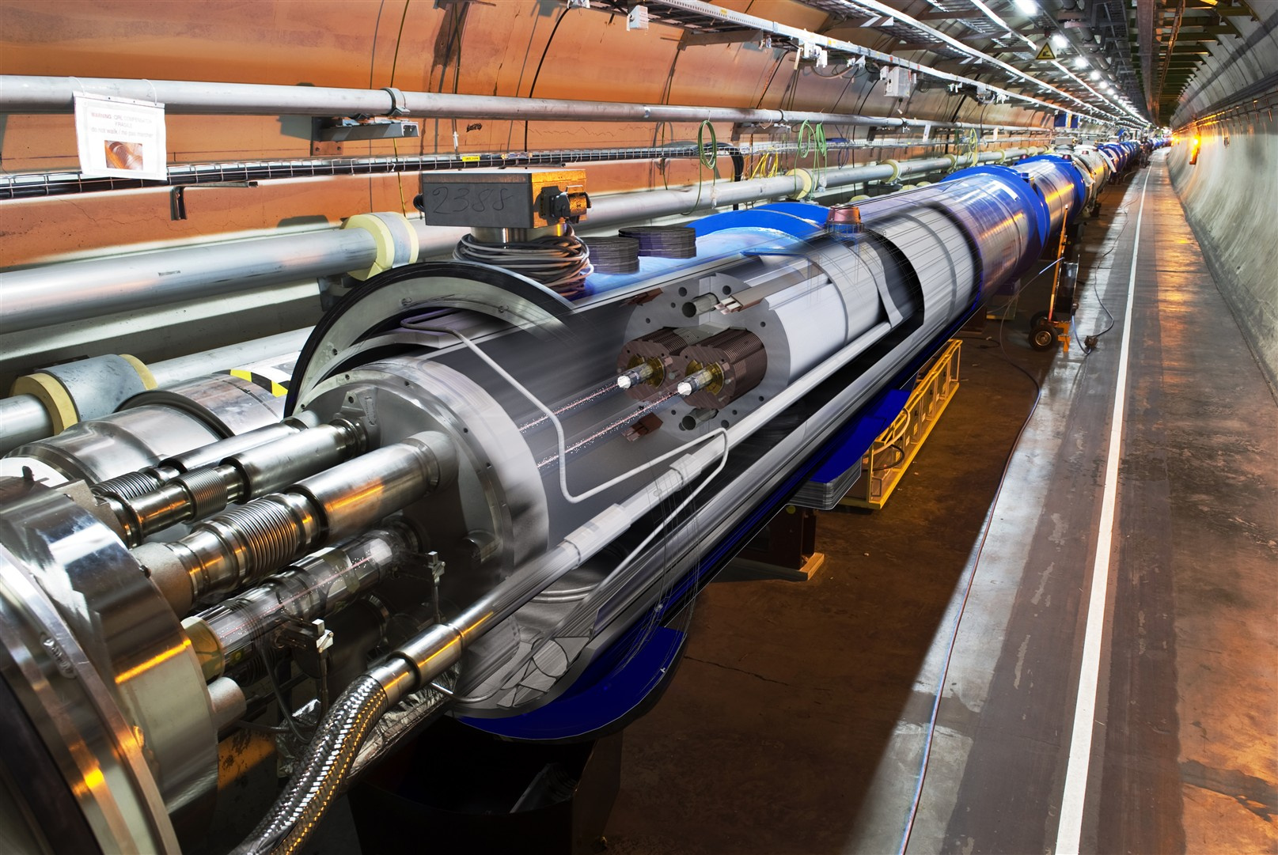
Large Hadron Collider at CERN, Geneva, 14TeV pp collisions
27km
8.3T Dipoles

Slide 4
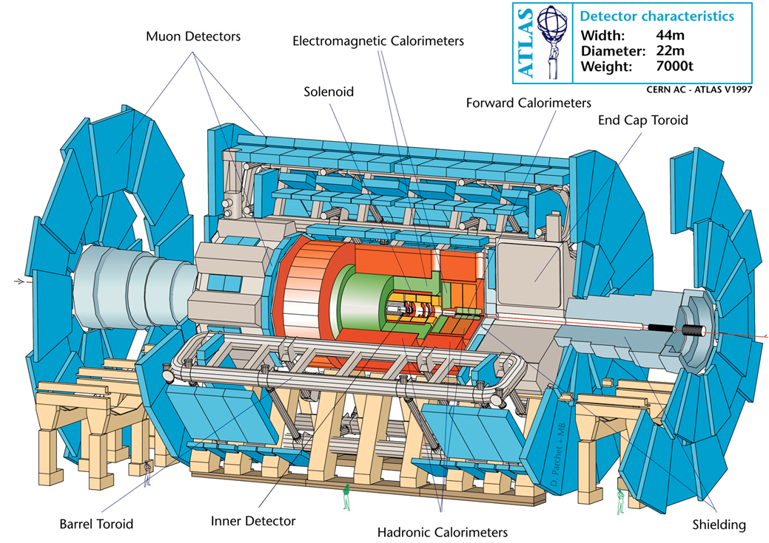
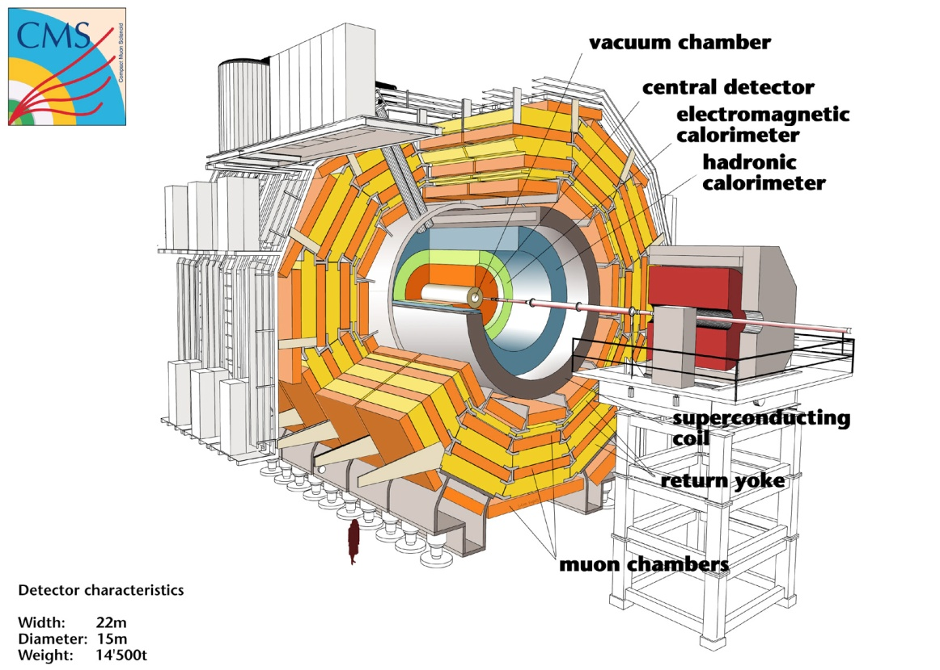
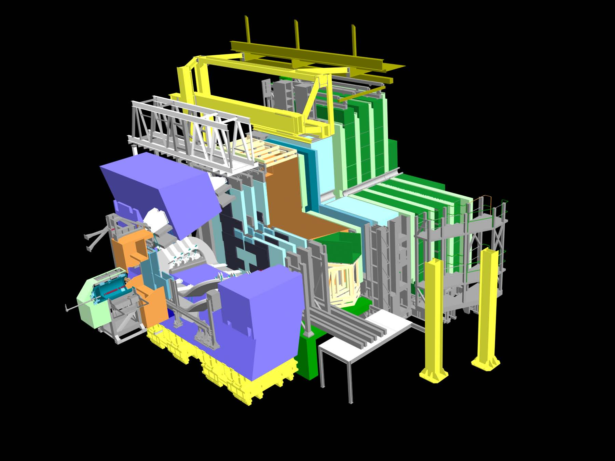
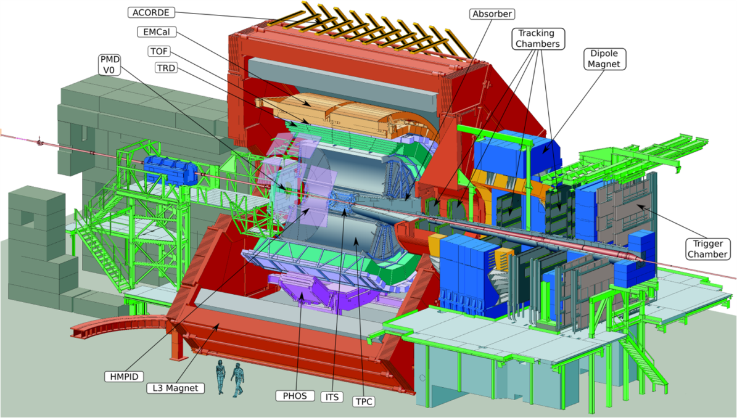
ATLAS, CMS, ALICE, LHCb

Slide 5
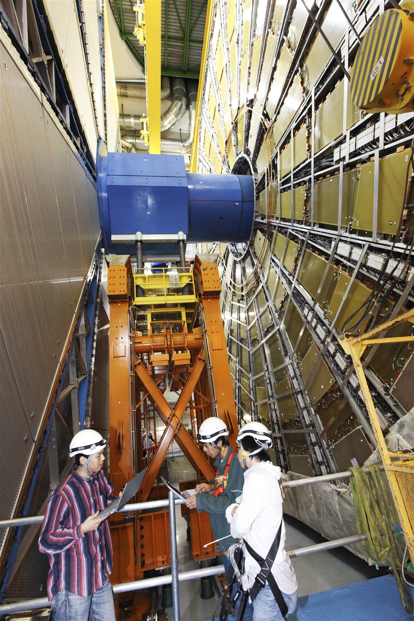
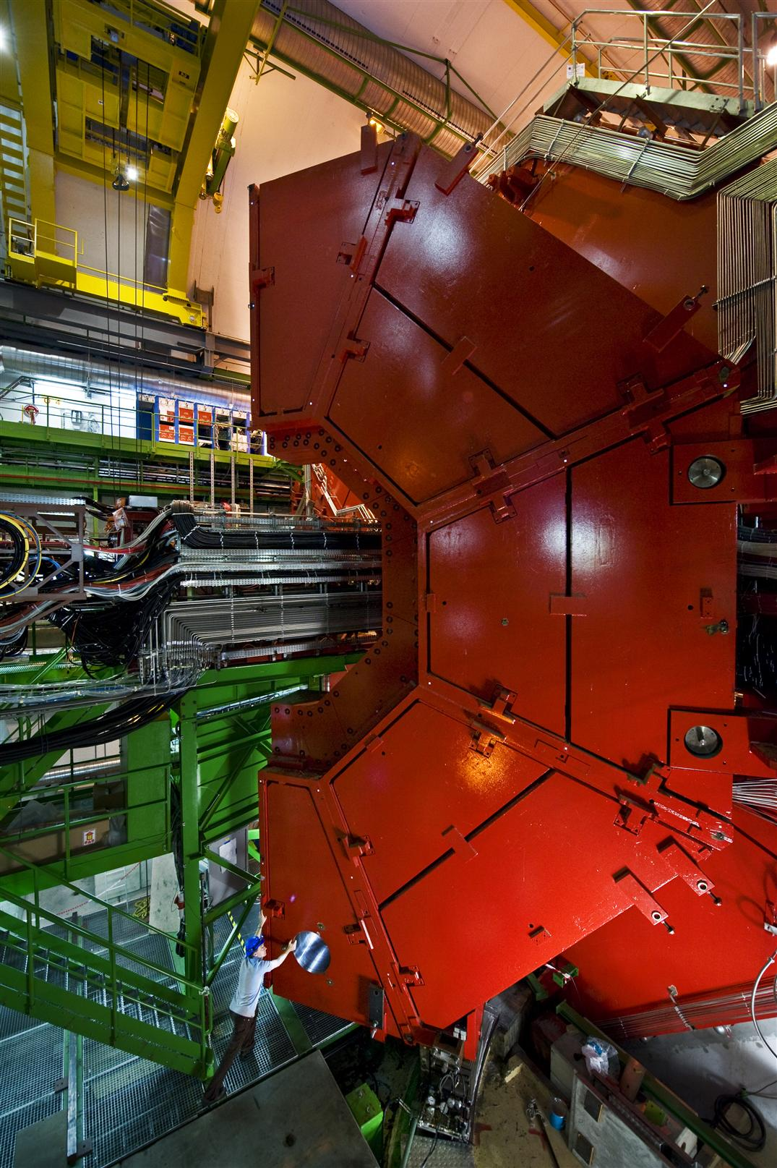
ATLAS, ALICE

Slide 6
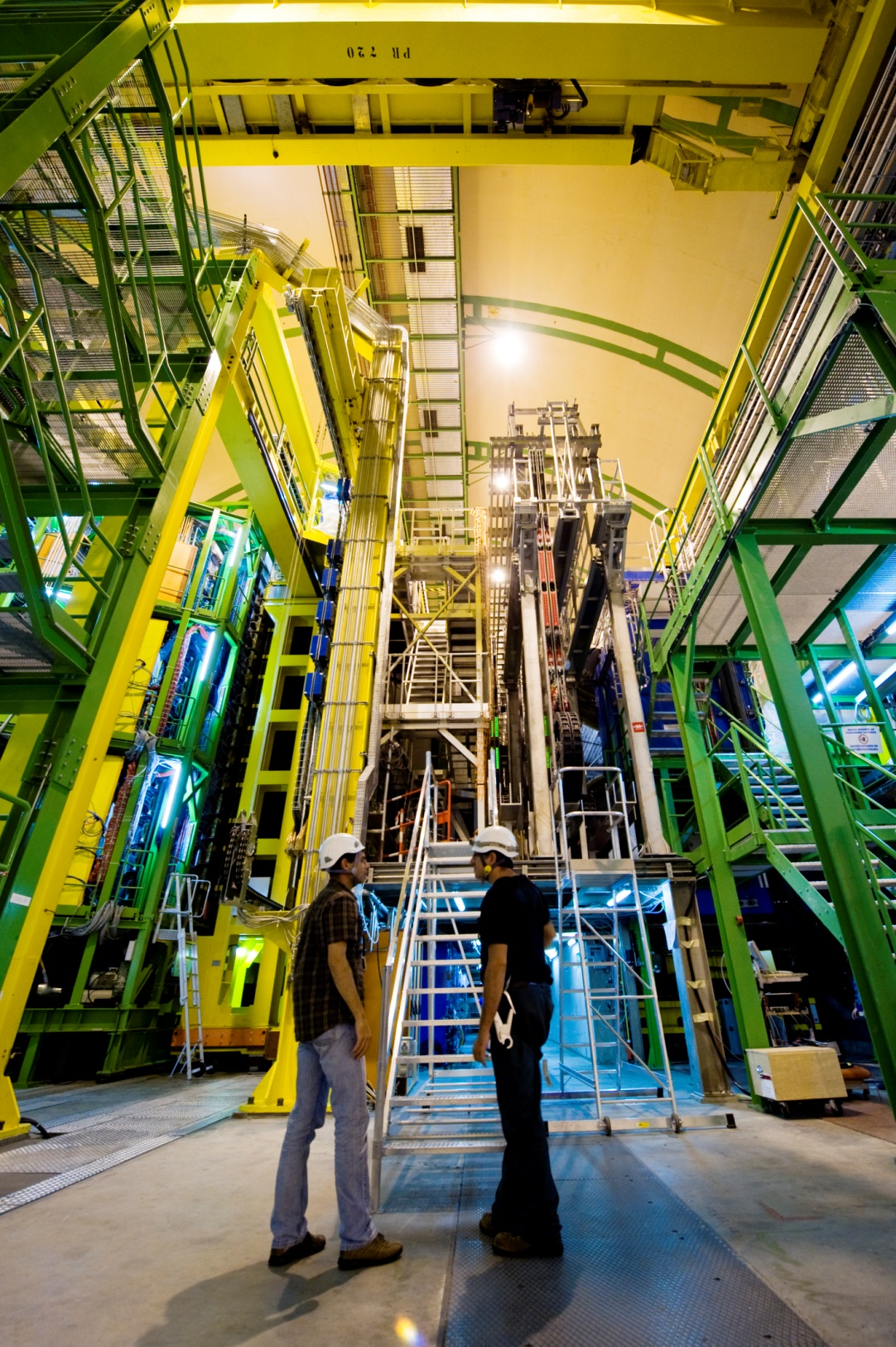
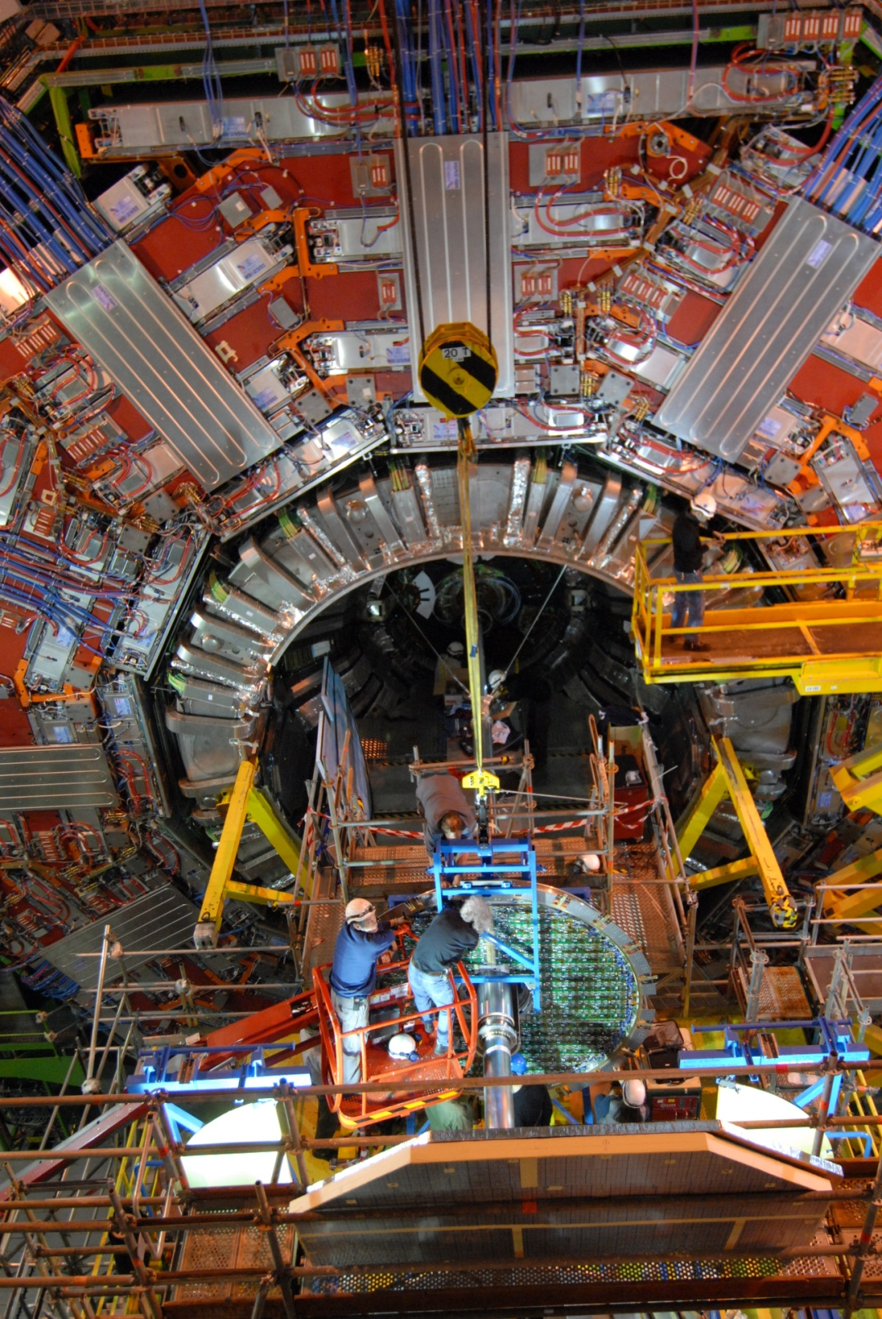
CMS, LHCb

Slide 7
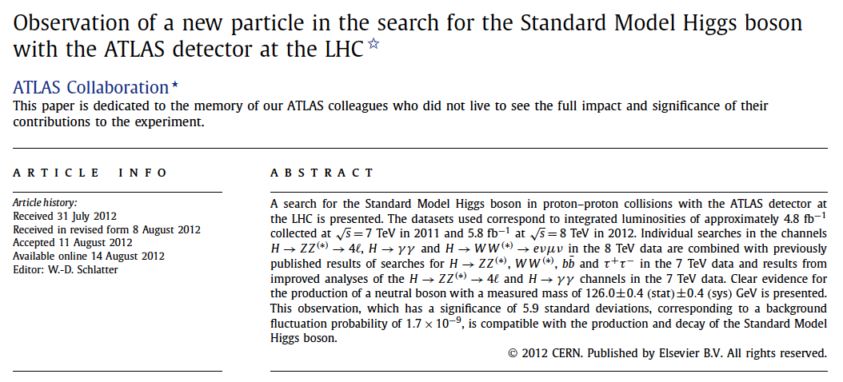
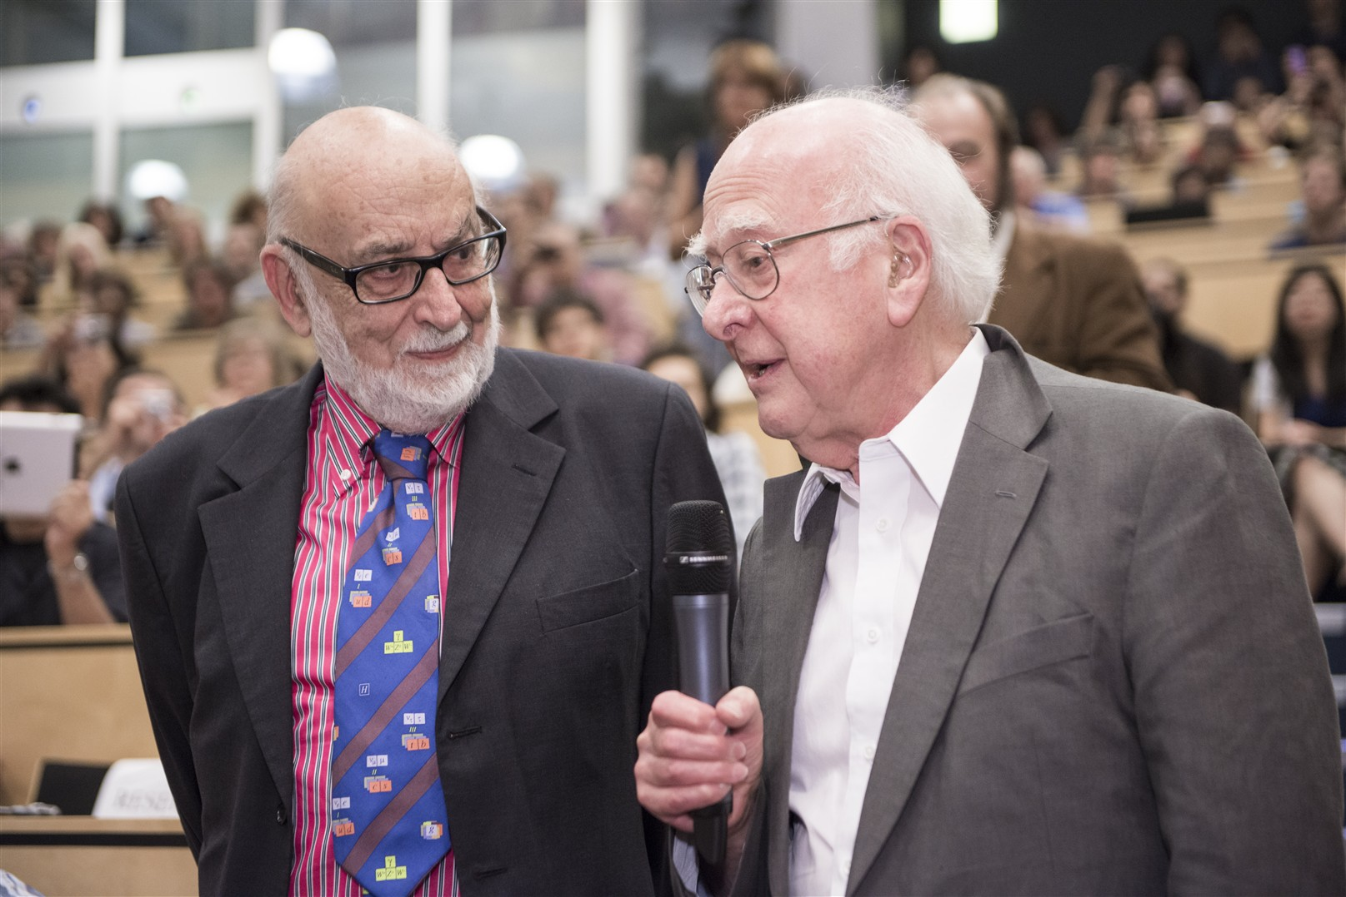
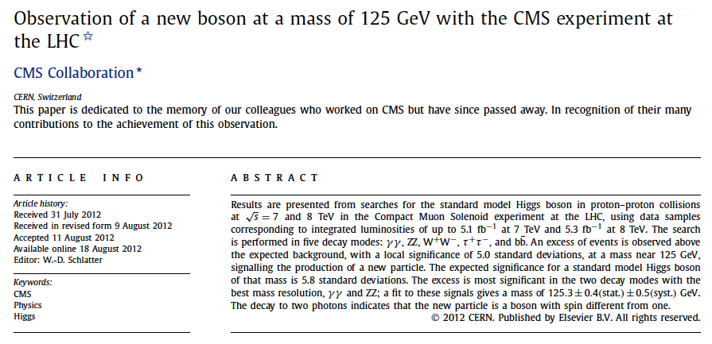
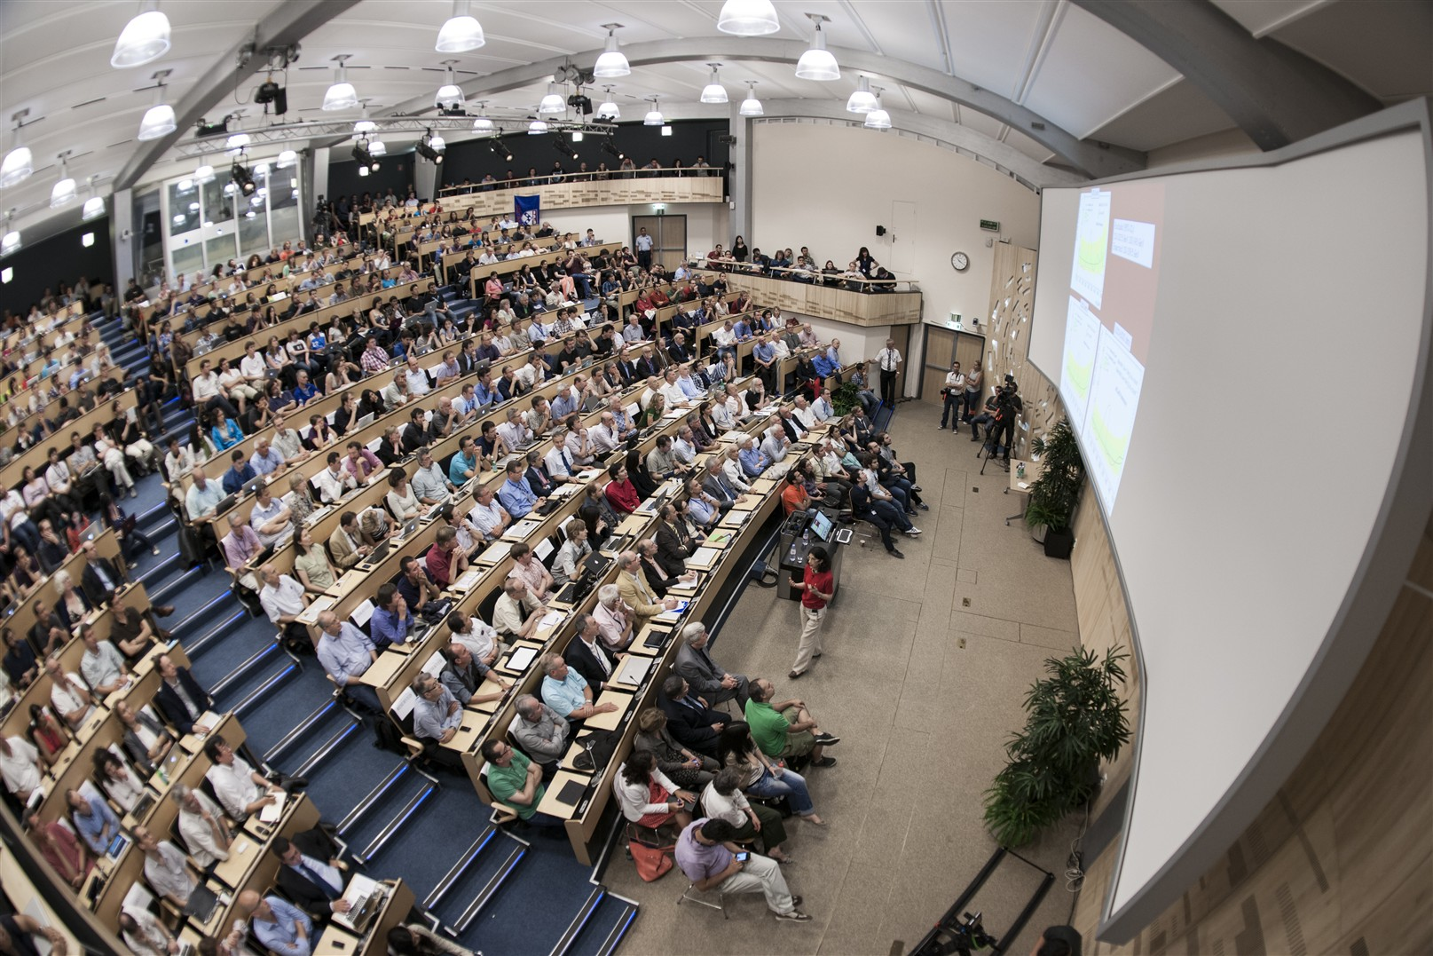
July 4th 2012

Slide 8
The Standard Model of Particle Physics

Slide 9
Some very biased statistics from an experimentalist
91 Persons got Nobel Prices related to the development of the Standard Model
59 Experiment
33 for Standard Model Experiments
13 for Standard Model Instrumentation and Experiments
3 for Particle Physics Instrumentation
1 for Relativity Experiment (Michelson)
9 for Quantum Mechanics Experiments
32 Theory
23 for Standard Model Theory
9 for Quantum Mechanics Theory

Slide 10

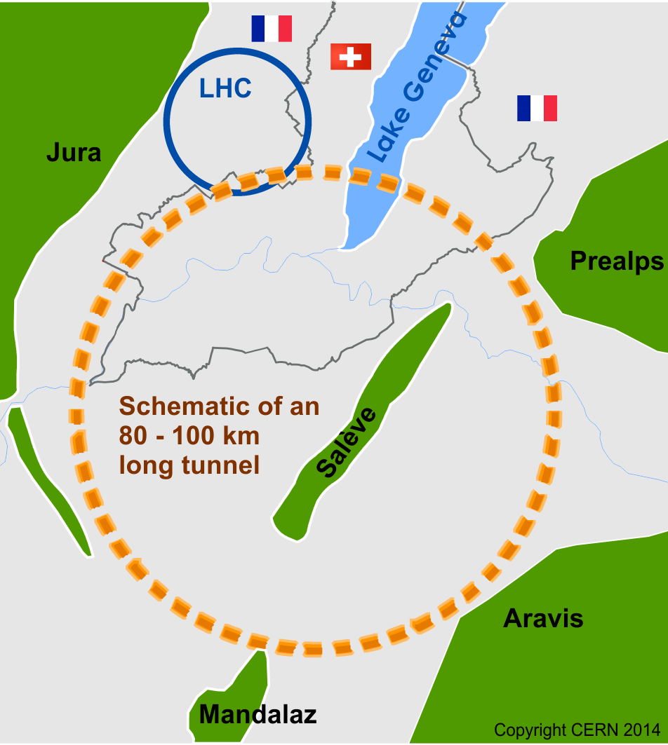
Scope of FCC Study
International FCC collaboration (CERN as host lab) to study:
pp-collider (FCC-hh)
→ main emphasis, defining infrastructure requirements
~16 T ⇒ 100 TeV pp in 100 km
~100 km tunnel infrastructure in Geneva area, site specific
e⁺e⁻ collider (FCC-ee) as potential first step
p-e (FCC-he) option, integration one IP, e from ERL
HE-LHC with FCC-hh technology (LHC Ring 8→16T, 14→28TeV)
CDR for end 2018

Slide 11
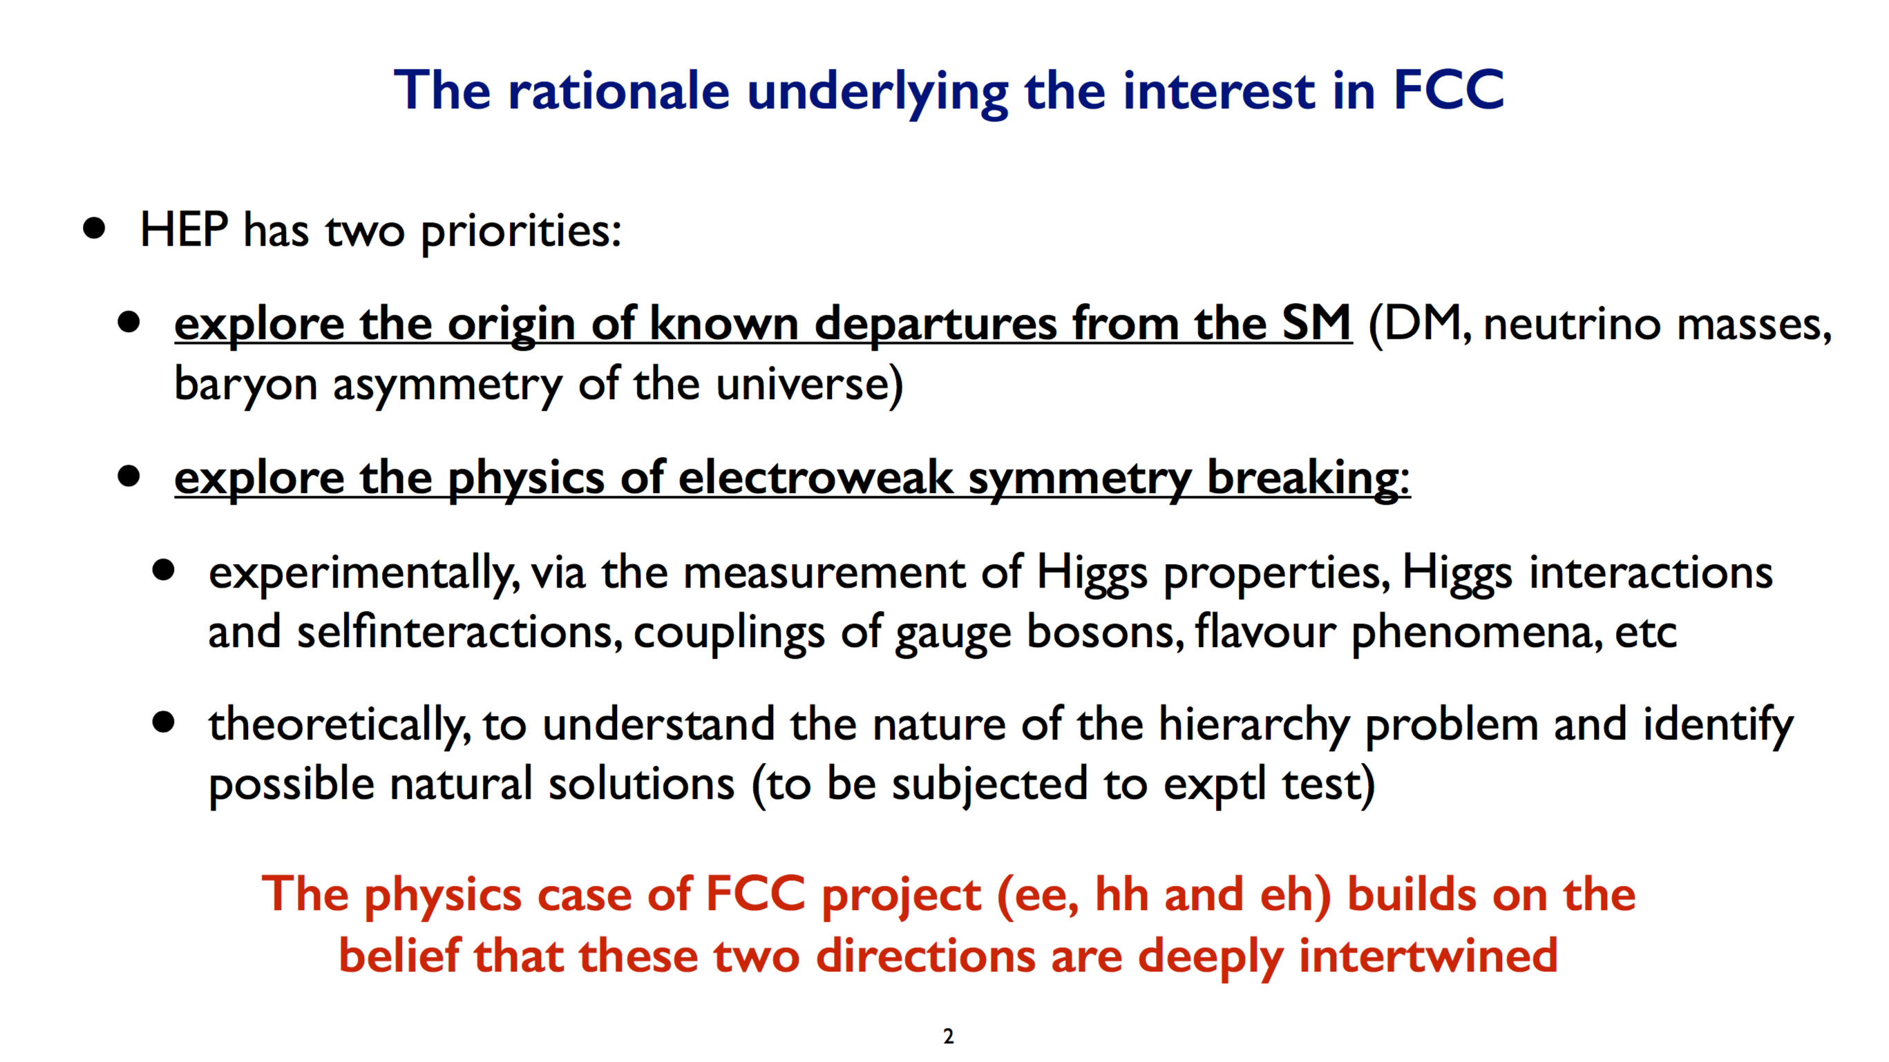
M. Mangano, Oct. 2017

Slide 12
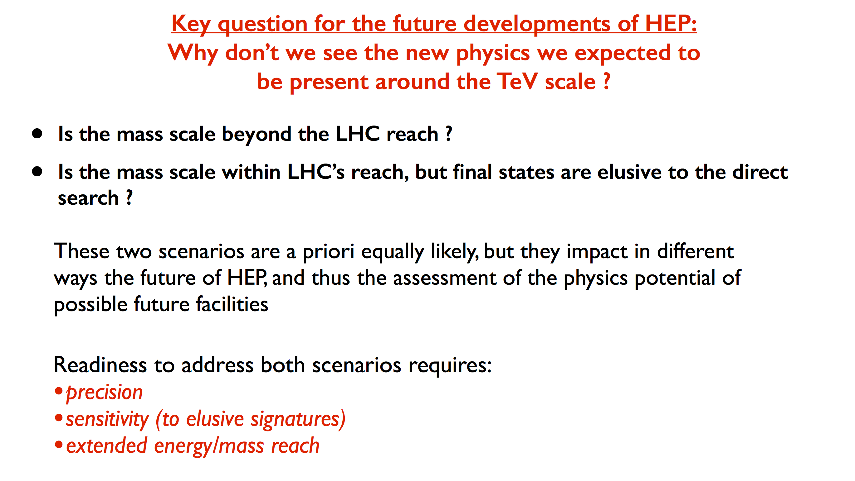
M. Mangano, Oct. 2017

Slide 13
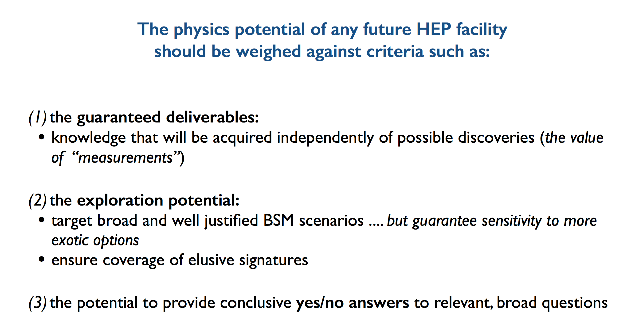
M. Mangano, Oct. 2017

Slide 14
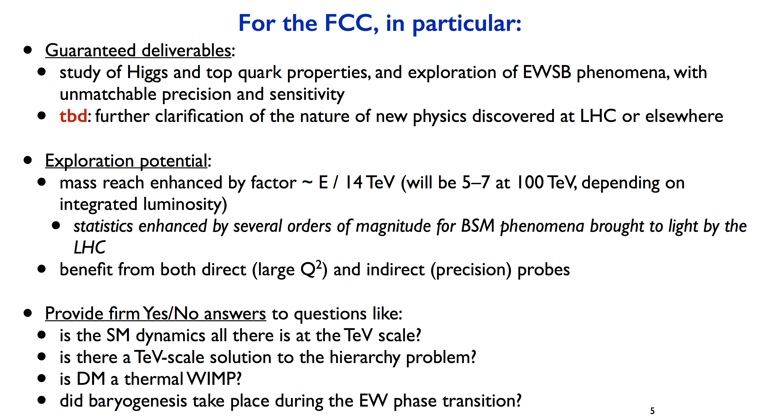
M. Mangano, Oct. 2017

Slide 15
Conceptual Design Report
1 – PHYSICS
2
Hadron
Collider
Summary
3 – Hadron Collider Comprehensive
Required for end 2018, as input for European Strategy Update
Common physics summary volume
Three detailed volumes FCChh, FCCee, HE-LHC
Three summary volumes FCChh, FCCee, HE-LHC
Physics opportunities across all scenarios
Accelerator
Injectors
Technologies
Infrastructure
Operation
Experiment
eh
4
Lepton
Collider
Summary
5 – Lepton Collider Comprehensive
Accelerator
Injectors
Technologies
Infrastructure
Operation
Experiment
6
High Energy LHC
Summary
7 – High Energy LHC Comprehensive
Accelerator
Injectors
Infrastructure
Refs to FCC-hh, HL-LHC, LHeC

Slide 16
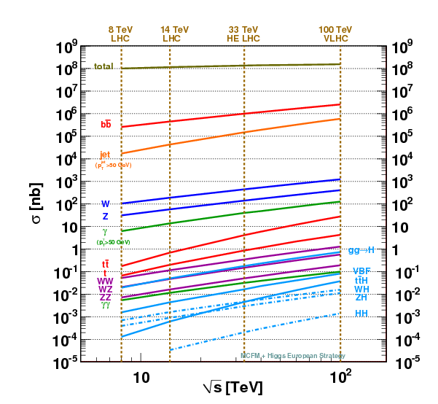
Crossections for key processes
Total crossection and Minimum Bias Multiplicity show only a modest increase from LHC to FCC-hh.
The crossection for interesting processes shows however significant increase !
Interesting stuff is sticking out more !!
Going from pileup of 140 at HL-LHC to pileup of 1000 at FCC does however reduced this possible advantage for triggering.

Slide 17
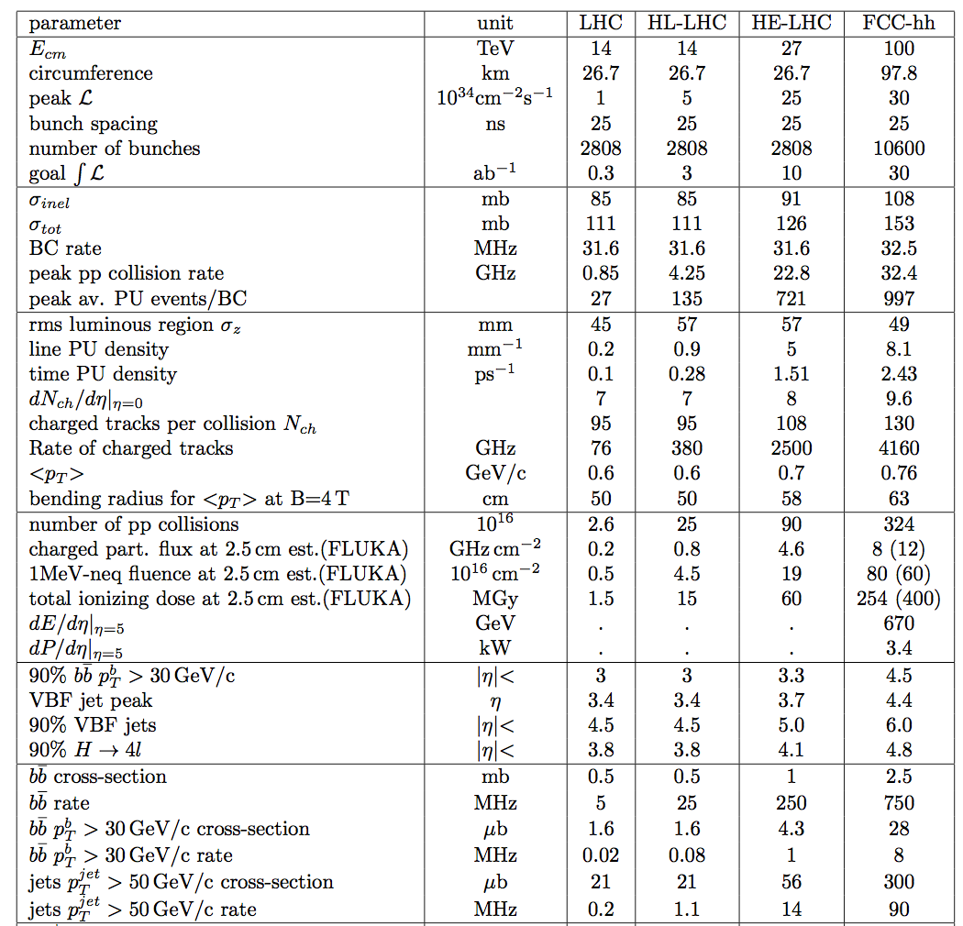

Slide 23
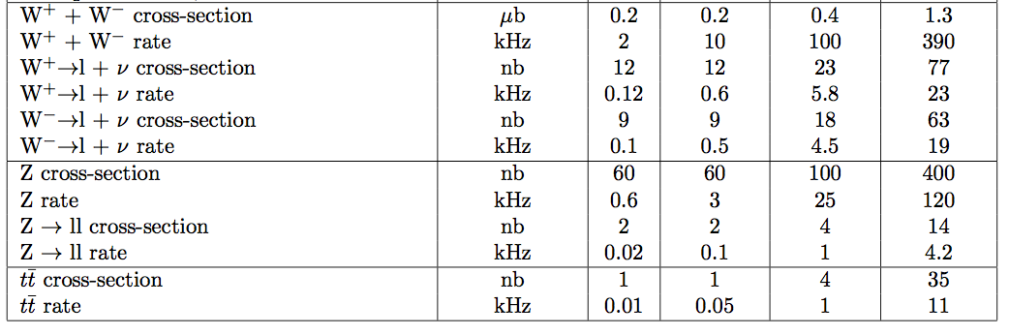

Slide 24

FCC-hh new layout
Two high-luminosity experiments (A & G)
Two other experiments combined with injection (L & B)
Two collimation insertions
  Betatron cleaning (J)
  Momentum cleaning (F)
Extraction insertion (D)
Clean insertion with RF (H)
Compatible with LHC or SPS as injector
New features:
Overall length 97.75 km
Economy length 2.25 km
Injections upstream side of experiments
Avoids mixing of extraction region and high-radiation collimation areas
Taking this layout as fixed
(for CDR preparation)

Slide 25
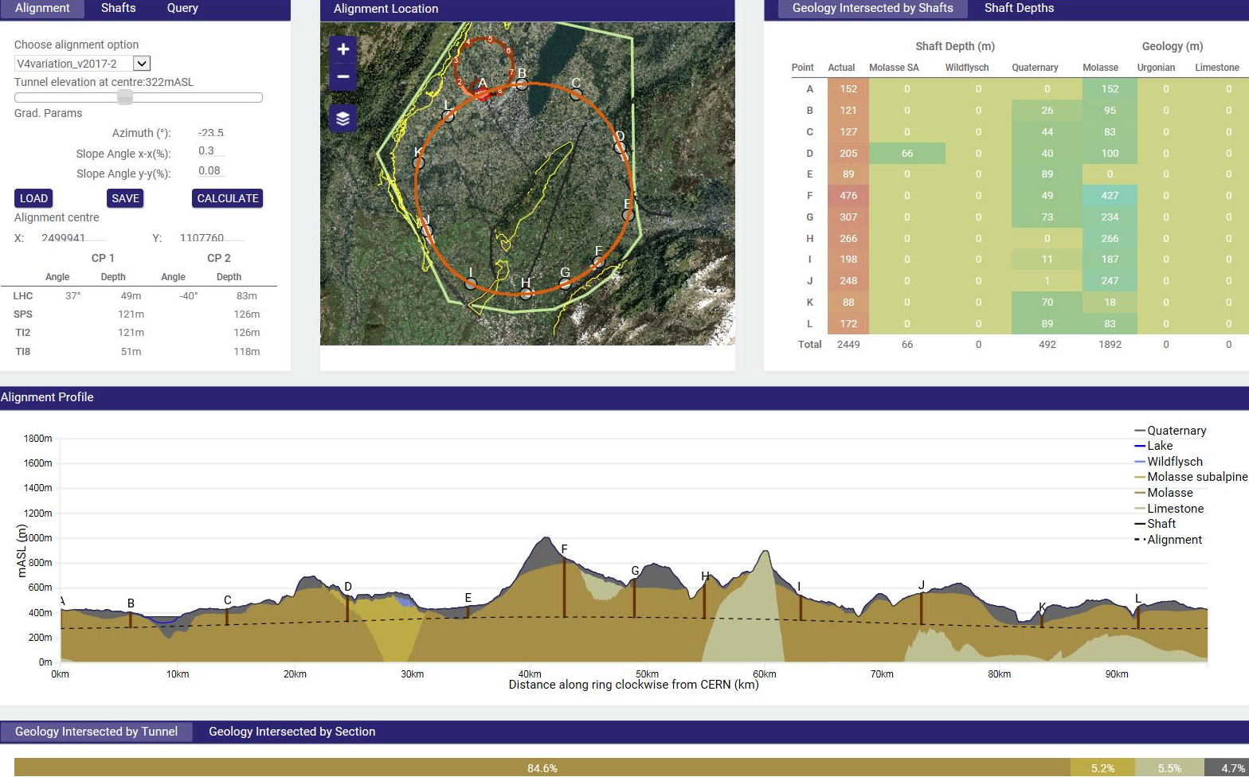
Implementation - new footprint baseline
Optimisation in view of accessibility surface points, tunneling rock type, shaft depth, etc.
Tunneling
Molasse 90%, Limestone 5%, Moraines 5%
Shallow implementation
~ 30 m below lakebed
Reduction of shaft length and technical installations
One very deep shaft F (RF or collimation), alternatives being studied, e.g. inclined access

Slide 26
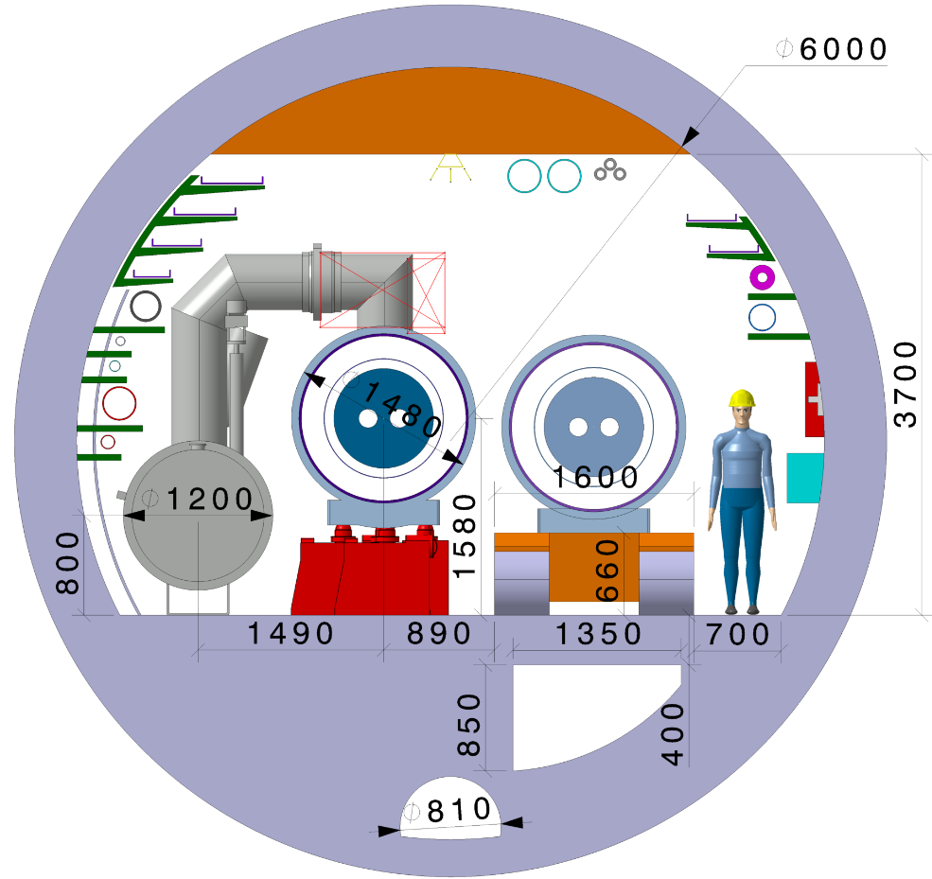
FCC-hh integration
  Basic layout following LHC concept
  6 m inner tunnel diameter
  Main space allocation:
    1200 mm cryo distribution line (QRL)
    1480 mm installed cryomagnet
    1600 cryomagnet magnet transport
    >700 mm free passage.

Slide 27
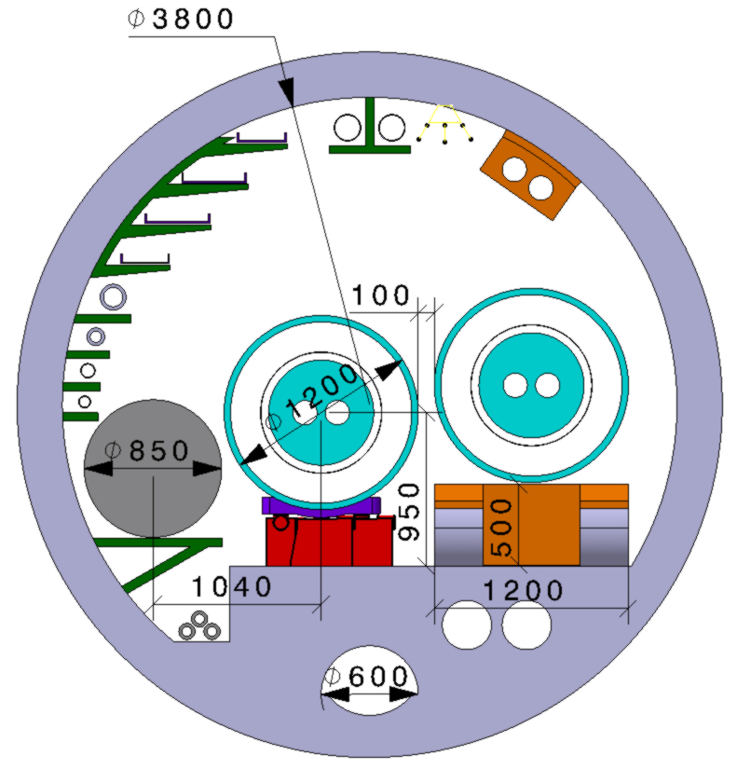
HE-LHC integration aspects
  Working hypothesis for HE LHC design:
  No major CE modifications on machine tunnel and caverns
  Similar geometry and layout as LHC machine and experiments
  Maximum magnet cryostat external diameter compatible with LHC tunnel ~1200 mm
  Classical 16 T cryostat design based on LHC approach gives ~1500 mm diameter!
Strategy: develop a single 16 T magnet, compatible with both HE LHC and FCC-hh requirements:
  Allow stray-field and/or cryostat as return-yoke
  Optimization of inter-beam distance (compactness)
  → Smaller diam. also relevant for FCC-hh cost optimization

Slide 28
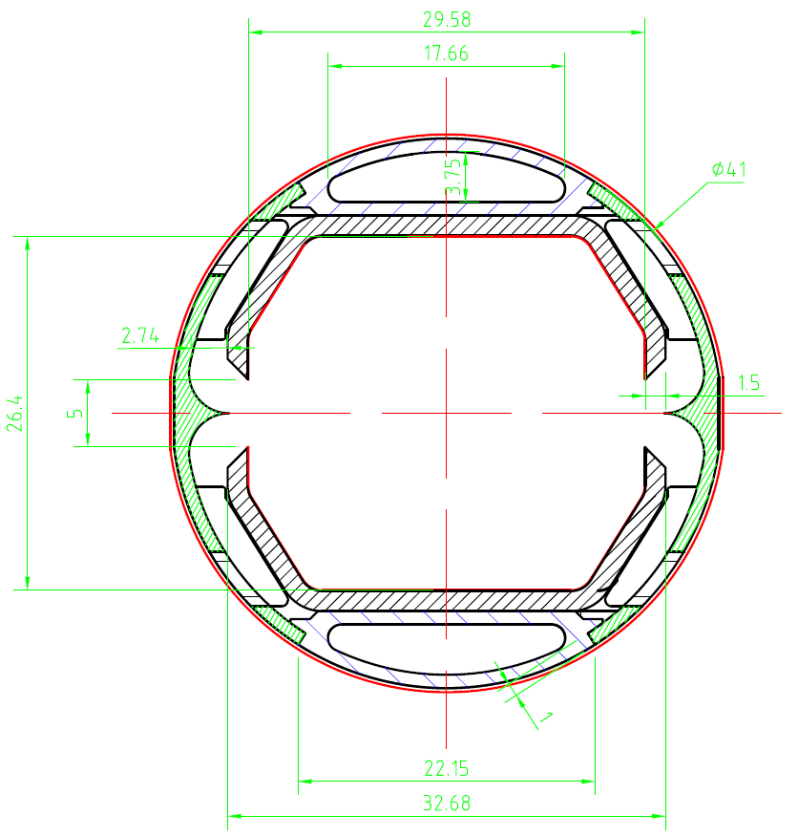
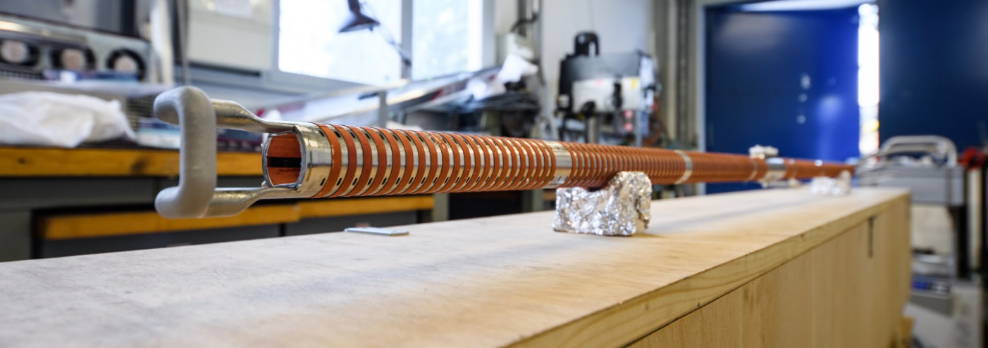
Cryogenic beam vacuum system
One of the most critical elements for FCC-hh
Absorption of synchrotron radiation at ~50 K for cryogenic efficiency (5 MW total power)
Provision of beam vacuum, suppression of photo-electrons, electron cloud effect, impedance, etc.
FCC Beamscreen prototype for test at ANKA:
External copper rings for heat transfer to cooling tubes

Slide 29
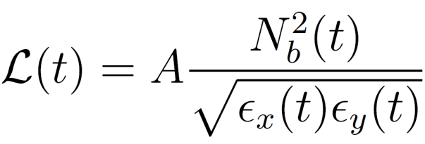





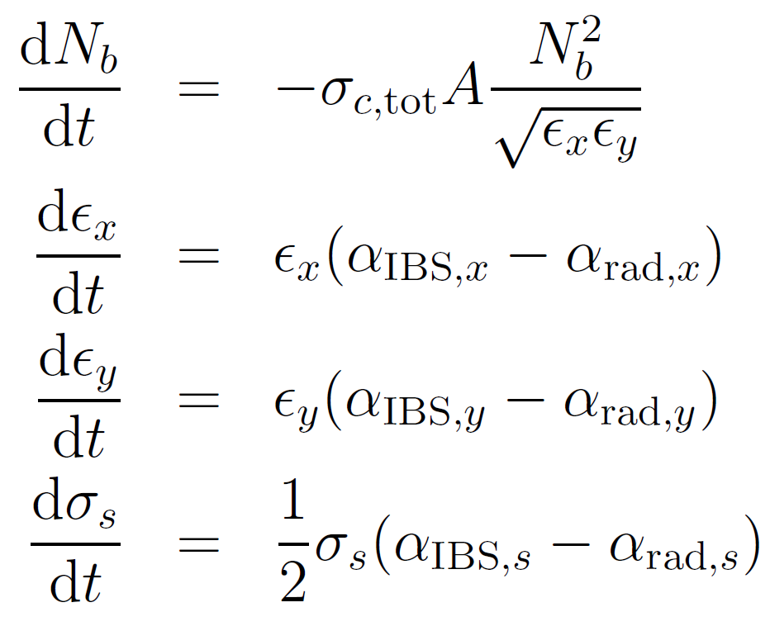




Beam and Luminosity Evolution
During the beams are in collision the instantaneous value of the luminosity will change:
with
: revolution freq.
: no. bunches/beam
: β-function at IP
: no. particles/bunch
: geom. emittances
: bunch length
: total cross-section
: IBS growth rate
: rad. damping rate
The beam evolution with time is obtained by solving a system of four differential equations (dominant effects only shown here, more included in simulations):
Intensity
Hor. Emittance
Ver. Emittance
Bunch Length
J. Jowett, M. Schaumann,
FCC week Washington 2015

Slide 30
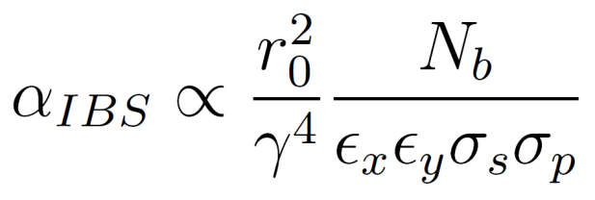
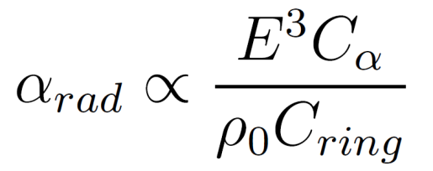
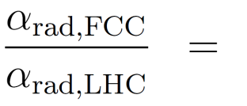
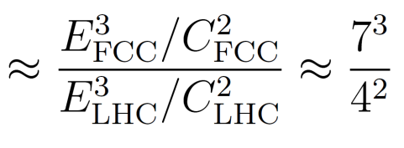
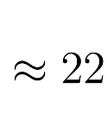
Effects on the Emittance – a new regime
Intra-Beam Scattering (IBS)
(Synchrotron) Radiation Damping
Multiple small-angle Coulomb scattering within a charged particle beam.
A charged particle radiates energy, when it is accelerated, i.e. bend on its circular orbit.
Emittance Growth
Emittance Shrinkage
Growth rate dynamically changing with beam properties:
Damping rate is constant for a given energy:
IBS is weak for initial beam parameters, but increases with decreasing emittance .
Fast emittance decrease at the beginning of the fill,
until IBS becomes strong enough to counteract the radiation damping.

Slide 31
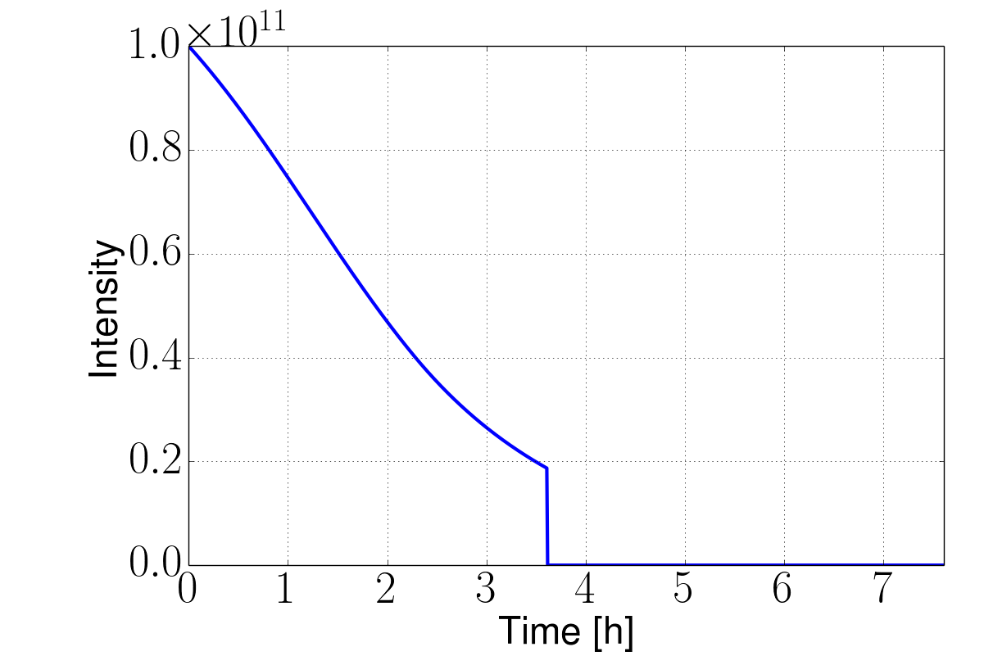
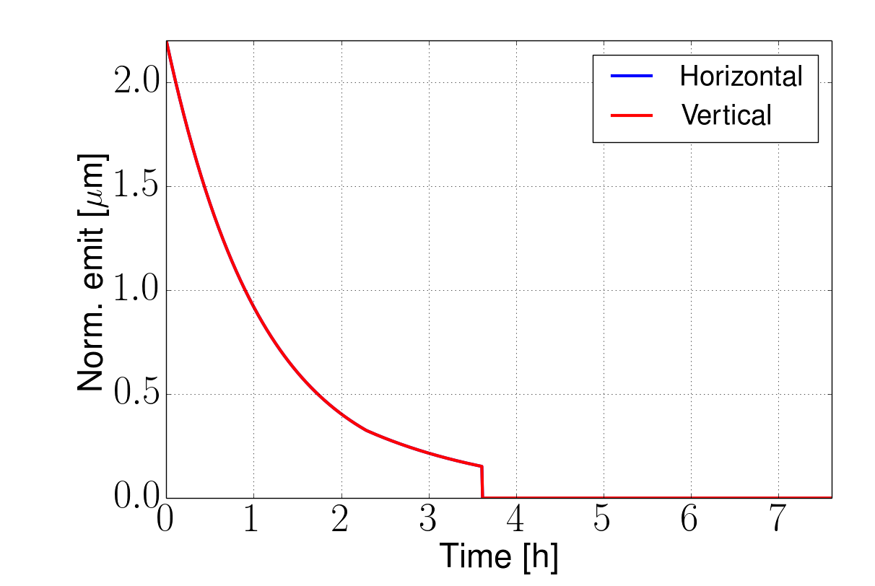
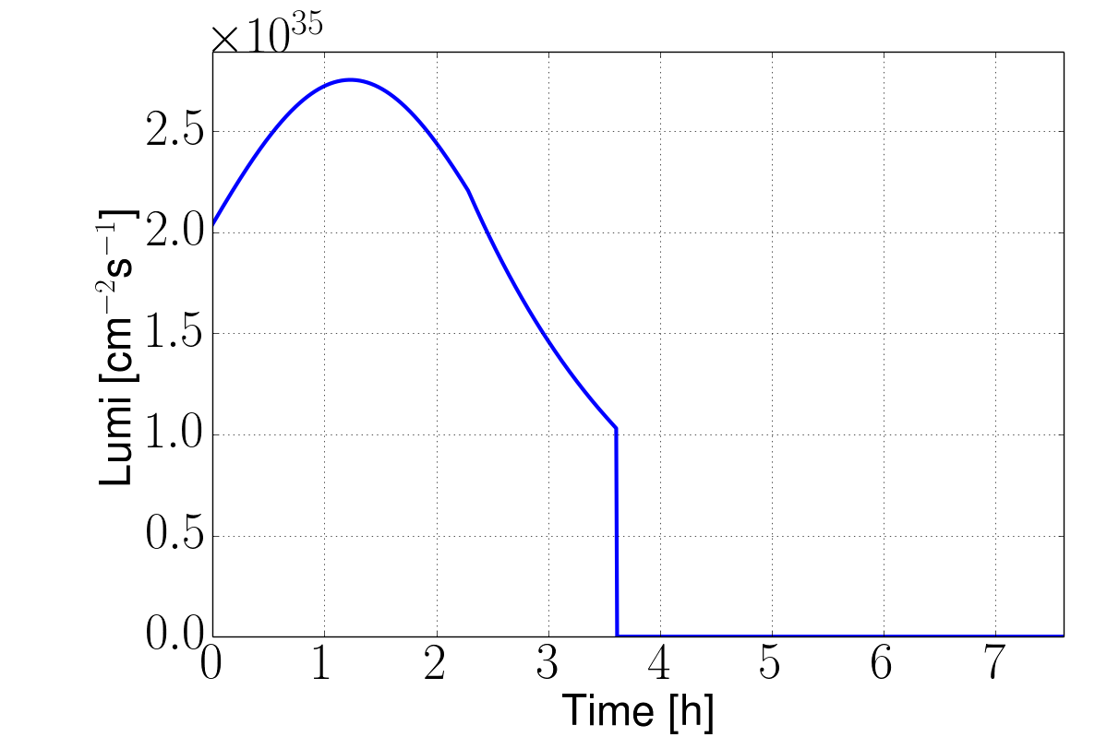
pp Luminosity evolution during a fill
X. Buffat, D.S..
Developed model including most relevant effects
Improvement with more detail planned
Reach 8fb⁻¹/day with ultimate for 25ns spacing
    5ab⁻¹ per 5 year run
Beam is burned quickly
  A reason to have enough charge stored
Ultimate example, 25ns, no luminosity levelling
8fb⁻¹/day
Turn-around time

Slide 32
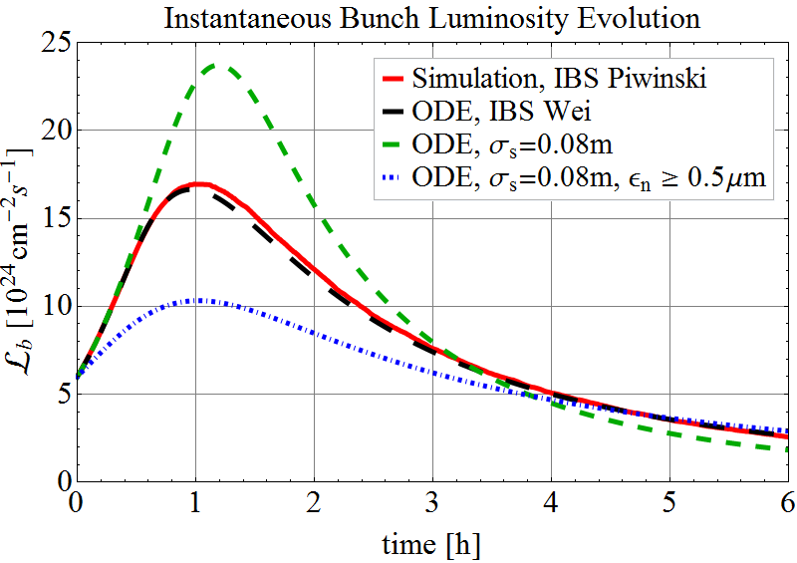
Pb-Pb Luminosity evolution during a fill
FCC-hh is also a very powerful Heavy Ion collider !

Slide 33
Draft Schedule Considerations
20
22
24
26
28
30
32
34
36
38
40
42
Technical Design Phase
Strategy Update 2026 – assumed project decision
Dipole short models
Dipole long models
SC Magnets
16 T dipole indust. prototypes
16 T dipoles preseries
16 T series production
Civil Engineering FCC-hh ring
FCC-hh
CE TL to LHC
LHC Modification
Installation + test FCC-hh
CE FCC-ee ring + injector
FCC-ee
Injector
Installation + test FCC-ee
HE-LHC
LHC Removal
Installation HE-LHC

Slide 34
Physics at a 100 TeV Hadron Collider
Exploration + Higgs as a tool for discovery
How to specify detectors for such a machine ?
ATLAS and CMS are general purpose detectors that were benchmarked with the ‘hypothetical’ Higgs in different mass regions with tracking up to η=2.5.
The Higgs is also key benchmark for the FCC detectors, with highly forward boosted features (100TeV, 125GeV Higgs)
FCC detectors must be ‘general general’ purpose detectors with very large η acceptance and extreme granularity.

Slide 35
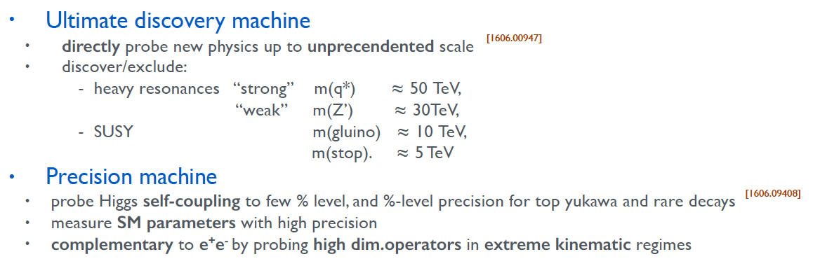
Physics at a 100 TeV Hadron Collider

Slide 36
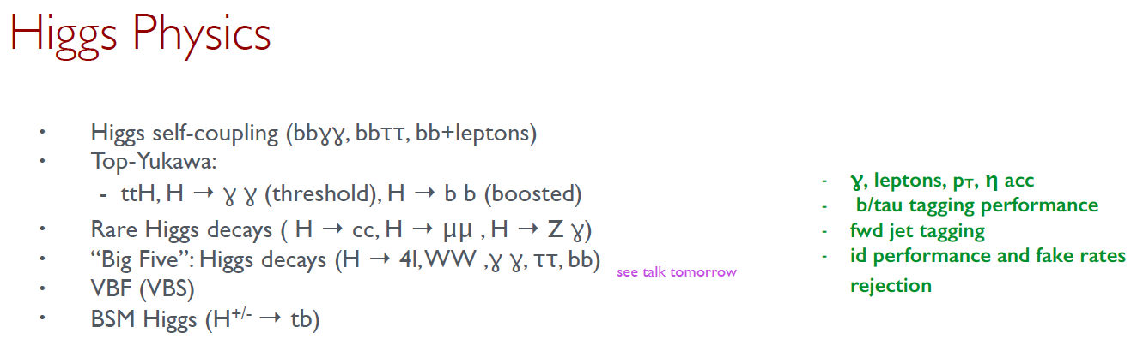
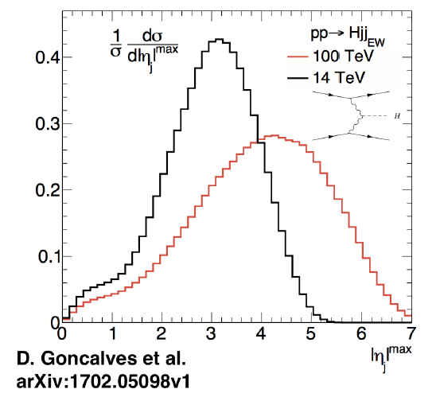
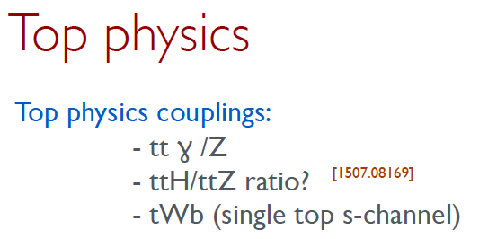
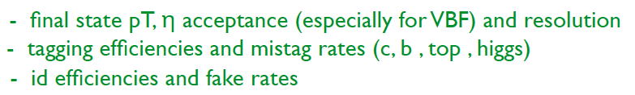
Physics at a 100 TeV Hadron Collider

Slide 37
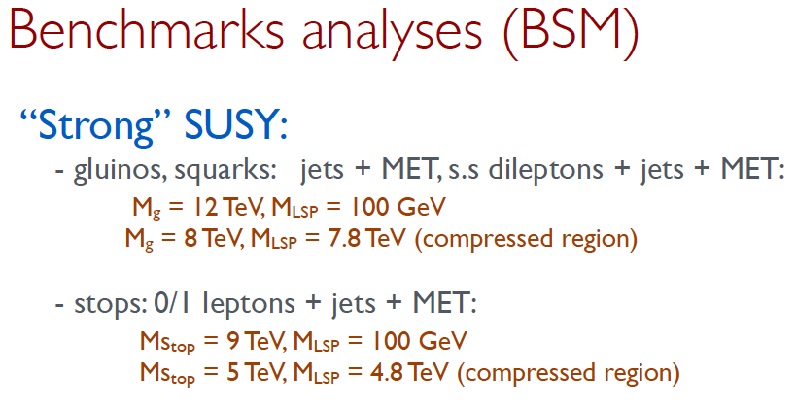
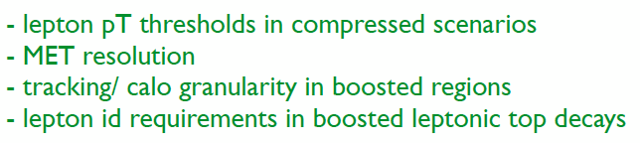
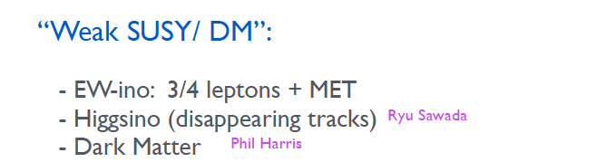


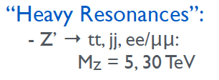
Physics at a 100 TeV Hadron Collider

Slide 38
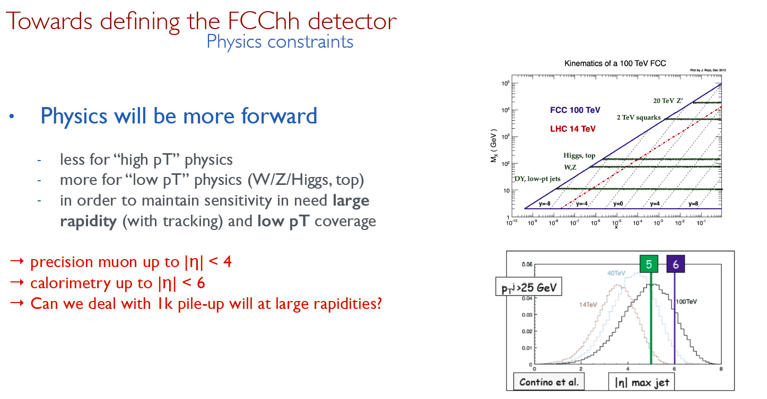
Detector Specifications

Slide 39
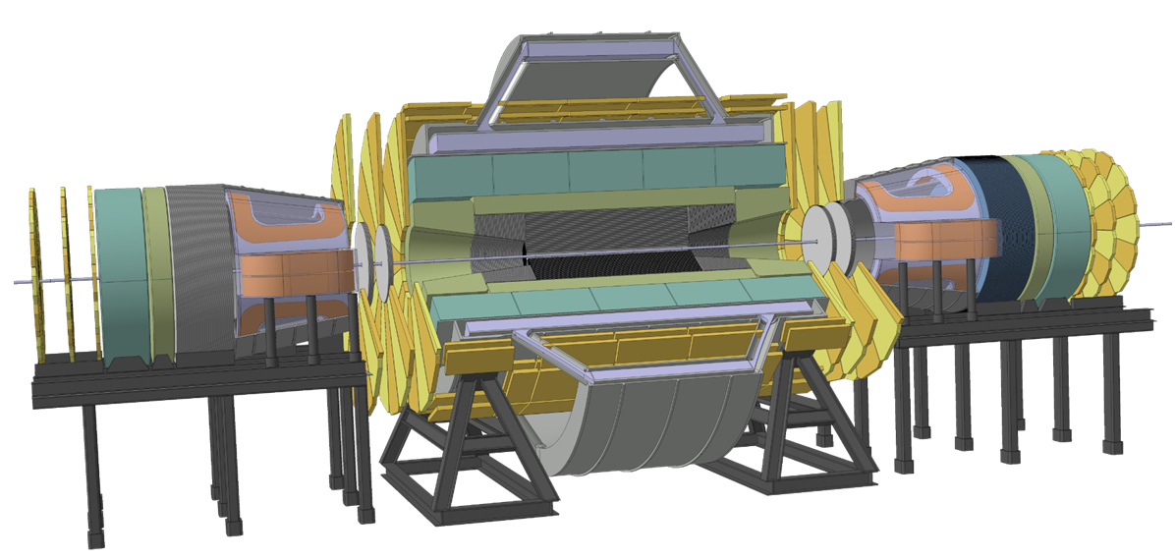
FCC week 2016: Twin Solenoid 6T, 12m bore, Dipoles 10Tm

Slide 40
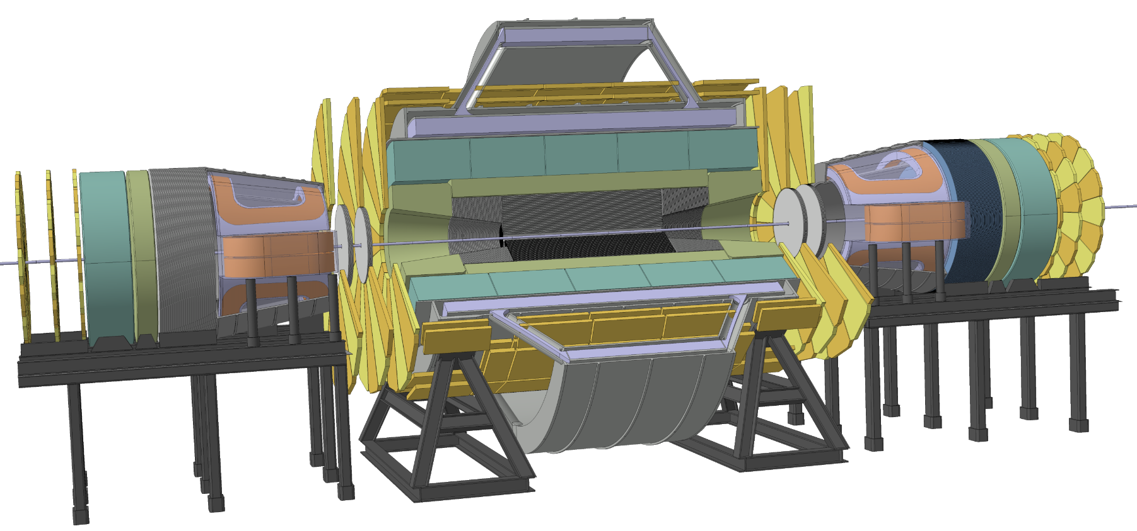
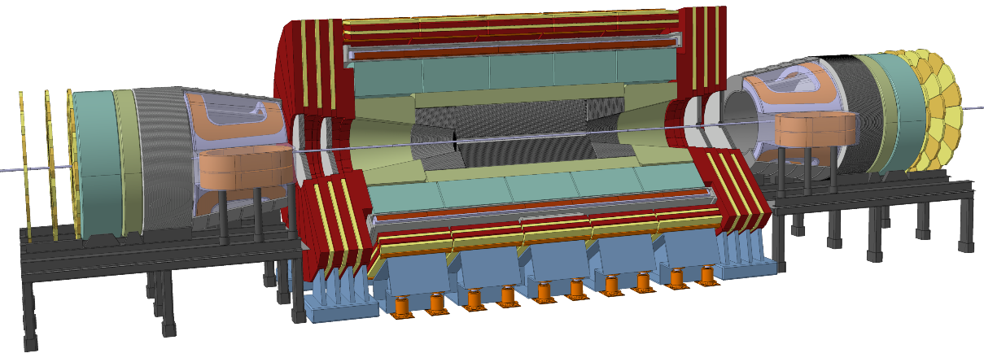



Magnet systems under consideration
Twin solenoid with dipoles (min. shaft diameter 27.5m)
Partially shielded solenoid with dipoles
Unshielded solenoid with dipoles
Twin solenoid with balanced conical solenoid
Unshielded solenoid with balanced conical solenoid

Slide 41

New Reference Design
6T, 12m bore solenoid, 10Tm dipoles, shielding coil
65 GJ Stored Energy
28m Diameter
>30m shaft
Multi Billion project
4T, 10m bore solenoid, 4T forward solenoids , no shielding coil
14 GJ Stored Energy
Rotational symmetry for tracking and trigger !
20m Diameter (≈ ATLAS)
15m shaft
≈ 1 Billion project

Slide 42
Reference detector for the CDR
4T 10m solenoid
Forward solenoids
Silicon tracker
Barrel ECAL Lar
Barrel HCAL Fe/Sci
Endcap HCAL/ECAL LAr
Forward HCAL/ECAL LAr
This is a reference detector that ‘can do the job’ and that is used to define the challenges.
The question about the specific strategy for detectors at the two IPs is a different one.

Slide 43

CDR will discuss performance with forward dipoles
B
B
B
compensation
compensation
B
B
B
B
B

Slide 44



Comparison to ATLAS & CMS

Slide 45


Comparison to LHCb & ALICE

Slide 46

Cavern Length
Q1 TAS Shield
Shield TAS Q1
66m
70m
80m
L*=40m → Distance between Q1&Q1 = 80m
TAS = 3.5m → Distance between TAS & TAS = 70m
TAS Shielding in Tunnel = 2m → Cavern Length = 66m
Cavern length of 66m is compatible with the opening scenario of the present detector.

Slide 47

ATLAS Cavern
12.6m diameter
18m diameter
ATLAS shafts and cavern, with cavern length increased from 50-70m will accommodate the reference detector
A cavern width of 35m would also accommodate the FCC-ee experiments assuming the present footprint with IP shift of 10m.
35m
50m
30m

Slide 48



Service Cavern
50m distance from main cavern to ensure <5mT field and to allow easier construction.
Placing the service cavern closer requires an iron shield between cavern and service cavern.

Slide 49

Charged Particle Fluence @ L=30x10³⁴cm⁻²s⁻¹
  Barrel muon chambers: ~300 cm⁻²s⁻¹ to ~500 cm⁻²s⁻¹
Central tracker:
  first IB layer (2.5 cm ): ~1.2 10¹⁰ cm⁻²s⁻¹
  external part: 3 10⁶ cm⁻²s⁻¹
  Endcap Muon Chambers: 10⁴ cm⁻²s⁻¹

Slide 50

Muon Systems
ATLAS muon system HL-LHC rates (kHz/cm²):
MDTs barrel: 0.28
MDTs endcap: 0.42
RPCs: 0.35
TGCs: 2
Micromegas und sTGCs: 9-10
LHCb
<0.5kHz/cm²
<10kHz/cm²
r>1m rate<500kHz/cm²
HL-LHC muon system gas detector technology will work for most of the FCC detector area

Slide 51

1 MeV neutron equivalent fluence for 30ab⁻¹
Central tracker:
first IB layer (2.5 cm ): ~5-6 10¹⁷ cm⁻²
external part: ~5 10¹⁵ cm⁻²
Forward calorimeters:
  maximum at ~5 10¹⁸ cm⁻² for both the EM and the HAD-calo
  10¹⁶ cm⁻² at R=2 m

Slide 52
Comparison to ATLAS & CMS
The forward calorimeters are a very large source of radiation (diffuse neutron source).
In ATLAS the forward calorimeter is inside the endcap calorimeter, in CMS the forward calorimeter is inside enclosed by the return Yoke.
For the FCC, the forward calorimeter is moved far out in order to reduced radiation load and increase granularity.
→ A shielding arrangement is needed to stop the neutrons to escaping into the cavern hall and the muon system.
2.7
3.0
2.5

Slide 53

Tracker Radius 1.6m, Length 32m

Slide 54


Magnetic Field Options

Slide 55


Magnetic Field, Tracking
Forward solenoid adds about 1 unit of η to full lever arm acceptance.
B-field non uniformities deteriorate the tracking by 35-45% with respect to a constant field of 4T, which has negligible impact on performance.

Slide 56

Tracker Performance

Slide 57

Parametrized Tracking Performance

Slide 58



Pileup of 1000 (25ns Bunchcrossing)
HL-LHC average distance between vertices at z=0 is
≈ 1mm in space and 3ps in time.
For 6 times higher luminosity at FCC-hh (an HE-LHC) this would become
≈ 170μm in space and 0.5ps in time.
x=0.8mm, X₀=35.28cm (Be), p=1GeV
θ₀
Beampipe
η
r = 2.5cm
Beam
Δz
Even having a perfect tracking detector, the error due to multiple scattering in the beampipe for η > 1.7 is already larger than the average vertex distance !
Timing, very clever new ideas needed …

Slide 59

Vertexing at Pileup of 1000, Timing
Effective pileup – number of vertices assigned at 95% CL to a track of a given momentum.

Slide 60
Tracking

Slide 61

Track Parameters
https://arxiv.org/abs/1805.12014

Slide 62


Relation to two simple Geometries

Slide 63



Fitting a linear combination of known functions
Track of known functional form
with (M+1) unknown parameters a_{i}
Given the measurement values y_{n} in the N+1 detector planes, how can we find the best estimates for a_{i} and what are their errors ? E.g. if σ_{n} are the position measurement errors in plane y_{n} we have to minimise
In case we have other sources of measurement errors that could also be correlated …

Slide 64




Fitting a linear combination of known functions
In case we have other sources of measurement errors that could also be correlated …
Where W_{mn} is a ‘weight matrix’ that still has to be defined. For W_{mn} = σ_{n} 𝛿_{mn} we get the previous expression.
The above relation can also be written in Matrix Form:

Slide 65


Fitting a linear combination of known functions
Find a_{i} sich that 𝜒² is minimized
The is the best estimate for a_{i} given the measurements y_{i}
Next question:
What is the variance of a_{i} for a given (known) variance of the measurement values y_{i}
We need to know the covariance matrix of y_{i}

Slide 66



Error Propagation
Let’s assume two random variable y₀ and y₁ to be distributed according to
The average, variance and correlation of y₀ and y₁ are given by
C_{y} is the ‘Covariance’ Matrix of y₀ and y₀.
In case y₀ and y₁ are uncorrelated, the covariance matrix is diagonal

Slide 67





Error Propagation
Let’s assume a function a₀ (y₀, y₁). We want to know the variance of a₀ if y₀ and y₁ are distributed according to p(y₀, y₁)
If a₀ (y₀, y₁) is not varying significantly in the region around the average values of y₀, y₁ we can expand the function around the average values

Slide 68







Error Propagation
Let’s now assume a vector of functions a_{i} (y₀, y₁). If we want to know the variances and correlations in case y₀ and y₁ are distributed according to p(y₀, y₁) we proceed accordingly
And in general

Slide 69



Fitting a linear combination of known functions
Continuing from before:
Last question: What is the best choice of W that minimizes the variances ?
The answer is given by the Gauss-Markov Theorem stating that which results in

Slide 70

Fitting a linear combination of known functions
Track of known functional form
with (M+1) unknown parameters a_{i}

Slide 71





Covariance Matrix for position resolution and multiple scattering
Assuming a Gaussian distribution for the position resolution and for the multiple scattering angle we have:
In case there are N+1 equidistant and equal layers between x=0 and x=L with the same position resolution σ and multiple scatterin angle σ⍺ we have

Slide 72



Covariance Matrix for position resolution and multiple scattering
If multiple scattering is negligible we have:
If multiple scattering dominates over position resolution:

Slide 73








Straight line track
Independent of N !
Two layers as good as N layers !

Slide 74
Vertex resolution
θ₀
Beampipe
η
r = 2.5cm
Beam
Beampipe + first tracking layer define the vertex resolution at low pT.

Slide 75






Parabolic track, position resolution

Slide 76



Parabolic track, multiple scattering, momentum resolution

Slide 77



Parabolic track, multiple scattering, angular resolution

Slide 78


Parabolic track, multiple scattering, d₀ resolution

Slide 79

Track Parameters

Slide 80

Momentum resolution
10 layers
10um position resolution
L=1m
B=4T
With 3% per layer, multiple scattering dominates the momentum resolution up to 100GeV/c !

Slide 81

Track Parameters

Slide 82

Track Parameters

Slide 83

Track Parameters

Slide 84

d0 resolution
3 layers
5um position resolution
first layer at 4cm
1.5% X0 per layer
Up to 10GeV/c, multiple scattering dominates

Slide 85

Calorimetry

Slide 86


Slide 87


Slide 88


Slide 89



Slide 90


Calorimetry
Barrel HCAL in Fe/Sci similar to ATLAS Tilecal
Barrel ECAL, Endcap ECAL/HCAL, Forward ECAL/HCAL are in LAr technology, which is intrinsically radiation hard.
Silicon ECAL and ideas for digital ECAL with MAPS are being discussed.

Slide 91

Barrel HCAL Single Particle and Jet Resolution

Slide 92

Calorimeter Granularity

Slide 93


Slide 94


Slide 95

Muon system performance estimate
Three ways to measure the muon momentum
Tracker only with identification in the muon system
Muon system only by measuring the muon angle where it exits the coil
Tracker combined with the position of the muon where it exists the coil
We assume a constant magnetic field inside the coil radius L₁.
The measurement points in the tracker of radius L₀ are equidistant and have all the same resolution σ₀.
The measurement point at L₁ has a position error σ₁ that is given by the multiple scattering inside the calorimeters
(σ_{y} in the following).
The formula for the momentum resolution is given in the next slide.
p_{t}=3.9GeV enters muon system
p_{t}=5.5GeV leaves coil at 45 degrees
L₁
L_{Calo}
L₀

Slide 96



Muon system performance estimate
2) Muon System standalone by measuring the angle of the muon when exiting the coil
1) Inner Tracker of radius L₀ with N+1 equidistant layers of resolution σ₀
3) Combined

Slide 97

Muon Systems
Tracker only with identification in the muon system
Muon system only by measuring the muon angle where it exits the coil
Tracker combined with the position of the muon where it exists the coil
2)
3)
With 50μm position 70μRad angular resolution resolution we find (η=0)
<10% standalone momentum resolution up to 3TeV/c
<10% combined momentum resolution up to 20TeV
1)
All within reach of ‘standard’ muon system technology

Slide 98




Muon Detector Layout – Optimised with the Simulation
Barrel and outer endcaps:
2 x 4 layers of 2.8 m long drift tubes (axial in barrel, radial in outer endcaps) with 1.4 m multilayer distance provide 40 µm spatial resolution, 60 µrad angular resolution, 100% tracking efficiency up to the maximum background rates. Monolithic sMDT construction, no optical alignment of multilayers needed. Chambers well accessible.
RPC
2.8 m
1.4 m
2 m
2.8 m
6 m
20 m

Slide 99

Muon Standalone Performance

Slide 100
Trigger/DAQ
Example: ATLAS Phase2 calorimetry will be digitized at 40MHz and sent via optical fibers to L1 electronics outside the cavern at 25TByte/s to create the L1 Trigger.
Muon system will also be read out at 40MHz to produce a L1 Trigger.
Reading out the FCC detector calorimetry and muon system at 40MHz will result in 200-300 TByte/s, which seems feasible.
40MHz readout of the tracker would produce about 800TByte/s.
Question:
Can the L1 Calo+Muon Trigger have enough selectivity to allow readout of the tracker at a reasonable rate of e.g. 1MHz ?
Un-triggered readout of the detector at 40MHz would result in 1000-1500TByte/s over optical links to the underground service cavern and/or a HLT computing farm on the surface.

Slide 101


ATLAS & CMS @ HL-LHC (2025-2026)
40 MHz
Hardware trigger to reduce events rate by factor 40
Level 1
Level 1
0.5-1 MHz
HLT
HLT
5-10 kHz (2MB/event)
10 kHz (4MB/event)
Storage
Storage
10-20 GB/s
⬅ PEAK OUTPUT ➔
40 GB/s

Slide 102

ALICE & LHCb in LS2 (2019-2020)
40 MHz
40 MHz
50 kHz
No Hardware trigger, all data into HLT !
Reconstruction
+
Compression
5-40 MHz
50 kHz (1.5 MB/event)
20 kHz (0.1 MB/event)
Storage
2 GB/s
⬅ PEAK OUTPUT ➔
75 GB/s

Slide 103
Moore‘s Law
http://www.livescience.com/23074-future-computers.html
“If the doubling of computing power every two years continues to hold, then by 2030 whatever technology we're using will be sufficiently small that we can fit all the computing power that's in a human brain into a physical volume the size of a brain”,
explained Peter Denning, distinguished professor of computer science at the Naval Postgraduate School and an expert on innovation in computing.
"Futurists believe that's what you need for artificial intelligence. At that point, the computer starts thinking for itself.“
Computers will anyway by themselves figure out what to do with the data by 2035.

Slide 104
Strategic R&D
The ATLAS/CMS Phase2 TDRs are being prepared. R&D for Phase2 is coming to an end.
The FCC CDR will be finished by end of 2018.
Strategic detector R&D plans must be discussed now, and put in place by 2019, that push and develop technology towards the next step.
FCC-hh and HE-LHC have very similar detector technology requirements in terms of resolution and radiation hardness.
FCC-hh, FCC-ee, FCC-eh have similar sensor technology requirements in terms of resolution and material budget.
Key technologies are radiation hard silicon sensors, radiation hard Monolithic Active Pixel Sensors (MAPS), Large scale integrated CMOS sensors, high speed low power optical links, radiation hard calorimetry, high precision timing detectors, large scale muon systems, and related electronics etc.

Slide 105


Slide 106


Slide 107


Slide 108


Slide 109


Slide 110


Slide 111


Slide 112
Summary
A 100TeV hadron collider with 100km circumference and 16T dipoles is being studied as the next machine to push the energy frontier.
A peak luminosity of 30x10³⁴ cm⁻²s⁻¹ at 25ns bunchcrossing results in a pileup of ≈ 1000.
An integrated luminosity of 20-30 ab⁻¹ results in a fluence of ≈ 10¹⁶-10¹⁸ 1MeVneq/cm² in the tracker volume and the forward calorimeters.
A general purpose reference detector is being studied to set the scale of the challenges for performing experiments at this machine.
We think that detectors can be built that can extract all the physics potential from such a machine, but a high profile R&D programme for detectors and electronics technologies has to be conducted.

