Slide 1
Summary 9 April
- First Quad results
Hit maps produced by Kevin see next slides
- There is a problem with one of the grids nr 2 that draws intermittently
current.
Fred has opened the Quad several times to remove traces of glue.
Since Friday morning 6 April the situation is better, although still
sometimes grid 2 draws current, but it comes back.
We plan to start taking laser measurements to measure the
performance.
2013

Slide 2
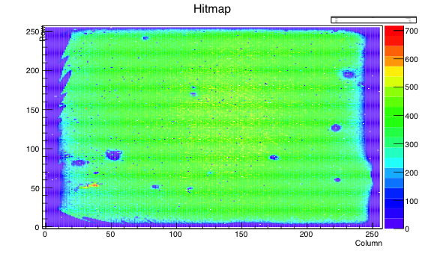
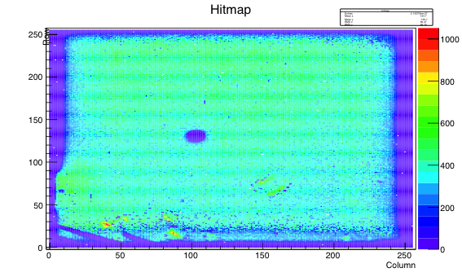
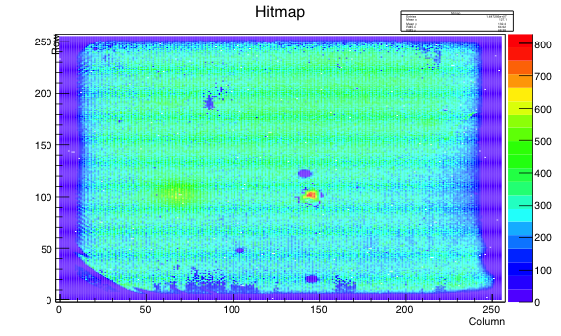
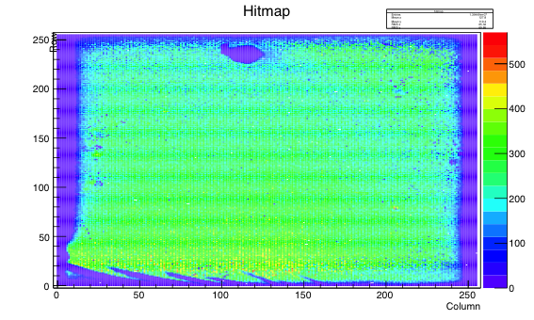
Quad Hit maps
Sr source 300 V

