Slide 1
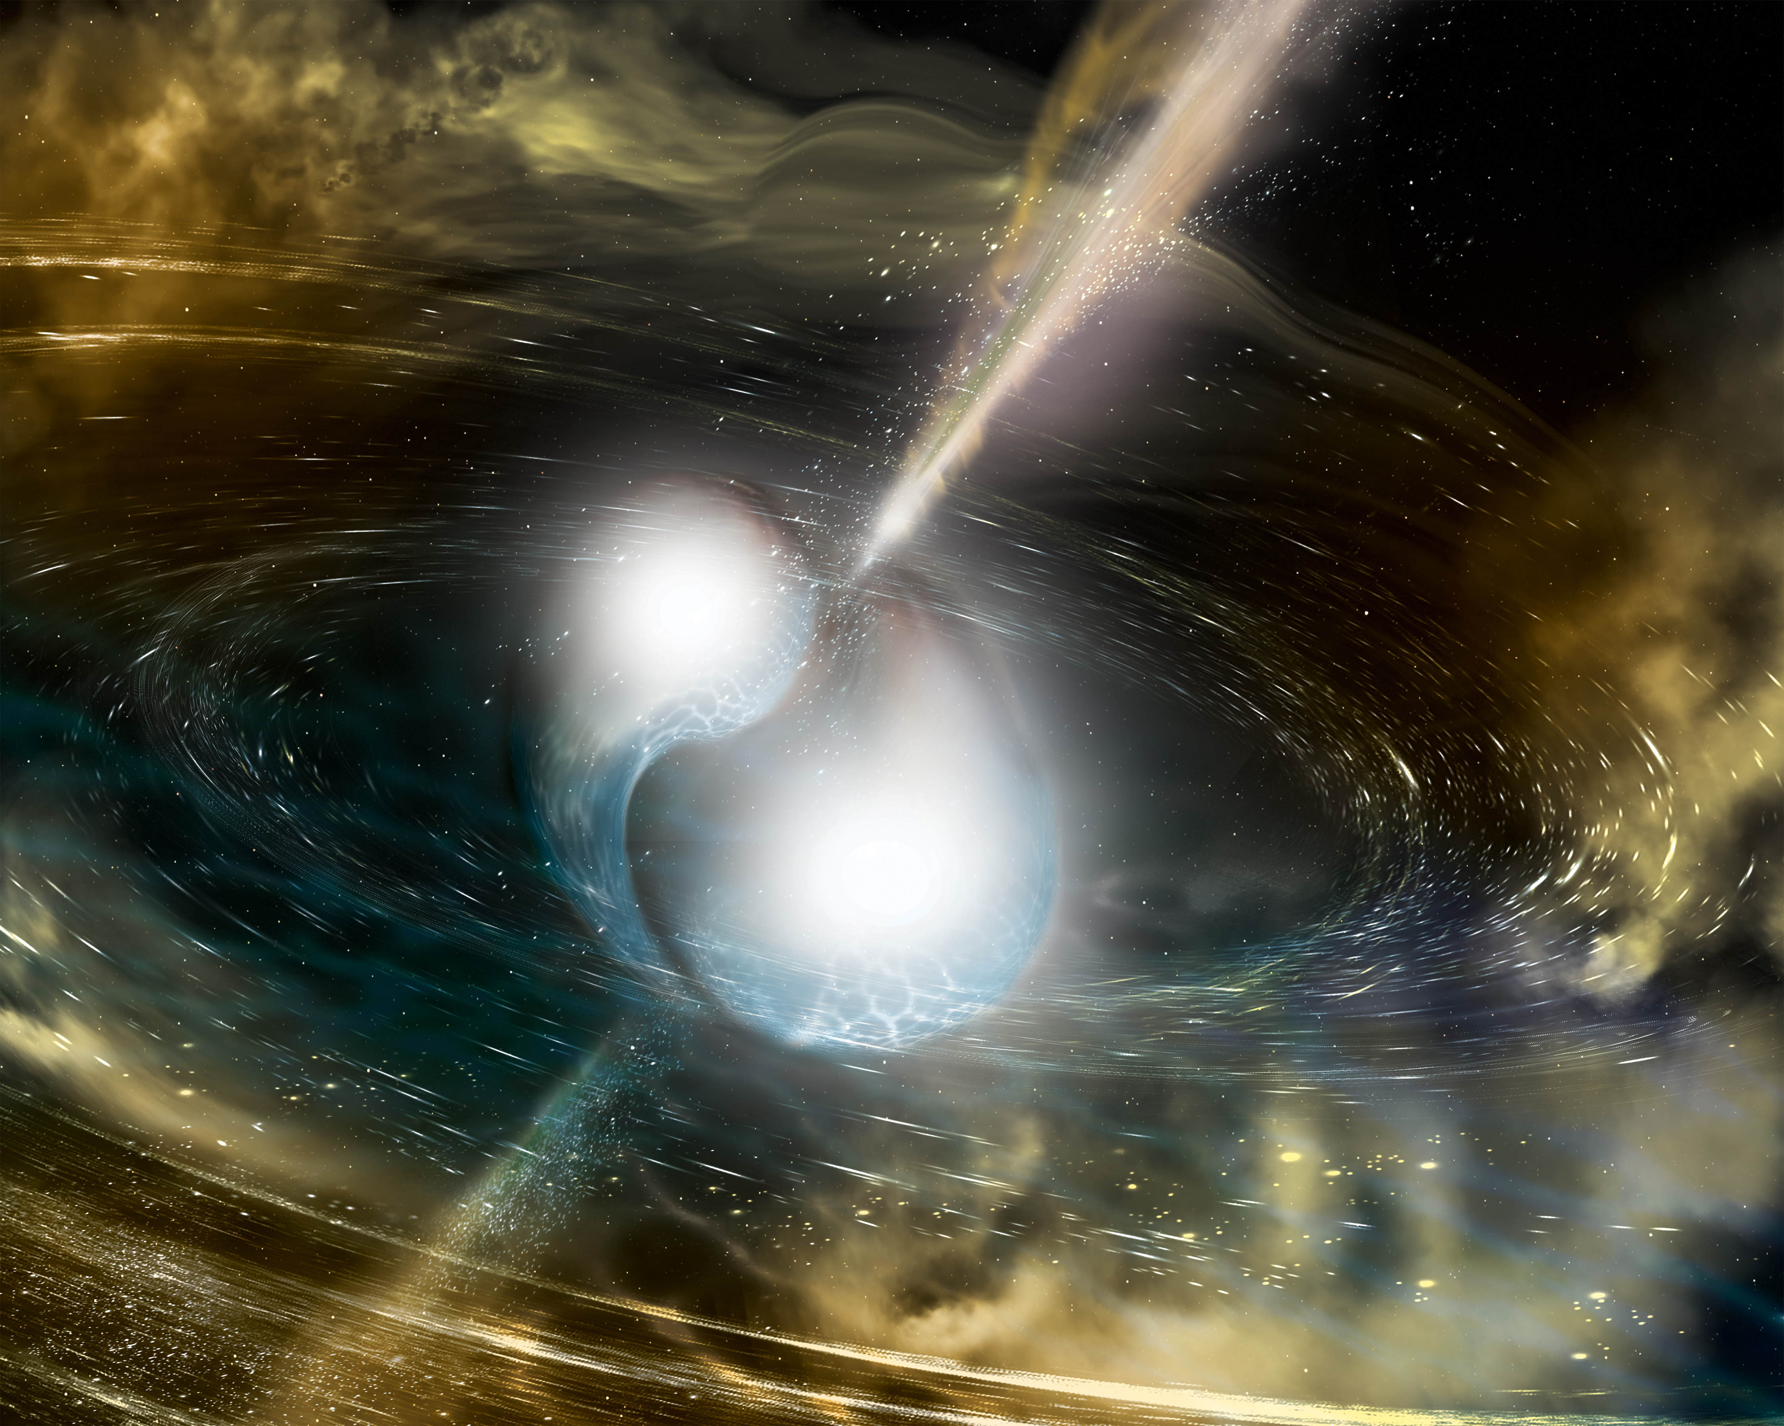


Gravitational waves and the neutron star equation of state
Chris Van Den Broeck
NuPPEC, Amsterdam, 16 March 2018

Slide 2
Advanced LIGO and Advanced Virgo

Slide 3
Sources of gravitational waves
Merging neutron stars, black holes
Fast-spinning neutron stars
Supernovae
Primordial gravitational waves

Slide 4
Compact binary coalescence

Slide 5
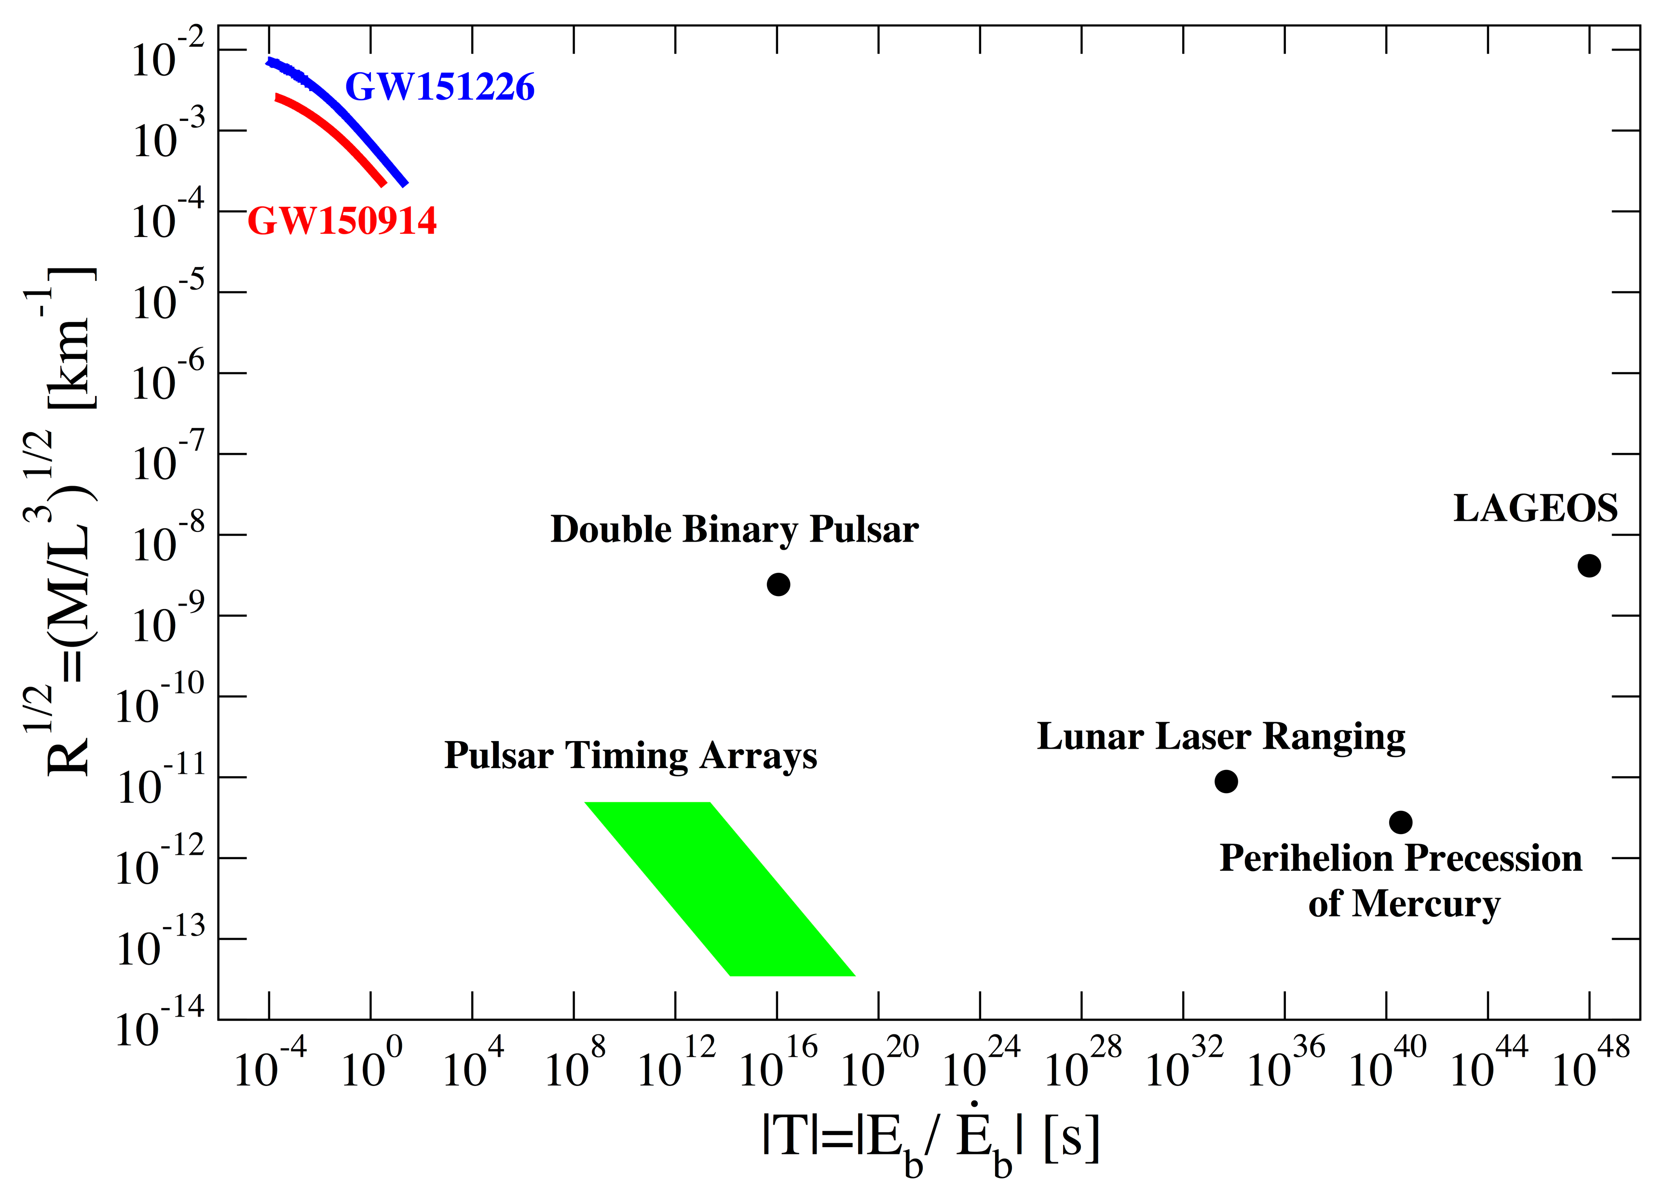
2015-2017: The first detections
14 September 2015
  First observation of binary black hole merger
  First direct evidence that black holes exist
  Exquisite tests of the strong-field dynamics of pure spacetime
So far 6 binary black hole mergers detected
Spacetime curvature
Characteristic timescale

Slide 6
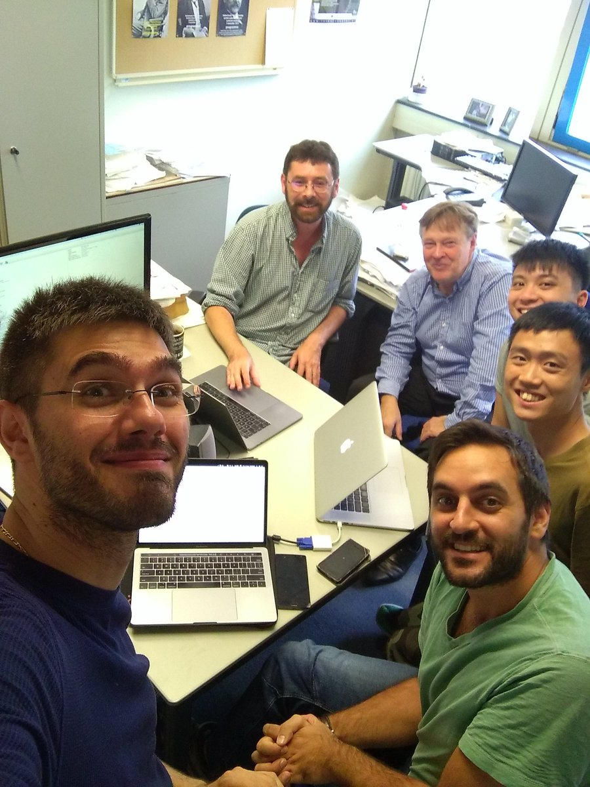
17 August 2017
“A binary neutron star!”
LIGO+Virgo, PRL 119, 161101 (2017)

Slide 7
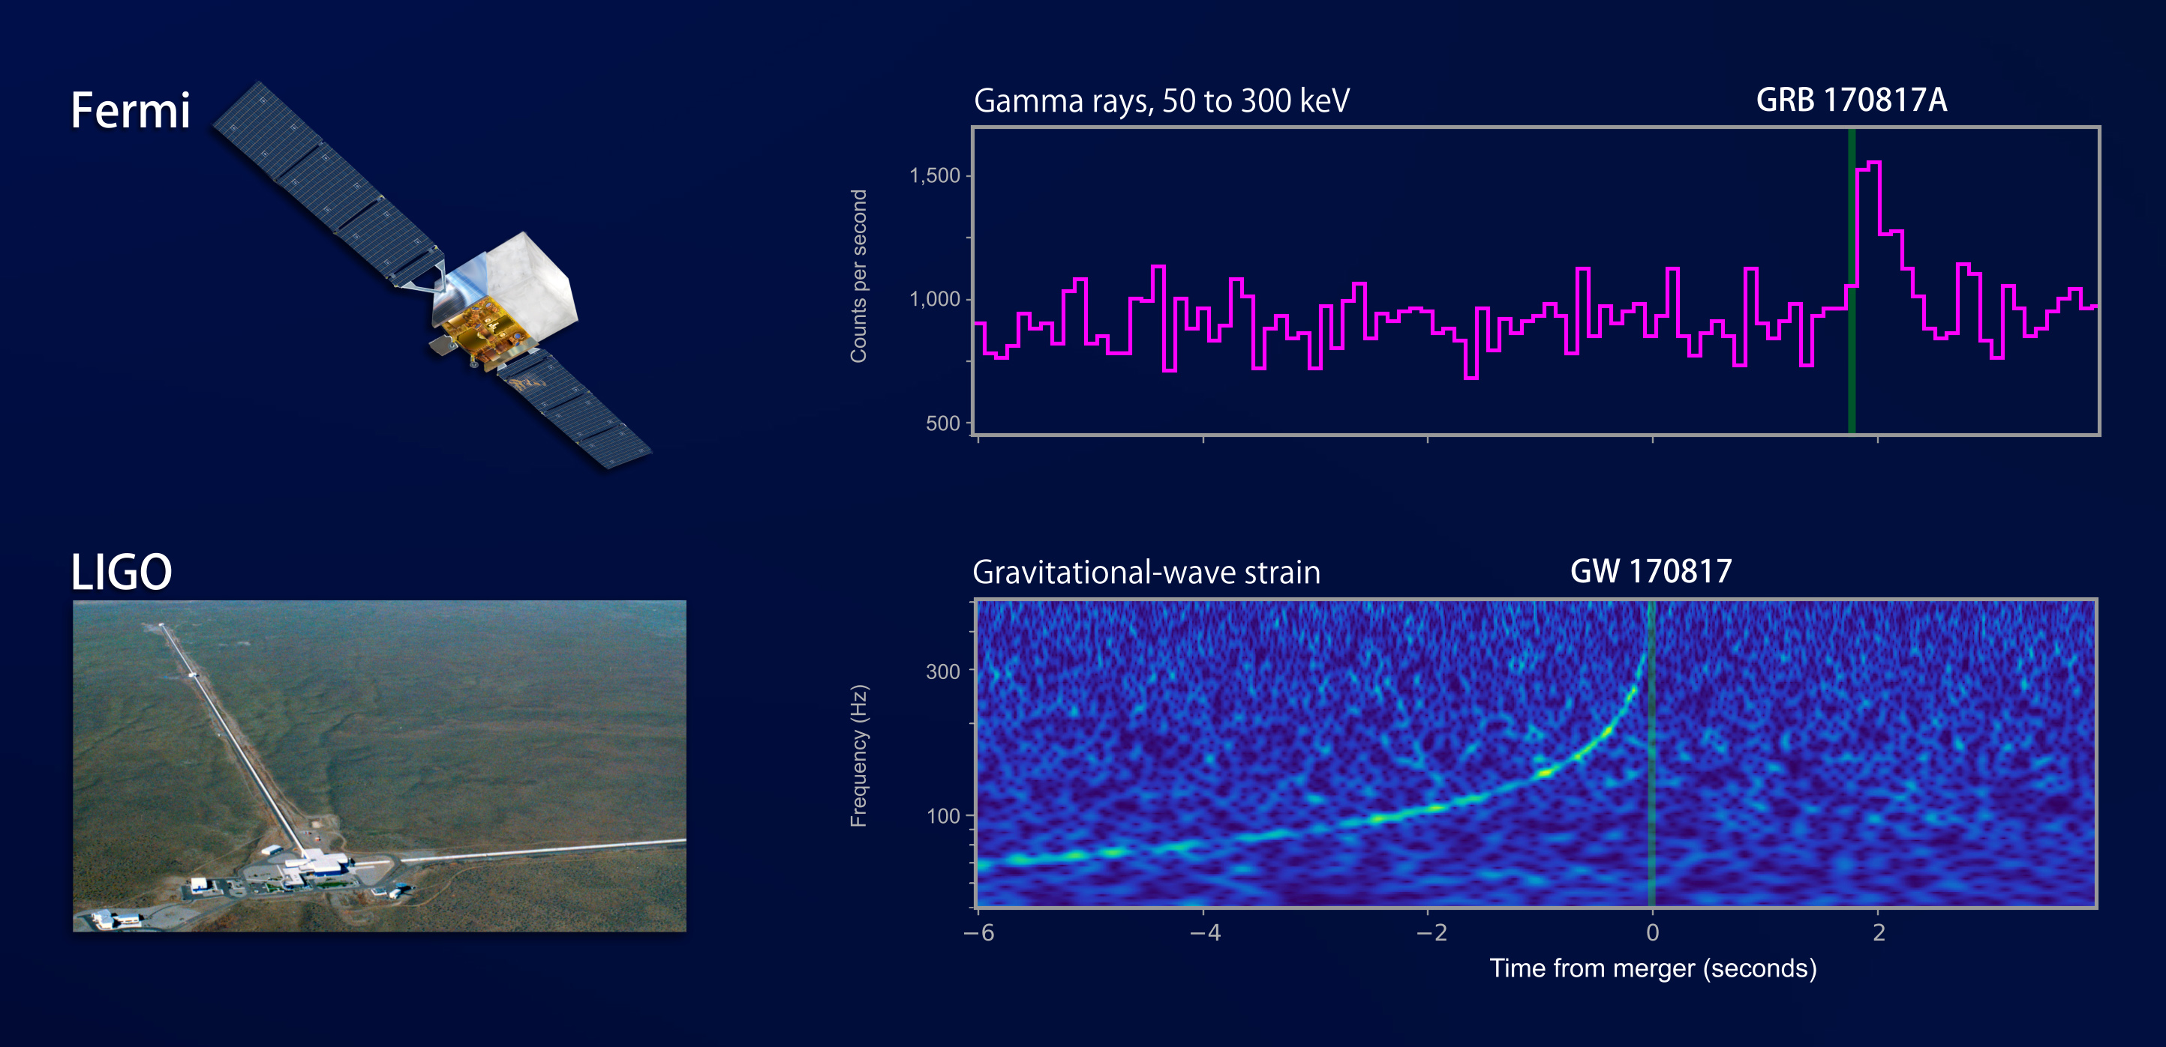
1.74 seconds after gravitational waves: Gamma ray burst

Slide 8
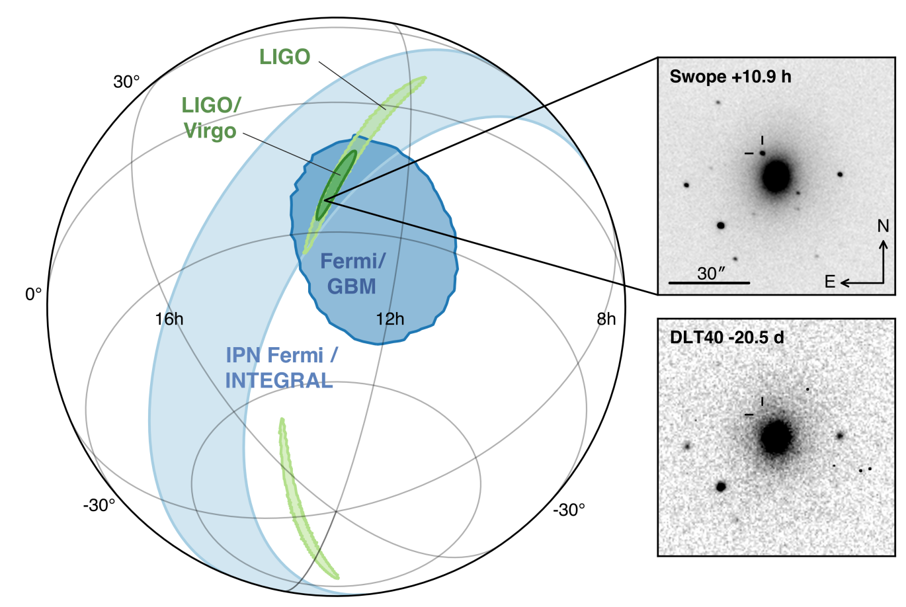
Discovery of an afterglow

Slide 9
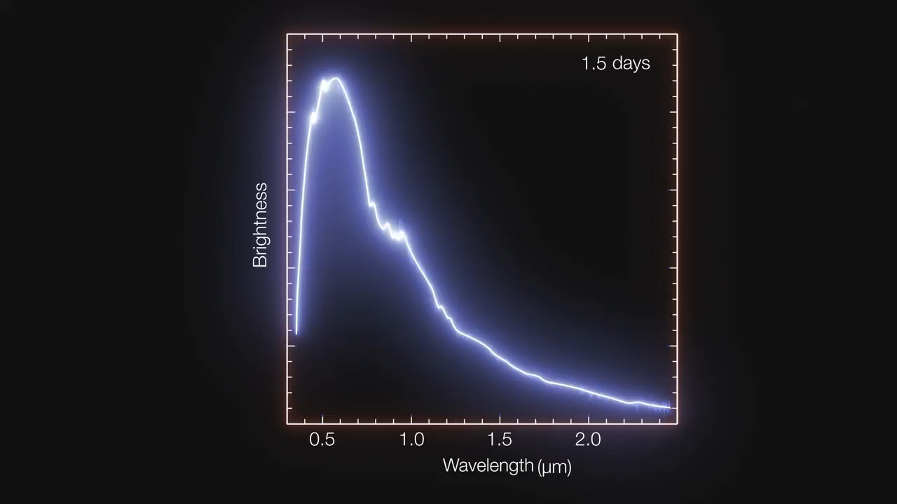
The spectrum of a kilonova

Slide 10
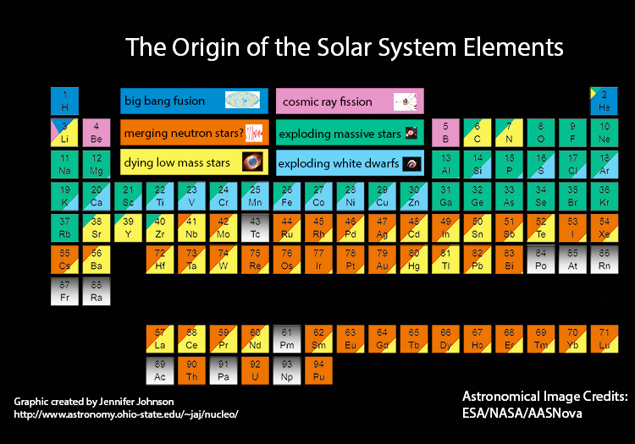

Slide 11
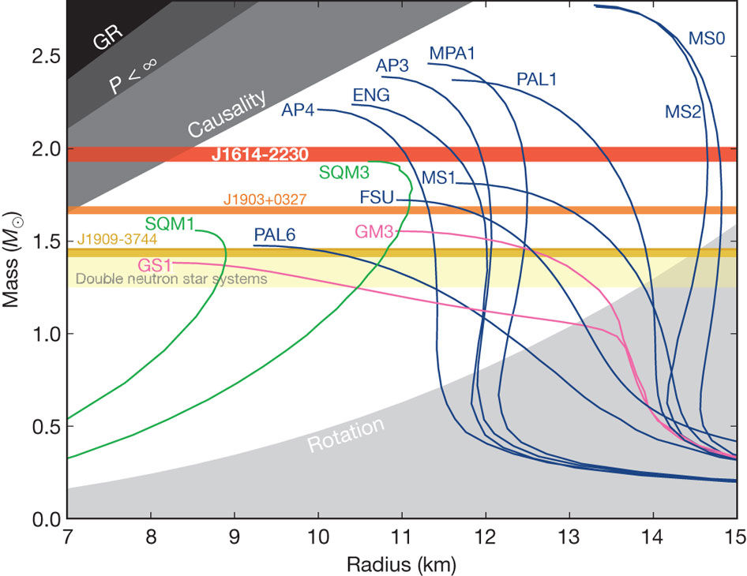
Solving an astrophysical conundrum
  Structure of neutron stars?
    Structure of the crust?
    Proton superconductivity
    Neutron superfluidity
    “Pinning” of fluid vortices to crust
    Origin of magnetic fields?
    More exotic objects?
  Widely differing theoretical predictions for equation of state
    Pressure as a function of density
    Mass as a function of radius
    Tidal deformability as a function of mass
Demorest et al., Nature 467, 1081 (2010)

Slide 12
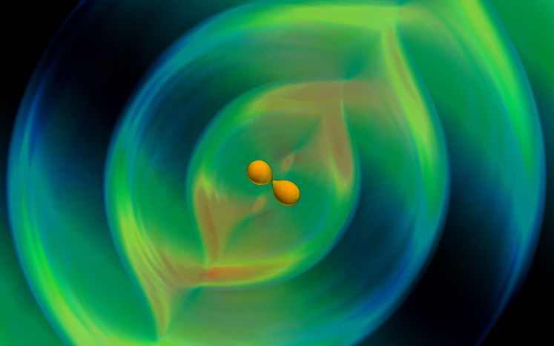
Constraining the equation of state with gravitational waves
  Gravitational waves from inspiralling binary neutron stars:
    When close, the stars induce tidal deformations in each other
    These affect orbital motion
    Tidal effects imprinted upon gravitational wave signal
    Tidal deformability maps directly to neutron star equation of state
  Measurement of tidal deformations on GW170817
    Tidal deformations relatively small
    More compact neutron stars favored
    “Soft” equation of state
LIGO+Virgo, PRL 119, 161101 (2017)

Slide 13
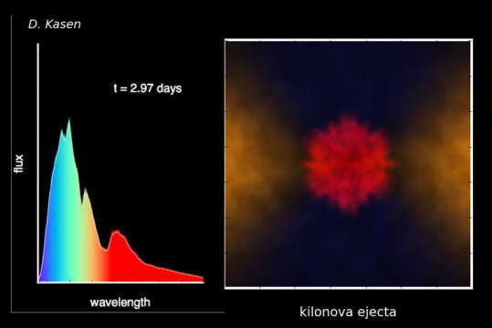
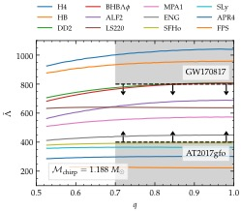
Constraint from the afterglow
  Final state of the merger not known (merger itself too high-frequency)
    Black hole?
    Neutron star?
  If equation of state too soft:
    Black hole formed too quickly
    Simulations: small accretion disk
    Not compatible with infrared emission of observed afterglow
  Puts lower bound on neutron star stiffness
Radice et al., Astrophys. J. 852, L29 (2018)

Slide 14
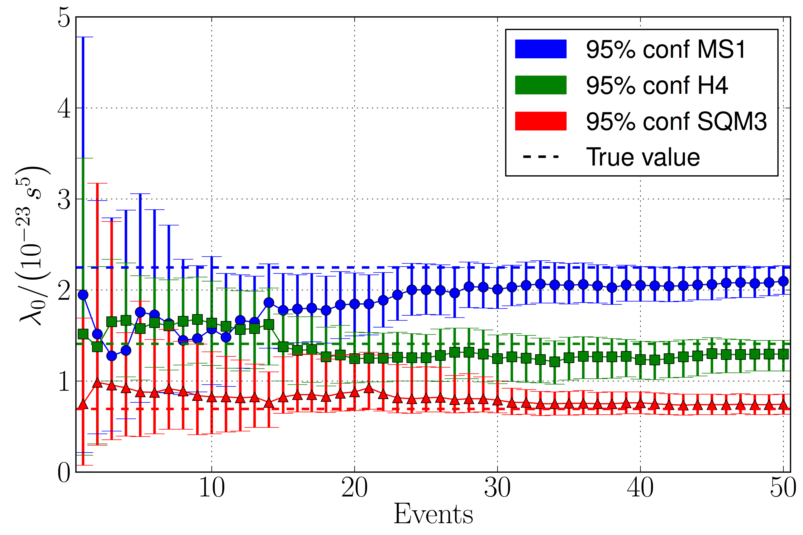
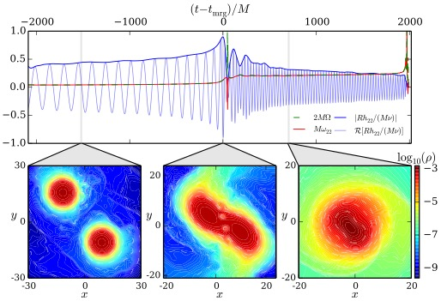
The (near) future
  More accurate determination of equation of state using tidal deformability after O(30) detection
  Post-merger signal?
    Depends strongly on equation of state
      “Soft”: prompt collapse to black hole
      “Hard”: hypermassive neutron star
    Characteristic frequencies in gravitational wave spectrum
Del Pozzo et al., PRL 111, 071101 (2013)
Bernuzzi et al., PRL 115, 091101 (2015)

Slide 15
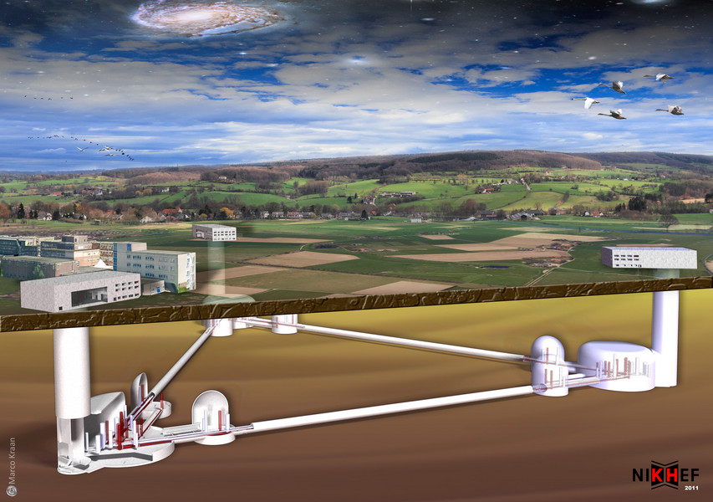
Einstein Telescope
EU-funded design study 2011
  Triangular, sides of 10 km
  Underground
  Superior noise suppression
  More sensitive optics
  Six interferometers:
    High frequencies (high laser power)
    Low frequencies (cryogenic)
Factor 10 improvement in sensitivity over Advanced LIGO/Virgo
Merging black holes, neutron stars in the entire visible Universe
  100,000 sources per year!
    Exquisite probe of post-merger physics for nearby, loud sources
    Combine information from large number of sources for detailed probing of neutron star equation of state

