Slide 1
Christa Hooijer – director institute organisation NWO-I

Slide 2
About NWO

Slide 6
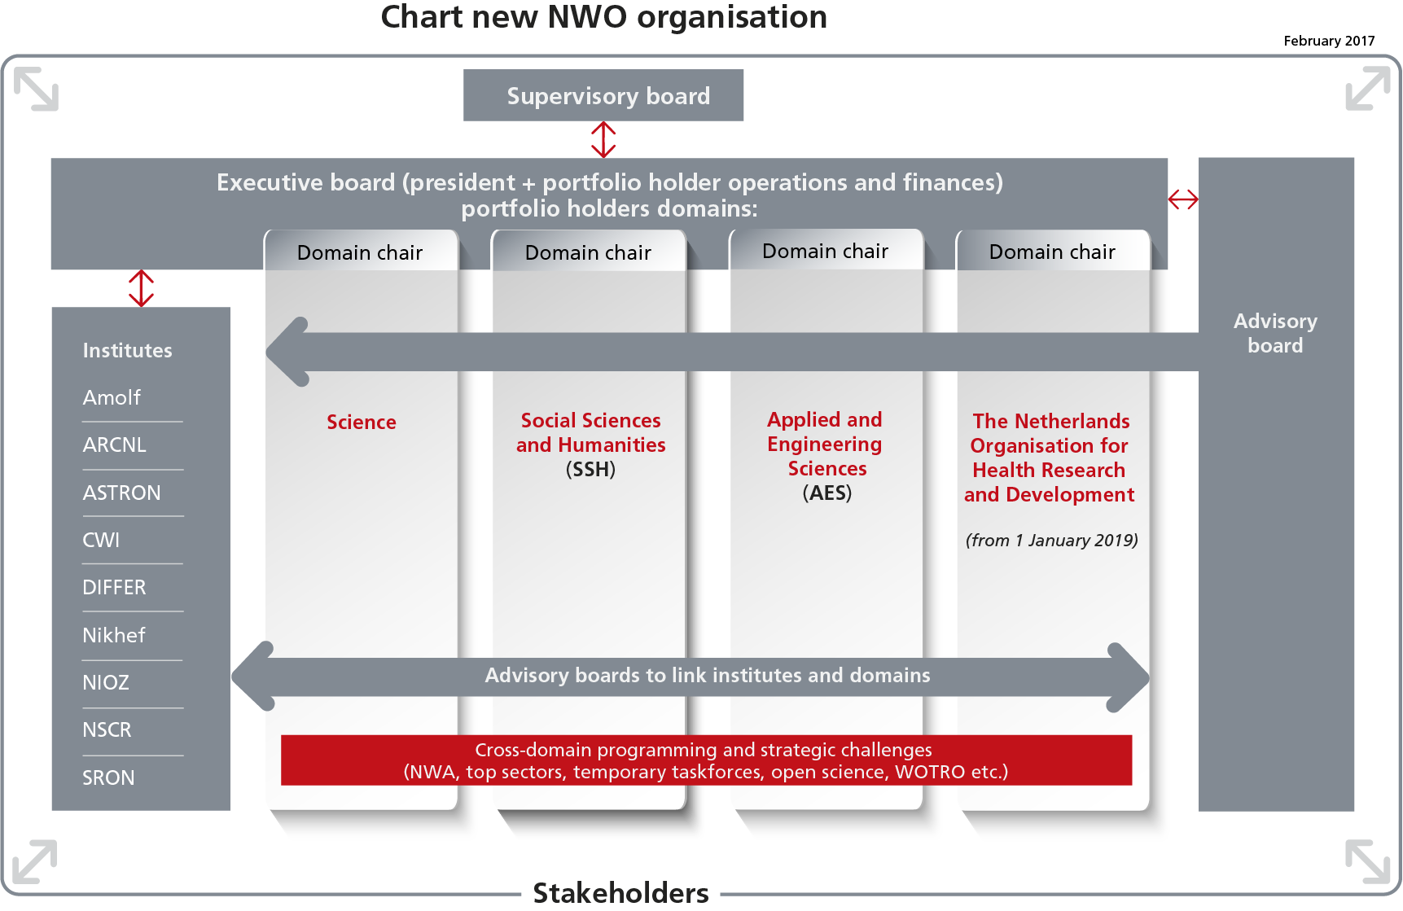

Slide 10
NWO strives for a strong science system in the Netherlands through:
encouraging quality and innovation in science
collaboration across disciplines and national borders
collaboration between scientists and between scientists and stakeholders in society
coherency in research programming and strategy development

Slide 11
Objective 1
National and international collaboration within science
Via research programming and funding NWO will further encourage collaboration at all levels:
within research groups
between scientists from different disciplines
between research institutes
internationally

Slide 12
Objective 2 Consolidating scientific strengths for societal challenges
NWO takes initiatives to realise connections that add value for societal and economic challenges
Examples are:
active contribution to development and realisation of Dutch Science Agenda
encouraging connections between academic, practice-oriented and applied research
encouraging and facilitating knowledge utilisation (e.g. via top sectors policy)

Slide 13
Objective 3
Organisation and strategy formation within science, nationally and internationally
NWO supports the organisation:
of researchers within and between disciplines
between academia, government, the business community and other societal partners

Slide 14
A few of the intended results 2015-2018
Reliable research funding open for innovative ideas
Talent programmes that meet the needs, opportunities and career perspectives of young researchers
Strong national research institutes with (inter)national research facilities that collaborate widely with universities, industry and society
Linking the research agendas for the top sectors with societal challenges and international agendas

Slide 15
Funding instruments

Slide 16
Long-term funding
National world-leading institutes
Strategic partnerships
Temporary taskforces

Slide 17
Curiosity-driven research
Open competition
Talent scheme (VENI-VIDI-VICI)
Collaborative programmes

Slide 18
Research into societal and economic challenges
Industrial partnershipprogrammes
Dutch Science Agenda (NWA)

Slide 19
National coordination through committee for large scale infrastructures
Competitive funding through National Roadmap and mid-size infrastructure grants
Research facilities and equipment

