Slide 1
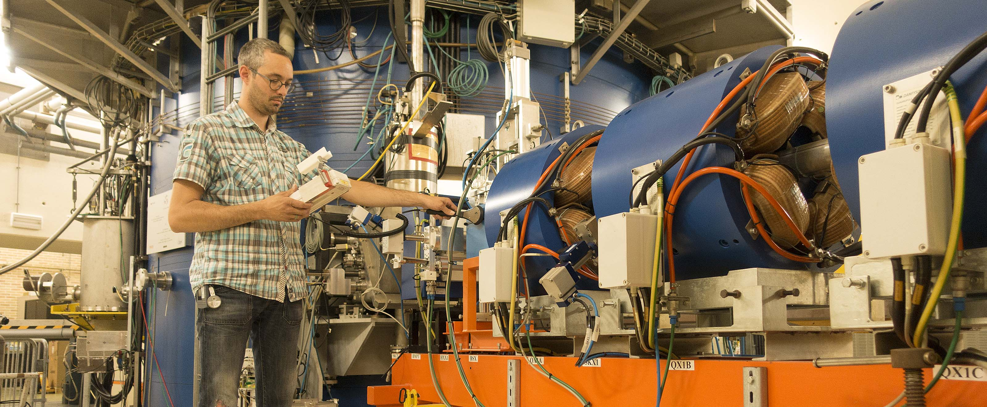
KVI Center for
Advanced Radiation Techonology
To answer fundamental questions in nature and to
contribute to solutions for societal challenges

Slide 2
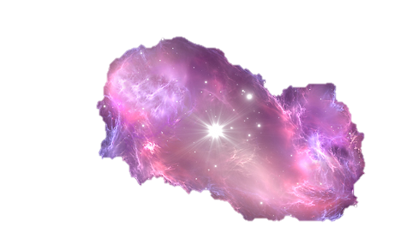
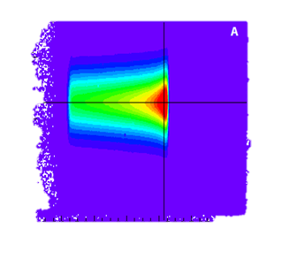
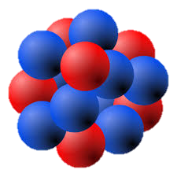
To answer fundamental questions in nature and to
contribute to solutions for societal challenges

Slide 3




AGOR = Large scale RI
  Unique facility for research on particle therapy and irradiations for aerospace industry; operations extended > 2025
  Recognized by ESA as Ground-Based Facility
Supported by EU Transnational Access programs
  ENSAR2
  INSPIRE
  Recognized by NWO as LsSF

Slide 4
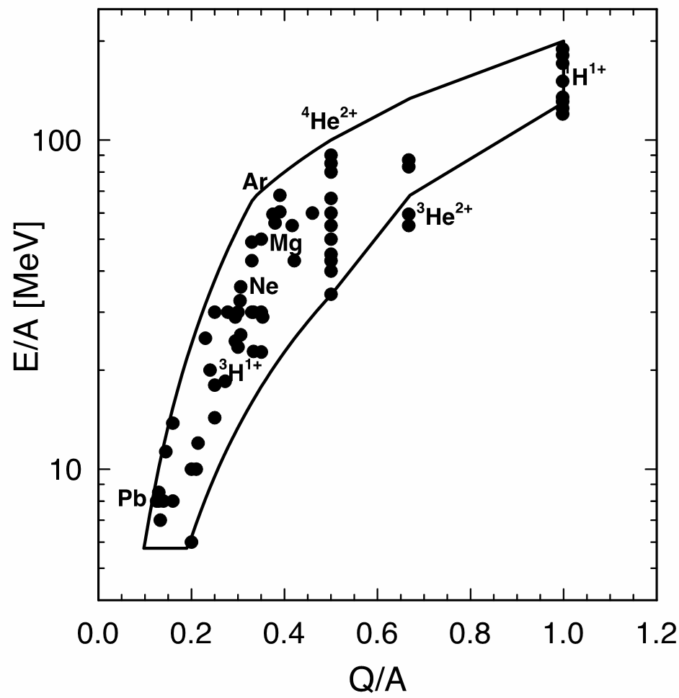
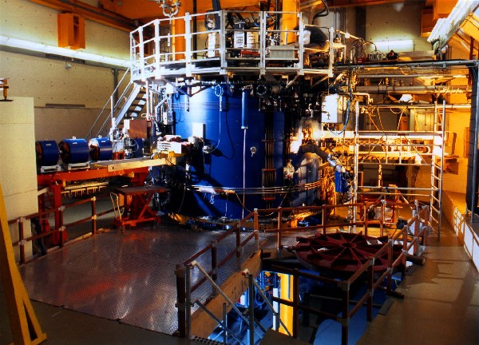
AGOR facility
To answer fundamental questions in nature and to
contribute to solutions for societal challenges
120-190 MeV p
light elements He, C, O
up to 90 MeV/u
Pb²⁷⁺
8 MeV/u

Slide 5
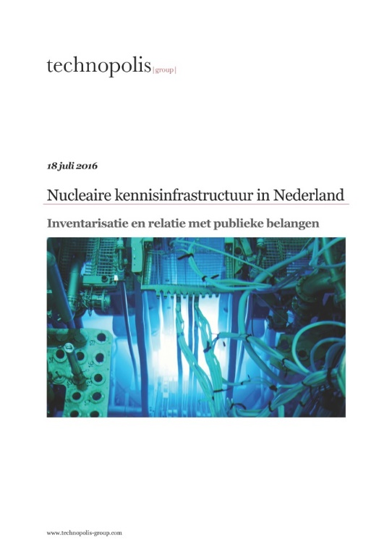
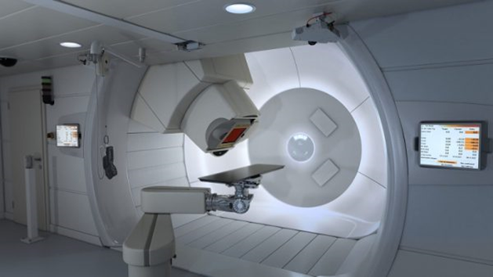
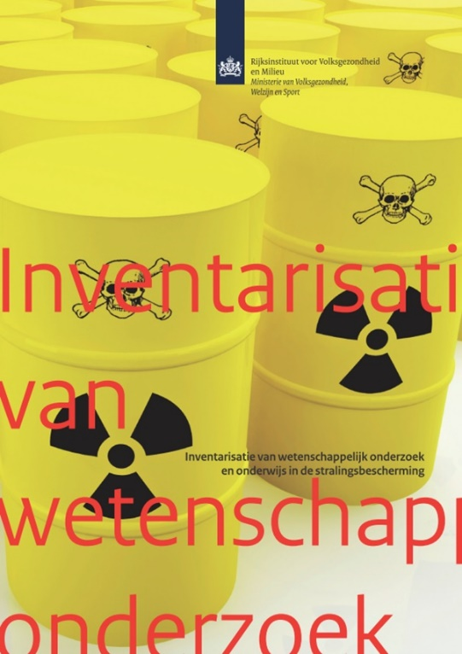
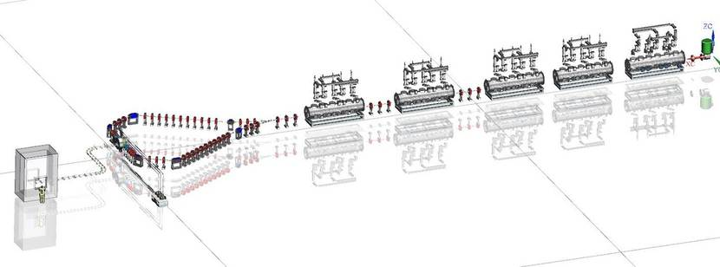
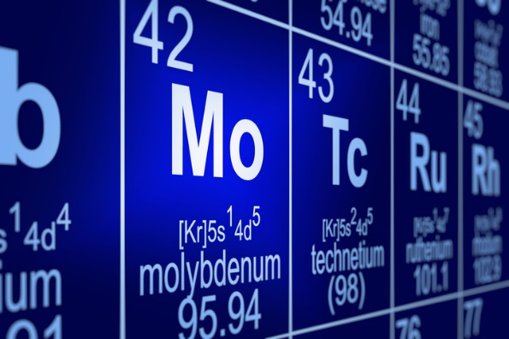
Science for society
To answer fundamental questions in nature and to
contribute to solutions for societal challenges

Slide 6
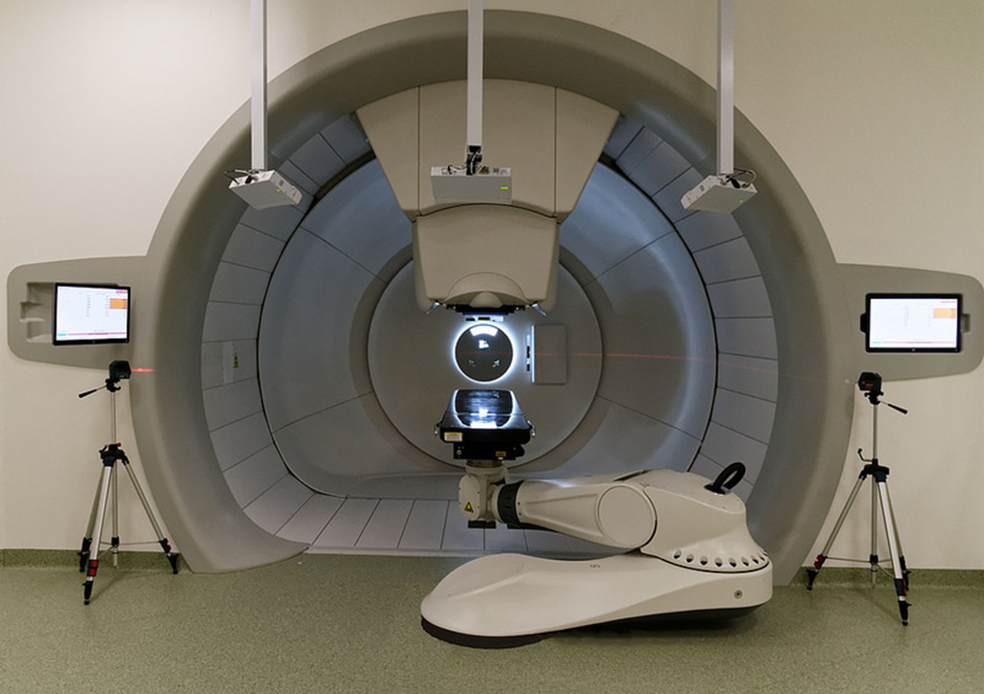
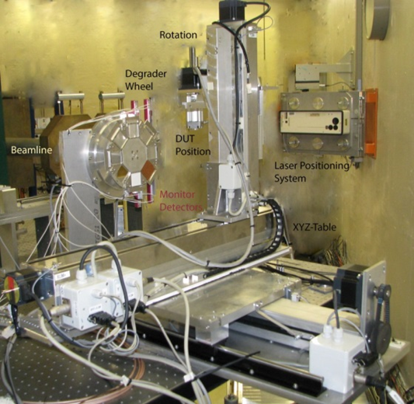

Particle therapy at Uni Medical Center
To answer fundamental questions in nature and to
contribute to solutions for societal challenges
Contribution by Peter Dendooven

Slide 7
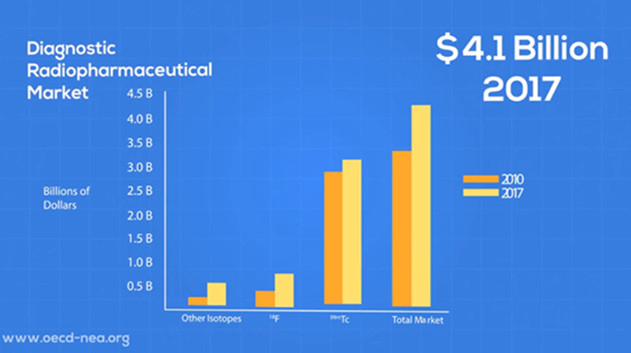
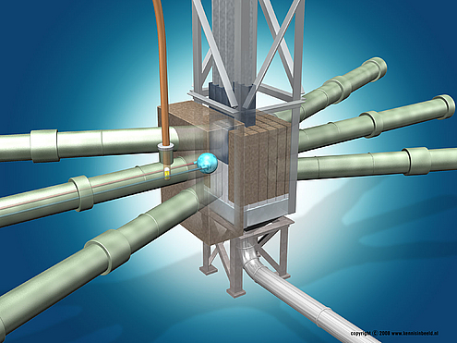

Medical isotope crisis??
To answer fundamental questions in nature and to
contribute to solutions for societal challenges
Medical isotope production by:
Nuclear reactors (existing and foreseen), but serious reshaping of the landscape
Particle accelerators (e.g. Myrrha, B)
Electron accelerators (e.g. Lighthouse Isotopes, NL)

Slide 8
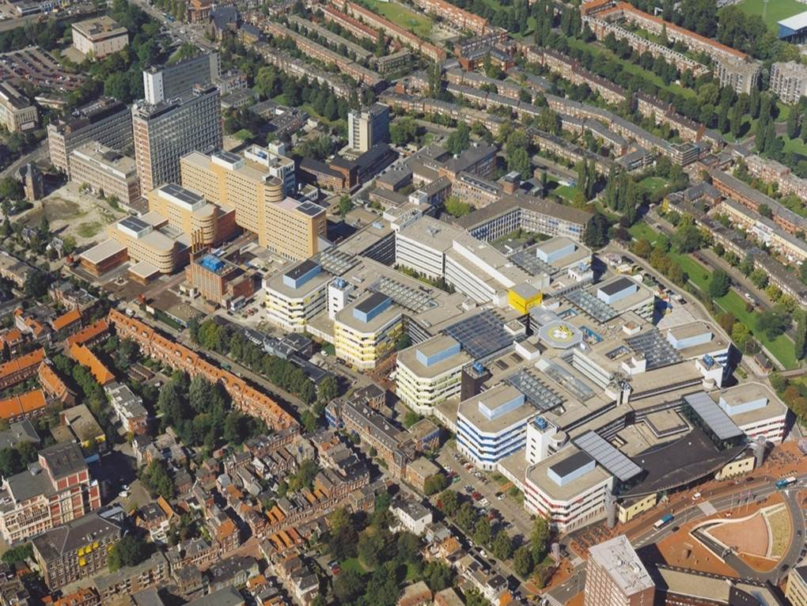
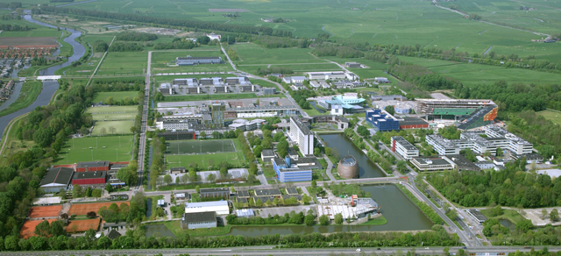
Research on medical isotopes
To answer fundamental questions in nature and to
contribute to solutions for societal challenges
Brings together expertise from:
Physics & Engineering
Chemistry
Nuclear Medicine and Molecular Imaging

Slide 9
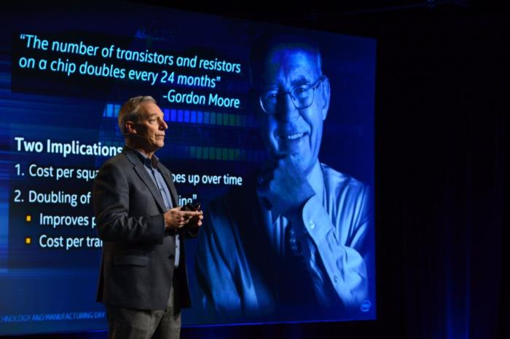
Stacy J. Smith (Intel)
To answer fundamental questions in nature and to
contribute to solutions for societal challenges

Slide 10
















AGOR facility
To answer fundamental questions in nature and to
contribute to solutions for societal challenges
120-190 MeV p
light elements He, C, O
up to 90 MeV/u
Pb²⁷⁺
8 MeV/u

Slide 11
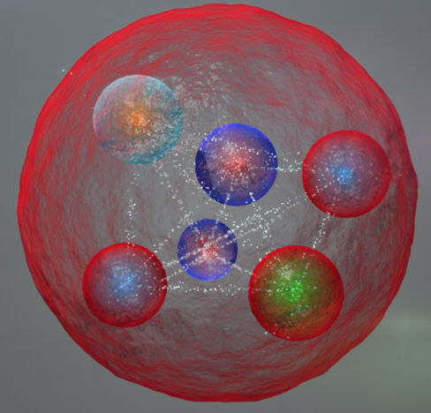
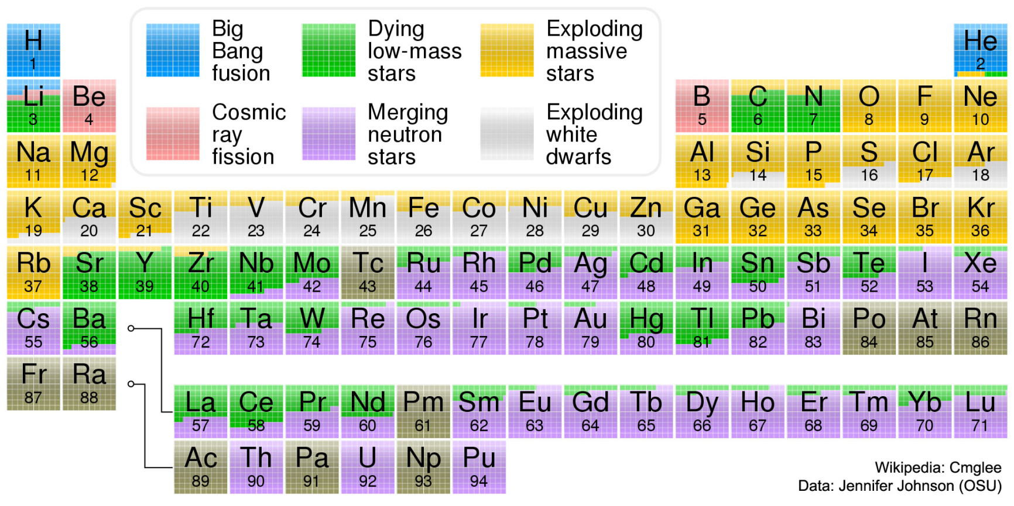
Building blocks of the Universe

Slide 12
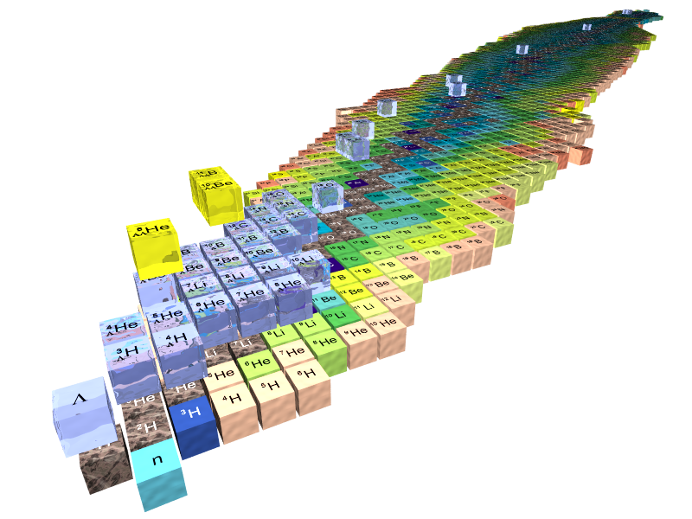
Extreme conditions of matter
Away from the stable nuclei
Following the edges near the proton and neutron driplines
Replacing the lowest mass quarks with heavier ones (hypernuclei)

Slide 13
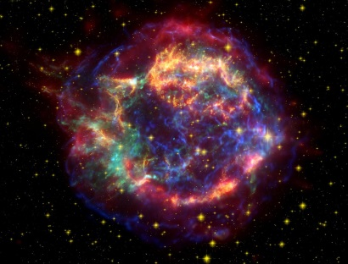
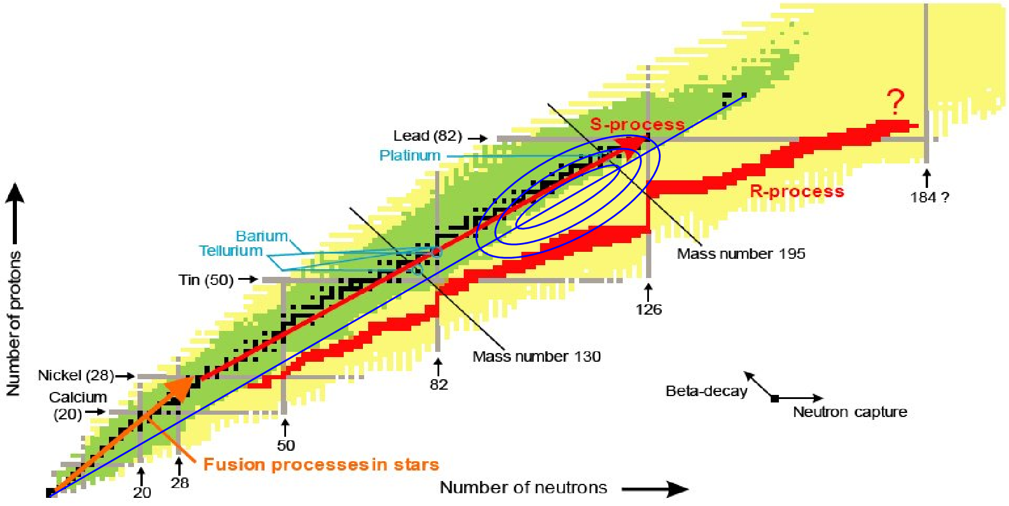
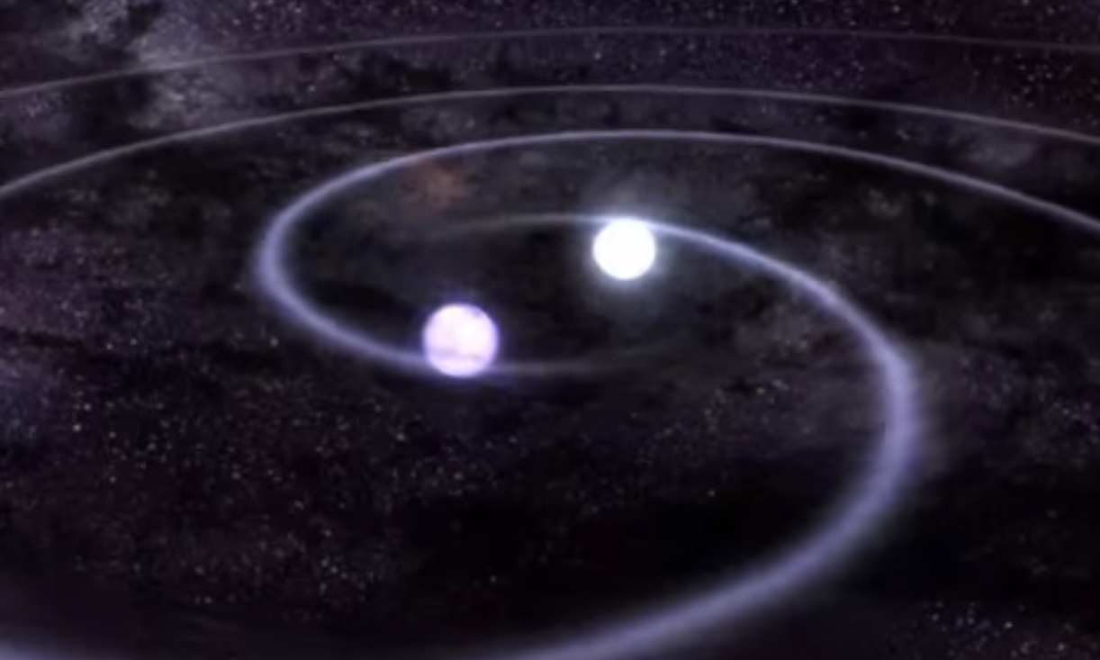
Building blocks in the Universe

Slide 14
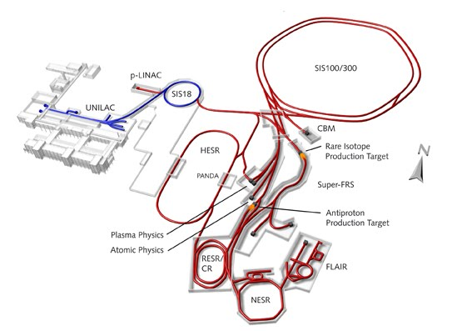
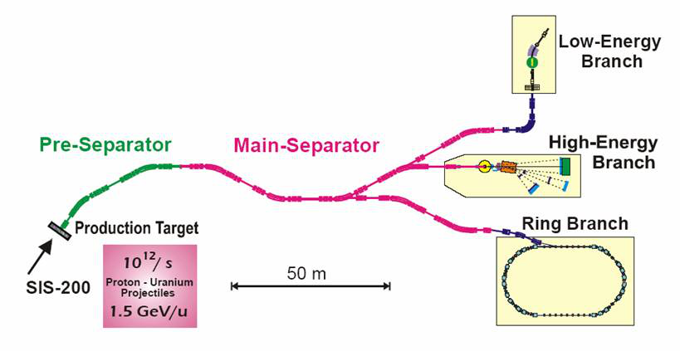
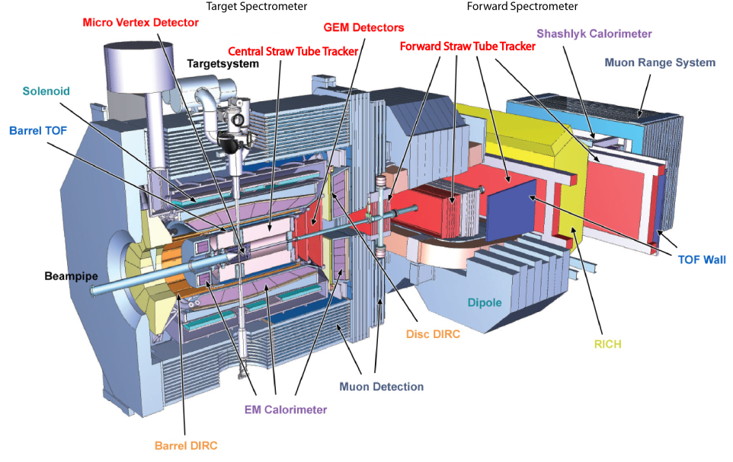
Facility for Antiproton and Ion Research
Contribution by Myroslav Kavatsyuk

Slide 15
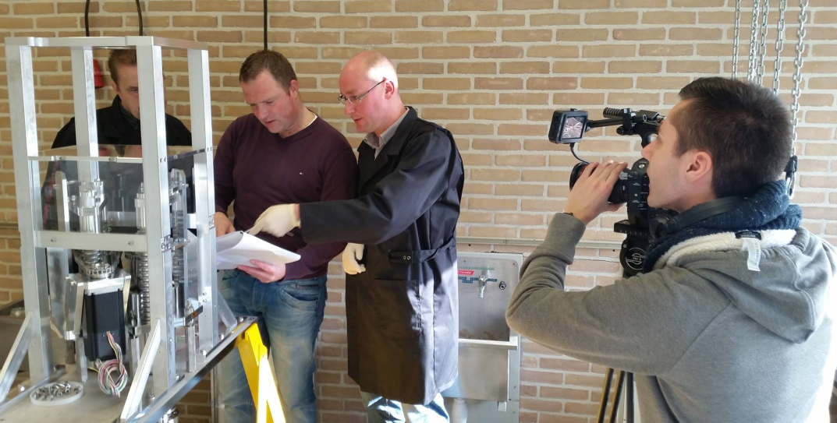
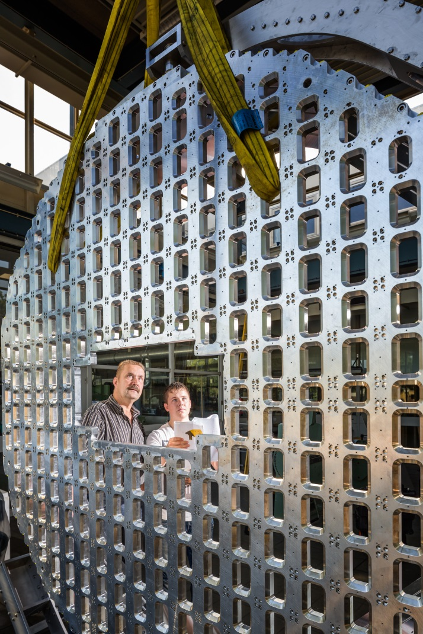
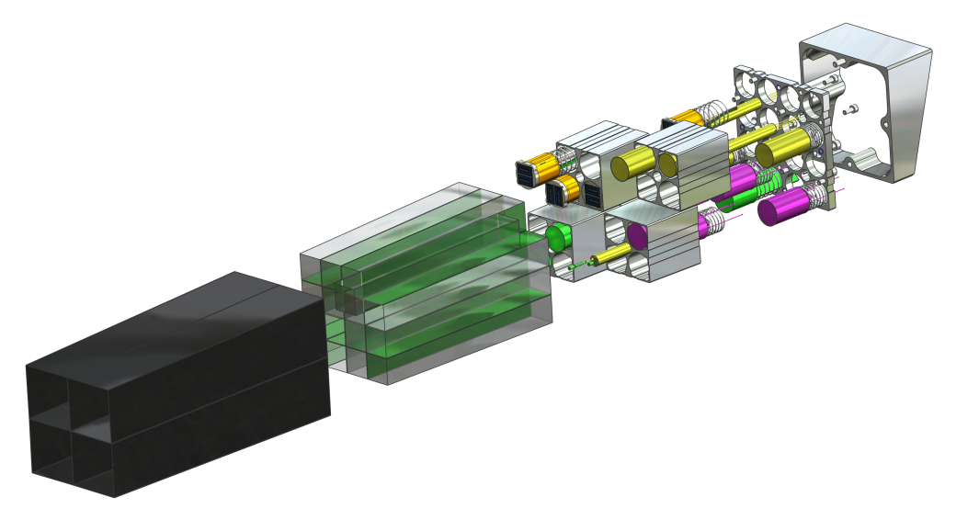
Advanced engineering

Slide 16
To answer fundamental questions in nature and to
contribute to solutions for societal challenges

