Slide 1
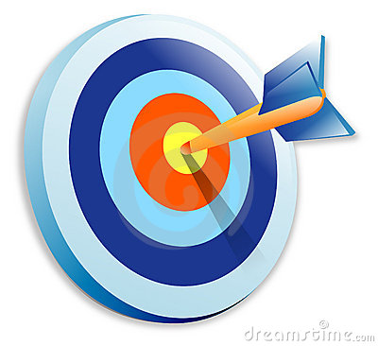
Hitting the bull’s eye in proton therapy
Imaging patient and beam: overview and recent work at KVI-CART
Peter Dendooven
91st meeting
16 March 2018 - Amsterdam

Slide 2
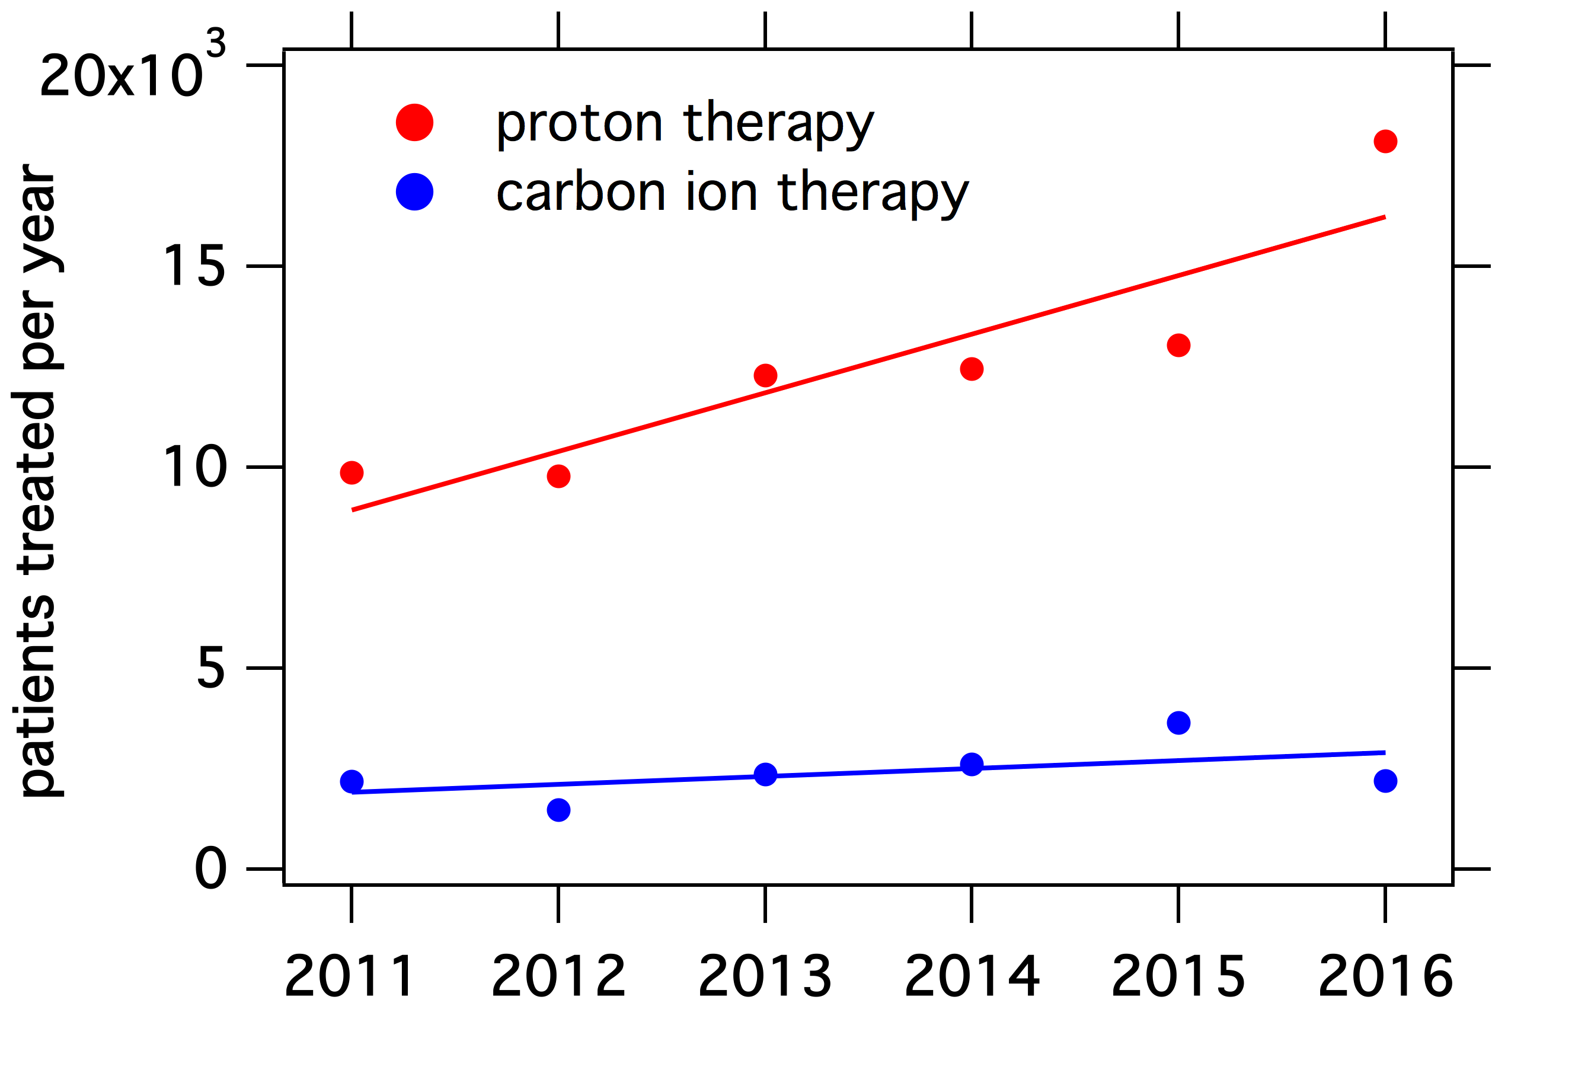
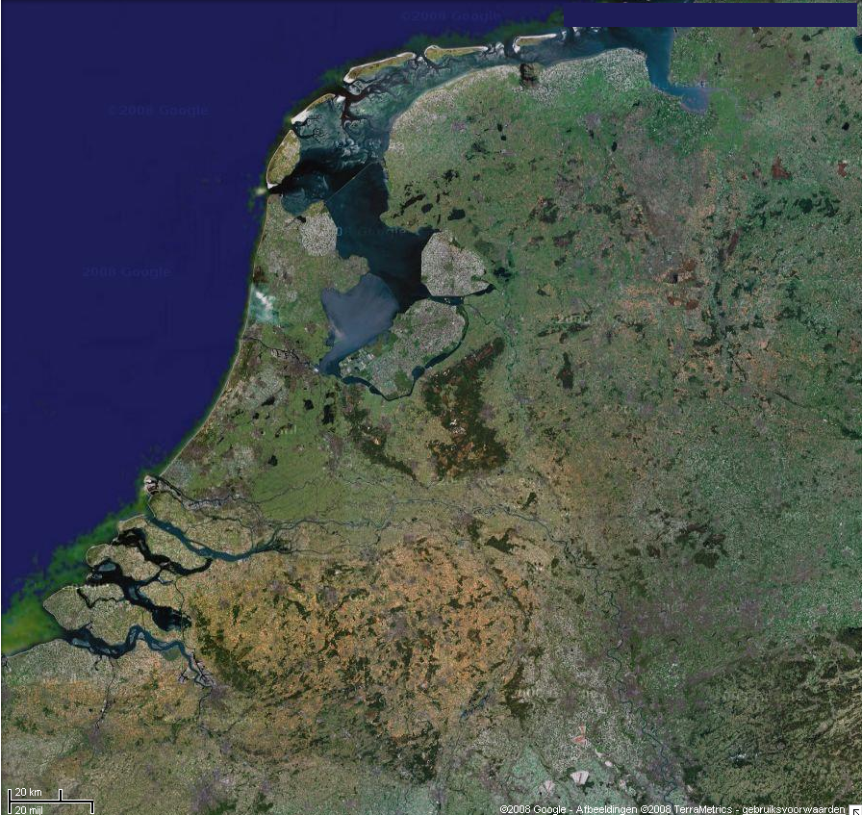
Particle beam radiotherapy worldwide and in NL
Groningen
source: www.ptcog.ch
Delft
175 000 patients treated (end of 2016)
20 000 patients treated in 2016
79 facilities in operation
46 facilities under construction
22 facilities under planning
Maastricht
- - - - - - - - - - Groningen
- - - - - Delft, Maastricht
(Amsterdam is undecided)

Slide 3
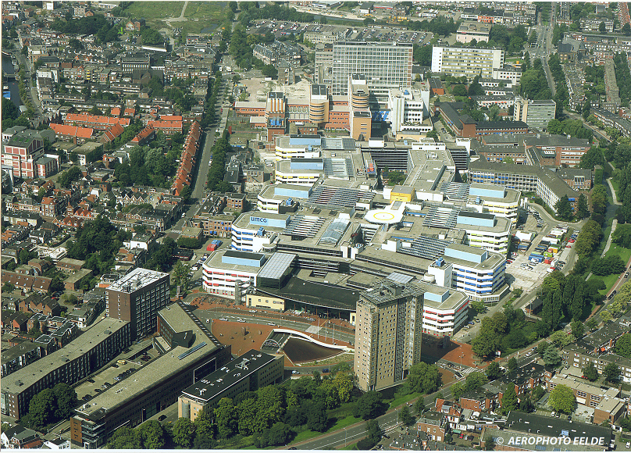

UMC Groningen Proton Therapy Center
IBA ProteusPLUS
2 treatment rooms
capacity ~ 600 patients per year
start of operations: 22 January 2018
first proton therapy treatment in the Netherlands
www.umcgroningenptc.nl/en/

Slide 4
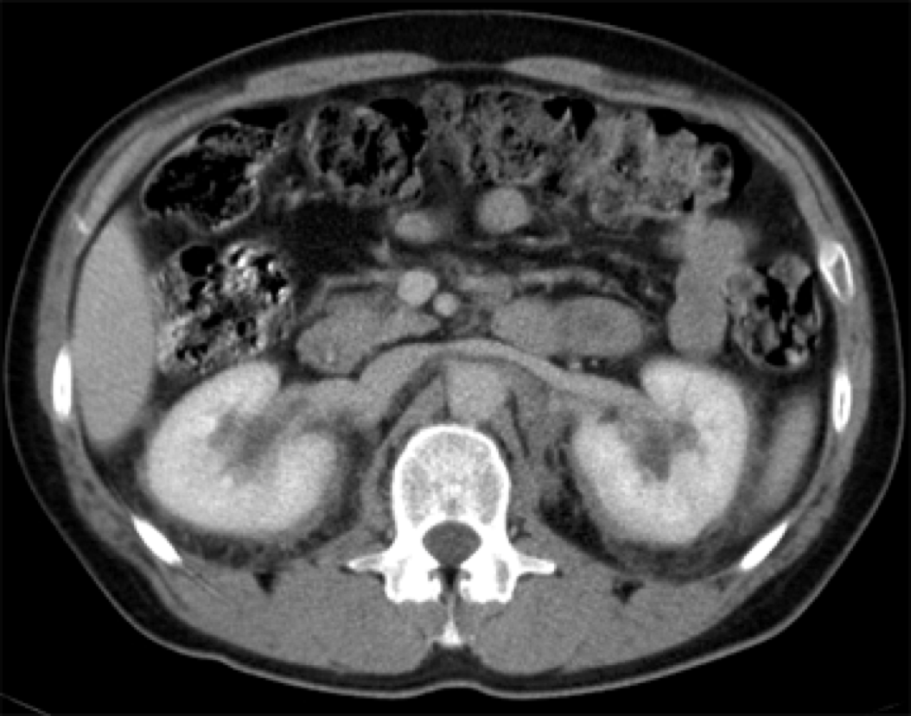
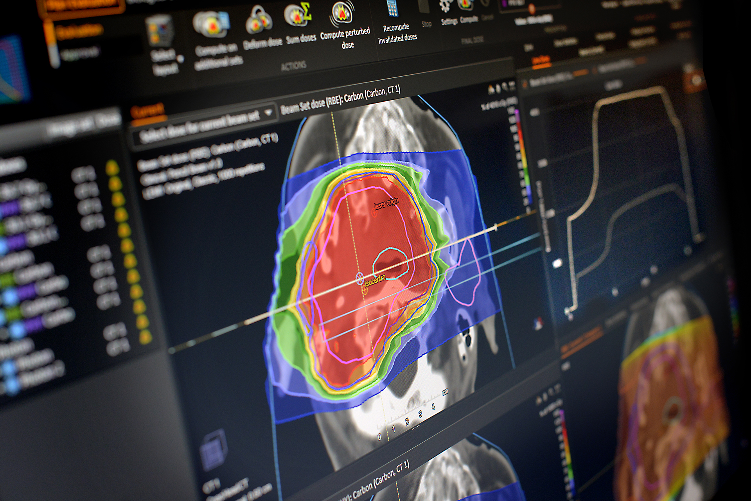
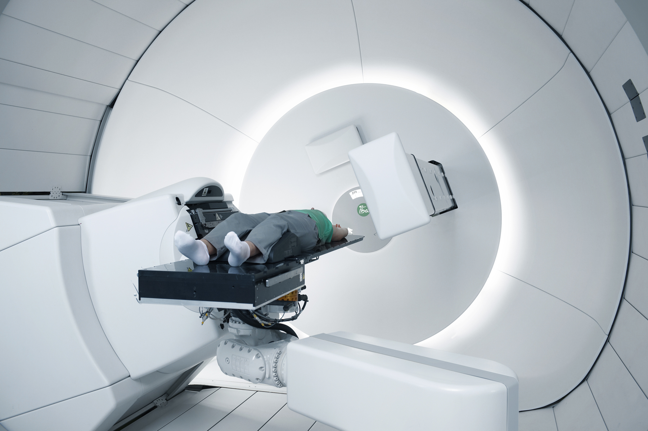
Proton therapy workflow (simplified)
radiation dose prescription
treatment plan
CT
How do protons behave inside the patient ?
www.raysearchlabs.com
treatment
Was the dose delivered according to plan ?
iba-worldwide.com
Notes:
Focus on 2 aspects:
How do protons behave inside the patient ?
Needed for good treatment planning.
Was the dose delivered according to plan ?

Slide 5
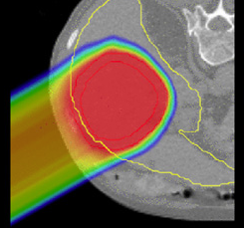
Knowing the patient
anatomy
proton stopping power, proton range
Ye Zhang et al., Phys. Med. Biol. 57(2012)1779

Slide 6
Knowing the patient anatomy
standard: CT

Slide 7
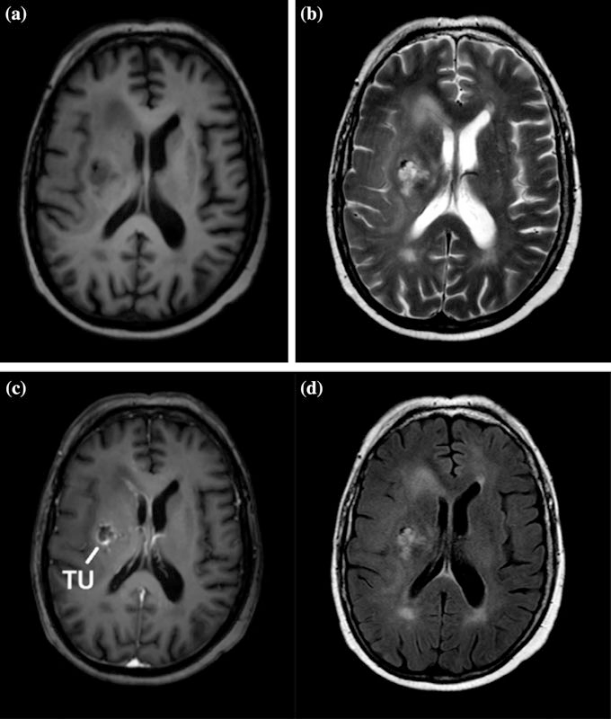
Knowing the patient anatomy
standard: CT
MRI: under development
D.A. Low, in “Advances in Radiation Oncology”, Eds. Wong, Schultheiss, Radany (2017)
Notes:
Why MR ? Under development at least for photon radiotherapy.
better identification of different soft tissues
ability to acquire multiple image datasets that highlight the tissue boundaries, and differentiate different tissue types, even within a specific tumor
Drawback: no direct relation to electron density and average atomic number, the material properties important for proton stopping power
Fig. from D.A. Low, in “Advances in Radiation Oncology”, Eds. Wong, Schultheiss, Radany (2017)

Slide 8
From anatomy to proton stopping power
CT
3-4% uncertainty in proton range
imposes a safety margin around tumour
better
information at different X-ray energies
information from protons
Notes:
main problem: protons interact fundamentally different with matter than photons
Better than CT: measure attenuation at different X-ray energies
high energy, Compton scattering ➔ ρ_{e}
low energy: photo-electric effect + Compton
techniques: DECT and spectral CT

Slide 9
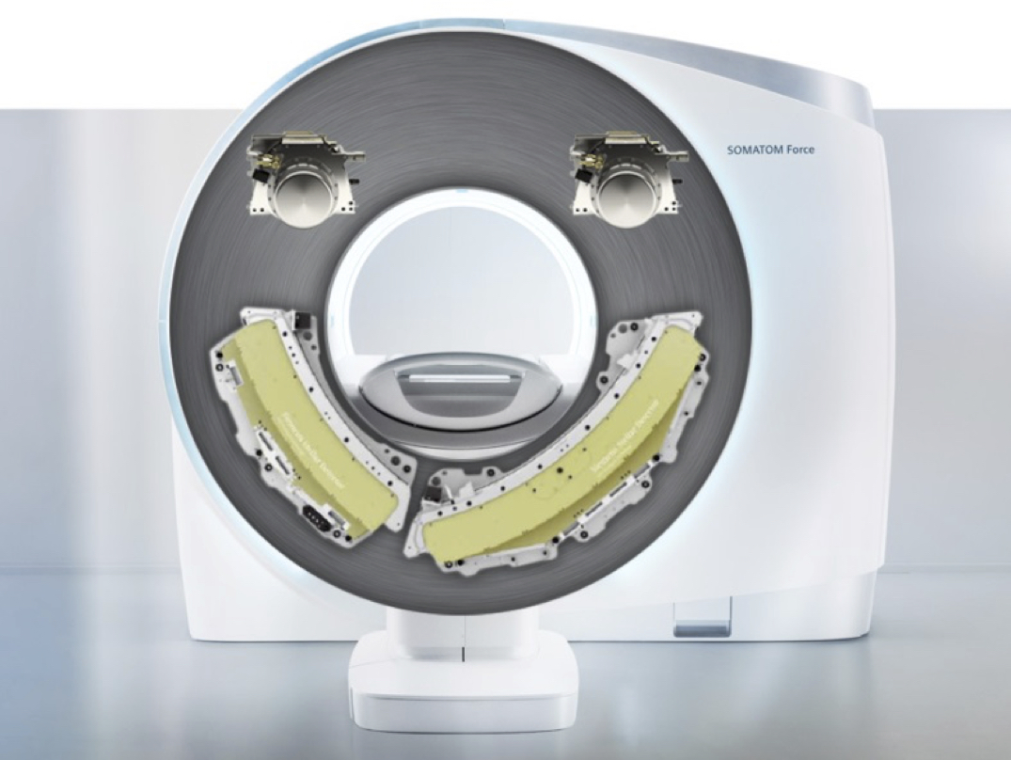
Different X-ray energies: DECT
dual-energy CT
www.healthcare.siemens.com
Notes:
main problem: protons interact fundamentally different with matter than photons
Better than CT: measure attenuation at different X-ray energies
high energy, Compton scattering ➔ ρ_{e}
low energy: photo-electric effect + Compton
techniques: DECT and spectral CT

Slide 10
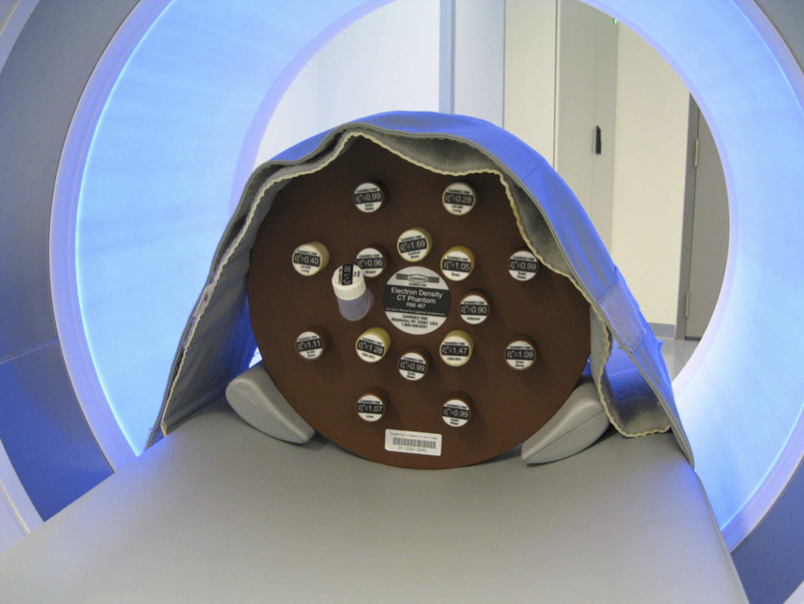
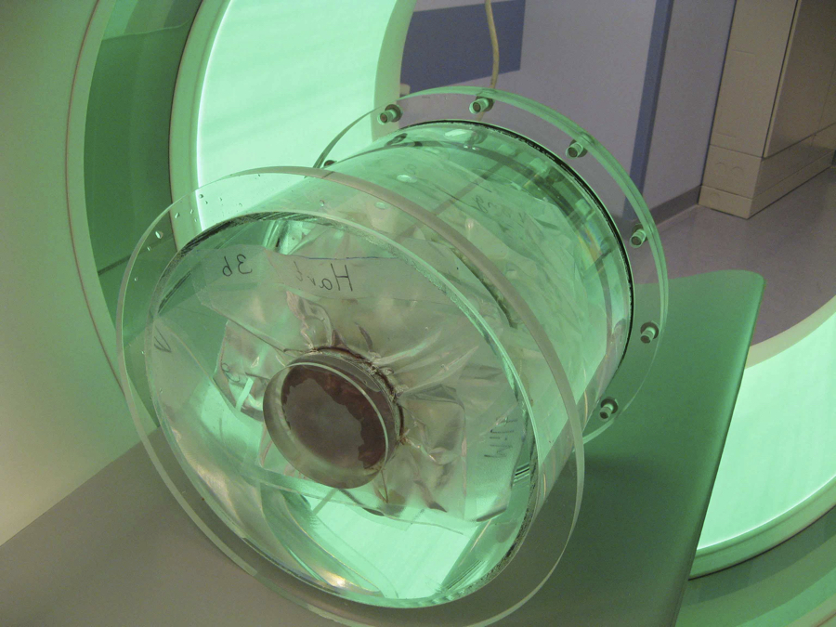
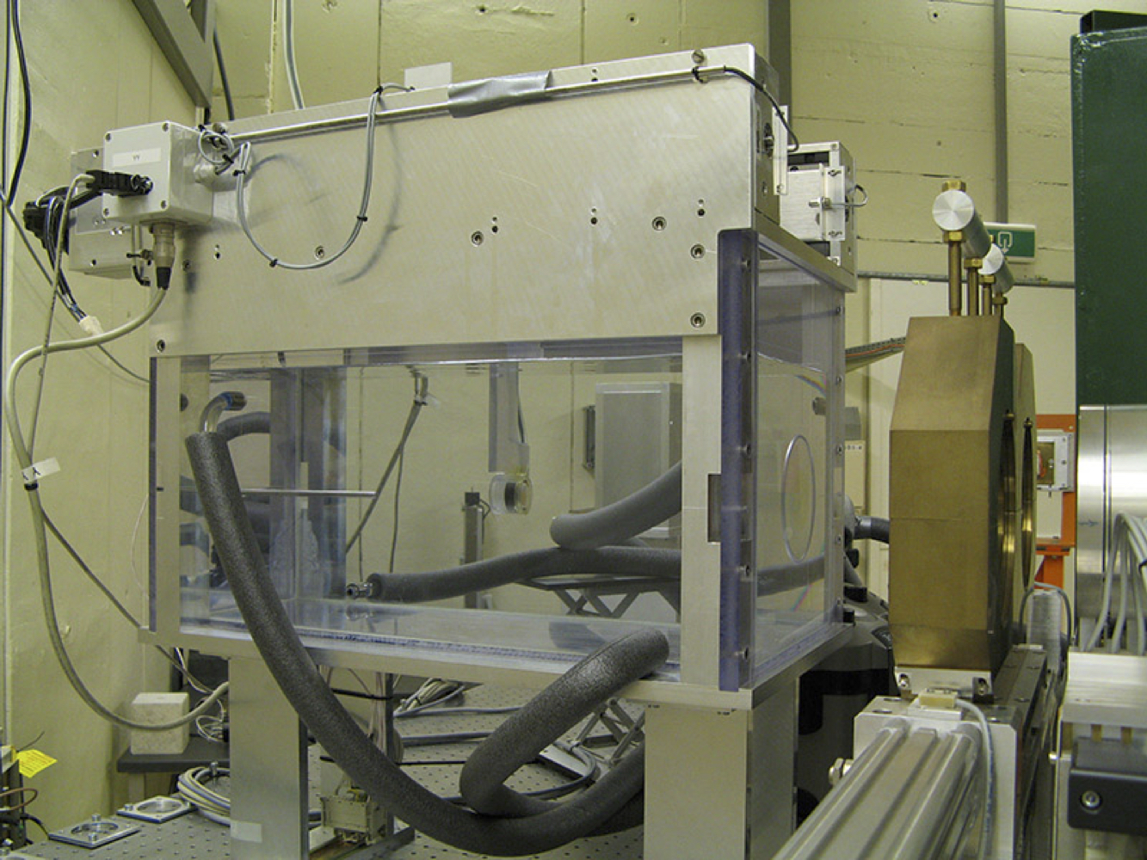
Experimental investigation
(DE)CT
at UMCG
proton stopping power
at KVI-CART
high-accuracy (≤ 0.05 mm) range measurements

Slide 11
Different X-ray energies: DECT
dual-energy CT
100 kV
140 kV
Notes:
main problem: protons interact fundamentally different with matter than photons
Better than CT: measure attenuation at different X-ray energies
high energy, Compton scattering ➔ ρ_{e}
low energy: photo-electric effect + Compton
techniques: DECT and spectral CT

Slide 12
Single energy vs. dual energy CT
accuracy of relative stopping power
tissue-equivalent materials
animal tissues
more accurate patient specific tissue proton stopping powers
J.K. van Abbema et al.,Phys. Med. Biol. 60(2015)3825
J.K. van Abbema, PhD Thesis, University of Groningen (2017)

Slide 13
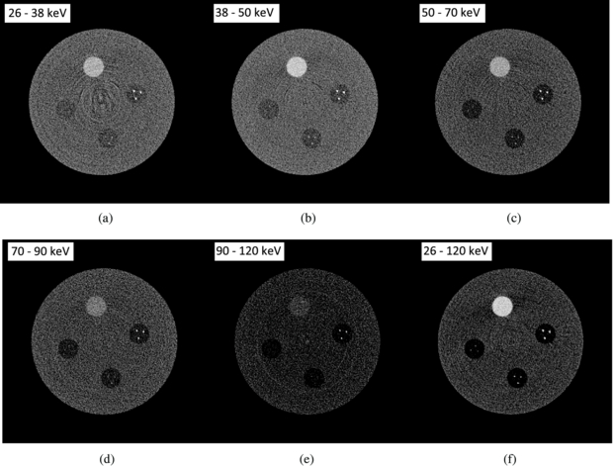
Different X-ray energies: spectral CT
Shikhaliev and Fritz PMB 56 (2011) 1905
Notes:
How much extra does this bring ? Needs to be determined.

Slide 14
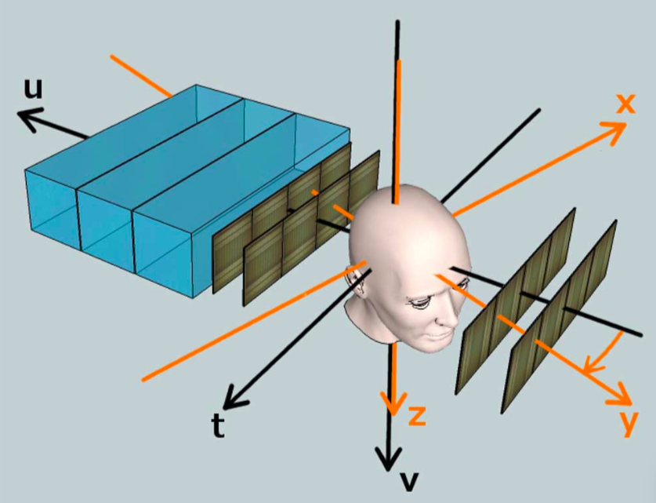
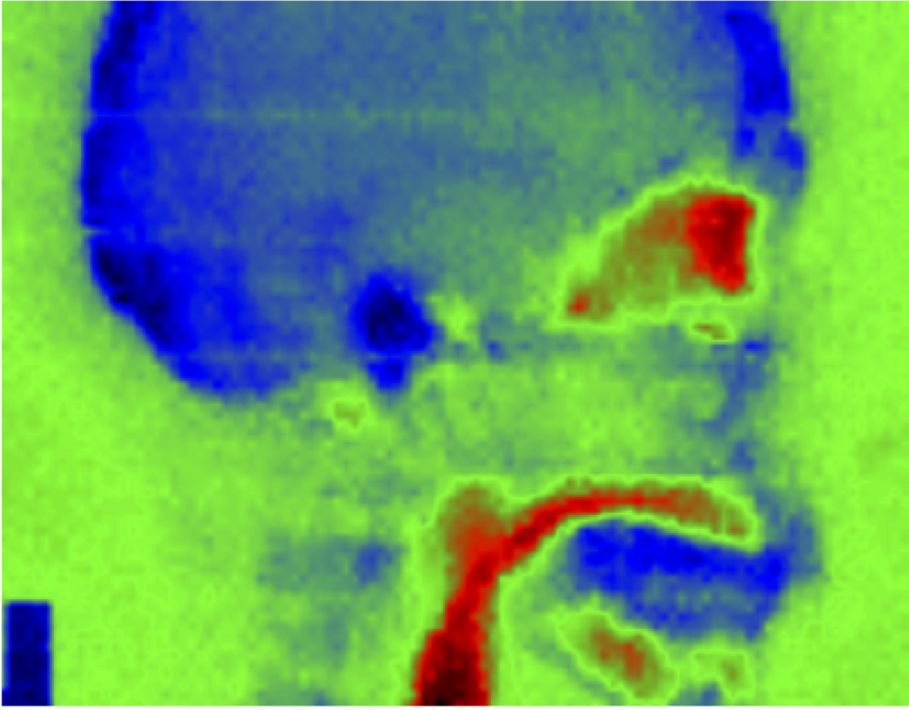
Stopping power imaging: proton imaging
head phantom scan; 219 MeV protons
proton beam for
proton radiography
proton beam
for treatment
T. Plautz et al, IEEE Trans Med Imag (2014) 33, 875-881
source: U. Schneider, PSI

Slide 15
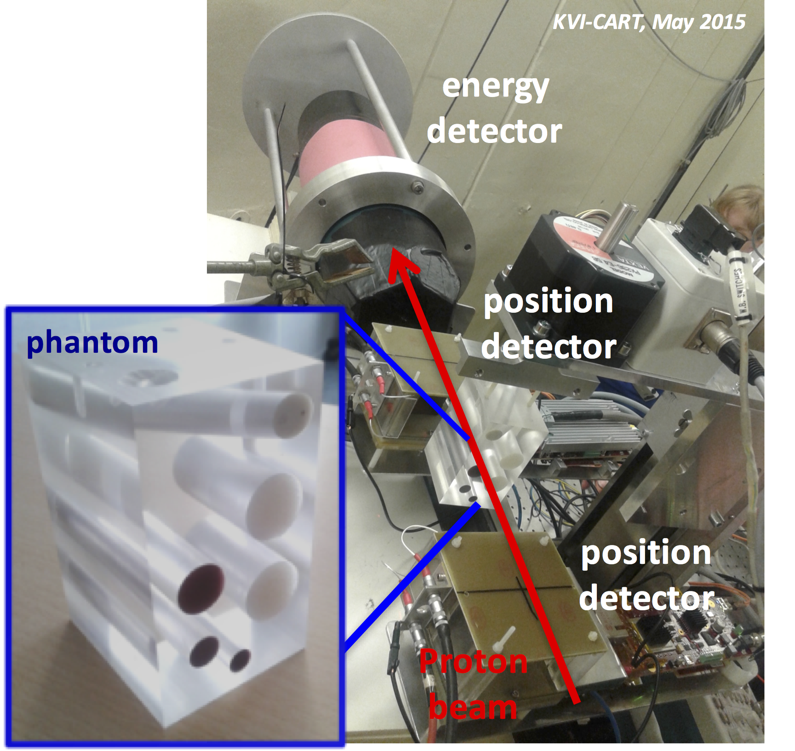
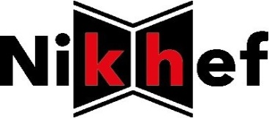
Proton radiography at KVI-CART
collaboration with
detector
phantom
detector
A.K. Biegun et al. Physica medica 41(2017)141 A. Biegun et al., J. Instrum.11(2016)[C12015
A.K. Biegun et al., IEEE Trans. Med. Imaging 35(2016)1099 A. Biegun et al., Acta Phys. Pol. B 47(2016)329
Notes:
Practical implementation of proton imaging is some time off. Several prototype systems around the world, non in routine clinical use.
Investigate e.g. the effect of angular selection on image quality and requirements needed for the absorption detector.

Slide 16

Proton therapy workflow (simplified)
radiation dose prescription
treatment plan
www.raysearchlabs.com
treatment
Was the dose delivered according to plan ?
iba-worldwide.com
Notes:
Focus on 2 aspects:
How do protons behave inside the patient ?
Needed for good treatment planning.
Was the dose delivered according to plan ?

Slide 17
In-vivo verification
if actual treatment situation ≠ treatment planning situation
→ serious dose deposition errors may occur
differences in
anatomy / positioning: “see what you treat”
proton range

Slide 18
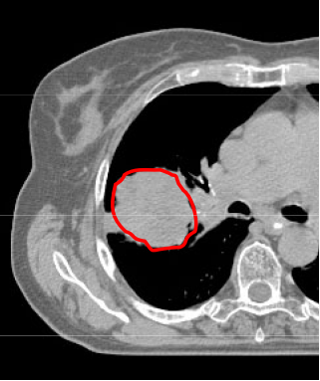
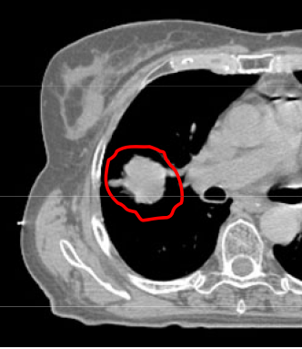
Deviation from the treatment plan: an example
before treatment
after 5 weeks
source: S. Mori en G.T.Y Chen, MGH

Slide 19
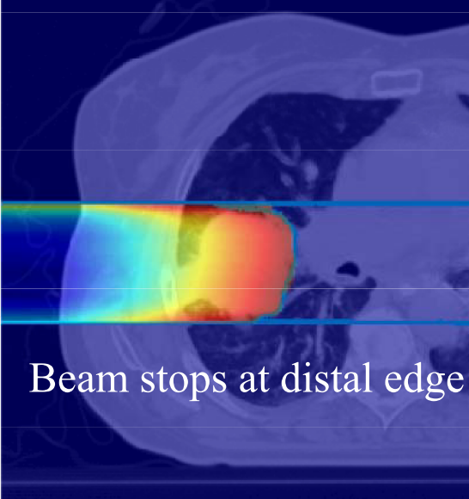
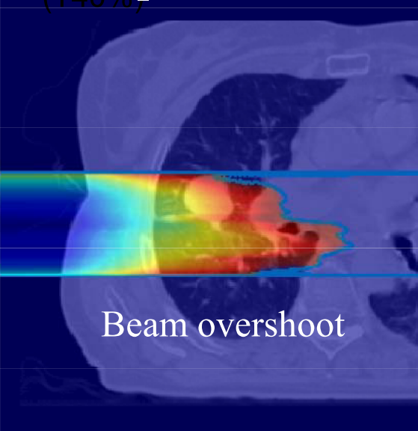
Deviation from the treatment plan: an example
before treatment
after 5 weeks
source: S. Mori en G.T.Y Chen, MGH

Slide 20
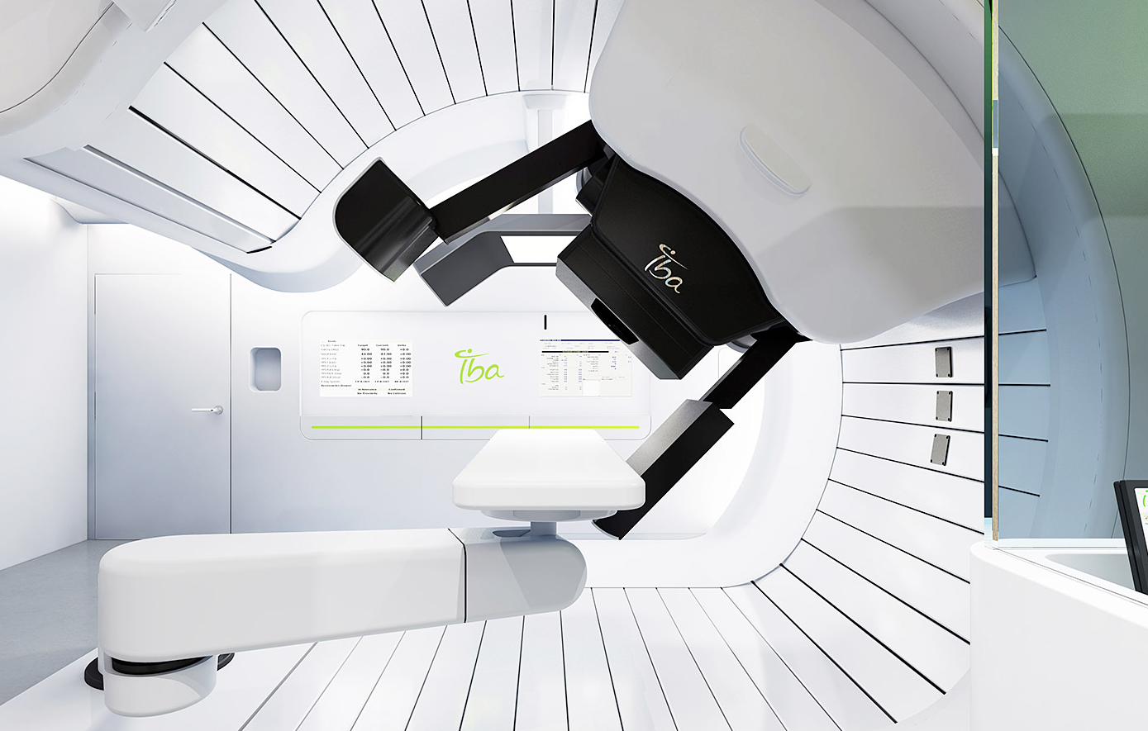
See what you treat: X-rays
in-room imaging for daily anatomy / positioning
  X-ray radiography – cone beam CT
Notes:
realtime anatomical feedback can be used in several ways:
motion tracking to control irradiation in real time (gating or steering)
calculate the actual dose distribution delivered
This technique is being introduced in photon beam therapy, but is even more appealing for proton therapy, because of the higher sensitivity to differences between the actual situation and the treatment situation.

Slide 21
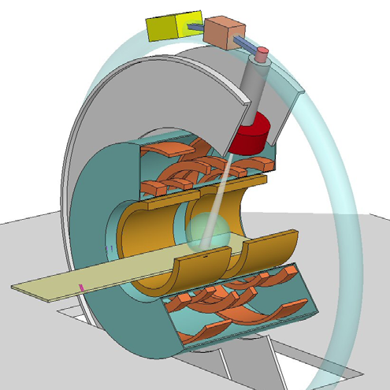
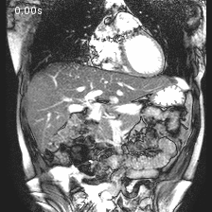
See what you treat: MR imaging
real-time anatomical feedback:
motion tracking for real-time irradiation control, adaptive workflow
calculation of the actual dose delivered
S. Crijns and B. Raaymakers, Phys. Med. Biol. 59(2014)3241
B.W. Raaymakers
Notes:
realtime anatomical feedback can be used in several ways:
motion tracking to control irradiation in real time (gating or steering)
calculate the actual dose distribution delivered
This technique is being introduced in photon beam therapy, but is even more appealing for proton therapy, because of the higher sensitivity to differences between the actual situation and the treatment situation.

Slide 22
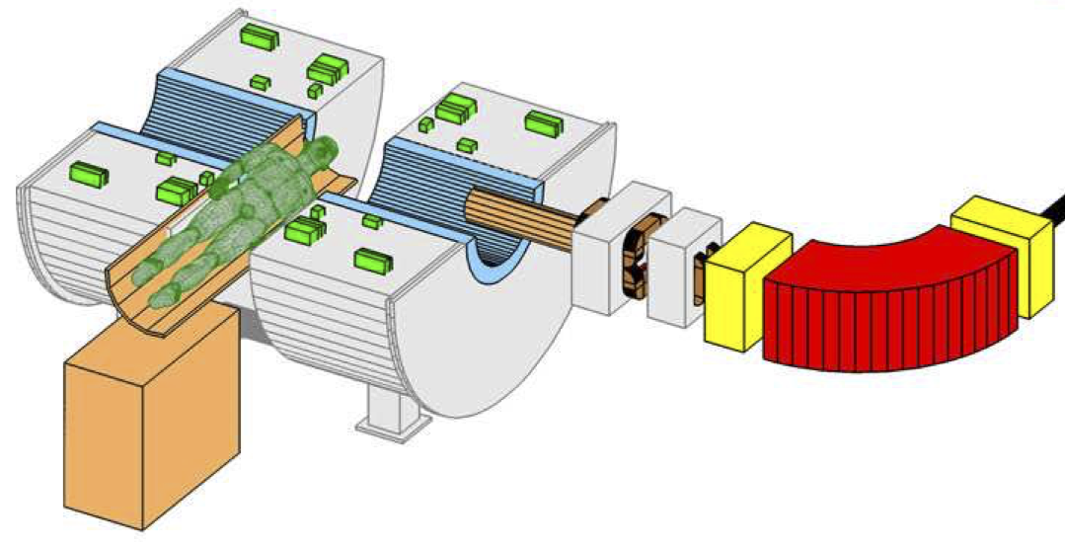
Real-time MRI-guided proton therapy
possible layout
B.M. Oborn et al., Med. Phys. 44(2017)e77

Slide 23
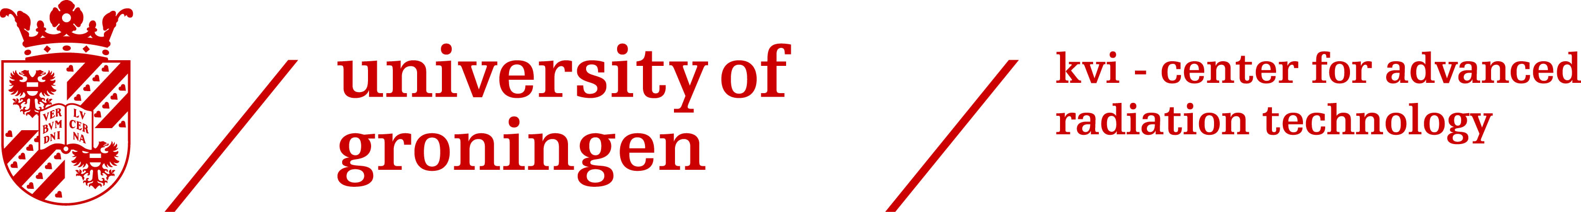
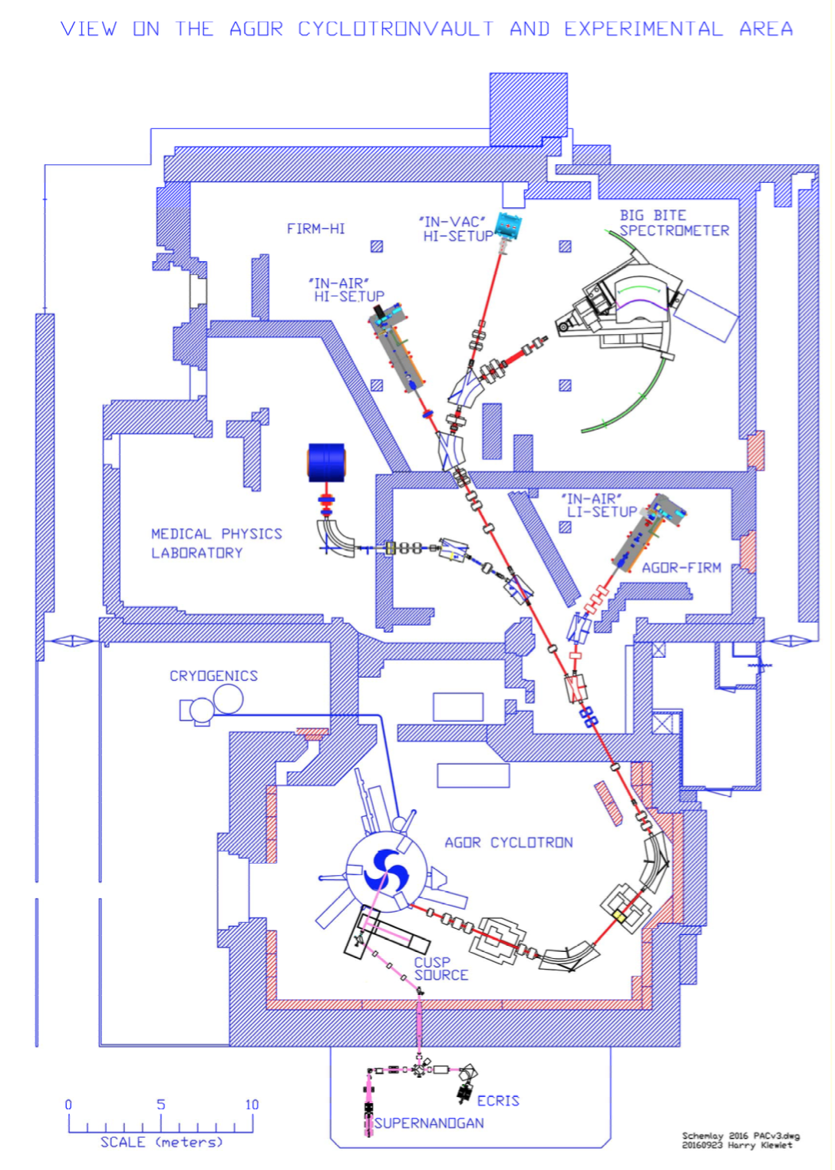


Collaboration on MRI-guided proton therapy
scanning magnets
degrader + energy
selection system

Slide 24
In-vivo dose delivery verification
How ?
measuring secondary radiation:
  positron emission tomography (PET)
  prompt gamma rays
  sound waves
Notes:
even if anatomy and positioning are fine, proton range can be wrong
sound waves is less developed than others, PET is used in the clinic in a few centers around the world

Slide 25
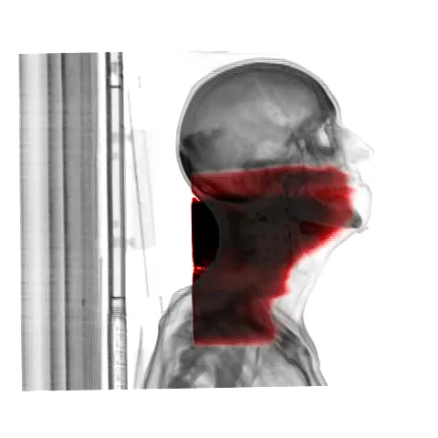
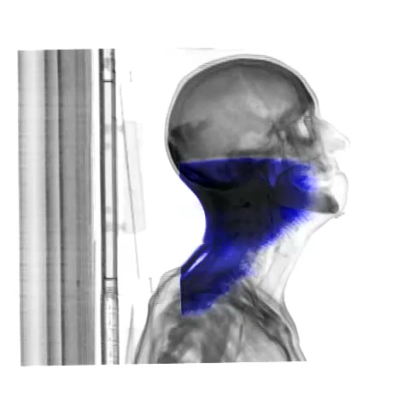
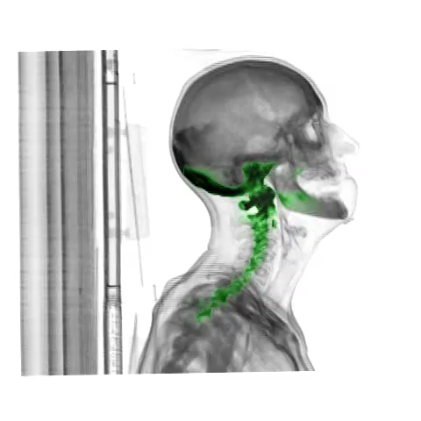
In-vivo dose delivery verification using PET
principle: production of positron emitters
correlates with radiation dose
treatment planning CT
simulated dose
treatment planning CT
oxygen-15 production
treatment planning CT
potassium-38 production
P. Dendooven et al.
Notes:
Movies:
IEEE 2012 > Hadron Therapy workshop talk >
Rendering_CT_dose.wmv
Rendering_CT_oxy15.wmv
Status Simulations August 2012 > RadiationDistributions >
Rendering_Pot38Map_CT2705_BU+Vinnie Full CT raw data format from AMIDE_1.wmv

Slide 26
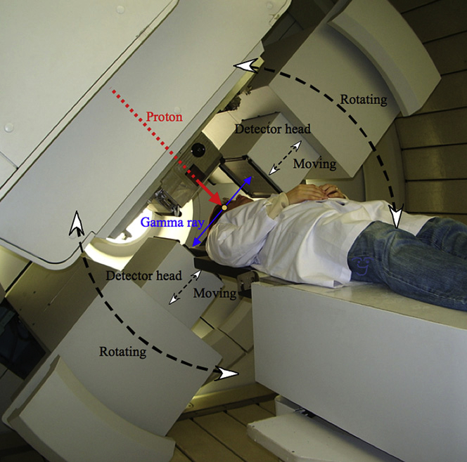
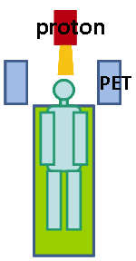
In situ / beam-on PET - an attractive option
in-situ / beam-on
National Cancer Center, Kashiwa, Japan
proton beam
dual-head
PET scanner
figure from Zhu X and El Fakhri G, Theranostics 3 (2013) 731
T. Nishio et al., Int. J. Rad. Oncol. Biol. Phys. 76 (2010) 277

Slide 27
In situ / beam-on PET - an attractive option
in-situ / beam-on
benefits:
  maximum number of counts
  minimal biological washout
  faster feedback
very short-lived nuclides are relevant
figure from Zhu X and El Fakhri G, Theranostics 3 (2013) 731

Slide 28
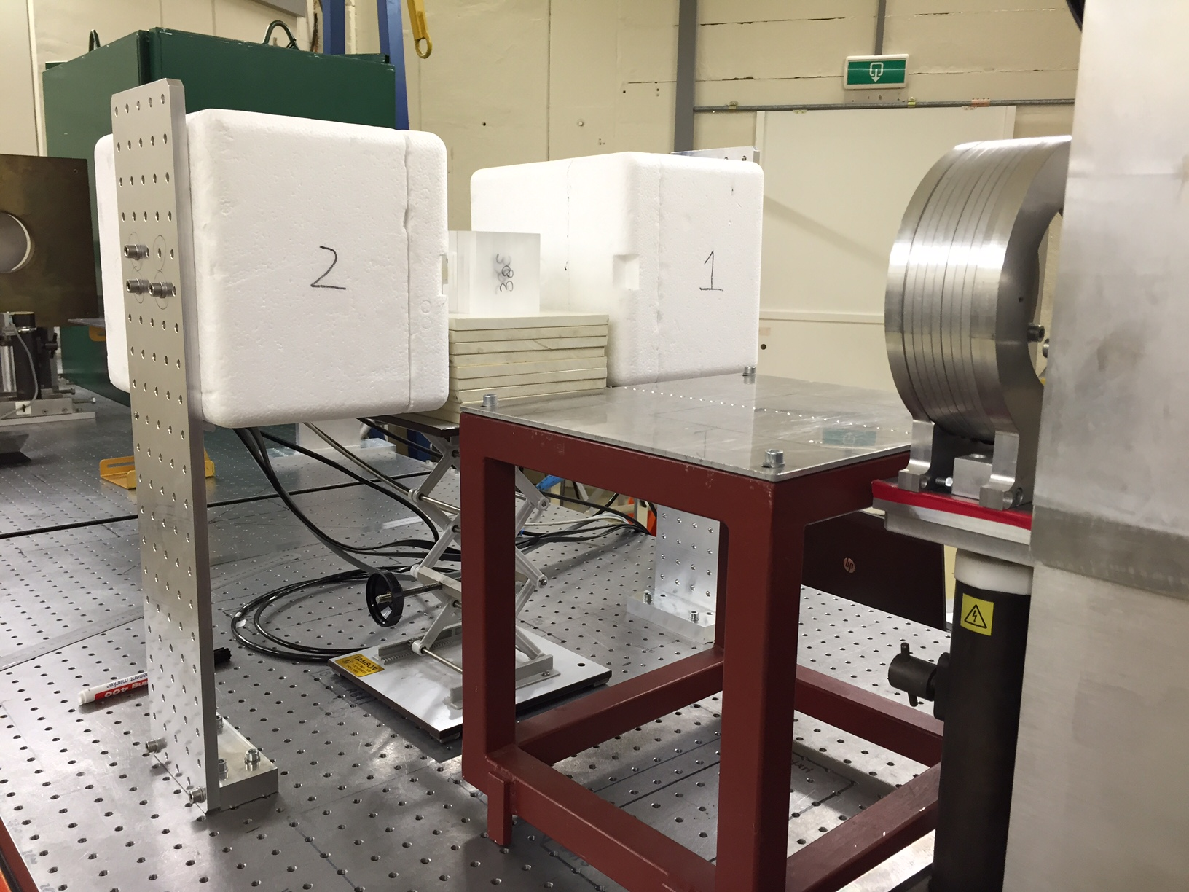
Nitrogen-12 imaging (half-life = 11 ms)
PET image profiles
experiments at KVI-CART
proton beam
all
Philips
PET detectors
90 MeV protons
long-lived
short-lived
Buitenhuis et al., Phys. Med. Biol. 62(2017) 4654–4672
Dendooven et al., Phys. Med. Biol. 60(2015) 8923–8947
Notes:
observed shift: 6±3 mm
simulations of realistic scanner and number of protonts: ~1 mm accuracy
same on bone

Slide 29
Nitrogen-12 imaging (half-life = 11 ms)
PET image profiles
experiments at KVI-CART
proton beam
all
Philips
PET detectors
90 MeV protons
millimeter range accuracy on 50 ms time scale
long-lived
short-lived
Buitenhuis et al., Phys. Med. Biol. 62(2017) 4654–4672
Dendooven et al., Phys. Med. Biol. 60(2015) 8923–8947
Notes:
observed shift: 6±3 mm
simulations of realistic scanner and number of protonts: ~1 mm accuracy
same on bone

Slide 30
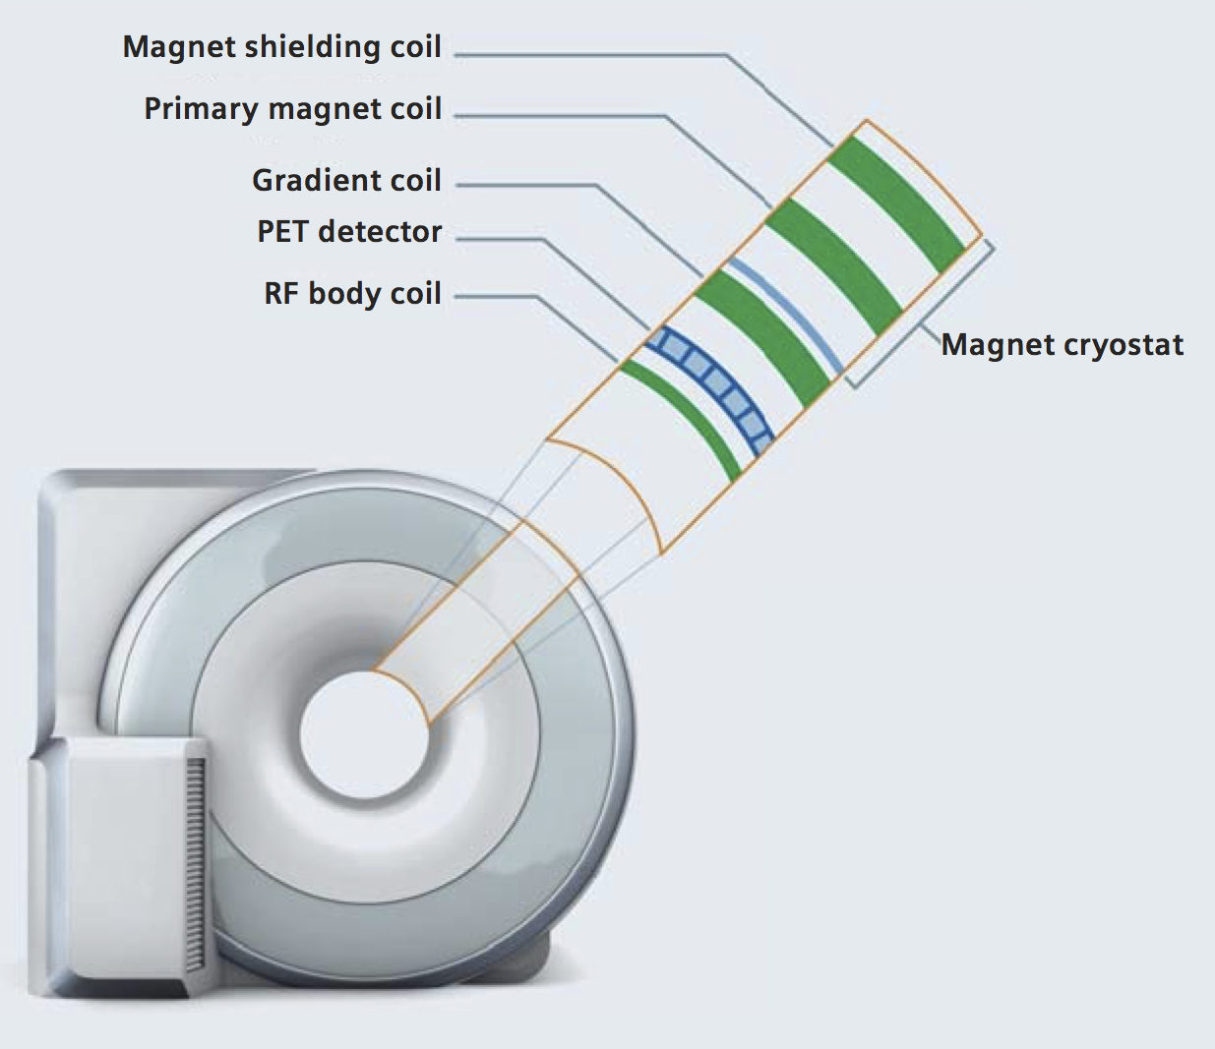
Real time anatomy and range measurement ?
MR-guided nitrogen-12-PET-verified proton therapy ?
Notes:
MRI shows what is being treated, but does not reveal the proton beam.
MR-PET systems are on the market.
So why not combine MR-PET with proton therapy ?

Slide 31
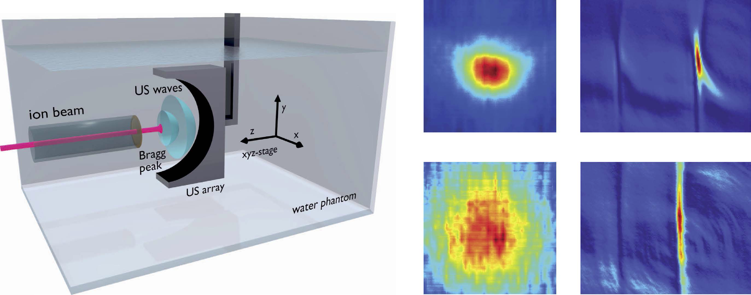
Real time anatomy and range measurement ?
ultrasound imaging and ionoacoustics ?
y
x
z
y
x
z
Kellnberger et al., Sci. Rep. 6(2016)29305
Notes:
MRI shows what is being treated, but does not reveal the proton beam.
MR-PET systems are on the market.
So why not combine MR-PET with proton therapy ?

Slide 32
Summary
How do protons behave inside the patient ?
  CT ➞ DECT
  DECT ➞ spectral CT ?
  proton radiography / CT
    (DE)CT calibration
    proton imaging
Was the dose delivered according to plan ?
  see what you treat: from X-rays to MR
  real time proton range measurement
    prompt gamma rays
    nitrogen-12 PET imaging
    ionoacoustics
Real time anatomy and range measurement
  MR + PET
  acoustics

Slide 33
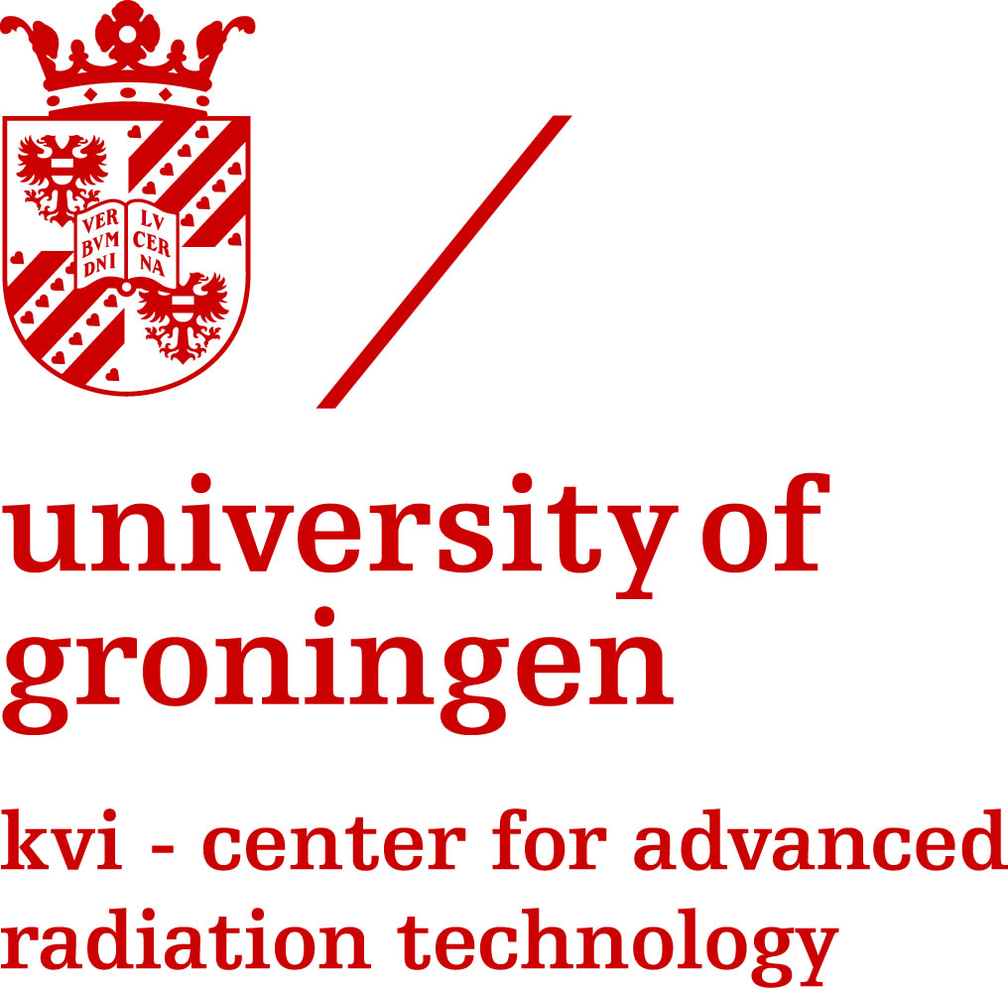
The people (now and recent past)
KVI-CART
Aleksandra Biegun, Sytze Brandenburg, Karol Brzezinski, Tom Buitenhuis, Peter Dendooven, Faruk Diblen, Oksana Kavatsyuk, Josbert Mulder, Francesco Olivari, Ikechi Ozoemelam, Joanne van Abbema, Emiel van der Graaf
UMCG Radiotherapy, Radiology
Marc-Jan van Goethem, Marcel Greuter, Arjen van der Schaaf, Erik Korevaar, Marleen Vonder, Rozemarijn Vliegenthart, Gert Jan Pelgrim

