Slide 1
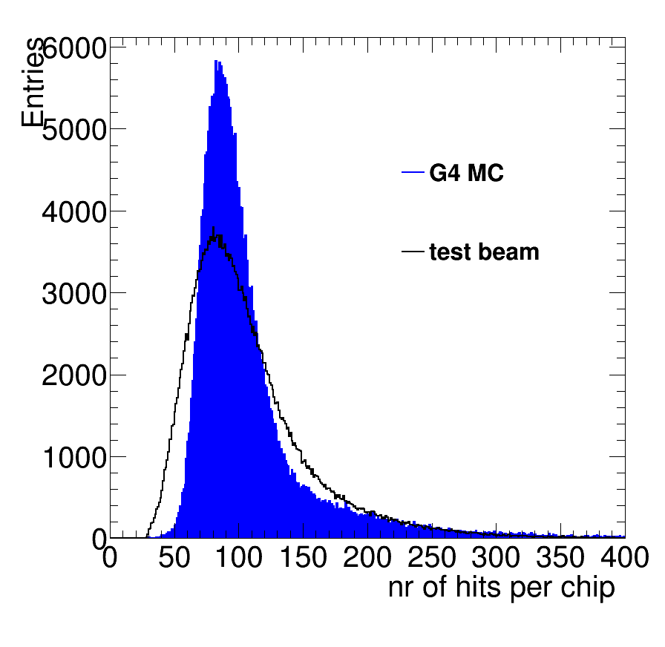
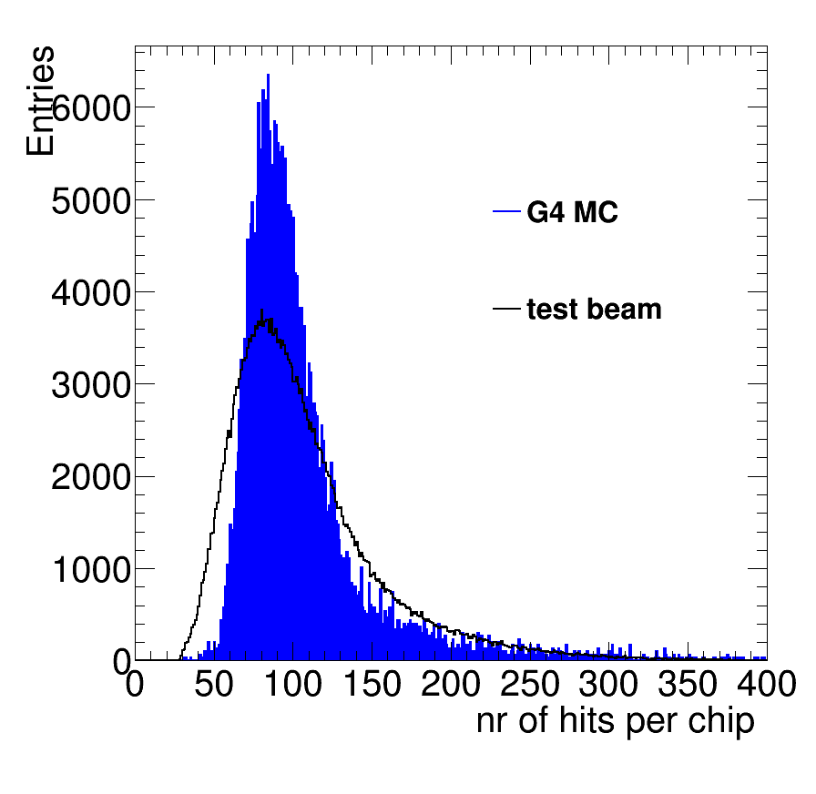
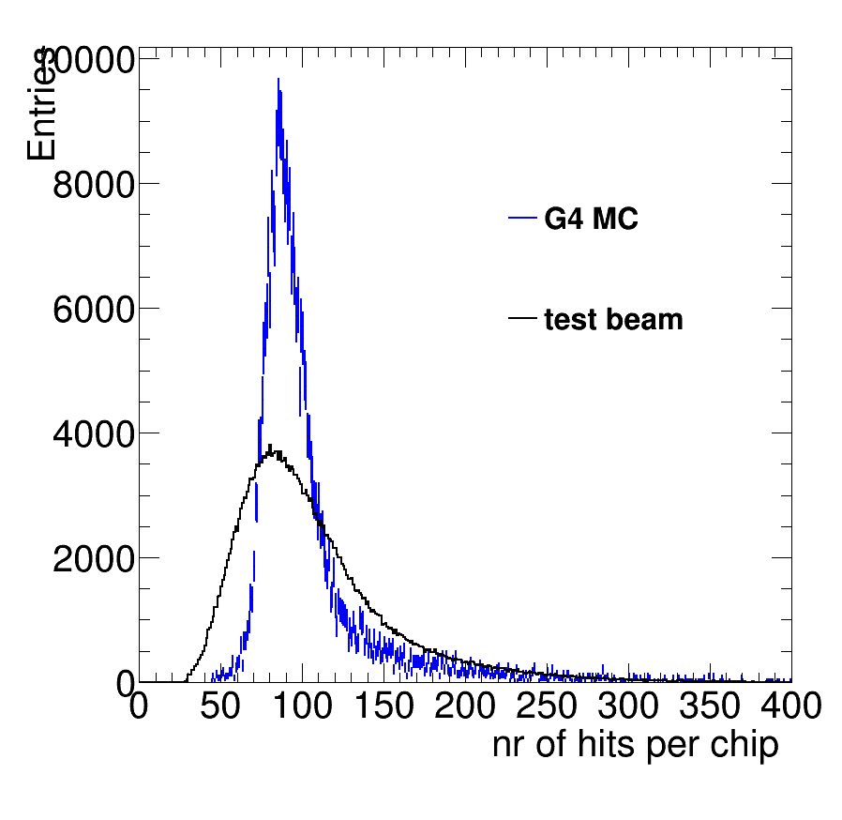
G4 modeling of hits
It is possible to change the ionization in G4 using the r parameter default = 0.55. The code is G4UniversalFluctuation.
r controls the ratio of ionization to excitations. Excitations are poissonian, while the ionization has a 1/E² behaviour.
Conclude: r=0.2 is further off and gives factor 2.5 less fluctuations. Need to go to higher r values.
Standard G4
electrons
G4 r=0.8
electrons
G4 r=0.2
electrons

Slide 2
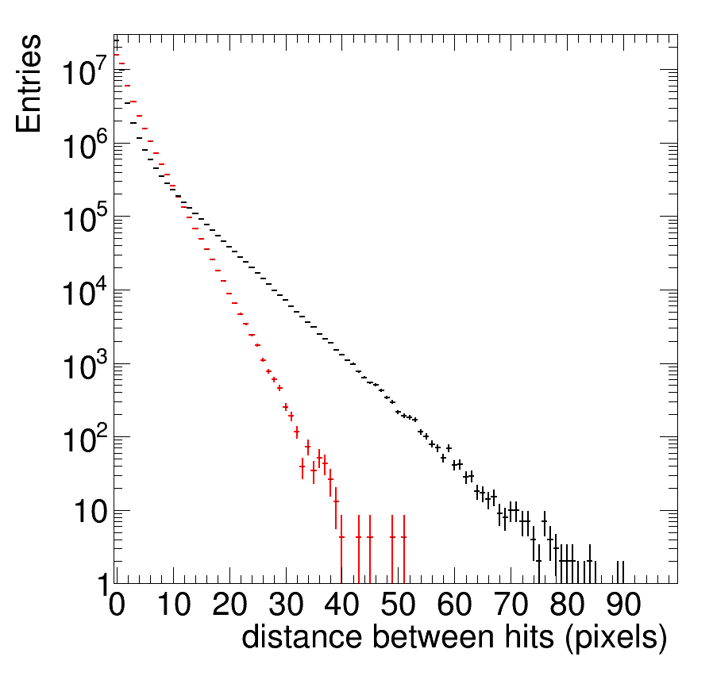
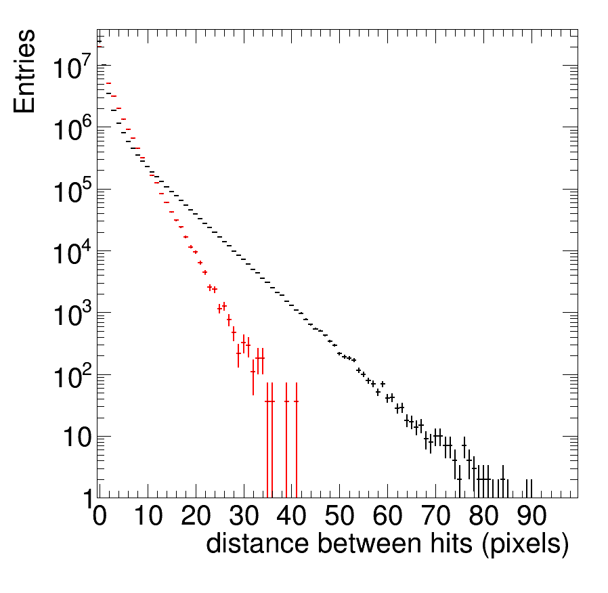
G4 modeling of distance
It is possible to change the ionization in G4 using the r parameter.
Standard G4
electrons
r=0.8 G4
electrons

Slide 3
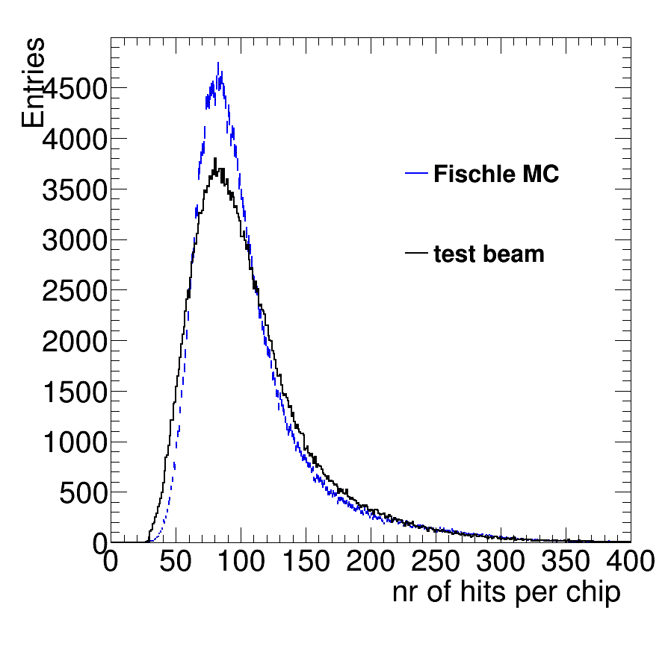
Modeling using Fischle of hits
Using the Ar data from Fischle et al NIM A 301 (1991) 202
<clusters>
42.8
<electrons>
105.3
Pretty good modeling. Data has slightly more fluctuations

Slide 4
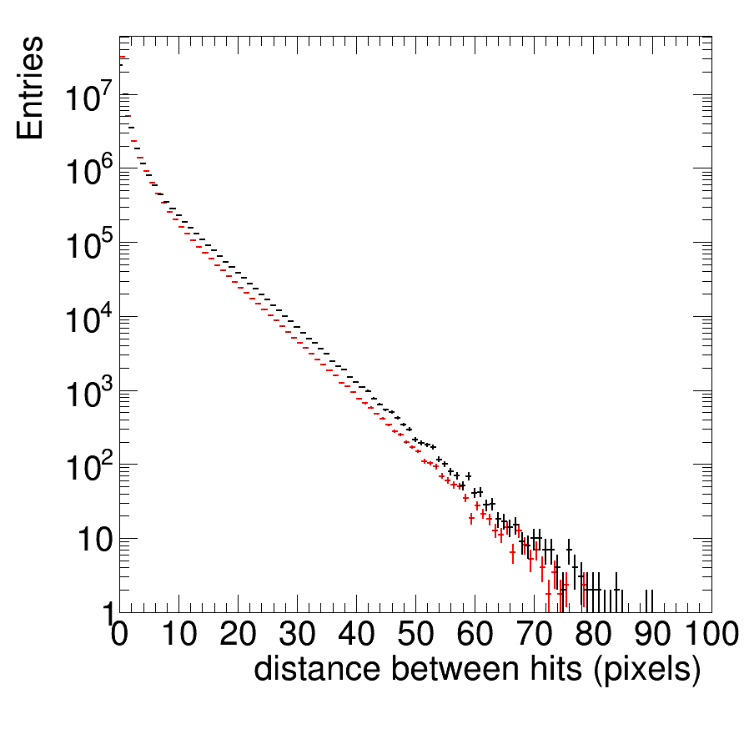
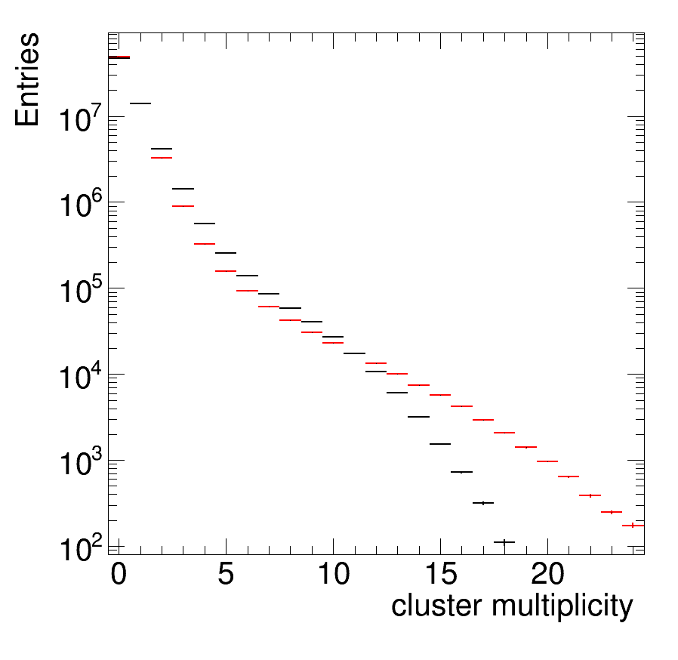
Modeling using Fischle of hits
High end is affected by tracking cuts
That remove deltas etc.
Very good!
Fischle
data
Fischle
data

Slide 5
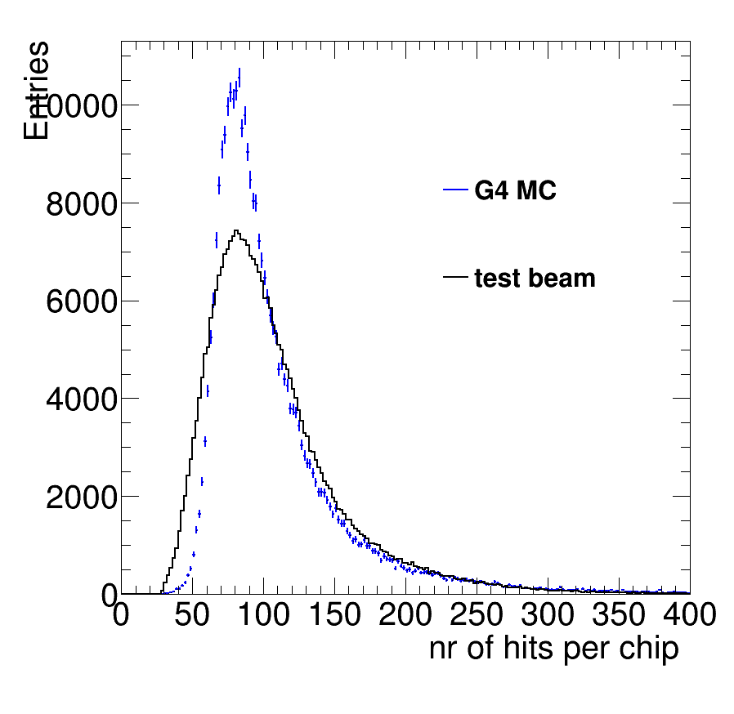
G4 modeling of hits and Trt
max
There is also a Tmax variable that is now default at 990 eV.
It determines the maximum energy in ionization (1/E²).
Above Tmax delta electrons are produced.
Clearly increasing doubling tmax increases the fluctuations.
Standard G4
electrons
G4 r=0.8
electrons
G4 r=0.55
Tmax = 2*990 eV
this plot is rebinned 2

