Slide 1
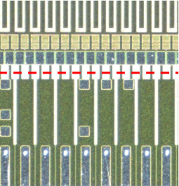
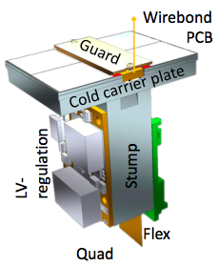
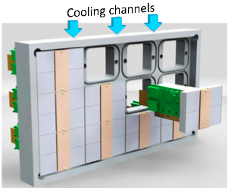
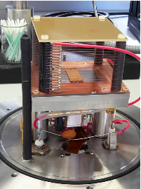
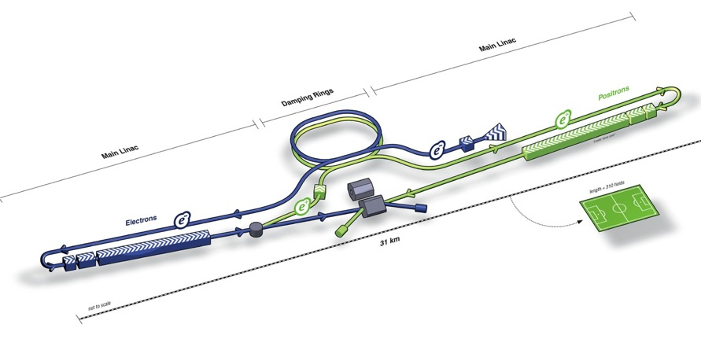
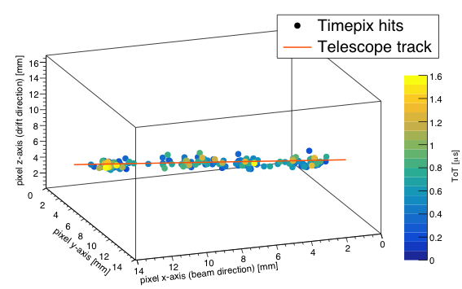
ILC highlight
plan 2018
IZM Bonn
Test beam TPX3 chip
Quad
Laser setup ready
DAQ firmware
2013
At CERN a European action plan EAP is made (dec 2017 Council) with contributions of CERN (like E-JADE) to ILC – starting phase - of 60 FTEs per year. https://agenda.linearcollider.org/event/7645/contributions/40215/attachments/32424/49264/european-strategy-lcws17.pdf.

