Slide 1
OIDC Federation for Infrastructures
EUGridPMA 42
Prague, CZ

Slide 2
“establish common policies and guidelines that enable interoperable, global trust relations between providers of e-Infrastructures and cyber-infrastructures, identity providers”
technology-agnostic assurance profiles (see IANA registry)
with specific renderings – PKIX, Attribute Authorities, …
How can we help support RI and e-Infrastructure use cases?
technology bridges: TCS, RCauth.eu, IGTF-eduGAIN bridge, …
native SAML R&E federation most effective through REFEDS now
behind the bridges for research & collaboration, OIDC prominence!

Slide 3
OIDC Federation Task Force
The IGTF task force for OIDC Federation will
identify specific objectives – I2 TechEx
scope needs and requirements for R/E infrastructure OIDC Fed
we will be doing that today!
verify compatibility of IGTF Assurance Profile framework
for ‘technology-agnosticity’ with OpenID Providers (proxies) and RPs
test a OIDCFed scenario
e.g. starting with use cases: WLCG, RCauth.eu, … ELIXIR, EGI CheckIn
assess structure and needed meta-data in a ‘trust anchor service’,
  how to address RPDNC
  links it with (dynamic) client registration
liaise with OIDC Fed efforts in AARC and GN*-*, and Roland Hedberg

Slide 4
Client ID and Client Secret
WaTTS service
EGI MasterPortal
MinE Credential Hosting
… B2ACCESS, …
SSH Proxy CLI
Prometheus WebDAV portal
mkProxy service
…
Master Portal

Slide 5
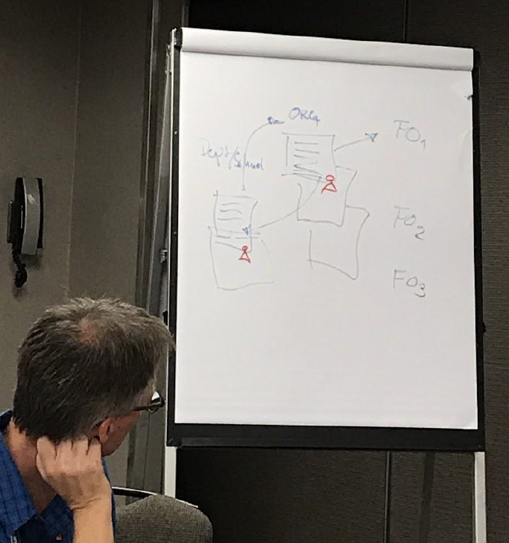
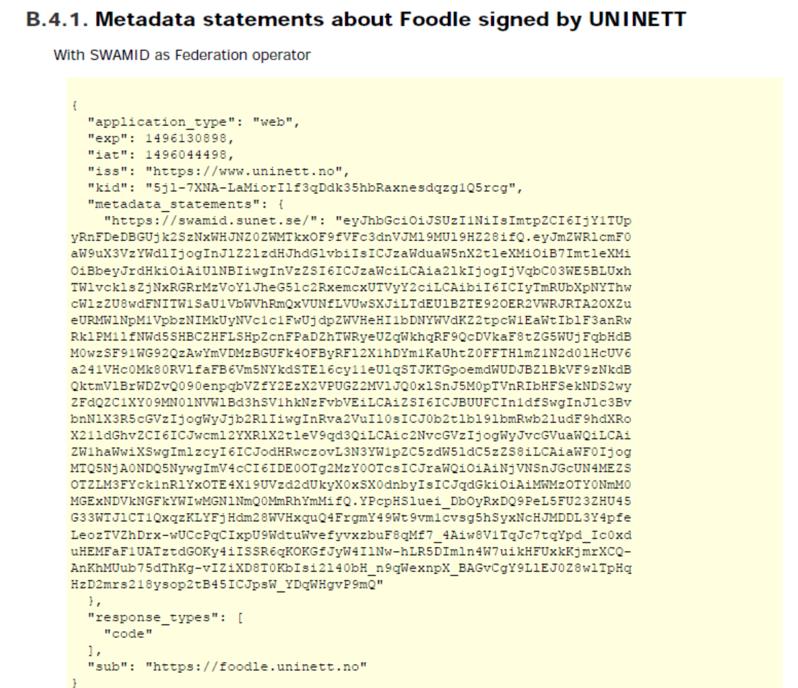
OIDC Fed
See spec by Roland Hedberg
scoped to the RP + Proxy case is not very complex, actually

Slide 6
OIDC Fed ‘policy’
IGTF “RP oriented” OIDC Fed can leverage existing framework
connect RPs from infrastructures that are IGTF members
(EGI, HPCI, OSG, WLCG, GEANT, PRAGMA, PRACE, XSEDE, …)
and new IGTF RP members can join of course!
Accreditation process and membership guidelines in place
OPs in the federation (RI/EI IdP-SP-Proxies) use IGTF APs
and Snctfi framework where needed
RPs in the federation become the responsibility of their member representatives
regional (‘national’) RP groups via their existing authority member
for RP trust (more than today) re-use Sirtfi, WISE, and trust groups

Slide 7
Scoping and model discussions
ACAMP session nodes (see Wiki)
  do not over-complicate the initial set-up
  retain dynamics in the system by leveraging existing trust
  stick to OIDC core attributes makes life easier
  discovery – leave this for the RPs, but make our data available
  allow overlapping federations and be complementary (COIs)
  Don’t boil the ocean
  scope to the expected O (100) organisations
  leverage existing trust and current operational mechanisms

Slide 8
Needs and Requirements
ELIXIR & Life Sciences AAI (Michal Prochazka)
CILogon developments (Jim Basney)
behind EGI Check-In (Nicolas Liampotis)
Recommendations in AARC and GN*-* (Davide Vaghetti)
WaTTS (Marcus Hardt)
followed by a discussion on
what tools we can use on the IGTF side (scripts, URL triggers) ,
what tools on the client side for auto-populating RPs
(periodic cron jobs, scripts)

Slide 9
Information sharing
Keeping in touch
http://wiki.eugridpma.org/Main/OIDCFed
oidcfed@igtf.net
(https://igtf.net/mailman/oidcfed)
And also
oidcre@lists.refeds.org (REFEDS)
TIIME, TNC, TechEx, …

