Slide 1
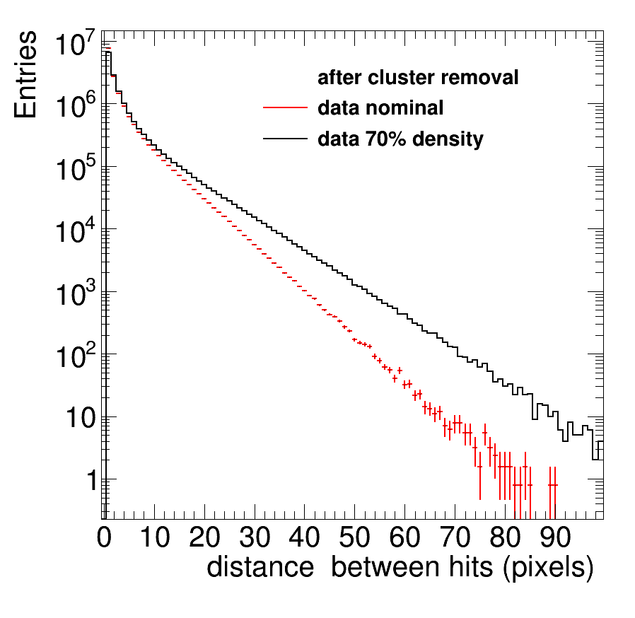
Separation: dEdx distance
The LCTPC workshop results were updated coding a scaling algorithm to obtain the prediction for 70% lower ionization; in stead of a simple hit dropping (that is wrong).
An algorithm was written that determines the mean and rms of the distance distribution
The mean distance has a large separation power (see next slide)

Slide 2
Separation: dEdx results I
separation = (dEdx(e)-dEdx(0.7*e))/σ(e)
Data results
algorithm difference error separation
Trunc hits 634. 111. 5.7
clusterz 256. 45. 5.7
cluster1 1030. 138. 7.4
G4 MC results
Trunc hits 1036. 120. 8.6
clusterz 478. 43. 11.0
cluster1 1308. 144. 9.1
NB a 5% σ(dEdx) for electrons corresponds to 6.0 σ
So the difference between the three algorithms is not that large. The simulation is a factor 1.2-1.7 too optimistic.
Can we do better? E.g. combining cluster”z” and “1”?
So changed wrt LCTPC

Slide 3
Separation: dEdx results II
Made simple linear combinations and optimized;
clusterc1 = clusterz + 0.5 cluster1
Data results
algorithm difference error separation
Trunc hits 634. 111. 5.7
clusterz 256. 45. 5.7
cluster1 1030. 138. 7.4
clusterc1 815. 99. 7.8
distance 0.906 0.09 9.5
G4 MC results
Trunc hits 1036. 120. 8.6
clusterz 478. 43. 11.0
cluster1 1308. 144. 9.1
clusterc1 1125. 97. 11.6
distance 0.938 0.07 13.3
- a 5% σ(dEdx) for electrons corresponds to 6.0 σ
- distance would then correspond to σ 3.1%

Slide 4
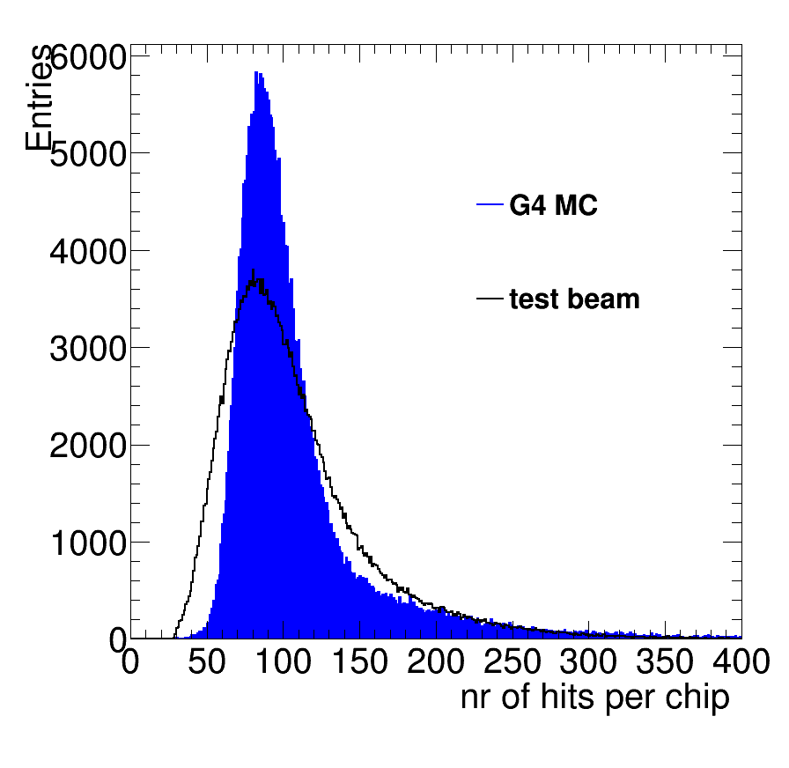
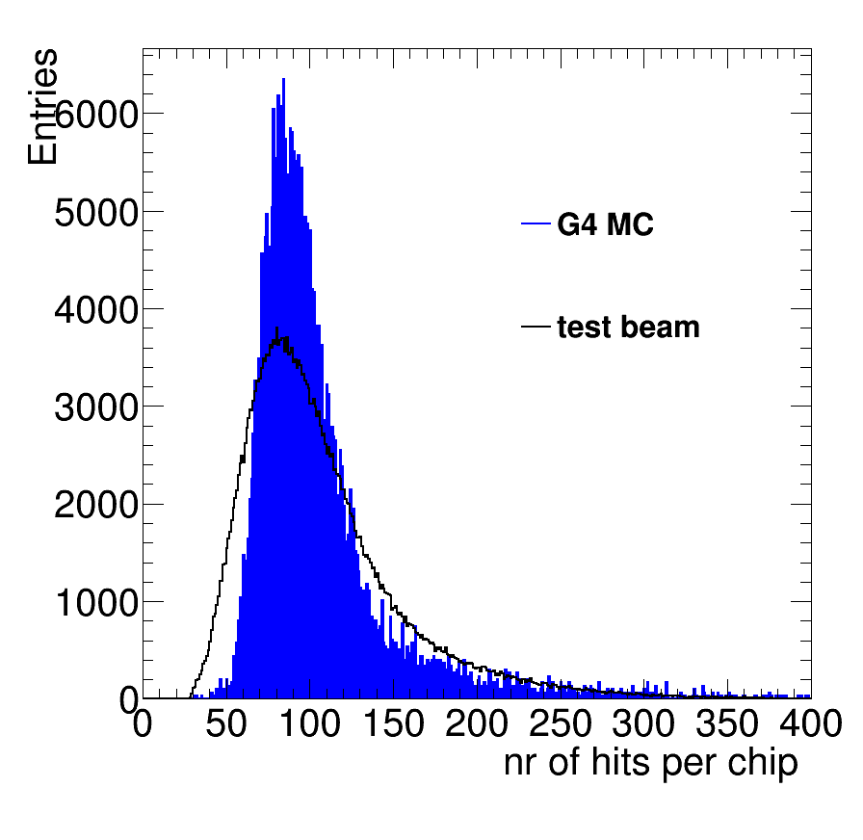
G4 modeling of hits
It is possible to change the ionization in G4 using the r parameter.
Standard G4
electrons
New r G4
electrons

Slide 5
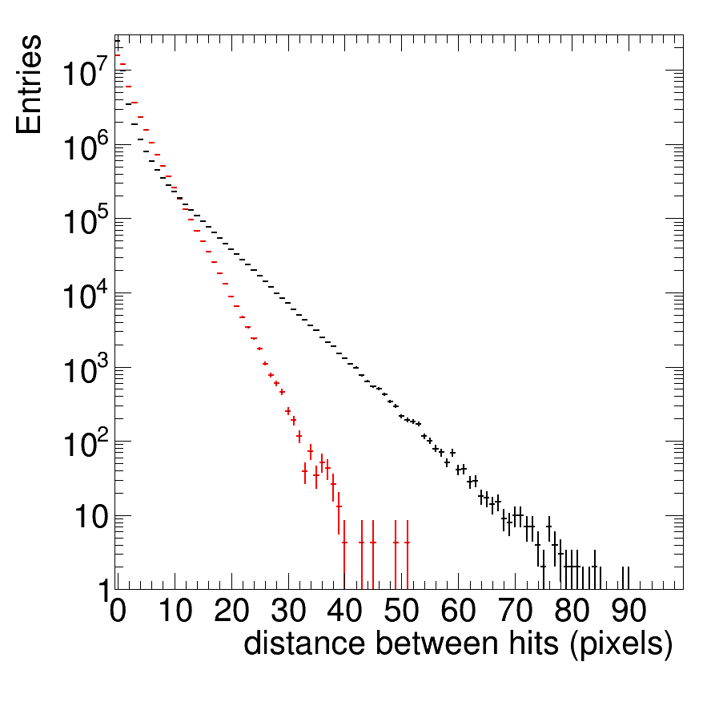
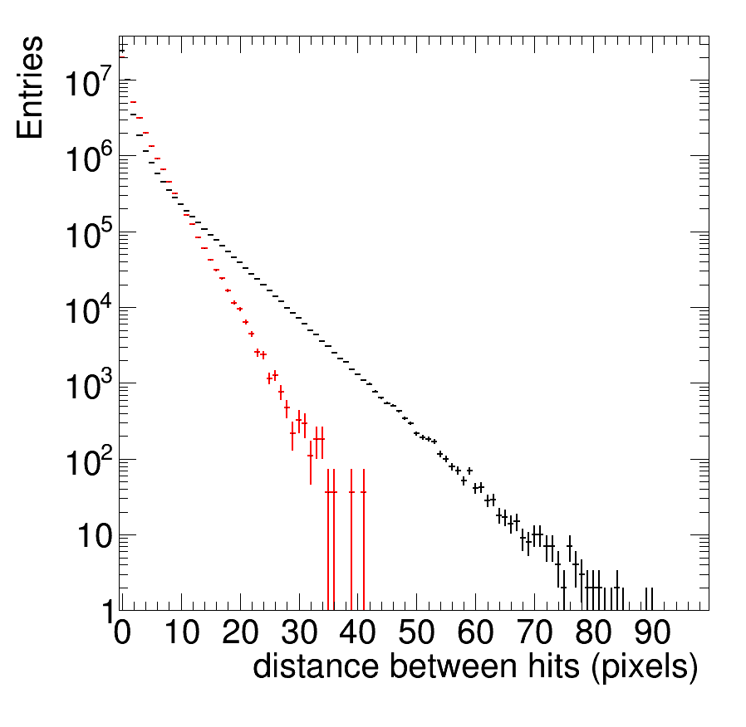
G4 modeling of distance
It is possible to change the ionization in G4 using the r parameter.
Standard G4
electrons
New r G4
electrons

