Slide 1
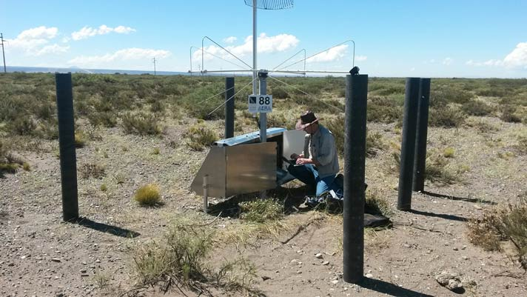
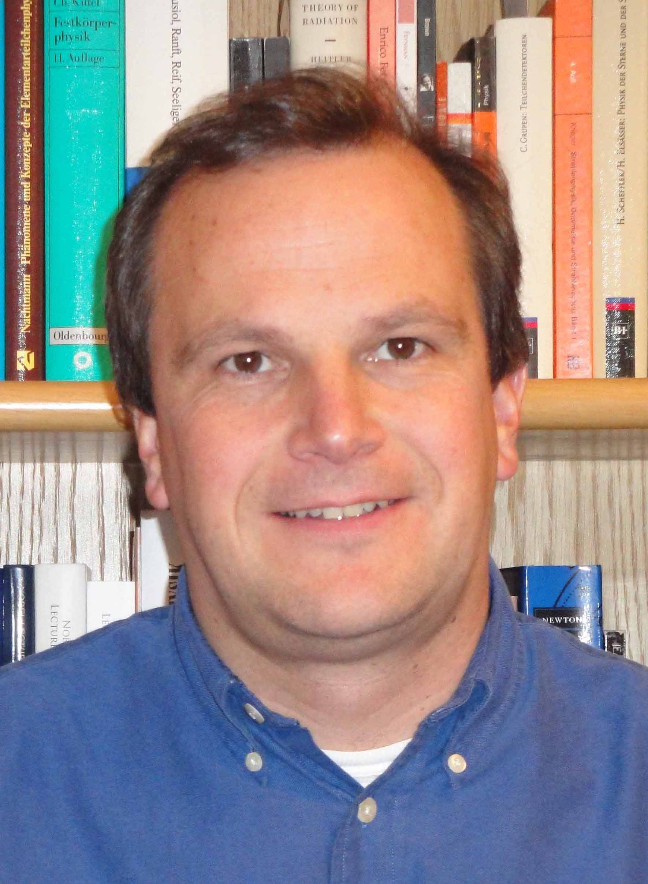
ERC Advanced Grant of 3.5 M€ for Jörg Hörandel for adding a Radio Detection layer to the Pierre Auger Observatory

Slide 2
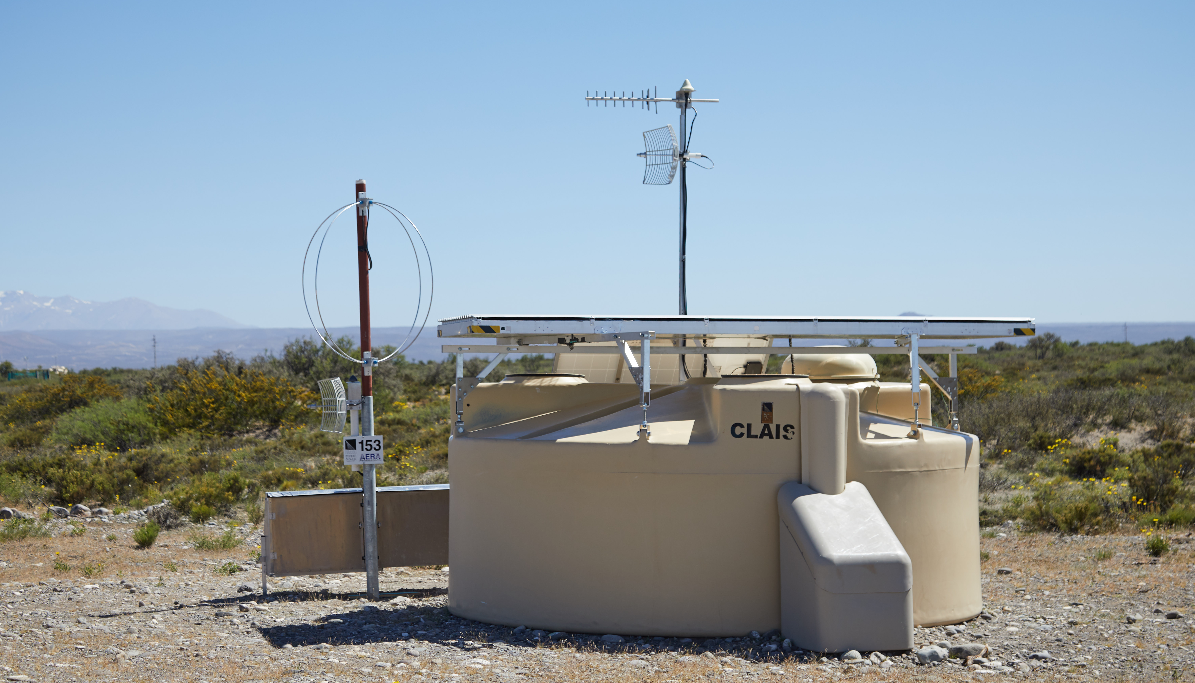
Cosmic Ray programme status 19 April 2018
ERC Advanced Grant of 3.5 M€ for Jörg Hörandel
to equip Auger with a radio detector layer
Request for remaining money for radio hardware (2.7 M€) pending with NWO-BIG (PI: SdJ)
SSD module production in full swing
16 ready so far, go to 3 per week
GRAND site selection for GRANDProto300
Balikun (Barkol), China

Slide 3
Cosmic Ray programme status 19 April 2018
combination gives
e and μ separately
RD
total # e
e + μ in
shower tail
total # e
SSD
μ in
shower
tail
a e + b μ
in shower tail

Slide 4
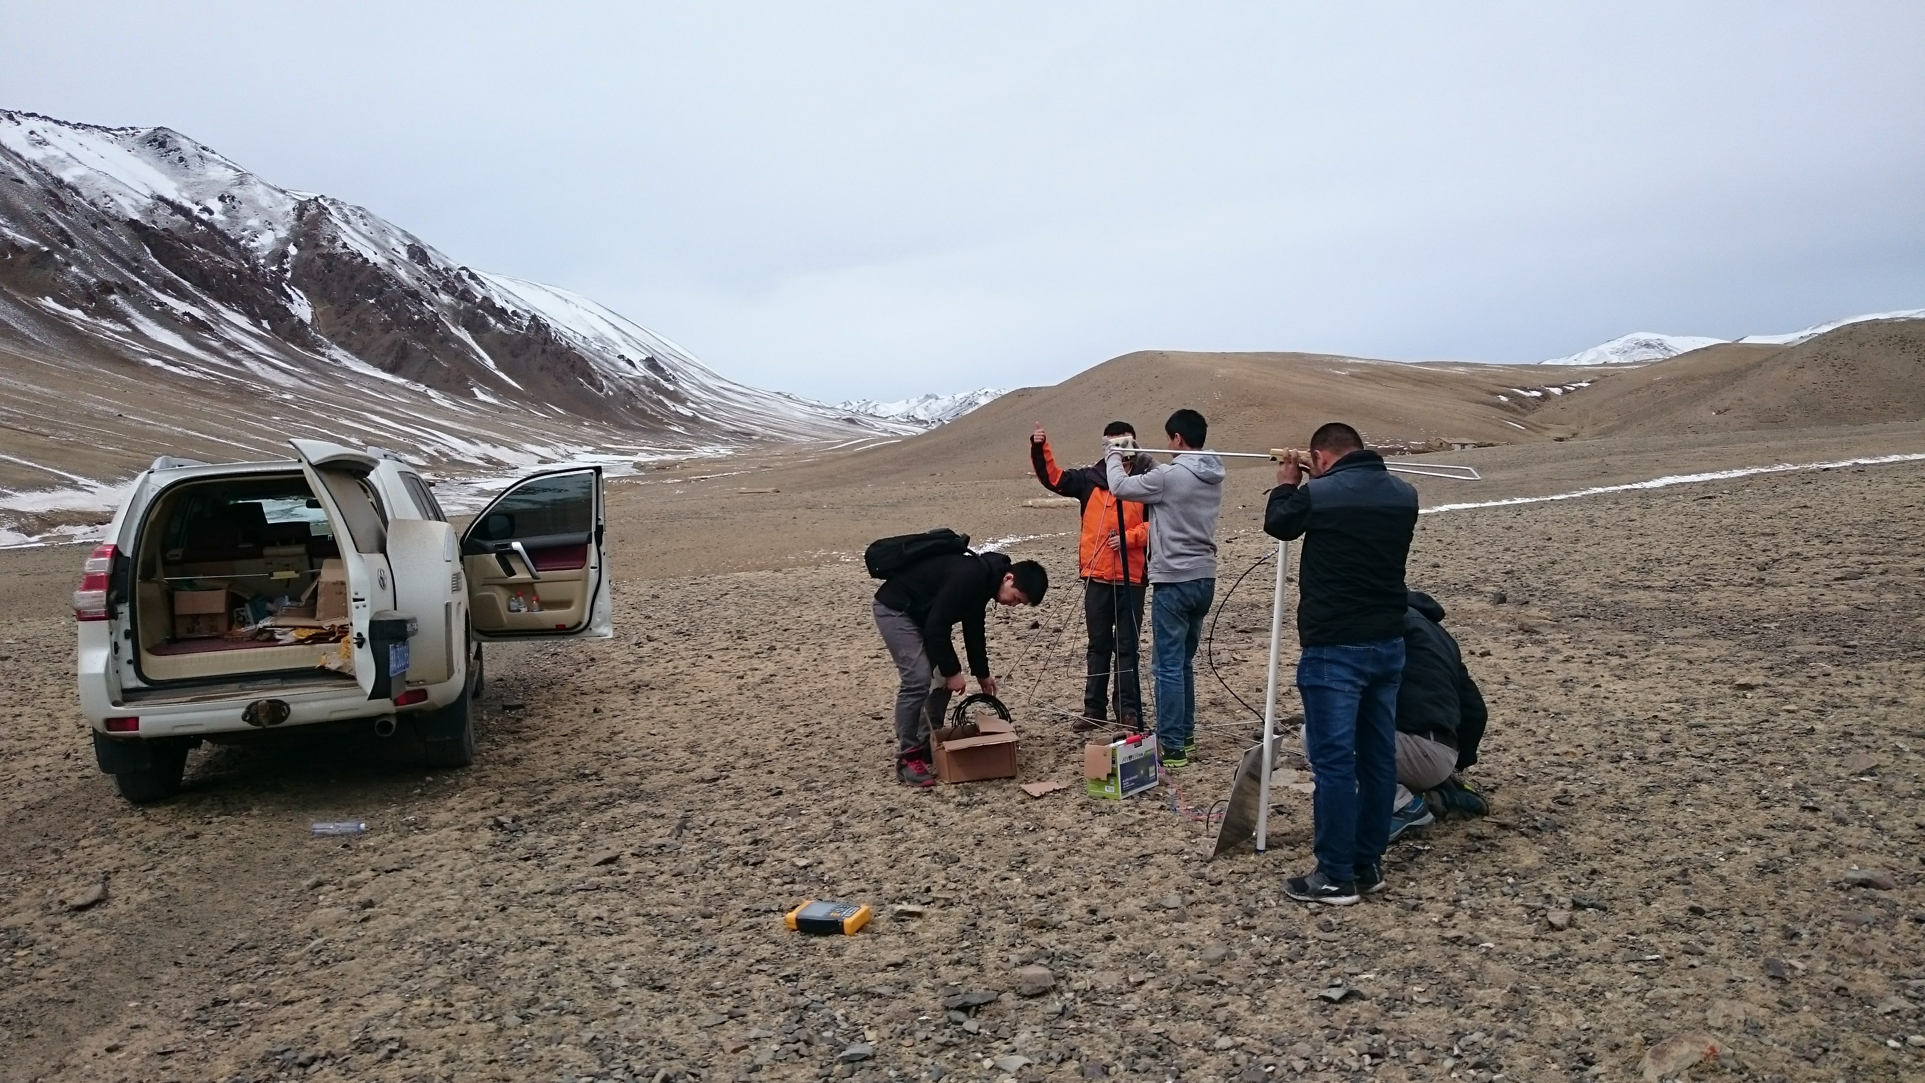
Cosmic Ray programme status 19 April 2018

