Slide 1
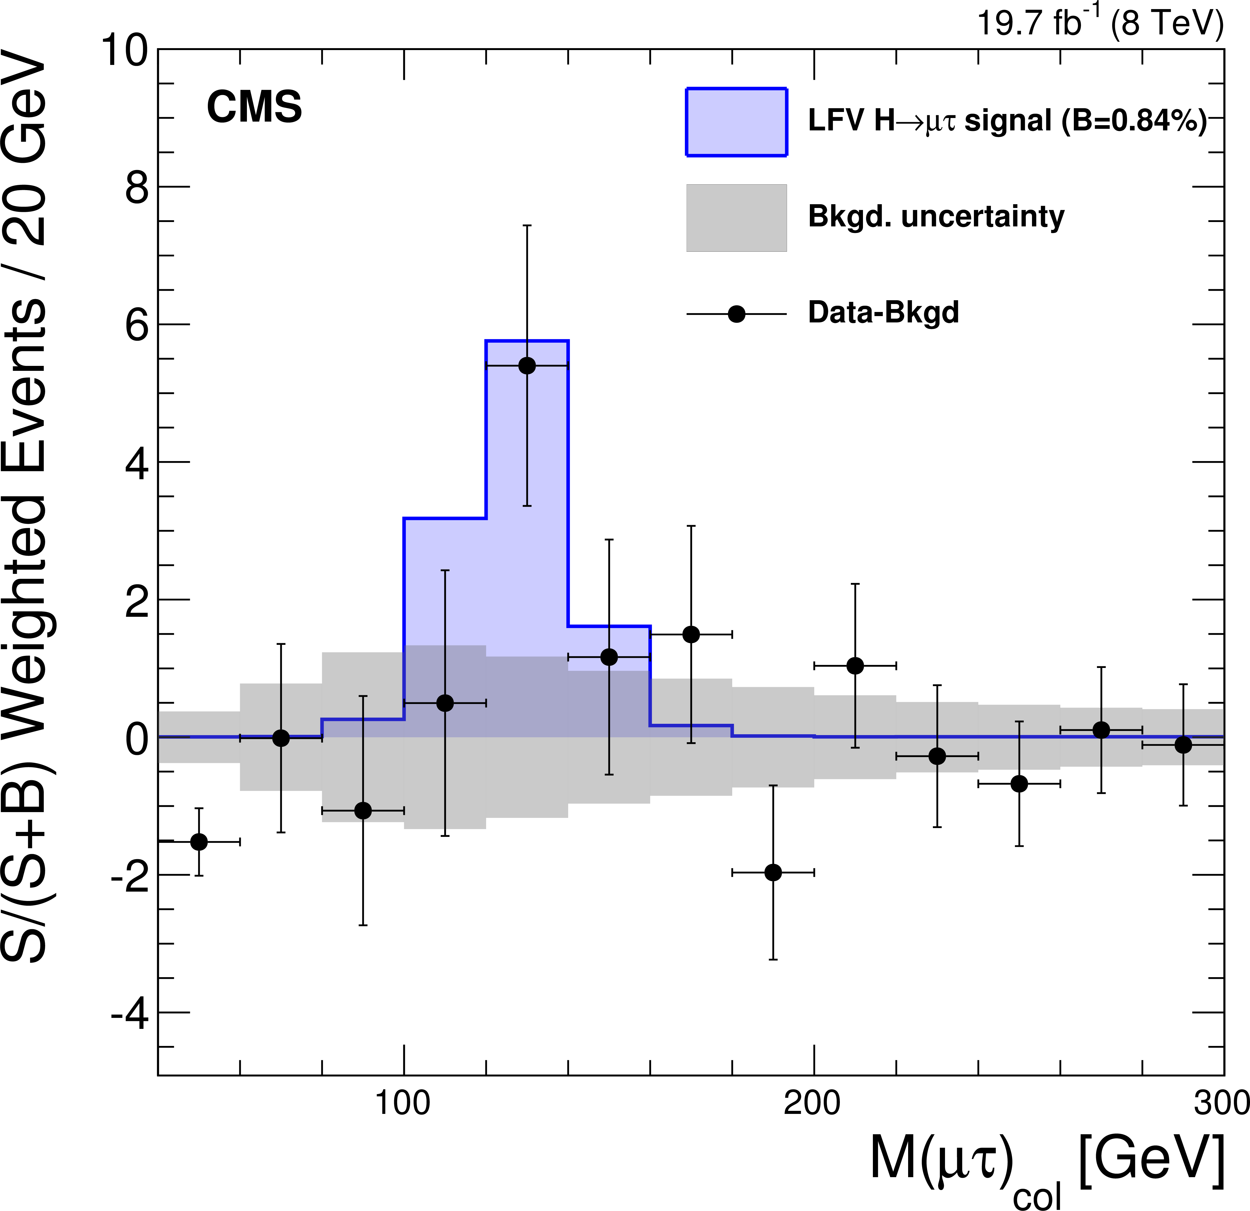
ATLAS 2018: LFV in Z and H decay
CMS-HIG-14-005:
Full run 1 data
2.4 σ excess in H -> μ τ
Br = 0.84 +- 0.38%
Lots of flavor hints in LHCb
(and BaBar, Belle)
If this is real we need to understand
It => measure as many flavor effects
as possible
Higgs and Z decay can only be done
By ATLAS and CMS

Slide 2
Z-> e τ and Z -> μ τ:
Olya, Terry
Using 36 fb⁻¹ run 2 data
Will be updated with full run 2
No excess in μ τ
2.3 σ in e τ
Br = 3.2+-1.5 x 10⁻⁵
To be published soon
H -> e τ and H -> μ τ:
Expect update in 2018 using 36 fb⁻¹ run 2 data
CMS Higgs statistics x4

