Slide 1
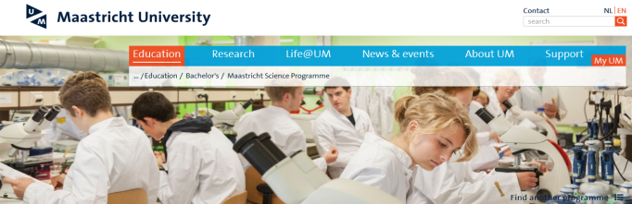
2018 Milestones Gravitational Waves
Virgo participates in O3 with respectable sensitivity
Assess seismic noise in Limburg @ 300 m depth (Voeren & Terziet)
Start miniET (5-10 M€) project
Get Nikhef to become a major Virgo computing (ab)use site
Establish a GW group at the UM
Submit lots of funding proposals
LIGOs
Virgo
•• • • • • • •

