Slide 1
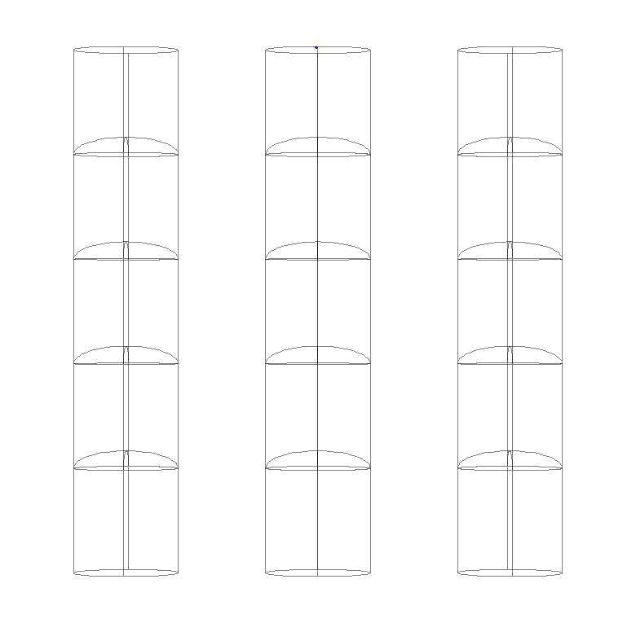
Timed photon counter
5 ΔV
4 ΔV
3 ΔV
30 μm
2 ΔV
ΔV
0
Diameter
30 μm
Pitch
55 μm

Slide 2
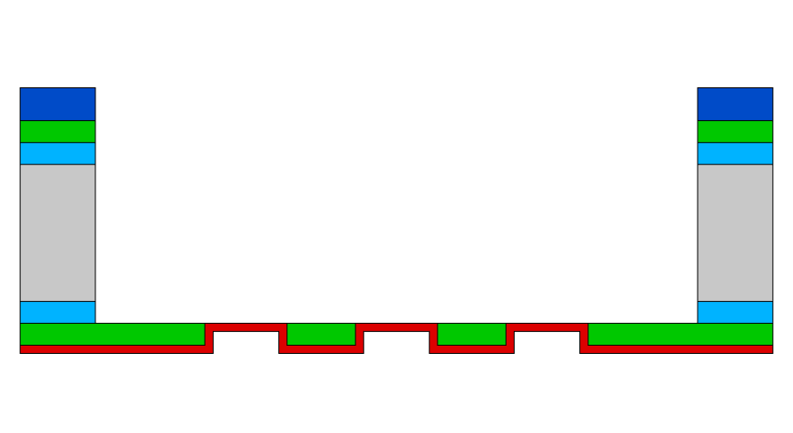
New Setup & Measurement method
Scanning Electron Microscope:
Electron beam energy
Measure beam current
Acquire image (4.2 min)
Keithley 2450 Sourcemeters
Measure Sample Current
Measure Collector Current
Repeat for different beam energies
Process data
TiN [2.5 nm]
MgO [5 nm]

Slide 3
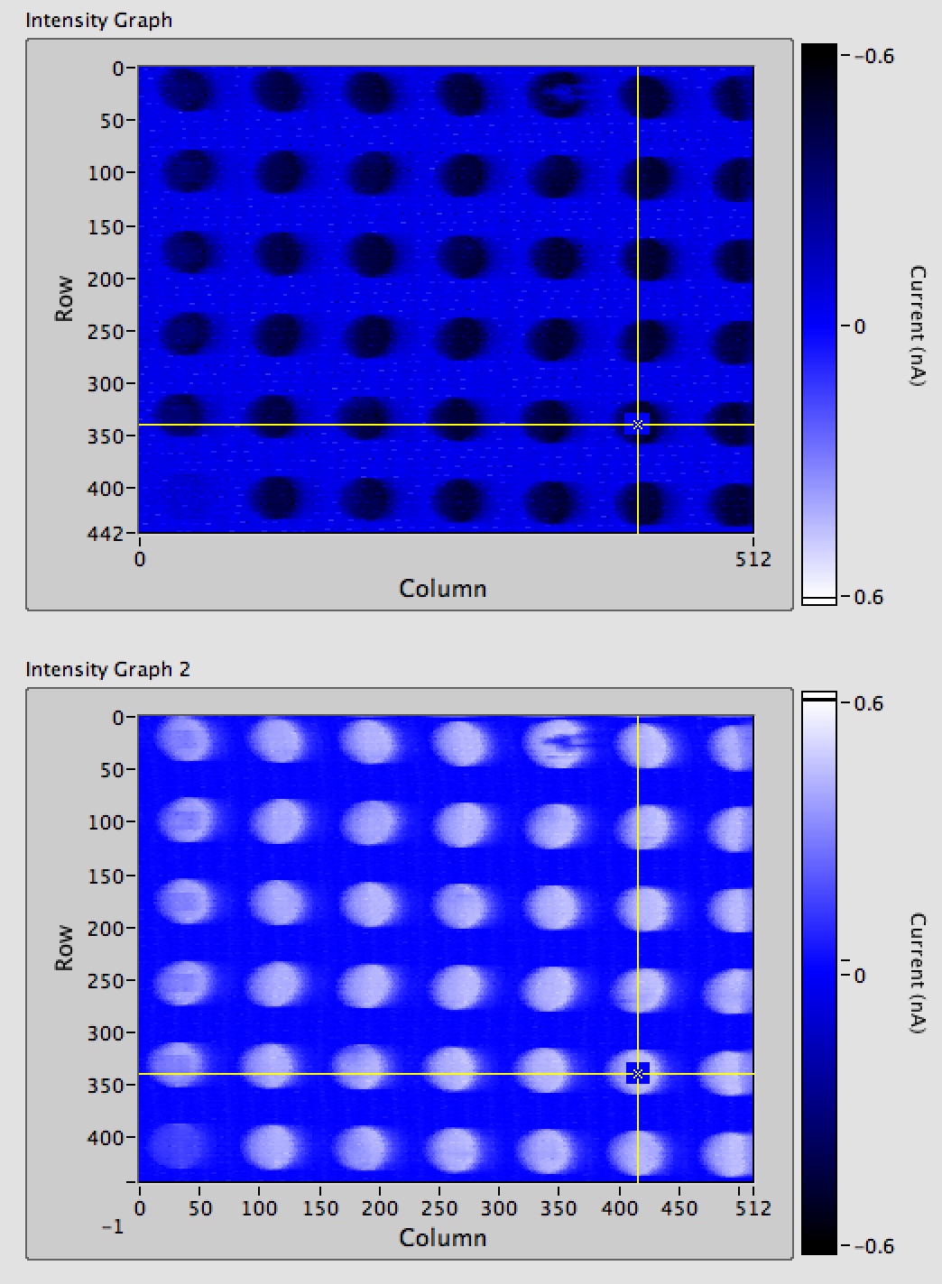
Preliminary results: Electron yields

Slide 4
Preliminary results: Extracting field
ΔV | Sample [V] | Collector [V] | Electron energy [eV] | Landing energy [eV]
50 | -50 | 0 | 1200 | 1150
100 | -50 | +50 | 1200 | 1150
200 | -50 | +150 | 1200 | 1150
300 | -200 | +100 | 1200 | 1000
400 | -200 | +200 | 1200 | 1000

