Slide 1

Imaging Technologies with Antineutrinos
Robert de Meijer, Pieter Dieleman, Gert de Lange, Han Limburg, Steven van der Veeke, Julian Wichello and Albert Zondervan,
EARTH-MEDUSA-SRON Collaboration

Slide 2
Recent developments
Decay corrected countrates measured with a 10.4cm diameter, 10.4cm long NaI well counter under a nuclear power plant show a status dependent effect for ²²Na but not for ⁶⁰Co.
Cross section for ²²Na, 17 orders larger than for IBD:1.65*10⁻²⁶cm²
⁶⁰Co indicates no systematic effect.
Reproduced in second measurement: λ/Δλ=-3.06*10⁻⁴
No additional reaction !!

Slide 3
If True
Application
Monitoring nuclear power plants on non-proliferation and fuel management aspects
Development
Understanding Physics
Optimising source;
Miniturising for drone application on land and on sea
Fundamental
Dirac or majorana?
Neutrino mass

Slide 4




Dirac or Majorana?
e⁺
²²Na
²²Ne
$$ν_{e}$$
$${\overline{ν}}_{e}$$
Dirac !
$${\overline{ν}}_{e}$$
$${\overline{ν}}_{e}$$
⁶⁰Co
⁶⁰Ni
e⁻

Slide 5
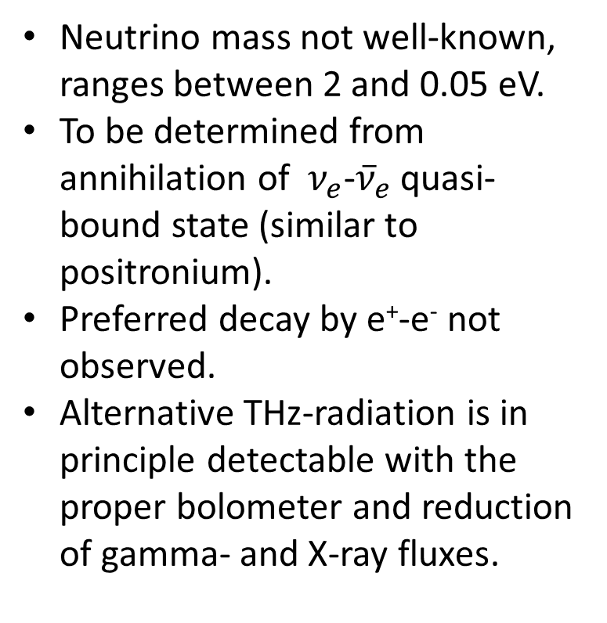
Neutrino Mass
Neutrino mass not well-known, ranges between 2 and 0.05 eV.
To be determined from annihilation of $ν_{e}$-${\overline{ν}}_{e}$ quasi-bound state (similar to positronium).
Preferred decay by e⁺-e⁻ not observed.
Alternative THz-radiation is in principle detectable with the proper bolometer and reduction of gamma- and X-ray fluxes.

