Slide 1
FleX-Ray Project: Real-Time 3D Tomography
8th February 2017
A. Kostenko
Centrum Wiskunde & Informatica
Amsterdam
Notes:
Introductie: onderzoeker bij het Centrum Wiskunde & Informatica; beeldreconstructie (denk aan: medische scanners)

Slide 2
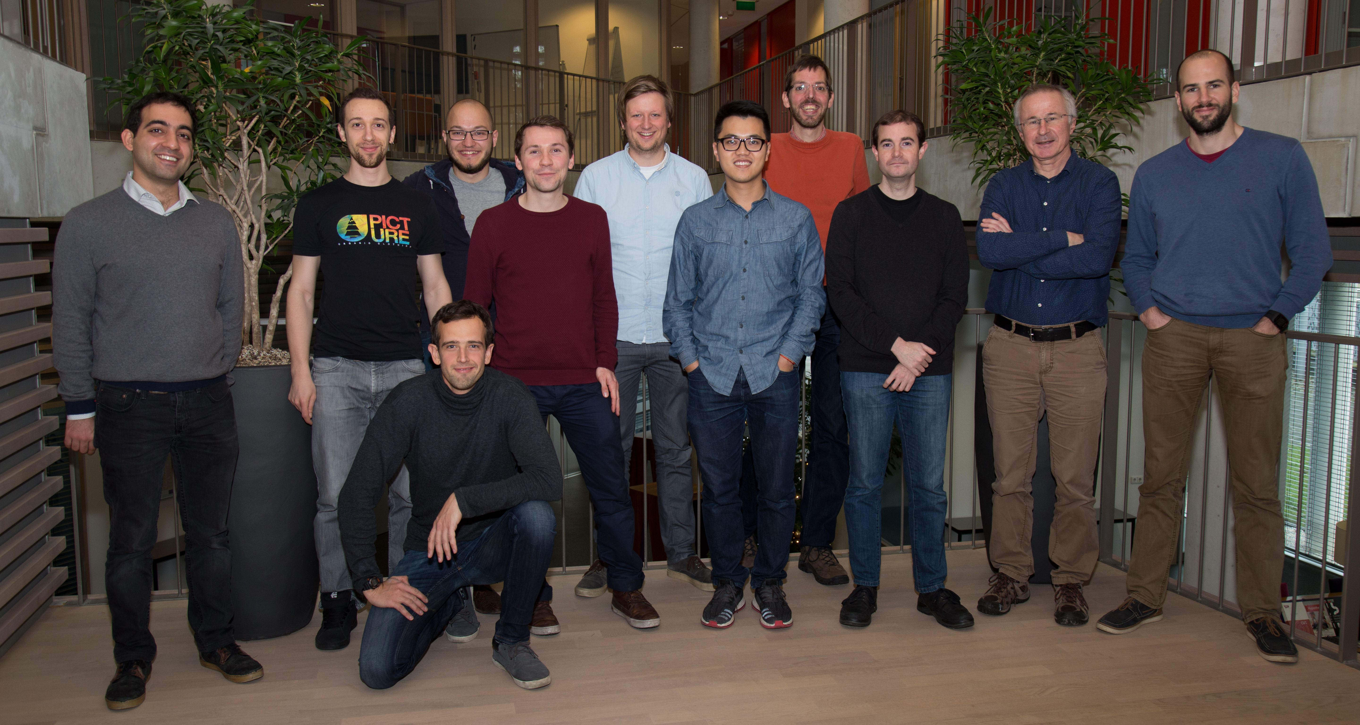
Computational Imaging
Computation of quantitative images from sensor data, based on rigorous mathematics
Examples:
Medical scanning (CT, MRI, PET/SPECT)
X-ray and electron tomography for industrial inspection
Interdisciplinary by nature
Physics (understanding the measurements)
Mathematics (relating measurements to images)
Computing (creating large images fast)

Slide 3
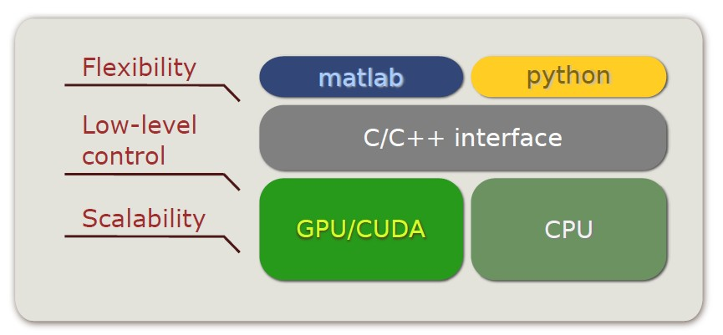
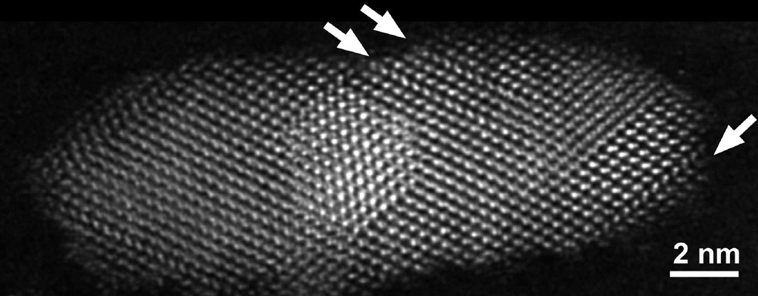
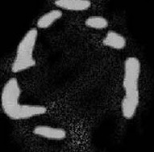
Current Projects
Distributed / GPU-based algorithms
Compressive sensing
Core-shell nanoparticle, individual atom columns are clearly visible
Limited angle tomography:
-45°- +45°
-60°- +60°
-75°- +75°
DART: -45°- +45°
HAADF STEM tomography, FEI Titan
Classical methods

Slide 4
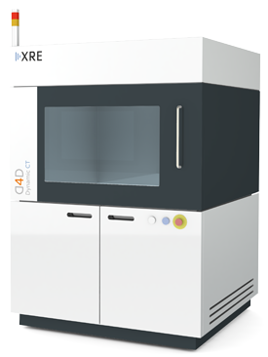
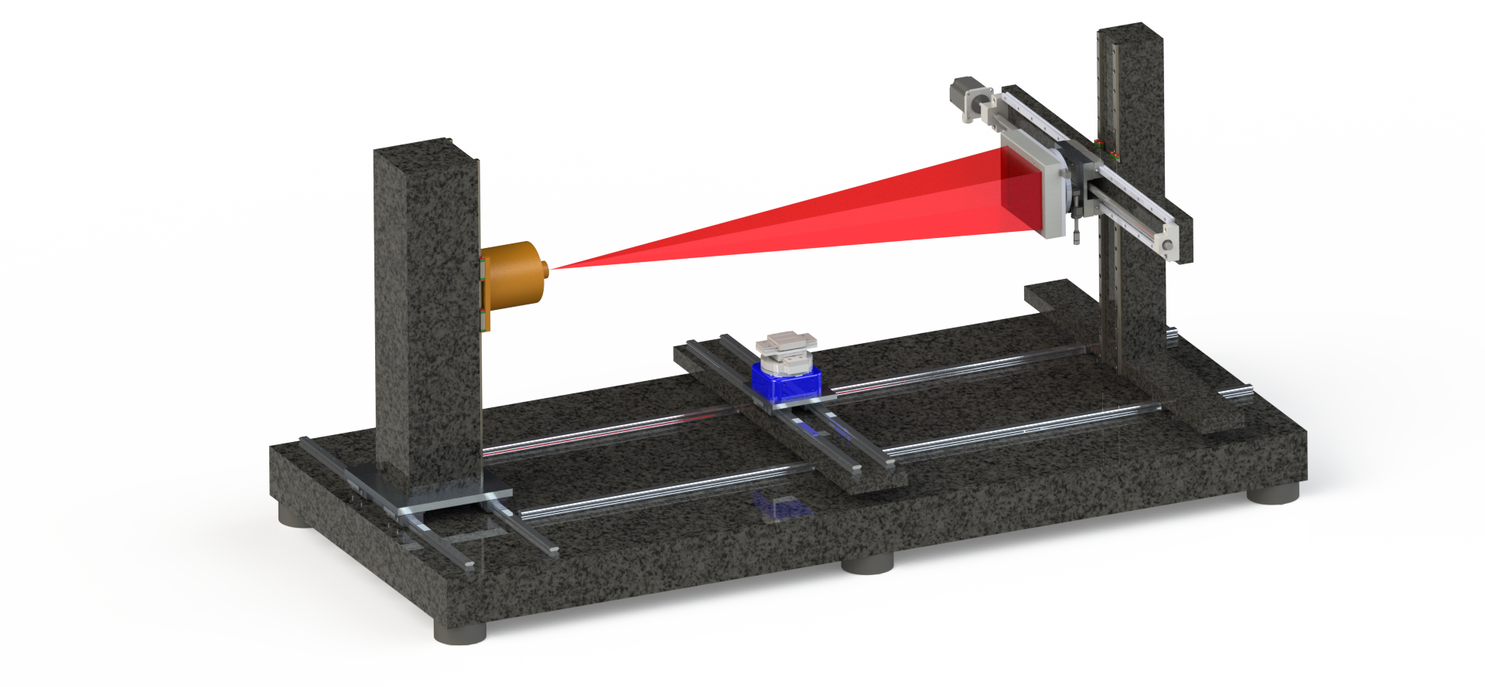
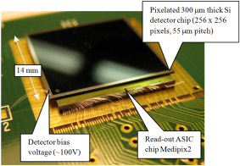
FleX-Ray Scanning Lab
Four partners: CWI, NIKHEF, XRE, ASI
Full geometric flexibility
State-of-the-art spectral X-ray detection
Unique capability for research on algorithms for 4D, spectral, and adaptive scanning

Slide 5
Trends & Problems
Real time reconstruction during the scan
5D imaging! (space + spectral + time)
Multi-modal imaging
Multi-scale imaging
Adaptive scanning (geometry + detector + source)
Integration of scanner with computation hardware and fast algorithms

Slide 6
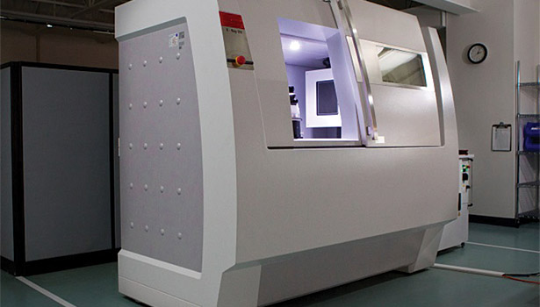
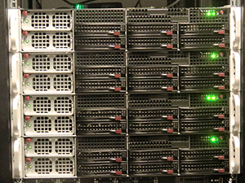
Conventional 3D Tomography
Imaging Pipeline:
Visualize and analyse
Batch of scans
Computational cluster
Go back and repeat the scan

Slide 7
Real-Time 3D Tomography
Imaging Pipeline:
Computational cluster
(ASTRA)
Visualize on fly
Continuous scanning
Feedback to the scanner:
Change geometry
Adjust resolution / SnR
Adjust energy thresholds

Slide 8
Enabling technologies
Single photon detection
using each photon
Spectral detection
getting all information out of each photon
Real-time 3D reconstruction and adaptive acquisition
targeting the photons to the most valuable regions
Limited data reconstruction
augmenting photonic data with prior knowledge

Slide 9
Thank you!

