Slide 1
Sensor on Foil platform
Matthias Simon, Walter Ruetten
Philips Research
Jan Jacobs, Olivier Tousignant
Philips Healthcare
Gerwin Gelinck, Albert v. Breemen, Hylke Akkerman
Holst Centre/TNO
February 9th, 2017

Slide 2
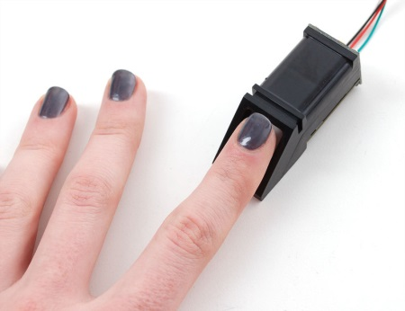
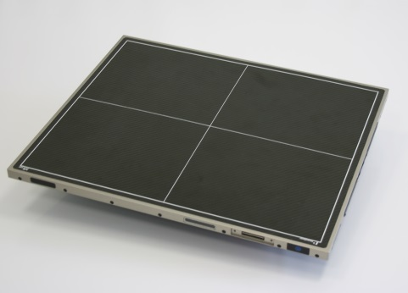
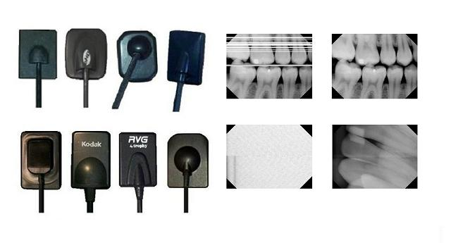
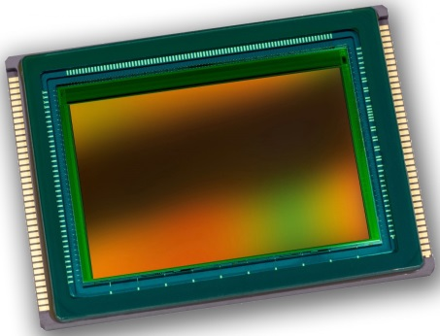
Image sensors today¹
Dominated by silicon based technology on rigid substrates
  High performance
  Large area applications difficult and/or expensive
  Rigidity hampers integration in products where form factor is important
  Mechanical integrity poor
CMOS sensor
Fingerprint sensor
Digital X-ray detectors
¹ Market size estimated to reach USD 17.5 Billion by 2020
CAGR of 30% between 2015 and 2020

Slide 3
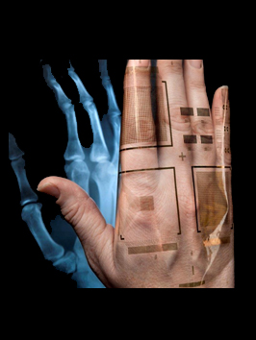
Flexible image sensors
Can offer similar performance as compared to silicon, but:
  can be processed over large area, hence have a competitive cost per area ratio
  are thin and light weight
  are robust
  are conformable
  can be (semi)-transparent
Enable new products and product design

Slide 4
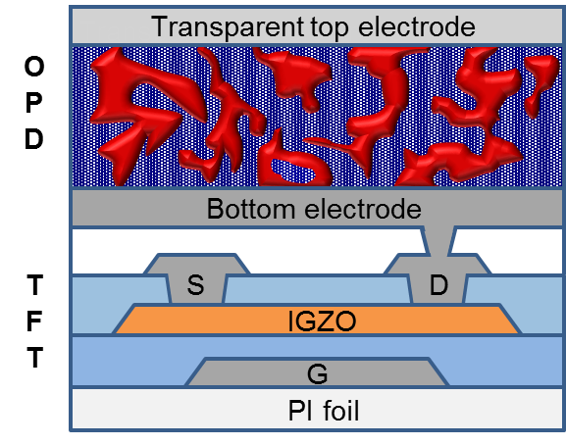
Combination of new technologies for imagers
Oxide TFT backplane:
High electron mobility (20 cm²/Vs), low off current (<1pA)
Low process temperatures, compatible with plastic film substrates
Optically transparent
Organic Photodiode frontplane:
Effective light absorption from UV to near-IR
Low process temperatures, compatible with plastic film substrates
Competitive cost per area ratio

Slide 5
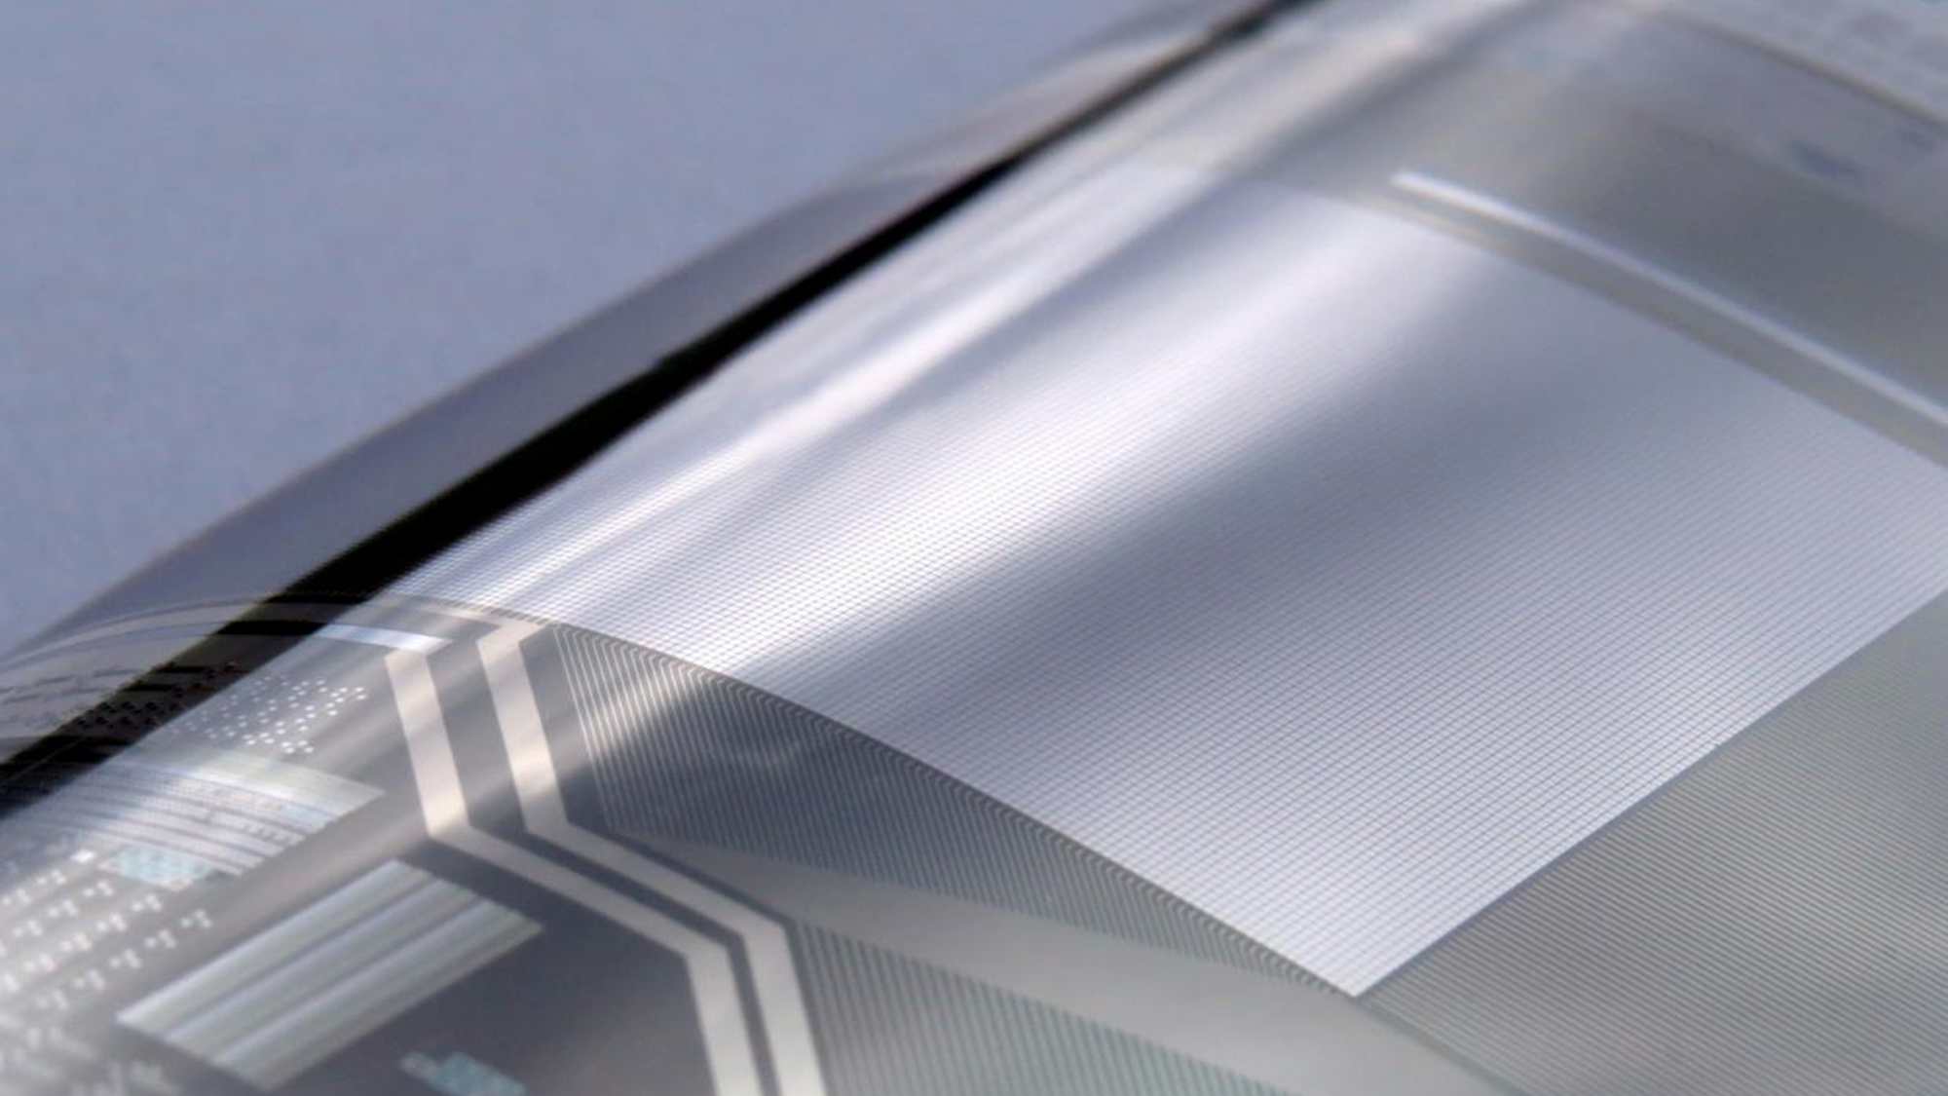
Oxide transistor backplane on plastics
A key enabler of flexible electronics

Slide 6
Oxide TFTs: semiconductor: In_{x}Ga_{y}Zn_{z}O (IGZO)
Etch stop layer (ESL) architecture
Flexible polyimide substrate
Processed on thin film barrier (optional)
Display fab compatible processes
(at low temperature)
PECVD inorganic dielectrics
PVD metals (no noble metals)
PVD semiconductor (IGZO)
5 mask TFT process

Slide 7
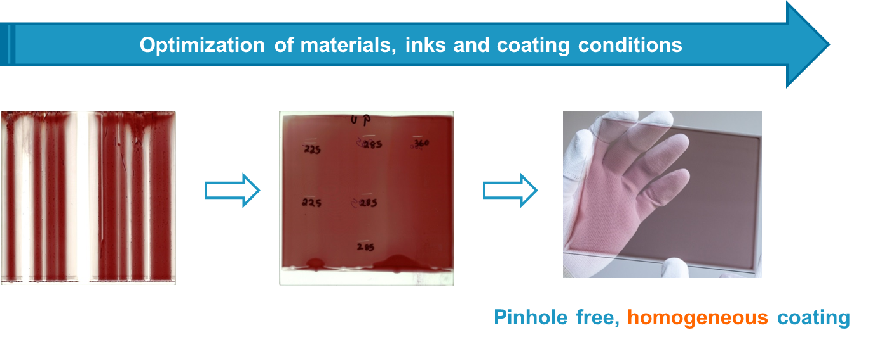
Organic photodiode (OPD)
Organic photoactive layer by slot-die coating: non-contact large-area blanket coating

Slide 8
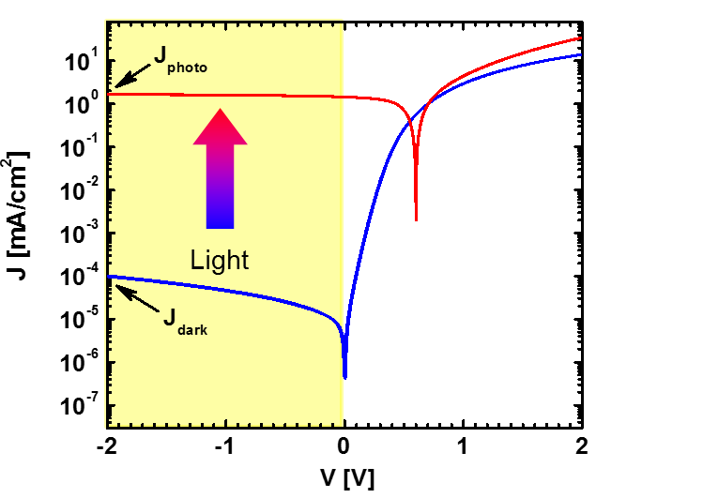
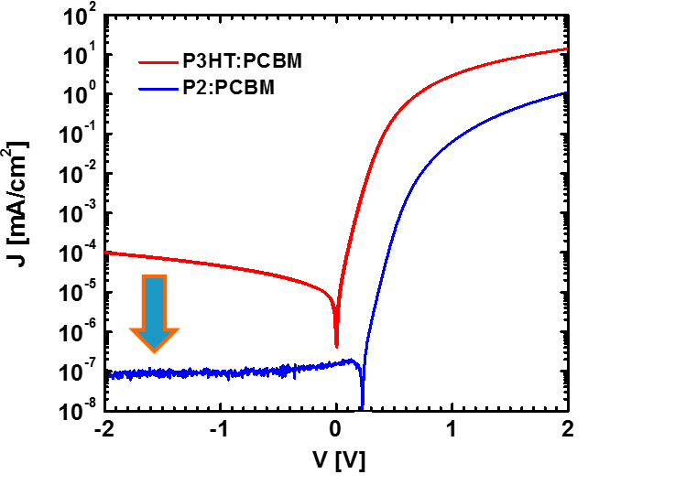
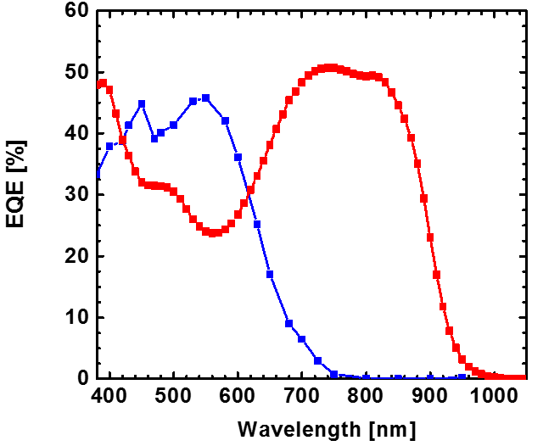
Organic photodiode (OPD)
Light
Transparent top electrode
Bulk heterojunction: mix of donor and acceptor material
High EQE
Low dark current
-
D
A
Bottom electrode

Slide 9
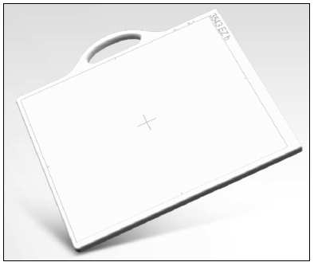
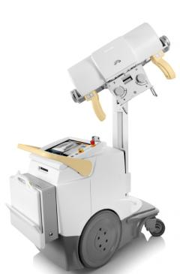
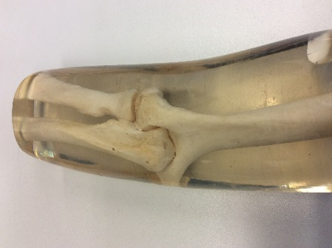
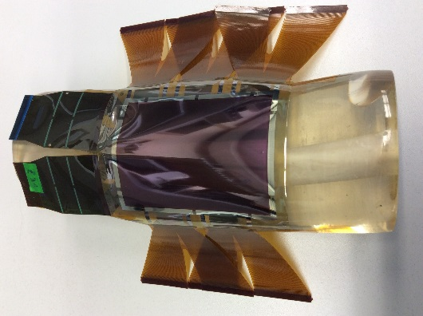
Example: X-ray detector on foil
Wireless portable X-ray detectors are becoming more and more popular
  in mobile X-ray units → bed-side x-ray
  as replacement for fixed detectors in radiography rooms
Lighter and more robust detector
  will ease workflow for staff and patient
  less damage due to dropped detectors
Visions
  flexible X-ray detector -> wrap around body
  ‘ultra-mobile portable X-ray’
Mobile X-ray unit
Trixell
Wireless portable detector

Slide 10
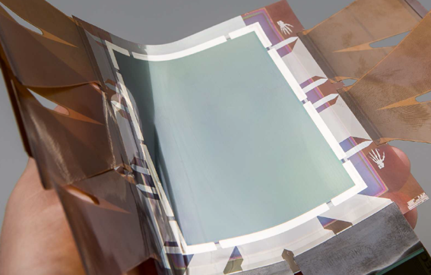
X-ray sensor on foil
Demo with image format VGA (480x640 pixel)
Area 6 x 8 cm²; pixel size 126 µm
Larger area in preparation

Slide 11
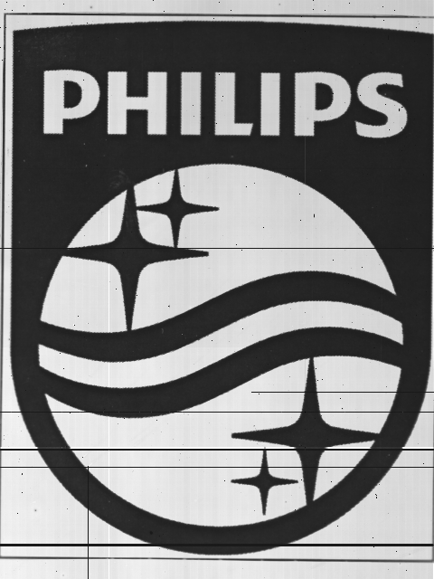

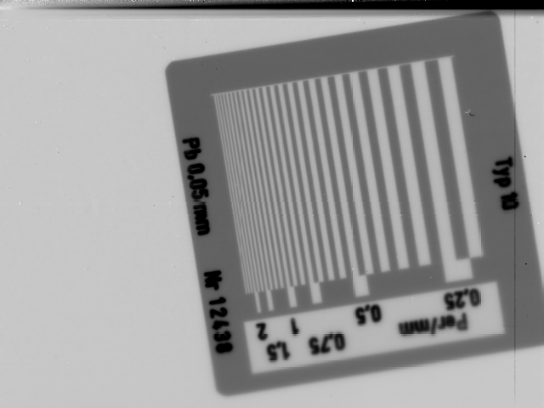
Characterization with light and X-ray
Optical images
CsI scintillator (400 µm) laid on
→ X-ray image

Slide 12
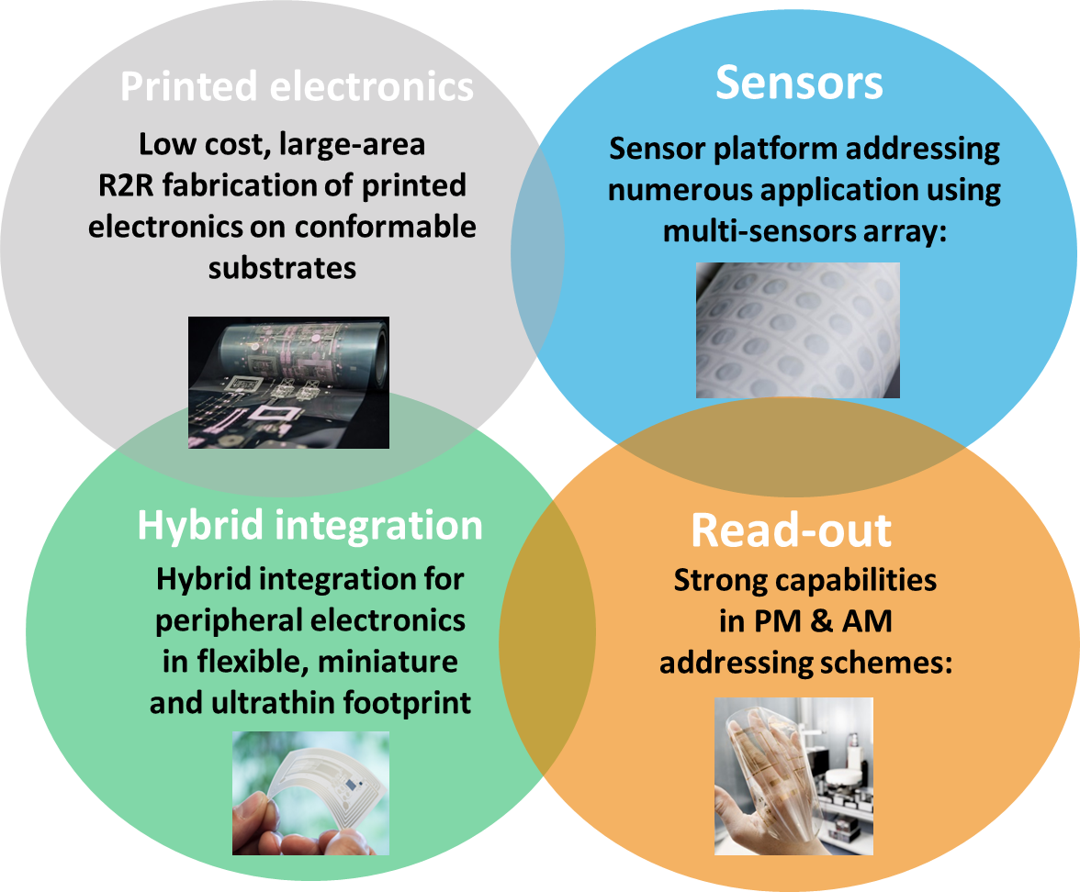
Flexible sensors platform at Holst Centre

Slide 13
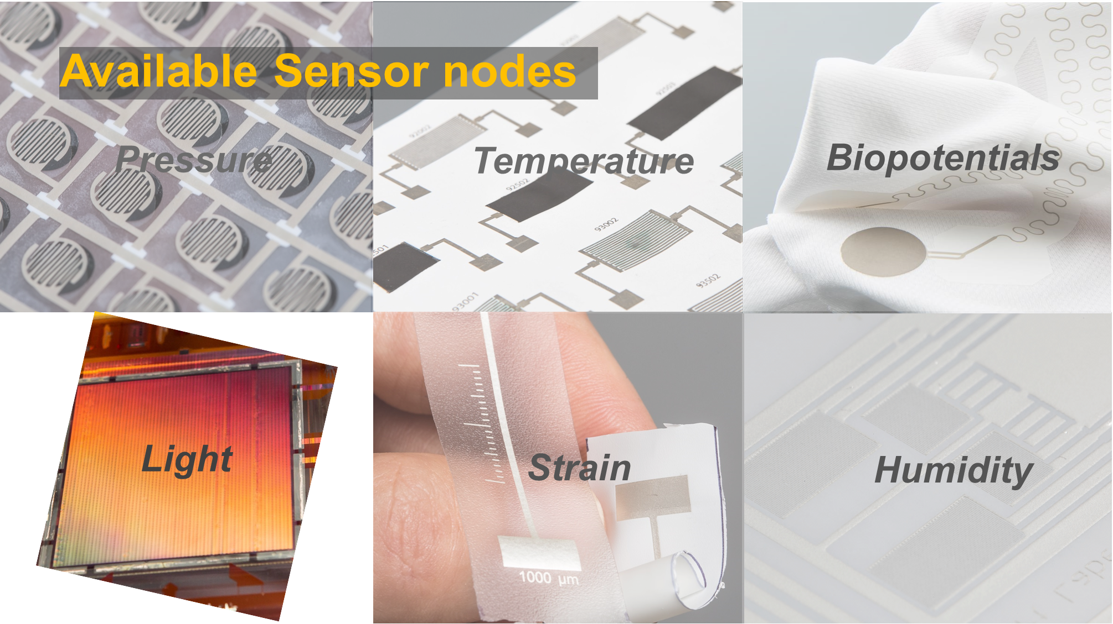
Flexible sensors platform at Holst Centre

Slide 14
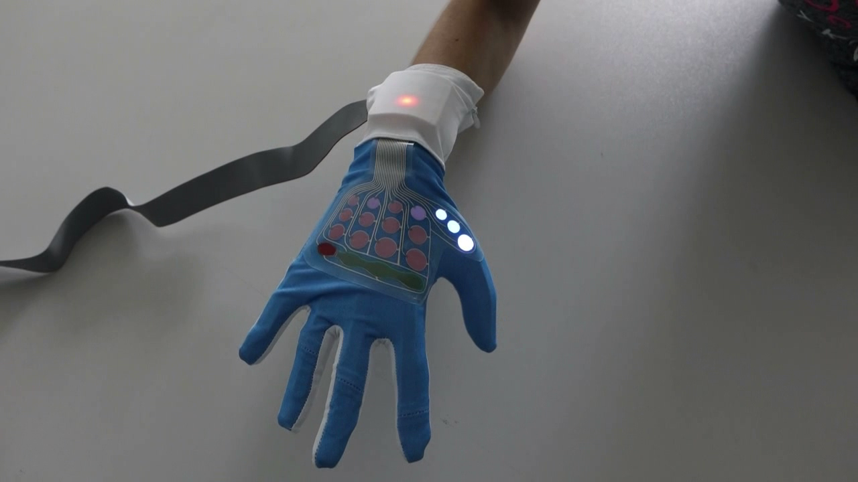
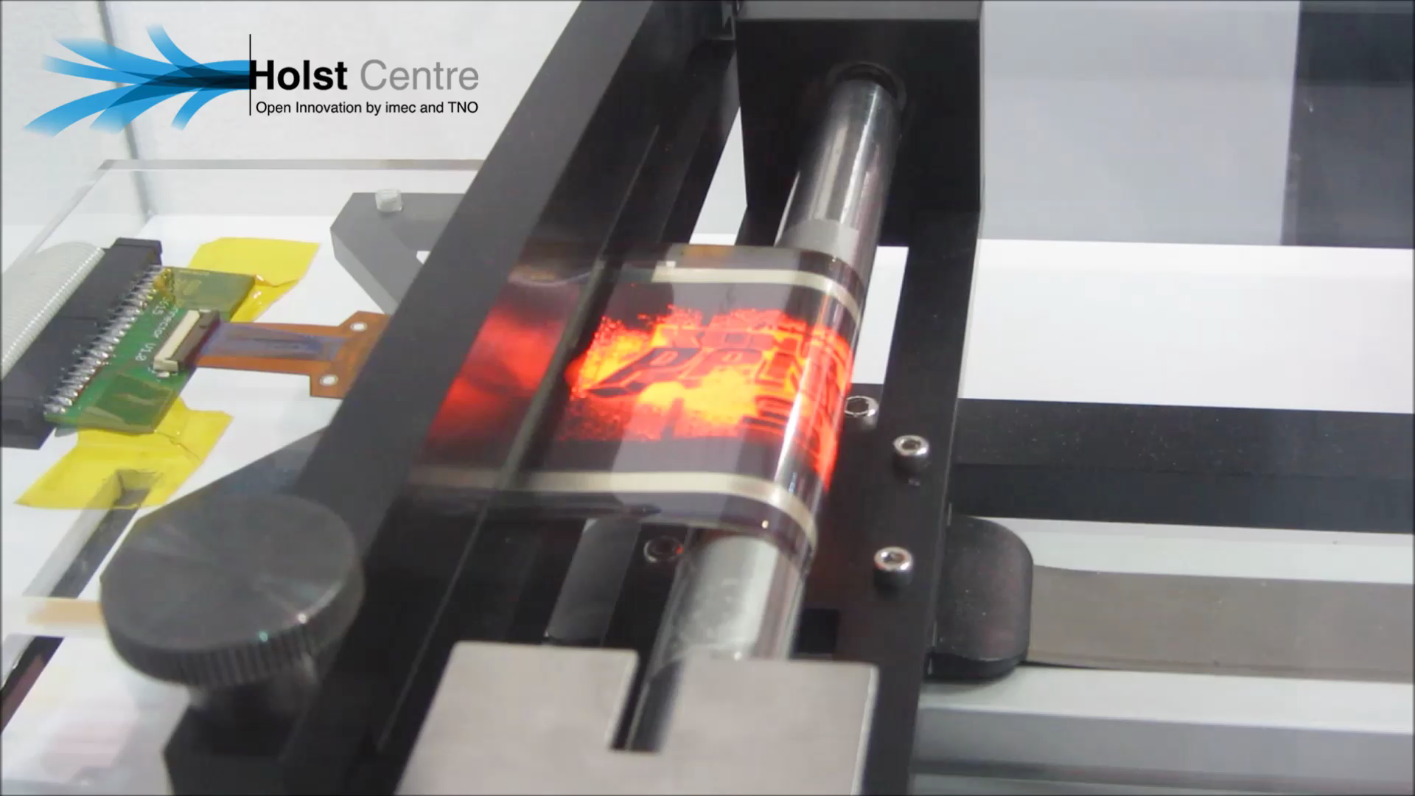
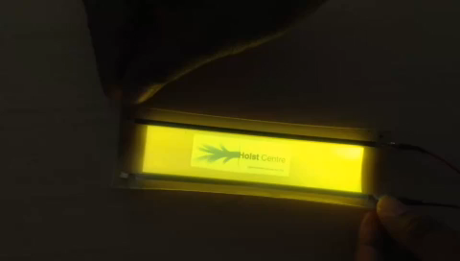
Holst Centre

Slide 15


Summary
Combination of different large area technologies
Foil-based imagers and X-ray detectors
Flexible sensor platform
18

Slide 16
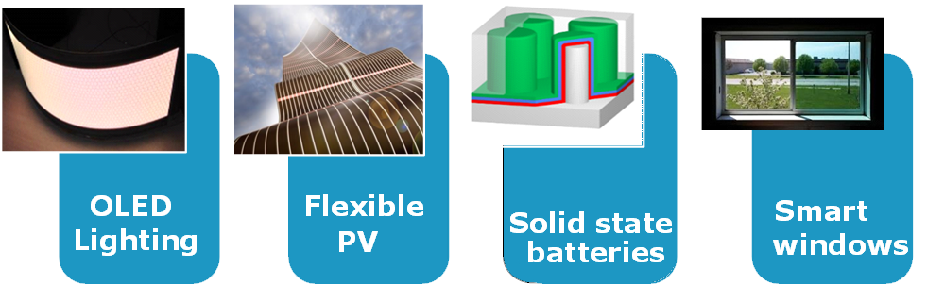
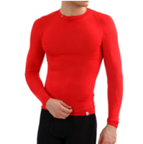
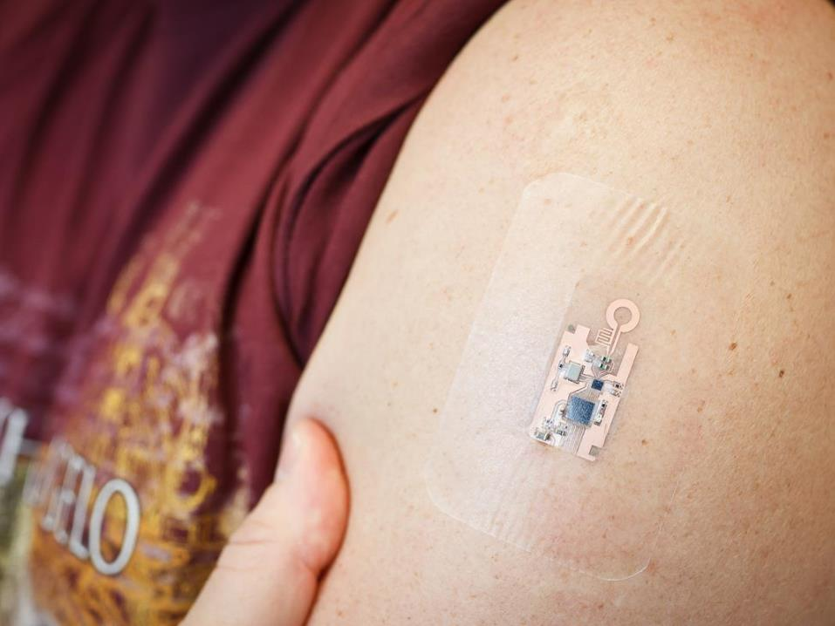
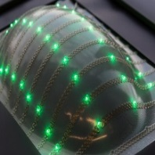
Research areas at Holst Centre
Large area
technology
Hybrid printed
technology
TFT technology
OLED
Lighting
Flexible
PV
Solid state batteries
Smart
windows
Smart clothing
Health patch
Structural
electronics
Flexible
displays
Flexible
imagers
Flexible
circuits

