Slide 1
Accelerating development of high-performance detector and imaging technologies for science and markets
Pablo Tello (CERN)
www.attract-eu.org

Slide 2
What is ATTRACT?
ATTRACT is a new, open, pan-EU initiative to accelerate the development of high-performance detector (sensor) and imaging technologies for both scientific and industrial use.
It involves European Research Infrastructures (ERIs), European research institutes and RTOs, small and medium enterprises (SMEs), companies, universities and business and innovation specialists.
http://www.attract-eu.org/

Slide 3
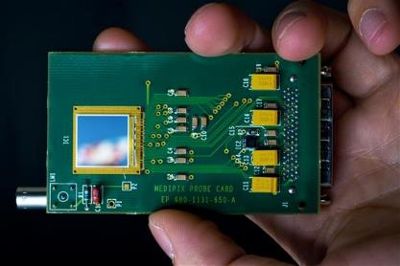
Focus on detection and imaging technologies
European Research Infrastructures (ERIs) - as well as the R&D communities associated to them - treasure an enormous and underexploited know-how on detection and imaging technologies.
Detection and Imaging technologies are at the core of future industrial developments applications and business.
Detection and imaging technologies allow for the emergence of fast innovators especially SMEs and Start-Ups.

Slide 4
Why ATTRACT?
There is a need from both ERIs and industry to make better use of the R&D platforms and co-develop path breaking innovations.
The detector R&D community has many ideas of potential suitability of its technologies for other use, but often have limited contacts and mechanisms available to properly exploit this options space
Developing new technologies for both improved research capabilities and new applications could make good use of complementary, fertile R&D funding possibilities potentially offered by H2020 to further enhance R&D capacities
The European industry, in particular SMEs, find it difficult to tap into the necessary supporting (scientific) infrastructure offered by ERIs and associated labs to absorb and shorten time to money
SMEs, in turn, are often better equipped to interface towards MNEs than researchers
The European detector R&D community has the experience and expertise to help but there is no coordinated effort to assist them, while maintaining their primary research motivation

Slide 5
How ATTRACT?
The approach in ATTRACT is unique because:
It is focused, technology domain-specific but touches industries and products worth over 100b$ per year
It is a bottom-up approach, scientific instrumentation development work being used as the engine of innovation
It is run as an international scientific collaboration or experiment, incorporating industry as partner
It engages cross-disciplinary involvement and engagement, including young innovators and entrepreneurs
It aims at generating an open access Innovation Depository

Slide 6
What type of ATTRACT technologies?
http://erdit.eu/ . Courtesy of Cinzia da Via

Slide 7
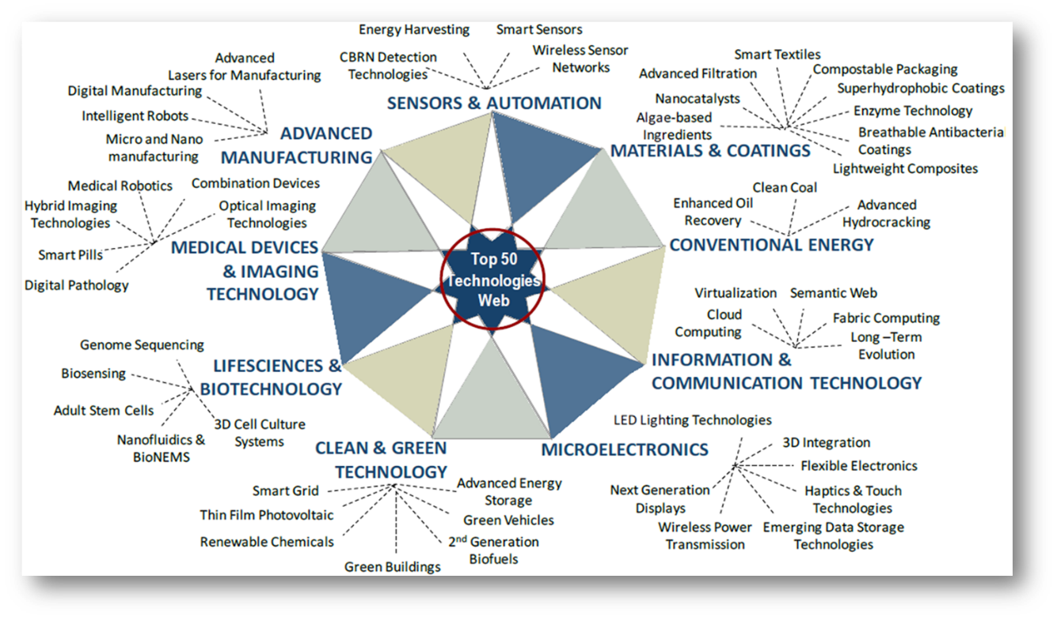
Science Connects to Markets
Frost & Sullivan Top 50 Technologies (TechVision 2020) estimate annual sensor & imaging market(s) at over 100 b$
ATTRACT is a 1 b$ Program to create an Innovation Ecosystem in detection & imaging technologies

Slide 8
ATTRACT Is About Need to Create an Ecosystem…
New Scientific Instruments, Products, Services, Entrepreneurs, Jobs
Contributing to …
Innovation Management Platform
Connecting through …
Cross-disciplinary MSc-Student Teams
Engaging …
Industry (special attention to on SMEs)
Co-developing with …
Sensor & Imaging R&D Community With Ambitious Goals and Projects
Being driven by …

Slide 9
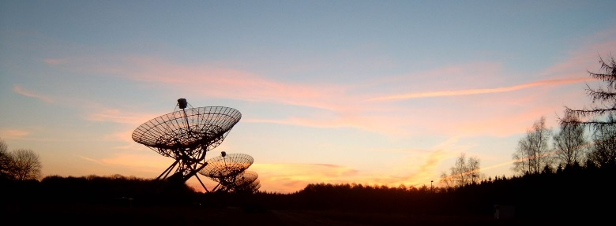
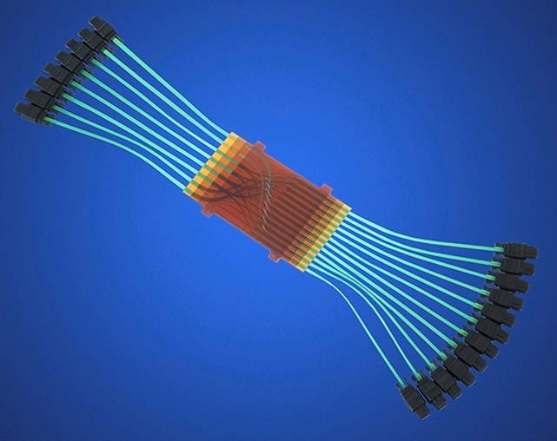
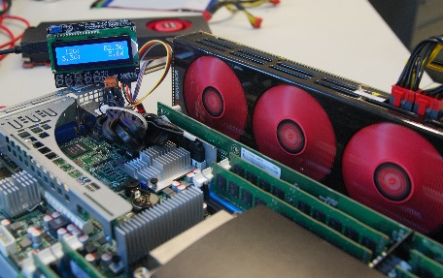
Examples of Projects for ATTRACT?
(Integrated) 3D detectors for photon and electron identification (<< 1 ps, 1micron spatial resolution)
Fast (< 1ps, 100Mcounts/s) preamplifiers and TDC electronics, with potential for medical imaging
New Additive Manufacturing tools for integrated manufacturing of detector support structures, with potential for compact (customized) electronic systems for eg. avionics

Slide 10
“Mini-ATTRACT” Phases 1 and 2
Phase 1
A wide scope of technologies with breakthrough potential (TRL 2 to 4). Plant the “Flowers”.
Selection process based on excellence (scientific merit, industrial scalability and social added value).
Phase 2
Scalability of Phase 1-selected technologies towards industrial deployment (TRL 5 to 9). Select and fund 10% of Phase 1 projects.
Construction and establishment of a self-sustained initiative (“Maxi” ATTRACT).
Preparing to repeat the “Flowers” in parallel.

Slide 11
Mini-ATTRACT Submission H2020 WP 16-17 Call
Core Consortium created to administrate the ATTRACT call(s), to be launched late 2017 or early 2018, depending if/when EC awards the INFRAINNOV-1-2017 call to ATTRACT
18 ME will be redistributed in 100 kE grants, based on received and selected short, few-page proposals
Max 2 ME will be used for administrating the call(s)
Proposals selected by independent scientific advisory committee (IC; coordinated by S. Bertolucci)
Some 20 distinguished identified members, supported by reviewers selected by the members (but not made public)
Funded projects have 12 months to develop their ideas/prototypes for the next funding stage. Big event in Brussels
An ad-hoc advisory body has been set up to prepare the way for “Maxi“, plan merged with Mini-ATTRACT Project Advisory Committee (PAC). Chaired by J. Wood

Slide 12
Funding “Mini-ATTRACT” Phases 1 and 2
Phase 1 (2017-2018): Research and Innovation Action (20 M Euros EC funding) with autonomy to launch open calls with the following objectives:
Identification of a wide spectrum of technology opportunities with breakthrough potential across the 28 EU Member States and Associated Countries.
Assessment of the feasibility and scalability of the identified opportunities.
Selection and clustering of those opportunities with potential for industrial implementation (transition towards Phase 2).
Phase 2 (2018-2019): Expected continuation call with autonomy to launch open calls with the following objectives:
Continuation with the selected opportunities from Phase 1 towards industrial applications having societal value.
Advancement towards a strategic model for a sustainable ATTRACT initiative.

Slide 13
Path Ahead for ATTRACT
2018
20 M Euros EC fund.
Seed funding of 180 breakthrough projects.
2025
Scale-up Public-Private
Capital Model
1
2019
4
Scale-up EC fund.
Private capital in place.
2
2020
Sustainable Public-Private
Capital Model
3

Slide 14
Thanks

