Slide 1
Imaging cryogenic detectors for space based astronomy
J. van der Kuur¹, L. Gottardi², H. Akamatsu², P. Khosropanah², R. den Hartog², R. Hijmering², D. Audley², B. Jackson¹
1) SRON Netherlands Institute for Space Research, Landleven 12, 9747AD Groningen
2) SRON Netherlands Institute for Space Research, Sorbonnelaan 2, 3584CA Utrecht

Slide 2
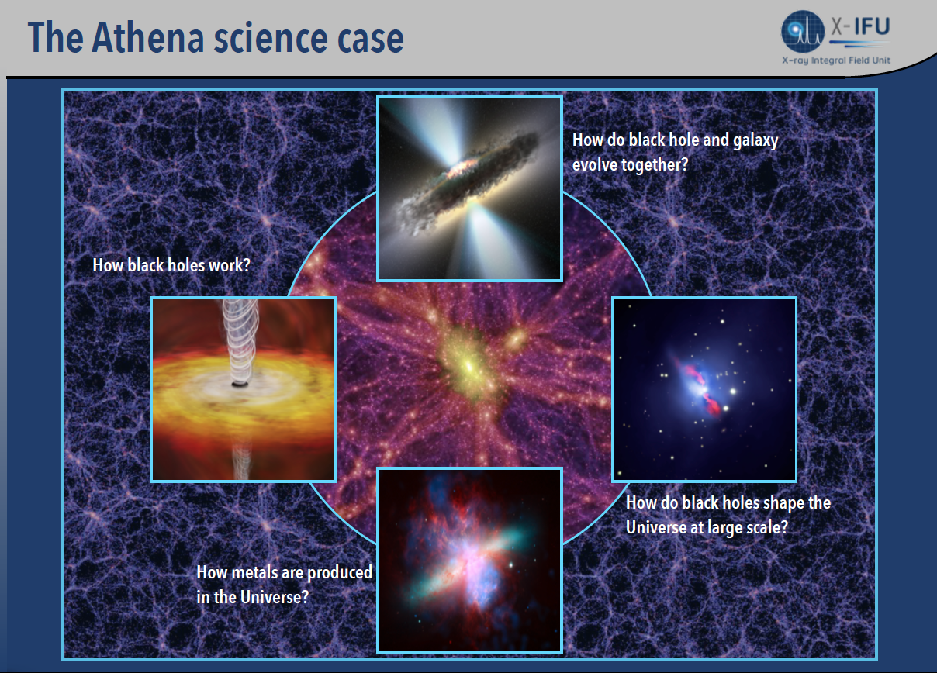

Slide 3
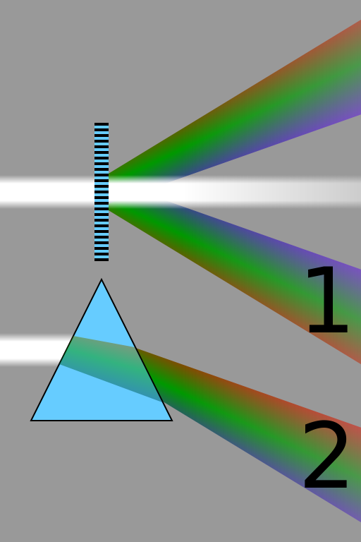
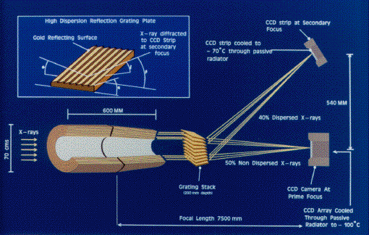
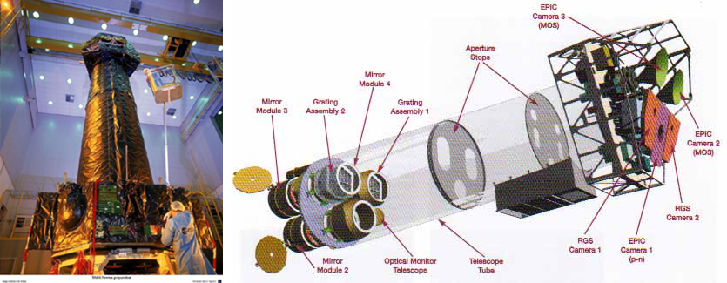
XMM X-ray observatory
In orbit since december 1999
CCD detectors
Grating spectrometers
Energy resolution limited at high energies (20eV @ 2.1keV)
X-ray astronomy requires ΔE < 3eV @ 6keV
Notes:
Astronomers interested in the intensity and color of light.

Slide 4
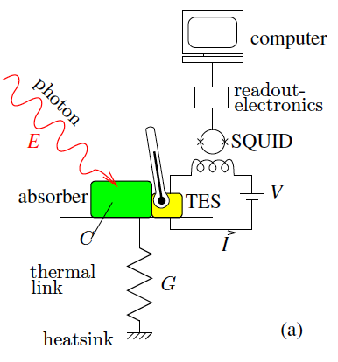
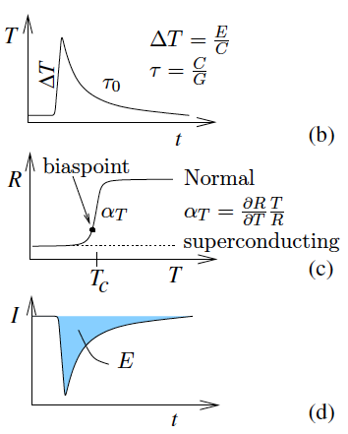
Cryogenic microcalorimeter operating principle
T = 100mK

Slide 5
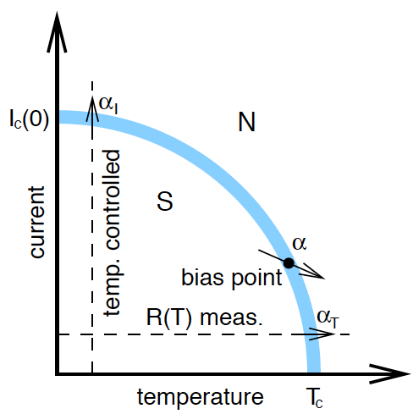
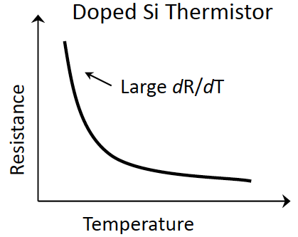
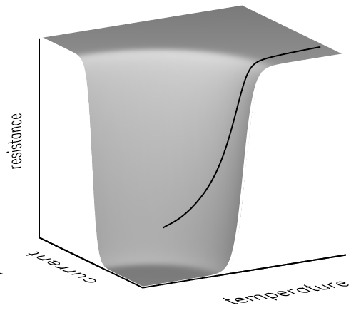
Thermometer sensitivity TES
Superconducting phase transition near Tc
Strong dependence resistance - temperature
T_{c} tuned by proximity effect
Normalized sensitivity (α=(dR/R)/(dT/T)):
  Si thermistor ~ α=1-5
  TES ~ α=100

Slide 6
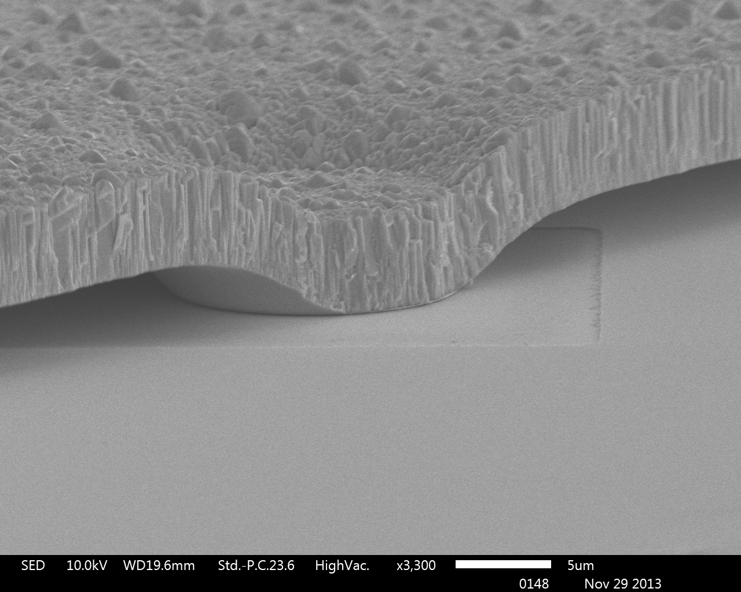
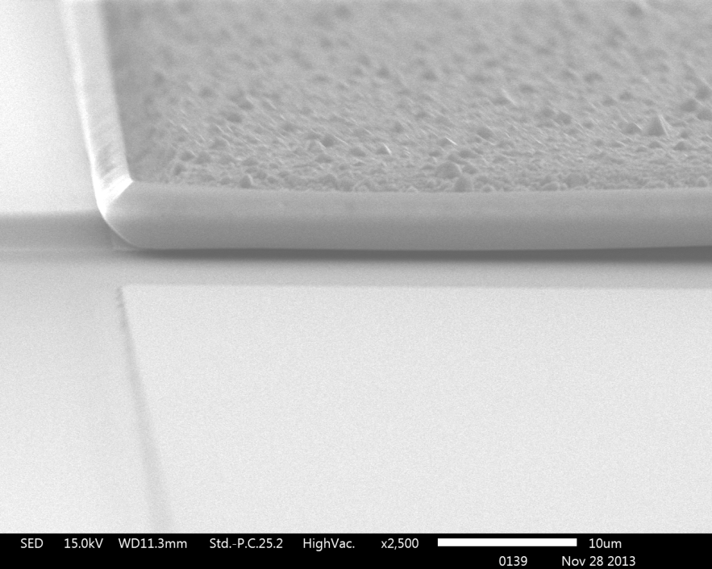
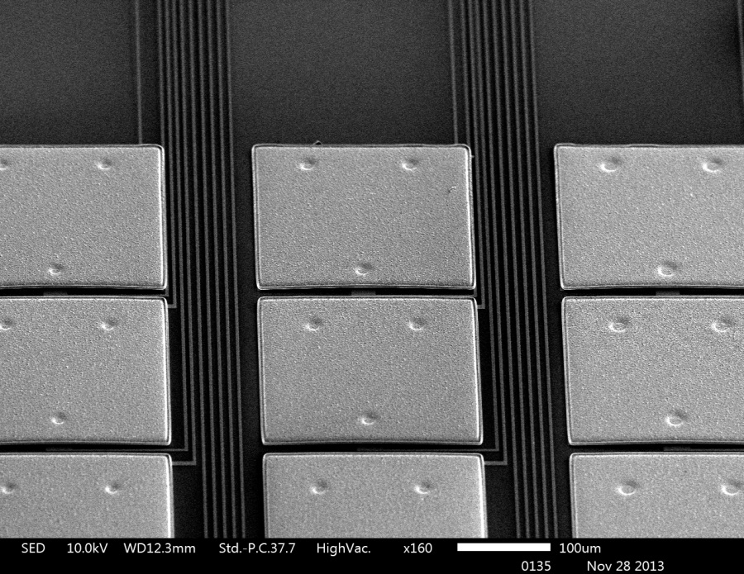
X-ray pixel micrograph
Development of high-filling factor and high QE pixels array
250x250um sputtered Bi on electroplated Au
TiAu TES with uniform current distribution

Slide 7
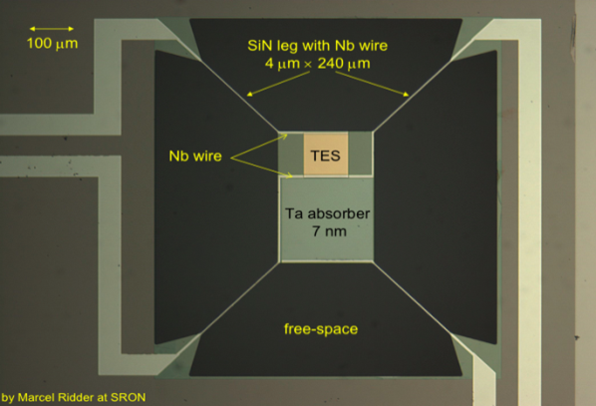
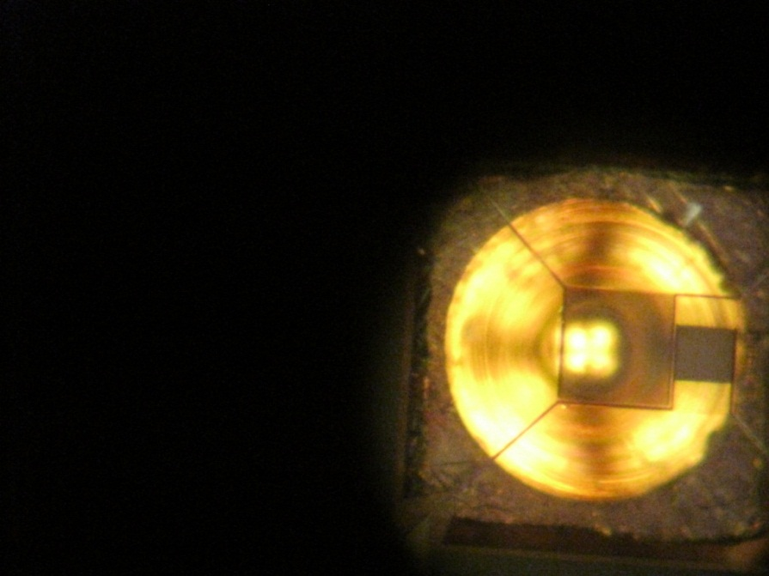
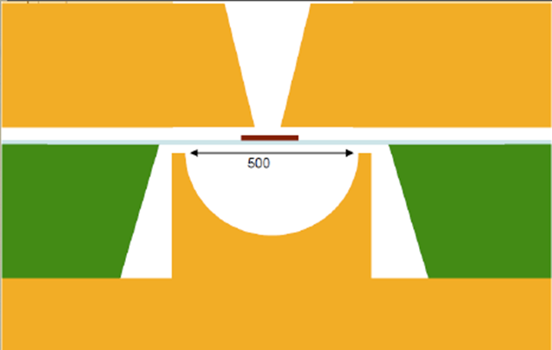
Optical coupling scheme
Absorber 200x200 μm
TES
Horn
Spherical Backshort
NEP ~ 2 10 ⁻¹⁹ W/√Hz

Slide 8
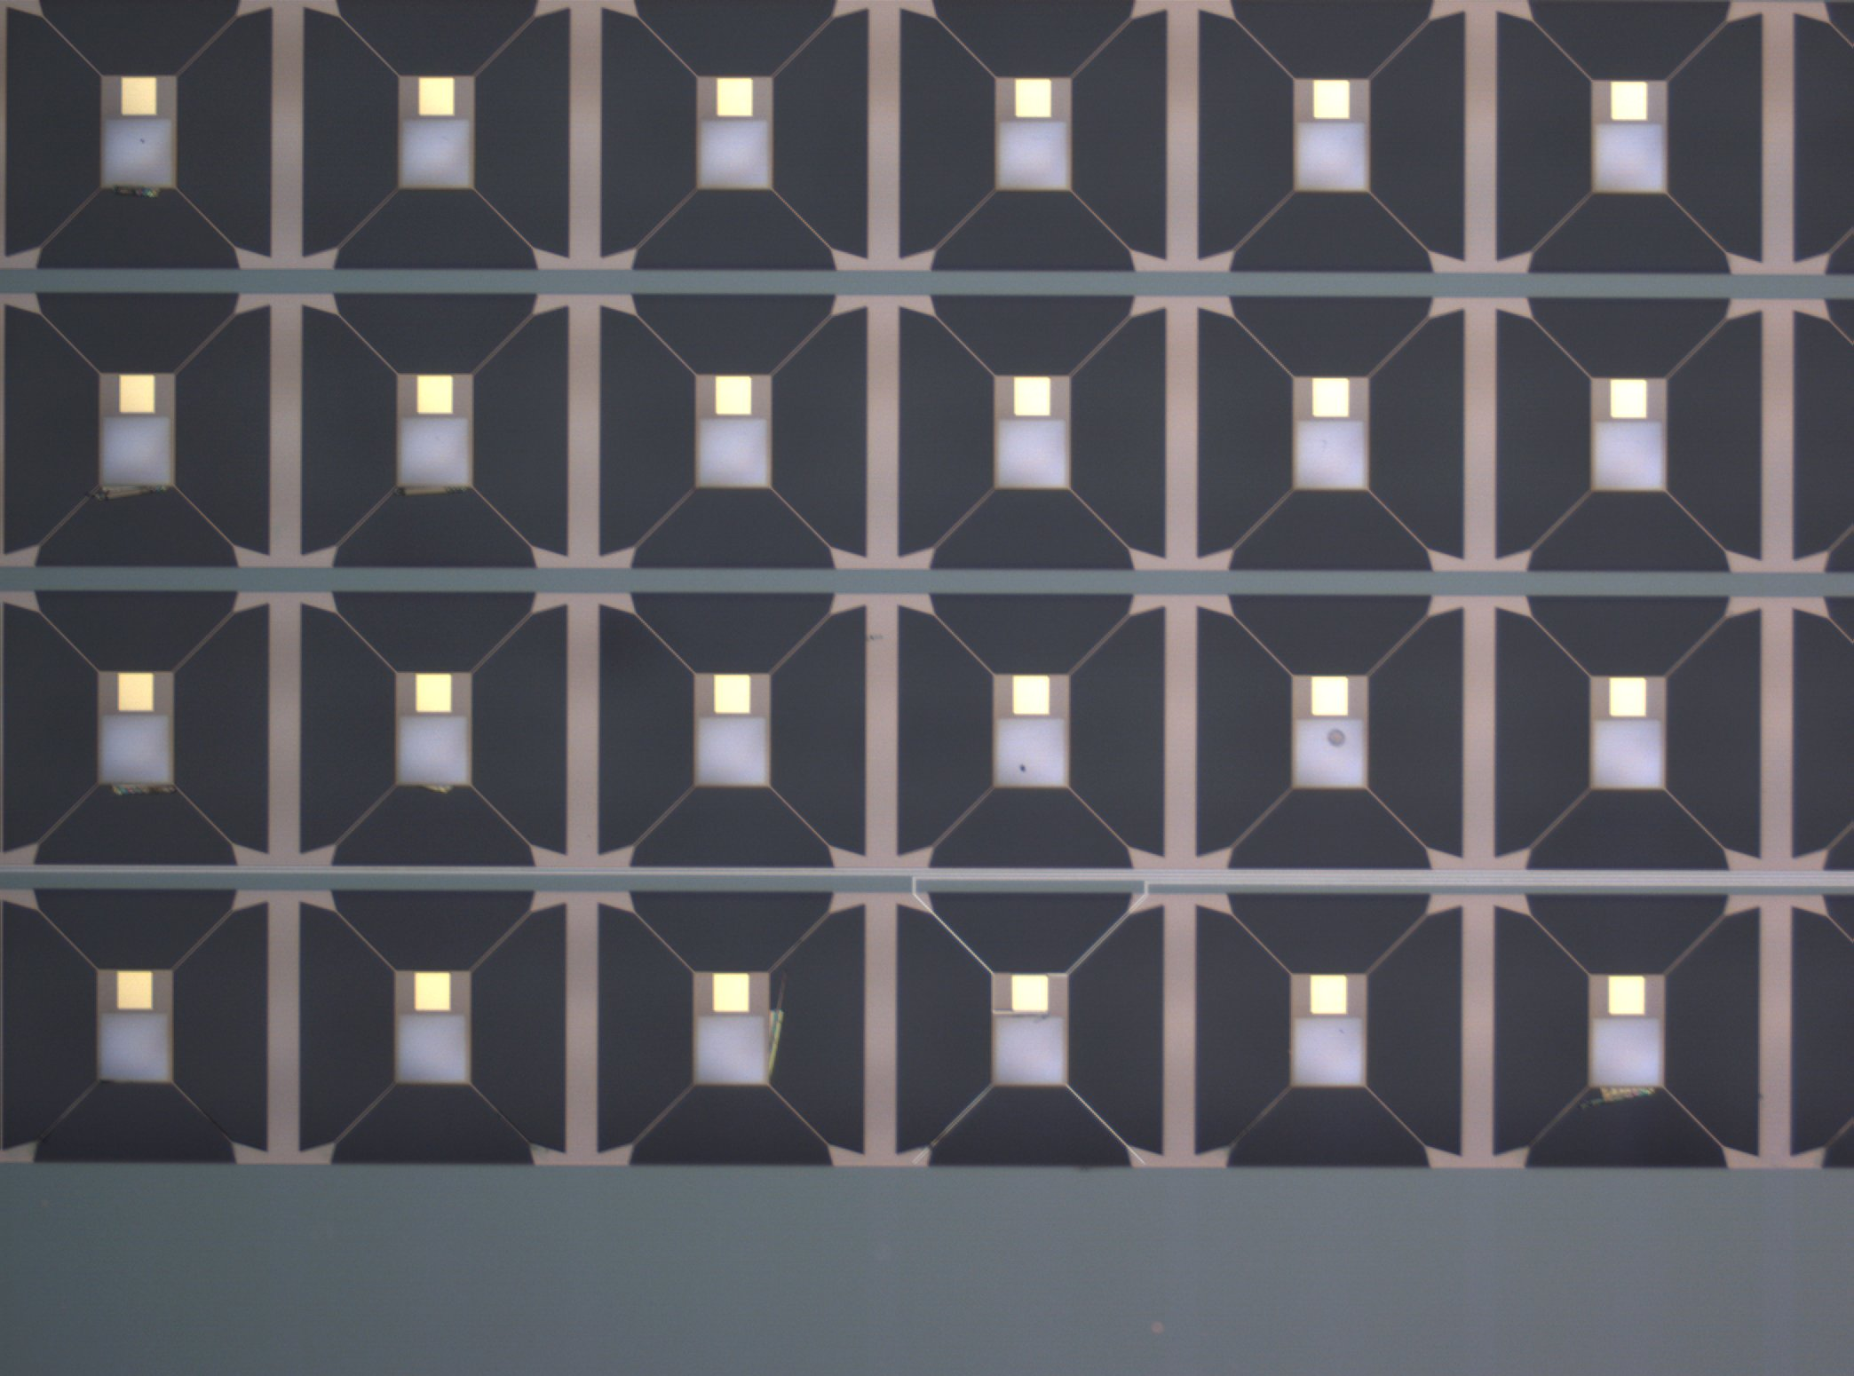
38x38 bolometer array
NEP = 2*10⁻¹⁹ W/rtHz
Notes:
These are some of the prototypes already fabricated to demonstrate the feasibility of achieving 10-19W/rt Hz at 100mK. Low A/L in the legs is required. If the legs are zig zag, then the ballistic phonons have a better chance of being scattered.

Slide 9
Summary detector properties
property | value
Number of pixels | ~4000 (64 x 64)
Pixel size | 250 μm x 250 μm
Energy range | 0.2 – 12 keV
Energy resolution | < 2.5 eV
Detector operating temperature | 100 mK
Cooler operating temperature | 50 mK
Heat lift @ 50mK | 1 μW
Target application | X-ray astronomy
Further uses | Material analysis, non-proliferation, infrared bolometers

Slide 10
Thank you

