Slide 1
Microscopy and spectroscopy with low-energy electrons
Sense Jan van der Molen – February 2017

Slide 2
A new Type of Microscopy
eV-TEM
TEM
‘Universal curve’
M.P. Seah, W.A. Dench, Surface and Interface Analysis 1, 2-11 (1979)
Notes:
TEM uses high energy electrons
Long mean free path
Damage
Low
We want to use this
And we want to do this using our existing infrastructure

Slide 3
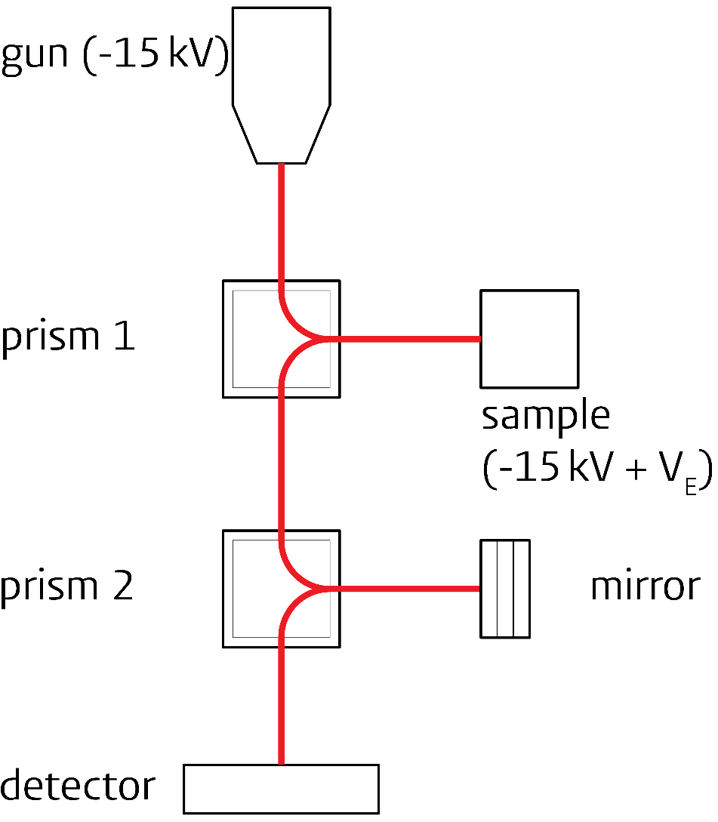
Start: Low-energy Electron Microscopy

Slide 4
eV-TEM

Slide 5
Transmission eV-TEM
3.1 eV
Gold nano-particle clusters
Notes:
Already worked last time
Now improved normalization

Slide 6
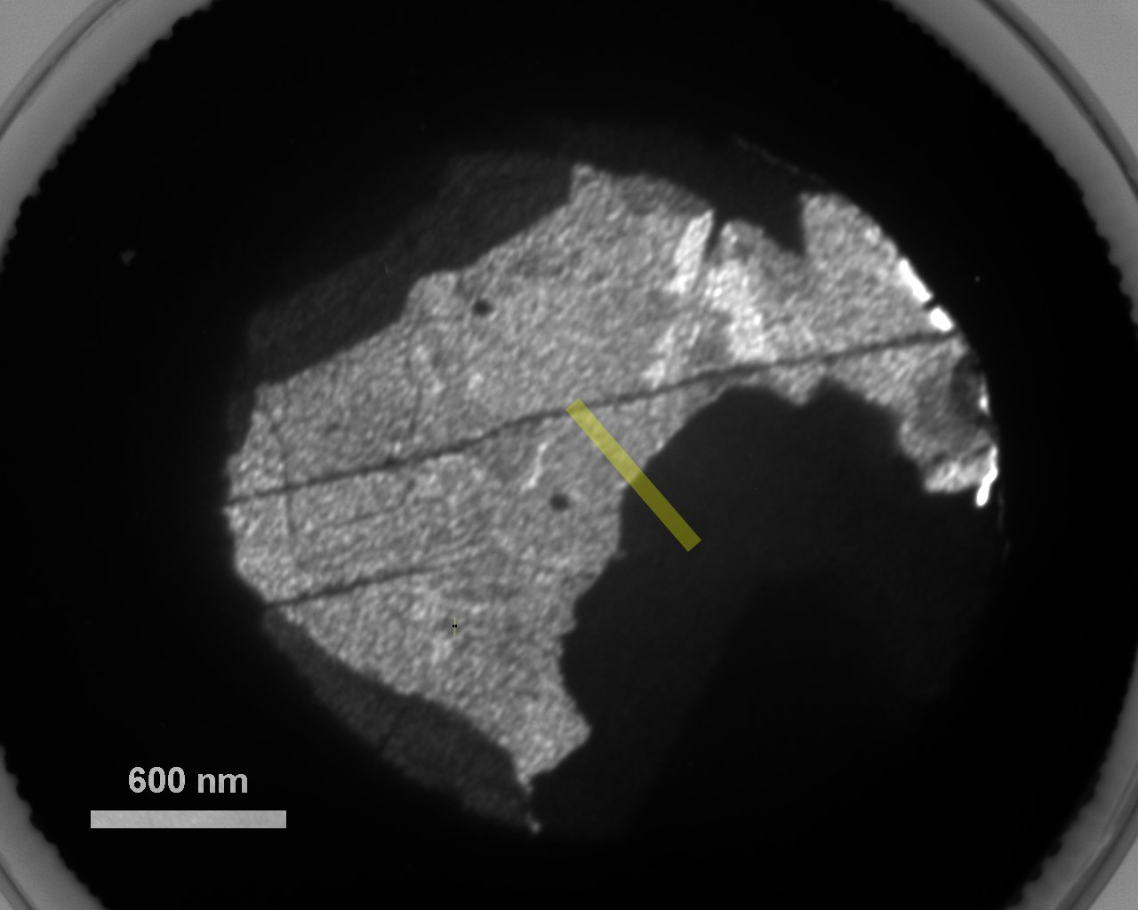
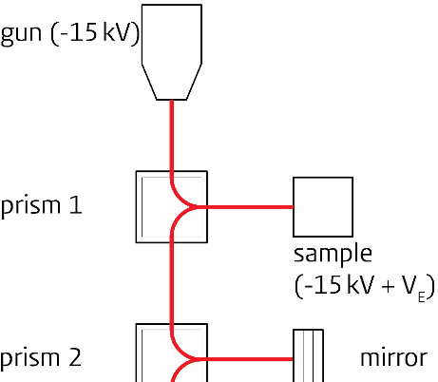
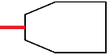
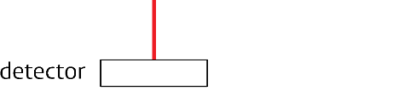
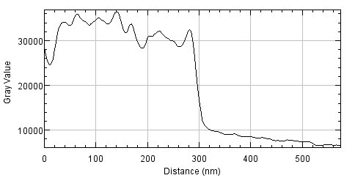
Resolution
3.1 eV

Slide 7
Transmission and Reflection
6.3 eV

Slide 8
Wanted in a detector
UHV compatibility!
Pixel detector for 15 kV electrons
High detector resolution < 50 microns
Large dynamic range (no background)
Fast read-out for ‘movies’: dynamic processes
Long lifetime

Slide 9
Detector comparison
factor 2 in detector resolution; better contrast
MCP
Medipix 2
Graphene on Ir (111). See: Ultramicroscopy 110 (2009) 33–35

Slide 10
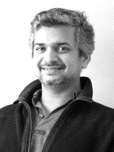
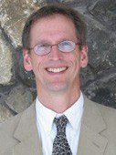
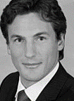
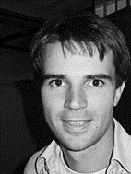
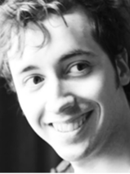
Cathode-lens Microscopy in Leiden
potentiometry
lithography
ARRES
PLD of complex oxides

Slide 11
Extra

Slide 12
Spectroscopy
3.1 eV
6.1 eV

Slide 13
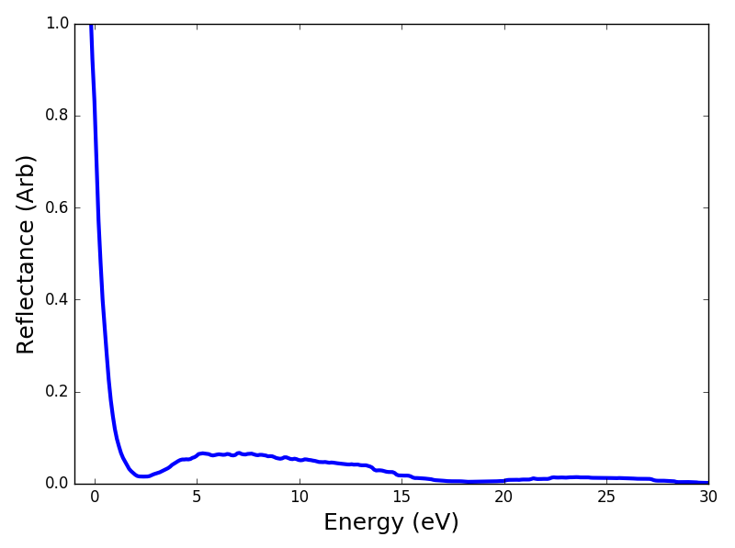
Spectroscopy
Reflection
Double layer

Slide 14
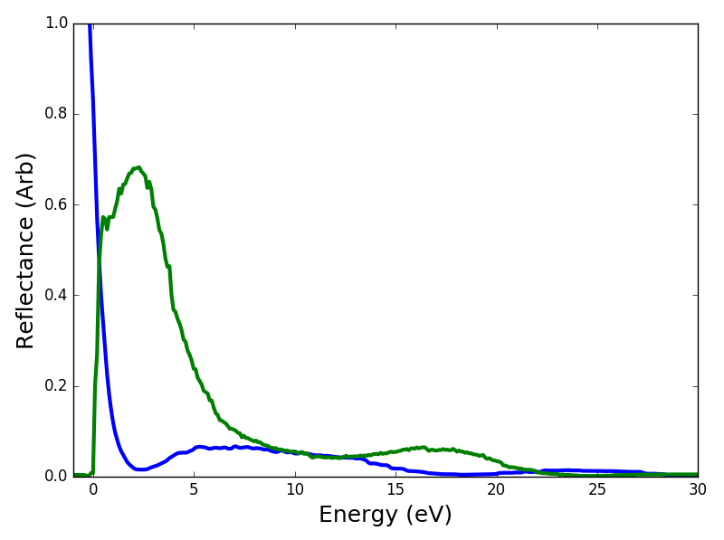
Spectroscopy
Reflection
Double layer
Transmission

Slide 15
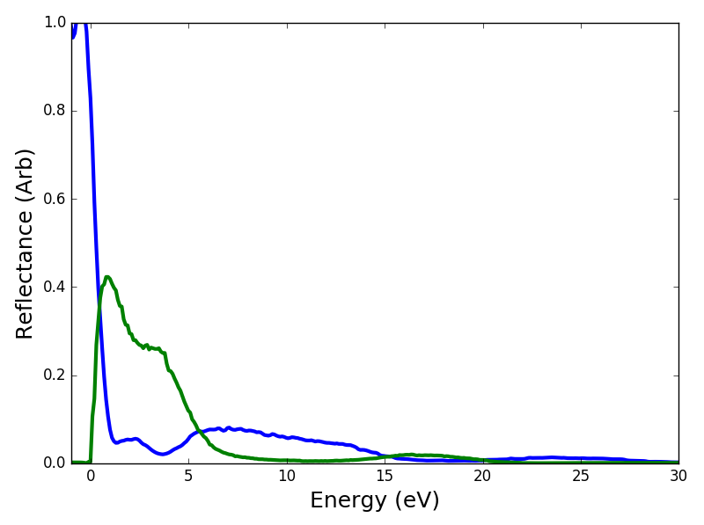
Spectroscopy
Reflection
Triple layer
Transmission

Slide 16
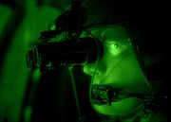
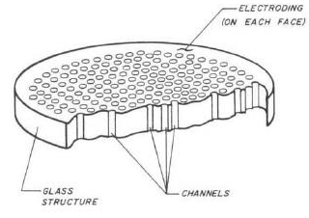
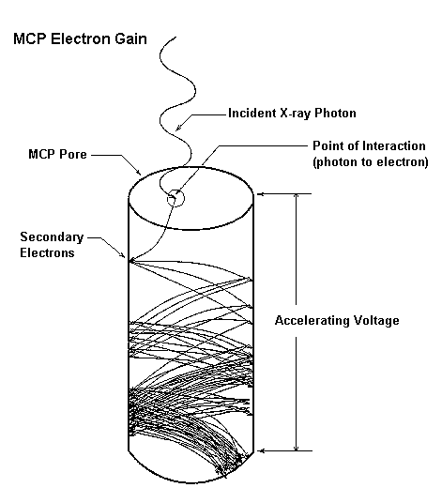
Detection. At present: MCPs
Phosphor screen
CCD-camera
d=42 mm
J.L. Wiza, Nucl. Instr. Meth (1979)
Notes:
16
Medipix: CERN: elementaire dltjes: snelle camera. Onafhankelijk tellen en verwerken per Pixel. MHz telsnelheid.
Leiden in consortium Medipix3 via Abrahams => toegang tot technologie

Slide 17
Disadvantages MCPs
Significant noise (dark current, readout CCD)
Limited dynamic range (by dark counts)
Effective spatial resolution > 140 μm*
Limited life time
* T. Koshikawa (unpubl.)

Slide 18
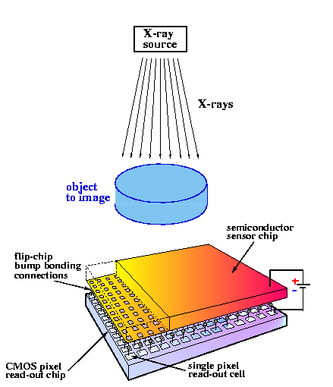
Medipix 2: hybrid pixel detector
Consortium: CERN, NIKHEF, Prague, Leiden (TEM), …
e⁻
Each pixel (55 μm): signal processing and counting
Count rate > 100 kHz per pixel
Notes:
18
Medipix: CERN: elementaire dltjes: snelle camera. Onafhankelijk tellen en verwerken per Pixel. MHz telsnelheid.
Leiden in consortium Medipix3 via Abrahams => toegang tot technologie

Slide 19
Hybrid pixel detector
Fully depleted
Reverse bias V
Each pixel has its own electronics

Slide 20
Properties Medipix
Thresholds (low, high) for each pixel ⇒
-Background-free detection
-Large dynamic range
Better detector resolution (by 140/55 x)
Aging negligible at LEEM energies
Continuous improvement (→ Medipix 3, consortium)
USB 1.0 read-out
But, electronic board: not UHV compatible

Slide 21
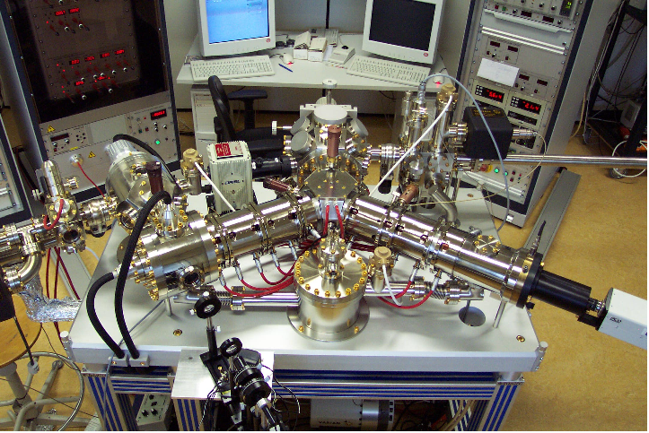
But where to test? Go east!
Elmitec LEEM in Twente (Van Gastel, Poelsema)

Slide 22

Putting Medipix in UHV
USB 1.0
Ruud van Egmond, Emiel Wiegers, Ewie de Kuyper

Slide 23
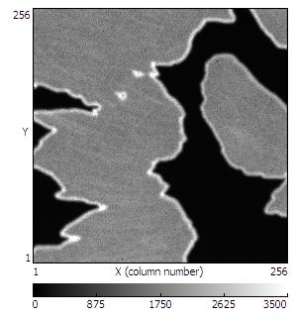
PEEM: Graphene on Ir(111)
Φ(C) < hν < Φ(Ir)
Medipix,100 s
FoV: 15.5 micron
MCP, 5 s, Field of View (FoV): 50 micron

Slide 24
Comparison LEEM images
Field of View: 3.1 micron
Resolution 2 x better

Slide 25
Correcting for each pixel
Take image of ‘ homogeneous’ area
Correct pixel settings so image has one intensity
Apply these settings to PEEM images taken
Before After correction

Slide 26
Correcting LEEM images
Before After correction

Slide 27
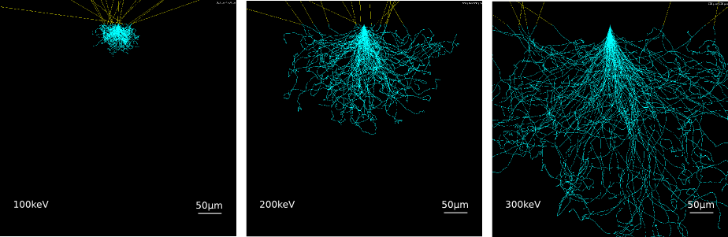
Cloud vs. incoming electron energy
Higher energy => higher signal
Let us tune lower threshold

