Slide 1

Experimental Higgs
Quantum Observables in ATLAS
Performing a Bell test in Higgs to WW decays
ATLAS Nikhef brainstorm in May 2023
Vince Croft, Karsten Burgard, Robin Hayes and Ivo van Vulpen
Triggered by a paper by Barr et al
‘Testing Bell inequalities in Higgs boson decays’

Slide 2
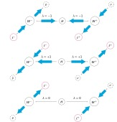
A Bell test in Higgs to WW decays
Barr argued: The Higgs decaying (S=0) into a pair of W bosons (S=1) is ideal for measuring spin if the W decays to a charged lepton and a neutrino. The lepton from the W is fully polarized.
A pair of bosons can form three states and are therefore called qutrits (see figure from Karsten Burgard).
To exploit the physics one has to reconstruct the lepton directions in the Higgs rest frame. Due to the spins the charged leptons are going in “similar” directions.

Slide 3
A Bell test in Higgs decays
Barr showed: by measuring the angular distribution of the two charged leptons in the Higgs rest frame, one can perform an angular analysis and a sensitive test of the Bell inequality, in this case the Collins-Gisin-Linden-Massar-Popescu (CGLMP) inequality.
The rest frame definition is a bit tricky: a) do we mean the rest frame of the Higgs or the W and W* rest frames? b) what is the precise orientation of the frame (next slide)? c) there is some freedom of choice of the orientation - like in the classical experiment - where the Bell or CGLMP theorem is maximally violated.
NB: In ATLAS all is measured, no need to rotate the detector (polarimeter)

Slide 4
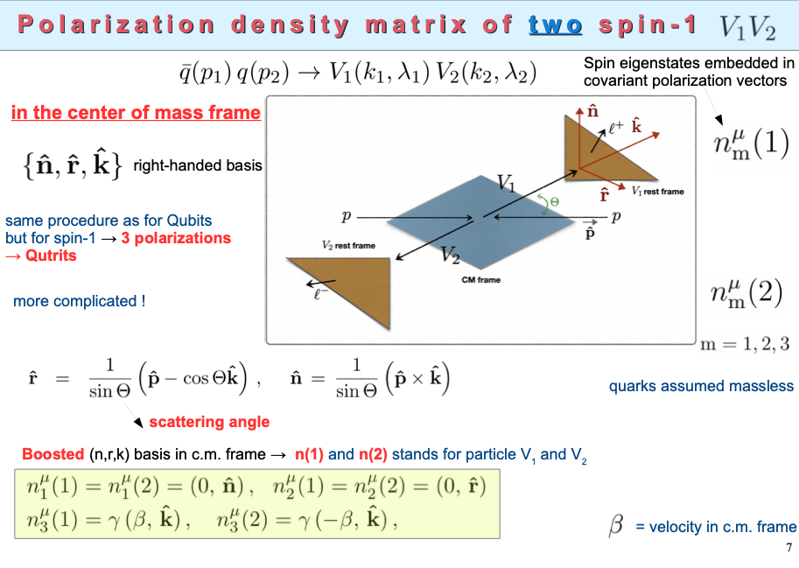
A Bell test in Higgs to WW decays
A definition of the rest frame
slide from E Gabrieli
arXiv: 2302.00683 [hep-ph];
EPJC 83 (2023) 2, 162, arXiv: 2208.11723 [hep-ph]

Slide 5

Can one reconstruct the Higgs rest frame in WW decays?
Rosemarie Aben wrote her thesis “Spinning the Higgs” (2015) exactly about this topic. And the answer is yes we can do that pretty well.
In ATLAS it was thought of little interest to reconstruct the Higgs rest frame. Contrary we were of the opinion that the rest frame variables are the key to Higgs physics, e.g. to determine the spin and parity of Higgs.
For a Bell test it is required to measure the lepton angles in the Higgs rest frame.

Slide 6
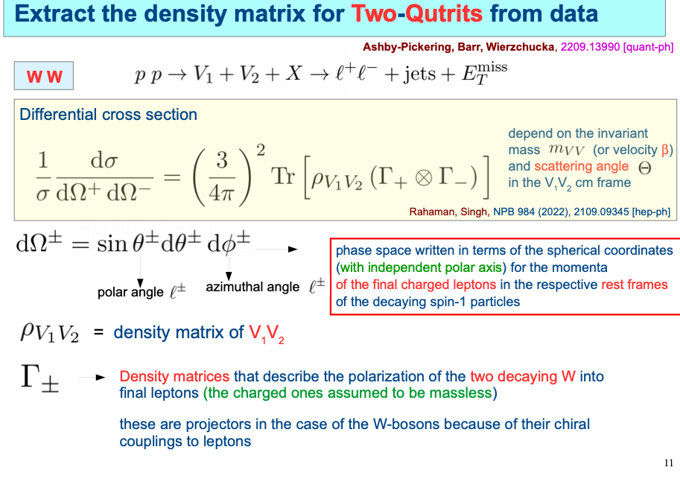
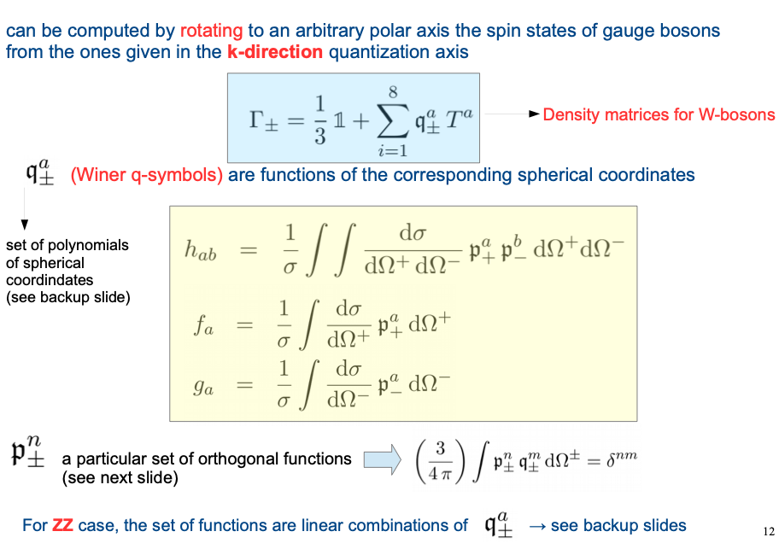
A Bell test in Higgs to WW decays
What is the expression for the differential cross section?
from E Gabrieli

Slide 7
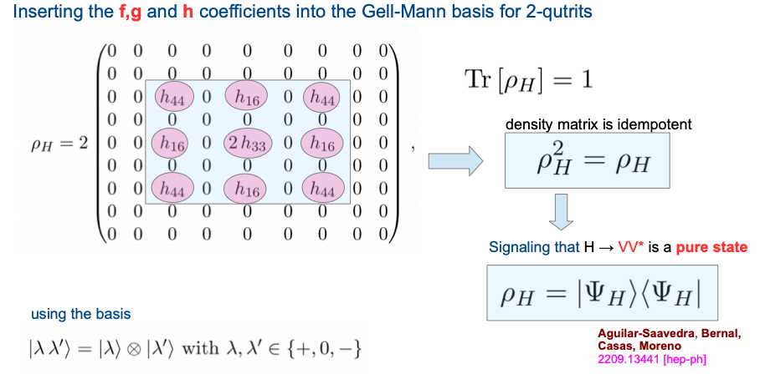
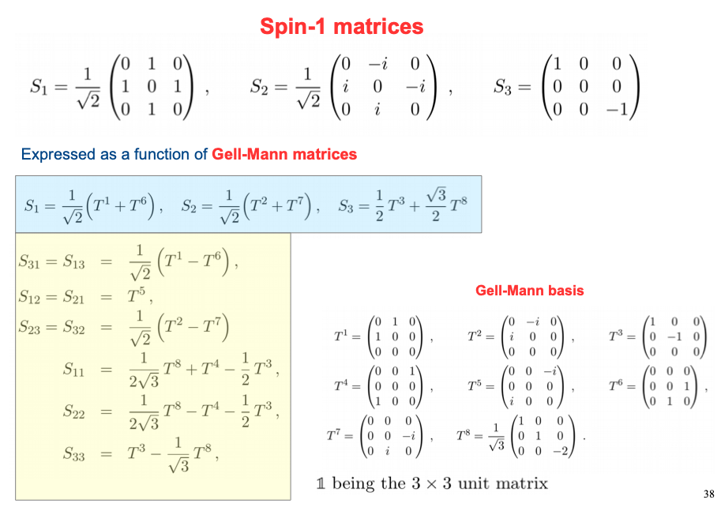
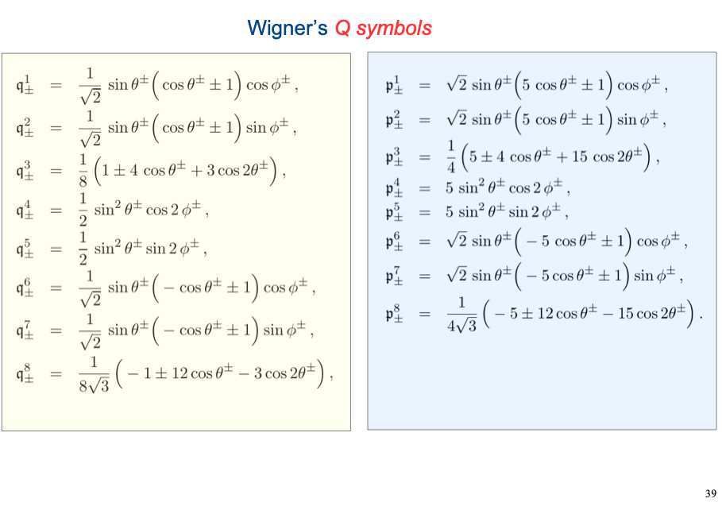
A Bell test in Higgs to WW decays
from E Gabrieli

Slide 8
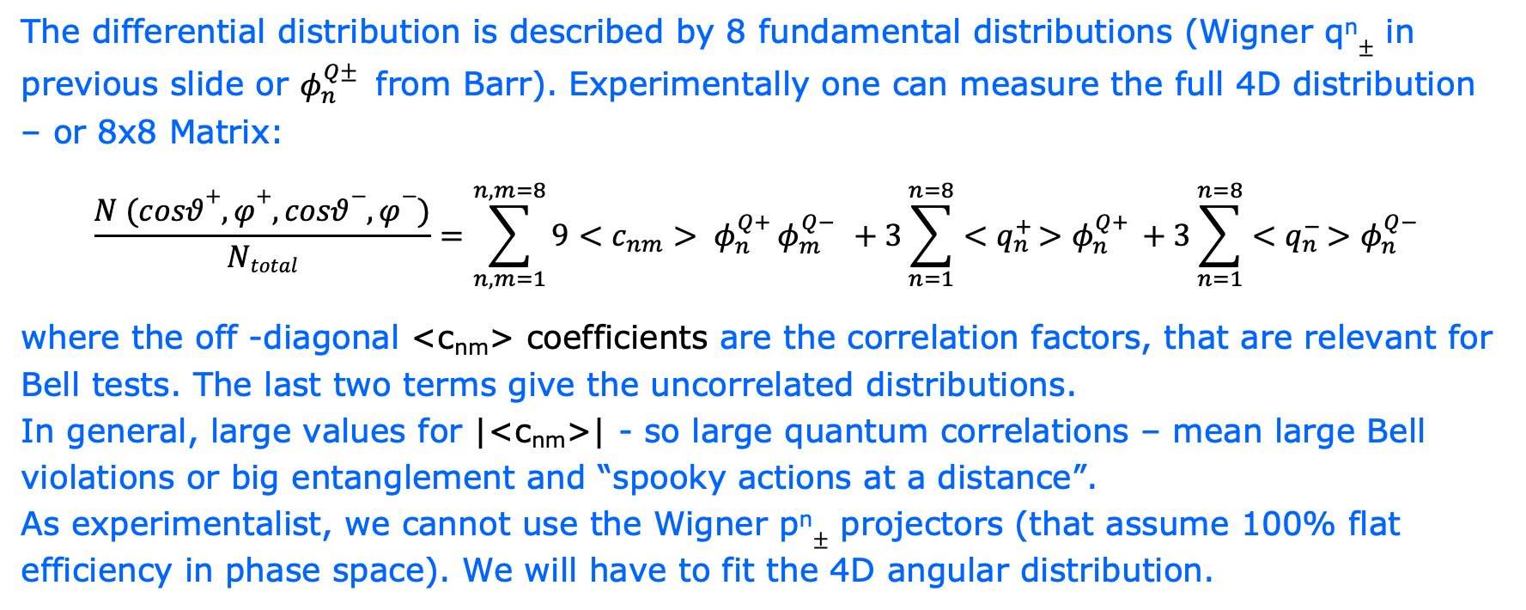
An experimental point of view
The differential distribution is described by 8 fundamental distributions (Wigner q^{n}$±$ in previous slide or $φ_{n}^{Q± }$ from Barr). Experimentally one can measure the full 4D distribution – or 8x8 Matrix:
$$\frac{N (cosθ+,φ+,cosθ−,φ−)}{Ntotal}=\sum_{n,m=1}^{n,m=8}{{{9<c}_{nm}^{ }> φ}_{n}^{Q+}}φ_{m}^{Q− }+3\sum_{n=1}^{n=8}{{<q}_{n}^{+ }{>φ}_{n}^{Q+ }}+3\sum_{n=1}^{n=8}{{<q}_{n}^{− }{>φ}_{n}^{Q− }}$$
where the off -diagonal <c_{nm}> coefficients are the correlation factors, that are relevant for Bell tests. The last two terms give the uncorrelated distributions.
In general, large values for |<c_{nm}>| - so large quantum correlations – mean large Bell violations or big entanglement and “spooky actions at a distance”.
As experimentalist, we cannot use the Wigner p^{n}$±$ projectors (that assume 100% flat efficiency in phase space). We will have to fit the 4D angular distribution.

Slide 9
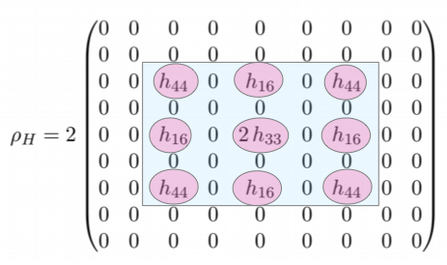
An experimental point of view
Recent review paper by Barr and Gabrieli al
Zoom slide 7 by Gabrieli
Ehh is there something I missed?
Shouldn’t this be the same? It looks pretty different
Left plot is similar to the expression on the previous slide …

Slide 10
Reconstructing the Higgs rest frame
What is measured by ATLAS in H->WW* ->μ ν e ν ?
The momentum vector of the two charged leptons (in ATLAS electron and muon). And the missing transverse momentum.
In the xy frame the momentum of the Higgs is known.
We don’t know the z momentum component (along beam) of the neutrino’s. The trick is to apply a Higgs mass constraint (125 GeV) and solve the z momentum component of the neutrino’s.
There are some details like the imposed M_{vv} mass and the choice of the solution as explained in the thesis chapter 5 and summarized on the next slide

Slide 11
Reconstructing the Higgs rest frame
Summary from
Karsten Burgard

Slide 12
Reconstructing the Higgs rest frame
What is measured and reconstructed in the experiment?
The momentum vector of the Higgs and the momenta of electron, muon and the vv system are measured.
Because the Higgs momentum vector is know, one can go to the rest frame of the Higgs, and Lorentz boost the electron and muon. This gives the angles and momenta in the rest frame.
That is in principle enough for the proposed Bell measurements.
NB we can use any well-defined frame of axes.
r,n along ATLAS x,y axis

Slide 13
Reconstructing the Higgs rest frame
From the thesis opening angle in rest frame in
xy (φ) and 3D opening angle (ψ) vs truth
Pretty nice reconstruction of the di-lepton opening angles
Experimental resolutions are best in the xy frame (φ) compared to rz (θ)

Slide 14
Reconstructing the Higgs rest frame
From the thesis momenta of the leptons in rest frame in vs truth
Mind: different horizontal scale
Reflects off-shell ness of W*
Off the road: theorist propose a Bell test without angles but using the W* (Z*) mass. Can we define an observable like m_{W*}/m_{W} = min(p_{l0},p_{l1}) /max(p_{l0}, p_{l1})?

Slide 15
More Bell tests in Higgs to WW decays?
What about Higgs production modes?
The Higgs to WW Bell test only takes into account the decay part of the process. For gluon-gluon we cannot measure the initial state.
Higgs production in the Vector Boson process?
Here one measures the jets and one can imagine
a Bell test by correlating the jet directions and leptons …
What is a suitable reference (rest) frame here?
What are important Bell observables?
Off the road

Slide 16
Perspective of a Bell test in Higgs to WW decays
The idea of performing a Bell test in the Higgs to WW decays, reconstructing the angles in the Higgs rest frame looks both challenging, interesting and feasible to me.
Need to works out better the mathematical framework to apply to the ATLAS data (reference frame, the 8 Wigner/Gell-Mann Matrix, and Bell sensitive variables).
Experimentally, quite a lot of work to do – but e.g. a H to WW event selection is available. Backgrounds need to be studied in the 4D differential cross section (cosθ⁺,φ⁺,cosθ⁻,φ⁻⁾ in particular for the Bell sensitive observables (off-diagonal elements).

Slide 17
An experimental point of view
Recent review paper by Barr and Gabrieli al
arXiv.2302.00683 by Gabrieli
Coefficients look the same f3, f8, h16 etc.

Slide 18
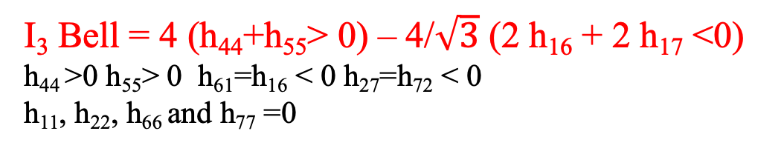
An experimental point of view
Recent review paper by Barr and Gabrieli al
I₃ Bell = 4 (h₄₄+h₅₅> 0) – 4/$\sqrt{3}$ (2 h₁₆ + 2 h₁₇ <0)
h₄₄ >0 h₅₅> 0 h₆₁=h₁₆ < 0 h₂₇=h₇₂ < 0
h₁₁, h₂₂, h₆₆ and h₇₇ =0

