Slide 1

ET: where to focus & where to accelerate?
Towards the optimal ET location in the Euregio site (Geology, …)
E-TEST consortium

Slide 2
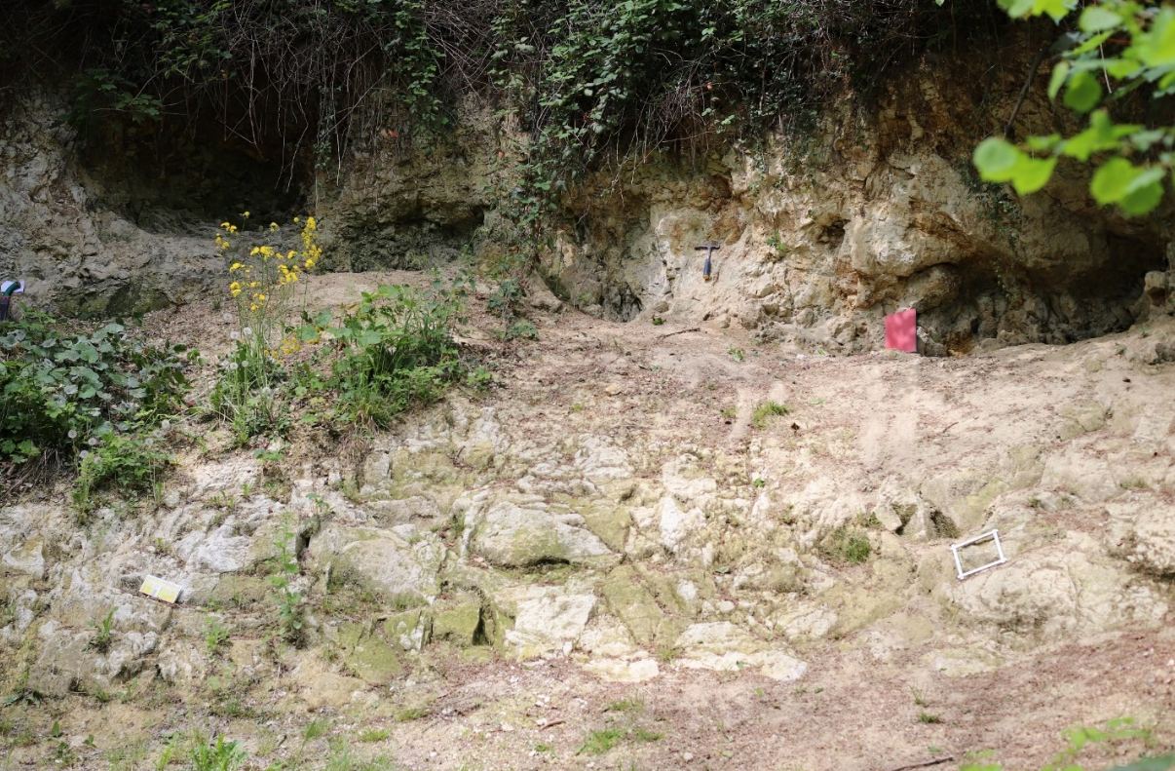
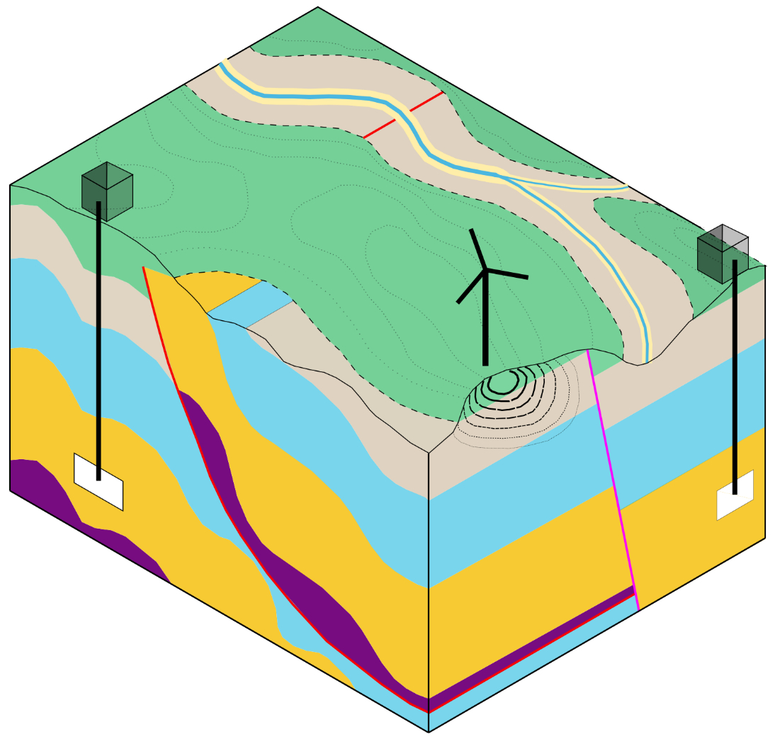
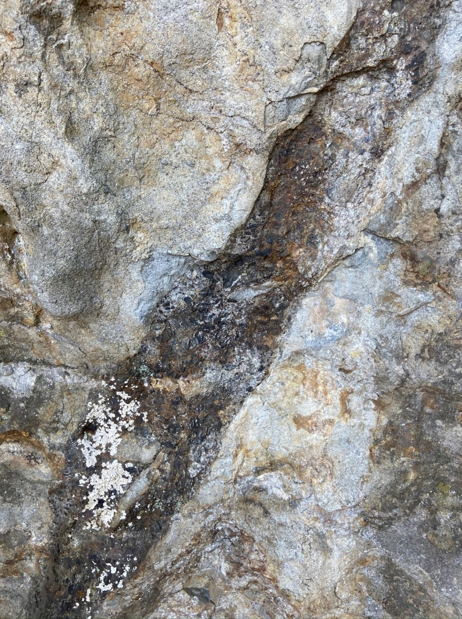
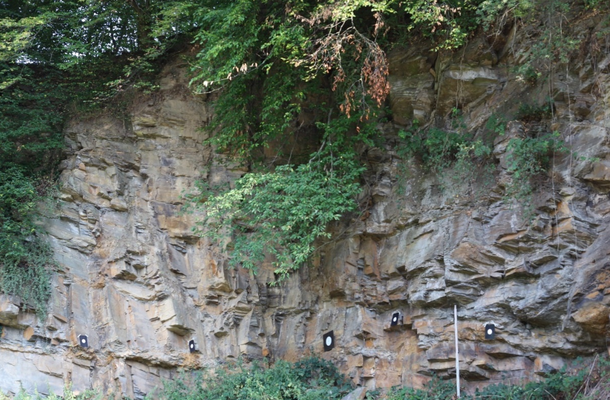
Key geological conditions
Soft rock to damp ambient noise
Surface access building
Fault zones / Karst
Hard rock to host ET subsurface cavern
ET subsurface cavern
Ambient noise in the subsurface

Slide 3
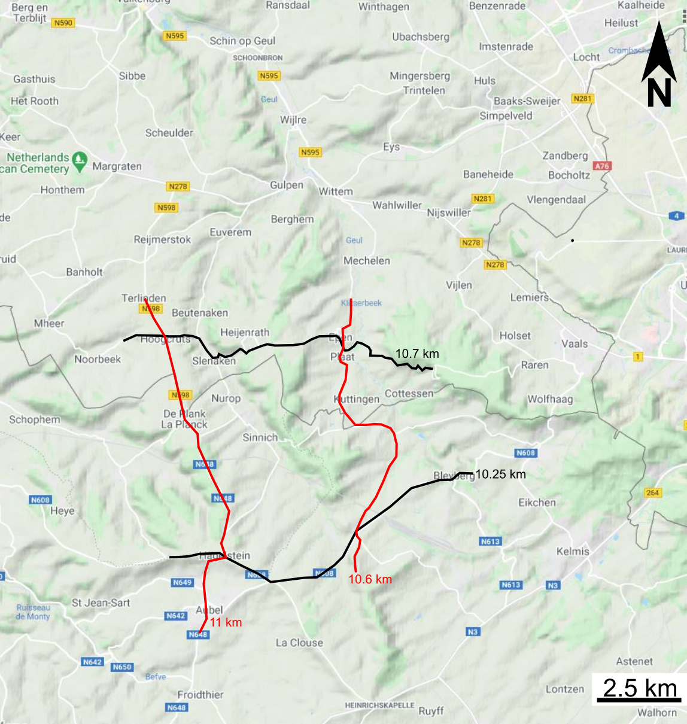
E-TEST will deliver for the GEO part
Cross-border database
  Existing boreholes
  New structural data
  New boreholes
  New geophysics
  New geomechanical tests
  New hydraulic tests
Underground models of the geology with different scopes:
  Engineering geology
  Groundwater
  Seismic noise
A limited set of new data
  5 drillings including an observatory (2) for :
    Geological exploration
    Seismic vibrations monitoring
    Hydrogeophysical tests
ET design in the EMR region
Informing local population
Foreseen drillings
Seismic lines

Slide 4
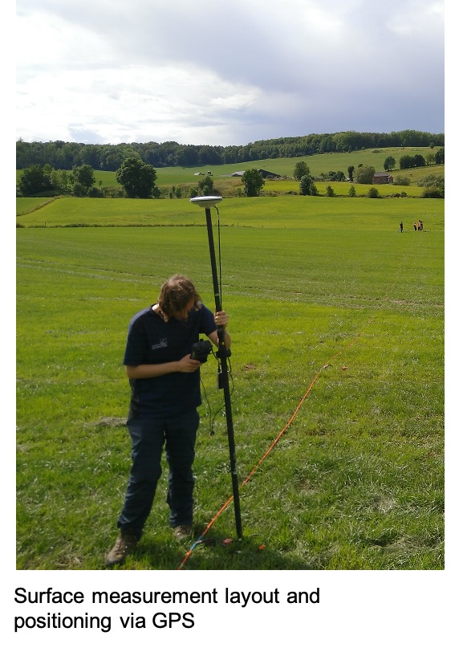

First results: ERT to delineate faults

Slide 5
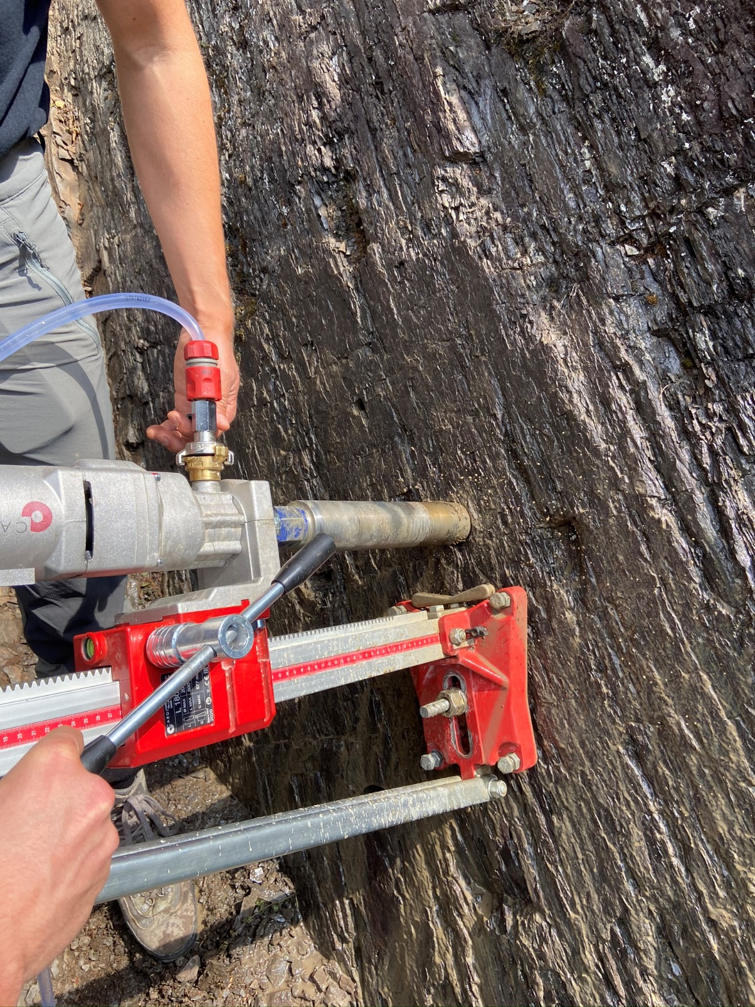
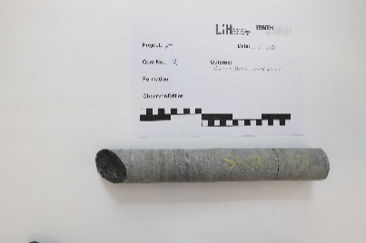
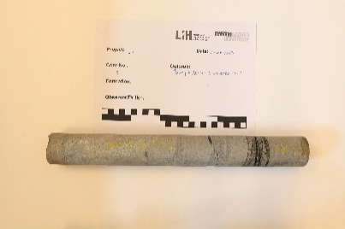
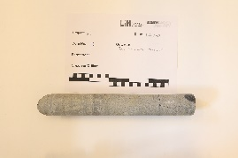
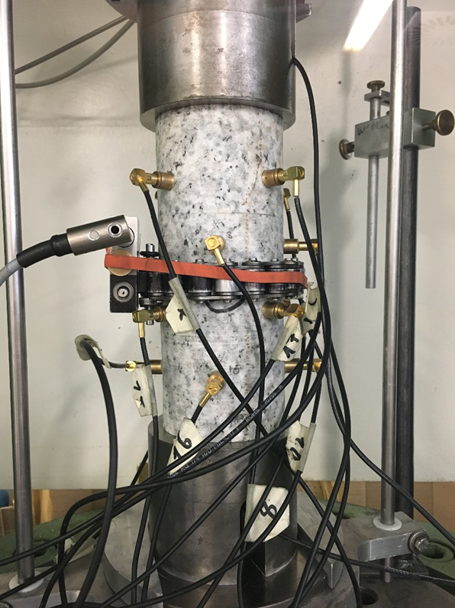
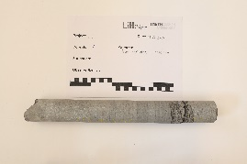
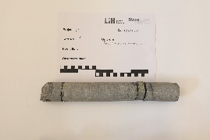
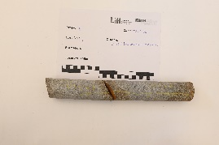
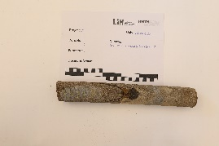
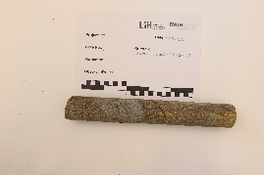
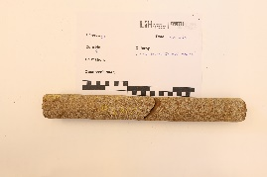
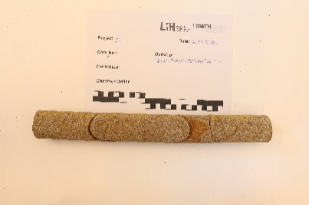
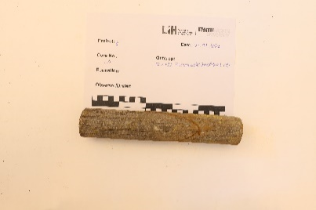
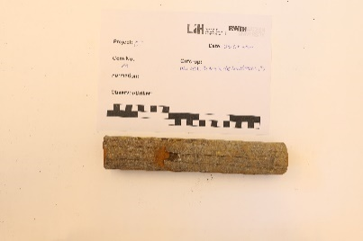
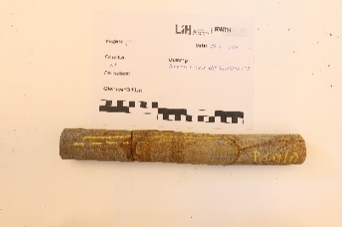
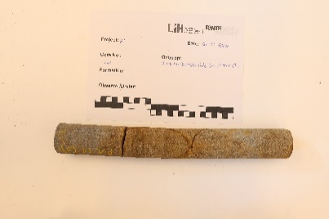
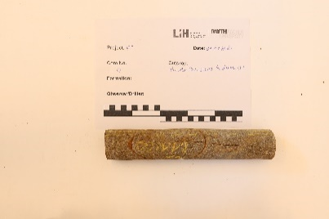
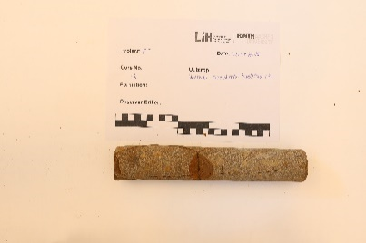
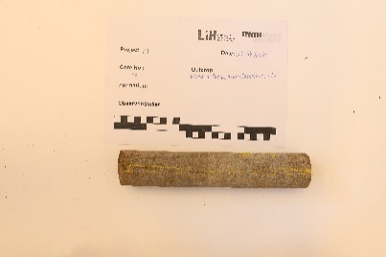
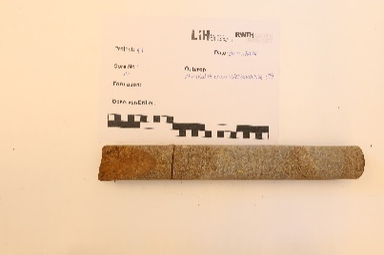
First results: collecting geomechanical tests
Collecting rock samples
at representative outcrops
Sampling of rock cores
Determination of
geomechanical parameters

Slide 6
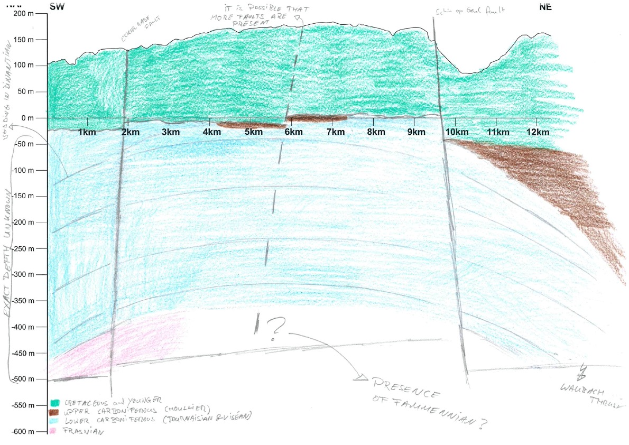
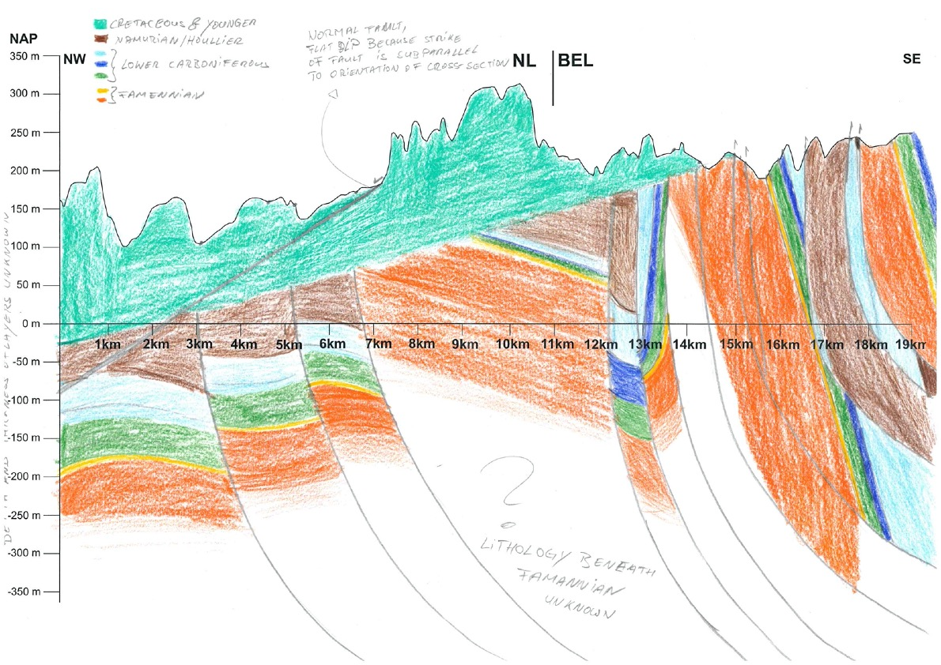
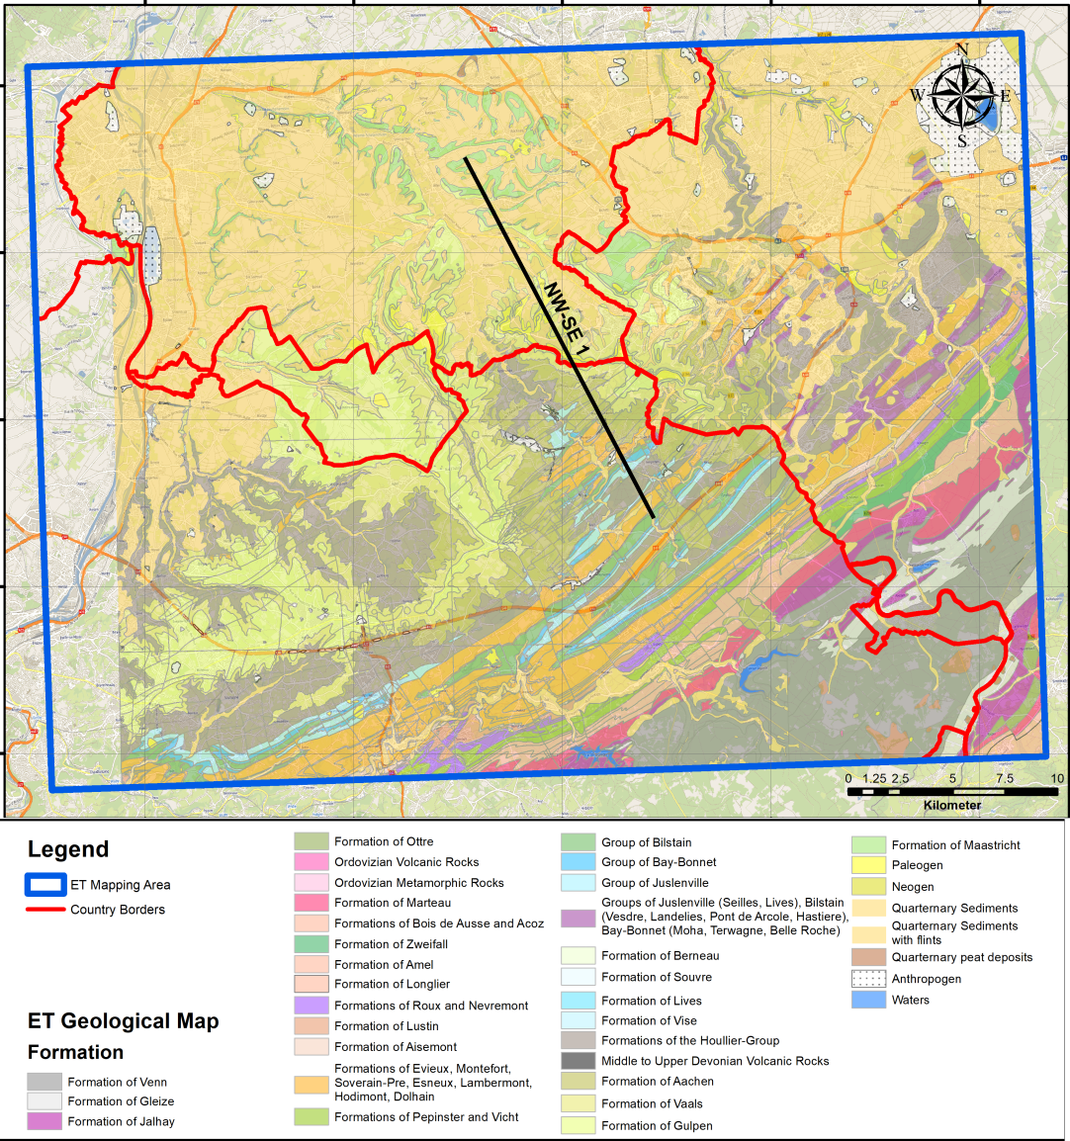
After E-TEST delivers, uncertainties will remain
1
2
1
2

Slide 7
Key issues towards the optimal location of ET in EMR
Our perimeter is relatively well defined (cf. GIS)
Lower the uncertainties on
  Corner points and access configuration
  Structural geology and faults properties
  Groundwater conditions
  Geomechanical properties
  Influence man-made structures/activities
Additional datasets (boreholes, geophysics) are welcome as well as expert advice, duplication of work not so much
We can make a case for it but who should we approach ?
Focus various companies which are willing to support our efforts
Anticipate legal/local issues
  Excavation fluxes
  Local politics and legal issues
  Population prepardness
Early contractor involvement
BE/NL/DE Information campaign

Slide 8
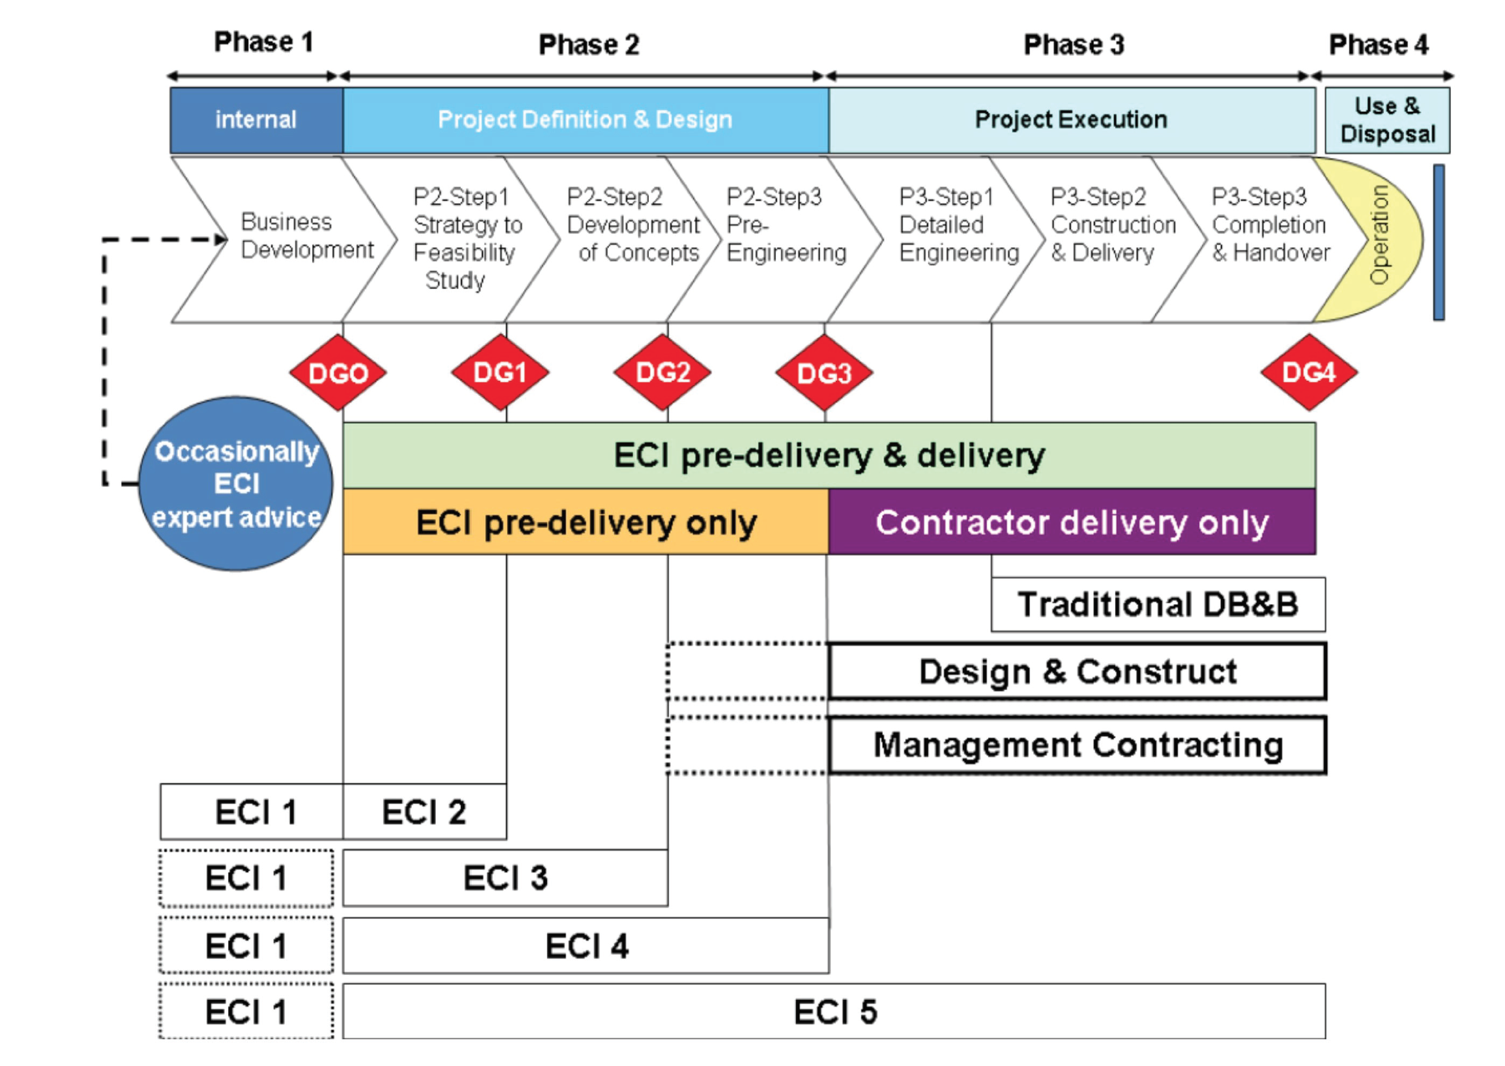
Early contractor involvment
Paulos Abebe Wondimu Doctoral theses at NTNU, 2019:36

Slide 9
Early contractor involvement benefits
The practice of “early contractor involvement” is about involvement of the contractor in design development to obtain a benefit of the contractor’s expertise as a builder.
Improved risk management (foreseen or unforeseent)
Environmental impact minimisation (dust, (ground)water use, noise, vibrations…)
Better ressources planning
Greatest influence on costs (10% to 30% cost savings)

Slide 10
Thanks

