Slide 1
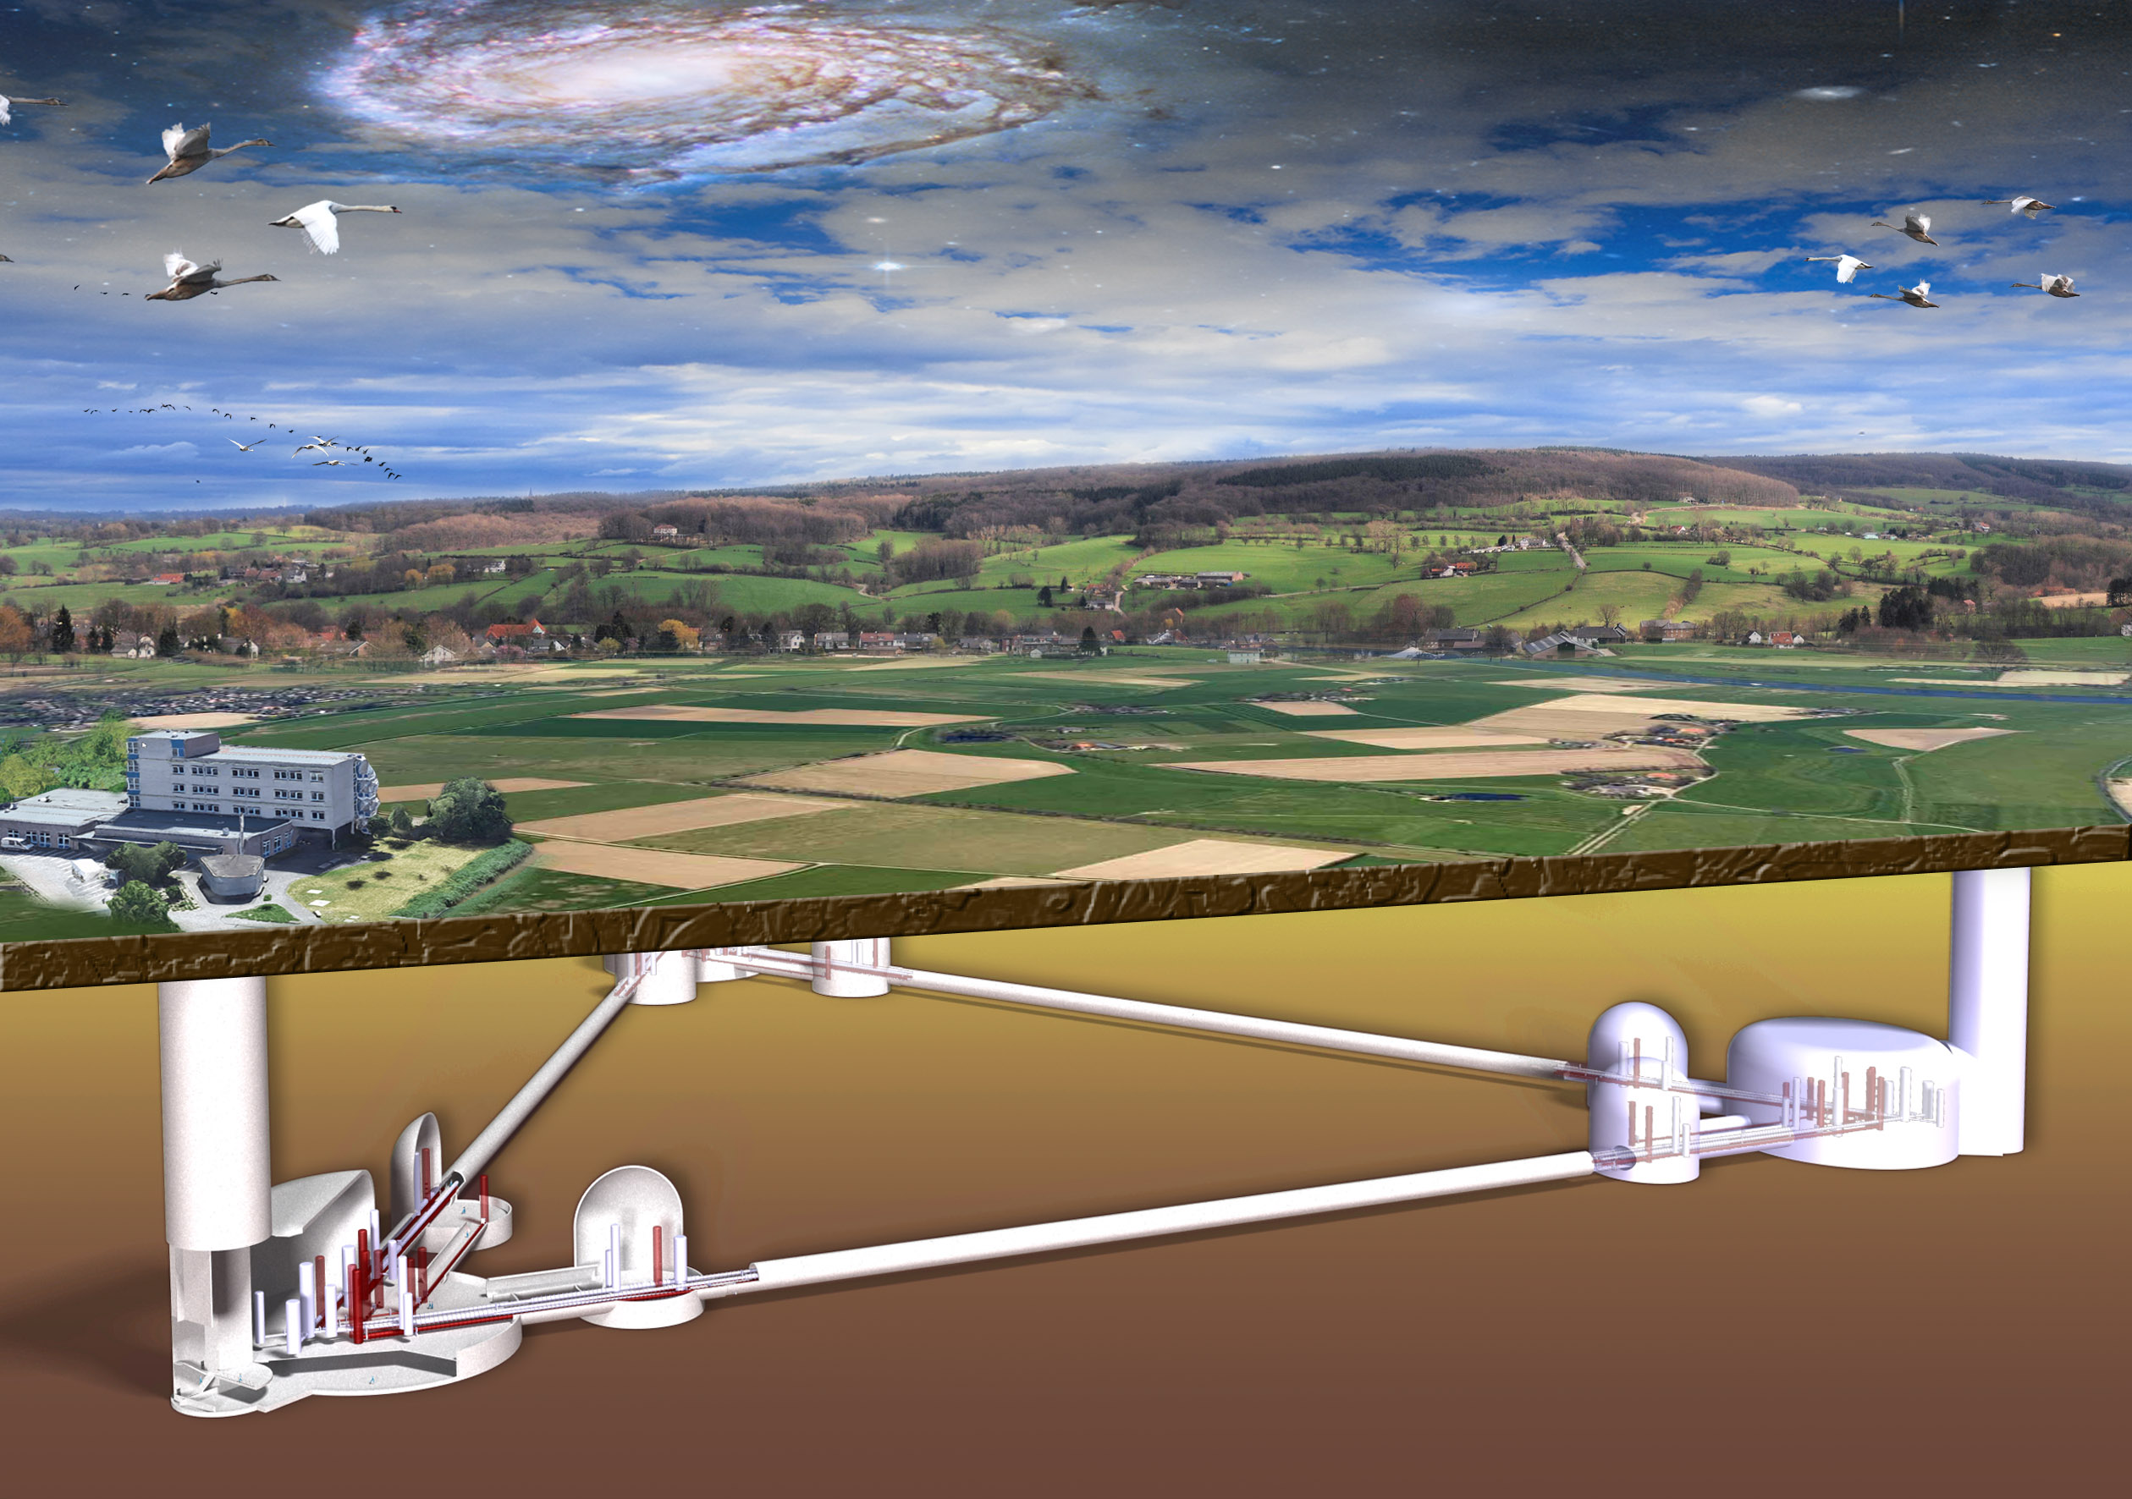
Einstein Telescope
There are substantial challenges ahead.
There are interesting new approaches in the making (Artificial Intelligence, Quantum Computing).
There are significant funding opportunities.
Challenges
Operation
Multimessenger-Trigger
Data Analysis
Computing

Slide 2
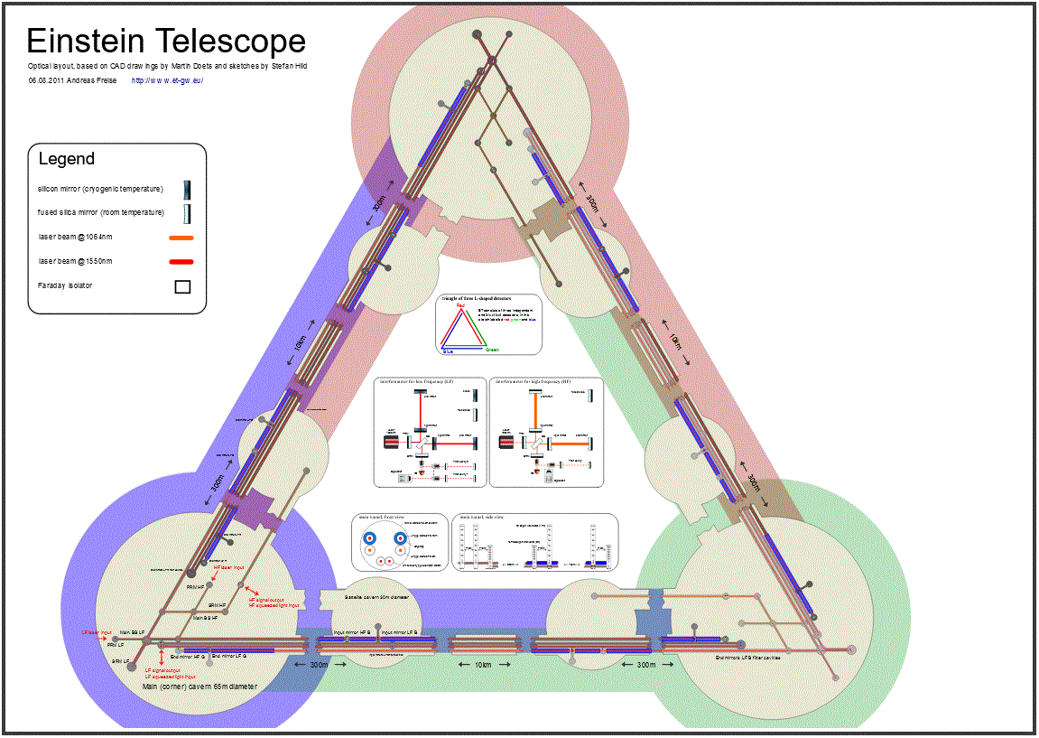
Operation
Interferometer Control
More complex than any instrument before!

Slide 3
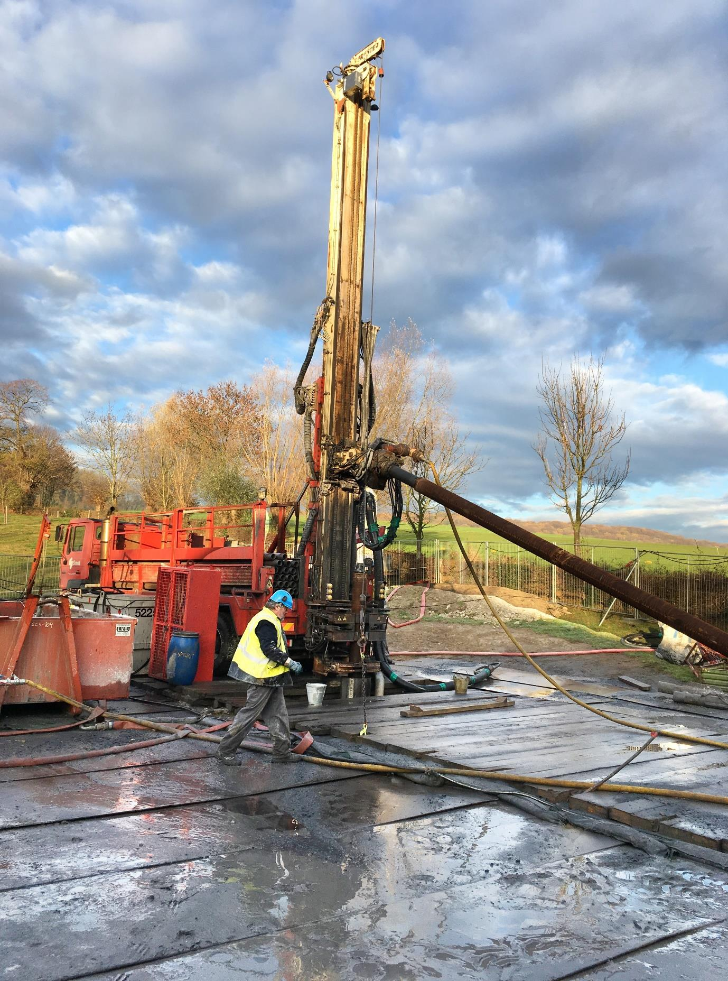
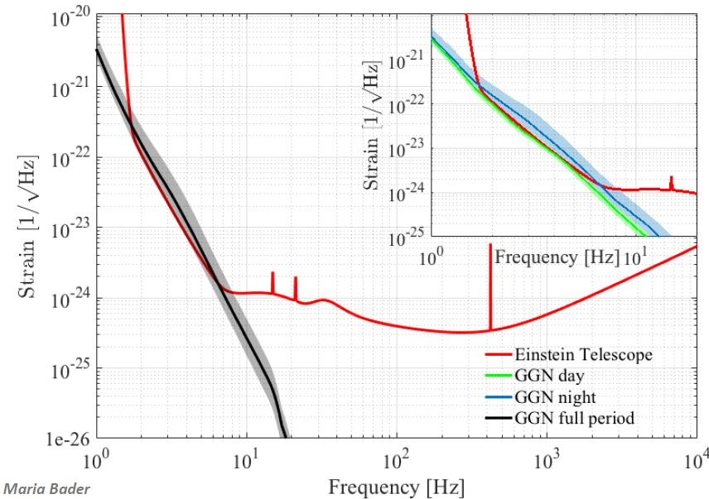
Seismic Noise
Measurements show appropriate conditions in the Euregio

Slide 4
Newtonian Noise
Newtonian Noise Correction
Seismometer arrays detect seismic waves.
Reconstruct waves → correct signals.
In real time?
Newtonian Noise: factor 2 above target.

Slide 5
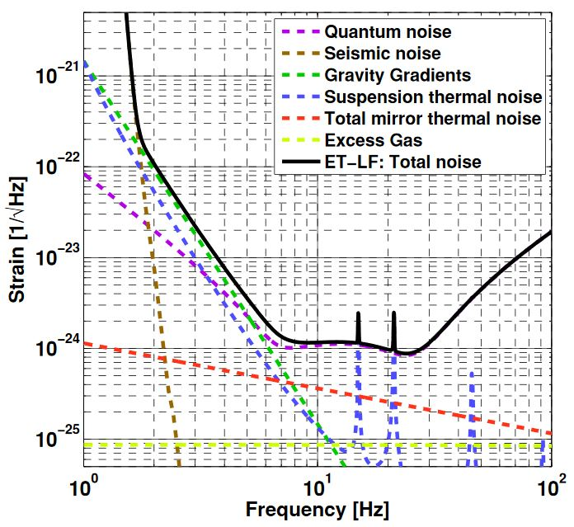
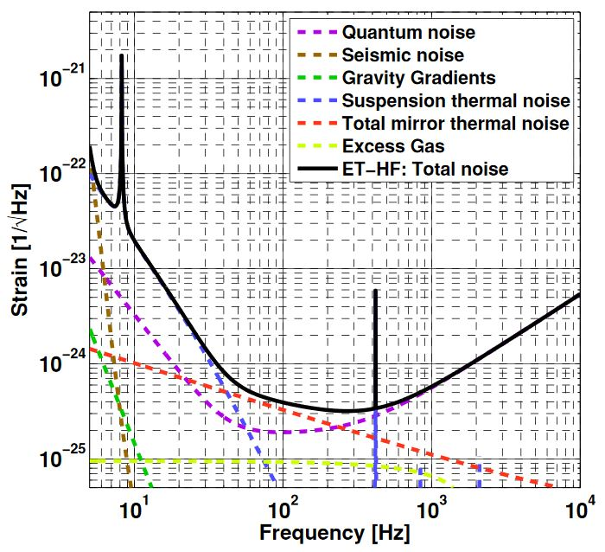
Total Noise
Interferometer Control
Extract a quantitative noise level from the control system?
Frequency dependent ?
In real time for the MM-trigger?
Current control systems: okay / veto

Slide 6
MM-Triggers
GW170817
Collision
ET
LIGO
X-Ray
Optical
Multi-
Messenger
MM-Trigger
handle 6 interferometers instead of 1
search for a larger variety of sources
determine the source direction
identify potential candidates for follow-up (too many signals to follow up on all)
10 days 1 day 3 hours 15 min. 100 sec. 10 sec. 0 10 sec. 100 sec. 15 min. 3 hours 1 day
Fast and efficient triggering enables multimessenger observations!

Slide 7
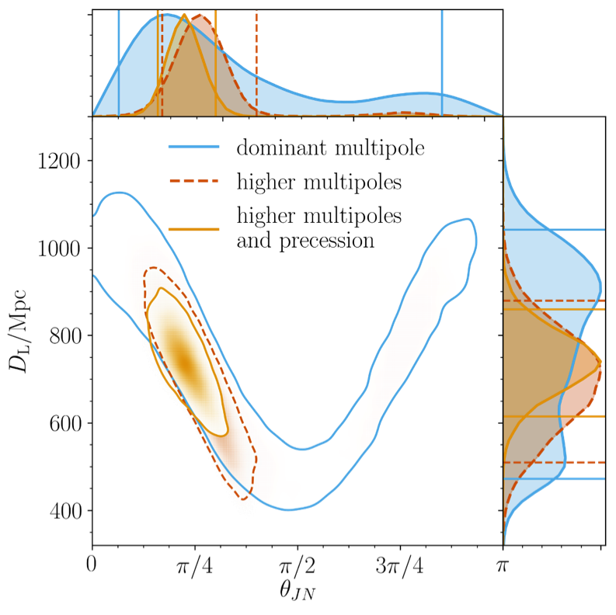
Data Analysis
LIGO/VIRGO: parameter extraction through template fit.
➔ catalogue of templates
Einstein-Telescope
Large variety of sources
More parameters
More events
Much longer duration
More precise estimates
Need new methods!

Slide 8
Einstein Telescope
Summary
New computing methods are needed at least for:
Operation
Multimessenger-Trigger
Data Analysis
Thanks

