Slide 1
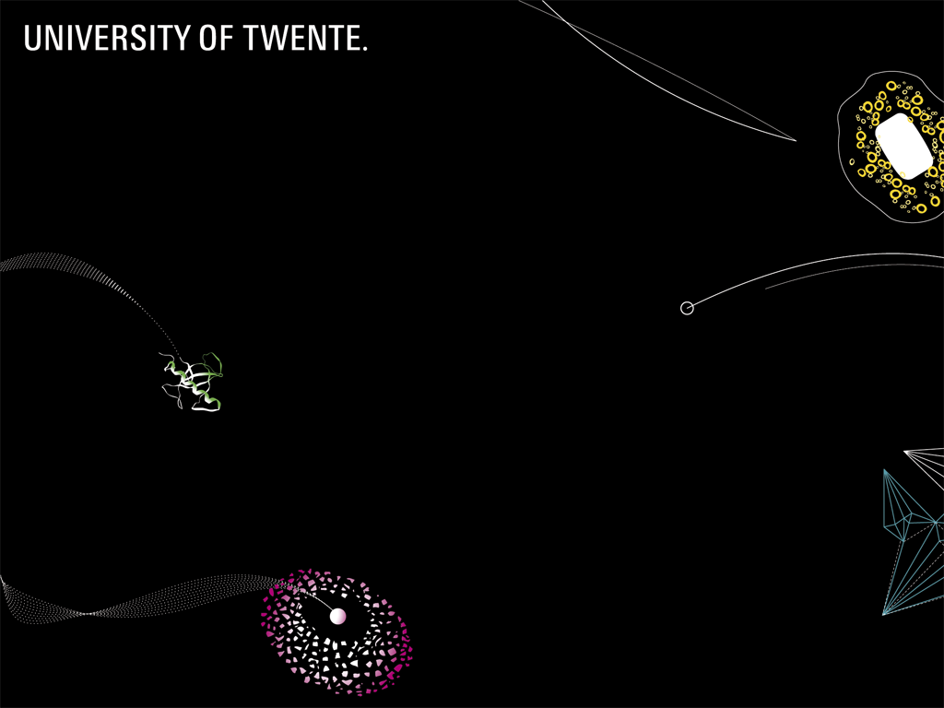
Vibration-free cryogenic cooling of ET(PF)
Marcel ter Brake et al.
Webinar Technical Challenges ET 15 July 2020

Slide 2
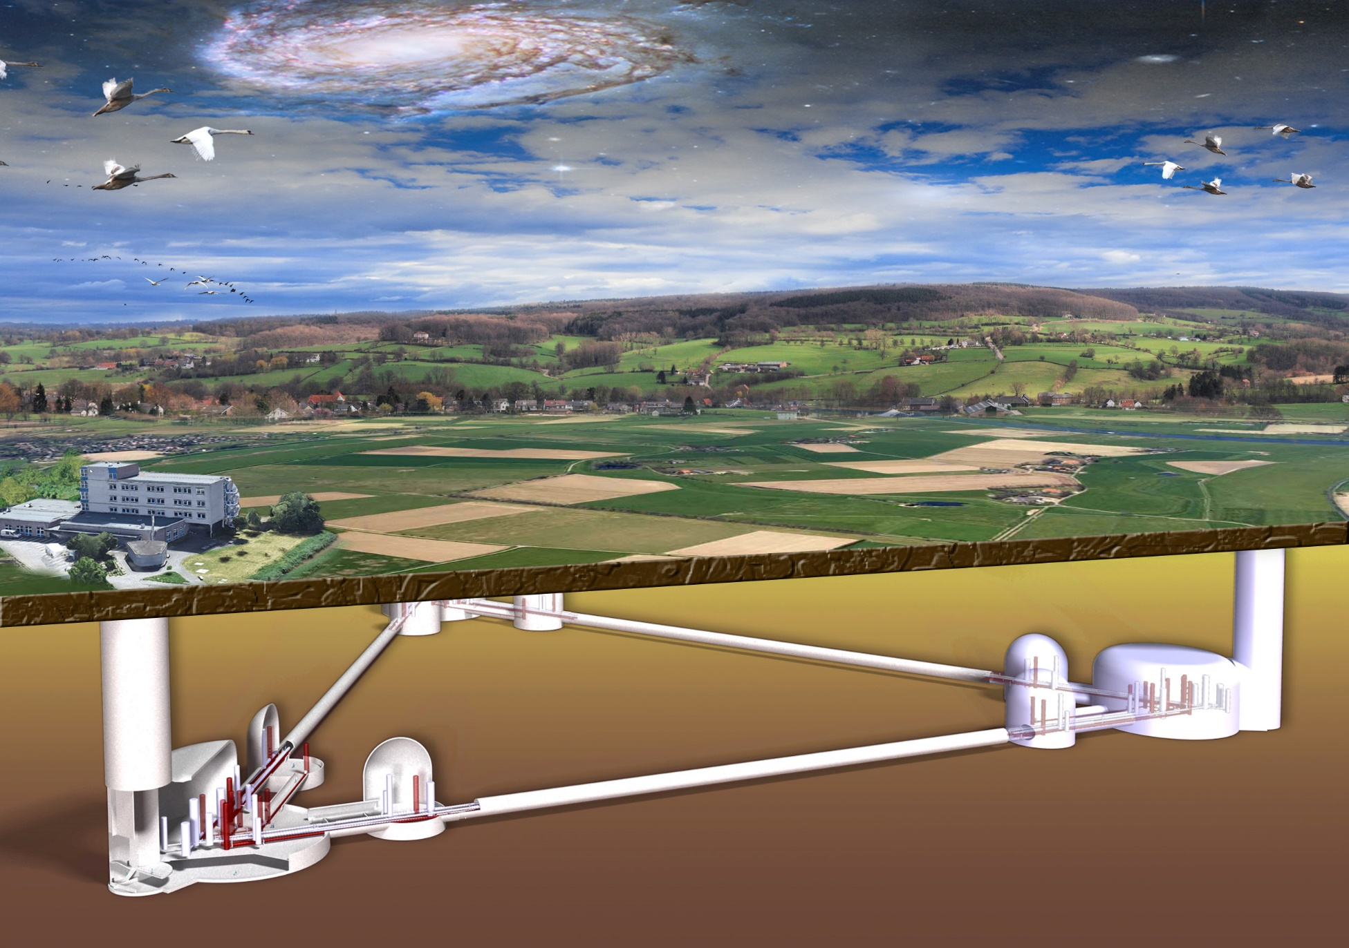
Einstein Telescope, next generation GW detector
Detector with higher sensitivity and starting at lower frequencies
- underground to reduce seismic noise
- longer arms (higher sensitivity) and more power in cavities (lower quantum noise)
- Cryogenic mirrors (lower thermal noise)
- 3 interferometers (measure all GW-polarizations)

Slide 3
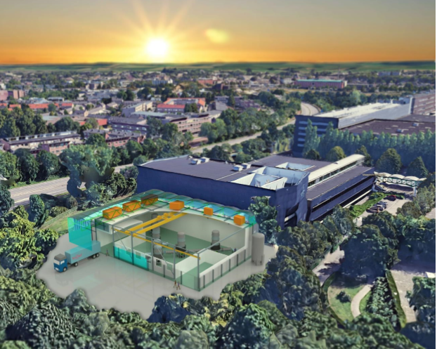
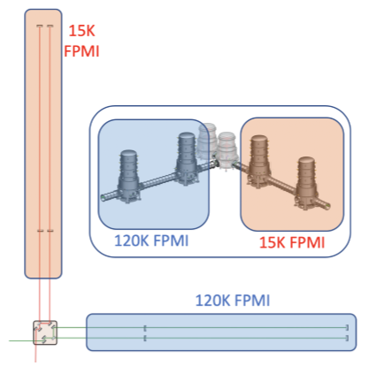
ET- Pathfinder (Maastricht)
at ca. 20 K: limited by mirror coating thermal noise
at 123K: α_{Si} = 0
Pictures: Design Report for ETpathfinder

Slide 4
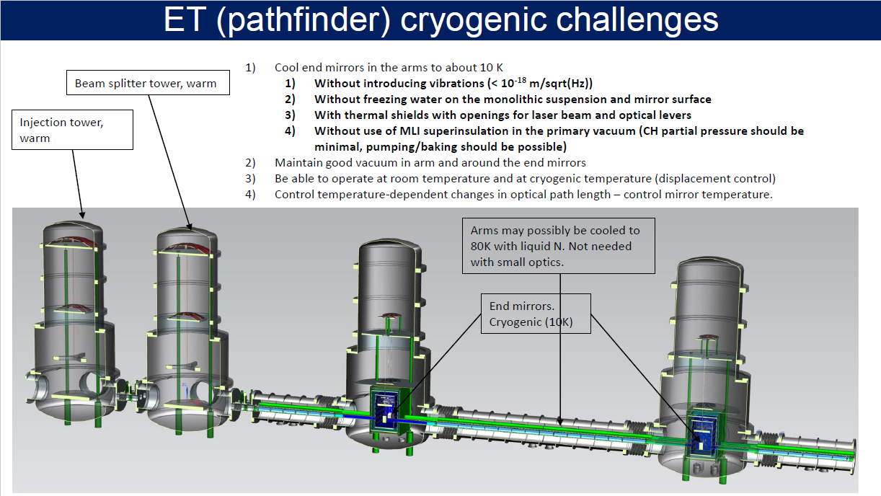
Slide of H.J. Bulten (Nikhef)
This is where the trouble is

Slide 5
300 K
ca. 100 K
ca. 30 K
Pictures of Nikhef

Slide 6
cold finger 10 K; 50 mW (TBD)
ca. 1m
mirror
15 K; 10 mW (TBD
300 K
ca. 100 K
(ca 420 W) → LN₂
ca. 30 K
LN₂ reservoir: 6 l/h
cold finger:
ca. 10 K
Pictures of Nikhef

Slide 7
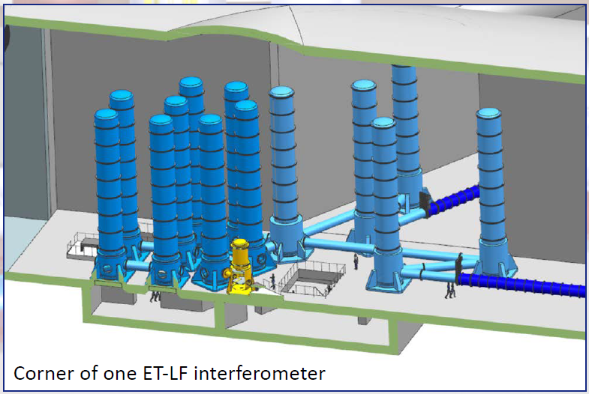
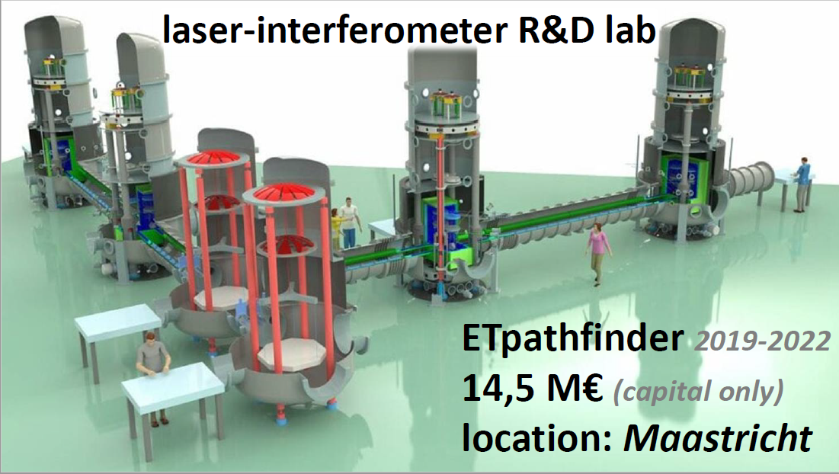
ETPF versus ET
ETPF: mirror ∅ 15 cm; 1,4 kJ/K
ET: mirror ∅ 45 cm; 95 kJ/K
one order of magnitude more cooling power needed in ET
(cool-down time will be one order of magnitude longer)

Slide 8
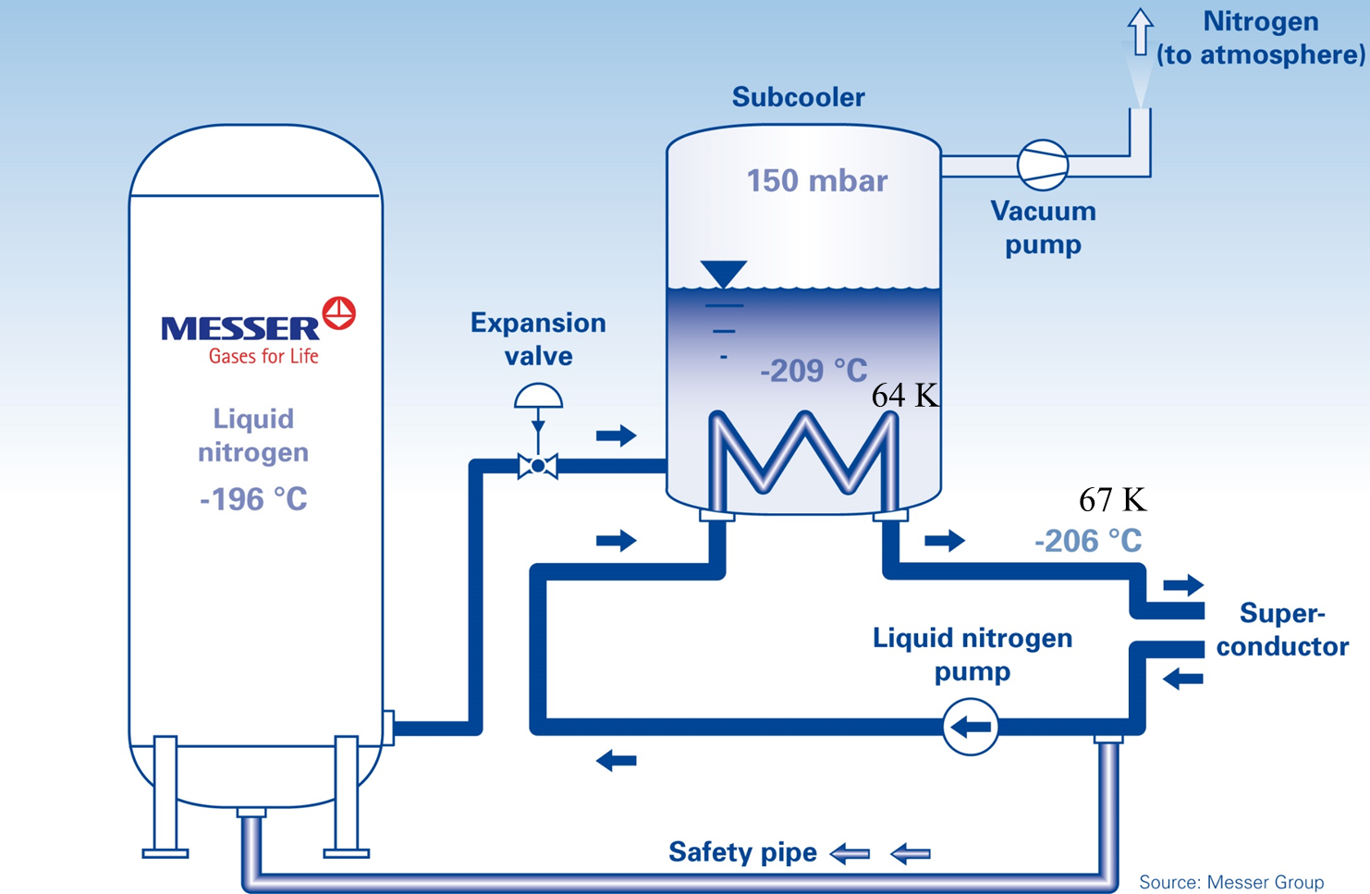
LN2 cooling: subcooled: minimum vibrations
Option1:
low-pressure LN2 bath
64K: 0,15 bar
FPMI (120K and 15 K)
required flow rates
1 tower: ca 1 l/min
1 arm: ca 2 l/min
both arms: ca 4 l/min

Slide 9
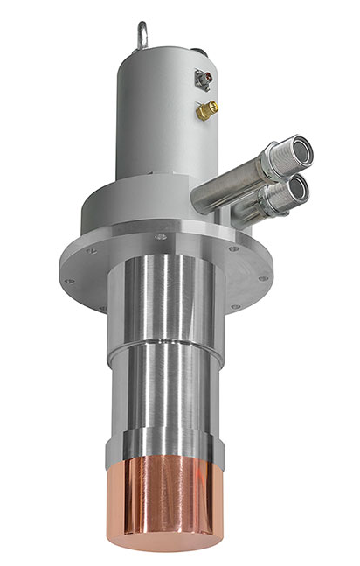
LN2 cooling: subcooled: minimum vibrations
Option2:
Cryocooler-cooled LN2 loop
(sub-cooled)
FPMI (120K and 15 K)
required flow rates
1 tower: ca 1 l/min
1 arm: ca 2 l/min
both arms: ca 4 l/min

Slide 10
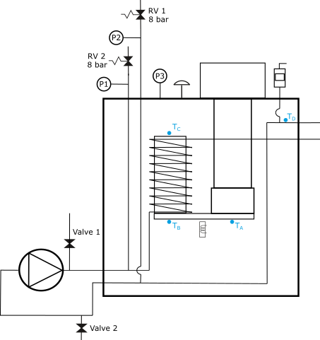
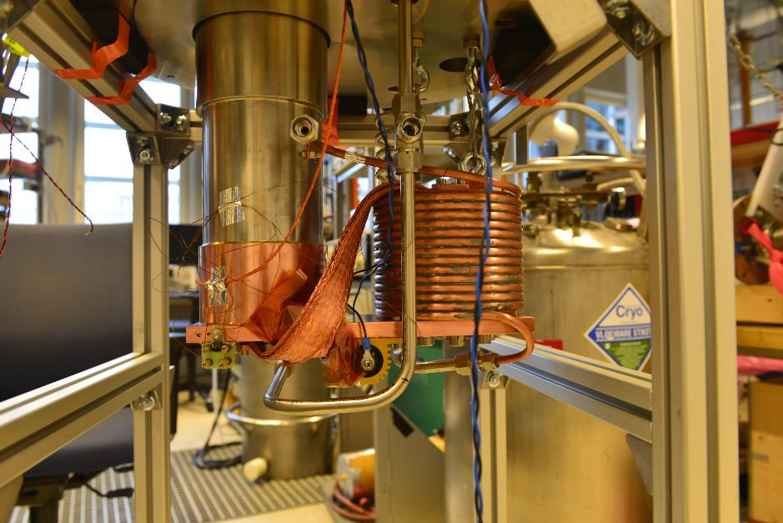
UT project for cooling superconducting coil (coop with Demaco)
AL600 Cryomech
500 W @ 70 K
(1 tower)
FPMI
T_{B}
T_{A}

Slide 11
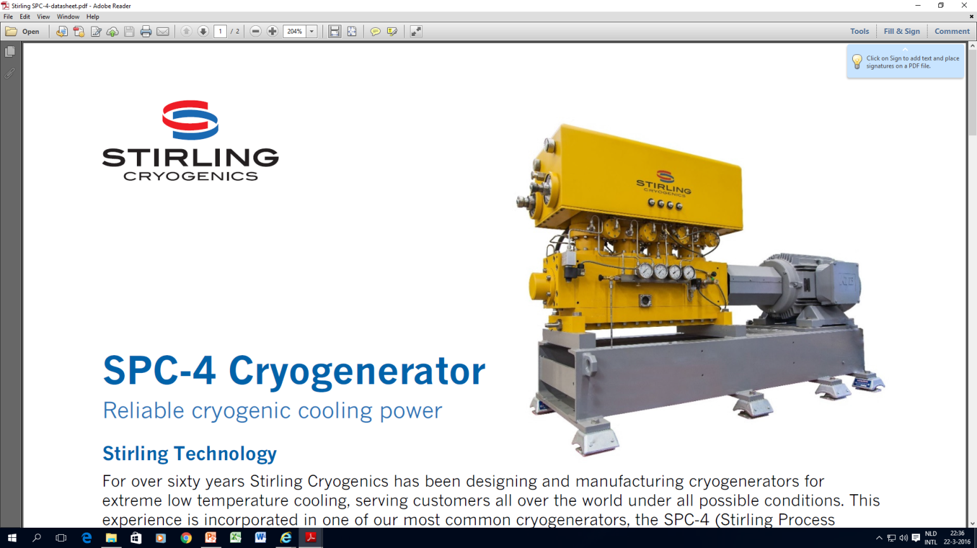
Two of many candidates for LN2 cooling of both arms
3⁺ kW @ 70 K
7⁺ kW @ 77 K

Slide 12
cold finger 10 K; 50 mW (TBD)
ca. 1m
mirror
15 K; 10 mW (TBD
300 K
ca. 100 K
(ca 420 W) → LN₂
ca. 30 K (ca 3W)
??
LN₂ reservoir: 6 l/h
cold finger:
ca. 10 K
(50 mW@10K)
Pictures of Nikhef

Slide 13
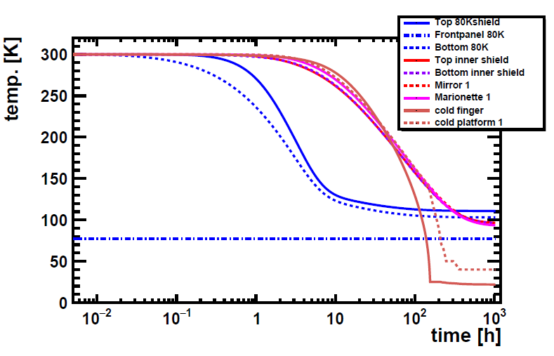
Inner radiation shield and mirror plus suspension cooled by radiation to about 100 K
Start with bottom of 80 K shield at 77K (simulation and figure: Nikhef)
takes ca 300 h: 12 days
(can be reduced by using additional coolers, e.g coolers for the 30K and 10 K stages)
Figure: Design Report for ETpathfinder

Slide 14
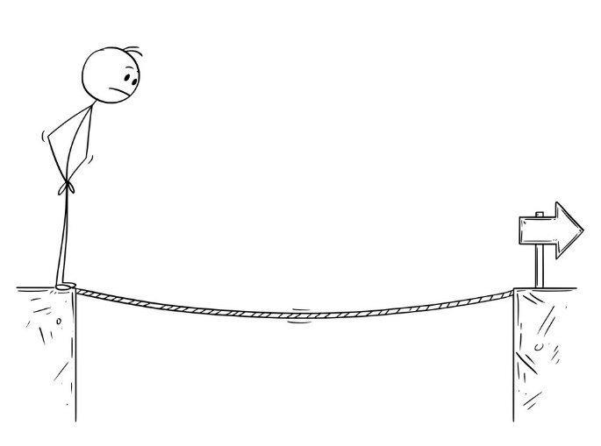
Vibration-free cooling to 30K (inner shield) and 10 – 15 K (mirror) This is where the challenge is…..
Pathfinder/ET
Two options for further cooling to 30K (ca 3W) and 10-15K (50 mW):
Helium-loop cooled by remote mechanical cooler:
- sub-cooled He (single-phase liquid)
- supercritical He (single-phase high-density gas, critical point 5.2K and 2.3 bar)
- two-phase flow (vibrations due to boiling?)
- superfluid helium (below 2.2 K, extreme thermal conductivity, zero viscosity)
2. Sorption-based thermal compressors with Joule-Thomson expansion:
- absolute minimum of vibrations
- but lower TRL (6 compared to 8)

Slide 15
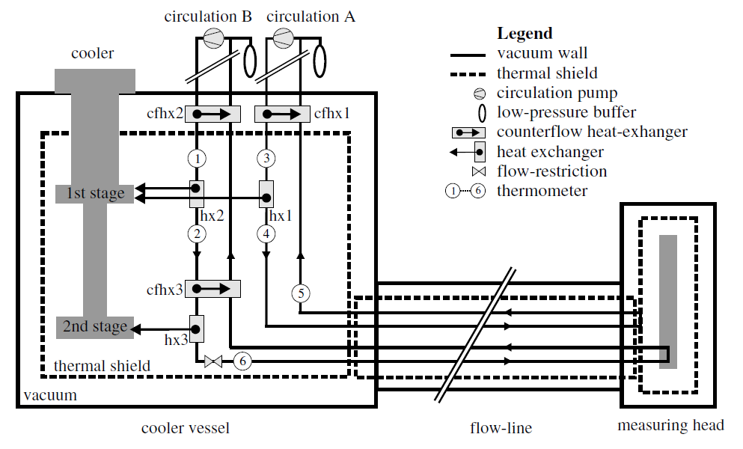
Helium-loop cooled by remote mechanical cooler:
- sub-cooled He (single-phase liquid)
- supercritical He (single-phase high-density gas, critical point 5.2K and 2.3 bar)
- two-phase flow (vibrations due to boiling?)
- superfluid helium (below 2.2 K, extreme thermal conductivity, zero viscosity)
As an example:
Cryogenics (2008) 48 61-67

Slide 16
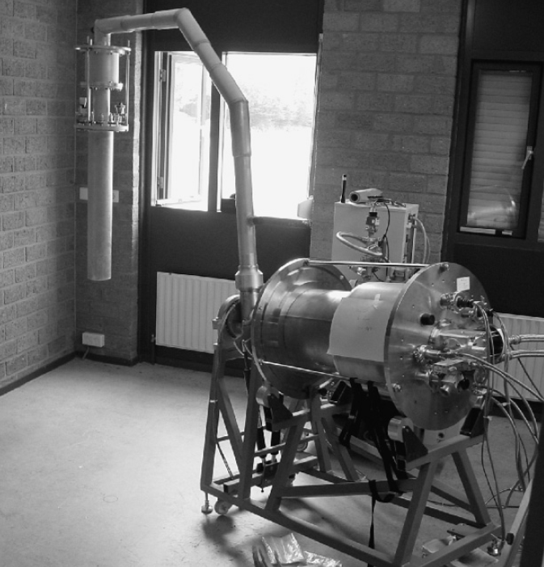
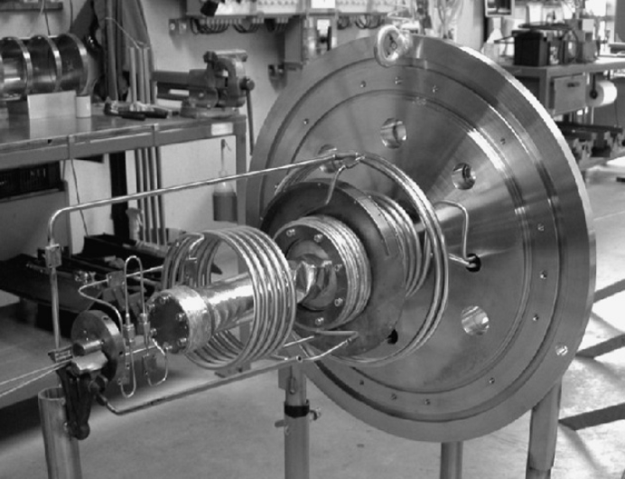
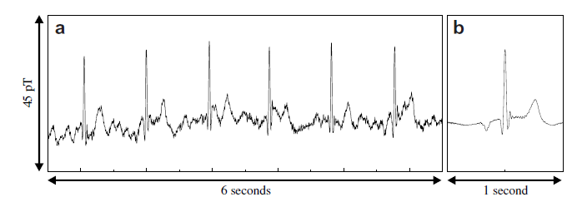
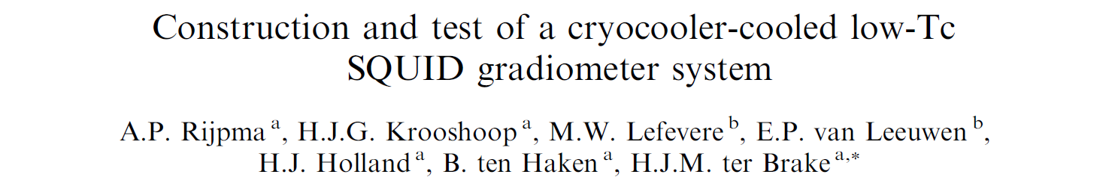
In this system: 20 mg/s
in an ETPF tower we would need 25 mg/s
(excluding losses in lines)
Cryogenics (2008) 48 61-67

Slide 17
Helium-loop cooled by remote mechanical cooler:
- sub-cooled He (single-phase liquid)
- supercritical He (single-phase high-density gas, critical point 5.2K and 2.3 bar)
- two-phase flow (vibrations due to boiling?)
- superfluid helium (below 2.2 K, extreme thermal conductivity, zero viscosity)
Open questions:
compressor
what distance is required?
vibrations?
losses in flow line?
what flow regime? (combination?)
distance compressor to cold head can be very long
distance cold head to FPMI trade-off between vibrations and losses
cold head
FPMI

Slide 18
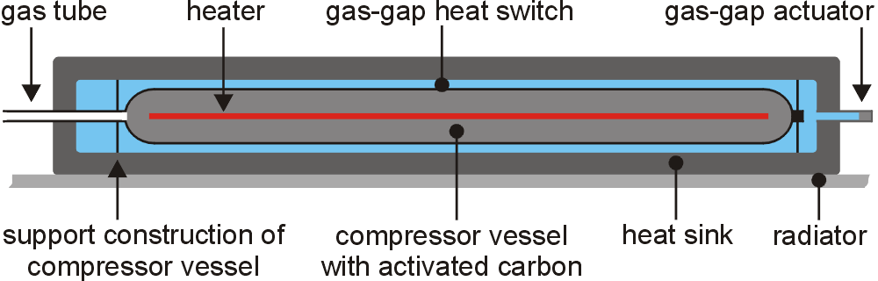
2. Sorption-based thermal compressors with Joule-Thomson expansion:
- absolute minimum of vibrations
- but lower TRL (6 compared to 8)

Slide 19
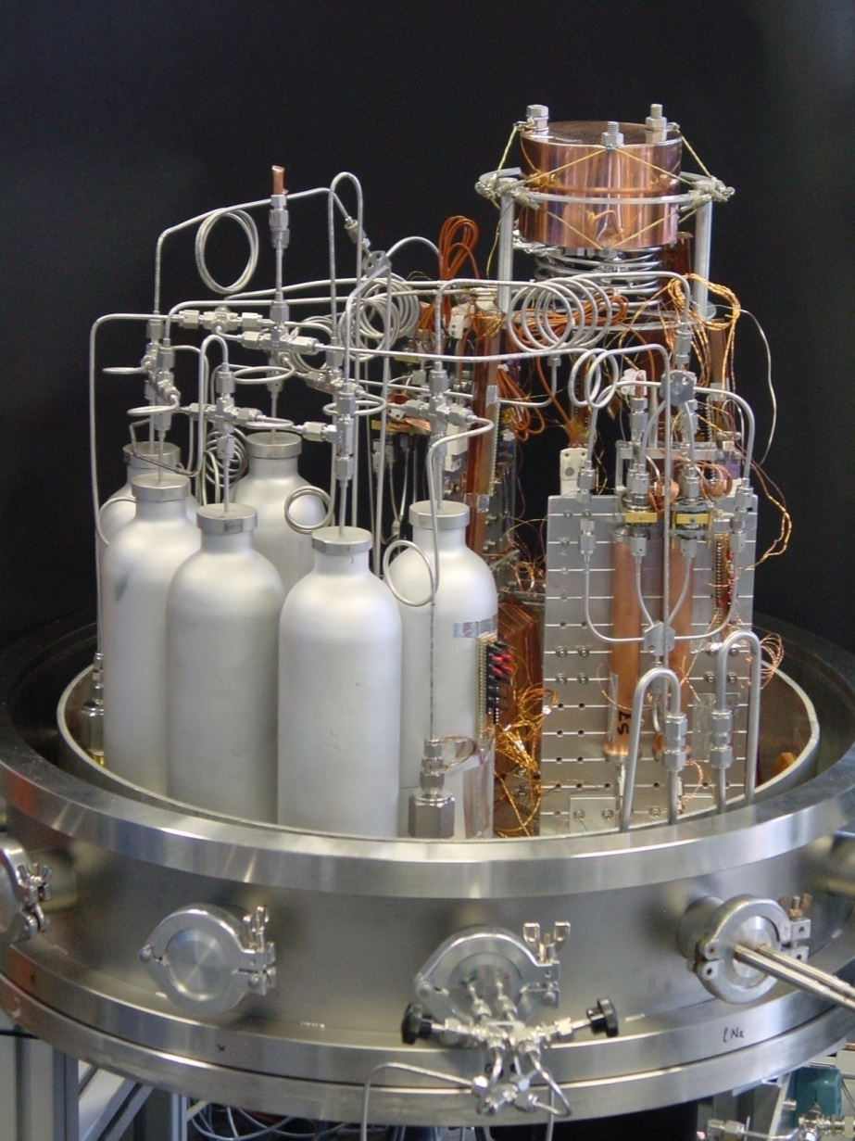
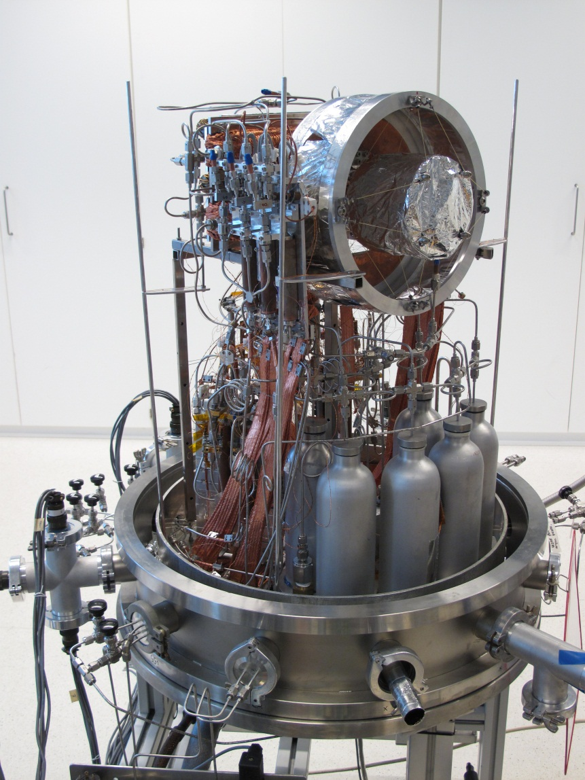


Sorption-based compressor with JT cold stage (heritage)
Hydrogen sorption-based cooler
90 K to 14.5 K (precooled at 50 K)
Helium sorption-based cooler
50 K to 4 K (precooled at 14.5 K)

Slide 20
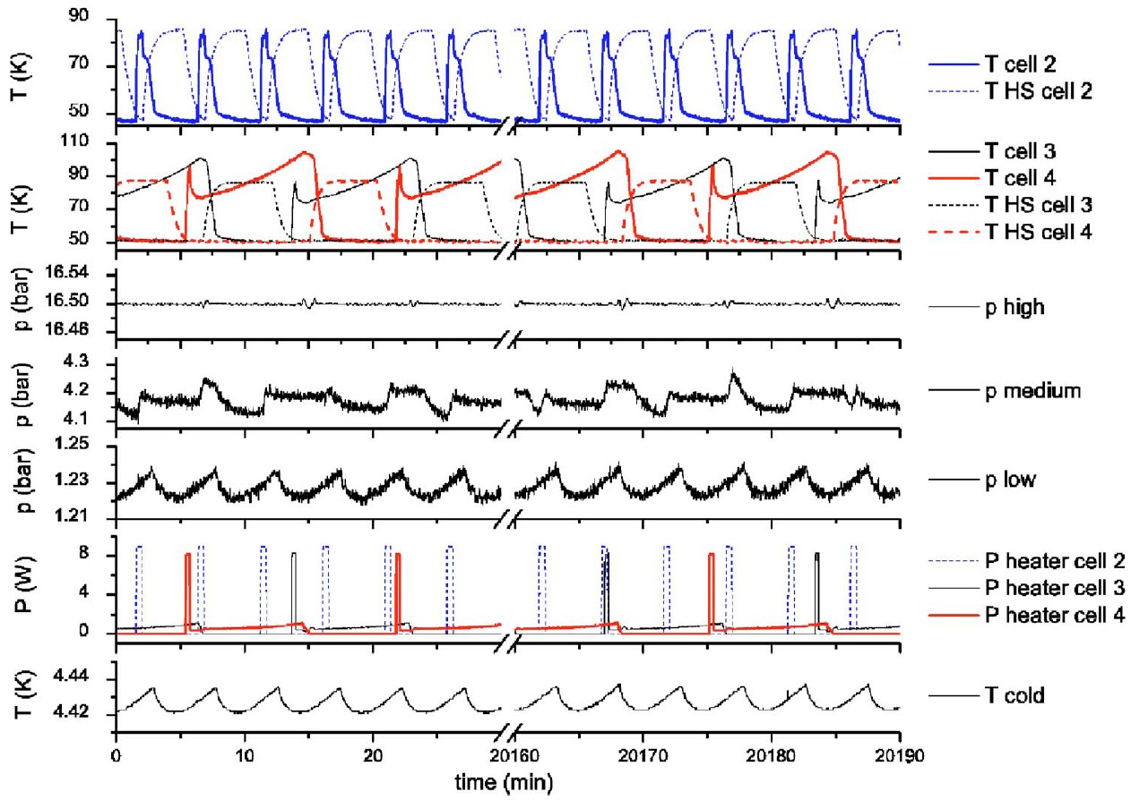
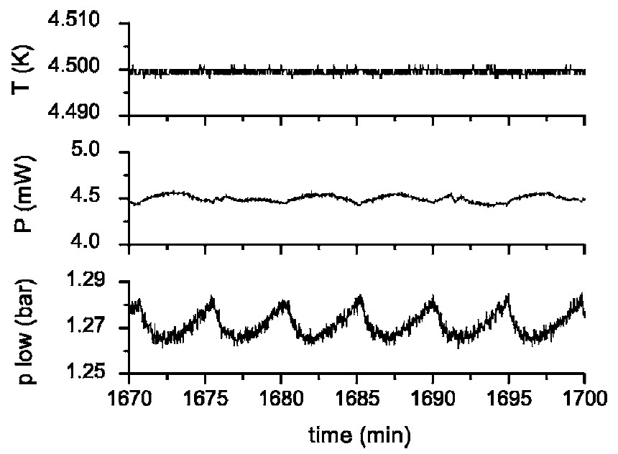
Test experiments: results
cold tip temperature stabilized
by PID controller and heater
day 1
day 14

Slide 21
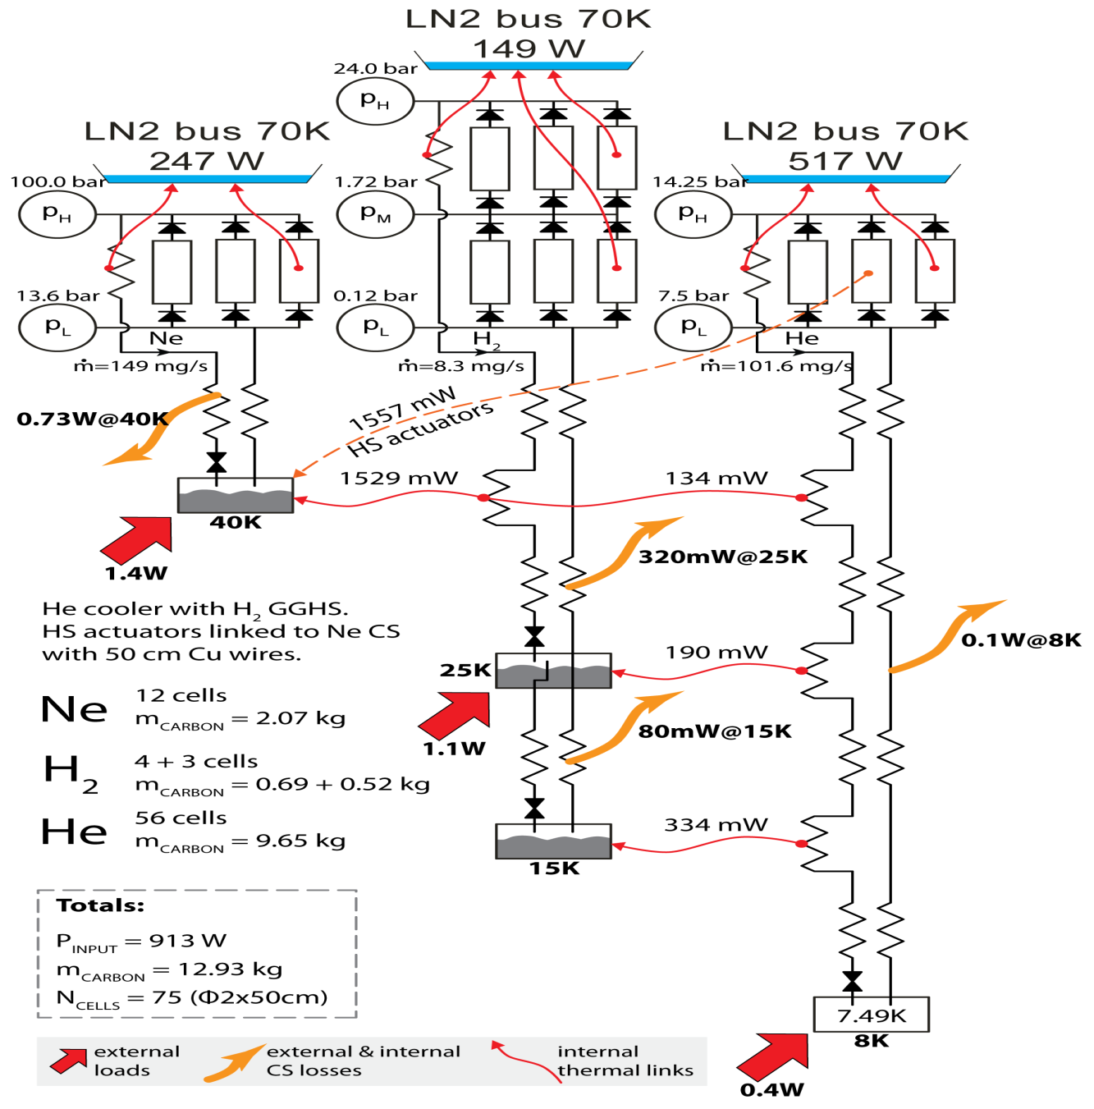
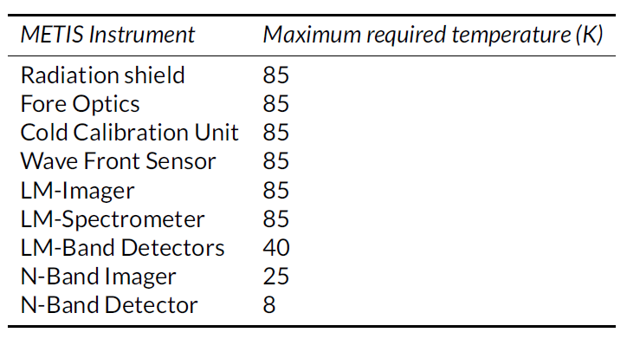
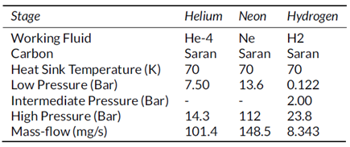
DM-1: 1W demo
Y. Wu, “Development of a sorption-based Joule-Thomson cooler for the METIS instrument on E-ELT”, 25 November 2015, PhD thesis, University of Twente
DM-2:
scaled He compressor
Mid Infrared ELT Imager and Spectrograph
Liquid nitrogen (LN2) cooled
3-stage sorption cooler starting from subcooled LN2
DM-3:
full-flow demo He cold stage

Slide 22
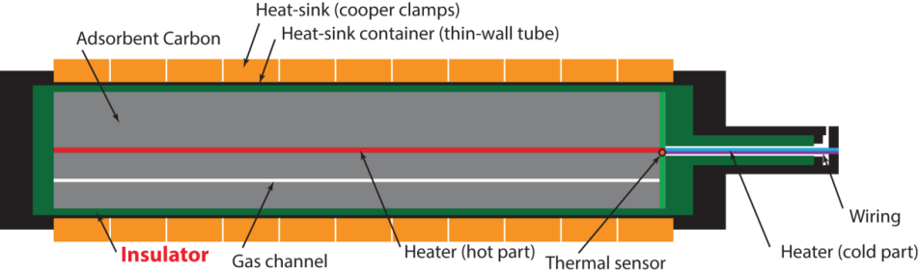
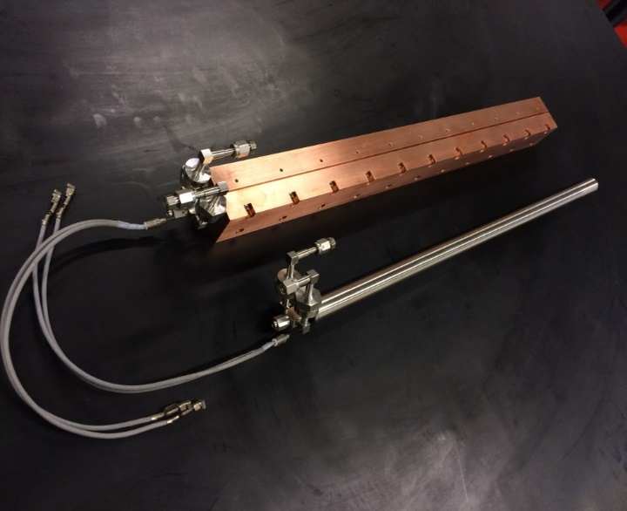
ETPF Proposed sorption-cooler configuration
Subcooled LN₂
Pathfinder/ET
C/Ne
C/H₂
C/He
CFHX
CFHX
CFHX
40 K
60 cm
CFHX
CFHX
Estimates (preliminary data!):
ETPF: ca 30 cells,
volume ca 70 liter, input ca 600 W
ET: x 10
15-20 K
CFHX
5-10 K
ETPF design based on ELT design and experiments:
ca. 30 cells, input 520 – 600 W (preliminary data)
Less cells and lower power needed if these go up

Slide 23
Conclusions / Challenges / Questions
LN₂ cooling (radiation shields and precooling of mirror plus suspension):
sub-cooled LN₂ loop
Cooling by pumped LN₂ bath
Cooling by cryocoolers preferred
1 tower: 0,5 kW
1 FPMI: 1 kW
Challenge: reduce vibrations: - cold box can be remote
- but loss in transfer line adds to required cooling power
trade-off

Slide 24
Conclusions / Challenges / Questions
Inner shield and mirror cooling (30K, ca 3W and 10-15 K, ca. 50 mW ??):
1. Can we establish Helium-loop cooling?
  What flow regime is best regarding vibrations?
subcooled/supercritical/2-phase/combination
  Is superfluid helium an option, specifically regarding the step to ET?
Challenge: reduce vibrations: - cold box can be remote
- but loss in transfer line adds to required cooling power
one of 2 options, or both?
trade-off
2. Can sorption-based cooling be realized?
  When does the low-T FPMI to be ready? (in other words: available time for realization?)
  What temperatures and cooling powers? (design of ETPF needs to be fixed)
Challenges: - demonstrate vibration-free operation (revisit analysis/design and experiments)
- optimize design (maximum reliability, minimize size, minimize input power)
UT-PhD student under Nikhef contract starts (hopefully) in September

Slide 25
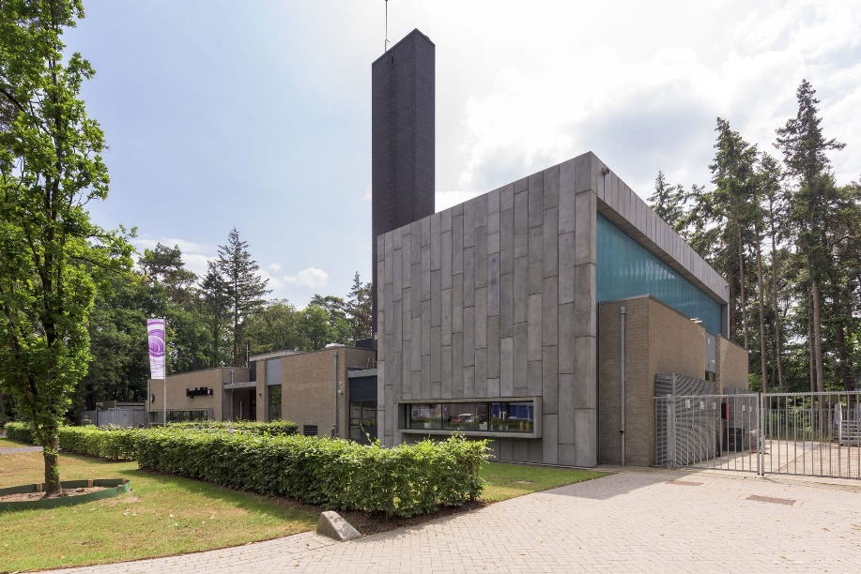
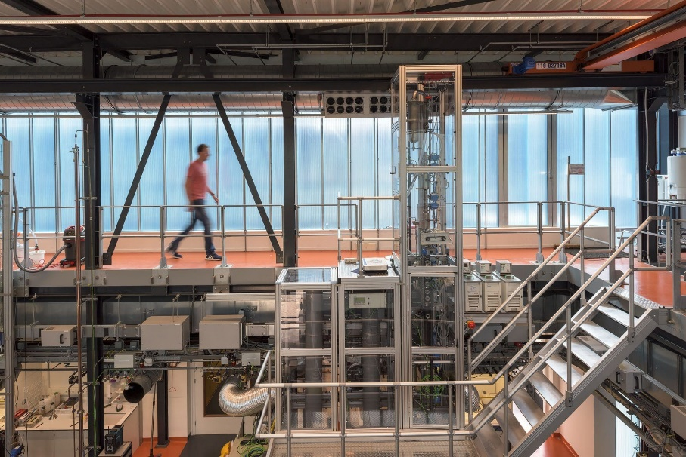
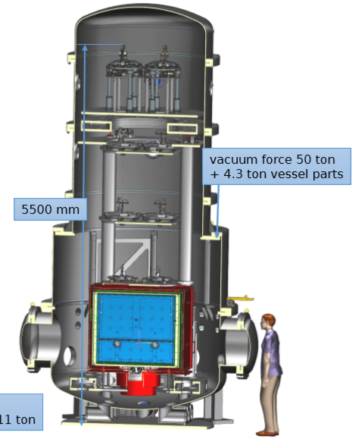
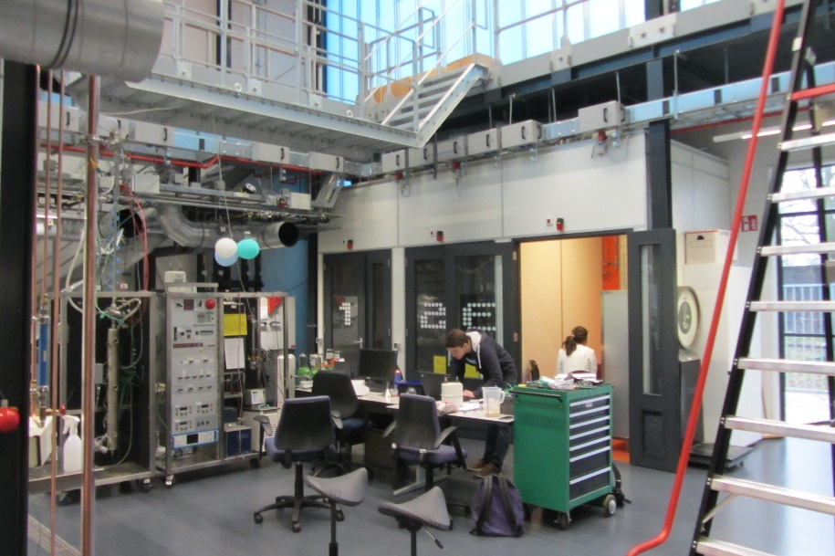
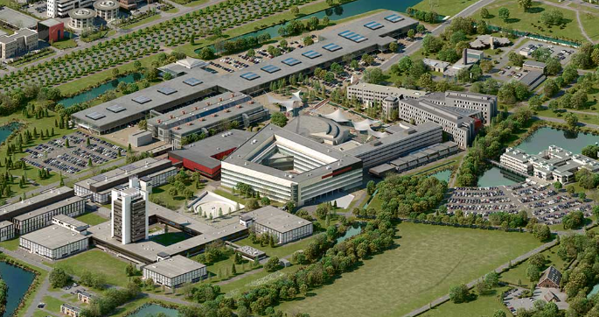
Cryogenic Test and Qualification Facility
for cryogenic component test experiments and qualification
in tower setup as of ET-Pathfinder
in HDL process hall at UT?
(picture: M. Doets Nikhef)

