Slide 1
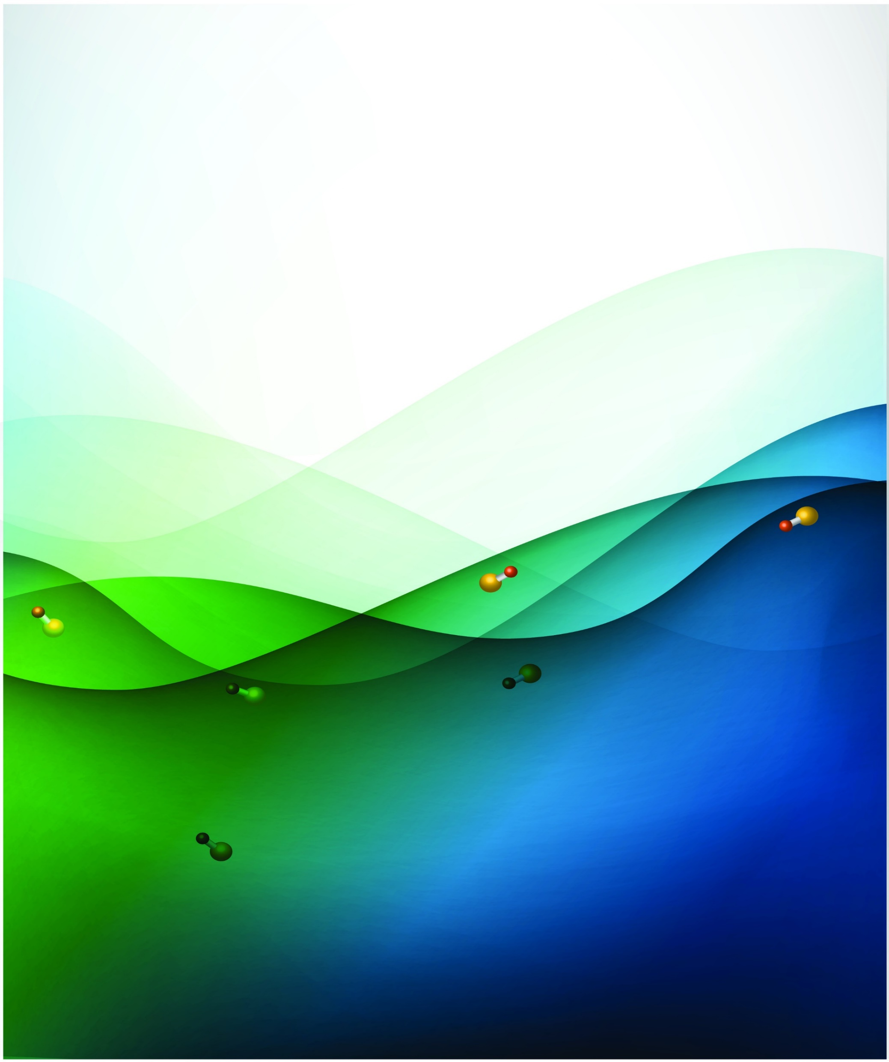
Ultracold molecules for quantum science and tests of fundamental physics
Mike Tarbutt
Centre for Cold Matter
Imperial College London

Slide 2
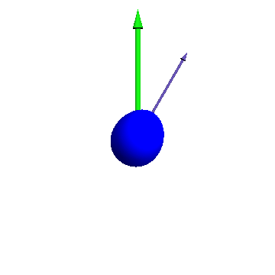
Directions
Rb
F
Ca
??
From Nature Physics 2, 636 (2006).
Collisions between ultracold atoms and molecules
Single molecules in tweezer trap arrays
Molecule chips for processing quantum information
Measuring EDM with ultracold molecules
See New J. Phys. 15, 053034 (2013)

Slide 3
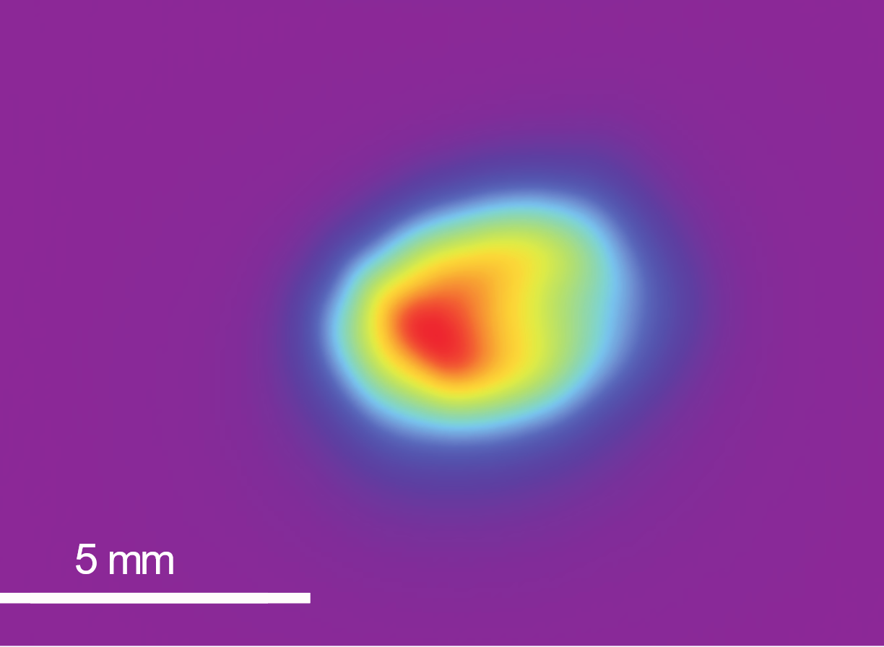
Magneto-optical trapping of CaF
130 cm
Slowing
Number of molecules: 2x10⁴
Density: 2x10⁵ cm⁻³
Temperature: 12 mK
Trap frequency: 100 Hz
Lifetime: 100 ms
B-X (0-0)
N=1
531.0 nm
excited
A-X (0-1)
N=0
628.6 nm
MOT
A-X (0-0)
cooling
606.3 nm
628.6 nm
A-X (0-1)
N=2
628.1 nm
A-X (1-2)
ground
N=1
627.7 nm
A-X (2-3)
N=0
See Williams et al, New J. Phys. 19, 113035 (2017)

Slide 4

Sub-Doppler cooling I
Load the MOT at full intensity
Ramp down the intensity to 1%
Switch off the MOT coils
Switch to a positive detuning of 20 MHz
Turn the intensity back up again
Ballistic expansion of an ultracold cloud at optimum molasses intensity
5 ms
7 ms
9 ms
11 ms
13 ms
T = 55 ± 2 µK
See S. Truppe et al., Nature Physics, 13, 1173 (2017)

Slide 5
Sub-Doppler cooling II
σ+
σ-
Δ
50
Excited state
F’=1
F’=1
F’=0
N = 0
40
30
Temperature (μK)
20
10
F=2
F=2
0
Electronic ground state
F=1
m = -2
m = -1
m = 0
m = 1
m = 2
0
1
2
3
148 MHz
Time (ms)
N = 1
F=0
T = 5.4 ± 0.7 µK
F=1
See L. Caldwell et al., arXiv:1812.07926

Slide 6
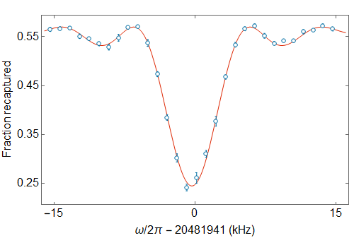
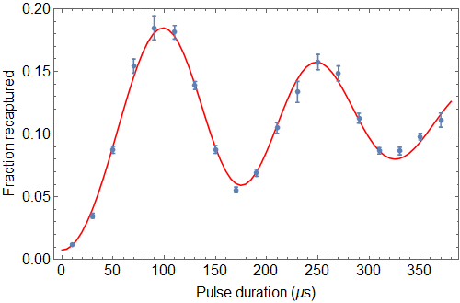
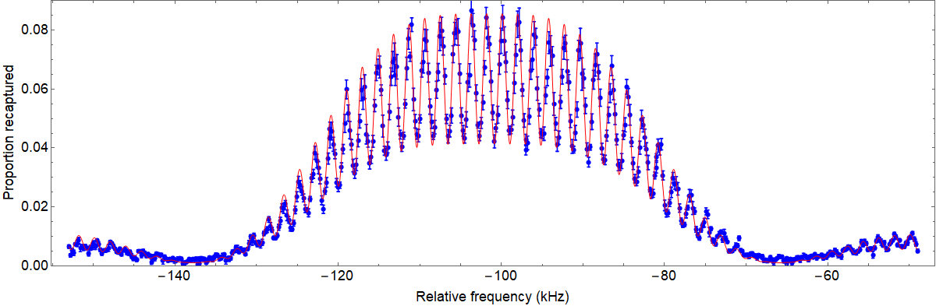
State selection and coherent control
2
1
F=2
0
-1
-2
1
F=1
0
N=1
N=1
-1
20.5 GHz
F=0
0
τ
N=0
-1
F=1
0
1
20.5 GHz
8
T
6
τ
τ
Percentage recaptured
1
4
F=1
0
2
N=0
123 MHz
-1
0
-140
-120
-100
-80
-60
F=0
0
Relative frequency (kHz)
See J. A. Blackmore et. al. Quantum Sci. Technol. 4, 014010 (2019)

Slide 7
Magnetic trapping
Blackbody heating rate (0.22 s⁻¹)
After installing helium beam shutter: 4.5 s trap lifetime
See H. Williams et al., Phys. Rev. Lett. 120, 163201 (2018)

Slide 8
Rotational coherence times (free space)
3
2
16
T
F=3
1
0
-1
τ
τ
-2
F=2
-3
12
N=2
N=1 population
τ_{c} = 16 ms
Motion-limited (50 µK)
F=1
8
41 GHz
F=2
4
2
Spin-echo
F=2
1
0
2
4
6
8
0
-1
Evolution time (ms)
-2
1
F=1
0
8
N=1
-1
F=0
0
τ_{c} > 47 ms
F=1
-1
6
0
1
N=1 population
T
20.5 GHz
4
τ
2τ
τ
1
F=1
0
2
N=0
-1
26
28
30
32
Evolution time (ms)
N.B. Preliminary data
F=0
0

Slide 9
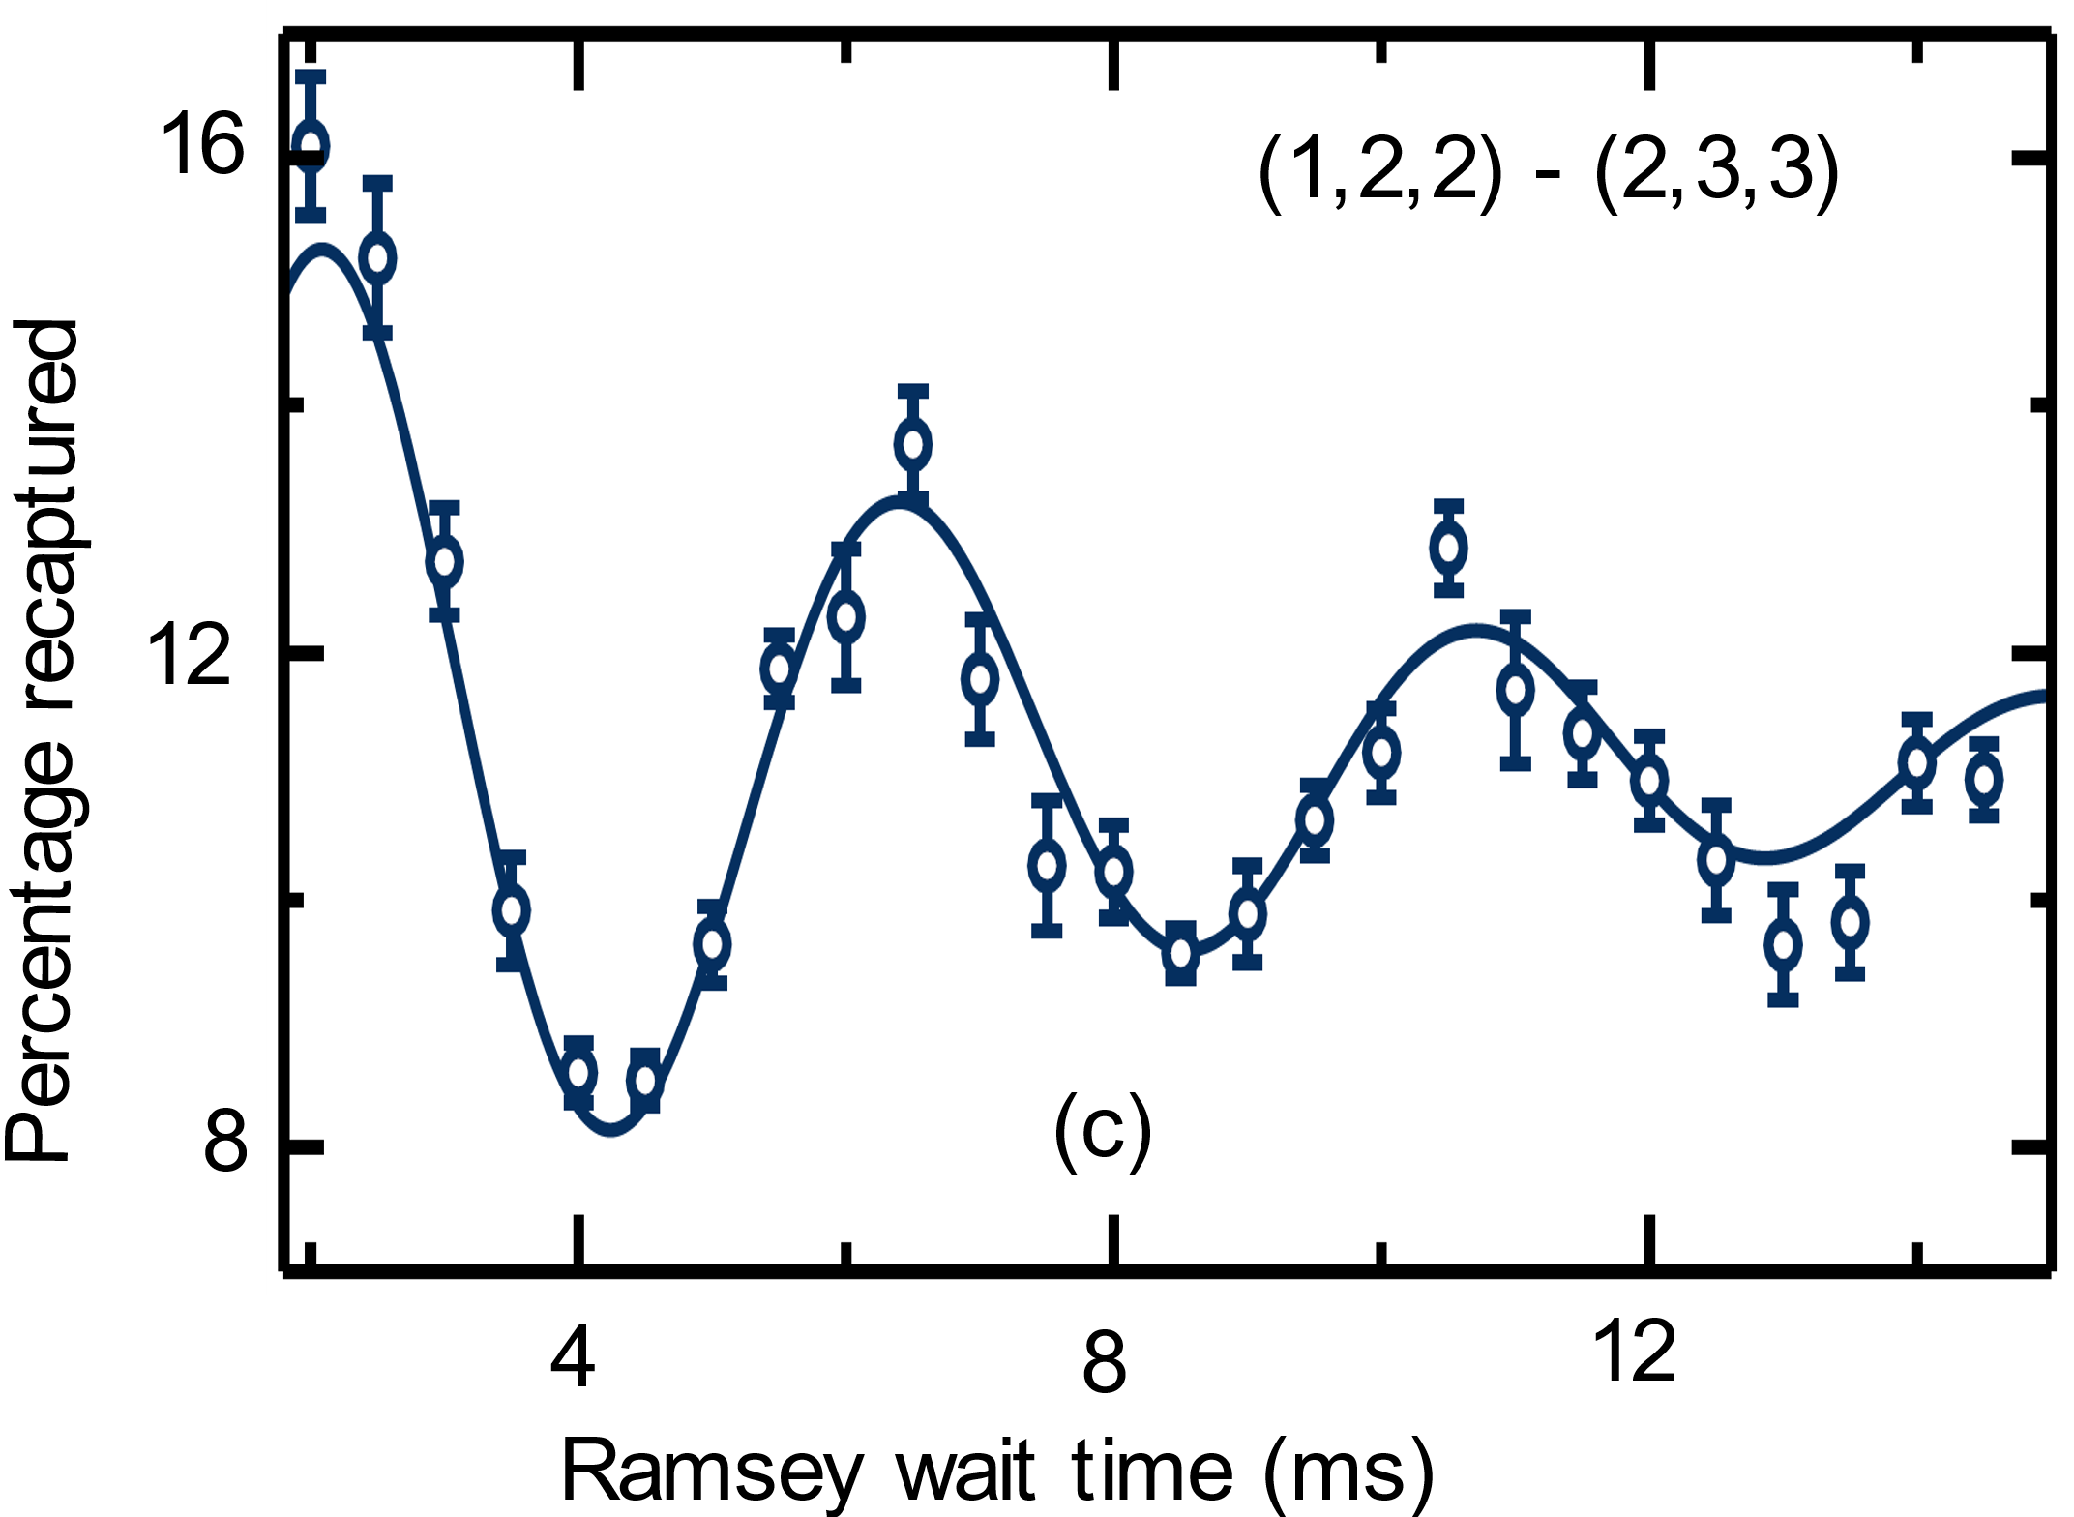
Rotational coherence times (magnetic trap)
3
2
F=3
1
0
-1
41 GHz transition
-2
F=2
-3
N=2
F=1
τ_{c} = 6.4(8) ms
when dB/dz = 45 G/cm
N=1 population
41 GHz
F=2
2
F=2
1
0
-1
-2
1
F=1
0
Evolution time (ms)
N=1
-1
F=0
0
F=1
-1
0
1
20.5 GHz
1
F=1
0
N=0
-1
N.B. Preliminary data
F=0
0

Slide 10
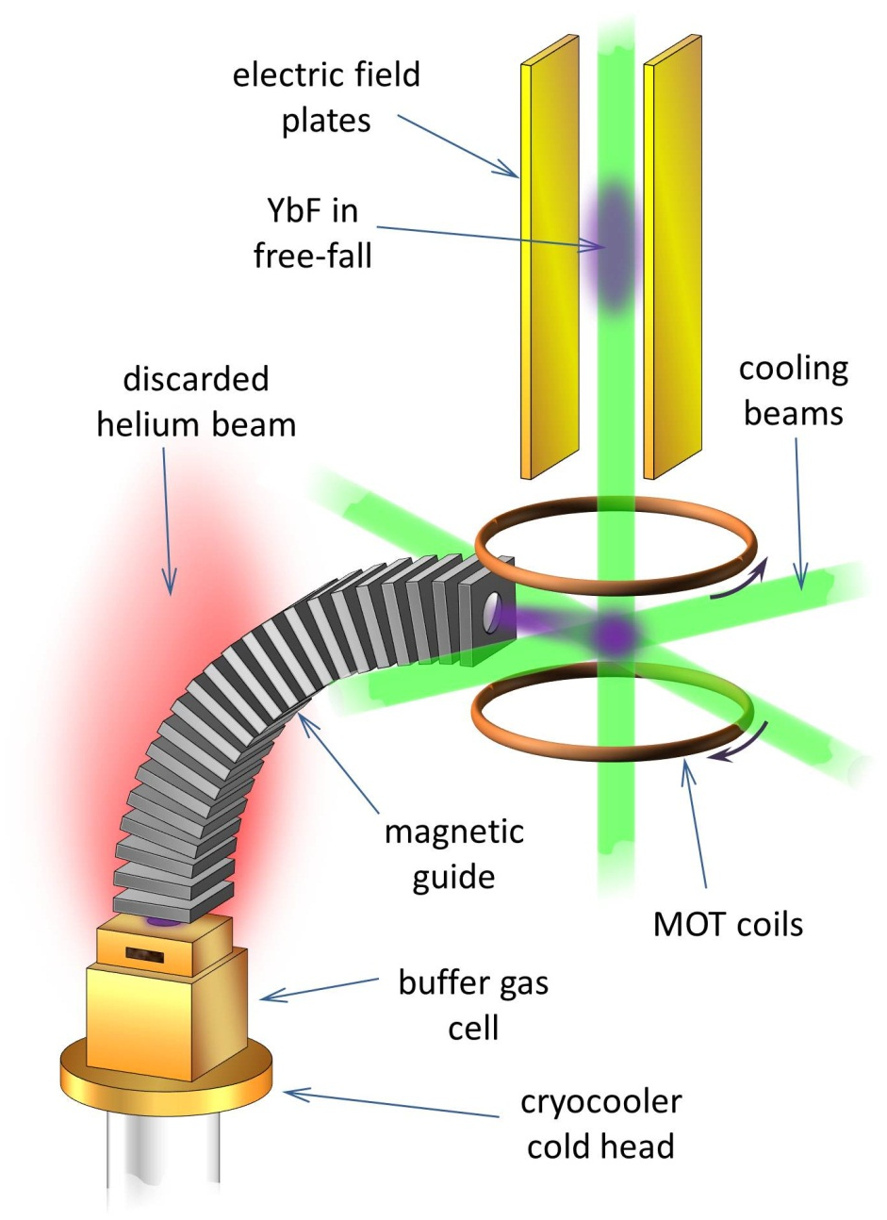
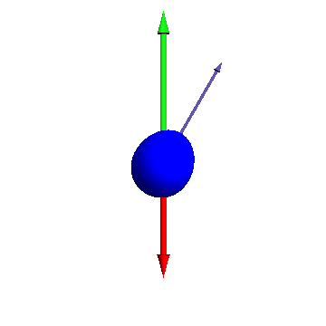
Measuring electron EDM using ultracold YbF molecules
A fountain of ultracold YbF for measuring the electron EDM
Sensitivity proportional to spin-precession time
Can be very long with ultracold molecules

Slide 11
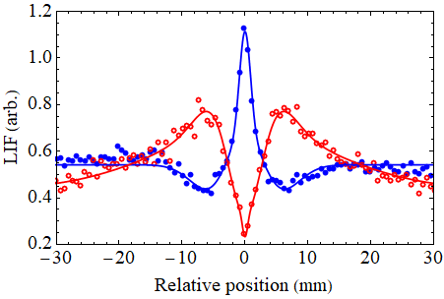
Transverse cooling of YbF
Camera 2
Blue-detuned
Red-detuned
No cooling applied
Probe lasers
Camera 1
T < 100 µK
Transverse cooling
20cm
552 + 568 + 565nm
YbF source
See J. Lim et al., Phys. Rev. Lett. 120, 123201 (2018)

Slide 12










Thanks to group members
Hannah Williams
Thomas Wall
MikeTrigatzis
Sarunas Jurgilas
Jonas Rodewald
Ed Hinds
Jongseok Lim
Ben Sauer
Noah Fitch

