Slide 1

Search for new physics with low-energy precision tests
Ameland summer school June 2019
Lectures on laser cooling of atoms and molecules
Mike Tarbutt
Imperial College London
https://flickr.com/photos/132646954@N02/43957957855

Slide 2
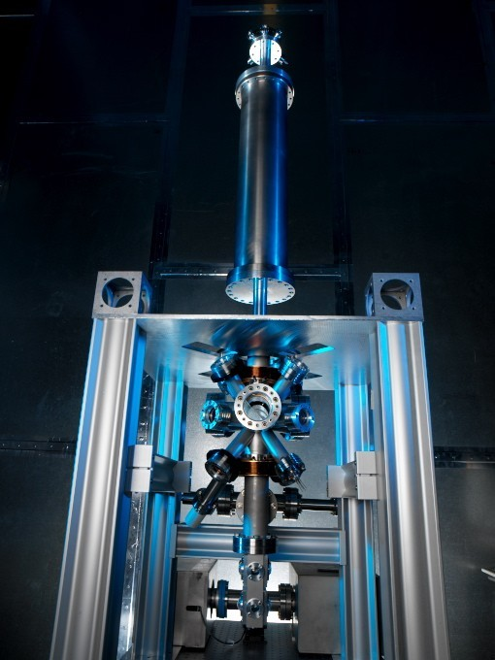
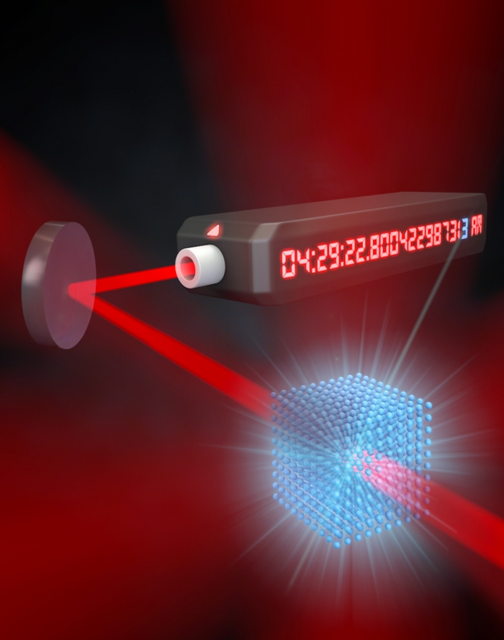
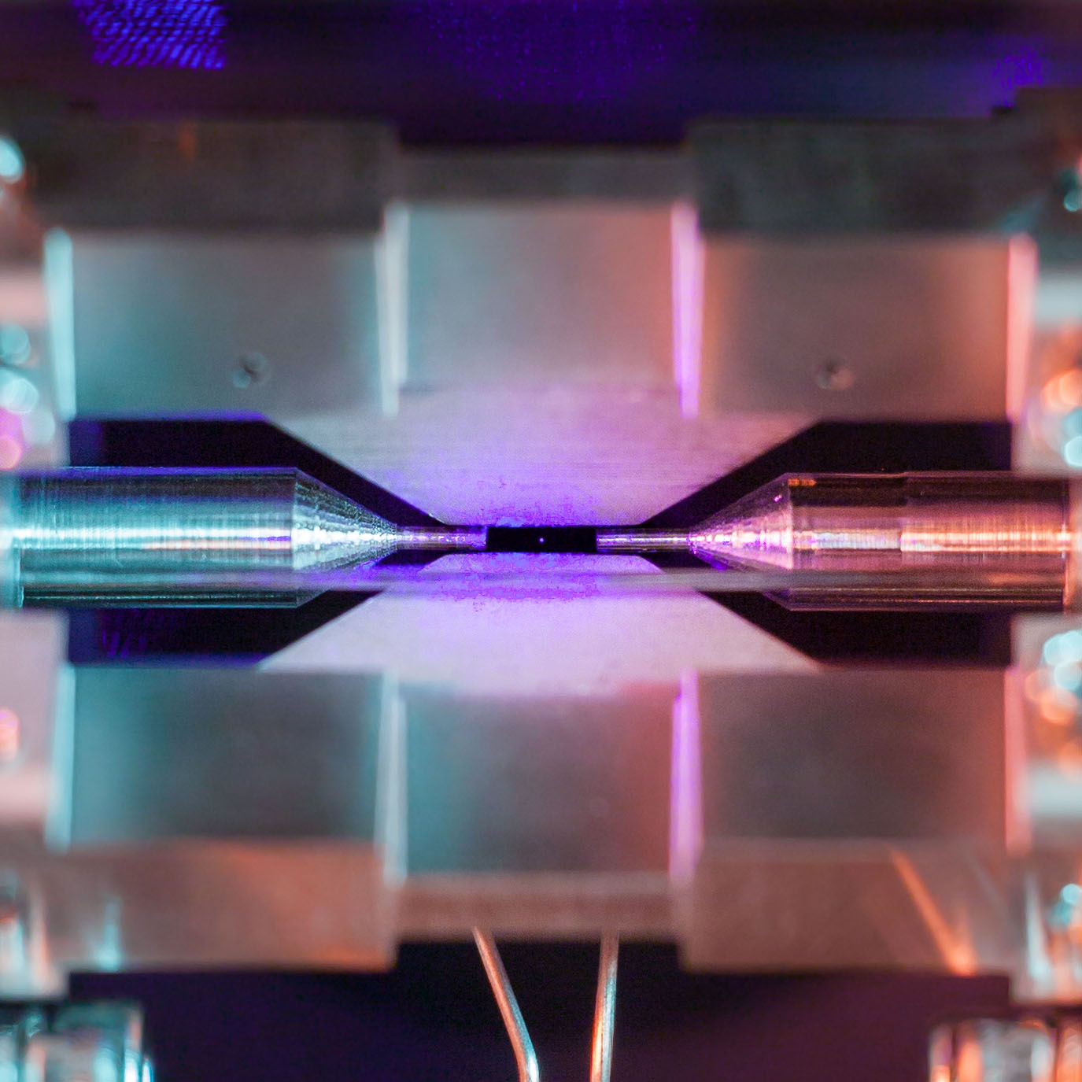
Low-energy tests of fundamental physics need cold particles*
Cs fountain clock (NPL)
Single trapped ion (Oxford)
Sr lattice clock (JILA)
*particle = atom, molecule, ion, neutron, antiproton, anti-atom….

Slide 3
Lecture outline
Today – Principles of laser cooling
Tomorrow – application to molecules
Thursday – some current research in my lab

Slide 4
I. Principles of laser cooling

Slide 5
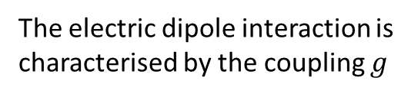


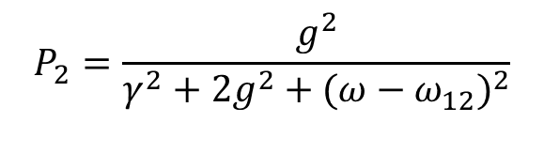





Atom-light interaction
Atom:
Light:
Interaction:
2
$$\left|ψ_{2}\right\rangle =e^{−iω_{2}t}\left|2\right\rangle$$
Classical field $E=\frac{1}{2}E_{0}\left(e^{iωt}+e^{−iωt}\right)$
$$\hat{H′}=−\hat{d}.E$$
2γ
Light intensity is $I=\frac{1}{2}ε_{0}cE_{0}^{2}$
electric dipole moment operator
electric field of the light
1
$$\left|ψ_{1}\right\rangle =e^{−iω_{1}t}\left|1\right\rangle$$
2$g$ is the “Rabi frequency”
The electric dipole interaction is
characterised by the coupling $g$
$$2g=−\left\langle 1\right|\hat{d}\left|2\right\rangle . E_{0}/ℏ$$
Question: What is the excited-state probability, P₂ ?
Solve Schrodinger equation
Add spontaneous emission
Optical Bloch equations
Steady-state solution
$$P_{2}=\frac{g^{2}}{γ^{2}+2g^{2}+(ω−ω_{12})^{2}}$$
In steady state,
saturation
broadening
natural width
detuning

Slide 6
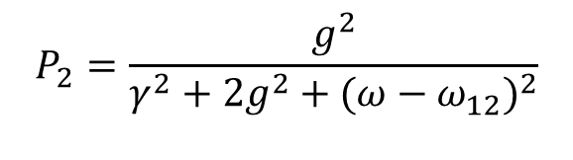

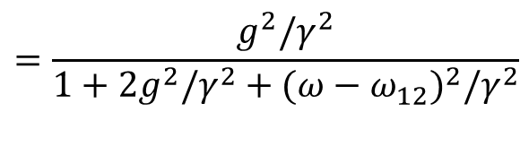
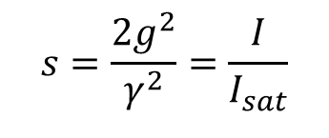

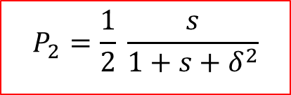

Steady-state solution
$$P_{2}=\frac{g^{2}}{γ^{2}+2g^{2}+(ω−ω_{12})^{2}}$$
$$=\frac{g^{2}/γ^{2}}{1+2g^{2}/γ^{2}+(ω−ω_{12})^{2}/γ^{2}}$$
In steady state,
Two useful dimensionless quantities:
$$s=\frac{2g^{2}}{γ^{2}}=\frac{I}{I_{sat}}$$
$$δ=\frac{ω−ω_{12}}{γ}$$
The intensity normalised to $I_{sat}$
The detuning normalised to $γ$
“saturation intensity”
typically a few mW/cm²
$$P_{2}=\frac{1}{2} \frac{s}{1+s+δ^{2}}$$
In terms of these dimensionless quantities

Slide 7
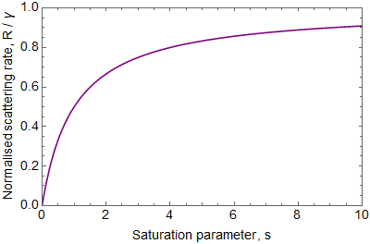
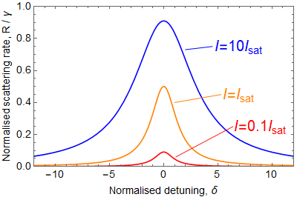



Photon scattering rate
The rate of photon emission is
$$(s,δ)$$
$$R = P_{2} 2γ$$
probability of
being excited
emission rate
when excited
$$R=\frac{s}{1+s+δ^{2}}γ$$
Saturating
Linear in s

Slide 8
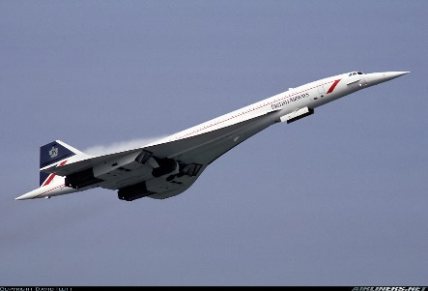
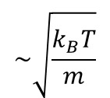

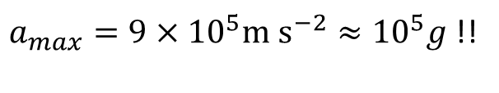

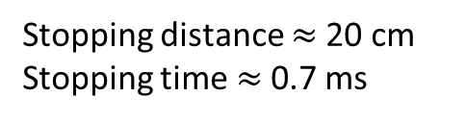



Basics of radiation pressure slowing
atomic beam
laser beam
oven
$$p=ℏk$$
$$\sim \sqrt{\frac{k_{B}T}{m}}$$
Initial speed
~ 600 m/s ~ 2200 km/hr
Atoms lose momentum $ℏk$ each time they scatter a photon
Scattering rate is R, and force is rate of change of momentum, so $F=ℏkR$
$F=ℏk γ \frac{s}{1+s+δ^{2}}$
Maximum acceleration (when $δ=0, s≫1$) is $a_{max}=\frac{ℏk γ}{m}$
How big is that?
$γ=3×{10}^{7}s^{−1}$
$a_{max}=9×{10}^{5}{m s}^{−2}≈{10}^{5}g$ !!
Take ²³Na
$k=\frac{2π}{589 ×{10}^{−9}} m^{−1}$
Stopping distance $≈$20 cm
Stopping time $≈$0.7 ms
$m=3.8×{10}^{−26}$ kg

Slide 9
First problem – optical pumping
Atoms are not really two-level systems. Even for alkali atoms, there’s hyperfine structure
The laser cooling transition for Na actually looks like this:
F=3
3p ²P_{3/2}
F=2
58 MHz
F=1
F=0
Slow
509 THz
Repump
F=2
3s ²S_{1/2}
1.77 GHz
F=1
Solution: use “repump” laser to close off the leak to the F=1 hyperfine state

Slide 10
Second problem – Doppler shift
Doppler shift: $∆ω_{Dopp}=\frac{v}{c}ω_{12}=kv=\frac{2π}{λ}v$
For Na ($λ=589$ nm) moving at 400 m/s, $Δω_{Dopp}/2π=680$ MHz
But the natural linewidth of the transition is only 10 MHz
As the atoms decelerate, they Doppler shift out of resonance with the laser
Possible solutions:
Broaden the frequency spectrum of the laser (often called white light slowing)
Change the frequency of the laser in time to follow the changing Doppler shift (frequency-chirp slowing)
Use the Zeeman shift in a magnetic field to follow the changing Doppler shift (Zeeman slowing)

Slide 11
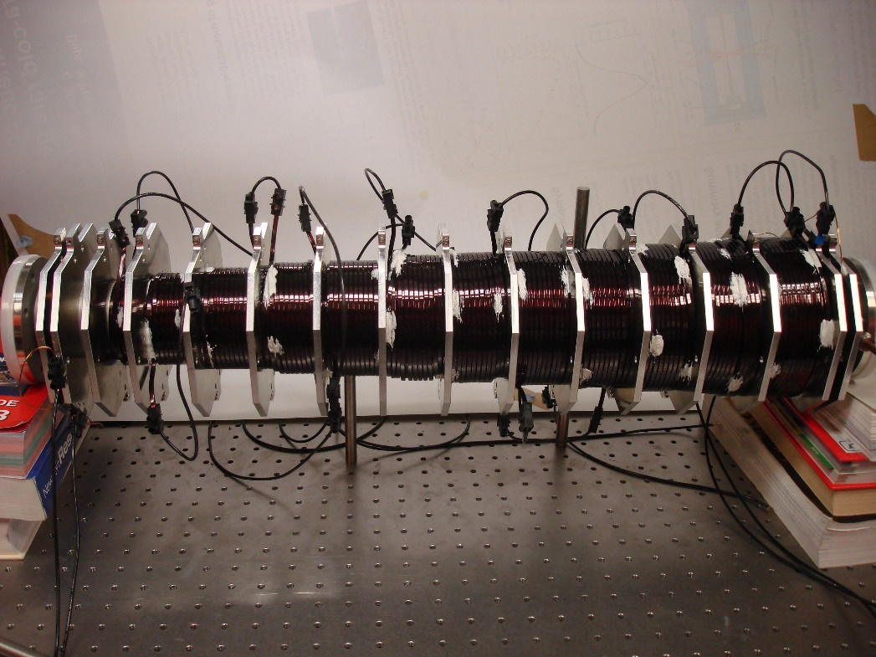


Zeeman slower
M=+1
Energy
Zeeman shift: $ΔE=g μ_{B}B M$
F=1
M=0
Drive this transition
M=-1
F=0
M=0
Magnetic field
Zeeman slower at UCL
Fix the frequency of the light. Match the Doppler shift with the Zeeman shift: $\frac{μ_{B}B}{ℏ}=kv$
Using $v^{2}=v_{i}^{2}−2a z$, we find the ideal magnetic field profile:
$$B\left(z\right)=\frac{ℏk}{μ_{B}}\sqrt{v_{i}^{2}−2 a z}$$
capture velocity
target acceleration
distance along slower

Slide 12
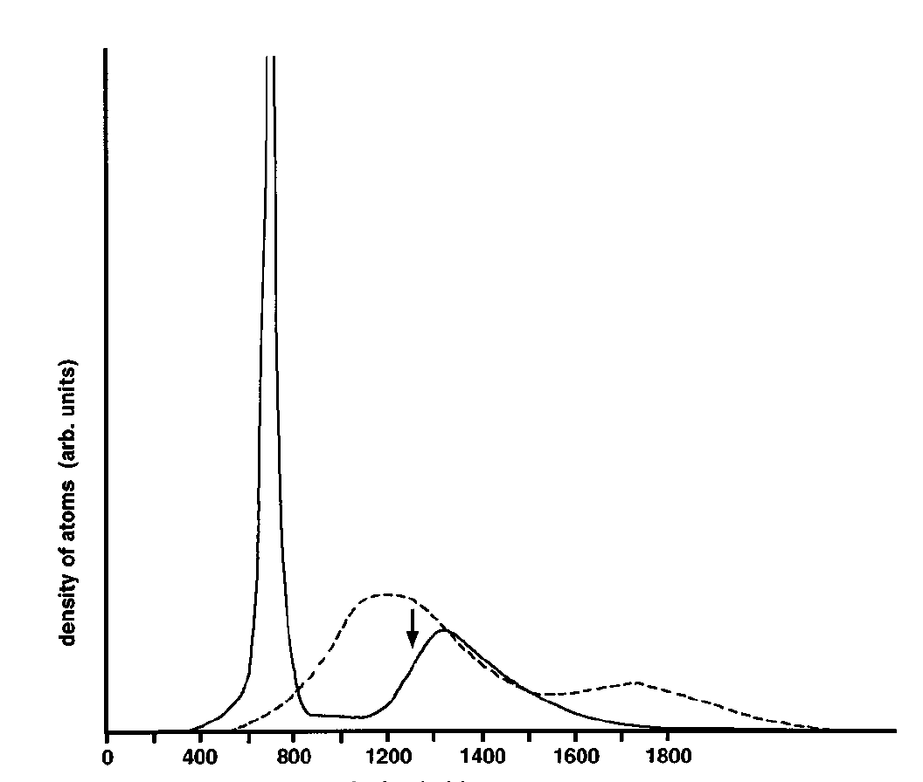
A decelerated sodium beam
Cooling (reduction of Δv)
decelerated beam
atom density
thermal beam
Deceleration (reduction of v)
velocity
Adapted from W.D. Phillips, Rev. Mod. Phys. 70, 721 (1998)

Slide 13
Why the velocity distribution gets narrower
Red detuned
v
laser beam
Force
slower atoms
faster atoms
velocity
force to left
Faster atoms are decelerated more – that’s friction: F ∝ -v.

Slide 14
Basic idea of the optical molasses
The slowing idea can be extended to cool to zero velocity
counter propagating
Red detuned
v
laser beam
laser beam
Force on atom
force to right
v
F = - α v
force to left

Slide 15
Damping force in an optical molasses
counter propagating
Red detuned
v
laser beam
laser beam
Force from the right-hand beam: $F_{1}=−ℏk γ \frac{s}{1+s+{\left(δ+kv/γ\right)}^{2}}$
Force from the left-hand beam: $F_{2}=ℏk γ \frac{s}{1+s+{\left(δ−kv/γ\right)}^{2}}$
Total force*: ${F=F}_{1}+F_{2}$
A Taylor expansion of the total force around v = 0 gives: $F=4ℏk^{2}\frac{s δ}{{\left(1+s+δ^{2}\right)}^{2}} v=−αv$
This is maximised when $s=1+δ^{2}$ and $δ=−1$. This maximum is $F_{max}=−\frac{1}{2}ℏk^{2}v$
In the presence of this force, plus gravity, atoms fall with a terminal velocity of $v_{t}=\frac{2mg}{ℏk^{2}}$
For Na atoms, $v_{t}=0.06 mm/s=22$ cm/hour
*This is only right at low intensity. At higher intensity, the presence of
one beam reduces the scattering rate of the other because of saturation.

Slide 16
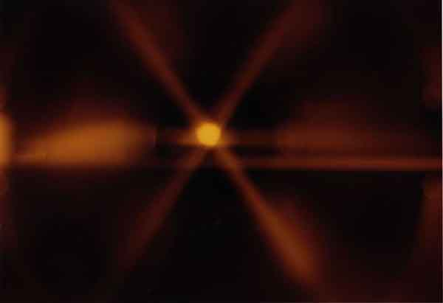
Optical molasses works in 3D
oven
slowing laser
molasses beams
Sodium atoms stuck in optical molasses

Slide 17
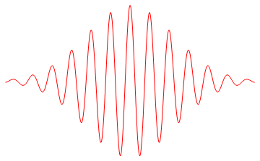
Principle of the magneto-optical trap (MOT)
Photon
Atom
Photon
F=1, M_{F}=
Excited-state, F=1
1
Laser light tuned slightly below resonance
0
δ
Ground-state, F=0
-1
Add magnetic field, linear in position
Coil
Coil
B
σ+
(drives ΔM=+1)
σ-
(drives ΔM=-1)
x
F=0, M_{F}=0
Both a damping force AND a restoring force

Slide 18
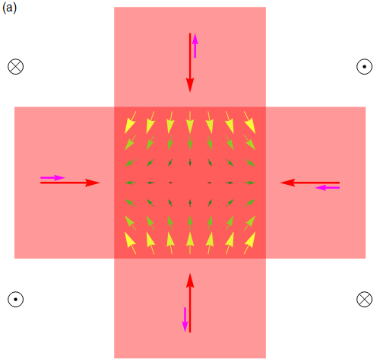

Layout of a magneto-optical trap
beams
6 red-detuned beams
molasses near centre - cooling
anti-Hemholtz coils
Circular polarisation
opposite to B field
B-field
provides trapping
force towards centre
beams
k-vector
$$B=A \left(x\hat{x}+y\hat{y}−2z\hat{z}\right)$$
photon-spin
Field gradient in xy-plane, typically ~10G/cm

Slide 19
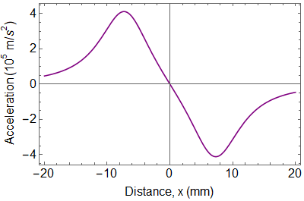
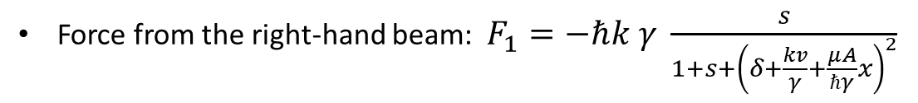
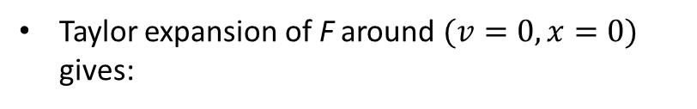



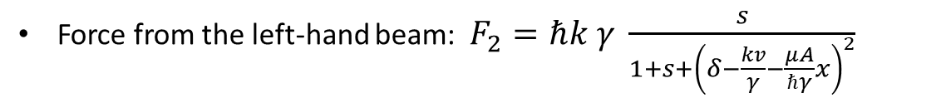

Force in a MOT
counter propagating
Red detuned
v
laser beam
laser beam
Same analysis as before, but now add Zeeman shift of transition frequency into the detuning. This adds to $δ$ the extra term $\frac{μB}{ℏγ}=\frac{μA}{ℏγ}x$ at displacement $x$.
Force from the right-hand beam: $F_{1}=−ℏk γ \frac{s}{1+s+{\left(δ+\frac{kv}{γ}+\frac{μA}{ℏγ}x\right)}^{2}}$
Force from the left-hand beam: $F_{2}=ℏk γ \frac{s}{1+s+{\left(δ−\frac{kv}{γ}−\frac{μA}{ℏγ}x\right)}^{2}}$
Total force*: ${F=F}_{1}+F_{2}$
Taylor expansion of F around $(v=0,x=0)$ gives:
$$F=−αv−κx$$
$$κ=\frac{μA}{ℏk}α$$
For Na, with:
$s=1$, $δ=−2$,
$$A=10 G/cm$$
Motion in the MOT is that of a damped harmonic oscillator
*at low intensity

Slide 20
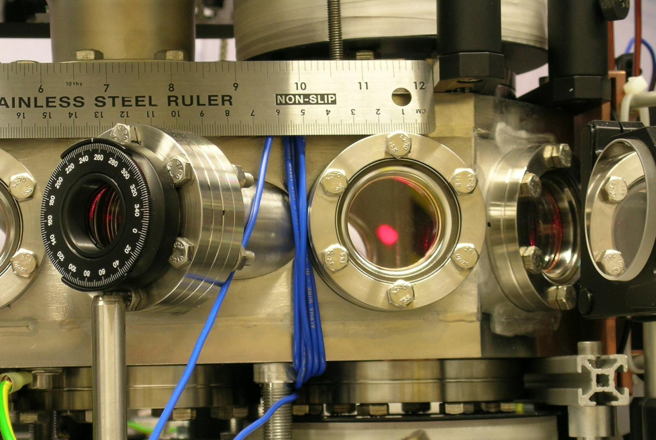
Example from my lab: a Lithium MOT
Look through the
vacuum window
The MOT is about
5 mm in diameter
There are
10⁹ atoms
Temperature ~ 1 mK
MOTs: Li, Na, K, Rb, Cs, Fr, Mg, Ca, Sr, Yb, He*, Ne*, Ar*, Kr*, Cr, Er, Dy….

Slide 21
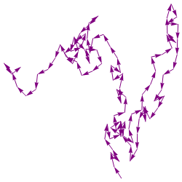

Do the atoms cool to zero temperature?
No. There’s heating due to randomness of momentum kicks :
scattering rate R
scattering rate R
In 3D, we have 6 beams – total scattering rate is 6R. For slow atoms, all absorption and emission events are in random directions – a random walk in momentum.
After N steps of the random walk the mean square momentum is $\left\langle p^{2}\right\rangle =N{(ℏk)}^{2}$
Number of steps in time $∆t$ is $N=2×6×R×∆t$
2 steps per scattering event
6 beams
scattering rate per beam
Energy increase after time $∆t$ is $∆E=\frac{\left\langle p^{2}\right\rangle }{2m}=12R\frac{{(ℏk)}^{2}}{2m}$ $∆t$
Heating power $P_{heat}={\left(\frac{∆E}{∆t}\right)}_{heat}=6R\frac{{(ℏk)}^{2}}{m}$

Slide 22


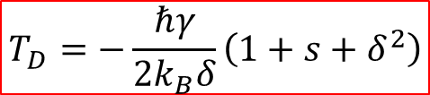

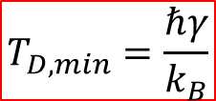
Minimum temperature
Heating power $P_{heat}=6R\frac{{(ℏk)}^{2}}{m}$
Compare this to the cooling power in the molasses. In 3D, $F=−αv$. Power is $F.v$, so we have
Cooling power $P_{cool}=−αv^{2}$
In equilibrium, $P_{heat}+P_{cool}=0$. Use expressions for $α$ and $R$, and use $\frac{1}{2}mv^{2}=\frac{3}{2}k_{B}T$
$$T_{D}=−\frac{ℏγ}{2k_{B}δ}\left(1+s+δ^{2}\right)$$
The temperature is minimised by choosing $s≪1$ and $δ=−1$. Then we get:
$$T_{D,min}=\frac{ℏγ}{k_{B}}$$
This is the lowest temperature achievable by Doppler cooling, and is known as the Doppler limit. For Na, $T_{D,min}=240 μK$.
Note: $δ$ is negative for Doppler cooling

Slide 23


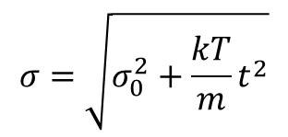
Do experiments agree with theory?
Prediction for Na: $T_{D,min}=240 μK$
Switch off
molasses beams.
Let the cloud fall.
$$σ_{0}$$
Watch radius grow using laser-induced fluorescence or absorption to image the cloud.
Result:
$$σ=\sqrt{σ_{0}^{2}+\frac{kT}{m}t^{2}}$$
t
There is more to laser cooling than we said !

Slide 24
II. Laser cooling of molecules

Slide 25

Why laser cooling (usually) fails for molecules
Laser cooling relies on repeated absorption – spontaneous-emission events
Laser
Laser
Excited state
How many cycles are required?
Example – Rb-87 atom with initial speed of 100m/s.
Spontaneous emission
Absorption
Ground state
For some atoms (e.g. alkalis), this is possible due to a “closed” energy level structure.
This situation is special.

Slide 26
Mean number of photons scattered
Excited state
1-r
r
No excitation out of this state
Every molecule scatters the first photon.
A fraction r scatter a second photon.
A fraction r² scatter a third photon etc.
Mean number of scattered photons, N_{γ} = 1 + r + r² + r³ +…. = 1/(1-r)
When r = 0.99, N_{γ} = 100
When r = 0.999, N_{γ} = 1000
When r = 0.9999, N_{γ} = 10000

Slide 27
Why laser cooling (usually) fails for molecules
Vibrational wavefunctions for LiH
Corresponding emission spectrum
1st excited electronic state
Ground electronic state
Following excitation, the molecule can decay to a multitude of other vibrational states.
It’s the vibrations that cause the trouble. The rotations are governed by selection rules
LiH
Need to scatter ~10,000 photons for laser cooling.
Most molecules scatter 1, start to vibrate, and decouple from the laser

Slide 28
Some molecules are better…
Vibrational wavefunctions for CaF
Corresponding emission spectrum
Many other molecules with almost “diagonal” Franck-Condon matrices,
e.g. SrF, AlF, YbF, BeH, MgH, CaH, SrH, BaH, AlH, NH, BH, AlCl, YO

Slide 29
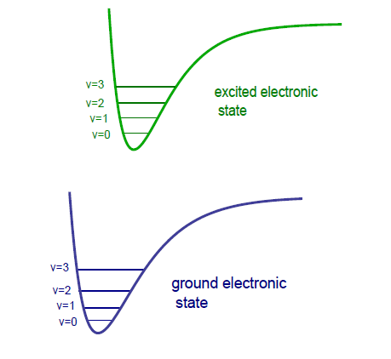
How to apply laser cooling to molecules
rotational
angular momentum
parity
3
-
2
+
1
-
0
+
3
-
2
+
1
-
0
+

Slide 30
Dark states
J=0
J=1
M=-1
M=0
M=+1
There are sub-levels that cannot couple to the laser polarization
Solve this by:
Rapid modulation of the laser polarization, or
Apply a magnetic field to rotate the dark states into bright states

Slide 31
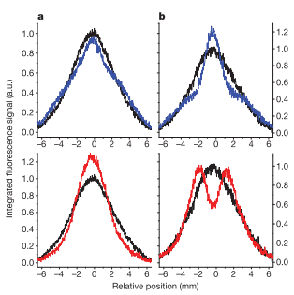
First demonstration - transverse laser cooling of SrF (Yale)
Doppler cooling
Sub-Doppler cooling
SrF beam
Cooling lasers (12 frequencies)
Nature 467, 820 (2010)

Slide 32

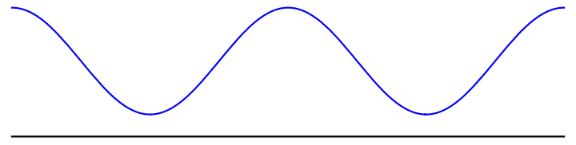

Sub-Doppler cooling
“Light shift” or “ac Stark shift”: energy level shift proportional to light intensity and strength of atom-light coupling
Shift is positive when detuning is positive
Counter-propagating laser beams set up intensity gradients and polarization gradients
F’=1
lin – φ – lin
e.g. φ = 45º
F=1
Light shift of bright state
Light shift of dark state
See M. Weidemüller et al., Europhys. Lett. 27, 109 (1994)

Slide 33

The particle finds itself always going uphill
This is called Sisyphus cooling by analogy with a character in Greek mythology who was condemned to push a rock forever uphill
Warning: there are actually (at least) four distinct sub-Doppler cooling mechanisms. I have shown you the one that occurs whenever there are dark states (usually called “gray molasses”).

Slide 34
Polyatomics too! Transverse cooling of SrOH (Harvard)
PRL 118, 173201 (2017)

Slide 35
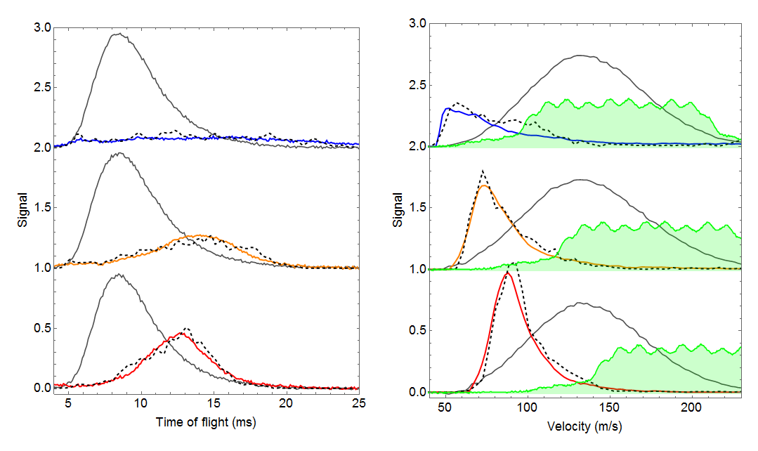
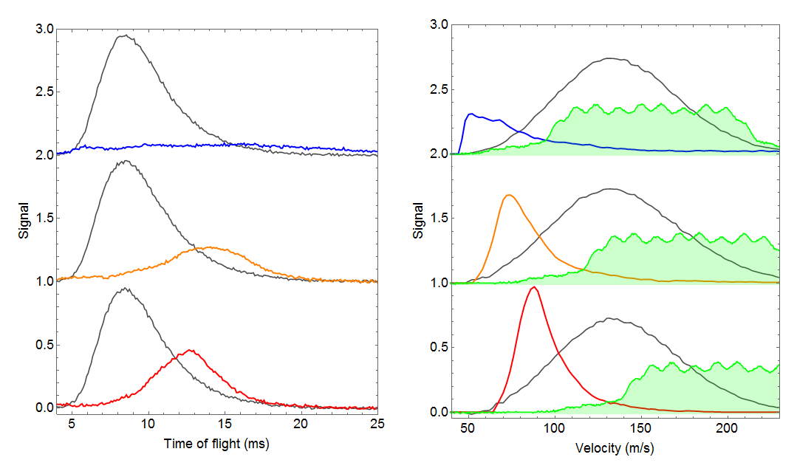
Slowing using frequency broadened light
62 m/s
87 m/s
103 m/s
New J. Phys. 19, 022001 (2017)
See also:
Phys. Rev. Lett. 108, 103002 (2012)
Phys. Rev. Lett. 114, 223003 (2015)
J. Phys. B 49, 174001 (2016)

Slide 36
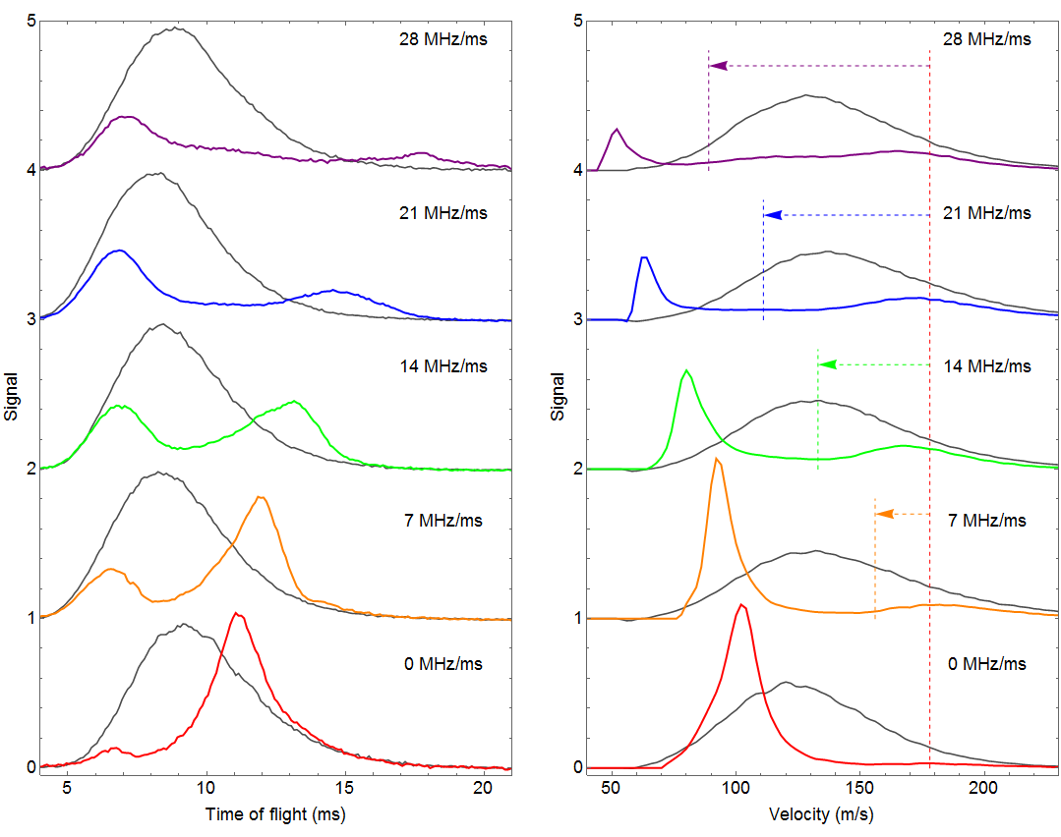
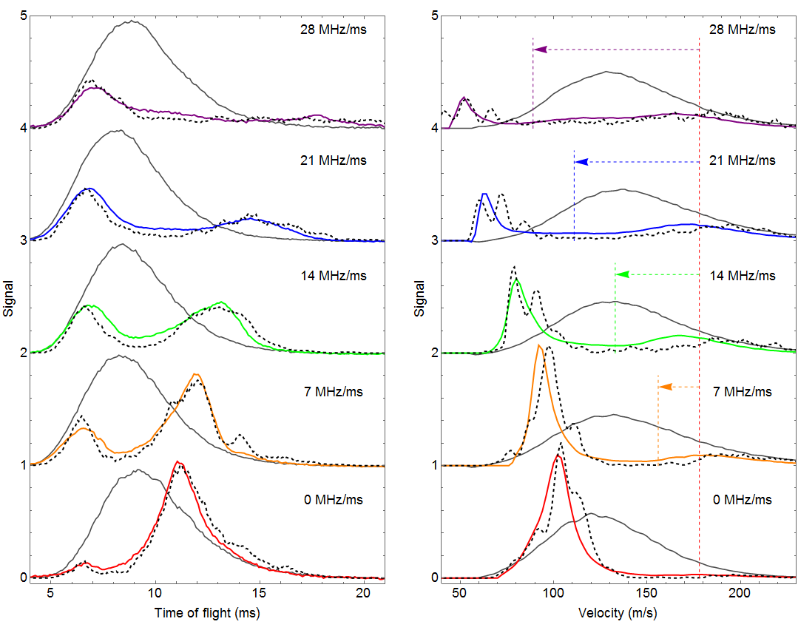
Slowing using a frequency chirp
52m/s
63m/s
80m/s
93m/s
103m/s
New J. Phys. 19, 022001 (2017)

Slide 37
Magneto-optical trapping of molecules

Slide 38
Radio-frequency (rf) MOT
Solves dark state problem
Net restoring force is large
σ+
σ-
σ-
σ+
+1
-1
0
0
-1
+1
σ+
σ-
σ-
σ+
+1
-1
0
0
PRL 116, 063004 (2016)
-1
+1

Slide 39
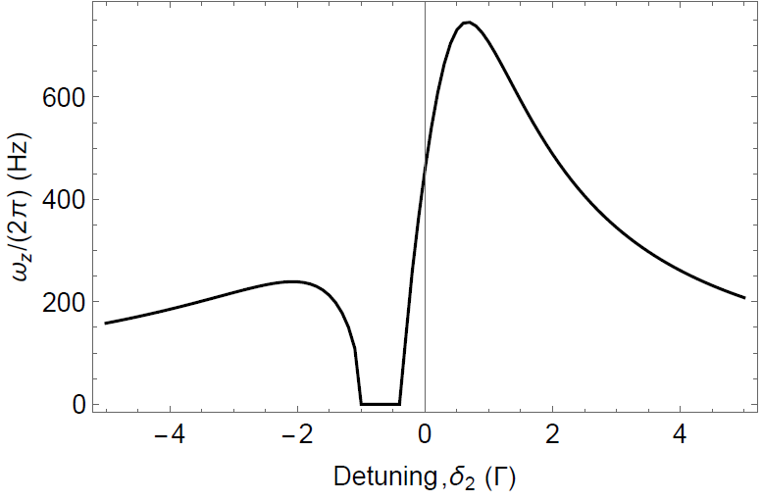
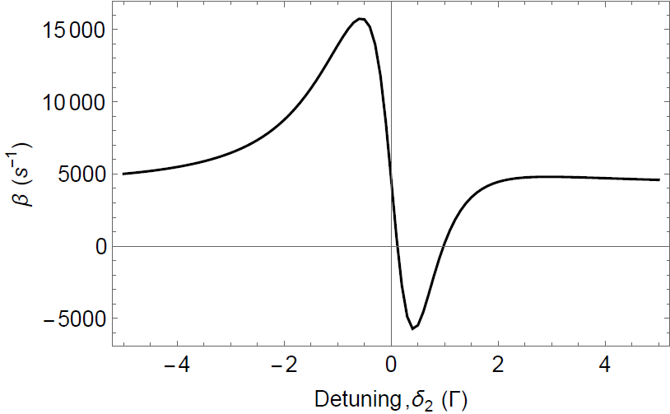
Dual-frequency MOT
+1
-1,0,+1
Red detuning
Blue detuning
-1
σ+
σ-
Trapping frequency (Hz)
σ-
σ+
2
δ₁
+2
1
MOT
MOT
0
δ₂
-1
-2
Damping coefficient (s⁻¹)
-2
Cooling
Parameters:
Mass = 59u, Γ= 2π * 8.3MHz, λ = 606 nm, δ₁ = − Γ,
dB_{z}/dz = 20 G/cm,
Beam radius (1/e²) = 12mm,
Power = 40 mW per beam per frequency
Heating
Phys. Rev. A 92, 053401 (2015)

Slide 40
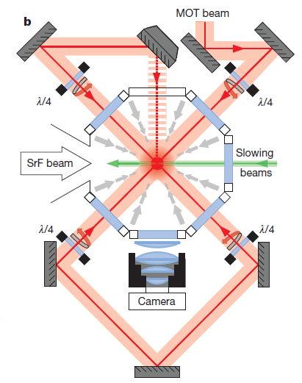
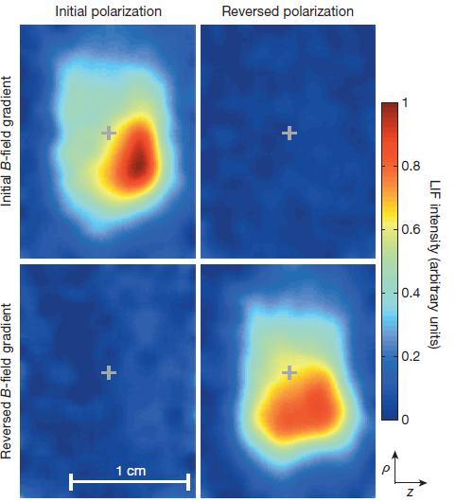
MOT of SrF molecules (Yale)
~ 300 SrF molecules in the MOT.
Temperature ~ 2mK.
Lifetime ~ 60ms.
Nature 512, 285 (2014)

Slide 41
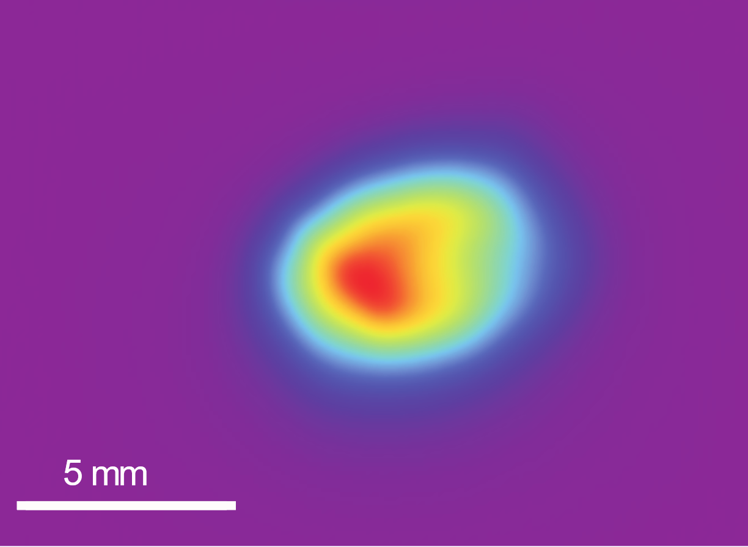
Magneto-optical trap of CaF molecules
2x10⁴ molecules
Density: 2x10⁵ cm⁻³
f = 94 Hz
β = 390 s⁻¹
See New. J. Phys. 19, 113035 (2017)

Slide 42

Cooling below the Doppler limit
Molecules transferred from MOT into a blue-detuned optical molasses
Ballistic expansion of an ultracold cloud at optimum molasses intensity
5 ms
7 ms
9 ms
11 ms
13 ms
T = 55 ± 2 µK
See Nature Physics 13, 1173 (2017)

