Slide 1
Predicting gravitational waves for neutron star – black hole systems
By: Bas Bemelmans Radboud University Nijmegen

Slide 2
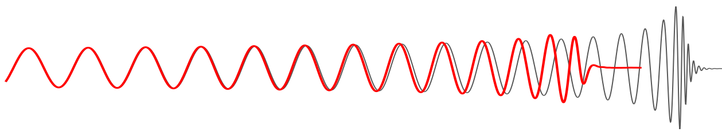
Motivation
Obtaining information about system needed to interpret the strain
Equation of state, mass ratio, spin etc.
Neutron star – black hole systems will (hopefully) be the next big discovery!

Slide 3
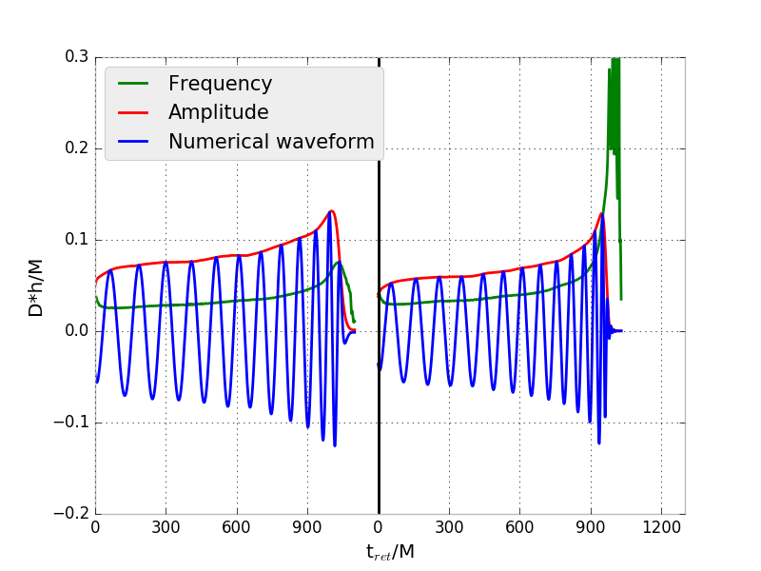
Neutron star – black hole systems
Equation of state of the neutron star → Tidal deformability & tidal disruption
Ringdown phase → Ringdown or accretion disk

Slide 4
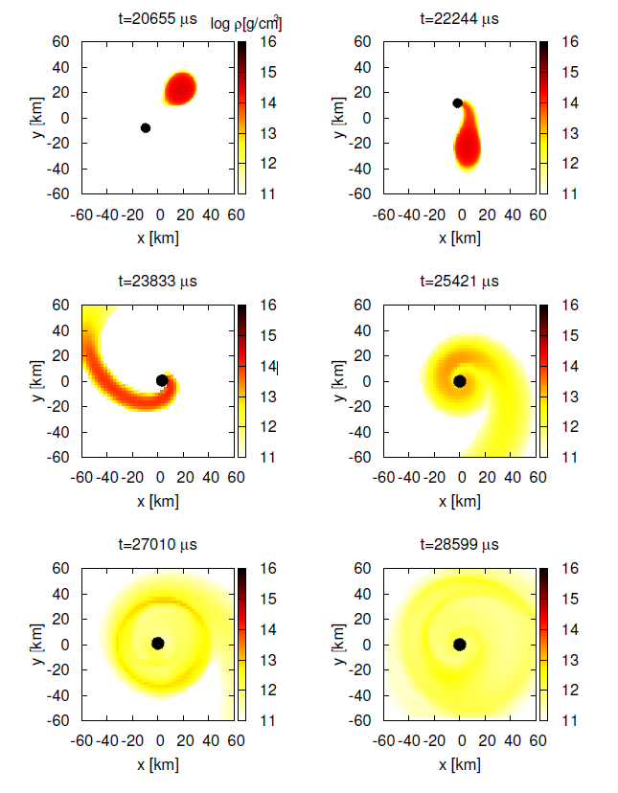
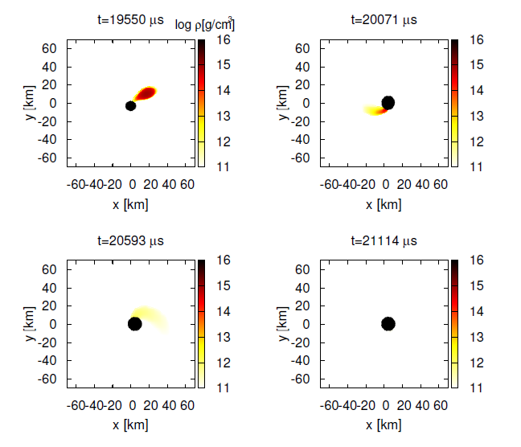
Shibata, Taniguchi, 2011

Slide 5
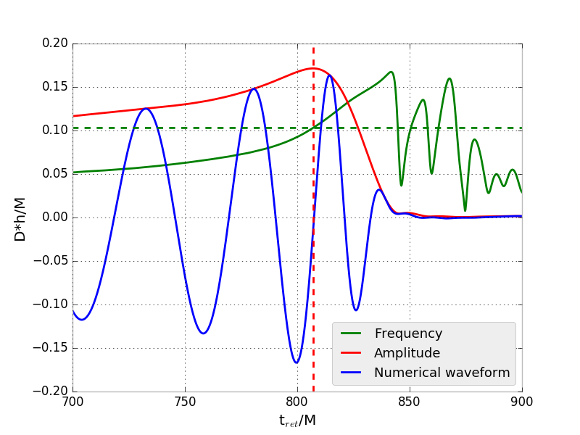
Frequency at the maximum amplitude
Numerical waveforms from Yukawa institute in Japan (Kyutoku et al.)
different EoS, mass ratio’s, spin etc.
Angular frequency at max. amplitude
→ Goal: Understanding the waveforms

Slide 6
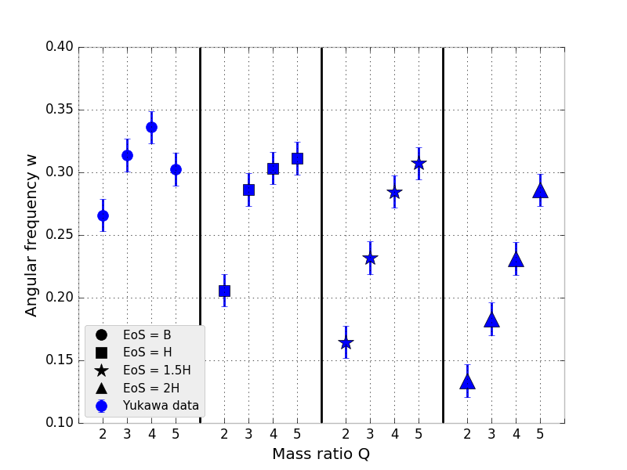
Small radius big radius
First: non-spinning case
Mass shedding caused by tidal disruption → lower angular frequency
Frequency increases for higher Q
Slope more linear for higher tidal deformability → ISCO

Slide 7
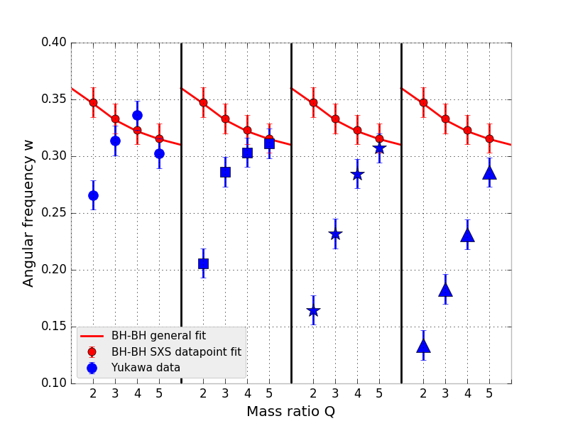
Small radius big radius
Added BH-BH data
Important differences:
No mass shedding
Lower frequency for higher Q

Slide 8
Innermost Stable Circular Orbit (ISCO)
Critical point in the merger process
Idea: The ISCO is the boundary that seperates ringdown or no ringdown systems depending on the tidal deformability of the neutron star
→ ISCO calculated for a binary system by Tanja Hinderer

Slide 9
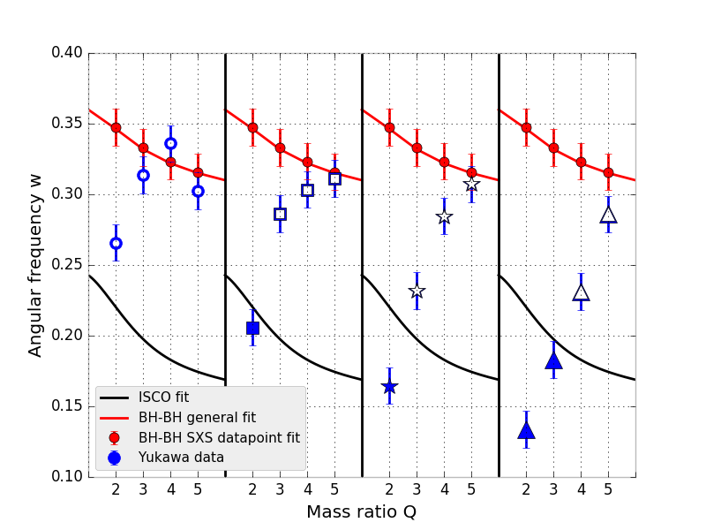

Slide 10
Predicting the frequency
Self-gravitational energy of the neutron star vs. tidal energy of the system
Idea: Turnover point of the tidal energy corresponds with the frequency at the maximum amplitude in the tidally disrupted case

Slide 11
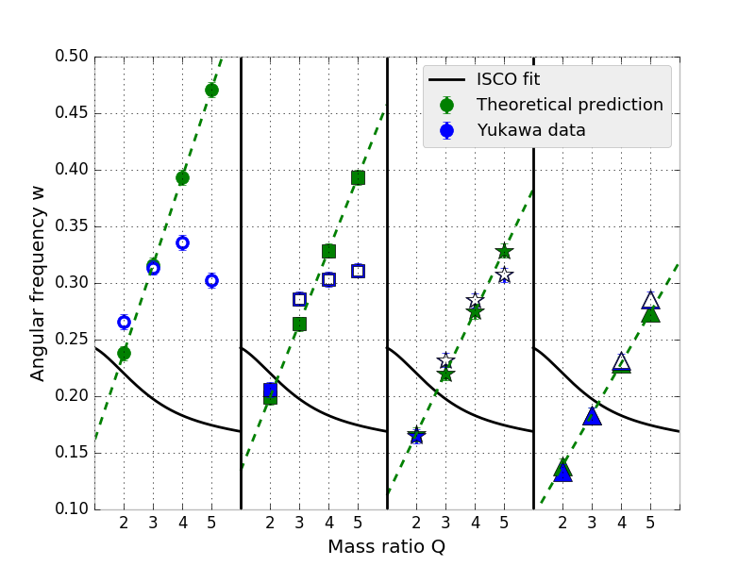
Small radius big radius
Prediction works quite good
for tidally disrupted systems

Slide 12
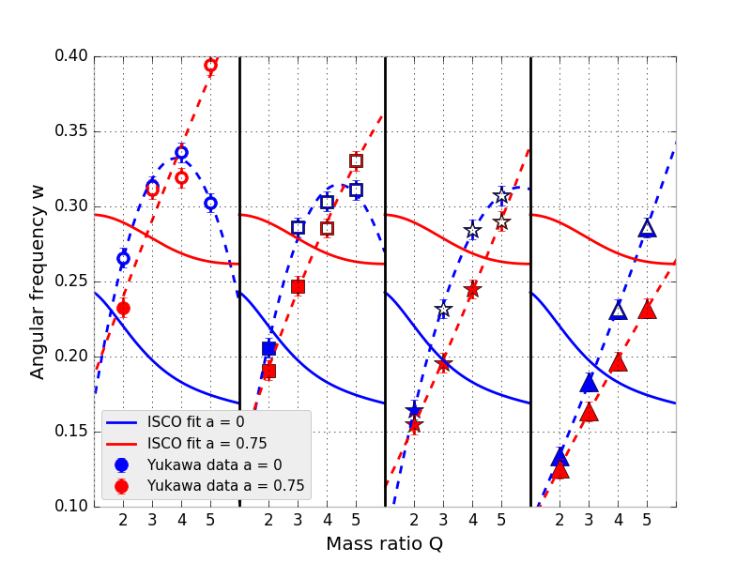
Nonzero black hole spin
Small radius big radius
Spin-orbit coupling effect
Additional repulsive force → Centrifugal forces reduce → lower angular frequency
Decrease of ISCO → longer lifetime of the system → possibility for tidal disruption enhances

Slide 13
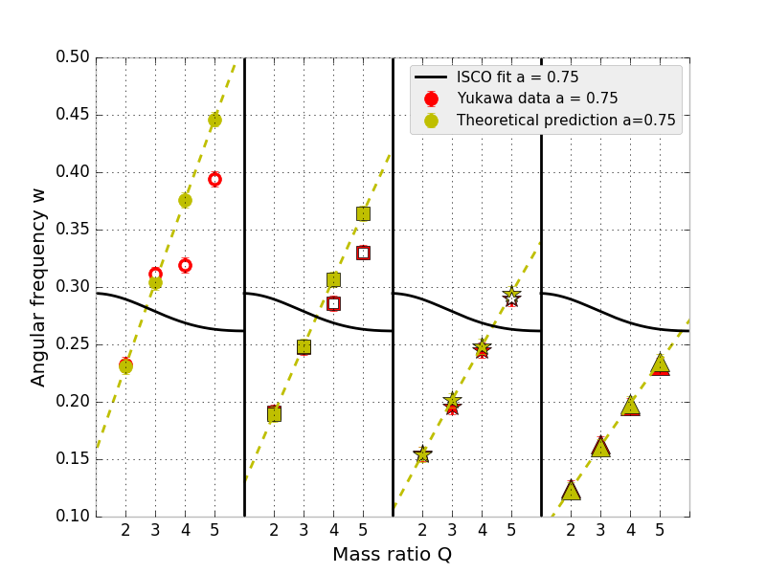
Prediction for the spinning case
Prediction with extra added factor for the spin
Works again for tidally disrupted systems
Small radius big radius

Slide 14
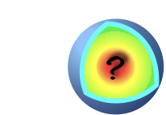
Conclusion & further research
Good prediction for the tidally disrupted systems
Next: Prediction for all systems → predicting entire waveforms
→ Collaboration University of Potsdam

