Slide 1
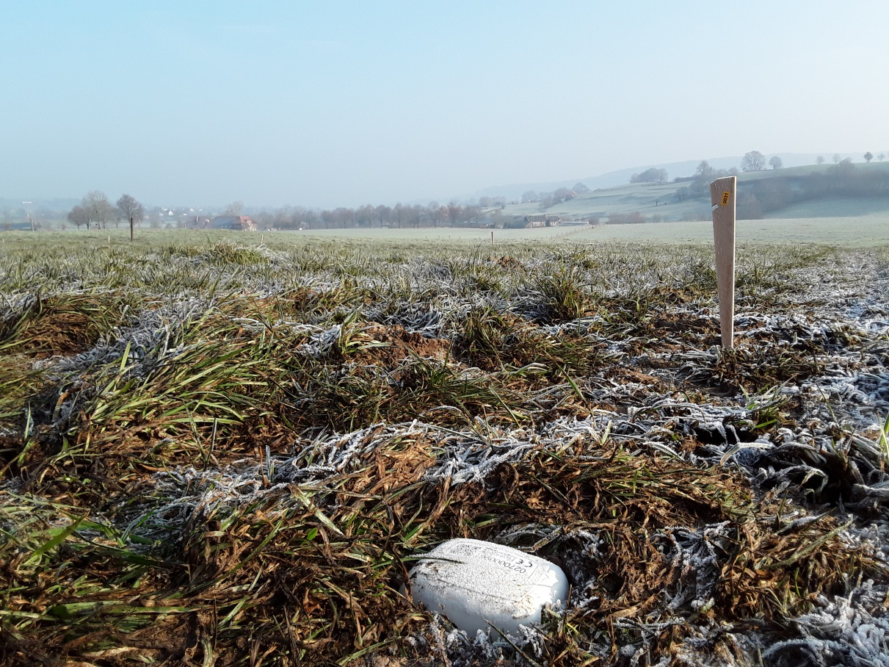
Seismic noise characterization at Limburg, a potential site for Einstein Telescope
Soumen Koley
Nikhef, Amsterdam
skoley@nikhef.nl

Slide 2
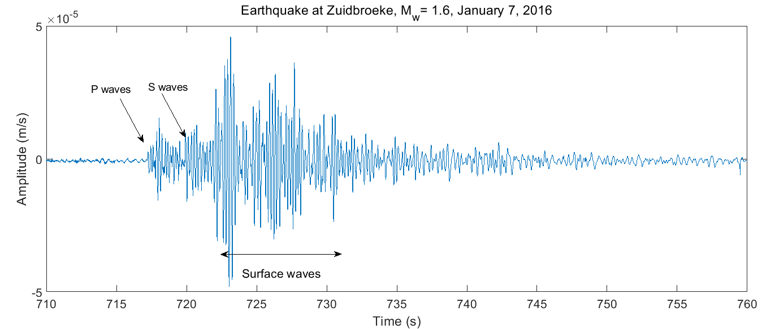
Seismology Basics
Seismic waves are elastic waves propagating through the earth surface.
Seismic Sources
Seismic waves can be generated by both normal and shear stress acting on the medium of propagation.
  Natural sources of seismic waves are earthquakes, or even the microseismic energy originating due to interaction of ocean waves with land mass.
  Man made sources like cars passing – generally dominant at high frequencies.
An example earthquake record
Figure 1. An example earthquake record

Slide 3
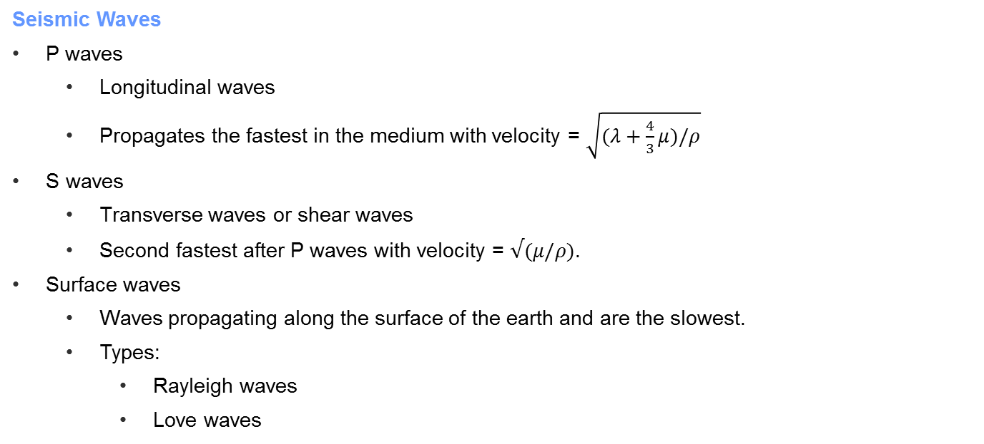
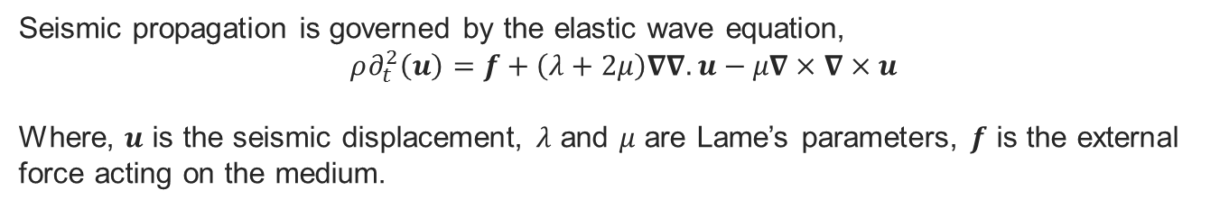
Types of seismic waves
Seismic propagation is governed by the elastic wave equation,
$$ρ∂_{t}^{2}\left(u\right)=f+\left(λ+2μ\right)∇∇.u−μ∇×∇×u$$
Where, $u$ is the seismic displacement, $λ$ and $μ$ are Lame’s parameters, $f$ is the external force acting on the medium.
Seismic Waves
P waves
  Longitudinal waves
  Propagates the fastest in the medium with velocity = $\sqrt{(λ+\frac{4}{3}μ)/ρ}$
S waves
  Transverse waves or shear waves
  Second fastest after P waves with velocity = $√(μ/ρ)$.
Surface waves
  Waves propagating along the surface of the earth and are the slowest.
  Types:
    Rayleigh waves
    Love waves
Figure 1. $Sensor Layout$

Slide 4
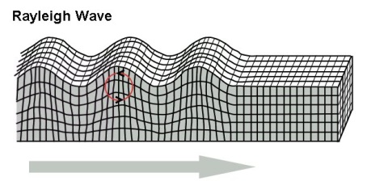
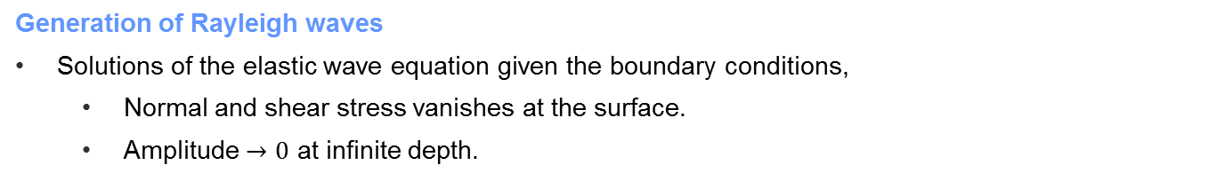
Seismic surface waves – Rayleigh waves
Seismic surface waves are particular solutions to wave equation, first discovered by Lord Rayleigh in 1885.
Generation of Rayleigh waves
Solutions of the elastic wave equation given the boundary conditions,
  Normal and shear stress vanishes at the surface.
  Amplitude $→0$ at infinite depth.
Ground motion during Rayleigh wave propagation
Figure 2. Rayleigh wave propagation and the retrograde elliptical particle motion at the surface.

Slide 5
Why are Rayleigh waves important ?
Unlike P and S waves that attenuate by $1/r^{2}$, Surface waves decay as exponentially with depth and are strongest signals in a seismogram.
Typical imaging techniques
Use a dynamite or a vibroseis to activate the subsurface, and then receive the direct and the reflected signals on a set of receivers.
These signals, which are response of the earth can be analyzed to image the subsurface.
What we propose.......
Use seismic sources like that of a car passing by or other seismic signals that are treated as noise for imaging the subsurface.
Also referred to as Passive seismic imaging.
How are Rayleigh waves useful ?
The phase and the group velocity of Rayleigh waves are implicit functions of subsurface properties like,
  Shear wave velocity
  Depth of layers and there interfaces
Hence computing the phase velocity dispersion of the Rayleigh waves can give us a shear wave velocity model for the region

Slide 6
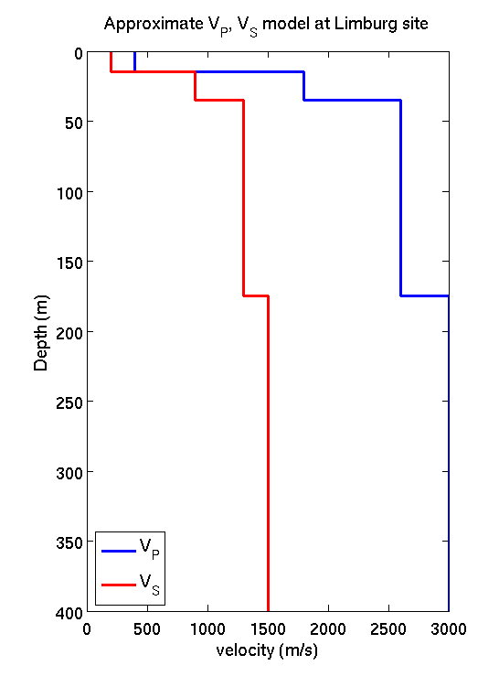
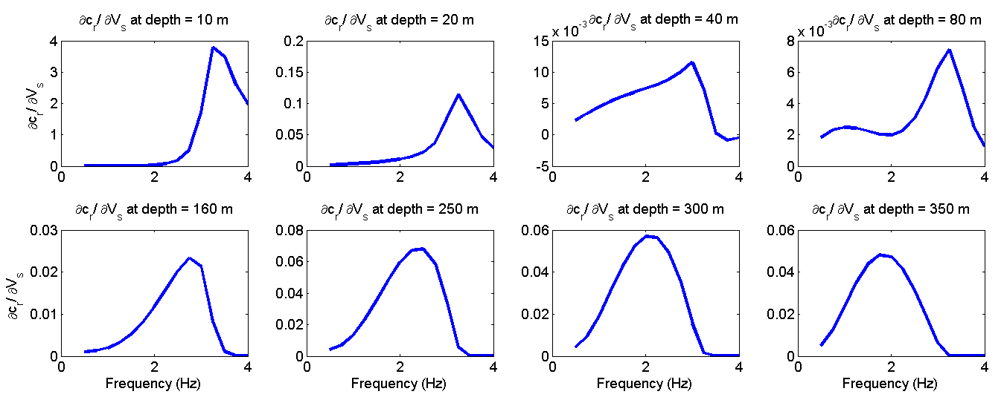
An Example of $∂C_{R}/∂V_{s}$
Given a shear wave velocity depth model, we compute the partial derivatives of the Rayleigh wave phase velocity with respect to the shear wave velocity at given depths.
Estimated derivatives behavior
Clearly the shallower structures are sensitive to high frequency data, whereas the deeper structures are sensitive to low frequencies as low as 1.5-2.0 Hz.
It is worth noting that the magnitude of the derivatives are also higher, implying more dependency.
Figure 4. An example velocity depth model at Limburg site
Figure 3. Partial derivative $∂c_{R}/∂V_{s}$ evaluated at depths of 10, 20, 40, 80, 160, 250, 300 and 350 m respectively.

Slide 7
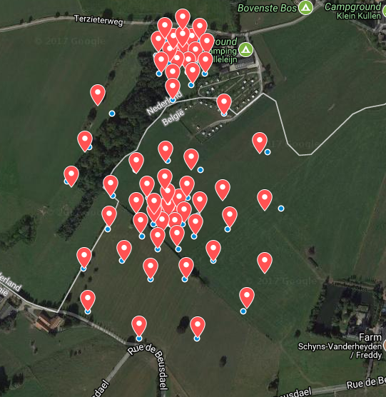
Sensor geometry at Limburg
An array of 74 wireless seismometers were deployed at Limburg for understanding the spatio-spectral properties of seismic noise in the region.
Objectives
Compute the dominant noise direction of Rayleigh wave propagation.
Estimate the phase velocity dispersion.
An obvious outcome is also observing the seismic noise level in the region, significantly important for the Einstein Telescope.
All analysis is performed in the frequency band 2.5 – 8.0 Hz.
Figure 4. $Sensor Layout$

Slide 8
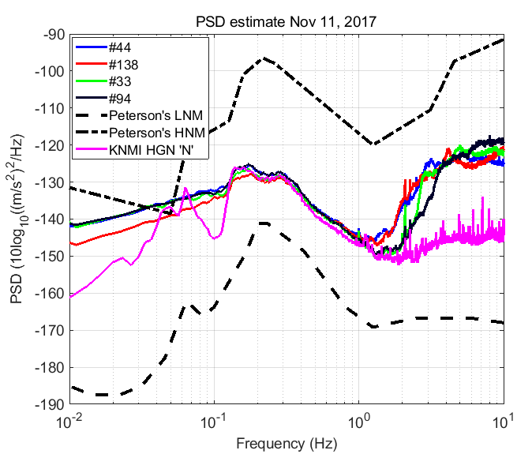
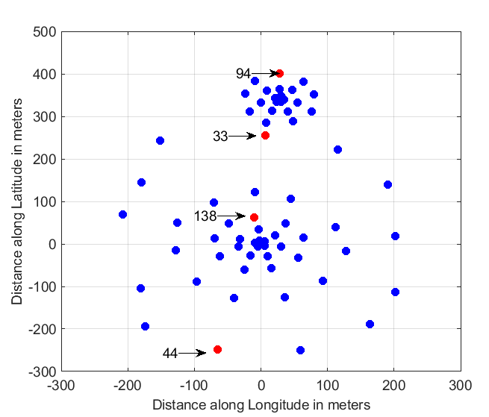
PSD Characteristics
Power spectral densities were computed hourly with 5 minute windows, and then averaged over every day.
Takeaway
Matches well with the KNMI HGN station at microseismic frequencies.
Figure 5(a) $Sensor Layout$, (b) Daily averaged PSD of sensors for Nov 11, 2017 marked in red

Slide 9
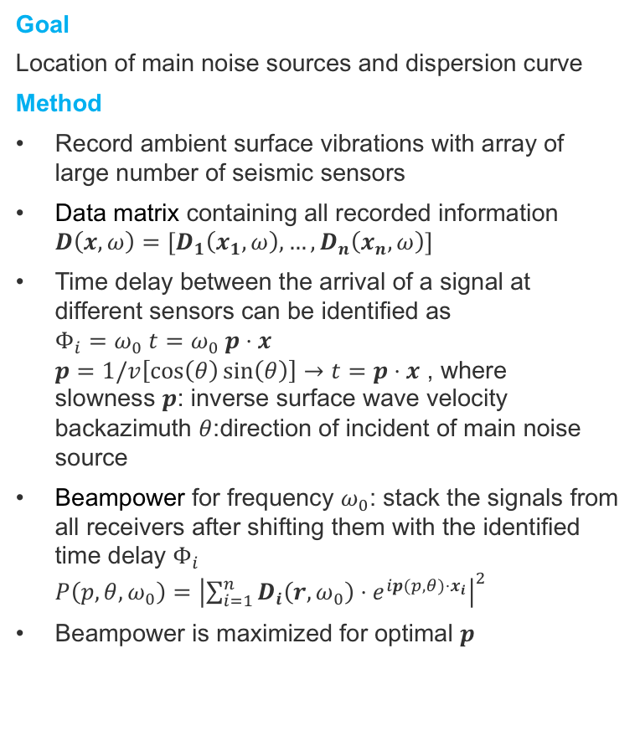




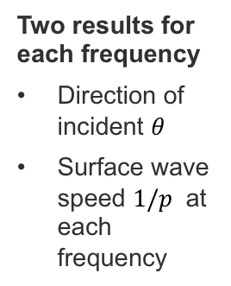
Passive seismic study: Beamforming
Beamforming allows to deduce information about the locations of the main seismic sources and the phase velocity of the Rayleigh waves, which leads to the formulation of the dispersion curve
Goal
Location of main noise sources and dispersion curve
Method
Record ambient surface vibrations with array of large number of seismic sensors
Data matrix containing all recorded information
$D\left(x, ω\right)=[D_{1}\left(x_{1}, ω\right), …,D_{n}\left(x_{n}, ω\right)]$
Time delay between the arrival of a signal at different sensors can be identified as
$Φ_{i}=ω_{0} t=ω_{0} p⋅x$
$p=1/v\left[\cos\left(θ\right)\sin\left(θ\right)\right]→t=p⋅x$ , where
slowness $p$: inverse surface wave velocity
backazimuth $θ$:direction of incident of main noise source
Beampower for frequency $ω_{0}$: stack the signals from all receivers after shifting them with the identified time delay $Φ_{i}$
$P\left(p, θ, ω_{0}\right)={\left|\sum_{i=1}^{n}{D_{i}\left(r, ω_{0}\right)⋅e^{ip(p, θ)⋅x_{i}}}\right|}^{2}$
Beampower is maximized for optimal $p$
Raw data
$$D_{n}\left(x_{n}, t\right)$$
$$D_{2}\left(x_{2} t\right)$$
$$D_{1}\left(x_{1}, t\right)$$
$$Φ_{1}$$
$$Φ_{n}$$
Beamforming
Two results for each frequency
Direction of incident $θ$
Surface wave speed $1/p$ at each frequency
Notes:
Easiest and cheapest compared to active and borehole study
Passive study: 1) beamforming to obtain dispersion curve 2) inversion
Plane waves travel across surface array, for e

Slide 10
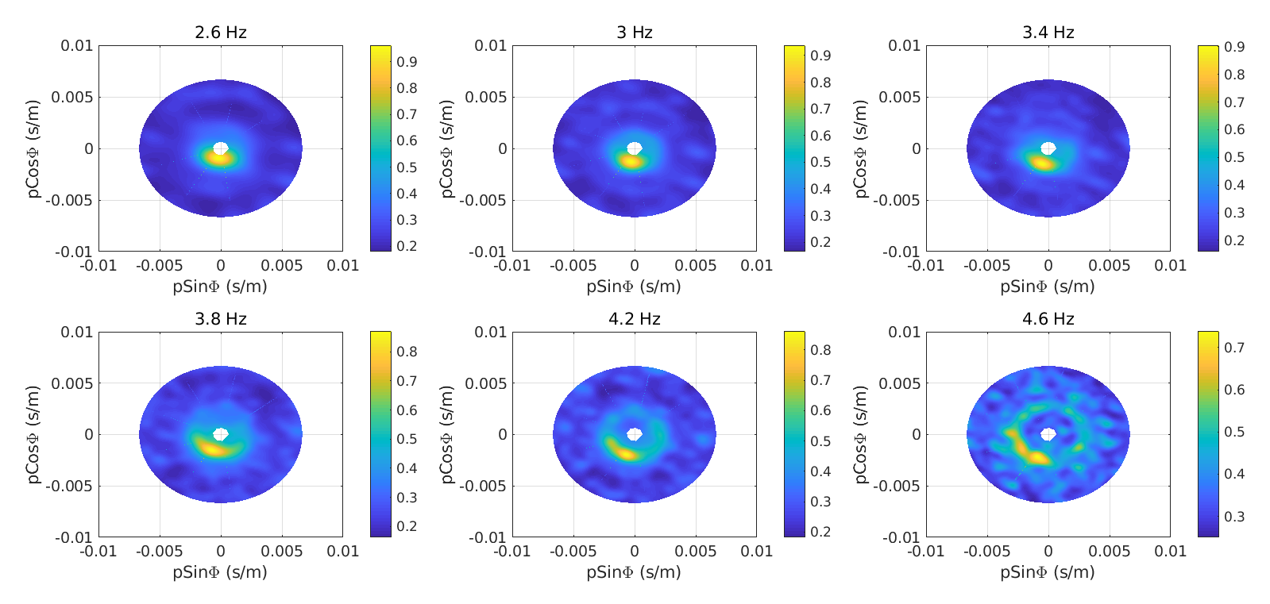
Beamforming Output (Nov 5-27, 2017 2.6-4.6 Hz)
Dominant noise originates from south west direction, possibly from the road nearby.
Figure 6. Beamforming output averaged over Nov 5-25, 2017. Radial axis coresponds to slowness in units of s/m and azimuth is measured anticlockwise from x-axis (east)

Slide 11
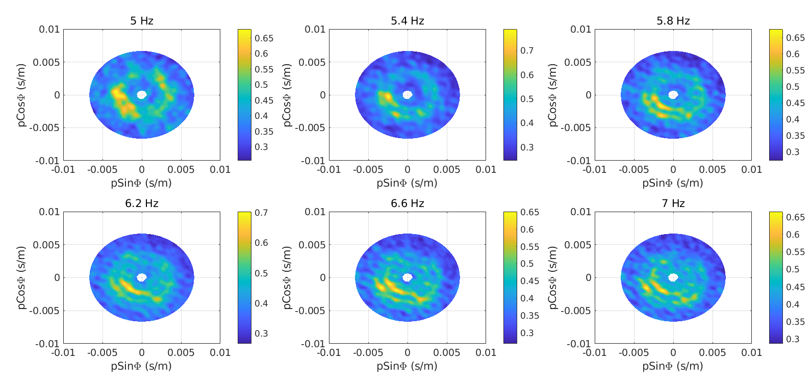
Beamforming Output (Nov 5-27, 2017 5.0 - 7.0 Hz)
Dominant noise originates from south west direction, possibly from the road nearby.
Higher mode observed at frequencies > 5 Hz
Figure 7. Beamforming output averaged over Nov 5-25, 2017. Radial axis coresponds to slowness in units of s/m and azimuth is measured anticlockwise from x-axis (east)

Slide 12
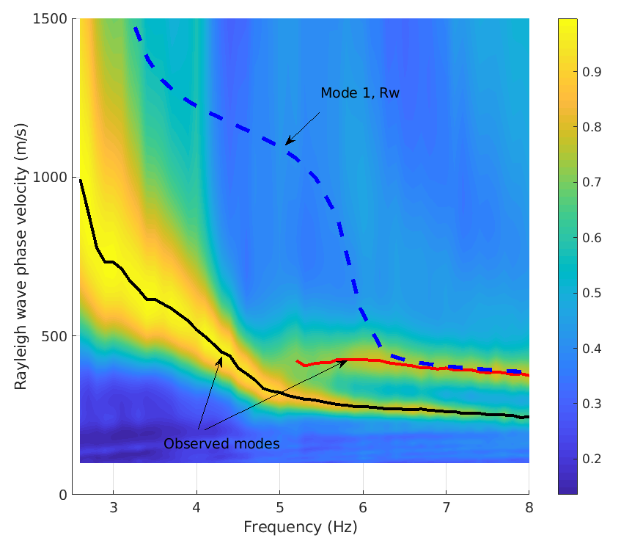
Rayleigh wave phase velocity dispersion curve
Rayleigh wave phase velocity computed using data between Nov 5-25, 2017.
The possible first order mode matches well with the theoretical dispersion curve.
Figure 8. Rayleigh wave phase velocity as a function of frequency.

Slide 13
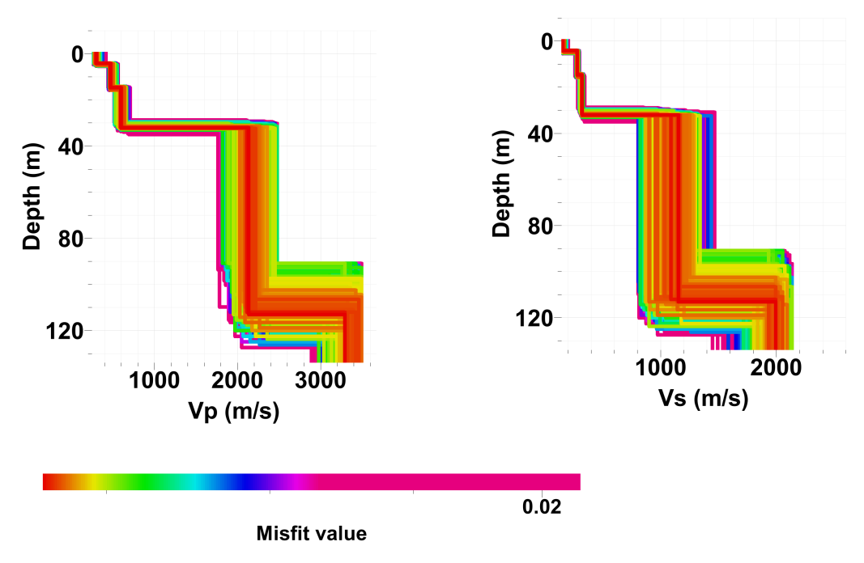
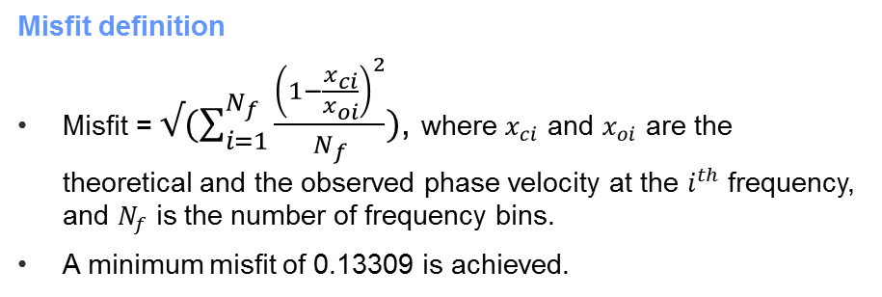
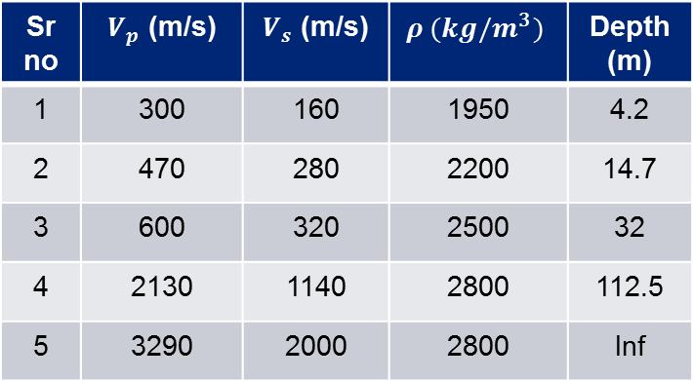
Inversion, Phase velocities $→$ Velocity depth model
Inversion using a stochastic direct search method (Wathelet et al., 2004) based on Malcolm Sambridge’s neighbourhood algorithm (1999) for a 5 layer model.
Inverted 1D model (Well constrained)
Sr no | $V_{p}$ (m/s) | $V_{s}$ (m/s) | $$ρ (kg/m^{3})$$ | Depth (m)
1 | 300 | 160 | 1950 | 4.2
2 | 470 | 280 | 2200 | 14.7
3 | 600 | 320 | 2500 | 32
4 | 2130 | 1140 | 2800 | 112.5
5 | 3290 | 2000 | 2800 | Inf
Misfit definition
Misfit = $√(\sum_{i=1}^{N_{f}}{\frac{{\left(1−\frac{x_{ci}}{x_{oi}}\right)}^{2}}{N_{f}})}$, where $x_{ci}$ and $x_{oi}$ are the theoretical and the observed phase velocity at the $i^{th}$ frequency, and $N_{f}$ is the number of frequency bins.
A minimum misfit of 0.13309 is achieved.

Slide 14
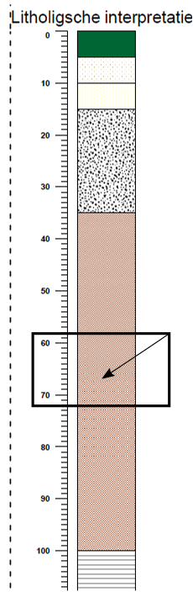
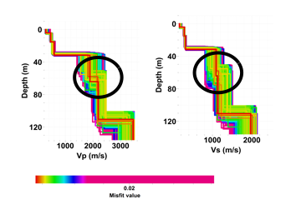
Question 1: Why 5 layers and not 6 ?(Deltares Report)
On close examination of the Deltares report, there is a layer between 60-70 meters, but we do not get that from inversion.
Test
So I introduced another layer for the inversion. The depth search was between 50-80 m and Vs between 800-2500 m/s and same for Vp.
Results indicate very less velocity fluctuation at the new interface, hence we can confirm that there is no layer there. The minimum misfit was 0.0136365 slighly more than observed for our previous result (slide 3).
Figure 11. Inversion results with a 6 layer model, the extra layer being inserted between 50-80 m. Results show that there is no layer at that depth.
Figure 10. Terziet Stratigraphy obtained from the borehole.

Slide 15
Conclusion and outlook
Conclusion
Passive seismic studies are very useful for understanding the propagation of seismic noise at the site especially in an urban setting where active seismic methods are not feasible.
Inverting for the shear wave velocity model is a bonus.
    This velocity model is useful for carrying out simulations for computing the level of seismic noise at depths where seismometers cannot be installed.
    An obvious outcome is also the Newtonian estimate as a function of frequency and depth.
Notes:
For

Slide 16
Questions?

