Slide 1
Estimation of cosmological parameters from gravitational-wave observations and its cross correlation with a galaxy catalog
Ankan Sur
with
A.Samajdar, A.Ghosh, W.Del Pozzo, J.Gair, C. Van Den Broeck, P.Ajith
As part of
CBC-Cosmology Group
7th Belgium-Dutch Gravitational waves Meeting
29th May 2018

Slide 2
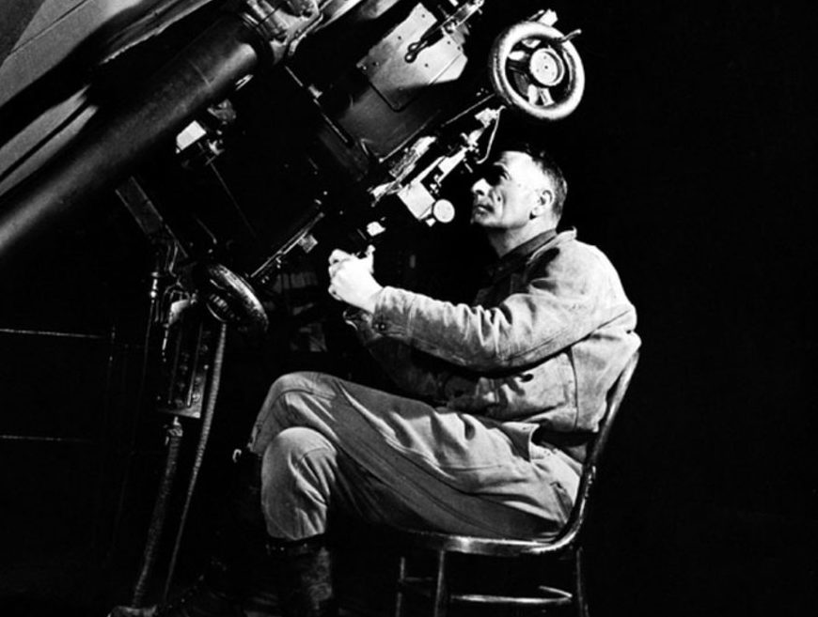
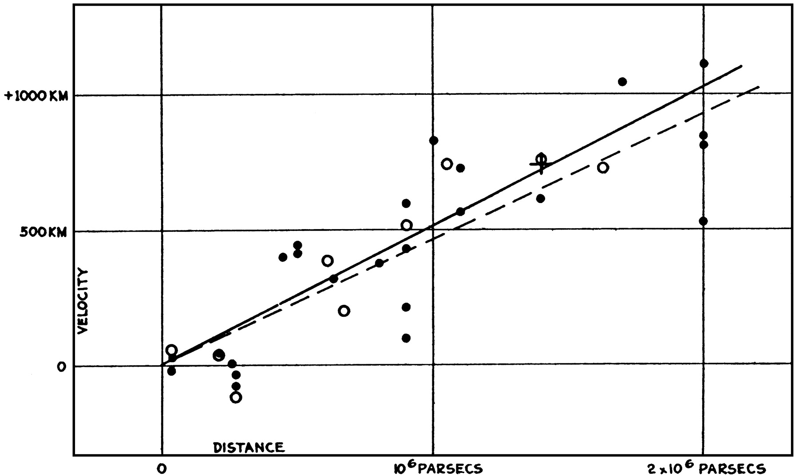
Measuring Hubble’s Constant
Plot velocity along y-axis and distance along x-axis
Get the best fit
$$vrec=zc=H0DL$$
(in local universe)
Slope = $H0$
Important parameter in cosmology!
PNAS March 15, 1929. 15 (3) 168-173

Slide 3
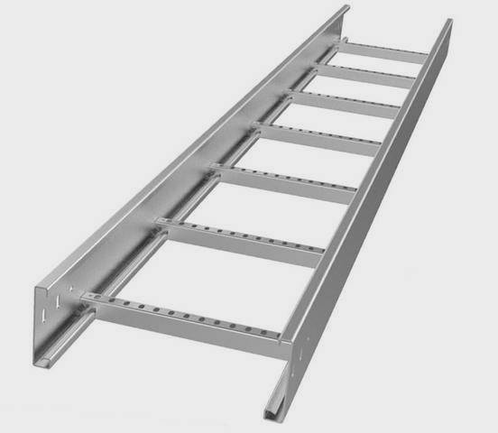
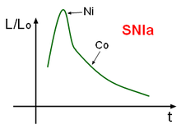
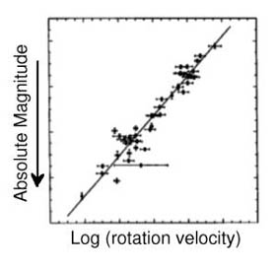
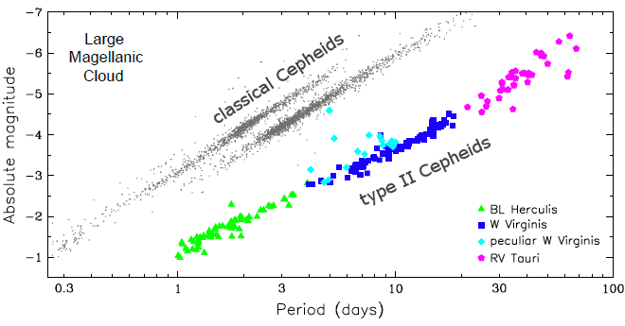
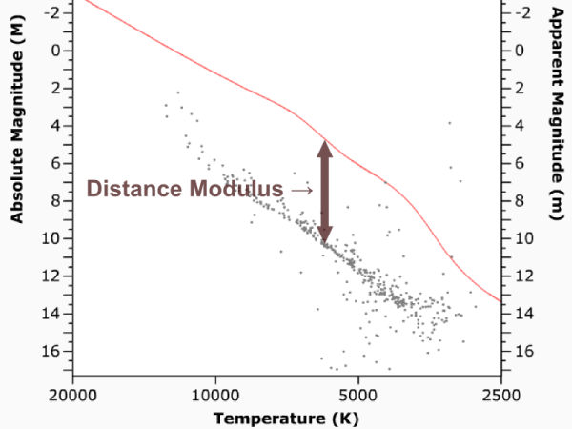
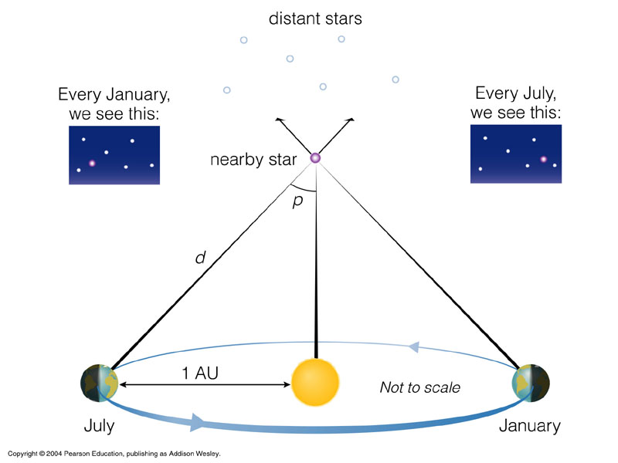
Cosmic Distance Ladder
Standard Candles
Tully Fisher Relation
200 Mpc
25 Mpc
Main sequence fitting
Cepheids
10 Mpc
10 kpc
parallax
100 pc

Slide 4
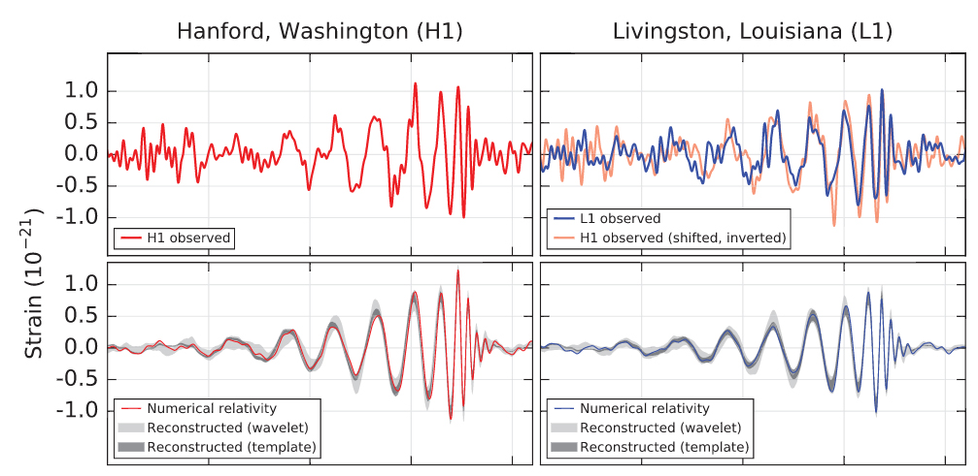
Gravitational Waves
Detected by LIGO and VIRGO
$$h(t)\sim \frac{M^{5/3}}{D_{L}}$$
Phase = Chirp Mass
Strain = D_{L}
Standard Sirens!
Credit:LIGO Caltech
PRL 116, 061102 (2016)

Slide 5
Motivation:
GW170817 + Electromagnetic counterpart = redshift
From https://www.ligo.org/

Slide 6
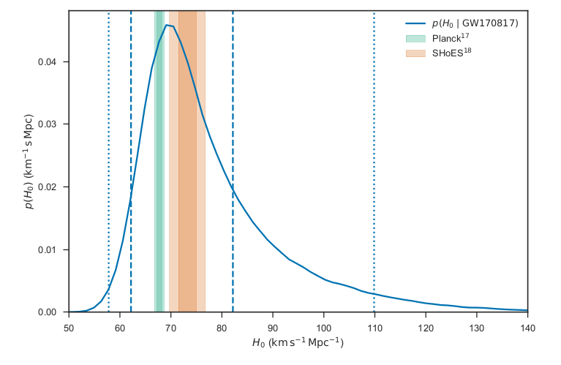
First standard siren measurement of H₀
Nature 551,8588 (02 November 2017)

Slide 7
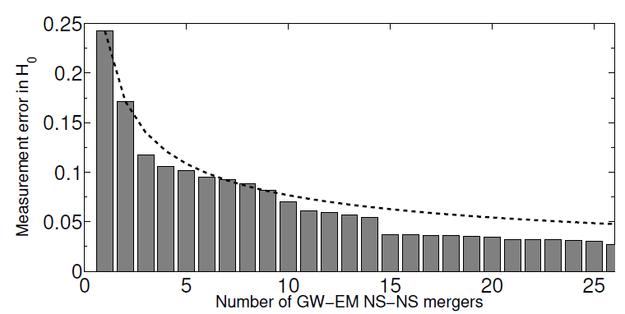
Convergence Plot
Nissanke et al (ArXiv:1307.2638)

Slide 8
Statistical Approach
In the absence of transient EM counterpart, we use information present in a galaxy catalog.
Take into account:
GW selection effects: detectors can only detect above a certain signal to noise ratio (ρ_{th} = 8.0)
EM selection effects: Use Schechter magnitude function to account for missing galaxies.
Use Bayesian analysis
$P\left(\left.Ω\right|ε\right)= \frac{p\left(\left.ε\right|Ω\right)p\left(Ω\right)}{p\left(ε\right)}$
$p\left(ε | Ω\right)= \frac{No}{Ng}$ $\sum{wo p\left(DL\left(zo,Ω\right)\right)+ \frac{N_{U}}{Ng} \int{dzdM p\left(\left.ε\right|M,z,Ω\right)φ\left(M\right)Θ\left(m\left(M,z,Ω\right)−mth\right)p(z|}}$ $Ω$)
Information from catalog Term accounting for missing information in the catalog
flat prior on $H0$

Slide 9
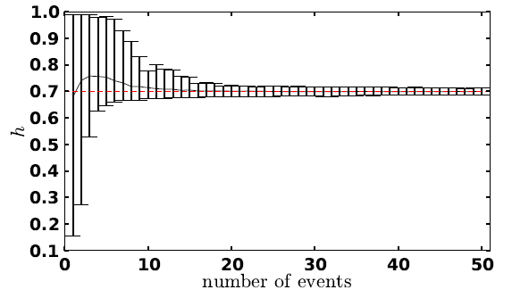
Statistical Approach
applicable to sources without counterparts and even binary black hole coalescences.
Combining information across events is crucial for measurement of H₀ be it the counterpart or the statistical approach. Understanding systematic effects is important, since even small systematic effects can get amplified over statistical errors while combining information from multiple events.
From: Del Pozzo, Phys. Rev. D 86, 043011

Slide 10
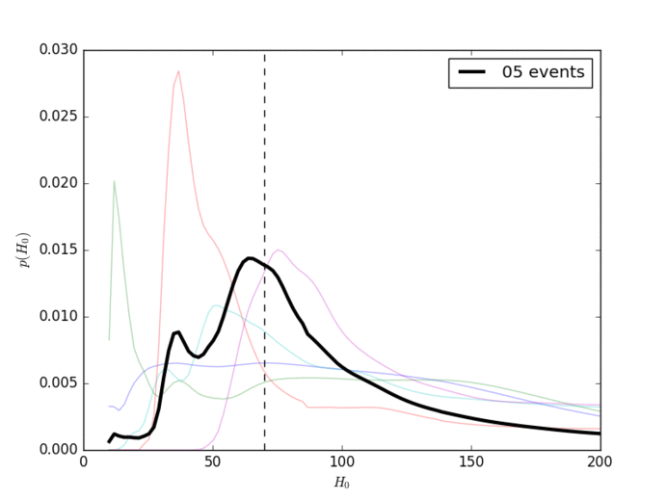
Results
Mock galaxy catalog (Gray et al. in preparation)
Simulations carried for binary
neutron stars
250 sources
Maximum redshift = 0.4
Catalog complete up to $z=0.1$
(distance = 435.5 Mpc)
Combined posterior on H₀

Slide 11
Conclusions and future directions
H₀ can be statistically measured.
Extend our analysis to determine other cosmological parameters.
More luminous galaxies have higher probability of hosting GW sources.
Account for redshift uncertainties in our analysis.

